Slide 1
Single Lung Ventilation
Somaletha T. Bhattacharya, MD, FFARCSI
Massachussets General Hospital
Updated 9/2019

Slide 2
Disclosures
No relevant financial relationships to report

Slide 3
Learning Objectives:
Anatomy of the airway
Physiology of single lung ventilation
Indications and contraindications
Techniques: advantages and disadvantages
Choosing a particular single lung ventilation technique

Slide 4
Anatomy of the Trachea
Tracheal cross-section circular in infants and ovoid in adults
A-P diameter limits the size of tube
Right tracheobronchial angle is more acute than left
Right main stem bronchus: shorter & wider
Left main stem bronchus: longer & narrower
Bronchial:tracheal diameters:
  Right: 0.86
  Left: 0.66
Notes:
Trachea is circular in cross section in infants but ovoid in adults. The anterior posterior diameter of the trachea is the limiting factor in selection of the size of the tube. The trachea bifurcates into right & left main bronchi. Right tracheobronchial angle is more acute than left and hence right main stem intubation is easier than left.
Right main stem bronchus is shorter & wider and the right upper lobe bronchus arises at much higher level than the left side. So the right DLT has a slot on its cuff for ventilating the upper lobe.
Chest x-ray and CT Scan of the chest can be used to measure the airway so as to choose the correct size tube . Brodsky JB devised a formula to calculate the width of the left bronchus from the tracheal width. Left bronchial width = (0.4xTracheal width)+3.3mm. (Adults).
In children if the tracheal diameter is known, the bronchial diameter can be calculated using the bronchial :tracheal ratio of 0.86 for the right bronchus and 0.66 for the left one.

Slide 5
Physiology
Ventilation & perfusion distribution:
Preferentially to non-dependent areas of lung
V/Q ratio best at the base in upright position
Non-symmetrical branching nature of airways & pulmonary vasculature accounts for 75% of ventilation perfusion distribution
Gravity (25%)
Notes:
Right lung has better ventilation than left due to the larger size . Ventilation is preferential to the dependent areas in lateral, supine or erect posture. But in the anesthetized patient, the upper lung is better ventilated.
Perfusion in a normal lung is matched to ventilation that is pulmonary perfusion per alveoli is fairly uniform. At FRC, the dependent lung has a larger number of alveoli and hence better perfusion than the apical areas. But it has been shown that regional flow is also dependent on the structure / branching pattern of the pulmonary vasculature.
Studies show that although gravity may play a role in the distribution of ventilation and perfusion, it is much smaller (25%) compared to the non-symmetrical branching architecture of airway and pulmonary vasculature (75%).

Slide 6
Lateral Decubitus in Adults
Dependent lung: better ventilation & perfusion
Hydrostatic pressure gradient
Diaphragmatic contractility proportional to resting length of muscle
Greater contractility = Greater ventilation
Resting length: Pressure of abdominal contents
Oxygen consumption: 3 ml/kg/min
Notes:
In adults, ventilation & perfusion are better in the dependent lung in the awake patient. The reasons for this are the difference in hydrostatic pressure and the improved contractility of the dependent portion of the diaphragm.
Contractility is proportional to the resting length, which in turn is influenced by the abdominal contents pressure on the diaphragm.
In unilateral lung disease it has been shown that, having the healthy lung dependent makes oxygenation optimal

Slide 7
Lateral Decubitus in Infants
Non-dependent lung: better ventilation
Chest floppy & compressible
Dependent lung compressed
FRC closer to residual volume
Diaphragmatic contractility less significant
Reduced hydrostatic pressure gradient
Oxygen consumption: 6-8 ml/kg/min
Notes:
Unlike adults, in infants it has been shown that the non dependent lung has better ventilation than the dependent one. The reason being that the chest in infants are floppy and easily compressed and so the dependent lung gets compressed in the lateral position. The contractility of the diaphragm is not affected much by the abdominal contents due to smaller abdominal size compared to an adults. The difference in hydrostatic pressure is also reduced. Perfusion gradient is less due to the reduced hydrostatic pressure. FRC is closer to residual volume resulting in airway closure even during tidal volume. This is because the chest is not able to support the dependent lung.
In unilateral lung disease involving an infant, the oxygenation is better with the diseased lung dependent

Slide 8
Thoracic Surgery
V/Q mismatch occurs
General anesthesia
Neuromuscular block
Mechanical ventilation
Single lung ventilation
Surgical retraction of lung
HPV (due to inhalational agents/vasodilators)
Notes:
Ventilation Perfusion ratio ( V/Q) is affected in any surgery involving anesthesia. Much more in thoracic surgeries. Anesthesia and neuromuscular block alters the normal V/Q ratio. The range of V/Q ratio is much broader than normal. Mechanical ventilation cause an increase in ventilation even in the less perfused areas, thus causing increased V/Q ratio. Under anesthesia, ventilation is preferentially delivered to the ventral areas and perfusion to the dorsal areas. Single lung ventilation causes a larger shunt and lower V/Q ratio.
Hypoxic pulmonary vasoconstriction ( HPV) attempts to maintain normal V/Q ratio by reducing perfusion to underventilated areas. Inhalational agents depresses HPV and is said to be dose dependent ( 30% decrease at a MAC 1.3) Intravenous agents – no effect. Vasodilator drugs inhibit the HPV.

Slide 9
Indications for SLV
Isolation/Lung Protection
  Hemorrhage
  Infective secretions – Pus
  Pulmonary lavage
Collapse of a lung: better visualization
Video Assisted Thoracoscopic Surgery (VATS) Pneumonectomy, Lobectomy
Intrathoracic non-pulmonary surgeries
    Vascular: PDA, Coarctation of aorta
    Vertebral: Anterior spinal fusion
    Esophageal: Hiatal hernia, Tracheo-esophageal fistula
    Tumors: Mediastinal mass
Differential Lung Ventilation
Bronchopleural fistula
Unilateral lung cyst
Notes:
Indications for SLV are isolation or protection of the lung, better visualization and differential lung ventilation.

Slide 10
Contraindications to SLV
Inability to place a device
Severe ventilation perfusion mismatch
Notes:
The only contraindications are
1. Inability to isolate a lung either due to anatomical anomalies or unavailability of the necessary equipment .
2. Severe ventilation perfusion mismatch

Slide 11
SLV: Techniques
Double lumen tubes: right & left sided
Univent tubes
Endobronchial blockers
Endotracheal tubes
Notes:
Available techniques are as in slide

Slide 12
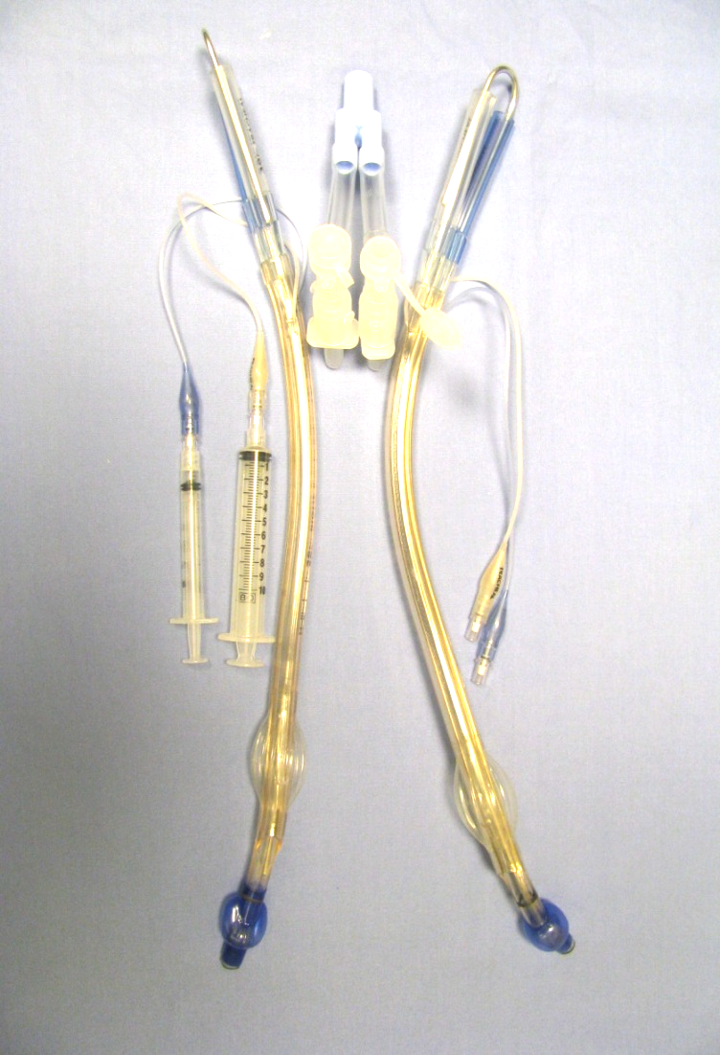
Double Lumen Tubes (DLT)
Two tubes molded together
Shorter tracheal & longer bronchial tubes
Two curves at almost 90°- proximal & distal
Cross section of tube is D shaped
RIGHT
LEFT
Notes:
The right & left tubes are shown with the connector and stylet in place. The bronchial cuffs are different in shape. The left inflates equally all round. The right is shaped different to accommodate the lumen for ventilating the right upper lobe.
The connector has an opening for both tracheal and bronchial lumens in order to insert the fiber optic scope or the suction catheters provided with the tubes. Smaller syringe (3ml) used for inflating bronchial cuff and a bigger syringe (10 ml) for inflating the tracheal cuff. The arrow points to the site where the clamp can be applied for lung isolation. The opening in the connector shows the port for inserting the fiber optic scope or for suction catheters.

Slide 13
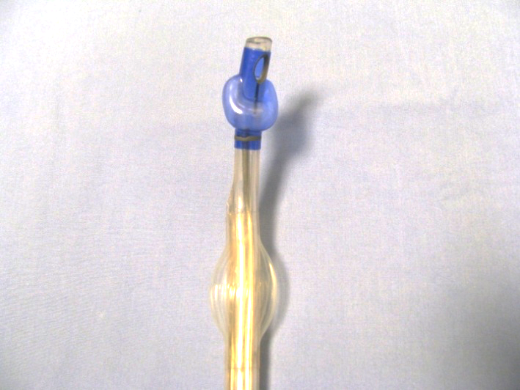
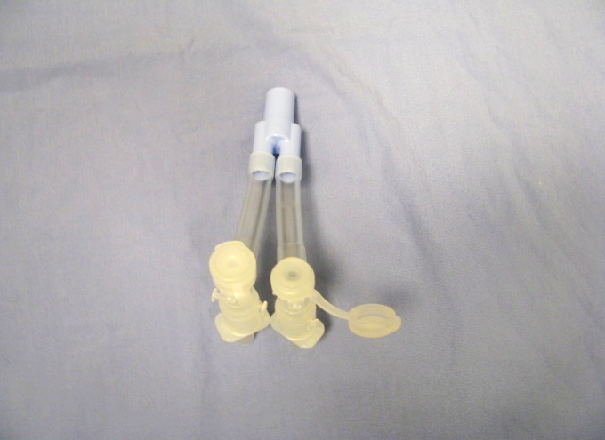
Double Lumen Tubes (DLT)
  Proximal tracheal and distal bronchial cuff
  High volume/low pressure cuffs
  Right endobronchial cuff slot for right upper lobe bronchus)
  Radiographic markers near cuffs and slot
Bronchial cuff
Connector
Lumen for right upper lobe
Site for clamp
Radiographic markersd
Fiberoptic scope or Suction
Tracheal cuff
Notes:
The left bronchial cuff inflates equally all round. The right is shaped different to accommodate the lumen for ventilating the right upper lobe. The radiographic markers help in confirming proper position.
The connector has an opening for both tracheal and bronchial lumens in order to insert the fiber optic scope or the suction catheters provided with the tubes. The arrow points to the site where the clamp can be applied for lung isolation. The opening in the connector shows the port for inserting the fiber optic scope or for suction catheters.

Slide 14
Double Lumen Tubes (DLT)
Inserted under direct laryngoscopic view
Utilize stylet
Insert with distal curve concave anteriorly
Remove stylet when tip is beyond larynx
Rotate 90°to the bronchial side
Proximal curve concave anteriorly (final position)
Confirm postion via auscultation and visual examination via fiberoptic bronchoscope
Notes:
DLT is provided with long suction catheters for both sides and a clamp is necessary for checking position clinically and for single lung ventilation. When the tracheal cuff is inflated there should be air entry both sides. When the bronchial cuff is inflated and the tracheal side clamped there should be air entry only on the bronchial side and vice versa. The bronchial cuff should be inflated only during single lung ventilation unless it is being used for differential lung ventilation.

Slide 15
Double Lumen Tubes (DLT)
Available sizes: 26, 28, 32, 35, 37, 39 & 41Fr
Chest X-Ray & CT Scan can measure the bronchial diameter for DLT selection
Proper size: deflated bronchial part < 1-2 mm of main stem bronchial lumen
E.g.: 8-year-old (26Fr ), 10-year-old (28Fr)
Size in Fr = 4 x ID of endotracheal tube + 2
Proper size and length fiberoptic scope
Left sided easier to place
Notes:
The smallest DLT is 26FR produced by RUSCH . It takes only a 2.2 mm scope
Proper selection of a DLT for a particular patient is not easy. To help with selection, the anatomy of the airway can be assessed from Chest X-ray and CT Scans of the chest. Measure the bronchial diameter, there will be a 10% increase of diameter on chest x-ray due to air bronchogram. This helps in assessing the size to be used . Prior to using the DLT, make sure your bronchoscope goes through the lumen. A 4mm fiberoptic scope can be used in all except the 26Fr.

Slide 16
Double Lumen Tubes (DLT)
Rapidity & ease of insertion
Suctioning of individual lung
Complete separation of lungs
Ventilation of individual lung
CPAP or Oxygen to the collapsed lung
Placement possible in absence of fiberoptic scope
Easy to convert from 2 lungs to SLV
Notes:
Advantages of DLT as in slide

Slide 17
Double Lumen Tubes: Disadvantages
Cannot be used in children < less 8 years old
Selection of proper size can be challenging
Difficult to place in abnormal airway
Potential for airway trauma
Requires conversion to single lumen ETT post operatively
Notes:
Disadvantages
Potential for airway trauma while insertion or from the bronchial cuff inflation.
Most often require conversion to single lumen endotracheal tube if the patient has to remain intubated. ICU staff may not be comfortable

Slide 18
Marraro Bilumen Tube
Two uncuffed tubes attached laterally
PVC tubes with radiopaque line (Portex -U.K)
Shorter tracheal tube attached to whole length of bronchial tube except a short part of the beginning
Longer bronchial tube –Murphy eye. Bent at 5° angle before the eye
Tubes end in lip shape facing outwards
No spur for anchoring
Bronchial lumen larger: different caliber tubes
Notes:
This is a pediatric double lumen tube developed in 1984 by Dr.Marrarro. It is not available in USA. It consists of 2 uncuffed tubes attached laterally. Shorter tracheal and a longer bronchial tube with a Murphy eye. Both tubes end in a lip shape with the opening facing outwards. The bronchial end is bend at 5 degrees to facilitate bronchial intubation. The tubes unlike the usual double lumen tube, maybe of different caliber.

Slide 19

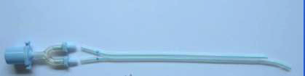
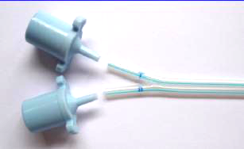
Marraro Bilumen Tube
Single Connector
Tracheal
Separate Connectors
Bronchial
Radio Opaque Lines
Photographs – Courtesy of Dr. Marraro
Notes:
The picture shows the bilumen tube with radio opaque lines, for confirming positions on X-ray. A flexible stylet is used in the longer bronchial lumen for insertion. The Murphy eye helps in ventilating the upper lobe in case the tube is inserted on the right side. The tube can be used with a single connector as for double lumen tubes or individual connectors for selective ventilation of each lung.

Slide 20
Marraro Bilumen Tube
Age | Suggested Caliber (mm)
Premature (1400-2500 g) | 2 + 2
Newborn | 2.5 + 2 or 2.5 + 2.5
1 Month | 2.5 + 2.5
6 Months | 3 + 2.5
12 Months | 3.5 +3
Notes:
This table shows the various calibers of tubes available for the different age groups from birth to infancy by Dr. Marraro. Remember the longer bronchial tube has the larger internal diameter. The tube has been used in children 3 years and under.

Slide 21
Marraro Bilumen Tube
Placed via laryngoscopy view
Rotate to required bronchus after both tubes are below the cords
Confirm correct position
Auscultation
Chest X – Ray
Fiber optic scope -1.8 mm
Right bronchial intubation easier
Left bronchial intubation preferred
Bronchial lumen larger: better fit & reduces leak
Tube position at level of cords - one above the other
O
O
Notes:
The Marraro tube is inserted under direct laryngoscopic view. Once both tubes are below the cords, the bronchial tube is rotated 90 degrees to the appropriate bronchus. The tube is pushed till resistance is met ( tracheal lumen at carina). Then the tube is pulled back a few mm. Although right bronchial insertion is easier, the left is preferred as rt. side upper lobe bronchus may be obstructed. Unlike the normal double lumen tube there is no special slot for the upper right lobe bronchus although the Murphy's eye on the tube is used for this purpose. The bronchial lumen is larger than the tracheal so it fits the bronchus better and reduces leak. Proper anchoring of the tube is crucial to prevent dislodgement. The lumen can easily become obstructed due to secretions due to the small calibers. Position is confirmed
1. Clinically – by auscultation for air entry and clamping individual tube ( just like any double lumen tube)
2. Radiologically (tube has a radiopaque blue line)
3. Use of FOB –the smaller tubes require a 1.8mm scope.
Once in place, the tubes position in such a way that the tubes lie one above the other instead of side by side.( personal communication –Dr.Marraro) as indicated in the schematic diagram of the glottic opening with the cross section of the tubes in yellow.

Slide 22
Marraro Bilumen Tube
Useful in children less than 3 years of age
Humidification and warming of gases
Increased resistance to air flow –small calibers
Suction catheters marked
Recommended PEEP: < 10 cm H₂O for tracheal, < 15 cm H₂O for bronchial
External diameter = sum of internal diameters of both tubes + 0.4 mm. (2.5/3 caliber tube = 5.9 ext diameter)
Notes:
The tube is useful in children 3 years and below. Because of the small size and length of the tube, resistance of air flow is increased and hence beware of higher pressures required for pressure mode ventilation. Obstruction also contributes to high pressures and hence good humidification and warming is required for loosening the secretions and suctioning. The suction catheters should be marked so that they do not go beyond the tube’s length.
Dr. Marraro recommends the following PEEP <10 cm of water for tracheal & < 15 cm of water for bronchial. The tube wall is very thin and hence the accommodation of the 2 tubes

Slide 23
Marraro Bilumen Tube
Advantages
All the advantages of a double lumen tube in < 3yrs age
Fiberoptic scope is not needed to confirm position
Delivery of drugs (surfactant) to specific areas of lung
Disadvantages
Experience & training required
Dislodgement /obstruction of the tubes
Trauma to larynx, trachea and bronchus
Size chosen is empirical & arbitrary
Notes:
All the advantages and disadvantages of a double lumen tube in an adult is applicable to the pediatric marraro bilumen tube

Slide 24
Univent Tubes
Single lumen tube with an enclosed blocker
Endobronchial blocker –separate channel
Blocker is long & can be locked in position
Blocks right / left bronchus
Fiberoptic scope required for placement
Pediatric sizes: 3.5 mm uncuffed, 4.5 mm cuffed
Lumen in blocker (not in 3.5mm)
Pediatric age 6 years and above
Notes:
The Univent tube is produced by Fuji System Corporation in Japan. It is a single lumen endotracheal tube with a blocker enclosed. The blocker can be directed into the right or left bronchus and can be fully retracted into its enclosed channel. It can also be locked in position. The 2 pediatric sizes are internal diameter of 3.5 mm uncuffed and a cuffed 4.5 mm tube But the outer diameter corresponds to conventional endotracheal tube with an internal diameter of 6mm and 6.5 respectively. A fiberoptic scope is necessary for positioning. The cross section is ovoid and most of the lumen is occupied by the blocker.

Slide 25
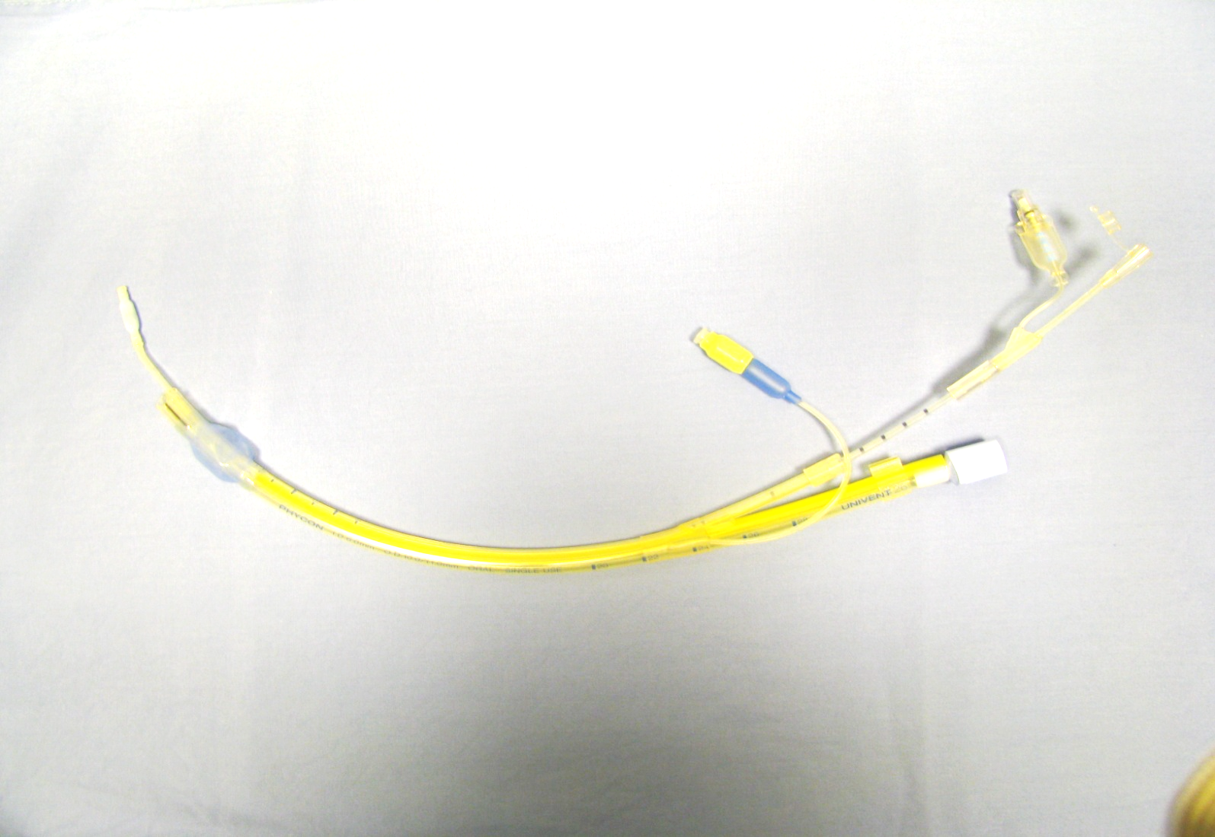
Univent Tube: Adult Size
Provide Oxygen/Suction
Blocker
To Lock Blocker
To Attach Blocker in Place
Notes:
Adult size univent tubes has a cuff unlike the 3.5 mm which does not and a lumen in the blocker for providing oxygen and suction.

Slide 26
Univent Tubes
Advantages
Displacement less since it is attached to the tube
No need to change tube – postoperative period
Disadvantages
Low volume high pressure cuff
High resistance to gas flow
Cannot use in < 6 years of age
No suction, oxygen or CPAP to collapsed lung
Lung collapse slow
Notes:
Advantages are
-Since the blocker is attached to the tube ,the chances of dislodgement is minimal.
-A change of the tube is not required as the blocker can be retracted back.
Disadvantages are
-The low volume high pressure cuff .
-The high resistance to air flow.
-Collapsing the lung slow.
-Suction ,oxygen and CPAP is not possible.
-Cannot be used in less than 6 years of age.

Slide 27
Univent Tubes
Internal Diameter (mm) | Outer Diameter (mm) | Equivalent Standard Endotracheal Tube
3.5 uncuffed | 7.5 / 8 | 6
4.5 | 8.5 / 9 | 6.5
6 | 10 / 11
6.5 | 10.5 / 11.5
7 | 11 / 12
7.5 | 11.5 / 12.5
8 | 12 / 13
8.5 | 12.5 / 13.5
9 | 13 / 14
Notes:
This table shows the various sizes of Univent tube and you can appreciate the small internal diameter and the large external diameter . If a 6 mm ET tube is very tight in a 6 year old than 3.5mm may not be ideal .

Slide 28
The Ideal Endobronchial Blocker
Shaped to fit securely in the bronchus
High volume/low pressure cuffs
Flexible & easy to manipulate
Channel for deflation & suction
Used external /internal to an endotracheal tube
Available in adult & pediatric sizes
Notes:
An ideal endobronchial blocker should have a high volume and low pressure cuff and a shape that would retain it in the bronchus. It should be easy to manipulate it into the bronchus. Ability to suction, provide oxygen /CPAP to the collapsed lung should be possible.

Slide 29
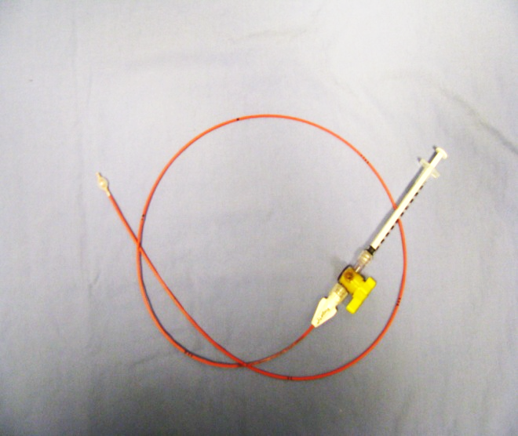
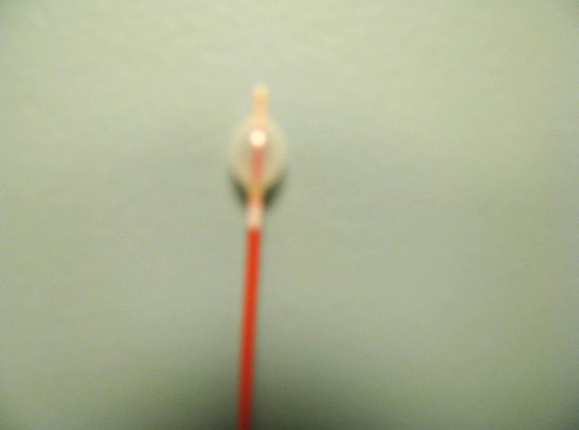
Endobronchial Blockers: Types
Fogarty Catheters
Fogarty catheters –vascular embolectomy catheters
Balloon wedge catheters: Swan Ganz catheters
Atrioseptostomy catheters
Arndt Cook bronchial blockers – specifically designed for bronchi
Blind End
Notes:
The different types of blockers that have been used in blocking the bronchus are the Fogarty embolectomy catheters, balloon wedge catheters (Swan Ganz & Atrioseptostomy ) and the Arndt Cook bronchial blockers. Some have an end hole ( Arndt Cook ) and others are blinded (Fogarty). The 4Fr embolectomy catheter is kept inflated with a 1 ml syringe using a 3 way stopcock.

Slide 30
Fogarty Catheters
Embolectomy catheter
Placed within /outside of endotracheal tube
Endobronchial intubation - for placement
FOB – reposition & confirmation of placement
Fluoroscopy: placement confirmation
Sizes (Pediatric): 3Fr, 4 Fr, 5 Fr
Potential problem: dislodgement & difficulty in maintaining position
Stylet removed & inflation maintained using a stopcock
Notes:
Fogarty catheters are embolectomy catheters designed for use in vessels and not bronchi. But they are useful in the younger age group to block the bronchus. They can be placed outside or inside the endotracheal tube. They are placed in the bronchus through an endotracheal tube using endobronchial intubation and the ET may then be pulled back into trachea and the final position confirmed by fiber optic scope. The endotracheal tube is removed and reinserted if the blocker is preferred outside the tube.

Slide 31
Arndt Endobronchial Blocker
Specifically designed for bronchus
Sizes: 5Fr, 7Fr & 9Fr (adult)
Spherical/elliptical (9Fr) balloon
Used in children 2 yrs and above
Multiport adapter & FOB for placement
Adjustable guide loop (nylon )
Central channel -Nylon wire
Notes:
Arndt Cook catheters are designed for the bronchus. It comes in 3 sizes. It is recommended for children above 2 years of age . It comes with a multiport adapter (scope, blocker and the anesthesia circuit) so ventilation need not be interrupted when the blocker is placed.
The scope and the blocker can be inserted through the ports prior to attaching it to the tube .

Slide 32
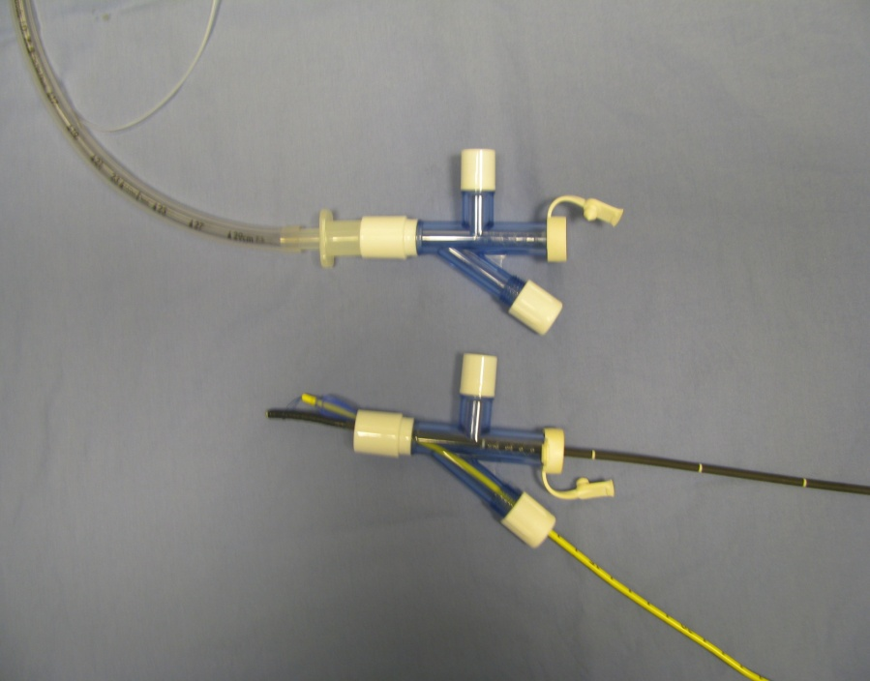
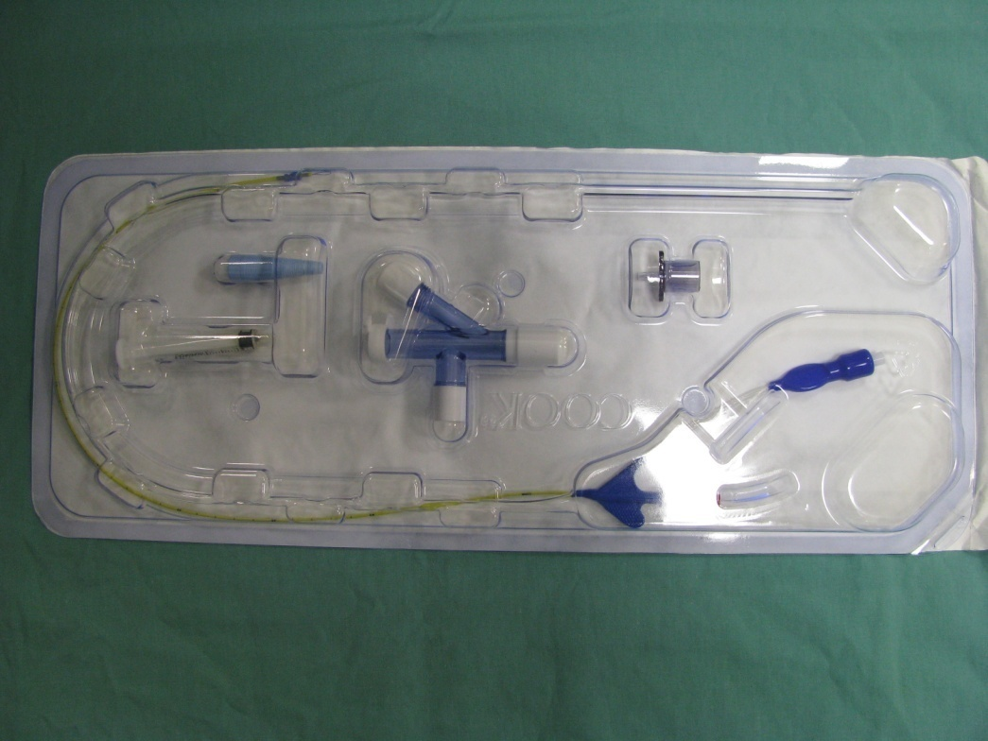
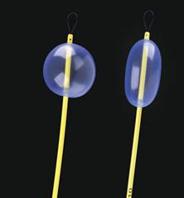
Arndt Bronchial Blockers
Multi-Port Adapter
Circuit
5 Fr Arndt Cook Bronchial Blocker
Nylon loop for scope
Spherical & Elliptical Balloons of Blocker
Notes:
Arndt Cook catheter in its package with the universal port and adapter for CPAP .The blocker has a wire loop to accommodate the FOS. The balloons are usually spherical but the 9 Fr is available also in the elliptical form.
The multi port adapter has ports to insert the scope and the blocker without any interruption in ventilation during placement.

Slide 33
Arndt Endobronchial Blocker
Size | Balloon Shape | Smallest ETT | FOB size
5 Fr | Spherical | 4.5 mm | 2 mm
5 Fr | Spherical | 5 mm | 2.2 - 2.8 mm
7 Fr | Spherical | 6 mm | 2.2 - 2.8 mm
9 Fr | Elliptical Spherical | 7 mm | 3.4 mm
Notes:
This table shows the size of the blocker ,the shape of the balloon, the smallest internal diameter of the endotracheal tube that would accommodate the blocker and the size of scope to be used. The nylon wire in the 9 Fr can removed and reinserted but the others it may be difficult to reinsert once removed.
If a 5 Fr blocker is used with a 4.5mm endotracheal tube ,only a 2mm bronchoscope can be used as the maximum diameter of the blocker is 2.5mm. A larger fiberoptic bronchoscope (2.2-2.8) can be used with a 5mm or bigger endotracheal tube .

Slide 34
Arndt Endobronchial Blocker
Most commonly used in children
Placed outside the ETT in children < 2 years or with ETT < 4.5 mm
Guide wire loop left in place for repositioning
Max diameter of blocker = 2.5 mm
Central lumen diameter = 0.7 mm
Balloon length = 1 cm & capacity = 1 - 3 ml
Confirm correct placement with FOB and auscultation
Notes:
5 Fr is the commonest blocker used in the pediatric age group. Although recommended for use in >2 years of age, it has been used in children <2 years of age .In these cases the blocker is placed outside the endotracheal tube. Smaller endotracheal tubes can be used if the blocker is placed outside the endotracheal tube.

Slide 35
Advantages
Able to block right or left or bronchus
Ventilation possible during placement
Used with an endotracheal tube
Connecter locks blocker at correct depth
Suction possible
CPAP possible
Ease of 2 lung ventilation from single lung ventilation
Notes:
Advantages
Ventilation possible during placement due to the multiport. Used with an endotracheal tube. Blocker can be locked in position . Suction, CPAP possible .

Slide 36
Disadvantages
Dislodgement
Frequent repositioning
Non optimal rt. lung isolation
Collapse of lung slower with smaller blockers
Guide wire required for proper placement
Pediatric FOB required
Airway injury
Bronchoscopy of isolated lung - impossible
Notes:
Disadvantages
Collapse slower if the nylon wire is left in place .Suggestion is to ventilate lungs with 100% oxygen prior to blockade and rely on absorption

Slide 37
Arndt Endobronchial Blocker: Insertion Techniques
Coaxial placement through the lumen of the ETT is recommended for endotracheal tubes sizes 4.5 ID and over
Extra-luminal placement parallel to ETT is recommended for endotracheal tubes < 4.5 ID
  Place bronchial blocker into trachea with laryngoscope
  Intubate with ETT
  Utilize fiberoptic bronchoscope to advance endobronchial blocker into right or left bronchus and inflate cuff
Notes:
The blocker can be placed within the endotracheal tube or outside the tube. Another technique suggested for preventing dislodgement of the blocker was to insert it through the Murphy eye prior to intubating and then positioning with a fiberoptic scope. When the blocker is placed outside the tube, the pediatric FOS is placed through the port for the blocker on the multiport adapter so as to prevent leak around the small scope when placed through the port intended for the scope.

Slide 38
Standard Endotracheal Tube
Endotracheal tube is advanced into the main stem bronchus opposite to the site of surgery
Collapse of lung in surgical area is by absorption atelectasis
Turn head to right to advance tube into left bronchus
Notes:
This is one of the oldest method of lung isolation and was used often in pediatric patients when endobronchial blockers were unavailable. A smaller caliber tube may be required for insertion into the bronchus

Slide 39
Disadvantages
Inadequate seal of the bronchus
Inadequate lung collapse on the operative side
Failure of complete protection of ventilated lung from contaminants
Inability to suction the non ventilated lung
Inability to provide oxygen: CPAP to non-ventilated lung
Hypoxemia: blockade of upper lobe bronchus
Notes:
The disadvantages of using a single lumen endotracheal tube for lung isolation are as in slide

Slide 40
Selection For a Patient
Age of the patient
Size of the patient
Anatomy of the airway
Skill & experience of the provider
Availability of equipment
Type of surgery
Notes:
Selection of a particular technique will depend on the age and size of the patient. The anatomy will help in deciding the type and the size required. Skill and experience of the provider and availability of equipment will also influence the selection . The type of surgery also influences the decision.

Slide 41
Age Based Selection
< 6 months | Fogarty catheter Marraro bilumen tube Endotracheal tube
6 months - 6 years | Fogarty catheter Endotracheal tube Marraro bilumen tube (< 3 yrs) 5 Fr Arndt endobronchial blocker
6 – 8 years | Univent tube 5 Fr Arndt endobronchial blocker
8 – 18 years | Univent tube 5-7 Fr Arndt endobronchial blocker Double lumen tubes
Notes:
This table gives an idea what are the selection that can be used in different age groups. When choosing an endotracheal tube it is important to make sure the size is not too big for the particular bronchus of the lung to be ventilated . The size can be determined by the measuring the diameter of trachea from chest x-ray and/or CTScan . The ratio of trachea and bronchus is 0.86 for the right side and 0.66 for the left. The answer will be the outer diameter of the endotracheal tube to be used.

Slide 42
SLV: Tracheostomy
Depends on age and size of tracheostomy
Endobronchial blocker - Fogarty or Arndt (co-axial or extraluminal)
Single lumen endotracheal tube directed to main stem bronchus via the stoma
Notes:
Lung isolation in a patient with tracheostomy can be challenging. A blocker could be used co-axially or along the tracheostomy tube. Another technique is to inserted a flexible /armoured tube into the main stem bronchus.

Slide 43
Tips: Avoiding Hypoxemia
Single lung ventilation only when needed
PEEP to the dependent lung
Oxygen & CPAP to the collapsed lung
Increasing Fi O₂
Check the tube
Treat any hemodynamic instability
Maintain CO₂ within normal limits
Clamp pulmonary artery (Pneumonectomy)
Notes:
Hypoxemia is not uncommon during single lung ventilation. Some of the methods to improve oxygenation are to maintain 2 lung ventilation as far as possible. Adding PEEP to the dependent ventilated lung The amount of PEEP should be such that it does not cause compression of the alveolar vessels, normally 5- 10 cm of water .Providing oxygen and CPAP to the collapsed lung will further improve the oxygenation. Care should be taken not to inflate the lung. Fi O₂ can be increased. If there is no improvement, check the patency & position of the tube. Hypotension can increase the shunt .Maintain normocapnia by using tidal volume of 8-10 ml /kg and increasing respiratory rate as required. Hypocapnia should be avoided as it can dilate the pulmonary vessels and interfere with HPV in non dependent lung . The last resort is clamping the pulmonary artery to the collapsed lung.
Clamping of the pulmonary artery ASAP in Pneumonectomy cases helps

Slide 44
Summary
Knowledge of patient’s airway anatomy
Physiology of single lung ventilation
Details of surgical procedure
Proper selection
Check all equipment before use
Recruit help if needed
Notes:
To summarize, in order to achieve one lung ventilation knowledge of the airway anatomy and physiology of single lung ventilation is useful. The details of the surgery helps in making the proper technique selection. Always check the equipments especially the fiberoptic scope. It is always good to have more than 2 hands when you have a scope & a blocker to manipulate.

Slide 45
References
Remolina C, Khan AU, Santiago TV, Edelman NH: Positional hypoxemia in unilateral lung disease. N Engl J Med 1981;304: 523-5.
Heaf DP, Helms P, Gordon I, Turner HM: Postural effects on gas exchange in infants. N Engl J Med 1983;308: 1505-8.
Galvin L , Drummond GB, Nirmalan M. Distribution of blood flow and ventilation in the lung :- gravity is not the only factor. British J. Anaesth. 2007; 98: 420-428.
Hammer GB. Pediatric thoracic anesthesia. Anesth Analg. 2001 Jun;92(6):1449-64.
Hammer GB, Fitzmaurice BG, Brodsky JB. Methods for single-lung ventilation in pediatric patients. Anesth Analg. 1999 Dec;89(6):1426-9.
Oliver Bagshaw, Steven Cray. Anesthesia for Thoracic Surgery. In: Dakshesh H. Parikh, David C.G. Crabbe, Alexander W. Auldist, Steven S. Rothenberg. Editors, Pediatric Thoracic Surgery , Springer. London 2009 : 57-74.
Choudhry DK. Single-lung ventilation in pediatric anesthesia. Anesthesiol Clin North Am. 2005 Dec;23(4):693-708, ix.
MARRARO G. Selective endobronchial intubation in paediatrics: the Marraro Paediatric Bilumen Tube. Pediatric Anesthesia. 1994 Jul;4(4):255-8.
Tan GM, Tan-Kendrick AP. Bronchial diameters in children--use of the Fogarty catheter for lung isolation in children. Anaesth Intensive Care. 2002 Oct;30(5):615-8.
Stephenson LL, Seefelder C. Routine extraluminal use of the 5F Arndt Endobronchial Blocker for one-lung ventilation in children up to 24 months of age. J Cardiothorac Vasc Anesth. 2011 Aug;25(4):683-6.

