Slide 1
Single Injection (non-catheter) Caudal Blocks for Pediatric Anesthesia
James Ko, M.D., M.P.H.
Elliot Krane, M.D.
Stanford Children’s Health,
Stanford University
Updated 7/2017

Slide 2
Overview
Indications
Special considerations
Technique
Local anesthesia options
Adjuncts to local anesthetics
Possible complications
Summary

Slide 3
Scope
Single “shot” caudal epidural injection is a frequently utilized regional anesthetic technique in children.
There is over 50 years of experience and safety data available for review

Slide 4
Indications for a Single “Shot” Caudal
Surgery involving dermatomes below T10:
Urologic procedures
Lower abdominal surgery
Pelvic and lower extremity surgery
If performed prior to incision, caudal block can
Decrease maintenance anesthetic requirement
Facilitate earlier extubation
Provide early postoperative pain control

Slide 5
Age Parameters
There is no literature definitively establishing upper or lower age limits for caudal blocks.
The decision is based upon a risk/benefit analysis and ease of use analysis individualized to each patient, situation, and anesthesia provider.

Slide 6
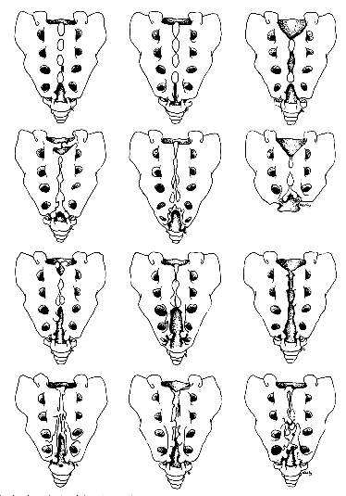
Special Considerations: Contraindications
Sacral deformities or sacral dimples
    May overlie spinal dysraphism, spina bifida occulta or tethered cord
    Consider MRI to evaluate
    Ultrasound exam of the sacrum may rule out anomalies and allow visualization of the thecal sac and spinal cord

Slide 7
Special Considerations: Contraindications
Neurologic abnormalities of the spinal cord or peripheral nervous system
  Postoperative progression of neuropathy often occurs after a surgical procedure, and may implicate the caudal block if performed
  Local anesthetics are neurotoxic, and neuropathic peripheral nerves are at increased risk of expression of neurotoxicity
  New postoperative neurologic deficits will require imaging to rule out complications of an epidural injection or needle insertion

Slide 8
Special Considerations: Contraindications
Increased risk of infection
  Skin infection in region of caudal needle insertion
  Bacteremia, sepsis

Slide 9
Technique: Equipment and Supplies
Needles:
  23G “butterfly” needle (infants)
  22 G SB (short bevel) needles
  22G IV cannula (older children)

Slide 10
Supplies
Sterile gloves
Skin preparation solution
    Chlorhexidine
    Povidone iodine
Sterile towels to drape area
Syringe containing injectate

Slide 11
Technique
Position: prone, or lateral decubitus with knees to chest
Cleanse skin and drape area

Slide 12
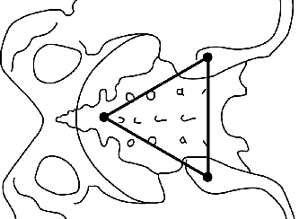
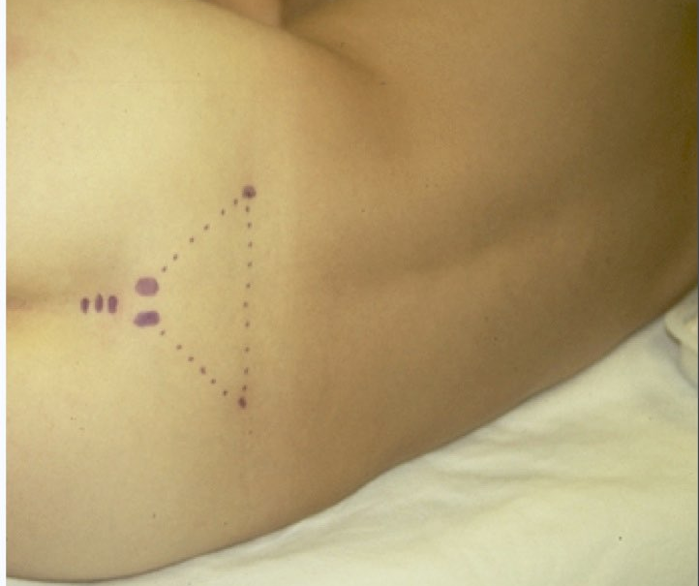
Identify the Sacral Hiatus
Palpation and Surface Anatomy
Palpate the posterior superior iliac spines (PSIS)
Visualize an equilateral triangle defined by the two PSIS’s
The 3rd angle will overlie the sacral hiatus in most children
Palpate the two sacral cornuae at this location
The indentation between the cornuae will be the sacral ligament and sacral hiatus

Slide 13
Identify the Sacral Hiatus
Ultrasound
Linear high-resolution transducer in sagittal plane, midline
Start at L5 and scan caudally until the sacrum and the sacral hiatus are visible
Insert the needle under ultrasound under visualization (in-plane)
D: Dura (ventral and dorsal)
ES: Termination of thecae sac
SCM: Sacral membrane. Note the hiatus as the space between the ventral table of bone and the posterior elements.

Slide 14
Needle Insertion
Needle is inserted 45° to skin in midline over sacral hiatus
Advance slowly until a distinct “pop” or “give” is felt as the sacrococcygeal ligament is pierced
Needle angle is flattened and advanced a 1cm, not further

Slide 15
Avoiding an Intravascular Injection
Aspirate to rule out vascular or CSF placement
Test dose to rule out intravascular placement
  0.1ml/kg of 1:200,000 epinephrine (0.5µg/kg)

Slide 16
Avoiding an Intravascular Injection
Observe for:
  Heart rate increase > 10 ppm
  Systolic blood pressure increase > 15 mm Hg
  T-wave amplitude increase > 25%
  Within 90sec of test dose administration

Slide 17
Pitfalls of Epinephrine Test Doses
Concomitant administration of inhalation anesthetics during epinephrine test dosing may yield false negatives
Since the sensitivity of this test is not 100%, incremental injection of local anesthetic (while observing for signs of LAST) should be done

Slide 18
Injection of Local Anesthetic
Inject full dose in 25% fractions over several minutes
Bulging of skin over sacrum indicates misplaced needle
Ultrasound may be used at L5/S1 in transverse or sagittal planes to observe local anesthetic in the epidural space; Usually will see compression of dura

Slide 19
Dosing of Local Anesthetic
Block level depends upon volume of local anesthetic injected
ml = 0.05 ml/kg/#dermatomes to be blocked
Rule of thumb: 0.5 ml/kg produces a T10 sensory level; 1 ml/kg produces a T6 sensory block

Slide 20
Choice of Local Anesthetic
Bupivacaine
Levo-Bupivacaine (in Europe)
Ropivacaine
Lidocaine

Slide 21
Dosing of Local Anesthetic
Reduce dose 50% if newborn < 6 weeks
Reduce dose by 25% – 50% in presence of hepatic dysfunction, cardiac dysfunction, volume contraction, hypoproteinemia

Slide 22
Bupivacaine
The most cardiotoxic of choices
Maximum dose = 3 mg/kg in an otherwise healthy child
Duration of action 2 – 6 hours (with or without epinephrine)

Slide 23
Levo-bupivacaine
Maximum dose = 3 mg/kg
Levo enantiomer has similar duration as bupivacaine
Levo enantiomer reduces cardio and CNS toxicity
Not marketed in the U.S. or Canada

Slide 24
Ropivacaine
Maximum dose = 3 - 4 mg/kg
Provides similar duration as bupivacaine
Compared with bupivacaine:
  Reduced cardio and CNS toxicity
  Reduced motor block

Slide 25
Lidocaine
Maximum dose = 5 mg/kg
Provides very short duration of action
Advantage: ability to monitor blood levels during continuous infusions

Slide 26
Adjuvants: Opioids
Options:
  Preservative free morphine, 30 - 50 µg/kg
  Hyrdomorphone 10 – 20 µg/kg
  Fentanyl 0.25 – 0.5 µg/kg
Enhanced analgesia due to spinal and central analgesia
Risks: delayed respiratory depression, nausea, pruritus, urinary retention

Slide 27
Adjuvants: Opioids
Fentanyl exerts most or all of its effects via systemic absorption from epidural space and not through selective spinal analgesia
Hydromorphone, more lipophilic than morphine, causes less nausea and vomiting than morphine
Risk of delayed respiratory depression mandates observation & monitoring for >12 hours

Slide 28
Adjuvants: Clonidine
Enhanced analgesia by direct stimulation of alpha-2 receptors and mu opioid receptors in spinal cord
Benefits: lengthens duration of opioid analgesia
No respiratory depression, pruritus, urinary effect
Dose 1 – 2 µg/kg

Slide 29
Adjuvants: Other
There have been other adjuvants reported (e.g., ketamine, diazepam, neostigmine, dexamethasone, dexmedetomidine) but none have been proven to not be neurotoxic in vitro or in vivo and should not be used
In fact, ketamine is indeed neurotoxic in the rabbit epidural model

Slide 30
Postoperative Management
A clear plan should address pain once caudal block recedes and should be communicated to caregivers and parents
Some patients may have distress over lower extremity numbness and weakness. This is usually alleviated with small doses of benzodiazepines.

Slide 31
Complications
Intravascular/intraosseous injection
Local anesthetic systemic toxicity (LAST)
Infection/epidural abscess
Bleeding/epidural hematoma
Neuronal injury
Bowel perforation

Slide 32
Keys to Success
Equilateral triangle method is most reliable method of locating the sacral hiatus
Most technique failures are due to needle placement that is too caudad
Test dose
Clonidine to lengthen duration of analgesia

Slide 33
Keys to Success
If surgery or pain is located above the umbilicus, a lumbar epidural (with or without catheter) will provide more reliable and effective analgesia.
The success rate will be enhanced with the use of ultrasound to confirm epidural drug injection if there is any doubt about the anatomy

Slide 34
Summary
Caudal analgesia/anesthesia is safe and effective for pediatric patients
Complications and failures are minimized by close attention to anatomic landmarks, sterile technique, and ultrasound guidance in some cases
Medication choice should be individualized to patient and surgery

Slide 35
References
Baird R, et al. A systematic review and meta-analysis of caudal blockade versus alternative analgesic strategies for pediatric inguinal hernia repair. J Ped Surg 2013;48:1077
Cook B, et al. Comparison of adrenaline, clonidine and ketamine on the duration of caudal analgesia produced by bupivacaine in children. BJA 1995;75:698
Dobereiner E, et al: Evidence-based clinical update: which local anesthetic drug for pediatric caudal block provides optimal efficacy with the fewest side effects? Can J Anesth 2010;57:1102
Krane E. Spinal epidermoid tumors: will a forgotten complication rise again? [editorial]. Reg Anes Pain Med 1999;24:494
Menzies R, et al. A survey of pediatric caudal extradural anesthesia practice Ped Anesth 2009;19:829
Polaner DM, et al. Pediatric Regional Anesthesia Network (PRAN): a multi-institutional study of the use and incidence of complications of pediatric regional anesthesia. Anes Analg 2012;115:1353
Roberts S. Ultrasonographic guidance in pediatric regional anesthesia. Part 2: techniques. Pet Anes 2006;16:1112
Tobias J Caudal epidural block: a review of test dosing and recognition of systemic injection in children. Anes Analg 2001;93:1156
Tsui B, et al. Color flow Doppler ultrasonography can distinguish caudal epidural injection from intrathecal injection. Anes Analg 2013;116:1376

