Slide 1
Fluid Management in Pediatric Patients
Graeme Segal, MD
Aruna Kamath, MD, MPH
Seattle Children’s Hospital
University of Washington
Published 9/2021

Slide 2
Disclosures
No relevant financial relationships

Slide 3
Learning Objectives:
Fundamentals:
Describe distribution of fluid and electrolytes at different ages
Compare types of IV fluids
Clinical Application:
Identify risk factors and exam signs for hypovolemia
Explain rationale of optimized fasting time
Calculate maintenance fluid rates
Recognize different mechanisms of intraoperative fluid losses and develop appropriate replacement strategies

Slide 4
Fundamentals

Slide 5
Total Body Water (TBW)
Age | TBW (% of weight)
Term Neonate | 80 %
6 months | 70 %
1 year | 60 %
Adult | 60 %
Notes:
NOTE: Highest in neonates and decreases with age

Slide 6
Fluid Compartments
Intracellular Fluid (ICF): the fluid located inside cells
Extracellular Fluid (ECF): Intravascular + interstitial fluid
    Intravascular: the fluid in blood vessels
    Interstitial: the fluid around the cells
  ECF electrolyte concentrations do not change with age
Notes:
Sümpelmann R, Becke K, Brenner S, et al. Perioperative intravenous fluid therapy in children: guidelines from the Association of the Scientific Medical Societies in Germany. Paediatr Anaesth. 2017;27(1):10-18.

Slide 7
Fluid Compartments
Age | Extracellular Fluid Volume (% of body weight) | Intracellular Fluid Volume (% of body weight)
Premature Neonate | 50% | 30%
Term Neonate | 35-40% | 35-40%
Infant | 30% | 35%
Adult | 20% | 45%
Notes:
NOTE: Small children have larger ECF percentage than adults
Lerman J, Coté CJ, Steward DJ. Manual of Pediatric Anesthesia: With an Index of Pediatric Syndromes.; 2016.

Slide 8
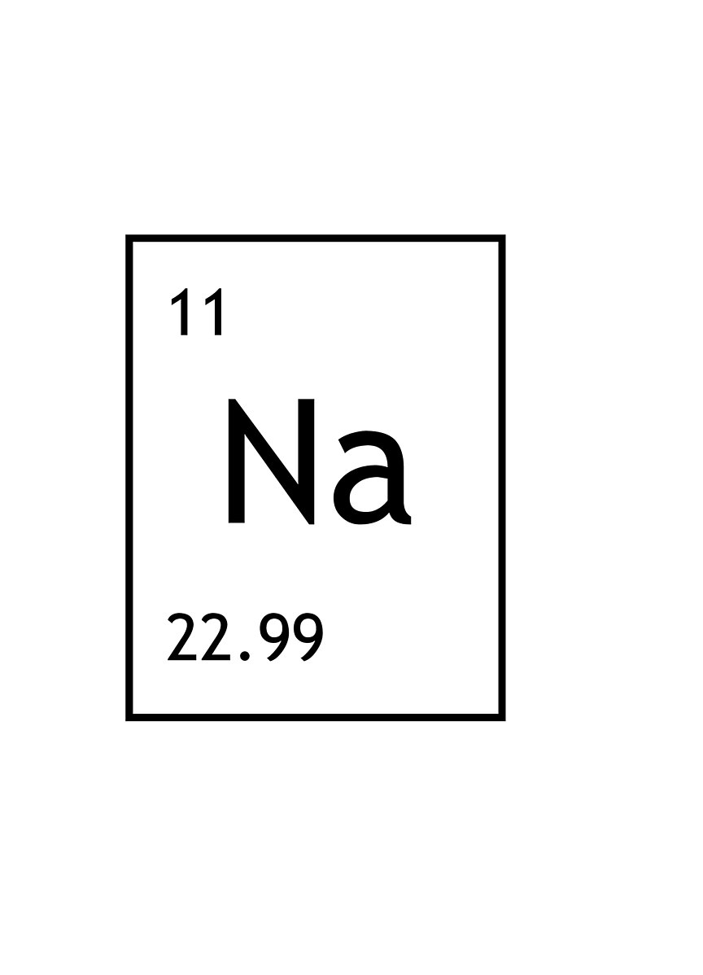
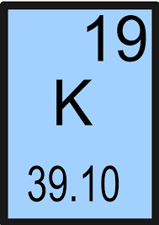
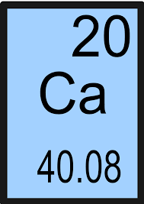
Electrolytes
Sodium
  Primary extracellular positively charged ion (cation)
  Water moves to areas of high Na⁺ concentration
  Hyponatremia (low Na⁺) can cause cerebral edema and encephalopathy
  Rapid correction of hyponatremia can cause central pontine myelinolysis
Potassium
  Primary intracellular cation
  Hypo/hyperkalemia can cause arrhythmia
Calcium
  Important for muscle and cardiac contraction
  Must be replaced during blood transfusion
Notes:
NOTE: Intracellular calcium regulation is less developed in neonates due to the immaturity of the sarcoplasmic reticulum and thus neonates depend more on extracellular ionized calcium for cardiac function.
Brightyellowjeans, CC BY-SA 4.0 <https://creativecommons.org/licenses/by-sa/4.0>, via Wikimedia Commons
Albedo-ukr, CC BY-SA 2.5 <https://creativecommons.org/licenses/by-sa/2.5>, via Wikimedia Commons
https://commons.wikimedia.org/wiki/File:Calcium.svg

Slide 9
Osmolality and Tonicity
Osmolality
  Measure of how many particles are dissolved in a solution
  Units are milliosmoles/kilogram
  Normal plasma osmolality = 288 mOsmol/kg
Tonicity
    Hypertonic: higher concentration
    Isotonic: equal concentration
    Hypotonic: lower concentration
Notes:
milliosmoles

Slide 10
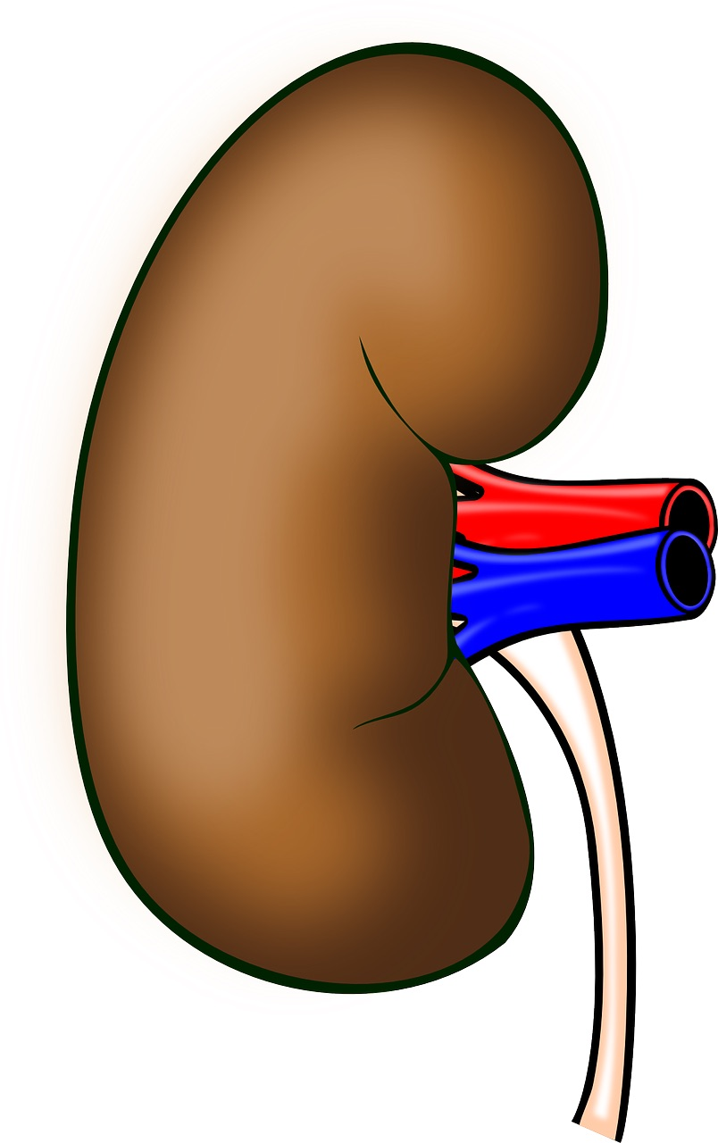
Renal Function
The kidney regulates fluid and electrolytes via renin-angiotensin-aldosterone and ADH
Renal function matures postnatally:
  Renal vascular resistance decreases after birth, increasing flow through kidneys and GFR
  Immature kidney is unable to concentrate urine
  Limited ability to reabsorb sodium and bicarbonate
  Limited ability to excrete potassium
Immature renal function places neonates at risk of dehydration, hyponatremia, hyperkalemia, and hypervolemia
Notes:
NOTE: The fetus has the same number of nephrons in the kidney by 35 weeks of gestational age, but their function is limited by immature renal tubules. The immature kidneys are able to excrete dilute urine, but are unable to concentrate urine to retain fluid in the setting of dehydration. Postnatally - renal function reaches adult levels between age 1 and 2. Older infants are at less risk of dehydration than neonates, but higher risk than older children.
Murat I, Humblot A, Girault L, Piana F. Neonatal fluid management. Best Pract Res Clin Anaesthesiol. 2010;24(3):365-374.
O’Brien F, Walker IA. Fluid homeostasis in the neonate. Paediatr Anaesth. 2014;24(1):49-59.
https://www.needpix.com/photo/download/99851/anatomy-kidney-organ-human-body-biology-human-free-vector-graphics-free-pictures-free-photos

Slide 11
Types of Fluids: Crystalloids
 | Human Plasma | Normal Saline | Lactated Ringer’s | Normosol or Plasmalyte
Na⁺ (mmol/L) | 142 | 154 | 130 | 145
K⁺ (mmol/L) | 4.5 | - | 4 | 4
Ca²⁺ (mmol/L) | 2.5 | - | 3 | -
Mg²⁺ (mmol/L) | 1.25 | - | - | 3
Cl⁻ (mmol/L) | 103 | 154 | 112 | 98
HCO₃⁻ (mmol/L) | 24 | - | - | -
Lactate (mmol/L) | 1.5 | - | 28 | -
Acetate (mmol/L) | - | - | - | 27
Osmolarity (mOsmol/L) | 290 | 308 | 276 | 294
Notes:
Sümpelmann R, Becke K, Zander R, Witt L. Perioperative fluid management in children: can we sum it all up now? Curr Opin Anaesthesiol. 2019;32(3):384-391.
Normal Saline
Osmolality of 308 mOsm/L
Hypertonic compared to plasma
Made of equal parts sodium and chloride (154 mmol/L Na⁺ and 154 mmol/L Cl⁻)
Does not contain potassium, calcium, or lactate
Lactate Ringer’s
Osmolality of 276 mOsm/L
Made of sodium, chloride, potassium, calcium, and lactate
Due to the potassium in this fluid it should be administered with caution to patient’s with hyperkalemia
Contains lower concentrations of sodium (130mmol/L) and chloride (112 mmol/L)

Slide 12
Types of Fluids: Crystalloids
Normal Saline:
  Hypertonic compared to plasma
  High level of chloride can result in hyperchloremic metabolic acidosis when given in large volumes
  Compatible with blood products
Lactated Ringers (Hartmann’s Solution):
  Lactate metabolized to bicarbonate by liver, lowering risk of metabolic acidosis
  Clot formation possible with blood administration
Plasmalyte/Normosol:
  Acetate metabolized to bicarbonate by liver
Notes:
The recommendation is to avoid administration of lactated ringer’s with blood products due to potential for calcium to bind to citrate in the stored blood increasing the chance of clot formation, however several studies have found no clot formation with the use of packed red blood cells and lactated ringers
Albert K, van Vlymen J, James P, Parlow J. Ringer’s lactate is compatible with the rapid infusion of AS-3 preserved packed red blood cells. Can J Anaesth. 2009;56(5):352-356
Lorenzo M, Davis JW, Negin S, et al. Can Ringer’s lactate be used safely with blood transfusions? Am J Surg. 1998;175(4):308-310.
Cull DL, Lally KP, Murphy KD. Compatibility of packed erythrocytes and Ringer’s lactate solution. Surg Gynecol Obstet. 1991;173(1):9-12.

Slide 13
Types of Fluids: Colloids
Albumin
  Natural colloid
  High cost
Hydroxyethyl starch (HES)
  Synthetic colloid
  Early formulations associated with coagulopathy and renal impairment
  Lower cost, similar outcomes to albumin
Gelatin (GEL)
  Synthetic colloid
  More allergic reaction in adults than HES
Notes:
Van der Linden P, De Villé A, Hofer A, Heschl M, Gombotz H. Six percent hydroxyethyl starch 130/0.4 (Voluven®) versus 5% human serum albumin for volume replacement therapy during elective open-heart surgery in pediatric patients. Anesthesiology. 2013;119(6):1296-1309.

Slide 14
Clinical Applications
Notes:
Sümpelmann R, Becke K, Brenner S, et al. Perioperative intravenous fluid therapy in children: guidelines from the Association of the Scientific Medical Societies in Germany. Paediatr Anaesth. 2017;27(1):10-18.

Slide 15
Goals of Fluid Management
Support and maintain normal physiological state
Maintain:
  Cardiac preload
  Intravascular volume
  Oxygen carrying capacity
  Organ perfusion
  Electrolyte balance
Notes:
Sümpelmann R, Becke K, Brenner S, et al. Perioperative intravenous fluid therapy in children: guidelines from the Association of the Scientific Medical Societies in Germany. Paediatr Anaesth. 2017;27(1):10-18.

Slide 16
Assessment of Volume Status
History concerning for hypovolemia:
  Prolonged fasting
  Vomiting
  Diarrhea
  Sweating
  Fever
  Hemorrhage
  Increased urination (diuretics or hyperglycemia)
Notes:
Decreased urine output would be seen as a result of hypovolemia. Increased urine output due to diuretic administration or hyperglycemia could precipitate hypovolemia

Slide 17
Signs of Hypovolemia in Infants and Children
Mild (5% of body weight - 50 mL/kg):¹⁰
  Increased thirst
  Flat fontanelle
Moderate (10% of body weight - 100 mL/Kg):
  Irritable
  Dry mouth, slight skin turgor, reduced tears
  Tachycardia, delayed capillary refill
  Urine output < 0.5 ml/kg/hr
Severe (15% of body weight - 150 mL/Kg):
  Lethargy
  Parched mouth, increased skin turgor, absent tears
  Sunken fontanelle
  Hypotension (may be a late sign of hypovolemia)
  Anuria
Notes:
Lerman J, Coté CJ, Steward DJ. Manual of Pediatric Anesthesia: With an Index of Pediatric Syndromes.; 2016. P. 128.
Butterworth JF. Morgan & Mikhail’s Clinical Anesthesiology. Sixth edition. (Mackey DC, Wasnick JD, Morgan GE, Mikhail MS, eds.). McGraw-Hill; 2018. P. 1162

Slide 18

Fasting Time
Fasting time required to avoid aspiration
Prolonged fasting before surgery leads to⁵
  Discomfort
  Dehydration
  Hypotension with induction
  Ketoacidosis
Keep fasting time as short as possible*!
Notes:
* Longer fasting time and additional aspiration precautions (suction stomach, rapid sequence induction) may be indicated for patients with specific conditions affecting gastric emptying, for example those with short bowel syndrome, gastroparesis, small bowel obstruction, pyloric stenosis, etc.
Sümpelmann R, Becke K, Brenner S, et al. Perioperative intravenous fluid therapy in children: guidelines from the Association of the Scientific Medical Societies in Germany. Paediatr Anaesth. 2017;27(1):10-18.
https://freesvg.org/no-food-or-drink-sign
FreeSVG.org offers free vector images in SVG format with Creative Commons 0 license (public domain). You can copy, modify, distribute and perform the work, even for commercial purposes, all without asking permission.

Slide 19

Clear Liquids
  Many centers are reducing clear liquid fasting time to 1 hour for elective cases
  Gastric pH and gastric residual volume is unchanged with 1 hour vs 2 hour clear fluid fasting⁴
  1 hour clear liquid fasting has a similar risk of pulmonary aspiration⁵
  Fasting time is often prolonged due to surgical delay or long travel
  European consensus statement recommends offering 3 ml/kg clear liquid up to 1 hour prior to induction of anesthesia⁶
Notes:
4. Schmidt AR, Buehler P, Seglias L, et al. Gastric pH and residual volume after 1 and 2 h fasting time for clear fluids in children†. Br J Anaesth. 2015;114(3):477-482.
5. Andersson H, Zarén B, Frykholm P. Low incidence of pulmonary aspiration in children allowed intake of clear fluids until called to the operating suite. Paediatr Anaesth. 2015;25(8):770-777.
6. Thomas M, Morrison C, Newton R, Schindler E. Consensus statement on clear fluids fasting for elective pediatric general anesthesia. Paediatr Anaesth. 2018;28(5):411-414.

Slide 20
Fasting Time
NPO Guidelines
Type of food/drink | Last intake prior to anesthesia induction
Clear Liquids | 1-2 hours*
Breast Milk | 4 hours
Infant formula, non-human milk, or light meal | 6 hours
Heavy meal | 8 hours
*ASA recommends 2 hours for clear liquids, while the 2018 European consensus statement recommends 1 hour for clear liquids
Notes:
ASA Perioperative fasting guidelines examples of each category:
Clear liquid: Water, fruit juices without pulp, carbonated beverages, carbohydrate-rich nutritional drinks, clear tea, and black coffee
Breast milk: Unfortified human milk. Non-human milk has slower gastric transit time and is considered in the light meal category
Light meal: Toast, low-fat, low protein
Heavy meal: Fried food, fatty food, or meat
Practice guidelines for preoperative fasting and the use of pharmacologic agents to reduce the risk of pulmonary aspiration: application to healthy patients undergoing elective procedures: an updated report by the american society of anesthesiologists task force on preoperative fasting and the use of pharmacologic agents to reduce the risk of pulmonary aspiration. Anesthesiology. 2017;126(3):376-393.
The European Consensus Statement on clear fluids fasting defines clear liquids:
Clear fluids are defined as water, clear (nonopaque) fruit juice or squash/cordial, ready diluted drinks, and non-fizzy sports drinks. Non-thickened, non-carbonated.
Thomas M, Morrison C, Newton R, Schindler E. Consensus statement on clear fluids fasting for elective pediatric general anesthesia. Paediatr Anaesth. 2018;28(5):411-414.

Slide 21
Effects of Surgical Stress
Release of antidiuretic hormone (ADH) → Results in retention of water by the kidneys and excretion of concentrated urine
Permeability of the vascular endothelium due to direct injury, inflammation, and ischemia

Slide 22
Maintenance Fluid
The fluid and electrolytes needed to meet basic metabolic needs of the pediatric patient while they are not eating or drinking
1957 Holliday and Segar⁷: “4-2-1 Rule”
  Based on metabolic rate (1 mL water needed for each kcal of energy expended)
  4 ml/kg/hr (first 10kg) + 2 ml/kg/hr (second 10kg) + 1 ml/kg/hr for each additional kg
  Historically D5 0.2% NS hypotonic fluids was used for pediatric patients. This is no longer recommended due to hyponatremia and hyperglycemia concerns.
Notes:
7. Holliday MA, Segar WE. The maintenance need for water in parenteral fluid therapy. Pediatrics. 1957;19(5):823-832.

Slide 23
Fluid Deficit
1975 Furman et al⁸: Pre-operative fluid deficit
  Amount of dehydration due to fasted period
  Pre-operative fluid deficit = Maintenance rate (4-2-1 rule) x hours NPO
  Recommended giving half the deficit in the 1st hour of surgery and the other half over 2 hours
  Assumes 6-8 hours of complete NPO
  Less significant with updated/shorter fasting guidelines
Notes:
8. Furman EB, Roman DG, Lemmer LA, Hairabet J, Jasinska M, Laver MB. Specific therapy in water, electrolyte and blood-volume replacement during pediatric surgery. Anesthesiology. 1975;42(2):187-193.
1986 Berry: Fluid deficit replacement simplification
Less than 3 years old: 25 mL/kg fluid bolus
Older than 3 years old: 15 ml/kg fluid bolus

Slide 24
Maintenance Fluids
Current practices and recommendations:
Use balanced isotonic electrolyte solution¹
  Recommended to avoid hyponatremia, hyperchloremia
  Hypotonic fluids (half normal or quarter NS) may lead to low plasma sodium concentration
  4-2-1 Rule⁷ or 10 mL/Kg/hr¹ (includes deficit) to calculate initial maintenance fluid rate
Notes:
NOTE: 10 mL/Kg/hr is greater than the maintenance rate calculated by the 4-2-1 rule, but it is thought to take the fasted deficit into account. The rate should be adjusted given the assessment of fluid status in a given patient.
1. Sümpelmann R, Becke K, Brenner S, et al. Perioperative intravenous fluid therapy in children: guidelines from the Association of the Scientific Medical Societies in Germany. Paediatr Anaesth. 2017;27(1):10-18.

Slide 25
Glucose Management
Patients at risk of developing hypoglycemia:
  Children less than 6 months old
  Patients in whom parenteral nutrition is held, chronically undernourished, or with endocrinopathies
  Monitor glucose frequently
Dextrose 2%
  Recommended to be added to maintenance fluids to avoid hypoglycemia and hyperglycemia¹ for at risk patients
  Add of 2 mL of D50 added to 48 mL LR → 50 mL D2LR
  Sterile technique and pharmacy-prepared solutions, if possible, to minimize infection risk from contamination
Neonatal patients
  Dextrose need is reduced with stress-induced glucose mobilization.
  When comparing D1% vs D2-4% vs D10%,¹⁶ D2-4% was most suitable in a recent RCT trial¹⁶
Notes:
Note: Glucose is rapidly taken up into the cells of the body. Prolonged hypoglycemia is associated with poor neurological outcomes and increased morbidity and mortality in the pediatric ICU population.
15. Kolesky 2020. Pediatric Anesthesia. 2021;31:197–204.
Note: Halving preoperative dextrose rates intraoperatively was associated with a decreased risk of hyperglycemia, without increasing hypoglycemia occurrence.
16. Datta 2016. Pediatric Anesthesia 26 (2016) 599–607.
7. Holliday MA, Segar WE. The maintenance need for water in parenteral fluid therapy. Pediatrics. 1957;19(5):823-832.
12. Welborn LG, McGill WA, Hannallah RS, Nisselson CL, Ruttimann UE, Hicks JM. Perioperative blood glucose concentrations in pediatric outpatients. Anesthesiology. 1986;65(5):543-547.
446 patients, age 1 month to 6 years old, at a single institution scheduled for outpatient elective surgery, randomized to LR or D5LR. A statistically significant increase in glucose concentration was found in both groups (85mg/dL to 111mg/dl in LR, and 83mg/dl to 244mg/dL in D5LR group).
13. Mikawa K, Maekawa N, Goto R, Tanaka O, Yaku H, Obara H. Effects of exogenous intravenous glucose on plasma glucose and lipid homeostasis in anesthetized children. Anesthesiology. 1991;74(6):1017-1022.
1. Sümpelmann R, Becke K, Brenner S, et al. Perioperative intravenous fluid therapy in children: guidelines from the Association of the Scientific Medical Societies in Germany. Paediatr Anaesth. 2017;27(1):10-18.

Slide 26
Fluids for Resuscitation
Balanced isotonic electrolyte solution without glucose
  Used to correct hypovolemia, or compensate for anesthesia related vasodilation
  10 - 20 mL/kg bolus (up to 3 doses)
  Boluses should NOT include glucose
  Large volumes may cause hemodilution
Colloid
  Recommended if a balanced crystalloid administration is insufficient to normalize circulation or hypoalbuminemia is present
Notes:
Fluid deficits or hypovolemia should be treated with a balanced isotonic solution without glucose. A fluid bolus of 10 - 20 ml/kg should be given up to three times, but caution should be used to avoid volume overload.
https://commons.wikimedia.org/wiki/File:Blausen_0086_Blood_Bag.png

Slide 27
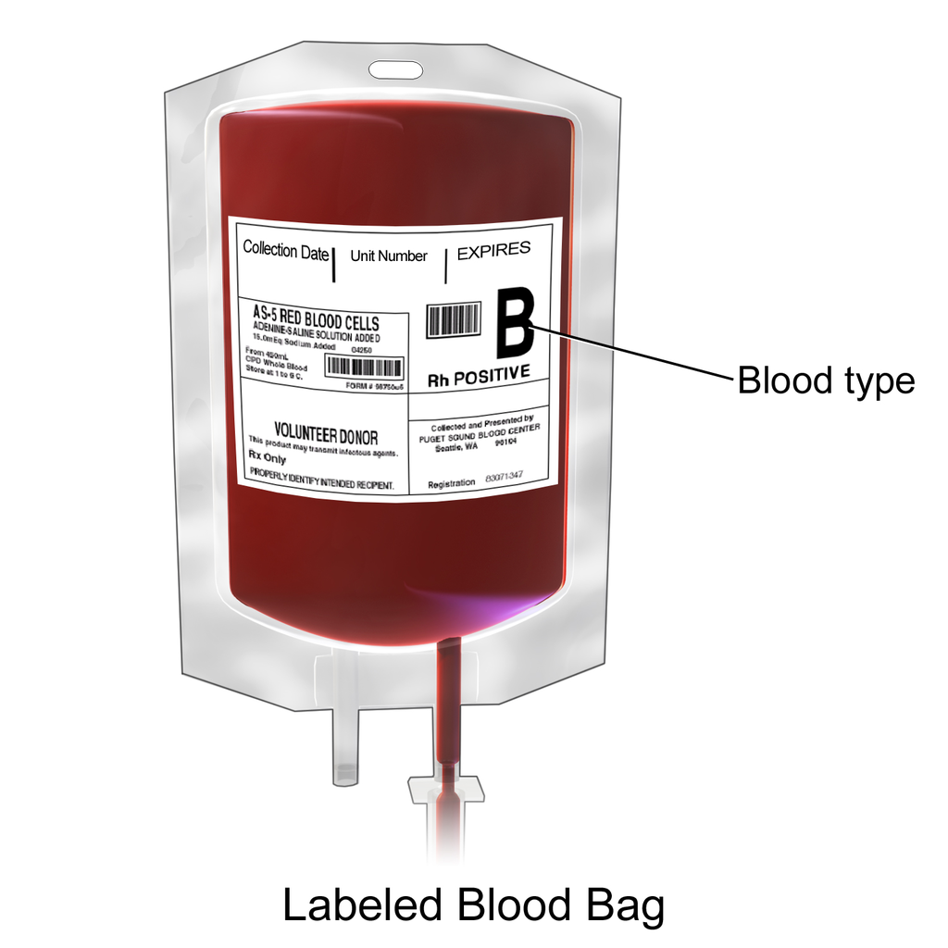
Fluids for Resuscitation
Blood transfusion (RBC, FFP, PLT)
  Large volume blood loss
  10 - 20 mL/kg doses for RBC, FFP
  5 - 10 mL/Kg doses for platelets
Refer to lectures on blood management, shock, trauma, burns for advanced applications
Notes:
Fluid deficits or hypovolemia should be treated with a balanced isotonic solution without glucose. A fluid bolus of 10 - 20 ml/kg should be given up to three times, but caution should be used to avoid volume overload.
https://commons.wikimedia.org/wiki/File:Blausen_0086_Blood_Bag.png

Slide 28
Insensible Losses
Losses related to evaporation, sweat, respiratory loss
Proportional to amount of exposed bowel or viscera
Neonates prone to evaporative loss due to high skin surface area to weight ratio
Consider adding humidification filter, if available, to reduce respiratory losses in small infants

Slide 29
Internal Redistribution of Fluids
Movement of fluid from blood vessels into other parts of the body (ascites, edema, etc).
The amount of fluid redistribution is related to the degree tissue trauma
  Minimal: 3-4 mL/kg/hr
  Moderate: 5-7 mL/kg/hr
  Severe: 10 mL/kg/hr
Notes:
Shires T, Williams J, Brown F. Acute change in extracellular fluids associated with major surgical procedures. Ann Surg. 1961;154:803-810.
Brandstrup B, Svensen C, Engquist A. Hemorrhage and operation cause a contraction of the extracellular space needing replacement--evidence and implications? A systematic review. Surgery. 2006;139(3):419-432.
Chappell D, Jacob M, Hofmann-Kiefer K, Conzen P, Rehm M. A rational approach to perioperative fluid management. Anesthesiology. 2008;109(4):723-740.

Slide 30
Goal Directed Therapy
Fluid therapy is ideally targeted to a measurable outcome:
  Heart rate, capillary refill, blood pressure, urine output, pulse pressure variation, cardiac output, lactate, pulse pressure variation
Fluid responsiveness
  Determine if a patient’s cardiac output will increase with an increase in pre-load
  Larger children: Passive leg raise or Trendelenburg positioning
  Smaller children and infants: external pressure on liver

Slide 31
Neonatal Summary
Fluid distribution: total body water and ECF
High insensible fluid losses due to high alveolar ventilation, thin skin, radiant heat use
Neonates are unable to compensate for blood loss
  Due to immature intracellular calcium regulation, less developed left ventricle stroke volume, parasympathetic dominance, and impaired baroreceptor reflex to hypovolemia
  As blood loss increases, cardiac output and blood pressure will decrease
  Blood pressure is a good end point for fluid resuscitation
  Significant blood loss may occur before it is evident in suction canisters/sponges
Notes:
Lerman J, Coté CJ, Steward DJ. Manual of Pediatric Anesthesia: With an Index of Pediatric Syndromes.; 2016.
Murat I, Humblot A, Girault L, Piana F. Neonatal fluid management. Best Pract Res Clin Anaesthesiol. 2010;24(3):365-374.

Slide 32
Neonatal Summary
Renal function in neonates is immature¹⁰
  Reduced renal blood flow and glomerular filtration rate
  Poor regulation of fluid or electrolytes
  Sodium (Na⁺) and glucose losses may be high
Glucose Metabolism
  Glucose metabolism is twice as high as adults
  Glycogen stores are small and gluconeogenesis is immature
  Keep fasting times as short as possible for neonates
  Add dextrose to maintenance fluids to avoid hypoglycemia
Notes:
10. Lerman J, Coté CJ, Steward DJ. Manual of Pediatric Anesthesia: With an Index of Pediatric Syndromes.; 2016.
Murat I, Humblot A, Girault L, Piana F. Neonatal fluid management. Best Pract Res Clin Anaesthesiol. 2010;24(3):365-374.

Slide 33
Intraoperative Fluids Summary
Minimize fasting time
  to reduce fluid deficit and metabolic abnormalities
  Clears (1-2 hrs); breast milk (4 hrs); formula/light meal (6 hrs); heavy meal (8 hrs)
Maintenance fluids
  4-2-1 calculation
  1-2% dextrose if needed (i.e. < 6 months old, TPN dependent, malnutrition, endocrinopathies)
Resuscitation
  Crystalloid 10 - 20 mL/Kg (up to 3 boluses)
  Colloid 20 mL/Kg
  RBC or FFP 10 - 20 mL/Kg
Notes:
Adding a summary slide

Slide 34
Conclusions
Fluid distribution and renal function change with age
Use of isotonic fluids can help avoid hyponatremia
Estimate volume status using history and physical exam
Minimize fasting time to reduce pre-operative fluid deficit and metabolic abnormalities
Administer glucose selectively to patients at risk of hypoglycemia
Target a measurable outcome when administering fluids

Slide 35
References:
Sümpelmann R, Becke K, Brenner S, et al. Perioperative intravenous fluid therapy in children: guidelines from the Association of the Scientific Medical Societies in Germany. Paediatr Anaesth. 2017;27(1):10-18.
Murat I, Humblot A, Girault L, Piana F. Neonatal fluid management. Best Pract Res Clin Anaesthesiol. 2010;24(3):365-374.
Van der Linden P, De Villé A, Hofer A, Heschl M, Gombotz H. Six percent hydroxyethyl starch 130/0.4 (Voluven®) versus 5% human serum albumin for volume replacement therapy during elective open-heart surgery in pediatric patients. Anesthesiology. 2013;119(6):1296-1309.
Schmidt AR, Buehler P, Seglias L, et al. Gastric pH and residual volume after 1 and 2 h fasting time for clear fluids in children†. Br J Anaesth. 2015;114(3):477-482.
Andersson H, Zarén B, Frykholm P. Low incidence of pulmonary aspiration in children allowed intake of clear fluids until called to the operating suite. Paediatr Anaesth. 2015;25(8):770-777.
Thomas M, Morrison C, Newton R, Schindler E. Consensus statement on clear fluids fasting for elective pediatric general anesthesia. Paediatr Anaesth. 2018;28(5):411-414.
Holliday MA, Segar WE. The maintenance need for water in parenteral fluid therapy. Pediatrics. 1957;19(5):823-832.
Furman EB, Roman DG, Lemmer LA, Hairabet J, Jasinska M, Laver MB. Specific therapy in water, electrolyte and blood-volume replacement during pediatric surgery. Anesthesiology. 1975;42(2):187-193.
Chappell D, Jacob M, Hofmann-Kiefer K, Conzen P, Rehm M. A rational approach to perioperative fluid management. Anesthesiology. 2008;109(4):723-740.
Lerman J, Coté CJ, Steward DJ. Manual of Pediatric Anesthesia: With an Index of Pediatric Syndromes.; 2016.
Sümpelmann R, Becke K, Zander R, Witt L. Perioperative fluid management in children: can we sum it all up now? Curr Opin Anaesthesiol. 2019;32(3):384-391.

Slide 36
References:
Welborn LG, McGill WA, Hannallah RS, Nisselson CL, Ruttimann UE, Hicks JM. Perioperative blood glucose concentrations in pediatric outpatients. Anesthesiology. 1986;65(5):543-547.
Mikawa K, Maekawa N, Goto R, Tanaka O, Yaku H, Obara H. Effects of exogenous intravenous glucose on plasma glucose and lipid homeostasis in anesthetized children. Anesthesiology. 1991;74(6):1017-1022.
Riegger LQ, Leis AM, Golmirzaie KH, Malviya S. Risk factors for intraoperative hypoglycemia in children: a multicenter retrospective cohort study. Anesth Analg. 2021;132(4):1075-1083.
Welborn LG, McGill WA, Hannallah RS, Nisselson CL, Ruttimann UE, Hicks JM. Perioperative blood glucose concentrations in pediatric outpatients. Anesthesiology. 1986;65(5):543-547.
Mikawa K, Maekawa N, Goto R, Tanaka O, Yaku H, Obara H. Effects of exogenous intravenous glucose on plasma glucose and lipid homeostasis in anesthetized children. Anesthesiology. 1991;74(6):1017-1022.
Kolesky SE, Nyshadham S, Williams HO, et al. Intraoperative dextrose rate during exploratory laparotomies in neonates and the incidence of postoperative hyperglycemia: A retrospective observational study. Paediatr Anaesth. 2021;31(2):197-204.
Datta PK, Pawar DK, Baidya DK, et al. Dextrose-containing intraoperative fluid in neonates: a randomized controlled trial. Paediatr Anaesth. 2016;26(6):599-607.
Free resources:
WFSA Handbook - https://wfsahq.org/wp-content/uploads/anaesthesia-handbook.pdf
WFSA Tutorial: Pediatric Fluids - https://resources.wfsahq.org/atotw/paediatric-fluids/
WFSA Tutorial: Perioperative Fasting in Children - https://resources.wfsahq.org/atotw/preoperative-fasting-in-children/

