Slide 1
Pharmacology of Local Anaesthetics in Children
Geoff Frawley
Royal Childrens Hospital
Murdoch Childrens Research Institute
Melbourne Australia
Updated 5/2017

Slide 2
Disclosures
I have no financial relationship with the manufacturer of a commercial product or provider of a commercial service that may be discussed in this presentation.

Slide 3
Learning Objectives
Describe pharmacokinetic data and the influence of developmental pharmacology
Discuss pharmacodynamic differences in response to local anaesthesia in infants and children
Discuss modification of pharmacodynamics by additives
Identify possible Pharmacogenetics effects on response

Slide 4
Developmental Pharmacology
Organ maturation, body composition and ontogeny of drug elimination pathways have marked effects on pharmacokinetic parameters in infants
  Body composition affects absorption and volume of distribution
  Immature hepatic metabolism affects maximum plasma concentrations (Cmax)
Scaling adult doses to infants based on body weight or surface area does not account for developmental changes that affect drug disposition or tissue/organ sensitivity
Notes:
The pharmacokinetic, pharmacodynamic, anatomical, and physiological features of children make this population different from adults. Ontogeny describes development of individual to maturity. A physiologically based pharmacokinetic model is required for children less than 1 year of age to differentiate age related factors from size-related factors. Pharmacokinetic parameters (Vd, Clearance) can be expressed as a product of size, maturation and organ function. Allometric models describe the nonlinear relationship between size and function. For example, clearance is a nonlinear function of size, resulting in higher local anesthetic infusion rates in children than predicted by using a per kilogram model.

Slide 5
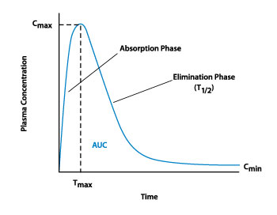
Developmental Pharmacokinetics
Peak plasma concentration (Cmax) depends on
    Dose
    Lipophilicity
    Absorption
    Metabolism
    Clearance
Free concentration depends on: Α1 acid glycoprotein (AAP) binding
Dosing interval depends on
    Elimination T1/2
    Context sensitive half life
Notes:
Pharmacokinetic parameters such as clearance and half life do not have a linear relationship with body weight. The allometric power model allows for this non linear relationship and converts measured paediatric values to a standard 70kg person. The allometric model is expressed as X=Xstd*(W/Wstd)^{PWR} where the PWR parameter is 0.75 for clearance,1 for volume of distribution and 0.25 for half lives. The measured increased clearances associated with per kilogram models disappear when the allometric model is used.
Mazoit JX , Dalens B. Pharmacokinetics of Local Anaesthetics in Infants and Children. Clin Pharmacokinet 2004; 43 (1): 17-32
Anderson BJ. The pharmacology of anaesthetics in the neonate. Best Practice Clin Anesthesiol. 2010; 24: 419-31.
Allegeart K. Clinical pharmacology in neonates: limited in their size, extensive in their interindividual variability.

Slide 6
Absorption Factors
Site of injection
    Spinal LA distributed into CSF volume 4 times that of adult
    Epidural LA is trapped locally with 50% absorbed at 3 hours.
Epidural fat
    Acts as LA sink
    Reduced in neonates so Cmax is earlier than older child
Lipophilicity of LA: Bupivacaine=Levobupivacaine> Ropivacaine
Epinephrine and Intrinsic vasoactivity of LA
  Tmax of ropivacaine is much longer in children than adults
Notes:
The maximum concentrations of LA (Tmax) are dependent on dose, speed of injection, clearance, volume of distribution and absorption half life (T_{abs}). The impact of caudal space vascularity, epidural fat or caudal absorptive surface area differences between infants and older children is undefined. Increased vascularity of the epidural space and sparse epidural fat may increase absorption in children. In neonates and infants, the blood volume is centripetally distributed so that it is likely that the epidural space is proportionately more perfused with blood as compared to older children where blood distribution increasingly becomes centrifugal. A more rapid absorption of the LA through a highly perfused epidural space may lead to higher plasma concentration in neonates.

Slide 7
Distribution
The volume of distribution of most LA’s in infants is higher than adults (1-3L)
  Higher Vd in infants results in higher dose requirements
  May prevent higher serum concentrations after single injection but not repeat bolus injections
Vd of ropivacaine is less than bupivacaine and Levo bupivacaine
Because absorption is delayed after injection a “flip-flop” phenomena occurs and Vd is overestimated
Notes:
Body composition undergoes extensive change in the first few years of life, affecting the volumes of distribution. Total body water decreases from 80% of body weight at birth to 60% at 1 yr. Extracellular fluid declines from 45% at birth to 26% at 1yr. Fat content is 12% at birth and 30% of body weight at 1yr. It is unsurprising that the Vd at steady state of most local anaesthetics is higher in infants.
When local anaesthetics are delivered epidurally rather than intravenously absorption is considerably slower than disposition and flip flop kinetics apply. In flip flop kinetics k_{a} (absorption constant) is much slower than K_{e} (elimination constant). This difference shifts the slope of log Cp versus time curve and underestimates the Ke. The downward part of the curve represents k_{a} and the upward part of the curve is the actual k_{e}.

Slide 8
Flip Flop Kinetics
Binding of local anaesthetics to epidural fat determines LA systemic uptake
Ropivacaine’s lipophilicity and vasoconstrictor activity contribute to prolonged biphasic absorption from epidural space
After Tmax is achieved the rate of absorption (Ka) slows and becomes longer than elimination rate (K) i.e. the constants are “flipped”
The result is a smaller AUC and lower Cmax in concentration time graphs
Notes:
Flip Flop Kinetics are common with extravascular injection of drugs and are most reported with epidural Ropivacaine. Drug disposition is governed by the rate of absorption rather than the rate of elimination. The slope of the terminal phase of the concentration time graph now represents delayed absorption rather than elimination. The lower Cmax could be falsely interpreted as ropivacaine having a lower potential for systemic toxicity

Slide 9
Protein Binding
α1 acid glycoprotein (AAG) is the major local anesthetic binding protein
  low levels in plasma (< 1 g/l in adults)
  AAG is very low at birth (< 30% of adult values)
  AAG is an acute phase protein and its concentration increases rapidly in the post operative period.
Reduced AAG is associated with higher unbound bupivacaine levels
Clearance of bupivacaine depends on intrinsic hepatic clearance (microsomal activity), and plasma unbound fraction
Notes:
Two days after surgery, near steady state is attained for unbound bupivacaine concentration in contrast to what is observed with total concentration. The continuous increase in α-1 acid glycoprotein concentration is likely responsible of the continuous increase in total concentration. This increase in AAG concentration may guard against toxicity however the fall in hepatic clearance due to decreased free fraction means there is no net effect. The role of bupivacaine AAG binding in neonates is contentious. Luz noted that although neonates have lower AAG concentrations than infants > 4 months there was a broad scatter of values (0.32-0.92gm/l). AAG binding is pH-dependent, meaning that any episode of hypoxia or hypercapnia will increase the free fraction of local anaesthetic.

Slide 10
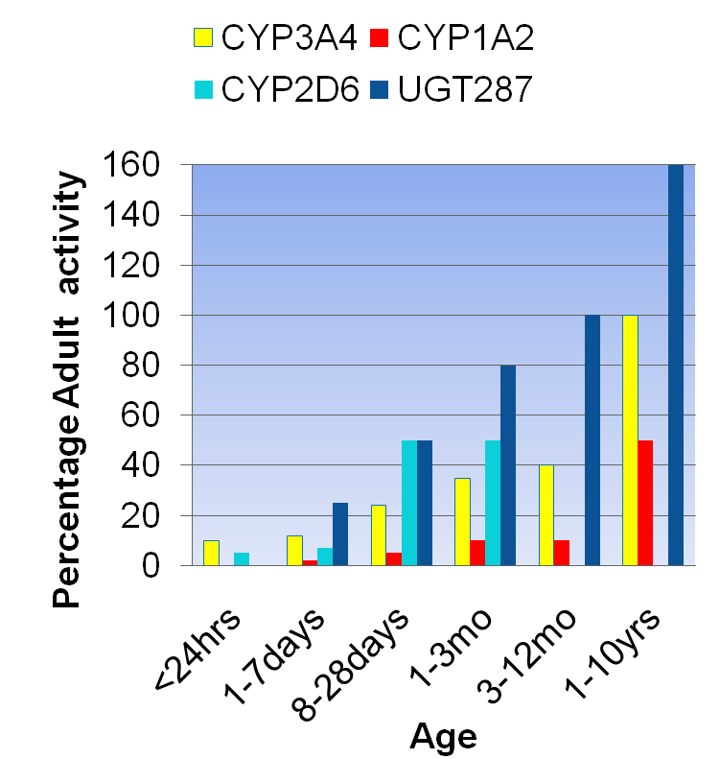
Metabolism
All amide LAs are metabolised in the liver by the cytochrome P450 group
Bupivacaine: CYP3A4
Levobupivacaine: CYP3A4
Ropivacaine: CYP1A2
CYP3A4 low in first 3-6 months of life
CYP1A2 low in the first year of life
Kearns GL et al. NEJM 349: 1157, 2003 22
Notes:
Bupivacaine is metabolised into pipecoloxylidide (PPX) by the CYP3A4 isoform
Ropivacaine is metabolised to 3 and 4 hydroxy-ropivacaine by CYP1A2 and to a minor extent to PPX by CYP3A4
The activity of the hepatic cytochrome P450 mixed function oxidases obtained from term neonates is half that of adult values.
Before birth and during the first 3-6 months of life CYP3A4 is deficient and parts of its biotransformation activities are achieved by CYP3A7 which disappears at 6 months of age. In contrast CYP1A2 is deficient during the first year of life and not fully functional before 4 years of age
CYP3A4 isoform and CYP1A2 isoform mediate the metabolism of levobupivacaine to desbutyl levobupivacaine and 3-hydroxy levobupivacaine, respectively. Metabolic inversion of levobupivacaine to R(+)-bupivacaine is not evident both in vitro and in vivo.

Slide 11
Clearance
  Post Menstrual Age (PMA) is a better predictor of drug elimination than post Natal Age (PNA).
Immaturity of hepatic microsomes and cytochrome P450 enzyme isoforms impairs clearance of low hepatic extraction drugs clearance such as LA’s
  Bupivacaine clearance is low at birth and slightly increases during the first 6-9 months of life.
  Ropivacaine clearance is also low in neonates and infants and increases in the first 2-6 years of life
  Levo clearance in infants is approximately half that described in adults

Slide 12
Common Local Anesthetics
Local Anaesthetic | MW | pKa | Octanol:buffer partition coefficient | Protein Binding
Esters
Tetracaine | 264 | 8.4 | 4.1 | 80%
Chloroprocaine | 271 | 9.1 | 9.0 | 0 %
Amides
Lignocaine | 234 | 7.8 | 2.4 | 65%
Bupivacaine | 288 | 8.1 | 346 | 95%
Ropivacaine | 274 | 8.1 | 115 | 94%
Levobupivacaine | 288 | 8.1 | 346 | 95%

Slide 13
Spinal Anesthesia in Newborns
 | Bupivacaine 1mg.ml⁻¹ Mean (sd) | Bupivacaine Adrenaline 1:200,000 | P=
Total Bupivacaine mg/ml | 0.31 (0.17) | 0.25 (0.09) | >0.05
Unbound Bupivacaine µg/ml | 0.047 (0.03) | 0.062(0.025) | >0.05
Free Fraction % | 16.5% (10.3%) | 12.7%(8.2%) | >0.05
α ₁Acid Glycoprotein µmol/l | 0.43(0.31) | 0.4890.18) | >0.05
Beauvoir Pediatr Anesth 1996
Notes:
Despite high weight based doses plasma concentrations are low and there was no clinical evidence of toxicity. Spinal local anaesthetic doses are large compared to adults (0.8-1mg.kg-1 vs 0.17-0.2mg.kg-1) Unbound and Total bupivacaine levels are well below toxic concentrations. α1-acid glycoprotein (AAG) concentrations varied widely
unbound fractions varied from 4-31%
Beauvoir C, Rochette A, D‘Athis F. Spinal anaesthesia in newborns: total and free bupivacaine plasma concentration. Pediatric Anesthesia 1996;6(3): 195–199

Slide 14
Caudal Pharmacokinetics
 | Bupivacaine | Bupivacaine adrenaline | Ropivacaine | Ropivacaine Adrenaline | Levo bupivacaine
C max (mg/ml) | 0.96 (0.42) | 1.0 | 0.93 (0.29) | 0.61 (0.28) | 0.91(0.40)
Tmax (min) | 28 (13) | 60 | 47 (16) | 124 (53) | 30 (15)
T_{1/2} (hr) | 2.75 | 6.05 | 4.32 (2.77) | 4.46 (1.26)
Cl (ml/kg/hr) | 420 |  | 406 (173) | 519 (271) | 182 (90)
Vd (l/kg) | 3.9 |  | 2.23 (0.9) | 3.49 (2.7) | 2.87 (0.23)
Mazoit 1988
Hansen 2001
Ala-Kokko 2000
Roelants 2000
Chalkiadis 2004
Notes:
Adrenaline has a small impact on the maximum concentration of bupivacaine but significantly decreases ropivacaine maximum concentrations
Mazoit JX. Pharmacokinetics of bupivacaine following caudal anaesthesia in infants. Anesthesiology. 1988;68 : 387-91
Hansen T Caudal Bupivacaine Acta Anesthesiol Scand 2001 45:42-7. K_{el} apparent terminal half time (T_{1/2})
Ala-Kokko TI Pharmacokinetics of 0.2% ropivacaine and 0.2% bupivacaine following caudal blocks in children. Acta Anaesthesiol Scand 2000; 44: 1099–1102
Roelants F, Veyckemans F, Verbeeck R. Pharmacokinetics of Caudal ropivacaine with or without epinephrine in children. 2000
G. A. Chalkiadis Pharmacokinetics of levobupivacaine 0.25% following caudal administration in children under 2 years of age. BJA.2004; 92 (2): 218-22.

Slide 15
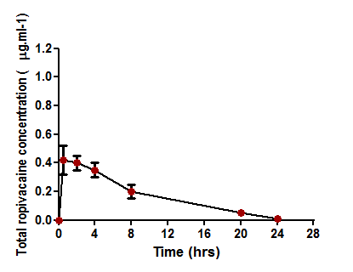
Caudal Ropivacaine
Peak Total concentration 0.83 (0.05–1.57) mg/l
Peak unbound concentration was 0.042 (0.012–0.081) mg/l
Unbound fraction was 6 (1–12)%.
Mean AAG level was 11 (4–31) µmol/l
The interindividual variability (coefficient of variation, CV) in apparent unbound clearance Clu/F was 39%
Lonnqvist BJA 2000
Notes:
Peak concentrations of ropivacaine after a single caudal injection of ropivacaine are significantly lower than levels associated with systemic toxicity (total concentrations >2mg.l⁻¹ , unbound 0.35 mg. l⁻¹ ). Highest values in neonates and infants with unbound ropivacaine plasma concentrations of 0.055 mg l⁻¹ ( range: 0.012–0.091 mg.l⁻¹)
Lönnqvist P A et al. Plasma concentration–time profiles of ropivacaine after caudal administration of ropivacaine 2 mg kg–1 to 1–8 yr old children Br. J. Anaesth. 2000;85:506-511
Rapp HJ et al Ropivacaine in neonates and infants: a population pharmacokinetic evaluation following single caudal block. Pediatric Anesthesia 2004 14: 724–732
Van Obbergh LJ. In children, addition of epinephrine modifies pharmacokinetics of ropivacaine injected caudally. Can J Anesth 2003 .50(6): 593–598.

Slide 16
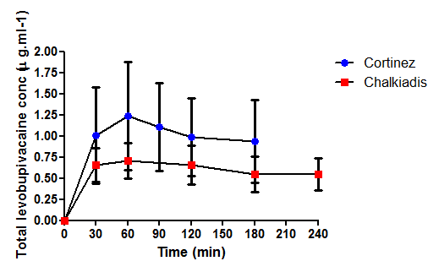
Caudal Levobupivacaine
Wide variation in :
Cmax (0.62-2.40 µg/mL) and Tmax (10-60 min).
Delayed Tmax in infants < 3 mo (50 min).
Longer Tmax related to reduced absorption and clearance
Cortinez 20% higher dose than Chalkiadis (2.5 vs. 2 mg/kg)
Notes:
Higher Cmax is seen with infants with similar doses supports the need to reduce doses in the very young. The longer Tmax observed in children less than 3 months of age could be attributed to slower absorption of levobupivacaine from the epidural space (consistent with the longer absorption half-life observed in this group) and/or reduced clearance. Tmax was 10-60 min and the caudal block was performed soon after induction of anaesthesia, so potential toxic symptoms could have occurred at a time when the child was still anaesthetised.
Chalkiadis G A et al. Pharmacokinetics of levobupivacaine after caudal epidural administration in infants less than 3 months of age Br. J. Anaesth. 2005;95:524-529
Cortínez L I et al. Pharmacokinetics of levobupivacaine (2.5 mg/kg) after caudal administration in children younger than 3 years. Anesth Analg 2008;107:1182-1184

Slide 17
Caudal Pharmacokinetics: The effect of Epinephrine
Bupivacaine
  1:400 000 epinephrine prolongs systemic absorption
  Higher total plasma bupivacaine at 360 min (0.74 vs. 0.4mg.ml-1)
  Prolonged terminal T1/2 (163 vs. 363 min)
Ropivacaine
  Absorption from the epidural space is slow and biphasic
  Effects of adrenaline on ropivacaine greater than bupivacaine due to less lipid solubility and greater intrinsic vasoactivity of ropivacaine .
Levobupivacaine: No data
Notes:
Hansen TG, Morton NS et al. Plasma concentrations and pharmacokinetics of bupivacaine with and without adrenaline following caudal anaesthesia in infants.Acta Anaesthesiol Scand 2001; 45: 42–47.
Prolonged systemic absorption and significantly higher median total plasma bupivacaine concentration at t½ 360 min in the ‘‘adrenaline’’ group 742 ng/ml (range 372–1423 ng/ml) vs. 400.5 ng/ml (range 114–446 ng/ ml) in the ‘‘plain’’ group. The resulting mean ‘‘apparent’’ Terminal half-life, too, was significantly prolonged in the ‘‘adrenaline’’ group, i.e. 363 min (range 238–537 min) vs. 165 min (104–264 min) in the ‘‘plain’’ group.
Luc J. Van Obbergh In children, the addition of epinephrine modifies the pharmacokinetics of ropivacaine injected caudally. Can J Anesth 2003. 50(6 ): 593–598
The estimated absorption half-time of plain ropivacaine was nine minutes while the addition of epinephrine increased it up to 27 min. The slower absorption of ropivacaine from the caudal space when compared to bupivacaine has been described recently. Its absorption from the epidural space is slow and has been described as biphasic; this is related to the high partitioning of ropivacaine into fat.

Slide 18
Epidural Infusions: Infants/Children
Bupivacaine
    Marked increases in total plasma bupivacaine concentration at 5-24 hours in children less than 4 months (Luz 1996, Larsson 1997)
    Total and unbound concentrations higher in children <6 months (Luz 1998, Meunier2001)
Ropivacaine:
Free concentration and fraction decrease over time (Bosenberg 2005, Berde 2008)
Levobupivacaine
    Total concentrations increase even with dilute solutions
    Steady state not attained at 24 hrs
    Free concentrations not measured (Lerman, 2003)
Notes:
Accumulation with bupivacaine may cause local anaesthetic toxicity. The new local anaesthetic agents offer significant advantages for epidural infusions in infants.
Larsson BA Plasma Concentrations of Bupivacaine in Neonates After Continuous Epidural Infusion Anesth Analg 1997;84:501-5
Luz G Bupivacaine Plasma Concentrations During Continuous Epidural Anesthesia in Infants and Children. Anesth Analg 1996;82:231-4
Luz G Pediatr Anesth 1998 Free and total bupivacaine plasma concentrations after continuous epidural anaesthesia in infants and children
Meunier J, Goujard E, Mazoit JX. Pharmacokinetics of Bupivacaine after continuous epidural infusion in infants with and without Biliary Atresia. Anesthesiology. 95(1):87-95, July 2001.

Slide 19
Infant Epidural Infusions
Drug | Concentration | Neonatal infusion rate mg/kg/hr | Infant Infusion rate mg/kg/hr
Bupivacaine | 0.0625% 0.125% | 0.2 | 0.2- 0.4
Levobupivacaine | 0.125% | 0.25 | 0.25- 0.5
Ropivacaine | 0.1% 0.2% | 0.375 | 0.2-0.4
2-Chloroprociane | 0.1% 0.15% | 3.5 | 3.5
Notes:
The dose of local anaesthetic delivered by epidural infusions in neonates are decreased because of the risks of systemic toxicity. The potential for toxicity is increased by low hepatic metabolic capacity and low protein binding. Most recommend lower local anaesthetic concentration solutions are infused at the same rate and total duration of infusion is decreased.
Luz G, Innerhofer P, Bachmann B, et al. Bupivacaine plasma concentrations during continuous epidural anesthesia in infants and children. Anesth Analg 1996;82;231. 52. Larsson BA, Lonnqvist PA, Olsson GL. Plasma concentrations of bupivacaine in neonates after continuous epidural infusion. Anesth Analg 1997;84:501-5.
Larsson BA, Lonnqvist PA, Olsson GL. Plasma concentrations of bupivacaine in neonates after continuous epidural infusion Anesth Analg 1997;84(3):501-5
Lerman J, Nolan J, Eyres R. Efficacy, safety, and pharmacokinetics of levobupivacaine with and without fentanyl after continuous epidural infusion in children: a multicenter trial. Anesthesiology 2003;99(5):1165-74
Berde C, Yaster M Meretoja O, McCann ME. Stable plasma concentrations of unbound ropivacaine during postoperative epidural infusion for 24–72 hours in children. Eur J Anesthesiology 2008, 25(5): 410-417
Veneziano G, Iliev P, Tobias J. Continuous chloroprocaine infusion for thoracic and caudal epidurals as a postoperative analgesia modality in neonates, infants, and children. Pediatr Anesth. 2016; 26(1): 84-91.

Slide 20
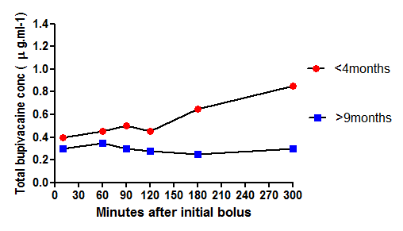
Epidural Bupivacaine Infusions
Significantly higher total plasma concentrations in infants <4 mo than in children >9 mo.
Increasing dose to treat poor analgesia could lead to toxicity in children < 4 mo of age.
Questioned safety of epidural bupivacaine for > 5 h in infants < 4 mo
Luz G 1996
Notes:
Venous Total bupivacaine plasma concentrations were measured in six neonates and infants aged 4 days to 3.9 mo (mean, 2.1 mo) and 10 infants and children aged 9 mo to 6 yr (mean, 3.1 yr) after administration of an initial bolus of 0.5 mL/kg bupivacaine 0.25%, followed by a continuous infusion of local anesthetic (0.25 mL.kg-1.h-1) over a period of 4 h (first hour: bupivacaine 0.25%, then reduced to 0.125%).
Luz G. Anesth Analg. 1996 Feb;82(2):231-4. 1996.
Follow up study measured Total and Free concentrations. Although total bupivacaine plasma concentrations were within acceptable limits (< 1.5 micrograms.ml-1), four of the seven infants showed adverse reactions. Maximum plasma concentrations of free bupivacaine were significantly higher in infants (P < 0.05) than in older children. Recommended lower bupivacaine bolus dose and concentration for continuous epidural anaesthesia in infants.
Luz G. Free and total bupivacaine plasma concentrations after continuous epidural anaesthesia in infants and children. Paediatr Anaesth. 1998;8(6):473-8.

Slide 21
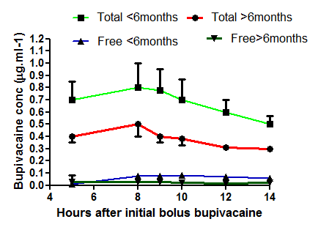
Free and Total Bupivacaine Concentrations After Epidural Infusion
Total bupivacaine acceptable (<1.5µg·ml-1) but jitteriness in 4 of 7 infants at 14 hrs of infusion
Neonates high free and total concentrations
Suggested reducing infusion rates and concentrations for neonates
Luz G, 1998
Notes:
Markedly higher plasma level of free bupivacaine concentration in neonates and infants despite lower bolus (1.25mg.kg-1 vs 2-2.5mg.kg-1) and infusion rate (first hour 0.25 ml·kg-1·h-1 0.25%; then reduced to 0.125%) than Berde’s recommendation. Peak levels of free bupivacaine plasma concentrations were markedly higher in infants when compared to older children with a significant difference between groups after eight hrs of bupivacaine administration. Binding is pH-dependent, meaning that any episode of hypoxia or hypercapnia will increase the free fraction of local anaesthetic.
Luz G Pediatr Anesth 1998 Free and total bupivacaine plasma concentrations after continuous epidural anaesthesia in infants and children

Slide 22
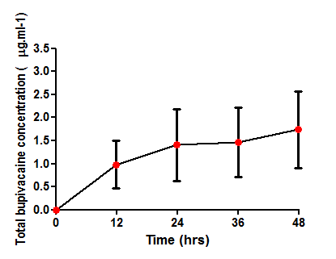
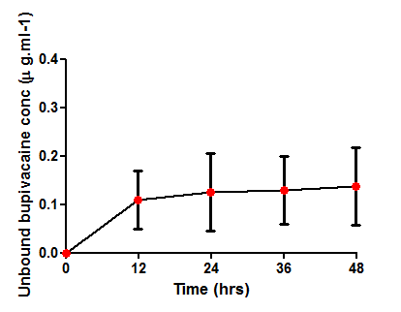
Bupivacaine Epidural Infusions
The free fraction decreases with time because of the increase in α-1 acid glycoprotein concentration, but the unbound concentration (which is considered as the toxic moiety) increases
Neurologic signs of toxicity occur with bupivacaine free concentration of 0.3 μg/ml
Meunier, 2001
Notes:
Free fraction (fu)= C _{free}/C_{total} and C Bound = (B max x C free)/ (K_{D} + C free) where B max is the maximal binding capacity and K_{D} is the equilibrium dissociation constant.
When plasma concentrations of binding proteins increase (α acid glycoprotein during inflammation) then B max increases, Free fraction decreases , C total increases and C Free remains unchanged. When drug displacement occurs there is a transient increase in C free with the amount released rapidly redistributed and eliminated.
At the end of the 48-h infusion period, the unbound bupivacaine concentration increased until pseudo–steady state at 24 h, but the total bupivacaine concentration continued to increase between 24 and 48 h. The increase in AAG observed after surgery did not fully buffer the unbound concentration and two infants aged 1.8 months had unbound concentrations greater than 0.2 mg/ml. Effects were more marked in patients with Biliary atresia as they were operated on prior to 12 weeks of postnatal age.
Meunier Pharmacokinetics of Bupivacaine after Continuous Epidural Infusion in Infants with and without Biliary Atresia. Anesthesiology. 2001 Jul;95(1):87-95

Slide 23
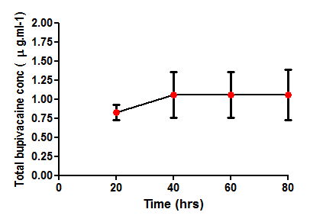
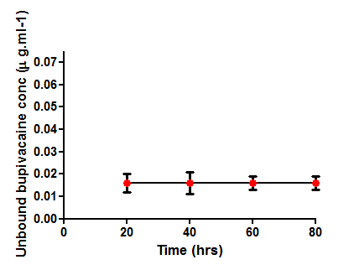
Epidural Ropivacaine Infusions
Total ropivacaine and a1-acid-glucoprotein increased over the course of the infusion secondary to increased AAG concentrations
Unbound ropivacaine stable or even decreased throughout the epidural infusion
May be safer for infusions exceeding 72 hours in neonates
Berde 2008
Bosenberg, 2005
Notes:
Ropivacaine is associated with total and free plasma concentrations below the concentrations commonly associated with systemic toxicity but inter individual variability in LA levels is wide.
Berde, Yaster, Meretoja, McCann. Stable plasma concentrations of unbound ropivacaine during postoperative epidural infusion for 24–72 hours in children Eur J Anesth 2008; 25(5):410
Bosenberg A et al Pharmacokinetics and efficacy of ropivacaine for continuous epidural infusion in neonates and infants. Pediatric Anesthesia 2005 15: 739–749
Epidural infusions (0.2–0.4 mg·kg⁻¹·h⁻¹ ropivacaine) provided satisfactory pain relief in neonates and infants under 1 year. As plasma concentrations of unbound ropivacaine were not influenced by the duration of the infusion, ropivacaine can be safely used for postoperative epidural infusion for 48–72 h. Levels of unbound ropivacaine were higher in the neonates than in the infants, but were below threshold concentrations for CNS toxicity in adults (≥0.35 mg·l⁻¹).
Hansen TG, Ilett KF, Lim SI et al. Pharmacokinetics and clinical efficacy of long-term epidural ropivacaine infusion in children. Br J Anaesth 2000; 85: 347-53
Following a 24–72 h epidural infusion of ropivacaine 0.4 mg kg⁻¹ h⁻¹ in 1–9-yr-old children, the plasma concentrations of unbound ropivacaine were stable over time with no age-dependency.

Slide 24
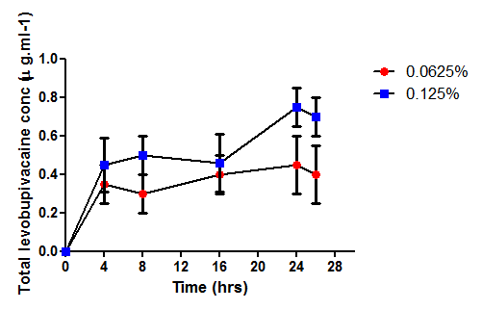
Epidural Levobupivacaine Infusion
Total levo-bupivacaine increased Free not measured
Maximum concentration at 24 hrs
0.76 g/ml in 0.125% group
0.48 g/ml in 0.0625% group
Recommends 0.0625% levobupivacaine epidural infusion at 0.3 ml/kg/hr
Lerman, 2003
Notes:
Concludes that the cumulative blood concentration of Levobupivacaine after 0.125% is approximately twice that after 0.0625%, but that the blood concentrations for both are well below the threshold for toxicity in children.. These data indicate that after a 24 h continuous infusion of epidural levobupivacaine in a concentration of either 0.0625% or 0.125% in children, the blood concentrations are < 1 ng/ml.
Lerman, J; Nolan J; Eyres R; Wolf A. Efficacy, safety and pharmacokinetics of levobupivacaine with and without Fentanyl after Continuous Epidural Infusion in Children: A multicentre trial. Anesthesiology.2003; 99(5):1166-1174

Slide 25
Pharmacodynamics
Developmental changes in peripheral nerve anatomy
Bias from different measures to estimate upper extent of solutions in anesthetised patients
    Response to mechanical/surgical stimulus
    Epidural contrast fluroscopy
    Ultrasound determination of upper limit
Relative potency
    Differences in formulation
    Non equivalent dose comparisons
MLAC studies

Slide 26
Myelination and Pharmacodynamics
Myelination is almost complete at 3-4 years of age
Incomplete myelination may explain
  Higher incidence of motor block with dilute LA in infants
  Higher success rate of plexus and neuraxial blocks
Nodes of Ranvier and paranodal axon diameters reach adult values at 4-5 years age
The absolute dose of local anaesthetic required to block a nerve should depend on the length of the nerve exposed to drug and should be only weakly dependent on body size
Notes:
Myelination begins in the third trimester and is incomplete at birth. Axon diameters and myelin sheaths undergo conspicuous growth during the first two years of life, but may not be fully mature before adolescence. Local anaesthetics must cover a sufficient length of nerve to block conduction. This “critical length” exceeds 2 cm (more than 3 nodes of Ranvier) except at very high LA concentrations. The minimal blocking concentration decreases dramatically as the length of nerve exposed to the local anaesthetic is increased. If adult and infant nerves receive the same weight scaled dose, other factors being equal, the adult nerve will have a longer duration nerve blockade than the infant nerve.

Slide 27
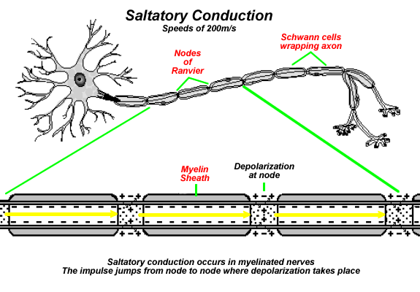
Differential Block
In neuronal conduction, depolarizing current moves along nodes of Ranvier
2-3 successive nodes must be blocked to completely impair neuronal conduction
Small fibers have smaller internodal distances and a shorter length of nerve fiber needs to be blocked to impair conduction as compared to larger nerve fibers
Notes:
Differential blockade (sensory block without motor block) is proposed for the new local anaesthetics especially Ropivacaine. Small Aδ lightly myelinated fibers are blocked by lower concentrations of ropivacaine than heavily myelinated fibers. Most data in infants does not report a detectable motor sensory differential but sensory block is seen at lower concentrations than seen in adults

Slide 28
Neonatal Spinal Conundrum
Larger dose required: 0.8-1mg/kg vs 0.17-0.2 mg/kg
Shorter block duration: 80 vs 180 minutes
Pharmacokinetic factors
  CSF volume: 4ml/kg infants vs. 2 ml/kg
  Increased CSF turnover
  Increased dural surface area and absorption
Pharmacodynamic factors
  Incomplete myelination
  Immature spinal cord
Notes:
Neonates have a shorter block duration and require a much larger (four fold) weight scaled dose to achieve a similar dermatomal levels when given a subarachnoid block or achieve a similar peripheral nerve block as an adult. This is not only due to a higher weight scaled volume of CSF but there may also be age related differences in pharmacodynamic responses, myelination, spacing of nodes of ranvier, tissue barrier and other factors. The pharmacokinetics of LA in CSF however is unknown particularly in paediatrics. The dural surface area is the determinant of clearance of both spinal and epidural drugs. Dural surface area is related to body surface area not weight hence clearance of LA from CSF is higher in younger patients.

Slide 29
New Local Anesthetics Relative Potency Debate
Ropivacaine and racemic Bupivacaine expressed as %wt/vol and concentration refers to mass of hydrochloride salt
Levobupivacaine is expressed in terms of mass of free base alone (European directive 1991)
Levobupivacaine thus has 12.6% more active molecules than bupivacaine
Epidural Potency ratios in labour are
    Ropivacaine: 0.7
    Levobupivacaine: 0.9
    racemic bupivacaine: 1.0
Notes:
Differences in potency between the three local anaesthetics are to be expected because of differences in formulation, lipid solubility, and intrinsic vasoconstrictor activity. Because of its formulation, levobupivacaine contains 12.6% more active molecules than bupivacaine and 11% less than ropivacaine. Levobupivacaine has 7.5% more active molecules than ropivacaine because levobupivacaine is formulated as the base not the hydrochloride salt and ropivacaine’s molecular weight is less than levobupivacaine (274 vs 288). Levobupivacaine is 2% less potent than bupivacaine when compared using % wt/vol concentration but 13% less potent using molar concentrations

Slide 30
Pediatric MLAC,MLAD,ED50
 | Age | ED50 | ED95 | Author
Ropivacaine | 3-10yrs Preschool School age 1-6yrs | 0.11 %(0.09-0.12) 0.107%(0.09-0.122) 0.143%(0.13-0.16) 0.068%(0.13-0.16) | 0.13%(0.12-0.21) 0.225% | Deng 2002 Deng 2010 Ingelmo 2009
Levo- Bupivacaine | 1-6yrs 1-3yrs | 0.068 (0.04-0.09) 0.109% (0.09-0.12) | 0.20% (0.16%-0.24%). 0.151%(0.135-0.122) | Ingelmo 2009 Yao 2009
Bupivacaine |  | N/A | N/A
Notes:
Deng XM The Minimum Local Anesthetic Concentration of Ropivacaine for Caudal Analgesia in Children Anaesth & Analgesia 2002 ;94 (6 ):1465-1468 (3-10yrs old)
Ingelmo P, Relative analgesic potencies of levobupivacaine and ropivacaine for caudal anesthesia in children. Anesth Analg 2009; 108(3):805-13.
Deng XM Minimum local analgesic concentration of ropivacaine for intra-operative caudal analgesia in pre-school and school age children. Anaesthesia2010 ;65(10): 991–995,
Yao Y.-S. The optimum concentration of levobupivacaine for intra-operative caudal analgesia in children undergoing inguinal hernia repair at equal volumes of injectate. Anaesthesia, 2009, 64, 23-6

Slide 31
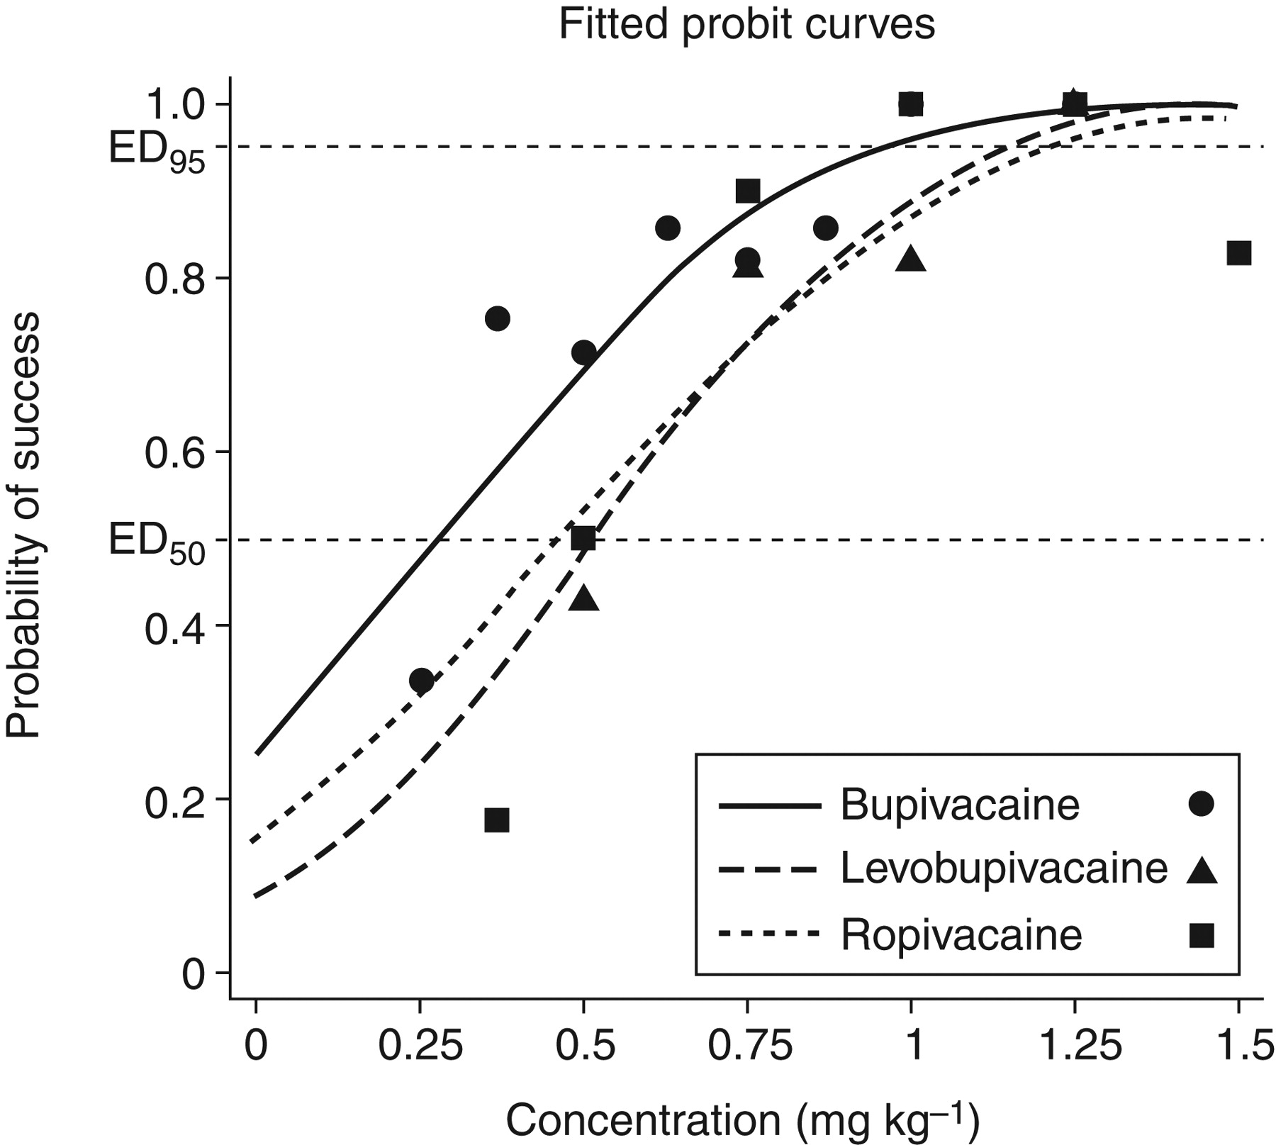
Neonatal Spinal Anesthesia
Potency ratios:
Bupivacaine:ropivacaine
ED₅₀ 0.61 (0.41–1.0)
ED₉₅ 0.97 (0.53–1.35)
Bupivacaine: levobupivacaine
ED₅₀ 0.55 (0.39–0.88)
ED₉₅ 0.81 (0.59–1.10)
Levobupivacaine:ropivacaine
ED₅₀ 1.09 (0.84–1.45)
ED₉₅ 1.19 (0. 62–1.66)
Frawley BJA 2009
Notes:
Whilst potency differences exist at ED50 the difference is much less at clinical doses ( ED95). An effective dose is 1mg.kg⁻¹ of these local anaesthetics
Frawley G et al. Br. J. Anaesth. 2009;103:731-738 Dose–response relationship generated using a probit regression model with group specific parameters for racemic bupivacaine, levobupivacaine and ropivacaine for neonatal spinal anaesthesia.

Slide 32
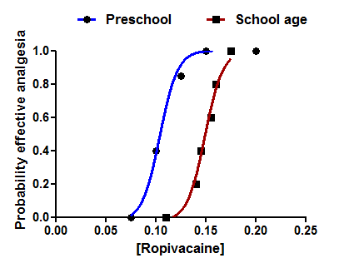
PD : the Effect of Age
3-10 yr old children
ED50 0.11% (0.09-0.12%)
ED95 0.13% (0.12-0.21%)
School age 0.143%
Preschool age 0.107%
Is gender also important???
Deng 2002
Deng 2010
Notes:
Minimum local analgesic concentration of ropivacaine caudal analgesia.Right shifting of the dose response curve in older children. MLAC in school age children was 34% higher than that in pre-school age children (p < 0.001).The MLAC of ropivacaine for caudal analgesia in adult patients is significantly higher than that in children.
Li et al reported that the MLAC of ropivacaine for caudal analgesia in 30–49 year-old patients undergoing anorectal surgery was 0.298% in male patients and 0.389% in female patients.

Slide 33
Adjuvants: Pandora’s Box?
Unresolved issues:
    Potential neurotoxicity of some spinally administered drugs
    Ethical issues related to unlicensed routes of administration
    Long term safety of spinal analgesic agents in children.
    The effects of developmental age on the potential for neurotoxicity
    Role of preservatives as a cause for neurotoxicity.
Do adjuvants add clinical benefits or complicate procedures and introduce risk for medication error???
Notes:
Many studies which compare the effect of neuraxial drugs are hampered by poor study design, such as:
Inadequate power and sample size. Small sample sizes make it is difficult to confirm any change in the incidence of uncommon side effects.
Insensitive outcome measures. No difference may be found between two active treatments (e.g. LA ± additive; different doses; different routes such as caudal versus systemic) if pain scores and supplemental analgesic requirements are low in both groups.
No measure of neuraxial injury
Insensitive or non standardized measures of side effects such as sedation and respiratory depression.
Cousins MJ, Miller RD. Intrathecal midazolam: an ethical editorial dilemma. Anesth Analg 2004; 98:1507–1508.

Slide 34
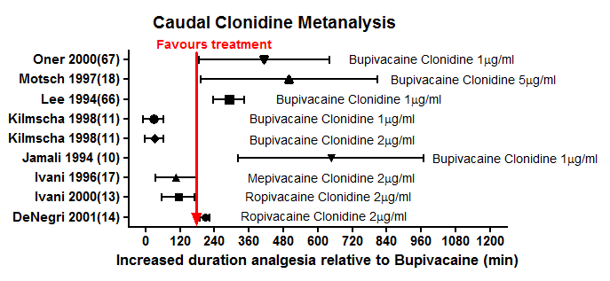
PD: the Effects of Clonidine on Analgesic Duration
Ansermino Pediatr Anesth 2003
Notes:
The addition of clonidine to the local anaesthetic solution produces an increase in the duration of analgesia following caudal blockade in children (pooled weighted mean difference of 145 min).Ketamine and midazolam also increase the duration of analgesia. The routine use of adjuvants for elective outpatient surgery may improve postoperative analgesia but it is unclear if the potential for neurotoxicity outweighs clinical benefit.
Ansermino M et al. Nonopioid additives to local anaesthetics for caudal blockade in children: a systematic review. Paediatric Anaesthesia 2003 13: 561–573
Elia N. Ketamine and postoperative pain: a quantitative systematic review Pain. 2005;113: 61-70. Four paediatric trials (168 children) reported on ketamine added to caudal ropivacaine, bupivacaine, or alfentanil. This review assessed the efficacy and safety of ketamine for the control of post-operative pain. The authors concluded that the role of ketamine in peri-operative analgesia remains unclear.

Slide 35
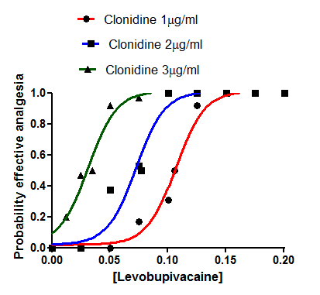
PD: Effect of Clonidine on MLAC
Dose dependent reduction in caudal levobupivacaine MLAC (ED50) by epidural clonidine
1 µg/ml Clonidine 0.106%
2 µg/ml Clonidine 0.077%
1 µg/ml Clonidine 0.035%
Disma 2011
Notes:
An advantage of adjuvants is that they allow lower doses of local anaesthetic to be used and the same clinical effect attained.

Slide 36
Assessment in Anesthetised Children
Both crude and oversensitive measures of effect used to determine effectiveness confound pharmacodynamic studies
Awake assessment of sensory level with bupivacaine epidural anaesthesia
Spread of ropivacaine by a weight based formula in a pediatric caudal block: a fluoroscopic examination
The effect of volume of local anesthetic on the anatomic spread of caudal block in children aged 1-7 years
Segmental distribution of high volume caudal anesthesia in neonates infants and toddlers as assessed by ultrasonography
Koo 2010
Spear 1991
Thomas 2010
Lundblad 2011

Slide 37
Toxicity
Infants are more prone to systemic toxicity than adults
    Low protein binding and reduced intrinsic clearance
    Neonatal brain more susceptible
    More rapid heart rate
Infants with right-to-left cardiac shunts may increase risk by bypassing first-pass clearance by the lung
Concurrent administration of general anaesthetics or sedatives (especially benzodiazepines) may mask CNS toxicity
Notes:
The Threshold for toxicity is about 0.3mg.l-1 of unbound bupivacaine and 0.6mg.ml-1 of unbound ropivacaine or levobupivacaine in adults. In neonates and infants less than 3 months of age the free drug concentration may be at the threshold for toxicity despite total concentrations far below the threshold. Unbound concentrations are usually not reported in children with local anaesthetic toxicity.

Slide 38
New Local Anesthetics Do Not Protect against Systemic Toxicity
Toxicity by progressive accumulation
  Initially described with excessive epidural bupivacaine infusions in children (2.5 mg/kg/hr)
  Lower recommended rates
    No greater than 0.2-0.25 mg/kg/hr⁻ in neonates
    No greater than 0.4-0.5 mg/kg/hr in older infants
Intravascular injection
  Reported with Ropivacaine and bupivacaine neonatal caudals
  Test dose and aspiration often negative in infants
Errors in calculation of dose
Hubler 2010
Notes:
Successful resuscitation of bupivacaine induced cardiotoxicity in a neonate. Lin EP, Aronson LA. (20% Intralipid used)
Successful resuscitation following ropivacaine induced systemic toxicity in a neonate. Hubler M, (10 mg.kg⁻¹ caudal)
Lin EP, Aronson LA Successful resuscitation of bupivacaine induced cardiotoxicity in a neonate. Paediatric Anaesth. 2010; 20(10): 955-7.
Hubler M, Gabler R, Koch T. Successful resuscitation following ropivacaine induced systemic toxicity in a neonate.. Anaesthesia. 2010; 65(11): 1137-40
Shah S, Gopalakrishnan S. Use of Intralipid in an infant with impending cardiovascular collapse due to local anaesthetic toxicity. J of Anesthesia 2009; 23(3):439-41.
e of Intralipid in an infant with impending cardiovascular collapse due to bupivacaine local anaesthetic toxicity. Shah S, Gopalakrishnan S. J of Anesthesia 2009; 23(3):439-41.

Slide 39
Intralipid and Systemic Toxicity
Suggested bolus dose 1.5ml/kg and infusion 0.25 ml/kg/hr
The mechanism of the postulated lipid sink effect is still unclear
Is Intralipid the new Dantrolene?
  Few pediatric clinical reports
  No animal model to validate doses
  Inability to perform clinical trials due to low incidence of toxicity in children
  Should be used early in resuscitation
Notes:
Lipid Sink theory is that lipid infusion creates a lipid plasma phase that extracts bupivacaine from the aqueous phase. The reduced free bupivacaine concentration in the plasma aqueous phase then increases the diffusion gradient between intoxicated tissue and plasma.
May be more effective with bupivacaine toxicity as Octanol/water distribution coefficient is higher than ropivacaine or levobupivacaine.
Zausig Y et al Lipid emulsion improves recovery from bupivacaine induced cardiac arrest but not from ropivacaine or mepivacaine induced cardiac arrest. Anesth Analg 2009;109:1323-6
Mazoit indicates that a fall in pH such as can occur in hypoxia reduces the affinity of lipid binding of both ropivacaine and bupivacaine counteracting the mechanism of action of Intralipid 20%. Mazoit JX, Le Guen R, Beloeil H, Benhamou D. Binding of long-lasting local anaesthetics to lipid emulsions. Anesthesiology 2009; 110:380 – 6

Slide 40
Pharmacogenetics
No reported polymorphisms in cytochrome P450 isoenzymes primarily involved in the metabolism of local anaesthetics (CYP 3A4, CYP 2D6 and CYP 1A2)
Polymorphisms of clinical relevance have been described for CYP2D6 (ultrarapid, normal and poor metabolizers of Codeine and tramadol)
Ethnicity is a factor in the occurrence of CYP2D6 variability
In single dose blocks the impact of polymorphisms for toxicity of local anaesthetics is likely to be small
Notes:
Polymorphisms of Cytochrome P450 isoenzymes metabolising local anaesthetics have not been reported but would produce unpredictable local anaesthetic plasma concentrations. The prevalence of CYP2D6 poor metabolizers is approximately 6–10% in white populations, but is lower in most other ethnic groups such as Asians (2%). In blacks, the frequency of poor metabolizers is greater than for whites. The occurrence of CYP2D6 ultrarapid metabolisers appears to be greater among Middle Eastern and North African populations.

Slide 41
Summary
Infants and children have unique pharmacokinetic and pharmacodynamic characteristics
Single dose regional anaesthesia is usually associated with acceptable total and free plasma concentrations
The risk of systemic toxicity is increased with
      Neonates and infants less than 3 months of age
      Continuous infusions of local anaesthetics
      Excessive doses of local anaesthetic
Lipid rescue of systemic toxicity has been shown to be effective in neonates

Slide 42
References
Anderson BJ, Allegaert K. The pharmacology of anaesthetics in the neonate. Best practice & research clinical anesthesiology. 2010;24:419-31
Simon L, Mazoit J-X. Pharmacology of local anaesthesia in different age groups. Baillière's clinical anaesthesiology. 2000;14(4):641-58.
Mazoit J-X. Pharmacokinetic/pharmacodynamic modeling of anesthetics in children. Pediatr Drugs.2006; 8(3): 139-50.
Kearns GL, Leeder JS. Developmental pharmacology-drug disposition action and therapy in infants and children. NEJM. 2003; 349(12): 1157-67.
Graf BM. Current status and clinical relevance of studies of minimum local anaesthetic concentration(MLAC). Current opinion Anaesthesiology. 2005; 18: 241-5.
LaCroix D. Sonnier, A. CYP3A Ontogeny.Eur J Biochem. 1997; 247:625-34
Weinberg G. Treatment of local anaesthetic toxicity (LAST). Reg Anesth Pain Med. 2010; 35(2):188-93.

