Slide 1
Pediatric Airway Management for the
Non-Anesthesiologist
David E. Liston, MD, MPH
Agnes Hunyady, MD
Helen W. Karl, MD
Updated: 2/2019
Notes:
The need to establish, maintain and monitor airway patency in children often happens in settings where non-anesthesiologist health care providers are in charge of the task. Large databases, critical event analyses and case reports demonstrate serious events occurring as a consequence of airway management failures in the field and within the hospital.^{1,2} Furthermore, the morbidity of tracheal intubation when non-anesthesiology providers are involved is high.^{3,4} These studies suggest that improved airway training will likely lead to better outcomes.

Slide 2
Learning Objectives
Recognize and evaluate impending respiratory failure
Describe an airway evaluation
  How to predict difficult face-mask ventilation (FMV)
  How to predict difficult tracheal intubation
List effective FMV techniques
Explain laryngeal mask airway (LMA) placement
Describe tracheal intubation
Notes:
After studying this lecture you will be able to do the tasks listed above.
The following slides contain detailed information about these topics with superscript numbers referring to articles listed in the references at the end. You do not need to read these references (unless you are interested in a particular part of the topic), but they are there so you can look them up if you want to and to show you that there is a lot of science behind the things we say.

Slide 3
Background
Decreasing role of direct laryngoscopy (DL)
  Reports document serious events after airway management failures¹⁻⁴
  Effective face mask ventilation (FMV) is a critical initial step in airway management^{5,6}
  New airway devices offer alternatives to direct laryngoscopy
Emphasis on a team approach to pediatric emergency airway management⁶
  Leading cause of sentinel events: human factors⁷
    Effective communication (i.e., Closed loop)
    Teamwork (practice using simulation)^{8,9}
  Crew Resource Management: practice non-technical skills^{10,11}
Notes:
Decreasing Role of Direct Laryngoscopy
In the past, a lot of airway management training was focused on teaching how to put a breathing tube in the trachea (Tracheal Intubation = TI) using devices to look at the larynx (Direct Laryngoscopy = DL). As studies were done to evaluate how well this training worked in regards to pediatric outcomes after events in which airway management was needed, it became clear that this should change: in one study of TI by non-anesthesiologists, Tracheal Intubation Adverse Events (TIAE, like putting the tube in the esophagus instead of the trachea) were reported in 20% of intubations, with severe TIAEs (such as cardiac arrest) in 9%.
Instead, providing positive pressure ventilation with a face mask (Face Mask Ventilation, FMV) is emphasized as a critically important skill. Laryngeal Mask Airways (LMA) can also be used as an technically easier method of managing ventilation.
Emphasis on team approach
When a patient stops breathing, often many people arrive to help. Clear communication techniques (such as closed loop communication) can be learned and are known to improve outcomes.
Practicing technical and non-technical skills (with or without simulation equipment) is important in keeping everyone prepared to deal with emergency airway problems. Crew resource management focuses on human factors that can be improved in emergency situations. Effective communication and teamwork are key elements. Failures in teamwork and communication are the leading contributing factors to sentinel events in hospitals according to the Joint Commission on Accreditation of Healthcare Organizations in the US.

Slide 4
What Do You See in a Patient With
Respiratory Distress?
  Nasal flaring
  Retractions (use of accessory muscles - intercostal and subcostal)
  Stridor (usually inspiratory)
  Wheezing (usually expiratory)
  Grunting: glottic closure during expiration to maintain positive airway pressure
↑ respiratory rate
↑ respiratory effort
↓ respiratory effort
Abnormal airway sounds
↑ heart rate
Changes in mental status
<
Give supplemental O2 and begin objective measurement (eg.oximetry) ASAP
Notes:
You can often identify a patient with respiratory distress from the door of the room. They may be:
Breathing too quickly for their age.
Working too hard – these patients are often anxious.
Not breathing enough (irregularly or too slowly) – these patients are often sleepy.
Making unusual sounds – you may not need a stethoscope to hear these
Call for help, give oxygen and begin electronic monitoring if available.

Slide 5
What is a Normal Respiratory Rate?⁶
Age Category | Age Range | Normal Respiratory Rate (breaths per minute)
Infant | 0 – 12 months | 30 – 53
Toddler | 1 – 3 years | 22 – 37
Preschooler | 4 – 5 years | 20 – 28
School Age | 6 – 12 years | 18 – 25
Adolescent | 13 – 18 years | 12 – 20
Notes:
The 2016 PALS provider manual does a nice job of describing normal respiration.
“Normal spontaneous breathing is accomplished with minimal work, resulting in quiet breathing with unlabored inspiration and passive expiration. The normal respiratory rate in inversely related to age; it is rapid in the neonate and decreases as the child gets older. A consistent respiratory rate of < 10 or > 60 breaths per minutes in a child of any age is often abnormal and warrants further assessment.”

Slide 6
Respiratory Distress
Initial Impression:
↑ work of breathing
Will Progress To:
irregular breathing
↓ respiratory effort
Can Then Quickly Progress To:
respiratory failure
↑ respiratory rate
↑ respiratory effort
and ultimately...cardiac arrest!
Keep treatment as simple as possible¹²
Notes:
Much poorer outcomes are associated with cardiac arrest if it progresses to that point
Treat respiratory distress early
Keep treatment as simple as possible¹²
- Non-technical (human) factors are frequently a cause of airway problems.
- Too much choice is taxing, so don’t consider all difficult airway options when presented with a difficult airway. Simple algorithms and user-friendly devices are key.
- Focus on maintaining situational awareness and maintaining oxygenation (via the difficult airway algorithm), not on intubation.
- Airway equipment should be purchased with the least experienced user in mind (not the most experienced).

Slide 7
Some Causes of Respiratory Distress
Upper airway obstruction
  Foreign body, anaphylaxis, secretions, edema, croup
  Likely to have inspiratory stridor
Lower airway obstruction
  Asthma, bronchiolitis, edema
  Likely to have expiratory wheezing
Lung tissue disease
  Eg. pneumonia, pulmonary edema, pneumothorax
  Likely to have decreased or abnormal breath sounds
Abnormal respiratory control
  Increased intracranial pressure (ICP)
  Decreased level of consciousness (LOC)
  Neuromuscular disease
Notes:
Easy breathing can be interfered with at a variety of places in the respiratory system.
Upper airway: the mouth, nose ,throat and larynx (voice box) above the vocal cords. Croup (also known as laryngotracheobronchitis) is a viral infection that leads to swelling of the larynx and upper trachea.
Lower airway: the trachea, bronchi and bronchioles
Lung: Beyond the airways, the lung tissue itself can be damaged by inflammatory cells or fluid. It can also be squeezed by outside forces.
Brain: The systems in the brain that control breathing can be harmed by injuries or drugs. The muscles needed to breathe can be weakened by disease or exhaustion.

Slide 8
What Do You See in a Patient With Respiratory Failure?
Marked tachypnea → bradypnea → apnea
Tachycardia → bradycardia
Poor breath sounds
Cyanosis
Stupor → coma
Give supplemental O2 and use objective measures (eg.oximetry) ASAP
Notes:
Depending on the situation, respiratory distress can become respiratory failure remarkably quickly. In this situation, blood oxygen decreases leading to blue/gray lips and nail beds. Carbon dioxide increases, initially stimulating breathing, then causing increasing drowsiness.
Therefore, you want to treat respiratory distress early and effectively.

Slide 9
Get Ready to Rescue
Understand and check your equipment
  Facemask ventilation (FMV) **
  Supraglottic ventilation [laryngeal mask airway (LMA)]
  Direct laryngoscopy (DL) and tracheal intubation (TI)
Outline potential complications and how to avoid them
  Equipment
  Resources at your institution (Anesthesiology, ENT)
  Patients: who is likely to present a particular challenge
**THE most important skill
Notes:
Individuals and institutions who may need to care for a child with respiratory distress need to be prepared. This must start long before the patient arrives. All providers should understand how airway equipment works and what complications may occur. These issues will be described on the following slides.

Slide 10
Prepare for Face Mask Ventilation (FMV)
Select appropriately sized transparent soft rimmed face mask
Understand how the equipment at your site of practice functions
Use supplemental oxygen
Make sure all equipment actually works: know how to test it!
  Oxygen flow
  Able to provide positive pressure
Notes:
Again…FMV saves lives, so it is important to understand the equipment available at your workplace and how to use it properly.
Whenever possible, use added oxygen from a wall outlet or a tank (make sure tanks are available and full).
Masks of variable sizes to fit everyone from infants to large teens should be available. Clear masks allow one to see if blood, secretions or vomit need to be removed.
Always have suction available if possible.

Slide 11
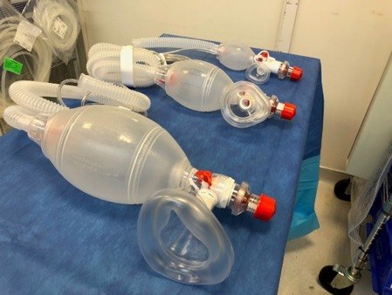
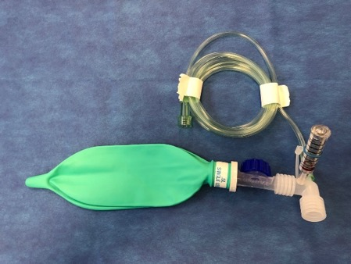
Equipment for Face Mask Ventilation
Self-inflating bags
  Age-appropriate sizes
  Oxygen flow not required (to ventilate)
  Blow-by O2 delivered via corrugated tubing.
  Provider skill level - basic
Flow-inflating bags
  Age-appropriate sizes
  Oxygen flow required (to ventilate)
  Blow-by O2 delivered via mask
  Provider skill level - advanced
  Can deliver very high pressure
Notes:
Important differences to note for self-inflating bags:
- Able to ventilate a patient even without being connected to an air or oxygen source.
Oxygen is not delivered to the patient through the mask unless the bag is being squeezed.
Blow-by oxygen can only be delivered by using the end of the corrugated tubing. Using the mask without squeezing the bag may result in asphyxiation!
Lower provider skill level will suffice, since self inflating feature does not rely on proper mask fit
Important differences of flow-inflating bags:
Not able to ventilate a patient unless connected to an air or oxygen source.
Oxygen is delivered to the patient through the mask even when the bag is not squeezed.
Blow-by oxygen can be delivered with the face mask (regardless of whether or not the bag is squeezed).
Higher provider skill level required, since a proper face mask fit is required to ventilate the patient.
- Able to deliver high (and possibly too much) pressure. Therefore flow inflating bags are used exclusively by anesthesia providers in our hospital.

Slide 12
The Basics
Airway
  Support an open airway
  Clear secretions from nose and mouth
  Minimize agitation
  Consider oropharyngeal (OPA) or nasopharyngeal (NPA) airway
Breathing
  Provide supplemental oxygen and measure SpO2
  Assist ventilation with positive pressure ventilation (PPV)
  Administer medications to decrease airway edema
FMV can be life-saving!

Slide 13
Airway Evaluation: History
Snoring, noisy breathing, sleep apnea
Cough, upper or lower respiratory infection
Previous anesthetic or airway problems
Neck injury
Syndromes
Having a written plan for management of patients with difficult airways is key^{13,14}
Notes:
As always, start with a brief history; ask the parents about related health problems, and prior issues related to anesthesia or airway.
Any prior airway manipulation should be investigated with chart review. It is also important to know if there has been an injury to the neck that could be made worse by efforts to open the patient’s airway.
Some genetic conditions also are associated with atlantoaxial instability (eg. Down Syndrome) or cervical vertebral anomalies.
Every institution should have or create a written plan for care of patients with a known or suspected difficult airway.

Slide 14
Airway Evaluation: Physical Exam¹⁵
In general
  Respiratory rate
  Increased work of breathing?
  Size of mouth, tongue and mandible
  Teeth
  Appearance: presence of anomalies?
Evaluation before anesthesia
  Mouth opening (Inter-incisor distance, IID)
  Modified Mallampati test (MMT)
  Thyro-mental distance (TMD)
  Upper lip bite test (ULBT)¹⁶
Notes:
Look at the parts of the breathing system that you can see directly. Do this from the outside, then briefly ask the child to open their mouth (if possible).
If you are planning to give drugs (eg. anesthetics) that may decrease or remove a child’s ability to breathe on their own, more formal tools that can be used to evaluate the airway. Knowing what these are will help make sense of some publications on this topic.
How far can the child open their mouth? Is it limited by pain, lack of cooperation or some structural difference.
The MMT is a classification of the view of the back of the mouth that may provide a warning that DL might be difficult. (See next slide #15)
The distance between the thyroid cartilage and the chin (TMD) is easily measured and gives an indirect estimate of the capacity of the lower jaw, which in turn is an estimate of how difficult it is to see the larynx with DL.
ULBT: Ask the patient to protrude the mandible and attempt to bite their upper lip with their lower teeth (you may need to demonstrate this)

Slide 15
Modified Mallampati Classification of Oropharyngeal View
In children:
Impossible in kids < 18 months and difficult below 5 years old
Poor predictive value, but still widely used ¹⁷
Notes:
Correctly identifying a child’s Mallampati score can be difficult given the amount of effort needed by the patient.

Slide 16
Optimize FMV¹⁸⁻²⁰
Create a tight seal between mask and face
E-C clamp technique
  Lifts the jaw (sniffing position)
  Keeps operator’s fingers off the soft tissues
Minimize gastric inflation
  If child is breathing spontaneously, give PPV during inspiration
  Use the lowest effective inspiratory pressure (keep <20 mm Hg)
  Give breath over 1 second
Consider a 2-person technique if difficult
Consider the lateral position²¹
Practice! Practice! Practice!
Notes:
In order to give positive pressure ventilation (PPV), you need a good seal between the mask and the patient’s face. Using an appropriately sized mask, practice repositioning your hands to ensure there are no leaks. It is easy to squash the throat of a baby or young child with your fingers, so pay attention to applying pressure only to bony areas. Consider placing fewer fingers on patient’s mandible on younger patients to reduce possibility of soft tissue compression. It is also easy to fill the stomach with air during PPV. A stomach full of air pushes up the diaphragm, making PPV more difficult; it also makes vomiting more likely. Slow, gentle breaths are most likely to be effective.

Slide 17
Optimize FMV (Con’t)
Watch the patient
  Chest rise during inspiration
  Condensation in the mask during exhalation
  Have someone listen to the chest
Watch the available monitors
  Carbon dioxide curve on capnograph
  Color change on a colorimetric CO2 detector
  Improvement in oxygen saturation (SpO2)
  Prepare for escalation to LMA or ETT
Notes:
Make sure that gas exchange is actually occurring!

Slide 18
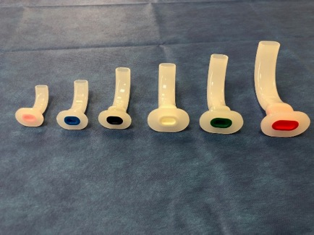
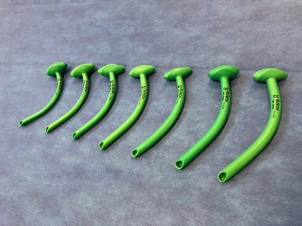
6 Essentials for Face Mask
Ventilation¹⁹
Call for help
Reposition
Jaw thrust
Oropharyngeal airway (OPA)
Nasal pharyngeal airway (NPA)
  AKA nasal trumpet
  May cause bleeding
Two-person technique
Notes:
If at first you don’t succeed…. try different approaches.
Let go! Your hand position may be part of the problem. You may be closing the mouth in a patient who breathes better with the mouth open.
Pull the mandible forward. Very important in children! This pulls the tongue away from the back of the throat, creating more room in the airway. This movement may also be painful and provide incentive for the patient to breathe on their own.
An airway in the mouth or nose can be helpful, but they must be the right size so as to not cause more problems than they solve.
One person can use 2 hands to hold the mask, while a coworker squeezes the bag.

Slide 19
Supraglottic Airways (SGAs)
Supraglottic Airway Device^{22,23}
  Rescue device (per ASA difficult airway algorithm) in can not intubate/can not ventilate scenario¹⁵
  Proper SGA size based on patient weight
Contraindications to SGA use
  Aspiration Risk: GERD or not NPO
  Patients when controlled or positive pressure ventilation is critical
Notes:
While many types of supraglottic airway devices exist today, LMA is the gold standard. An LMA is an excellent rescue device when presented with the inability to ventilate or intubate. The ASA difficult airway algorithm clearly recommends the use of an LMA for this scenario. It can literally be a life saver. Furthermore, early attempt at placement of an LMA when face mask ventilation is inadequate is encouraged.
When providing general anesthesia with an LMA in place it is important to maintain spontaneous ventilation. Controlled ventilation is controversial as it can blow air into the stomach and create a higher risk of vomiting and aspiration.
Choosing the correct size LMA to place is important. An LMA that is too large will not pass the posterior pharynx. An LMA that is too small may pass easily but will not form a proper seal.

Slide 20
Pediatric Airway Management
Airway-related problems during general anesthesia are 4x more common in children < 1-year-old²⁰
Infants have increased oxygen consumption per kg and higher minute ventilation to FRC ratio
Infants and children with upper respiratory infections have a higher incidence of perioperative laryngospasm and bronchospasm; consider postponing elective cases 3-4 weeks²⁴
Notes:
It is always helpful to be able to guess in advance which patient is likely to have a challenging airway. Neonates consistently present an airway challenge. This also applies to healthy term neonates with normal airways.
Neonatal airways:
A large tongue relative to their mouth leads to easier airway obstruction.
A larger more pronounced occiput makes proper positioning more difficult.
Anteriorly placed epiglottis results in more difficulty obtaining a view via direct laryngoscopy.
The speed at which an infant develops hypoxia when not being ventilated is considerably faster than an adult.

Slide 21
Difficult Airways in Children
Often associated with a syndrome with dysmorphic facial features,²⁵ especially bilateral microtia²⁶
Obesity and a history of obstructive sleep apnea (OSA) are associated with difficult FMV²⁷
Difficult FMV is as high as 6%²⁷
Difficult intubation (DI) is more common in infants < 1-year-old and especially < 1 month-old²⁸
Unexpected DI is only 0.045%²⁵
Can’t Ventilate-Can’t Intubate scenario in children is extremely rare²⁹

Slide 22
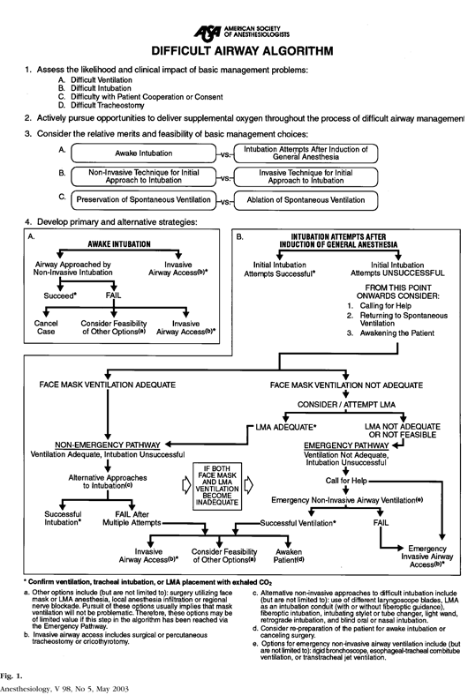
ASA Difficult Airway Algorithm:
Key Points
Assess the likelihood and clinical impact of basic management problems
  Difficult ventilation
  Difficult intubation
  Difficulty with cooperation or consent
  Difficult tracheostomy
Actively pursue opportunities to deliver supplemental O2 during management
Call for help early
Preserve spontaneous ventilation

Slide 23
Direct Laryngoscopy (DL) and
Tracheal Intubation (TI)
Establish indication
Checklist to gather equipment³⁰
  Suction
  Oxygen
  Positive pressure ventilation device
Position patient (sniffing position)
Determine need for sedation/anesthesia
Notes:
Proper preparation for intubation is vital. A plan should be formulated that includes the personnel and equipment involved, steps of the process (from insertion of the blade to verifying correct tube placement) as well as considerations to mitigate possible complications and failures. Using a preintubation checklist is now highly recommended, although its impact on the outcome has not clearly been proven yet.

Slide 24
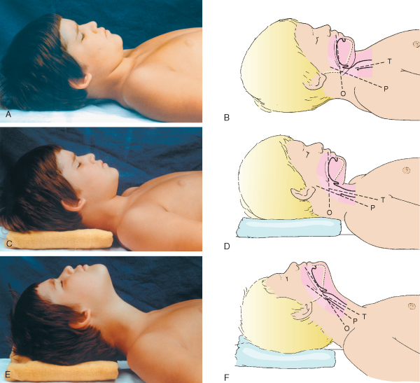
Sniffing Position:
Optimize 1st laryngoscopy attempt
T = axis of trachea
P = axis of pharynx
O = axis of oral
Photo used with permission from Charles Coté
Notes:
When performing direct laryngoscopy, 3 separate axes must be aligned: tracheal, pharyngeal and oral in order to obtain a direct view of the larynx. This only occurs when the patient’s head is extended in the sniffing position (see pictures E and F above). While the tracheal axis may be aligned after elevating the head with a foam pillow (C and D), neck extension is required to achieve alignment of the oral axis (E and F).
Sniffing position:
- Flexion at the lower cervical spine
Moderate extension at the atlanto-occipital (AO) joint
Consider a shoulder roll in younger children
Consider a small pillow (to elevate the occiput) in older children
Minimize position changes if suspected C-spine injury or children with potential atlanto-axial instability (i.e. Down Syndrome)

Slide 25
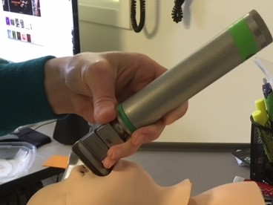
Direct Laryngoscopy
Open mouth
  neck extension vs scissor fingers
Laryngoscopy blade
  Insert from right side, sweep tongue to left
  Pull handle up at a 45-degree angle, in a caudal direction
  Do not bend wrist, may cause oral trauma
Notes:
The process of tracheal intubation via direct laryngoscopy can be divided into two tasks:
exposure of the larynx
placement of the endotracheal tube.
Unless its contraindicated or impossible, it is preferable to open the mouth by extending the neck with the right hand placed on the occiput. Regardless of the type of blade used, the left hand places the blade into the mouth from the right hand side, and moves it towards the middle by sweeping the tongue to the left. When straight blade is used, the tip should be placed on the undersurface of the epiglottis, while curved blade tip should lie in the vallecula. On exposure of the larynx the laryngoscope should be pulled to the direction the handle points, but never rotated or tilted towards the front teeth.
A common tip we use with our airway learners when teaching direct laryngoscopy is to pull the handle of the blade in the direction where the ceiling and the wall come together.”

Slide 26
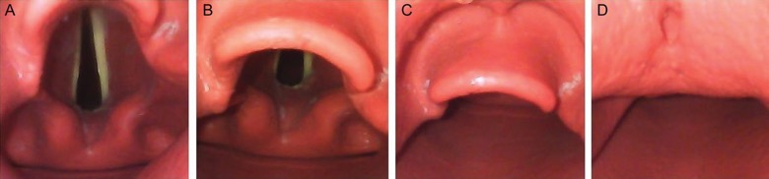
Direct Laryngoscopy
Expose larynx
  Cormack-Lehane system for grading laryngoscopic view at intubation³¹
Optimize view
  Adjust blade tip position in vallecula or on the epiglottis
  External laryngeal manipulation (BURP maneuver)
Grade 1 | Grade 2 | Grade 3 | Grade 4
Notes:
External laryngeal manipulation (Backward-Upward-Rightward-Pressure) can help achieve a better view. Not to confused with cricoid pressure, which is a maneuver to compress the esophagus by pressing on the cricoid ring to prevent regurgitation of stomach contents, and can make the laryngeal exposure actually more difficult.

Slide 27
Tracheal Intubation
ETT selection: age/4 +3.5
Stylet
Depth: Height in cm/10 + 5³²
Cuff: Inflate to 20 – 25 cmH₂O
Confirmation
  Breath sounds
  Presence of ETCO₂
  Chest rise
Call for help early
Do not continue to do the same thing & expect a different result
Notes:
Placing the appropriate size endotracheal tube is typically best accomplished without a stylet. If one is used, one must be aware of its dangers, as tracheal injury can happen from inappropriate use. Shape as a hockey stick (straight blade) or a C (curved blade). All ETTs have markings to aid with appropriate depth of insertion. If they are not visible, the height (in cm)/10+5 formula is useful in estimating the correct depth in proportionate children. The gold standard of checking the correct ETT tip position is chest X-ray. Use of a cuffed tube is now recommended for all ages, as long as the cuff is not overinflated. Correct placement of the ETT should always be immediately verified by calorimetric or infrared capnography.
It is important to call for help early if expecting or experiencing difficult managing a pediatric airway. As a general rule: do not continue to do the same thing (i.e. repeatedly attempting to intubate) and expect a different

Slide 28
References
*Please note: any reference that is clickable has a link to the article free of charge
Cook TM, Woodall N, Frerk C. A national survey of the impact of NAP4 on airway management practice in United Kingdom hospitals: closing the safety gap in anaesthesia, intensive care and the emergency department. Br J Anaesth. 2016;117(2):182-90.
Cook TM, Woodall N, Harper J, Benger J, Fourth National Audit P. Major complications of airway management in the UK: results of the Fourth National Audit Project of the Royal College of Anaesthetists and the Difficult Airway Society. Part 2: intensive care and emergency departments. Br J Anaesth. 2011;106(5):632-42.
Gausche M, Lewis RJ, Stratton SJ, Haynes BE, Gunter CS, Goodrich SM, et al. Effect of out-of-hospital pediatric endotracheal intubation on survival and neurological outcome: a controlled clinical trial. JAMA. 2000;283(6):783-90.
Nishisaki A, Turner DA, Brown CA, 3rd, Walls RM, Nadkarni VM, National Emergency Airway Registry for C, et al. A National Emergency Airway Registry for children: landscape of tracheal intubation in 15 PICUs. Crit Care Med. 2013;41(3):874-85.
Maconochie IK, de Caen AR, Aickin R, Atkins DL, Biarent D, Guerguerian AM, et al. Part 6: Pediatric Basic Life Support and Pediatric Advanced Life Support: 2015 International Consensus on Cardiopulmonary Resuscitation and Emergency Cardiovascular Care Science With Treatment Recommendations (Reprint). Pediatrics. 2015;136 Suppl 2:S88-119.
American Heart Association. Pediatric Advanced Life Support - Provider Manual. 2016.
Joint Commission on Accreditation of Healthcare Organizations. Root causes of sentinel events (all categories, 1995-2004) 2005.
Gaba DM, Howard SK, Fish KJ, Smith BE, Sowb YA. Simulation-Based Training in Anesthesia Crisis Resource Management (ACRM): A Decade of Experience. Simulation & Gaming. 2001;32(2):175-93.
Dieckmann P, Friis SM, Lippert A, Østergaard D. Goals, Success Factors, and Barriers for Simulation-Based Learning: A Qualitative Interview Study in Health Care. Simulation & Gaming. 2012;43(5):627-47.
Howard SK, Gaba DM, Fish KJ, Yang G, Sarnquist FH. Anesthesia crisis resource management training: teaching anesthesiologists to handle critical incidents. Aviat Space Environ Med. 1992;63(9):763-70.
Clancy CM, Tornberg DN. TeamSTEPPS: assuring optimal teamwork in clinical settings. Am J Med Qual. 2007;22(3):214-7.

Slide 29
References
Greenland KB. Art of airway management: the concept of 'Ma' (Japanese: , when 'less is more'). Br J Anaesth. 2015;115(6):809-12.
Black AE, Flynn PE, Smith HL, Thomas ML, Wilkinson KA, Association of Pediatric Anaesthetists of Great B, et al. Development of a guideline for the management of the unanticipated difficult airway in pediatric practice. Paediatr Anaesth. 2015;25(4):346-62.
Weiss M, Engelhardt T. Proposal for the management of the unexpected difficult pediatric airway. Paediatr Anaesth. 2010;20(5):454-64.
Apfelbaum JL, Hagberg CA, Caplan RA, Blitt CD, Connis RT, Nickinovich DG, et al. Practice Guidelines for Management of the Difficult Airway: An Updated Report by the American Society of Anesthesiologists Task Force on Management of the Difficult Airway. Anesthesiology. 2013;118(2):251-70.
Khan ZH, Kashfi A, Ebrahimkhani E. A comparison of the upper lip bite test (a simple new technique) with modified Mallampati classification in predicting difficulty in endotracheal intubation: a prospective blinded study. Anesth Analg. 2003;96(2):595-9.
Baudouin L, Bordes M, Merson L, Naud J, Semjen F, Cros AM. Do adult predictive tests predict difficult intubation in children? European Journal of Anesthesiology. 2006; 23:63.
Davies JD, Costa BK, Asciutto AJ. Approaches to manual ventilation. Respir Care. 2014;59(6):810-22; discussion 22-4.
Eppich WJ, Zonfrillo MR, Nelson K, Hunt EA. Residents’ mental model of bag-mask ventilation. Pediatr Emerg Care. 2010;26(9):646-52.
Holm-Knudsen RJ, Rasmussen LS. Paediatric airway management: basic aspects. Acta Anaesthesiol Scand. 2009;53(1):1-9.
Arai YC, Kawanishi J, Sakakima Y, Ohmoto K, Ito A, Maruyama Y, et al. The lateral position improved airway patency in anesthetized patient with burn-induced cervico-mento-sternal scar contracture. Anesth Pain Med. 2016;6(2):e34953.

Slide 30
References
White MC, Cook TM, Stoddart PA. A critique of elective pediatric supraglottic airway devices. Paediatr Anaesth. 2009;19 Suppl 1:55-65.
Ramesh S, Jayanthi R. Supraglottic airway devices in children. Indian Journal of Anaesthesia. 2011;55(5):476-82.
Tait AR, Malviya S. Anesthesia for the child with an upper respiratory tract infection: still a dilemma? Anesth Analg. 2005;100(1):59-65.
Heidegger T, Gerig HJ, Ulrich B, Kreienbuhl G. Validation of a simple algorithm for tracheal intubation: daily practice is the key to success in emergencies--an analysis of 13,248 intubations. Anesth Analg. 2001;92(2):517-22.
Uezono S, Holzman RS, Goto T, Nakata Y, Nagata S, Morita S. Prediction of difficult airway in school-aged patients with microtia. Paediatr Anaesth. 2001;11(4):409-13.
Valois-Gomez T, Oofuvong M, Auer G, Coffin D, Loetwiriyakul W, Correa JA. Incidence of difficult bag-mask ventilation in children: a prospective observational study. Paediatr Anaesth. 2013;23(10):920-6.
Mirghassemi A, Soltani AE, Abtahi M. Evaluation of laryngoscopic views and related influencing factors in a pediatric population. Paediatr Anaesth. 2011;21(6):663-7.
Sabato SC, Long E. An institutional approach to the management of the 'Can't Intubate, Can't Oxygenate' emergency in children. Paediatr Anaesth. 2016;26(8):784-93.
Long E, Cincotta DR, Grindlay J, Sabato S, Fauteux-Lamarre E, Beckerman D, et al. A quality improvement initiative to increase the safety of pediatric emergency airway management. Paediatr Anaesth. 2017;27(12):1271-7.
Krage R, van Rijn C, van Groeningen D, Loer SA, Schwarte LA, Schober P. Cormack-Lehane classification revisited. Br J Anaesth. 2010;105(2):220-7.
Hunyady AI, Pieters B, Johnston TA, Jonmarker C. Front teeth-to-carina distance in children undergoing cardiac catheterization. Anesthesiology. 2008;108(6):1004-8.

