Slide 1
Pain Management in Infants and Children
Celeste Martin, MD
Elisha Peterson, MD FAAP
Children’s National Hospital

Slide 2
Disclosures
No relevant financial relationships

Slide 3
Learning Objectives:
Define pain
Characterize different types of pain
List age-appropriate pediatric pain assessment tools
Identify classes of medications used for pain treatment
Recognize special considerations for pain treatment in children

Slide 4
What is Pain?
  Pain is
  “An aversive sensory and emotional experience typically caused by, or resembling that caused by, actual or potential tissue injury”
  International Association for the Study of Pain, proposed new definition 2019
Notes:
Pain is always a subjective experience that is influenced to varying degrees by biological, psychological, and social factors.
Pain and nociception are different phenomena: the experience of pain cannot be reduced to activity in sensory pathways.
Through life experiences, individuals learn the concept of pain and its applications.
A person’s report of an experience as pain should be accepted as such and respected.
Although pain usually serves an adaptive role, it may have adverse effects on function and social and psychological well-being.
Verbal description is only one of several behaviors to express pain; inability to communicate does not negate the possibility that a human or a non-human animal experiences pain. -International Association for the Study of Pain

Slide 5
Pain Classification
 | Acute Pain | Chronic Pain
Purpose: | Protective | Not protective
Cause: | Related to an anatomical injury | Neuronal processing problem
Duration: | Self limited: resolves with tissue healing | Persistent: continues beyond the time frame expected for tissue healing
Treatment: | Medications and conservative management are the mainstay of therapy | Multiple modes of therapy (medications, physical therapy, psychological therapy)
Notes:
Chronic pain is not just a temporal extension of acute pain. It is its own disease state characterized by maladaptive neuro-circuitry changes that promote pain potentiation.

Slide 6
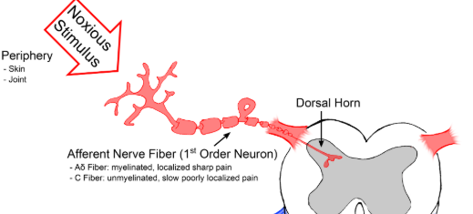
Types of Nociception
  commons.wikimedia.org
Notes:
When tissue is damaged and pain receptors (nociceptors) are activated. Reminder: nociception is a sensory sensation. Pain is a subjective experience.
Somatic pain is transmitted via the Adelta fibers. An example is fractured arm.
Tissue damaged: skin, muscle, bone
It is well localized.
Visceral pain- travels on C fibers like noxious heat and chemical stimuli- an example is appendicitis
Tissue damaged: hollow organs such as gut
Poorly localized
They synapse in the dorsal horn.

Slide 7
Types of Pain: Neuropathic
Neuropathic pain
Damage to nerves
Can be peripheral or central
Mixed pain: combines elements of nociceptive and neuropathic pain
Notes:
Neuropathic pain can occur in the peripheral or central nervous system. The nervous system detects pain, problems with the pain detection system is often found in chronic pain. There are chronic medical illnesses that result in mixed pain such as cancer and sickle cell disease.

Slide 8
Pain Assessment
Pain scales: different scales for different developmental abilities
Nonverbal and preverbal children: assess behaviors
School age children and adolescents: self-reporting
Use scale before and after treatment of pain

Slide 9
Pain Scale: Newborn and Infants
NIPS
For acute and procedure pain
Valid in 25 weeks gestation up to 1 year old
Pain Score
  0 - 2: mild
  3 - 4: moderate
  4+: severe
Notes:
Pain scores are stratified into mild, moderate and severe pain.
With treatment as follows based on pain score:
0-2 :no intervention
3-4: non-pharmacologic intervention-such as pacifier, breastfeeding, swaddling
4+ :pharmacologic intervention

Slide 10
Pain Scale: NIPS
Variable | Finding | Points
Facial Expression | Relaxed (restful face, neutral expression) | 0
 | Grimace (furrowed brow, chin, jaw) | 1
Cry* | None | 0
 | Whimper | 1
 | Vigorous | 2
Breathing pattern | Relaxed | 0
 | Irregular, breath holding, gagging | 1
Arms | Relaxed (no rigidity) | 0
 | Flexed/extended (tense) | 1
Legs | Relaxed (no rigidity) | 0
 | Flexed/extended (tense) | 1
State of Arousal | Sleeping/Awake (peaceful) | 0
 | Fussy (restless, thrashing) | 1
Heart Rate | Within 10% of baseline | 0
 | 11-20% of baseline | 1
 | >20% baseline | 2
O2 saturation | Supplemental oxygen not needed | 0
 | Additional oxygen required to maintain saturation | 1
Notes:
Pain scores are stratified into mild, moderate and severe pain. * if child is intubated, use the facial expressions as the infant may be crying silently.
A score may be falsely low in a critically ill infant or who has been given a paralyzing agent.
With treatment as follows based on pain score:
0-2 :no intervention
3-4: non-pharmacologic intervention-such as pacifier, breastfeeding, swaddling
4+ :pharmacologic intervention

Slide 11
Pain Scale: Pre-verbal and Non-verbal Children
FLACC scale
Face, Leg, Activity, Cry, Consolability
For acute and post operative pain
Valid in children 2 months to 5 years of age and nonverbal children
Pain Score
  0 - 3: mild
  4 - 6: moderate
  7+: severe
Notes:
FLACC scale created to help providers assess pain in those who are too young to verbally communicate pain or older individuals who are unable to communicate.
Maximum score is 10.
0 = Relaxed and comfortable
1 to 3 = Mild discomfort
4 to 6 = Moderate pain
7 to 10 = Severe discomfort/pain

Slide 12
Pain Scale: FLACC Scale
Category | Score
 | 0 | 1 | 2
Face | Neutral expression | Occasional grimace or frown | Very frequent clenched jaw or quivering chin
Legs | Relaxed | Restless, tense | Kicking or legs drawn up
Activity | Lying quietly | Squirming | Arched, rigid, or jerking
Cry | None | Moans or whimpers | Crying steadily, screams or sobs
Consolability | Content, relaxed | Reassured by occasional hugging, distractible | Difficult to console
Notes:
FLACC scale created to help providers assess pain in those who are too young to verbally communicate pain or older individuals who are unable to communicate.
Maximum score is 10.
0 = Relaxed and comfortable
1 to 3 = Mild discomfort
4 to 6 = Moderate pain
7 to 10 = Severe discomfort/pain

Slide 13
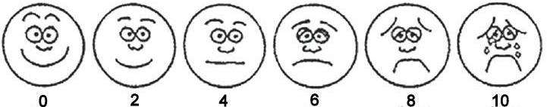
Pain Scale: School-aged Children
FACES Scale: for children 6-8 years of age
Instruct the child by stating :
“These faces show how much something can hurt. This face [point to the left most face] shows no pain. The faces show more and more pain [point to each from left to right] up to this one [right most face]. It shows a lot of pain.
Point to the face that shows how much you hurt now.”
  commons.wikimedia.org
Notes:
Faces scale called such due to use of faces to assist child in identifying pain severity
Wong Baker FACES scaled, validated tool. [Picture acquired from wikipedia commons]

Slide 14
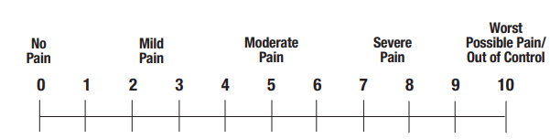
Pain Scale: Adolescents
Numeric Rating Scale (NRS)
Validated in children 8 years of age and older
“Rate your pain from 0 being no pain, to 10 being the worst possible pain”

Slide 15
Pharmacologic Treatment of Moderate and Severe Pain
Consider scheduling pain medications for children who have an active ongoing pain process (such as after surgery)
WHO supports a 2 tier approach for pain
  Acetaminophen and non-steroidal anti-inflammatory drugs (NSAIDS) for mild to moderate pain
  Morphine for moderate to severe pain
  Use of codeine and/or tramadol discouraged
Severe pain: Opioid scheduled +/- non-opioid +/- adjuvant
Moderate Pain:
Opioid as needed +/- non opioid +/-adjuvant
Mild pain:
Non opioid +/- adjuvant
World Health Organization (WHO) ladder for pain, designed to address cancer pain
Notes:
WHO step ladder was initially designed to treat cancer pain in adults; its approach is used to address all pain types in pediatrics as well.
Codeine and tramadol are drugs that have to be metabolized into morphine. Depending on the patient’s cytochrome p450 system, some children may not metabolize the medication, leading to inadequate pain relief, while others may metabolize these mediations aggressively leading to overdose.

Slide 16
Multimodal Approach
NSAIDs
Acetaminophen
Opioids
Non-opioid adjuncts
Regional anesthesia
Notes:
A multimodal approach to pain management uses nonopioids and opioid medications to minimize side effects and improve analgesia.

Slide 17
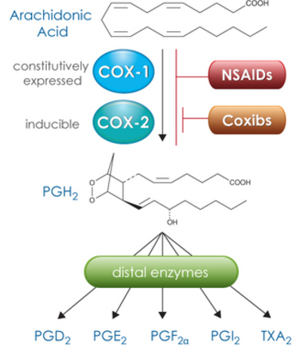
NSAIDs
Inhibit cyclo-oxygenase → prevents formation of inflammatory mediators that cause pain
Act peripherally but may have some central analgesic effects
Use caution in infants less than 6 months old due to immature renal function
  commons.wikimedia.org
Notes:
There are several side effects associated with the use of NSAIDs. GI bleeding occurs due to impairment of the protective gastric mucosal lining as a result of prostaglandin inhibition. Renal dysfunction can occur due to decreased renal blood flow. This is especially prominent in hypovolemic states. Prolonged bleeding can occur due to inhibition of platelet function. The impact of NSAIDs on bone healing is controversial. Although NSAIDs can potentially impair osteogenesis, low doses of short duration may not have a significant effect.

Slide 18
NSAIDs
Proprionic acid derivatives
    Naproxen: 5 - 6 mg/kg PO BID
    Ibuprofen: 6 - 10 mg/kg PO QID
Acetic acid derivatives
    Diclofenac: 1 mg/kg tid or 1.5 mg/kg bid
    Ketorolac: 0.5 mg/kg (max dose of 30 mg) IV QID; do not use for more than 5 days

Slide 19
Acetaminophen
Analgesic and antipyretic that produces analgesic effect by inhibiting prostaglandin synthesis
No adverse effect on platelet function or gastric mucosa
Metabolized in liver
Available PO, PR, IV routes
Single dose: 10-15mg/kg/dose up to 1 g every 4 to 6 hours
Maximum daily dose: 75 mg/kg/day (or 3750 mg)
Notes:
Doses from Harriet Lane Handbook for children ages 2-12 years old

Slide 20
Acetaminophen
Major side effect is Hepatotoxicity
Not usually seen unless significant overdose or high doses used consistently for several days
No guidelines to limit length of time used, but caution urged when given continuously for > 10-14 days

Slide 21
Acetaminophen
Be cautious when using medications containing opioid-acetaminophen mixtures
Percocet (oxycodone-acetaminophen)
Vicodin (hydrocodone-acetaminophen)
Risk of acetaminophen overdose when acetaminophen alone is used with these opioid-acetaminophen medications
Notes:
Acetaminophen administered with combined opioid-acetaminophen mixtures can potentially exceed daily maximum dosing leading to hepatic dysfunction.

Slide 22
Opioids
Derivative of opium/poppy plant
Act as a μ receptor agonist at the level of the spine and the brain
Side effects:
      Short term: sedation, respiratory depression, delayed GI motility, pruritus, urinary retention
      Long term: decrease testosterone production, opioid induced hyperalgesia, tolerance, dependence
Continuous pulse oximeter and regular physical exams assessing mentation, oxygenation and ventilation recommended for safety

Slide 23
Opioids: Morphine
Potency used as comparison for all other opioids
Bolus IV dose 0.05 - 0.2 mg/kg every 2 to 4 hours as needed
  Decrease dose in neonates, critically ill, and in patients with obstructive sleep apnea
Active metabolites (can accumulate in renal dysfunction)
  Morphine-6-glucuronide: analgesia
  Morphine-3-glucuronide: no analgesia, agitation, seizures
Notes:
*recommended dosing is for an opioid naïve patient; caution with use of morphine in patients with renal dysfunction- metabolites can accumulate and cause seizures

Slide 24
Opioids: Hydromorphone
5 - 7.5 times more potent than morphine
Bolus IV dose* 10 - 20 μg/kg every 4 - 6 hours
No active metabolites
Notes:
*recommended dosing is for an opioid naïve patient; can be used in patients with renal failure

Slide 25
Opioids: Fentanyl
100 times more potent than morphine
Short duration of activity
IV Dose: 0.5 - 1 μg/kg IV every 30 min to 2 hours
No active metabolites
Notes:
Fentanyl is a highly potent analgesic agent. However, the effects are relatively short in duration; can be used in patients with renal failure

Slide 26
Opioids: Oxycodone
Several formulations
    immediate-release (IR)
    extended release (ER)
    combination with acetaminophen (Percocet)
Excreted by kidneys and dose must be decreased with renal dysfunction
Oral (IR) Dose: 0.1 -0.15 mg/kg every 4 to 6 hours

Slide 27
Opioids: Codeine
Pro-drug metabolized to morphine by cytochrome p450 system
Ultra rapid metabolizers have increased morphine levels → risk of overdose
Under metabolizers have decreased morphine levels → lack of analgesia

Slide 28
Opioids: Codeine
FDA Black Box warnings: Codeine should not be used for:
Postoperative pain management in children following tonsillectomy and/or adenoidectomy
Treating pain in children younger than 12 years
Treating pain in children between 12 and 18 years who are obese or have OSA
Notes:
Respiratory depression and death have occurred in children who received codeine following tonsillectomy and/or adenoidectomy and had evidence of being ultra-rapid metabolizers of codeine due to a CYP2D6 polymorphism

Slide 29
Opioids:Tramadol
Weak μ-opioid receptor agonist
Serotonin and norepinephrine reuptake inhibitor
If given with SSRIs, can potentiate serotonin syndrome; induce seizure
Oral Dose: 1 - 2 mg/kg every 6 hours (Max: 400mg daily)

Slide 30
Opioid Conversion Table
Opioid | IV | PO
Morphine | 10 mg | 30 mg
Fentanyl | 200 mcg | -
Hydromorphone | 1.5 mg | 7.5 mg
Oxycodone | - | 15-20 mg
Notes:
This table displays the dose equivalency of several opioids via two routes of administration.

Slide 31
Non-opioid Adjuvants
Gabapentin
First line for neuropathic pain
Binds to voltage-gated calcium channels at the alpha-2-delta subunit and decreases the release of glutamate, norepinephrine, calcium and substance P
Oral dose (no IV formulation) must be titrated:
  Starting dose 5-7 mg/kg/day
  Maximum of 45 mg/kg/day if over 15 kg or 60 mg/kg/day if less than 15 kg

Slide 32
Non-opioid Adjuvants: Clonidine
Nonselective alpha 2 adrenergic agonist
  Binds to alpha 1 and alpha 2 receptors
  Decreases central norepinephrine release
Produces sedation, anxiolysis and analgesia
Oral absorption is slow; peak concentrations reached in an hour
Oral dose of 4 μg/kg preoperatively reduces analgesic use after surgery

Slide 33
Non-opioid Adjuvants: Ketamine
N-methyl-D-aspartate (NMDA) receptor antagonist
  Inhibits release of glutamate, an excitatory amino acid, from the central nervous system
  Responsible for analgesia
Facilitates analgesia in patients with chronic pain or chronic opioid use
IV Infusion dose for analgesia: 0.1 - 0.2 mg/kg/hour
Side effects: confusion, dysphoria, hallucinations, tachycardia and hypertension
Notes:
Low dose ketamine 0.1-0.2 mg/kg/hr prevents tolerance via NMDA antagonist activity. Analgesia provided at higher doses through noradrenergic mechanisms.
Metabolism through P450 active metabolite norketamine 1/5 to 1/3 as potent as parent agent.

Slide 34
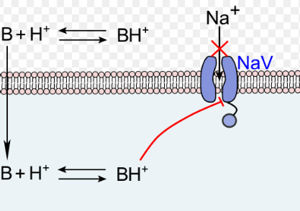
Local Anesthetics
Block voltage gated sodium channels
  Anti-inflammatory
  Increase tissue oxygenation
  Decrease opioid consumption
Protein bound, weak bases
  Patients less than 6 months of age are at risk of overdose
  Do not function in acidic environments (abscess)
B=nonionized Local Anesthetic
BH=ionized local anesthetic
  commons.wikimedia.org
Notes:
Children less than 6 months of age- have decreased hepatic proteins which means more free fraction of the drug in the blood. Only the nonionized form of the local anesthetic penetrates the nerve, the ionized form acts to block sodium channels. In an acidic environment, the local anesthetic becomes ionized and cannot penetrate the nerve.

Slide 35
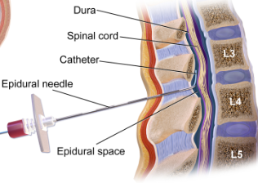
Regional Anesthesia: Epidural
  Commonly used for postoperative abdominal or thoracic pain
    Common local anesthetics are ropivacaine and bupivacaine
  Risks are dural puncture, bleeding, infection, urinary retention and nerve injury
  commons.wikimedia.org

Slide 36
Regional Anesthesia: Truncal Blocks
Can be used for umbilical hernia repairs and other abdominal surgery
Include rectus sheath block, transversus abdominal plane block (TAP) and quadratus lumborum block
0.3% rate of complication when done under ultrasound guidance

Slide 37
Regional Anesthesia:
Peripheral Nerve Blocks
Provides targeted pain control for orthopedic procedures
Examples include brachial plexus blocks, femoral and popliteal blocks
Complications of interscalene and clavicular nerve blocks include include pneumothorax and phrenic and recurrent laryngeal nerve paralysis
Notes:
Block of these nerves result in respiratory distress in children who have preexisting pulmonary compromise.

Slide 38
Regional Anesthesia
Absolute Contraindications
  Lack of patient consent
  Skin infection at the site of needle insertion
  Nerve blockade would hinder the proposed surgery or desired postoperative neurologic exam
Relative Contraindications
  Coagulopathy
  Neuropathy
  Sepsis

Slide 39
Conclusions:
Pain in children is often under-recognized and under-treated
Assess and reassess for signs and symptoms of pain by using developmentally appropriate pain scales
By identifying the type of pain present, can select appropriate treatment (such as gabapentin for neuropathic pain)
A multimodal approach to treat pain is ideal

Slide 40
References:
Anand KJS and Craig KD. New perspectives on the definition of pain. Pain, 67 (1996) 3-6.
Beltramini, A, Milojevic, K, Pateron, D. Pain assessment in newborns, infants, and children. Pediatr Ann. 2017;46(10):387–395.
Schechter NL, Berde CB, Yaster M. Pain in infants, children, and adolescents. 2003.
WHO Guidelines on the Pharmacological Treatment of Persisting Pain in Children with Medical Illnesses. Geneva: World Health Organization; 2012. 1, CLASSIFICATION OF PAIN IN CHILDREN. Available from: https://www.ncbi.nlm.nih.gov/books/NBK138356/.
Scholten, W. WHO Persisting Pediatric Pain Guidelines: A Research Agenda. November 2011.
Crellin DJ, Harrison D, Santamaria N, Huque H, Babl FE. The psychometric properties of the FLACC scale used to assess procedural pain. J Pain 2018 Aug; 19(8): 862-872.
IASP https://www.iasp-pain.org/Education/Content.aspx?ItemNumber=1519.
Cravero JP, Agarwal R, Berde C, et al. The Society for Pediatric Anesthesia recommendations for the use of opioids in children during the perioperative period. Pediatr Anesth. 2019.
Barash P et al, editors: Clinical Anesthesia (6th ed), Philadelphia, 2009, Lippincott Williams & Wilkins.
Wheatley BM, Nappo KE, et al. Effect of NSAIDs on bone healing rates: a meta-analysis. J Am Acad Orthop Surg. 2019;27(7):e330–e336.

Slide 41
References:
Konturek PC, Kania J, Burnat G, Hahn EG, Konturek SJ. Prostaglandins as mediators of COX-2 derived carcinogenesis in gastrointestinal tract. J Physiol Pharmacol. 2005;56 Suppl 5:57–73.
Cravero JP, Kaplan RF, Landrigan-Ossar M, Coté CJ. A Practice of Anesthesia for Infants and Children. Sixth Edition. Elsevier Inc; 2019:1109-1128.e7.
Kaguelidou F, Le Roux E, Mangiarini L, et al. Non-inferiority double-blind randomised controlled trial comparing gabapentin versus tramadol for the treatment of chronic neuropathic or mixed pain in children and adolescents: the GABA-1 trial-a study protocol. BMJ Open. 2019;9(2):e023296. Published 2019 Feb 20. doi:10.1136/bmjopen-2018-023296
Lambert P, Cyna AM, Knight N, Middleton P. Clonidine premedication for postoperative analgesia in children. Cochrane Database of Systematic Reviews 2014, Issue 1. Art. No.: CD009633. DOI: 10.1002/14651858.CD009633.pub2.
Mion G, Villevieille T. Ketamine pharmacology: an update (pharmacodynamics and molecular aspects, recent findings). CNS Neurosci Ther. 2013;19(6):370–380. doi:10.1111/cns.12099
Schwenk ES, Viscusi ER, Buvanendran A, et al. Consensus Guidelines on the Use of Intravenous Ketamine Infusions for Acute Pain Management From the American Society of Regional Anesthesia and Pain Medicine, the American Academy of Pain Medicine, and the American Society of Anesthesiologists. Reg Anesth Pain Med. 2018;43(5):456–466. doi:10.1097/AAP.0000000000000806
Wilder, RT. Local Anesthetics for the pediatric patient . Pediatric Clin June 2000; 47 (3): 545-558..
Long JB, Birmingham PK, De Oliveira GS Jr, Schaldenbrand KM, Suresh S. Transversus abdominis plane block in children: a multicenter safety analysis of 1994 cases from the PRAN (Pediatric Regional Anesthesia Network) database. Anesth Analg. 2014;119(2):395–399.

