Slide 1
Anesthetic Considerations for Pediatric Patients with Osteogenesis Imperfecta
Carl Lo, MD
Children’s Hospital Los Angeles
USC Keck School of Medicine
Updated 9/2019

Slide 2
Disclosures
No relevant financial relationships

Slide 3
Learning Objectives:
Describe preoperative considerations in managing pediatric patients with Osteogenesis Imperfecta (OI)
Formulate an appropriate anesthetic plan for patients with OI
Discuss strategies for minimizing perioperative fractures in pediatric patients with OI

Slide 4
Pathophysiology
“Brittle bone disease”
Estimated at 1 in 13,500
Genetic disorder of connective tissue
  Most OI has mutation in genes that code for collagen type I alpha chains, COL1A1 and COL1A2
Collagen is the main component of organic bone matrix and a key ingredient in bone tissue integrity

Slide 5
Pathophysiology
Abnormal collagen synthesis leads to bone fragility and other skeletal deformities
Multiple subtypes
  Type I-most common, mildest
  Type II-most severe/lethal
  Type III-severe, but survivable
  Type IV-severity between type I and III
  Many other subtypes with similar clinical presentation as above
Notes:
Osteogenesis imperfecta (OI), also known as “brittle bone disease,” is a genetic disorder of connective tissue that involves abnormal collagen synthesis and leads to frequent fractures. It is sub-divided into numerous subtypes and it is important to distinguish their differences. While mostly inherited in an autosomal dominant pattern, it can also present in recessive forms. It has a wide spectrum of severity with type I being the mildest and type II the most severe. Type I is the most common making up about ~50% of patients with OI. These patients usually have normal stature and are often asymptomatic except for the occasional fracture. Type II is the most severe and patients are typically small for gestational age and have limb deformities with multiple spontaneous fractures. Type II is usually lethal in the perinatal period, often as a result of respiratory and/or cardiac failure, so it is almost never seen in a typical pediatric clinical practice. Type III OI is also a severe form with short stature, multiple fractures, progressive deformities, and hearing loss, but is usually a survivable disease[1]. Type IV is in between type I and III in terms of severity. The characteristic features of OI vary greatly from person to person, even among the people with the same type of OI, and even within the same family.

Slide 6
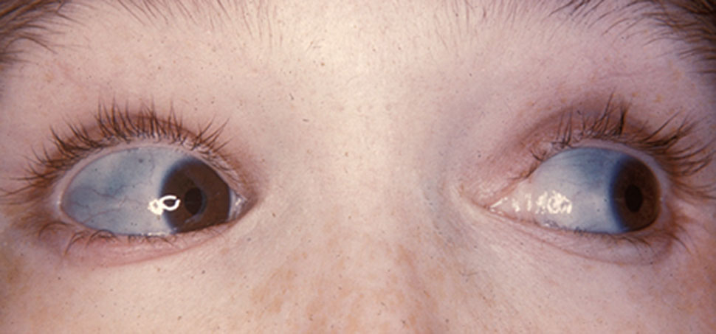
Clinical Features
Bone fragility
Blue or grey discoloration of the sclera
Dental discoloration, tooth fracture, and attrition
Dysplasia of the mandible and maxilla
Decreased muscle mass
Rarely associated with posterior fossa compression, Chiari malformation, spinal cord syrinx formation and hydrocephalus
Notes:
https://commons.wikimedia.org/wiki/File:Characteristically_blue_sclerae_of_patient_with_osteogenesis_imperfecta.jpg

Slide 7
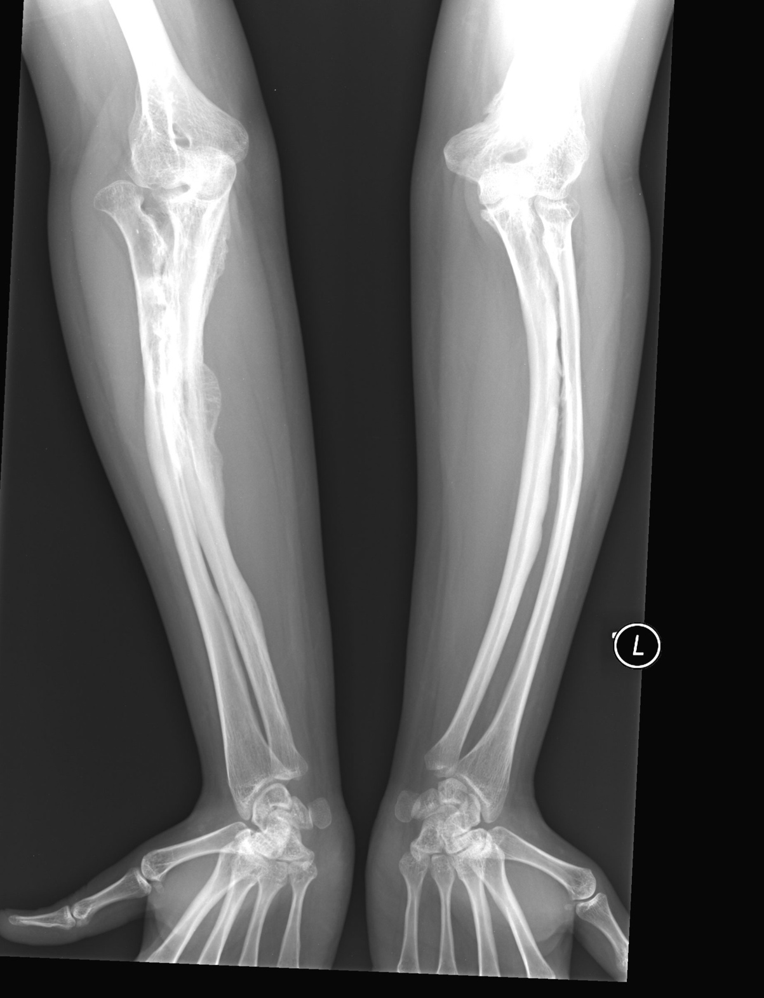
Diagnosis of OI
Molecular tests analyze structure and quantity of type I collagen synthesis
Definite diagnosis is by clinical traits
Notes:
https://commons.wikimedia.org/wiki/File:Osteogenesis_Imperfecta_Type_V.jpg

Slide 8
Common Surgeries Performed
Orthopedic surgeries for fracture repair
Intramedullary rod implant to improve function and ambulation
Deformity corrections
Telescopic rods for vertical height gain

Slide 9
Preoperative Evaluation
Airway evaluation: assess OI severity
Excessive neck extension may lead to atlantoaxial subluxation and dislocation
Reasons for potentially difficult airway
  Brittle bones
  C-spine instability
  Short neck
  Edentulous
Notes:
Let’s start with preoperative evaluation. What concerns regarding airway management might you have for a patient with OI presenting for surgery? These patients can be extremely delicate. Preoperative evaluation should include an assessment of the severity of the disease and susceptibility to fractures. Airway manipulation in fragile patients can result in fracture of the mandible, maxilla, and cervical spine. Excessive neck extension may lead to atlantoaxial subluxation and dislocation. Most airway instrumentation can cause fractures when excessive force is used, especially in patients with Type III OI. Traditional direct laryngoscopy may also be difficult due to abnormal facial features of small mandible, C-spine instability, and spine deformities.

Slide 10
Preoperative Evaluation
Airway techniques
  Direct laryngoscopy: avoid in patients with C-spine instability and consider videolaryngoscope or fiberoptic bronchoscope for intubation
  Mask: avoid excessive force
  LMA: least invasive way to ventilate, and a great rescue airway device
Avoid further fractures!
Notes:
Flexible bronchoscope intubation offers the least invasive method of intubation. Alternatively, use of a laryngeal mask airway (LMA) may offer a less invasive airway alternative. In general, it’s best to anticipate a challenging airway, even in the setting of normal physical features. It’s not uncommon for patient with OI to have cleft palates, restricted neck and jaw mobility, and chest wall deformities with or without kyphoscoliosis. Any of these comorbidities can complicate airway management, especially when one is trying to use as little forced as possible.

Slide 11
Preoperative Evaluation
Pulmonary Evaluation
  Restrictive lung disease
  Kyphoscoliosis
  Pulmonary hypertension
  Cor pulmonale
Cardiac Evaluation
  Premature atherosclerosis
  Valvular disease
Notes:
Preoperative cardiac evaluation is important because these patients are predisposed to pulmonary insufficiency and restrictive lung disease (from kyphoscoliosis) that may lead to pulmonary hypertension and cor pulmonale. While spirometric tests can delineate the severity of restrictive lung disease, it’s rarely done during infancy and early childhood due to the high amount of patient cooperation required. Also, don’t forget children with OI can develop premature atherosclerosis and valvular heart disease.

Slide 12
Preoperative Evaluation
Hematologic Evaluation
Poor collagen function on platelet-endothelial cell may lead to bleeding diathesis
Platelet dysfunction from capillary fragility (qualitative, not quantitative)
Coagulation test to rule out platelet dysfunction for surgery and regional anesthesia
Notes:
In addition to your standard pre-op evaluation, hemostasis deserves a bit more attention. It’s not a bad idea to check platelet function and coagulation tests prior to surgery as patients with OI have platelet dysfunction which increases the risk of surgical bleeding. The coagulation defect is related to the effect of abnormal collagen on platelet-endothelial cell interactions and capillary strength. By its action on capillary endothelial cells, desmopressin, a synthetic analog of antidiuretic hormone, may improve the coagulation abnormality perioperatively.

Slide 13
Intraoperative Implications
Anything can cause iatrogenic fractures!
PIV placement
Tourniquet placement
Blood pressure cuff
Surgical position
Transport
Careful padding needed
Notes:
There are many additional unique challenges we face when anesthetizing OI patients. The number one concern is to do no harm and not cause any further iatrogenic fractures! Positioning and transporting require extreme precautions, and meticulous padding at all joints is recommended. Frequent non-invasive blood pressure cuff cycling should be avoided, thus arterial line placement may be indicated just to avoid potential fractures from blood pressure cuff cycling! The same applies with application of a tourniquet. Imagine causing a fracture by simply placing a tourniquet for IV placement. Although this sounds improbable, it is not. In patients with severe forms of OI, tourniquet application during IV placement is not recommended due to high probability of causing fractures. Tourniquet effect can be accomplished by having another healthcare provider gently squeeze the extremity to facilitate IV cannulation. IV placement can also be done via ultrasound on larger bore caliber veins that are usually deep and not visible or palpable, such as cephalic and basilic veins.

Slide 14
Intraoperative Implications
Avoid Succinylcholine
  Hyperkalemic arrhythmia in immobile patients
  Succinylcholine induced fasciculations can cause fractures!
Twitch monitor can cause fractures!
Notes:
Succinylcholine should be avoided for two reasons: (1) lethal hyperkalemic arrhythmias due to up-regulation of acetylcholine receptors in patients who are immobile, as these patients frequently are due to risk of fracture, (2) the potential of succinylcholine induced fasciculations themselves causing further fractures. For some patients with OI, even checking Train of Four twitches can lead to contraction induced fractures!

Slide 15
Intraoperative Implications
Hypermetabolic state
Can be triggered by atropine/glycopyrrolate
Symptoms: excessive diaphoresis, hyperthermia, tachycardia, and tachypnea
Avoid routine use of warming devices without monitoring temperature
This hyperpyrexia reaction not associated with MH (malignant hyperthermia)
Notes:
Another intra-operative consideration in OI patients is they may have a hypermetabolic state, manifested as excessive diaphoresis, hyperthermia, tachycardia, and tachypnea. Therefore, atropine and glycopyrrolate should be used judiciously due to potential worsening hyperthermia [3]—most likely due to suppression of sweat gland activity, especially in infants and small children. The routine use of warming blanket and heating the OR room in pediatric anesthesia should be adjusted according to the patient’s core temperature. It is important to note that this hyperpyrexia reaction is not associated with malignant hyperthermia [4].

Slide 16
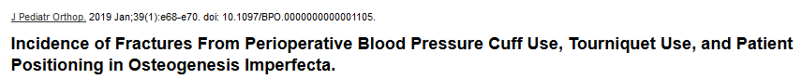
Brittle Bone Myths
Recent study in the Journal of Pediatric Orthopedics
37 OI patients underwent 96 orthopedic procedures
NIBP cuffs used in 81 surgeries
Tourniquets applied to lower extremity at a pneumatic pressure of 250 mm Hg in all patients
No iatrogenic fractures with NIBP cuff use
No fractures associated with tourniquet use
One patient had a humerus fracture from preoperative patient positioning

Slide 17
Regional Anesthesia
Preferred method in OI patients with severe cardiac/pulmonary diseases
Peripheral regional anesthesia
  Nerve stimulator at high voltage at cause fractures!
  Ultrasound guidance is preferred
Neuroaxial anesthesia
  Platelet dysfunction in OI patients can result in epidural hematoma
Notes:
Use of peripheral nerve blocks patients with OI must be done carefully. In particular, nerve stimulation can lead to contraction induced fractures, therefore ultrasound guidance is preferred. Neuraxial anesthetic procedures (spinal anesthesia, epidural anesthesia and caudal nerve block) can be safely done, but platelet dysfunction has to be ruled out prior to the block.

Slide 18
Postoperative Disposition
Postoperative sedation to avoid further fractures
Hemorrhagic diathesis from platelet dysfunction
If the patient has restrictive lung disease may need PICU admission postoperatively
Notes:
For the most part, postoperative care does not differ from those of patients without OI. PICU admission is necessary when patients present severe intraoperative complications such as hemorrhagic diathesis or restrictive pulmonary symptoms.

Slide 19
Conclusions:
Identify severity of OI
Preoperative evaluation
  Airway
  Cardiopulmonary
  Hemotologic
Fracture, fracture, fracture!
Avoid succinylcholine
Consider regional anesthetic options
Postoperative disposition
Notes:
In conclusion, OI patients must be treated very carefully. Pre-operative evaluations need to identify any cardio-pulmonary deficits and airway concerns. Even routine, seemingly benign maneuvers may cause fractures in patients with severe disease. The ultimate goal is to prevent any further fractures without compromising patient safety. The airway must be managed carefully and usually requires flexible bronchoscope intubation. Succinylcholine is contraindicated due to increased risk for hyperkalemia and fractures. Blood pressure cuffs and tourniquets should be carefully applied or avoided to reduce the risk of fracture. All extremities and joints should be carefully padded.

Slide 20
References:
Van Dijk FS, Cobben JM, Kariminejad A, et al. Osteogenesis Imperfecta: A Review with Clinical Examples. Mol Syndromol. 2011;2(1):1-20.
Basel D, Steiner RD: Osteogenesis imperfecta: recent findings shed new light on this once well understood condition. Genet Med 2009; 11: 375–85.
Santos ML, Anez C, Fuentes A, et al. Airway management with ProSeal LMA in a patient with osteogenesis imperfecta. Anesth Analg 2006; 103: 794.
Carlson Jay, Halrass F. Management of Osteogenesis Imperfecta in Pregnancy. Journal of Reproductive Medicine, 1993; 38.

