Slide 1
Anesthesia for Ophthalmologic Procedures in Pediatric Patients
Updated 11/2019
Amanda J. Darling, MD
Marissa G. Vadi, MD, MPH
UC Davis Department of Anesthesiology & Pain Medicine

Slide 2
Disclosures
No relevant financial relationships.

Slide 3
Learning Objectives:
Review ophthalmologic physiology relevant to anesthetic management.
Identify commonly used ophthalmologic medications and their side effects.
Recognize the effect of surgical urgency on anesthetic management.
Recognize the perioperative issues specific to common pediatric ophthalmologic procedures.

Slide 4
Ophthalmologic Physiology

Slide 5
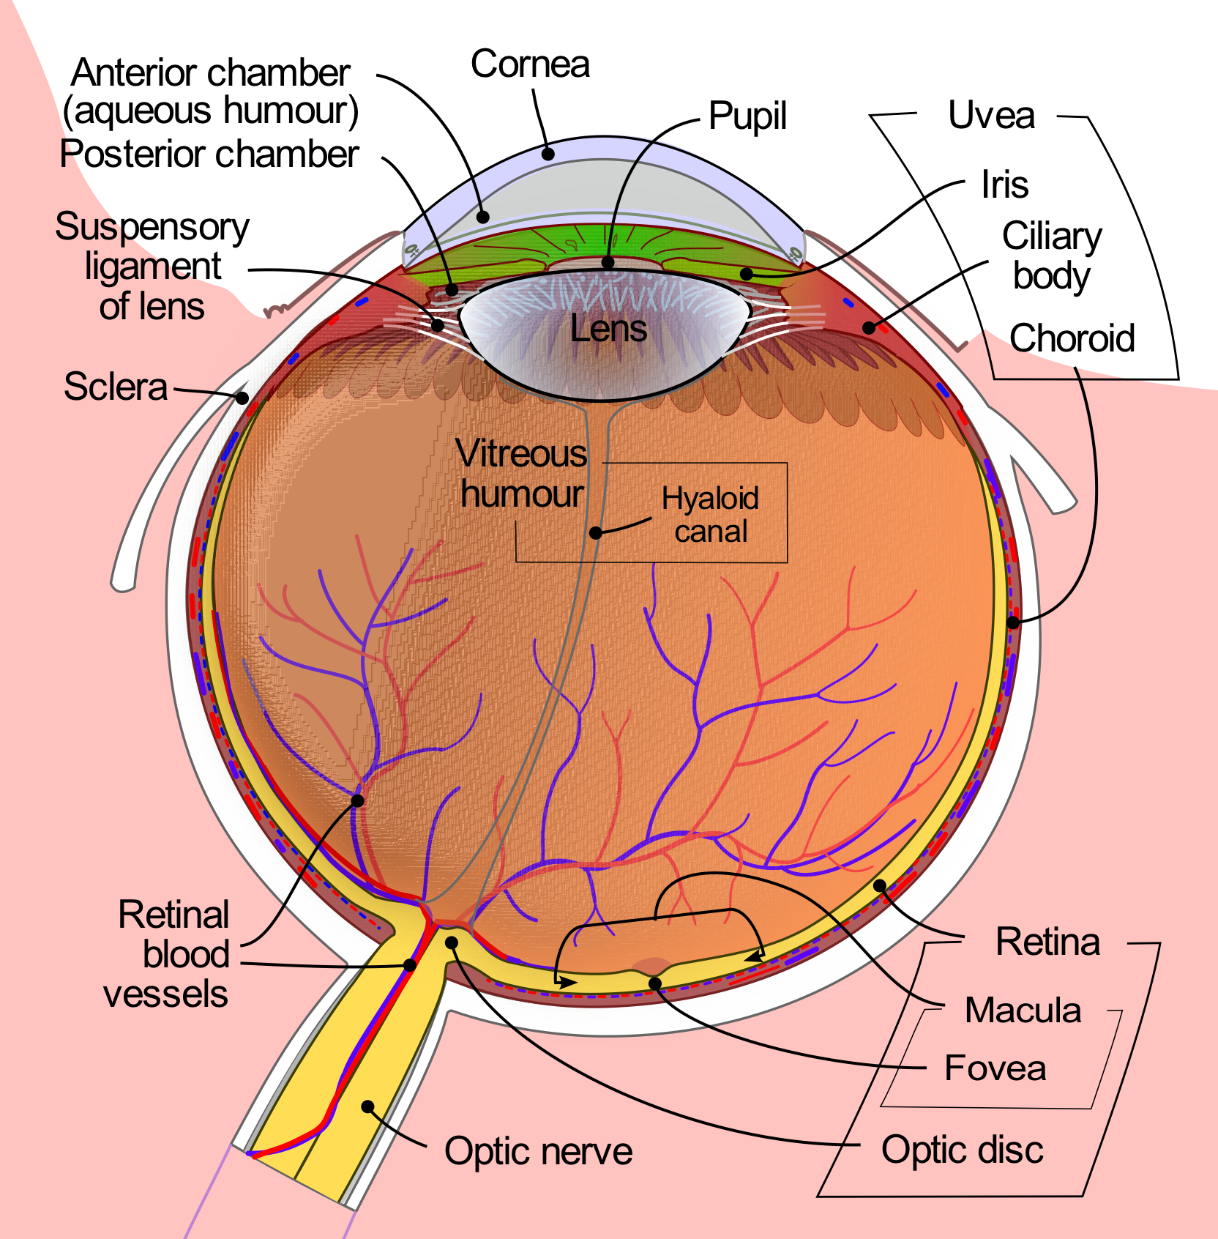
Anatomy of the Eye
https://commons.wikimedia.org/w/index.php?curid=1597930
Notes:
Components of the Eye Include:
Anterior Chamber (Aqueous Humour): the anterior chamber is the space between the cornea and the iris. It is filled with aqueous humour, a clear, slightly alkaline liquid that supplies nutrients to eye tissues and removes waste products. Aqueous humour maintains intraocular pressure and the eye’s shape.
Choroid: layer that lines the back of the eye; contains blood vessels
Ciliary Body: located behind the iris; contains muscle and focuses the lens
Cornea: clear front portion of eye; responsible for sharpness and clarity (focuses light entering the eye)
Iris: colored part of eye; regulates the amount of light that enters the eye
Lens: transparent structure that focuses light onto retina
Macula: contains light-sensitive cells that regulate ability to see fine details
Optic Nerve: bundle of nerve fibers responsible for carrying information from the retina to the brain
Posterior Chamber: area between the iris and the lens; also filled with aqueous humour
Pupil: dark center of iris; changes size to modulate amount of light entering eye
Retina: nerve layer at back of eye; senses light and creates electrical impulses transmitted to the brain via the optic nerve
Sclera: white outer layer of eye; surrounds the iris
Vitreous Humour: clear, gelatinous substance filling the central portion of the eye

Slide 6
Intraocular Pressure (IOP)
Normal: 12-15 mmHg; Elevated: >20 mmHg
Elevated IOP may lead to extrusion of contents if the globe is ruptured
Factors increasing IOP
  Increased central venous pressure
  Systemic hypertension
  Hypercarbia
  Drugs (succinylcholine, ketamine)
Notes:
The globe is a relatively non-compliant structure. IOP is the pressure exerted by the internal components of the globe on the sclera and conjunctiva. Obstruction to the drainage of aqueous humor or processes leading to increases in choroidal blood volume (e.g. hypercapnia, coughing, increased CVP) increase IOP. Increased CVP may result from coughing, straining (Valsalva maneuver, crying), increased intrathoracic pressure, or Trendelenberg positioning. The anesthesiologist should carefully control these factors during the induction of anesthesia to avoid unnecessary increases in IOP.
Agents that DECREASE IOP include most IV and volatile anesthetics (exceptions noted above), non-depolarizing neuromuscular blockers, and topical beta blockers (ex. timolol). Hyperventilation and hypothermia may also decrease IOP.

Slide 7
Succinylcholine and IOP
Increases IOP 6 to 10 mmHg
  Effect begins 1 min after administration
  Duration of effect: 10 min
Mechanisms
  Cycloplegia
  Tonic contraction of extraocular muscles
  Increased choroidal blood volume
  Relaxation of orbital muscles
Consider rocuronium 1.2 mg/kg as an alternative to succinylcholine
Notes:
Some eye muscles develop prolonged tonic tension (up to 20 min) following succinylcholine administration. In patients with a ruptured globe, this tonic tension may cause extrusion of intraocular contents.
Rocuronium administration at 1.2 mg/kg IV rapidly allows for optimal intubating conditions without succinylcholine-associated increases in IOP.

Slide 8
Oculocardiac Reflex
Triggered by pressure on globe or traction on extraocular muscles.
  Afferent Pathway: cranial nerve V (ophthalmic branch)
  Efferent Pathway: cranial nerve X
May result in dysrhythmias
  Sinus or junctional bradycardia
  Atrioventricular block
  Ventricular ectopy
  Asystole
Notes:
The oculocardiac reflex (OCR) is triggered by pressure on the globe or traction on the extraocular muscles. It is commonly encountered in patients undergoing strabismus surgery. Retrobulbar block may trigger the OCR by external pressure on the globe. The block may not completely prevent the OCR reflex during later surgical stimulation or manipulation.
The afferent pathway is as follows: stretch receptors in extraocular muscles → long and short ciliary nerves → ciliary ganglion → cranial nerve V (trigeminal nerve, ophthalmic branch) → Gasserian (trigeminal) ganglion → main sensory nucleus of the trigeminal nerve.
The afferent signal then connects to the efferent pathway in the brainstem. The efferent pathway is as follows: motor nucleus of vagus nerve → cranial nerve X (vagus nerve). Efferent fibers from the vagus nerve activate parasympathetic output in the heart, leading to dysrhythmias.

Slide 9
Treatment of Dysrhythmias
Stop surgical stimulation
Verify adequate oxygenation/ventilation
Vagolytic agents
  Atropine 20 mcg/kg IV
  Glycopyrrolate 10-20 mcg/kg IV
Epinephrine 1-10 mcg/kg IV
Refractory cases may require local anesthetic infiltration of ocular muscles
Notes:
Hypercarbia or hypoxia may worsen the oculocardiac reflex. IV vagolytic agents typically interrupt the OCR arc and restore the heart rate. Epinephrine is rarely required but should be available during ophthalmologic procedures.

Slide 10
Ophthalmologic Medications and Syndromes

Slide 11
Commonly Used Ophthalmologic Medications
Drug | Indication | Side Effect Profile
Cholinergic Agonists Carbachol Pilocarpine | Induce miosis Glaucoma | Corneal edema, retinal detachment
Cholinesterase Inhibitors Physostigmine Echothiophate | Glaucoma | Retinal detachment, miosis
Muscarinic Antagonists Atropine Scopolamine Homatropine Cyclopentolate Tropicamide | Cycloplegic retinoscopy | Photosensitivity, blurred vision, increased heart rate, dry mouth

Slide 12
Commonly Used Medications (continued)
Drug | Indication | Side Effect Profile
Sympathomimetic Agents Dipivefrin Epinephrine Phenylephrine Apraclonidine Brimonidine | Glaucoma Glaucoma Mydriasis Glaucoma Glaucoma | Photosensitivity, hypersensitivity
Alpha and Beta-Adrenergic Antagonists Dapiprazole (alpha) Betaxolol (beta 1) Carteolol (beta) Levobunolol (beta) Metipranolol (beta) Timolol (beta) | Reverse mydriasis Glaucoma Glaucoma Glaucoma Glaucoma Glaucoma | Conjunctival hyperemia Decreased heart rate and blood pressure, bronchospasm

Slide 13
Associated Systemic Disorders
Systemic Disorder | Ophthalmologic Condition
Prematurity | Retinopathy of prematurity, congenital cataracts, glaucoma, strabismus
Trisomy 21 (Down syndrome) | Neonatal cataracts, strabismus, glaucoma, nasolacrimal duct obstruction, nystagmus
Alport syndrome | Cataracts, retinal detachment, keratoconus
Connective tissue disorders Marfan syndrome Homocysteinuria Ehlers-Danlos syndrome | Retinal detachment, lens dislocation, glaucoma, cataracts, optic atrophy, intraocular hemorrhages
Craniofacial syndromes Apert syndrome Crouzon syndrome | Severe proptosis, multiple other ocular disorders

Slide 14
Ophthalmologic Procedures

Slide 15
Common Ophthalmologic Procedures in Children
Emergent and penetrating globe injury
Examination under anesthesia
Cataract excision
Strabismus repair
Glaucoma surgery
Treatment for retinopathy of prematurity

Slide 16
Emergent Procedures
Example - Ruptured Globe
May need to proceed with surgery despite not being NPO
Modified rapid sequence IV induction with Propofol* and rocuronium; intubation with cuffed ETT to secure airway
If no IV, gentle inhalational induction; proceed with second practitioner available to place IV as quickly as possible to facilitate securing airway
*Consider thiopental 5 mg/kg or methohexital 1-2.5 mg/kg if Propofol unavailable.
Notes:
Emergent ophthalmologic procedures post unique challenges for anesthesiologists.
Patients presenting for emergency procedures may not be adequately nil per os (NPO) and are at risk for aspiration of gastric contents. In such cases, a rapid sequence induction followed by endotracheal tube placement is preferred.
Patients with a ruptured globe or a penetrating eye injury risk extravasation of intraocular contents with increases in IOP during the induction of general anesthesia. Factors that may increase IOP include inadequate depth of anesthesia, crying, coughing/bucking, hypertension or elevated CVP during laryngoscopy (occurs when the sympathetic nervous system is not adequately blunted), or succinylcholine administration.
Many pediatric patients will present to the operating suite with IV access in situ. In such cases, a reasonable choice for the induction of general anesthesia is propofol 2-3 mg/kg IV followed by rocuronium 1.2 mg/kg IV, with tracheal intubation 30-60 seconds after the administration of neuromuscular blockade. Consider thiopental 5mg/kg or methohexital 1-2.5 mg/kg if propofol is unavailable. Methohexital should be used cautiously in asthmatics. Use of rocuronium avoids the increases in IOP associated with succinylcholine. Lidocaine 1-2 mg/kg IV or opioid pretreatment may also help to decrease the sympathetic response to laryngoscopy.
The induction of general anesthesia becomes more challenging when IV access is not present or IV access attempts fail. Options include: 1) Obtain IV access with ultrasound and topical analgesia; 2) IM ketamine administration with succinylcholine or rocuronium → may increase IOP, may take 2-8 minutes with gradually paralyzing airway reflexes (aspiration risk); 3) Inhalational induction with sevoflurane or halothane → requires careful avoidance of mask pressure on eyes to avoid increasing IOP, overpressure technique preferred to rapidly achieve a deep plane of anesthesia, aspiration risk; 4) Central line placement or intraosseous needle placement → unlikely to be tolerated by an awake child, crying/struggling may increase IOP; 4) Rectal methohexital 30 mg/kg → infants only, risk for incomplete induction if child evaluate all or part of the dose.

Slide 17
Exam Under Anesthesia (EUA)
Common Indications:
    General eye exam
    Fundoscopy
    IOP measurement
General anesthesia needed when child uncooperative or too young to follow commands
Preoperative evaluation for associated conditions or syndromes
Notes:
EUA under general anesthesia is typically reserved for patients who are too young to follow commands during the exam or are uncooperative with the efforts of the ophthalmologist.
Preoperative evaluation for associated conditions such as history of prematurity, developmental delay, or congenital syndromes is required. The presence of comorbidities may affect anesthetic management depending on the suspected risk of laryngospasm, bronchospasm, or difficult airway.

Slide 18
Exam Under Anesthesia
Anesthetic technique
Simple/short duration exam: consider mask general anesthetic
    Inhalational induction
    +/- IV access
    Intermittent deepening of anesthetic as needed
Longer/more involved exams: consider LMA
  Inhalational induction
  IV access established
  LMA placement
Notes:
The technique for general anesthesia maintenance is often dependent on the needs of the ophthalmologist and the specifics of the exam needed.
Simple exam: the anesthesiologist may choose to preform a mask induction of anesthesia, maintain spontaneous ventilation, forgo IV placement, and remove the mask to allow for the exam to take place with intermittent deepening of the anesthetic as needed.
Longer exams with fundoscopy or microscope utilization: an LMA may be placed after mask induction and IV placement to allow the ophthalmologist unrestricted access to the eyes without interruption for deepening of the anesthetic.

Slide 19
Exam Under Anesthesia
IOP measurements – special considerations
Important to have accurate measurement for assessing glaucoma/treatment
“Safer” to have falsely elevated measure as falsely low measure could delay treatment
Notes:
If the EUA’s priority is to obtain an accurate IOP measurement to assess for glaucoma or treatment success, caution must be taken to ensure the anesthetic does not cause a falsely low pressure measurement.

Slide 20
IOP Measurement
Consider effects of induction agents on IOP to limit effects on the measurement
Allow measurement of IOP as soon as child stops moving
Ensure face mask does not compress eyes
If airway device planned, measure IOP prior to airway manipulation
Notes:
Both volatile and IV anesthetics (except ketamine) decrease IOP
Volatile/IV agents: 1. decrease BP/CVP → decreased choroidal volume → decreased IOP; 2. relax EOM → decreased IOP; 3. cause pupillary constriction → increased aqueous outflow → decreased IOP
If volatile used should strive to keep sevoflurane concentration < 5%
Allow measurement of IOP as soon as patient stops moving to minimize the IOP lowering effects of volatile agent
Ketamine may slightly increase IOP; however, this may be preferred to agents that lower IOP secondary to the risk of delaying glaucoma treatment if a falsely low IOP is measured.
5-10 mg/kg IM ketamine reliably leads to a quiet still child with maintenance of spontaneous ventilation (ideal for measuring IOP)
Caution with increased secretions and risk for laryngospasm if no IV access/airway device planned
During IOP measurement ensure face mask is not compressing eyes → falsely elevated IOP measure
IOP should be measured prior to airway manipulation/laryngoscopy to avoid falsely elevated IOP measure

Slide 21
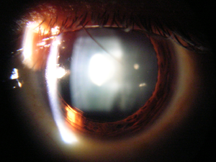
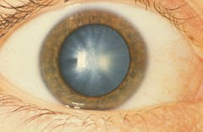
Cataract Surgery
Types of cataracts
Congenital: Early repair may allow photo-stimulation of retina
Post traumatic
Metabolic
Surgery involves corneal incision, removal of opacified patient lens, +/- intraocular lens implant
https://search.creativecommons.org/search?q=cataract&provider=&li=&lt=commercial&searchBy; accessed 7/22/19

Slide 22
Cataract Surgery
Preoperative evaluation
Identify associated conditions/syndromes and anesthetic implications
Evaluation of child to determine anesthetic technique
  General anesthesia in the majority of pediatric patients
  Can consider local anesthetic with sedation in older and more mature teenagers

Slide 23
Syndromes Associated with Cataracts
Condition/Syndrome | Potential Anesthetic Implications
Mucopolysaccharidoses | Difficult airway
Hallerman-Strieff syndrome | Difficult airway
Trisomy 21 | Congenital heart disease, atlantoaxial instability, subglottic stenosis, bradycardia with induction
Alport syndrome | Hearing loss, renal disease, myopathy
Homocystinuria | Coronary artery disease, hypercoagulability, renal disease
Marfan Syndrome | Aortic dilation/dissection concern
Fabry disease | Cardiac/renal/pulmonary involvement
Prematurity/congenital cataract | Postoperative apnea, pulmonary disease, patent foramen ovale, patent ductus arteriosus

Slide 24
Cataract Surgery
Communication with ophthalmologist important
  Limited access to airway
  Microscopic surgery requires still operating field
  LMA or ETT can be used for airway
Induction/maintenance
  Elevated IOP usually not a concern
  Inhalational or IV induction at anesthesiologist’s discretion
  IV access important to treat possible OCR
Notes:
The head of the bed is typically turned 90-180 degrees from the anesthesiologist, limiting access to the airway.
The advent of fine sutures to close the ocular wound has decreased the risk of extrusion of ocular contents with rises in IOP. Thus, there is less risk of patient injury or disruption of the surgical repair with transient rises in IOP during emergence or post-operatively.

Slide 25
Cataract Surgery
Emergence/postoperative management
Prevent acute rises in IOP
  Consider deep extubation
  Topical local anesthetic +/- sub-tenon blocks for post-op pain control
  Pharmacologic PONV prophylaxis
  Limit opioids to prevent post-op nausea or vomiting (multimodal anesthesia)
Typically outpatient procedure unless coexisting conditions or prematurity mandate post-operative monitoring
Notes:
The head of the bed is typically turned 90-180 degrees from the anesthesiologist, limiting access to the airway.
The advent of fine sutures to close the ocular wound has decreased the risk of extrusion of ocular contents with rises in IOP. Thus, there is less risk of patient injury or disruption of the surgical repair with transient rises in IOP during emergence or post-operatively.
Prematurity is defined as birth prior to post-conceptual age (PCA) of 37 weeks. Infants without coexisting medical conditions are candidates for outpatient surgery at 44 weeks PCA (if born full-term) or 60 weeks PCA (if born prematurely).

Slide 26
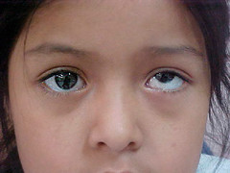
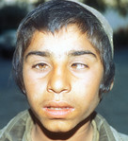
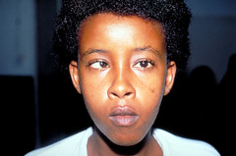
Strabismus
https://search.creativecommons.org/search?q=strabismus&provider&li&lt=modification&searchBy;
accessed 7/22/19

Slide 27
Strabismus
Divergent visual axes of eyes
Common names: squint or cross eyed
Often isolated finding but may be related to systemic disease/syndromes
  Craniofacial syndromes: Crouzon, Apert, Pfeiffer
  Prematurity
  Myopathies/cardiomyopathies
  Central nervous system disorder
  Fetal alcohol syndrome
Notes:
Malignant hyperthermia is no longer considered as being an issue associated with strabismus. The laryngeal mask airway is used frequently and has been shown as being associated with a low incidence of complications in strabismus surgery. The use of opioids should be minimized due to the increased incidence of PONV.

Slide 28
Strabismus Repair
Realigns divergent visual axes of eyes by detaching and reattaching extraocular muscles of the globe
Forced duction test
  Performed prior to repair
  Mechanical restriction to movement of eye assessed by ophthalmologist
  Differentiates a paretic EOM from muscle restriction impeding movement of eye
High risk for postoperative nausea and vomiting
One of most painful ophthalmologic procedures
Notes:
EOM – extraocular muscle
Occasionally the ophthalmologist may ask for neuromuscular blockade to facilitate the forced duction test. A nondepolarizing neuromuscular blocking agent should be used as succinylcholine may cause tonic EOM contraction for up to 20 minutes leading to erroneous results.

Slide 29
Strabismus Repair
Induction/Maintenance
Inhalational or IV induction at discretion of anesthesiologist
IV access essential for treating PONV, pain and possible OCR
LMA for airway management
Pharmacologic PONV prophylaxis
Limit opioids to prevent PONV
Multimodal analgesia: acetaminophen, NSAIDS
Consider propofol-based anesthetic to minimize PONV
Notes:
PONV – post-operative nausea/vomiting; OCR – oculocardiac reflex; LMA – laryngeal mask airway
Administration of local anesthetic drops decreases opioid requirement. Long-acting opioid administration rarely required. Consider small doses of short-acting opioids such as fentanyl if necessary.
NSAIDs may increase risk of postoperative bleeding, discussion with ophthalmologist is necessary prior to administration
Ketorolac in some studies was effective as morphine for postoperative pain control
Malignant hyperthermia is no longer considered as being an issue associated with strabismus. The laryngeal mask airway is used frequently and has been shown as being associated with a low incidence of complications in strabismus surgery. The use of opioids should be minimized due to the increased incidence of PONV.

Slide 30
Strabismus Repair
Emergence/Postoperative Management
  Pharmacologic PONV prophylaxis prior to emergence
  May consider deep extubation
  May need additional PONV treatment such as scopolamine patch or benzodiazepine (Ativan)
  Often an outpatient procedure
  Discharge from PACU if no significant PONV and able to take POs
Notes:
PONV – post-operative nausea/vomiting
NSAIDs may increase risk of postoperative bleeding, discussion with ophthalmologist is necessary prior to administration
Ketorolac in some studies was as effective as morphine for postoperative pain control

Slide 31
PONV Prevention Review
Limit preoperative dehydration: Give clears until 2 hours prior to surgery
Avoid nitrous oxide
Consider intraoperative fluid bolus of 30 ml/kg
Serotonin 5-HT₃ antagonist (e.g. ondansetron)
Dexamethasone (0.1 mg/kg up to 10 mg)
Benzodiazepines
Scopolamine patch
Propofol-based anesthetic with minimal volatile agents
Minimize narcotics: utilize multimodal analgesia

Slide 32
Glaucoma
Medical Management
Agents may be used as first-line management or as adjunct to surgery
Therapeutic window for topical medications can vary widely with age
Most common: beta-blocker +/- carbonic anhydrase inhibitor (CAI)
  Beta blocker: systemic effects include bronchospasm, bradycardia
  CAI: topical usually systemically safe; oral therapy may result in metabolic acidosis
Notes:
The plasma volume of a small child is lower than that of an adult, leading to much higher systemic drug levels in smaller children (when compared to adults) after a dose of topical glaucoma medication.
Medications include:
Alpha agonists (typically selective alpha-2 agonists): reduce IOP by suppressing aqueous production; examples include brimonidine and apraclonidine. Brimonidine should be avoided in young children due to central nervous system suppressive effect.
Beta blockers: work by reducing aqueous production; often first-line agents. Systemic side effects such as bradycardia, fatigue, and hypotension are seen in 3-6% of children after topical timolol administration. Medication must be used with caution in infants and in children with a history of reactive airway disease and/or cardiac problems.
Carbonic anhydrase inhibitors: reduce aqueous production; systemic side effects rare after topical administration. Oral CAIs (acetazolamide and methazolamide) are reserved for refractory glaucoma cases. Oral CAIs may cause metabolic acidosis, compensatory respiratory alkalosis, renal calculi, and hypocalcemia.
Miotics: stimulate the longitudinal ciliary muscle to pull open the trabecular meshwork and increase trabecular outflow; examples include pilocarpine and ecothiophate. Chronic ecothiophate use may limit the metabolism of succinylcholine, resulting in prolonged respiratory paralysis.
Prostraglandin and Prostamide Analogs: enhance uveoscleral outflow of eye; relatively contraindicated in presence of uveitis. Examples include latanoprost, tafluprost, and bimatoprost.

Slide 33
Glaucoma Surgery
Goniotomy and Trabeculectomy are most common surgical procedures.
Eye must remain motionless to avoid extrusion of intraocular contents
  Avoid coughing on extubation
  Consider endotracheal intubation and neuromuscular paralysis
Acetazolamide may be administered IV during procedure to reduce IOP

Slide 34
Retinopathy of Prematurity
Abnormal blood vessel growth in the retina
Associated with prematurity, low birth weight, exposure to supplemental oxygen
Severe disease (Stage 3 or above) may lead to retinal detachment and blindness

Slide 35
ROP Treatments
Cryotherapy or laser therapy
Neonatal unit versus operating room
Avoid high FiO₂
May require opioid administration
Consequences of extreme prematurity
  High incidence of bronchopulmonary dysplasia
  Apneas → may require postoperative ventilation
Notes:
Patients presenting for treatment of retinopathy of prematurity need careful assessment. Many will have systemic disorders resulting from extreme prematurity (e.g. bronchopulmonary dysplasia) that affect the intraoperative and postoperative anesthetic management. Cryotherapy, in particular, is a painful procedure and topical analgesia is not sufficient. Opioid administration should be considered, which has implications for the post-operative management of patients at risk for apneic episodes due to low gestational age.
Procedures may be performed in the neonatal unit or the operating room, depending upon the particular hospital. Hyperoxia may worsen retinopathy of prematurity and should be avoided.

Slide 36
Conclusions:
Communication with the ophthalmologist is essential.
Thorough preoperative assessment for associated conditions and syndromes is vital.
Oculocardiac reflex: Be vigilant and have anticholinergic medications immediately available.
During emergent ocular surgery, the risk of aspiration must be weighed against the risk of IOP increases.
PONV prevention is important.
Notes:
Communication with the ophthalmologist is essential and it is important to understand the goals of the procedure so that the anesthetic can be tailored to provide appropriate exam and operating conditions (for example if the goal of the exam is to measure an accurate IOP, allowing the ophthalmologist to measure the IOP early and before airway manipulation).
PONV prophylaxis is indispensable during ocular surgery especially for intraocular procedures (when increased IOP from vomiting could damage the repair or lead to ocular content extravasation) and for strabismus surgery (PONV can lead to increased length of stay in PACU or unplanned admission if uncontrollable).

Slide 37
References:
Chapter: Tobin JR and Grey Weaver Jr. R: Ophthalmology, A Practice of Anesthesia for Infants and Children, 6th edition. Edited by Coté CJ, Lerman J, Anderson BJ. Philadelphia, Elsevier, 2019 pp790-803.​
Dell R, Williams B. Anaesthesia for strabismus surgery: a regional survey. Br J Anaesth 1999; 82: 761-3.​
James I. Anaesthesia for paediatric eye surgery. Continuing Education in Anaesthesia, Critical Care & Pain 2008; 8: 5-10.​
University of Michigan Kellogg Eye Center. (2019, July 29). Anatomy of the Eye. Retrieved from https://www.umkelloggeye.org/conditions-treatments/anatomy-eye
Rodgers A and Cox RG. Anesthetic management for pediatric strabismus surgery: Continuing professional development. Can J Anaesth 2010; 57: 602-17.
Papadopoulos M, Edmunds B, Fenerty C, Khaw PT. Childhood glaucoma surgery in the 21st century. Eye 2014;28:931-943.
James I. Anaesthesia for paediatric eye surgery. Continuing Education in Anaesthesia Critical Care & Pain 2008;8:5-10.

