Slide 1
Non-cardiac Surgery for Children with Congenital Heart Disease
Raquel Hernandez, DO
Emily Knipper, MD
Seattle Children’s Hospital
Updated 7/2019

Slide 2
Disclosures
No relevant financial relationships

Slide 3
Learning Objectives:
Identify pertinent information in the preoperative evaluation of a patient with Congenital Heart Disease (CHD) undergoing Noncardiac surgery (NCS)
Review common L→ R shunts (PDA, ASD, VSD) and their anesthetic considerations
Review a common R→L shunt, Tetralogy of Fallot (TOF), and its anesthetic considerations
Review the anesthetic goals and physiologic concerns for congestive heart failure, pulmonary hypertension, cardiomyopathy and supraventricular tachycardia
Identify indications for spontaneous bacterial endocarditis (SBE) prophylaxis and appropriate prophylactic regimens

Slide 4
Background Information
Incidence of congenital heart disease: 8:1,000 live births (in USA)
Congenital heart disease increases risk of surgery/anesthesia
  Emergency surgery
  Pulmonary hypertension
  Supra-valvular aortic stenosis (with or without Williams Syndrome)
  Cardiomyopathy
  Symptomatic CHF (i.e., active arrhythmias)
  Major lung/thoracic surgery

Slide 5
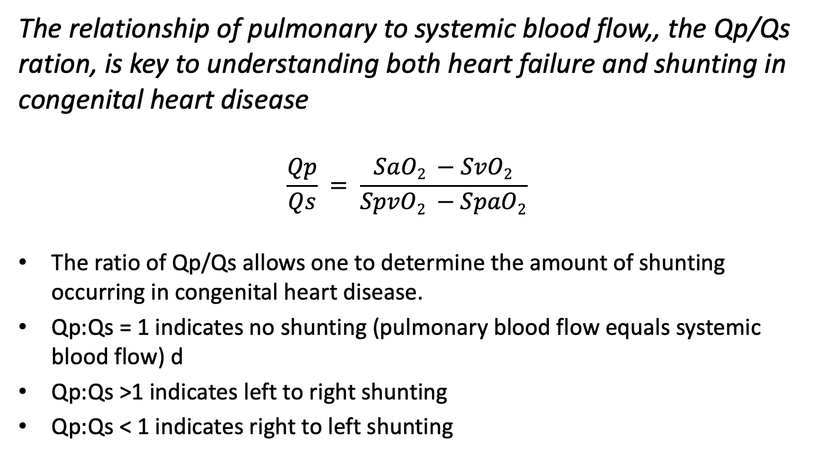
Background Information
The relationship of pulmonary to systemic blood flow,, the Qp/Qs ration, is key to understanding both heart failure and shunting in congenital heart disease
$$\frac{Qp}{Qs} = \frac{SaO2 −SvO2}{SpvO2 −SpaO2}$$
The ratio of Qp/Qs allows one to determine the amount of shunting occurring in congenital heart disease.
Qp:Qs = 1 indicates no shunting (pulmonary blood flow equals systemic blood flow) d
Qp:Qs >1 indicates left to right shunting
Qp:Qs < 1 indicates right to left shunting
Notes:
Ratio of Qp:Qs is 1 without shunting. Congenital heart disease and shunting may alter that level. It is helpful to think through each patient in terms of this ratio, because anesthetic goals frequently revolve around manipulation or maintenance of pulmonary and systemic blood flow through avoiding things that cause increase in SVR (systemic vascular resistance) or PVR (pulmonary vascular resistance).
For each patient, consider what his/her baseline Pulmonary blood flow/supply is? How will surgery/anesthesia interfere with the pulmonary blood flow/supply?
Anesthesia and perioperative situations frequently alter both SVR and PVR. An understanding of the patient’s baseline pulmonary and systemic blood supply given his/her congenital heart defect is key, and anesthetic management should be geared to avoid detrimental changes to pulmonary and systemic blood flow.
Specific factors that alter SVR and PVR are discussed on the following slides.
The concept of Qp:Qs is further discussed later in this lecture.

Slide 6
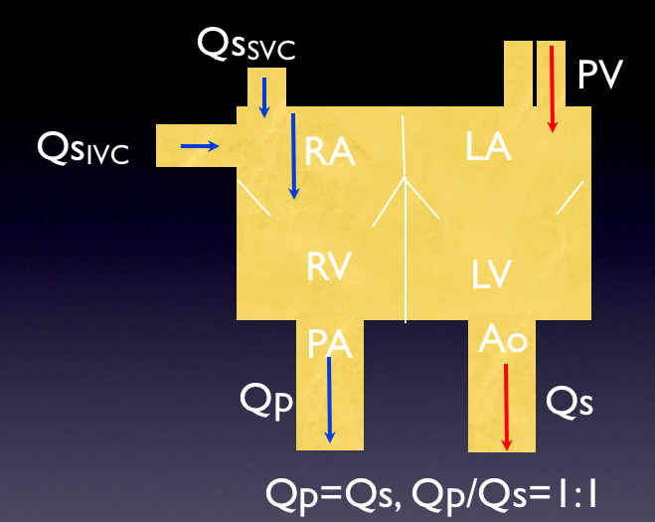
Qp/Qs in the Normal Heart
Ratio of Qp/Qs is 1 without shunting
Congenital heart disease and shunting may alter the Qp/Qs
Image: “Understanding Intracardiac Shunts,” SPA Education Series, Dr. Denise Joffe.

Slide 7
Background: SVR and PVR
Anesthetic factors frequently influence systemic vascular resistance (SVR) and pulmonary vascular resistance (PVR)
Factors that Decrease SVR:
- Adequate anesthesia
- Positive intrathoracic pressure
- Vasodilation from any cause
Factors that Increase SVR:
- Sympathetic stimulation (pain/agitation/catecholamines)
- Acidosis
- Hypothermia
- Negative intrathoracic pressure

Slide 8
Pulmonary Vascular Resistance (PVR)
Factors that Decrease PVR
- No PEEP, Low PIP
- Hypocapnia
- Adequate anesthesia/analgesia
- High FiO2
Factors that Increase PVR
- PEEP, high PIP
- Low FiO2 (in presence of normal autoregulation)
- Pain/agitation/sympathetic stimulation/acidosis
- Hypercapnia

Slide 9
Preoperative Evaluation
A thorough pre-anesthetic evaluation is necessary, with a complete Review of Systems
  Surgical history/complications during prior procedures
  Current cardiac anatomy, recent echocardiograms
  Ventricular function
  Pulmonary hypertension, valvular abnormalities
  Shunting (direction and degree of)
  Pulmonary blood supply (how is it supplied and obstruction to flow)
  History of arrhythmias, recent interrogation of pacemaker/defibrillators
  History of difficult vascular access/blood clots
  Baseline O₂ saturation/O₂ requirements

Slide 10
Preoperative Evaluation
New heart failure symptoms/changes in baseline activity
Recent URI
Current doses of cardiac medicines: antiarrhythmics, antihypertensives, pulmonary vasodilators, diuretics, anticoagulation
Premedication: Risks of hypercapnia/hypoxia with over-sedation vs Benefit of avoiding increasing O2 consumption and PVR and SVR with agitation.
Notes:
All aspects of the preoperative evaluation are important, but these topics are particularly pertinent prior to noncardiac surgery for children with congenital heart disease.
Recent changes to current medication doses?
Recent URI can be catastrophic in patients with congenital heart disease, changes in airway reactivity and PVR are poorly tolerated in children with reduced pulmonary compliance or pulmonary HTN

Slide 11
Left →Right Shunts
Acyanotic
Normal arterial saturations
Can occur at level of atria, ventricles and between great vessels
Examples:
  Patent Ductus Arteriosus (PDA)
  Atrial Septal Defect (ASD)
  Ventricular Septal Defect (VSD)
  Atrioventricular Septal Defect (AV canal defect) and Aortopulmonary Window (AP window)

Slide 12
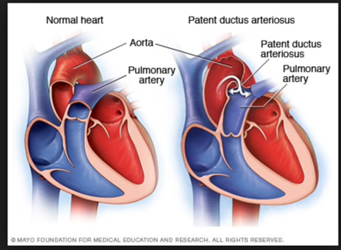
Patent Ductus Arteriosus
1/2500 live births
More common in preterm infants
Functional closure by 10-15 hrs after birth
Anatomical closure usually by 2-3 weeks after birth
Tachypnea, failure to thrive, frequent URIs
Continuous murmur, low diastolic BP from diastolic runoff, left heart dilation
Reversal of shunt from L → R to R → L can occur immediately after birth as PVR is still high
Image from Mayo Foundation

Slide 13
Anesthetic Considerations
Maintain balance of Pulmonary Vascular Resistance (PVR) : Systemic Vascular Resistance (SVR)
Monitor saturations in a pre-ductal location (RUE) and a post-ductal location (LE) to detect reversal of shunting (i.e., PVR > SVR resulting in R→L shunting)

Slide 14
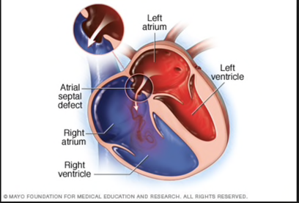
Atrial Septal Defect
10% of CHD
Can occur in isolation but also associated with other lesions
Blood flow (BF) depends on R and L ventricular compliance in diastole
Excessive BF creates a volume load that causes RA and RV enlargement
Most close spontaneously
Image from Mayo Foundation

Slide 15
ASDs: Anesthetic Considerations
Meticulous de-airing of IV tubing
Embolic risk
Paradoxical (R→L) embolus
Venous air embolus during craniosynostosis
Thromboembolism
Atrial dysrhythmias

Slide 16
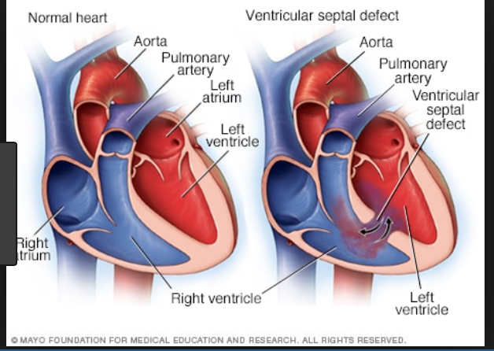
Ventricular Septal Defects
20% of CHD
Occur in isolation or associated with chromosomal abnormalities
Trisomy 13, 18, and 21
VACTERL and CHARGE syndromes
Image from Mayo Foundation

Slide 17
Ventricular Septal Defects
Restrictive VSD: small defect prevents equalization of pressures across L and R ventricles
Unrestrictive VSD: flow is unimpeded and dependent on PVR and SVR
Over time, excessive blood flow results in damage to pulmonary vasculature and development of pulmonary hypertension
Typically repaired by 6 months of age

Slide 18
VSDs: Anesthetic Considerations
Potential for shunt reversal in neonates or pulmonary hypertensive crisis
Maintain balance of PVR:SVR
Risk of paradoxical embolus
Presence of heart block, or other dysrhythmias post-op
De-air IV tubing adequately
Anesthetic induction can decrease SVR leading to R → L shunting in concurrence with elevated PVR in the neonate

Slide 19
Tetralogy of Fallot (ToF)
Basic Anatomy/Physiology:
Most common cyanotic lesion
Anatomy consists of deviation of outlet septum leading to right ventricular outflow tract (RVOT) obstruction, VSD, the aorta overriding the VSD, and right ventricular hypertrophy (RVH).
The misaligned portion of the VSD leads to the narrow RVOT, which leads to RVH, which results in right-to-left shunting in cyanosis.
If the RVOT is not significantly stenotic, RVH is less and the VSD results in a simple L → R shunt (“pink” tets), rather than cyanosis.

Slide 20
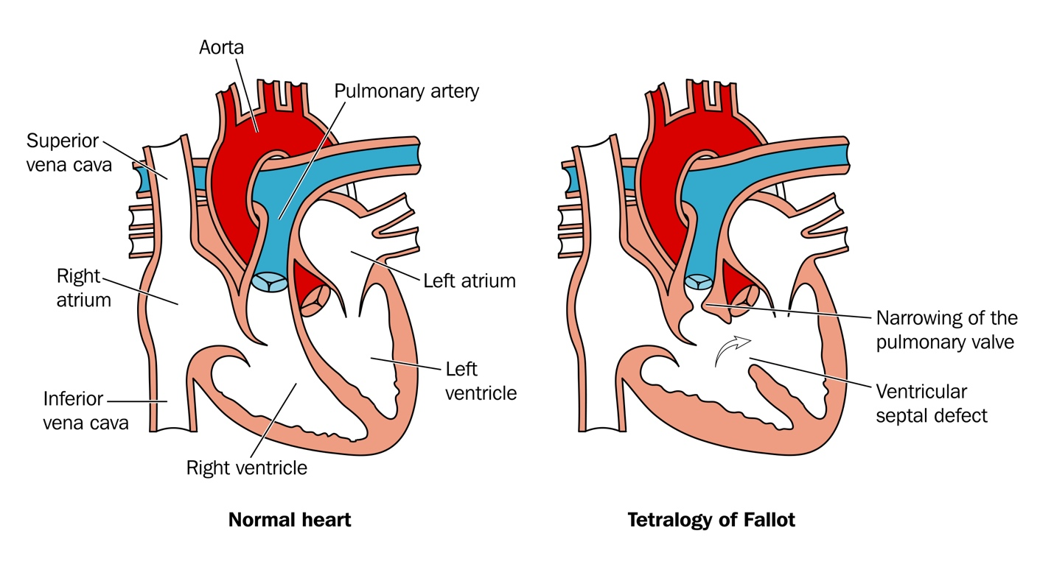
Tetralogy of Fallot

Slide 21
Tetralogy of Fallot (ToF): Unrepaired
“Tet spells” are hyper-cyanotic episodes with increased cyanosis and can progress to syncope, convulsions, and death
Peak frequency around 2-3 months of age
Results from infundibular spasm/increased contractility of the RVOT causing worsening of RVOT obstruction and greater R → L shunting
Exacerbated by crying, defecation, feeding, fever
Hypoxia causes decrease in SVR, which worsens R → L shunt and worsens/sustains spell

Slide 22
Tet Spells: Treatment
Goal: Increase SVR
If patient is awake – position patient with knees to chest, administer 100% oxygen, give Morphine (0.05-0.1 mg/kg IM) to relieve distress and air hunger.
If IV present, phenylephrine 0.5-2 mcg/kg IV to increase SVR, IV fluid bolus 15-30 ml/kg to increase preload and decrease dynamic nature of RVOT spasm.

Slide 23
TOF: Anesthetic Concerns
Monitoring | Induction | Maintenance | Hemodynamic Goals
Standard ASA, arterial line | IV induction preferred: Ketamine, fentanyl ideal Mask induction OK in infants or children with sevoflurane | Avoid “Light” anesthesia Opioid/benzo/ Sevoflurane Muscle relaxant as appropriate | Preload: ↑ HR: normal/slightly ↓ PVR: ↓ SVR: avoid decreases in SVR Contractility: avoid decreases in contractility

Slide 24
TOF: Other Considerations
Avoid ↓ SVR and ↓ contractility.
Hyperventilation can worsen a Tet spell
  ↑ mean airway pressure and reduces venous return
  ↑ RVOT obstruction
If patient has had prior ToF repair:
  Assessment of RV function is key
  Consider presence/degree of PI
  RV may need inotropic support
Notes:
In patient’s who have had prior ToF repair, pulmonary insufficiency (PI) is a frequent result of the repair. Overtime, RV overload and dysfunction may occur. (see next slide)

Slide 25
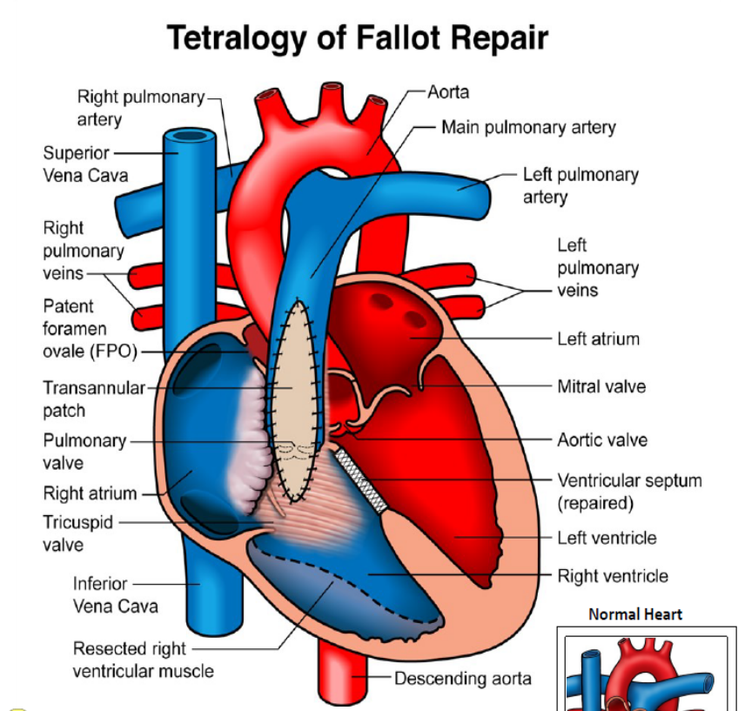
Repaired TOF
TOF repair frequently occurs in infancy
Closure of VSD with a patch
Resection of RVOT obstruction
If a trans-annular patch is necessary to repair the pulmonary valve, free pulmonary insufficiency is a result
Image from The Children’s Heart Clinic, Children’s Hospitals and Clinics of MN, 2014
Notes:
ToF repair may occur in infancy. It consists of closure of the VSD with a patch and resection of RVOT obstruction. Patients may or may not need significant intervention on their pulmonary valve during repair.
If the placement of a trans-annular patch (above, below, and through the pulmonary valve annulus) is necessary, patients develop free pulmonary valve insufficiency, and often develop RV volume overload and RV dilation, leading to RV dysfunction.
Image: http://www.childrensheartclinic.org/downloads/8/2018/10/tetraology-of-fallot-repair.pdf

Slide 26
Congestive Heart Failure
Key Concept: Qp:Qs ratio
CHF in children is frequently caused by a high Qp/Qs, leading to pulmonary over-circulation Large left to right shunts “steal” a percentage of the systemic cardiac output and send it back to the pulmonary circulation, causing right heart volume overload The body is under-perfused because the portion of oxygenated blood that is returning to the lungs via the shunt is not reaching its targeted location Significantly increased myocardial work to achieve the same cardiac output

Slide 27
CHF: Adults vs Children with
Congenital Heart Disease
 | Adults | Children
Determinants of Cardiac Function | Preload Afterload Contractility Diastolic Relaxation
Causes of CHF | LV Dysfunction Valvular disease | Imbalance of pulmonary to systemic blood flow (Qp/Qs)
Symptoms | Dyspnea Orthopnea LE edema Angina Arrhythmias | Respiratory (tachypnea, wheezing, retracting, grunting) Cardiac (tachycardia, decreased systemic perfusion Failure to thrive, feeding difficulties with poor weight gain

Slide 28
Pulmonary Hypertension
Pulmonary hypertension carries high risk with general anesthesia and surgery
High risk of perioperative morbidity and mortality (20-fold higher that without pulmonary HTN)
Baseline PAH is defined as mPAP > 25 mmHg
These patients may develop pulmonary hypertensive crises, which carries high morbidity and mortality
“Just sedation” is not necessarily safer

Slide 29
Pulmonary Hypertension
Patients may or may not have physical exam findings consistent with pulmonary HTN
Prominent right ventricular impulse/heave
Pulmonary ejection click
Narrowly split 2nd heart sound
Murmur (PI, TI)
Jugular venous distention
CXR may show prominent main PA or cardiomegaly

Slide 30
Pulmonary HTN in CHD
L → R shunts with elevated PVR
Eisenmenger syndrome: Large L → R shunts with PAP > Systemic pressure and reversal of shunting
Post op Pulmomary HTN
Pulmonary HTN related to single ventricle palliation procedure
Pulmonary HTN due to left heart disease

Slide 31
Anesthetic Goals in Pulmonary Hypertension
Avoid elective procedures
If anesthesia necessary:
  Avoid increases in pulmonary vascular resistance (PVR) from hypercarbia, hypoxia, noxious stimuli, or hypothermia
  Avoid RV Strain
  Avoid major drops in SVR
  Maintain aortic root pressure (adequate aortic root pressure is key for perfusion to coronary arteries in the setting of a thick myocardium).

Slide 32
Anesthesia for Patients with Pulmonary HTN
No single technique has been shown to be safer
Overall goal is to limit increase in PVR
Preop
  Consider premedication to avoid sympathetic stimulation during induction
  Avoid dehydration prior to induction
Intraop
  Maintenance: Midazolam, fentanyl, low doses of propofol or sevoflurane are all options
  Muscle relaxant as appropriate (Rocuronium or Vecuronium preferred given minimal effects on SVR)
  Standard ASA monitors + arterial line (if available)
Notes:
Any anesthesia carries significant risk for patients with PAH. That being said, there are multiple ways of providing anesthesia as long as the overall goal of avoiding increases in PVR is met.
Preoperatively, premedication may decrease patient agitation and help limit increases in PVR.
Standard monitors plus arterial line if available.

Slide 33
Pulmonary Hypertensive Crises
Hypoxia, Hypercarbia, Acidosis, Sympathetic stimulation lead to rapid increase in PVR → Right Heart Failure, myocardial ischemia → Cardiac arrest → Death
Physical exam findings during crisis: syncope, dyspnea, cyanosis, pallor, bradycardia, bronchospasm
MUST BE TREATED aggressively to avoid death
Treatment: decrease PVR, support cardiac output, remove stimuli that is causing increased PVR
Moderate hyperventilation with 100% fiO₂, treat acidosis, remove stimuli, treat bradycardia with atropine. Inotropic support with dopamine, epinephrine, or norepinephrine if crisis continues

Slide 34
Cardiomyopathy: Background
Cardiomyopathy = Decreased ventricular function
  Can lead to failure to thrive, arrhythmias, heart failure, and multiple organ dysfunction
Causes:
  Frequently idiopathic
  Genetic factors
  Infection
  Poisoning
  Congenital heart disease
  Other medical conditions.

Slide 35
Cardiomyopathy
High risk for morbidity/mortality
If cardiac arrest occurs, high mortality
ACLS is frequently unsuccessful
Elective procedures should be avoided
Notes:
Patients with cardiomyopathy represent extraordinary risk under GA. Cardiac arrest occurs frequently, and when it does occur, carries high risk of mortality, and cardiopulmonary resuscitation is frequently not successful.
Elective procedures should be avoided in children with cardiomyopathy.

Slide 36
Anesthetic Goals in Cardiomyopathy
If possible, AVOID ELECTIVE PROCEDURES → Light sedation with injection of local anesthesia as surgical intervention allows is preferable
If deeper plane of anesthesia is required → Slow, judicious titration of IV agents is recommended
Monitors: Standard ASA monitors, arterial line (if available)
Notes:
In general, elective procedures should be avoided in patients with cardiomyopathy. If a procedure is required, light sedation with injection of LA by the surgeon is preferable to decrease the likelihood of cardiac arrest.
If general anesthesia/deeper sedation is required, it is key to titrate agents slowly and judiciously (i.e. premedication with midazolam, slow titration of ketamine and opioid, consider etomidate), with careful monitoring of hemodynamic affects.

Slide 37
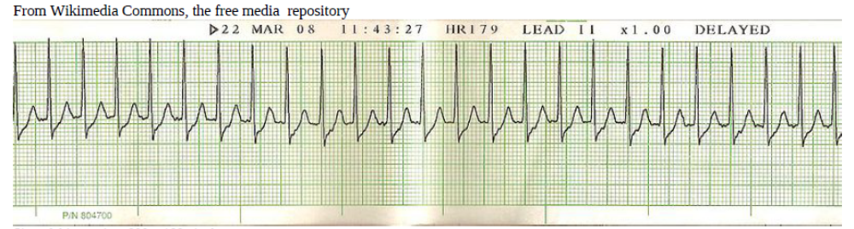
Supraventricular Tachycardia
Infants >220 BPM, Children >180 BPM
Compatible history (vague, nonspecific, history of abrupt rate changes)
P waves absent or abnormal
HR not variable

Slide 38
Treatment of SVT
Hemodynamically Stable SVT
  Vagal maneuvers
  Adenosine 0.1 mg/kg IV push or IO push (6 mg maximum dose)
  May repeat Adenosine 0.2 mg/kg IV push or IO push
  Sedation and synchronized cardioversion
  1st cardioversion: 0.5-1.0 J/kg
  Following cardioversions: 2 J/kg
Hemodynamically Unstable SVT
  Sedation and synchronized cardioversion
  1st cardioversion: 0.5-1.0 J/kg
  Following cardioversions: 2 J/kg

Slide 39
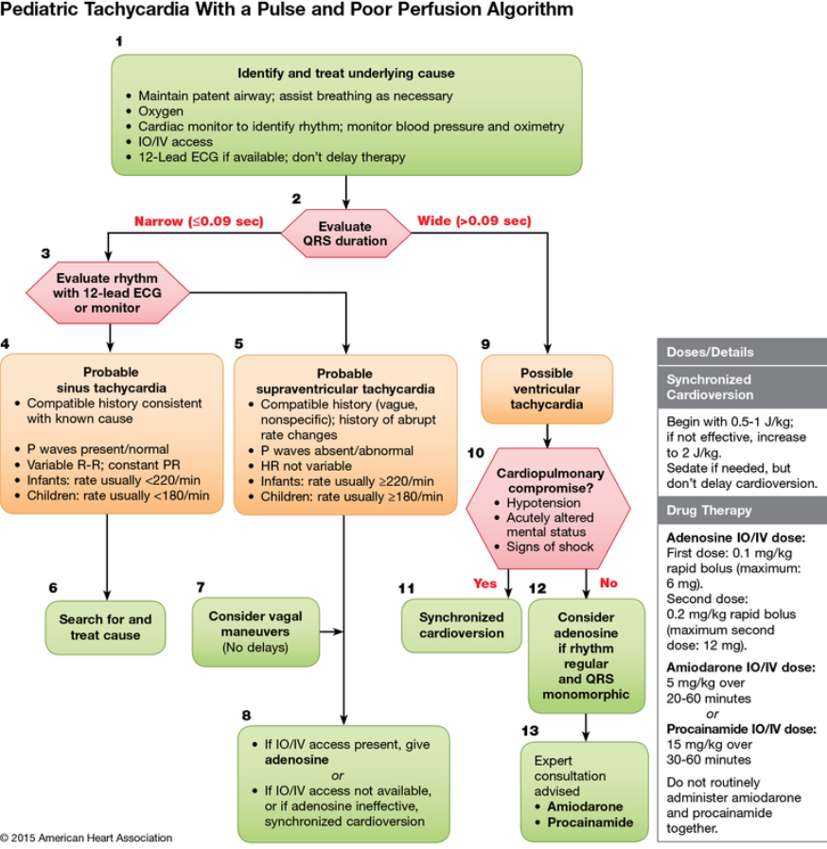
PALS Algorithm

Slide 40
Spontaneous Bacterial Endocarditis (SBE) prophylaxis
Congenital heart disease (CHD) is a risk factor for infective endocarditis, which is a devastating disease
The American Heart Association (AHA) has issued guidelines for which patients and procedures require antibiotic prophylaxis.
Prophylaxis is indicated for all dental procedures involving manipulation of gingival tissue or the periapical region of teeth or perforation of the oral mucosa.

Slide 41
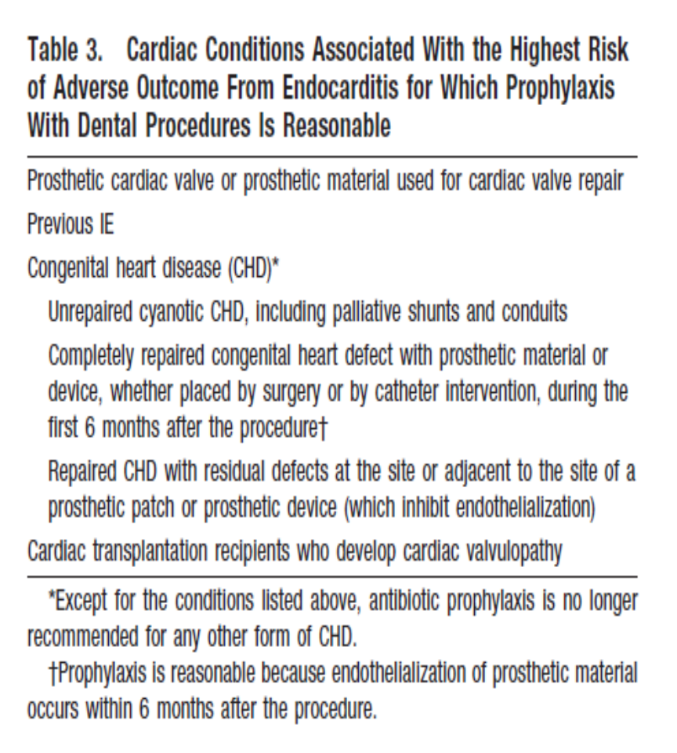
SBE Prophylaxis GuidelinesThe American Heart Association has offered specific guidelines for which patients should receive antibiotic prophylaxis when having dental procedures. (Wilson W, Taubert KA, et al. Prevention of infective endocarditis: Guidelines from the American heart Association. Circulation. 2007;116-1736-1754.)
SBE Prophylaxis Guidelines from the American Heart Association
The need for prophylaxis is dependent on the specific congenital heart defect and the timing of the current intervention in relationship to surgical intervention for the CHD.

Slide 42
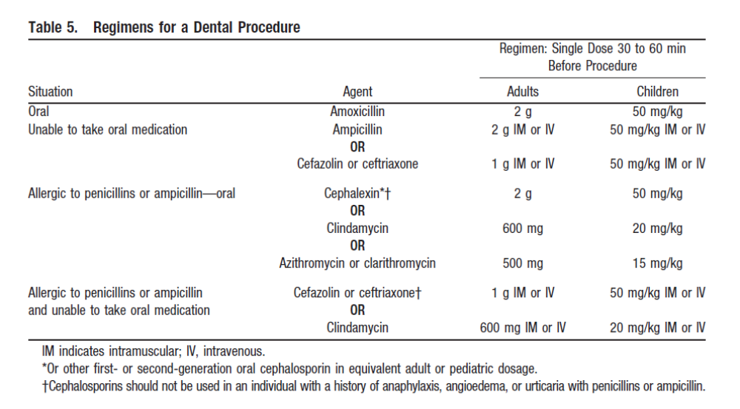
Recommended SBE Regimens
Wilson W, Taubert KA, et al. Prevention of infective endocarditis: Guidelines from the American heart Association. Circulation. 2007;116-1736-1754

Slide 43
References:
Wilson W, Taubert KA, et al. Prevention of infective endocarditis: Guidelines from the American heart Association. Circulation. 2007;116-1736-1754.)
Holzman RS, Mancuso TJ, Polaner, DM, 2016. A Practical Approach to Pediatric Anesthesia. Philadelphia (PA): Wolters Kluwer.
Carmosino MJ, Friesen RH, Doran A, Ivy DD. Perioperative complications in children with pulmonary hypertension undergoing noncardiac surgery or cardiac catheterization. Anesth Analg. 2007 Mar;104(3):521-7.
Latham GJ, Yung D. Current understanding and management of pediatric pulmonary hypertension. Pediatric Anesthesia 2019(29):441-456.
Gottlieb EA, Andropoulus DB. Anesthesia for the patient with congenital heart disease presenting for noncardiac surgery. Curr Opin Anaesthesiol 2013;26(3):318-326.
Kipps AK, Ramamoorthy C, Rosenthal DN, et al. Children with cardiomyopathy: complications after noncardiac procedures with general anesthesia. Paediatr Anasths 2007;17(8):775-81.
Ross, FE, Introduction to Congenital Heart Disease, Part 1, OpenAnesthesia.org Pediatric podcast, April 10, 2018
Ross, FE, Introduction to Congenital Heart Disease, Part 2, Open Anesthesia.org Pediatric podcast, July 2, 2018

