Slide 1
Neurodevelopmental Impact of Anesthetics in Pediatric Patients: 2019 Update
Zhe Chen, MD
Assistant Clinical Professor
Andrew Infosino, MD
Clinical Professor
UCSF Benioff Children’s Hospital
UCSF Department of Anesthesia & Perioperative Care

Slide 2
Disclosures
We have no relevant financial relationships.

Slide 3
Learning objectives:
Review key animal and human studies
Analyze PANDA and GAS studies
Interpret FDA drug safety communication
Describe approaches to address potential neurotoxicity with parents and surgical colleagues

Slide 4
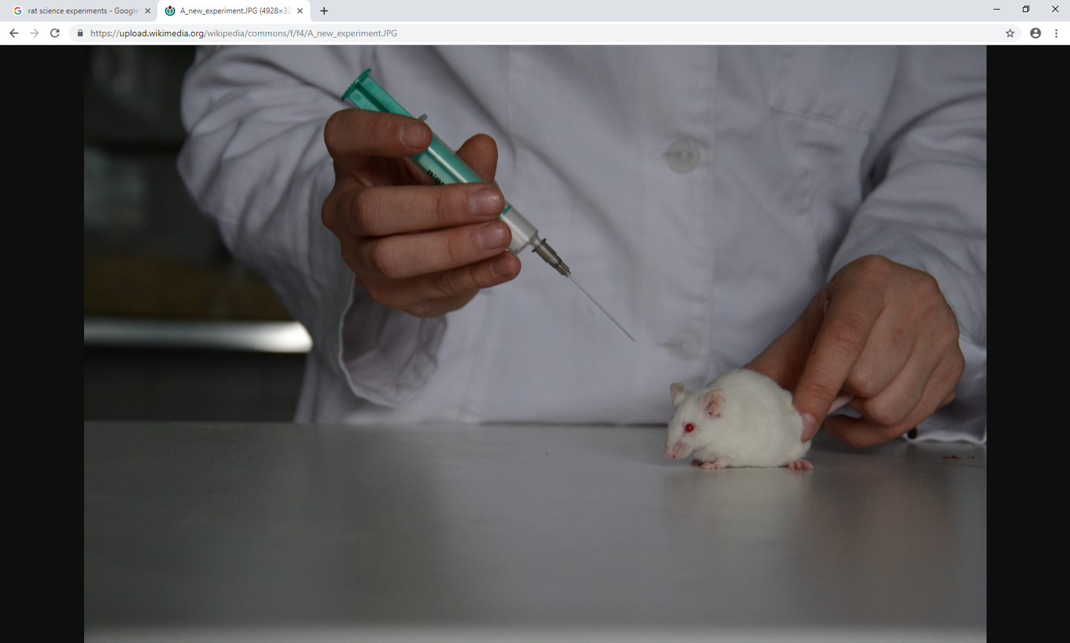
Animal Studies

Slide 5
Initial Animal Study
Seminal 1999 paper by Ikonomidou et al on anesthetic neurotoxicity was published in Science
Showed widespread neuronal apoptosis in 7-day-old rats treated with a potent NMDA receptor blocker
Threshold dose to trigger apoptosis extrapolated to amount to about 4 hours of blockade of NMDA receptors

Slide 6
What We Have Learned From Animal Studies
Infant rats: Anesthetized with isoflurane, nitrous, & midazolam for 6 hours were found to have neuronal cell death and lasting memory impairment (Jevtovic-Todorovic 2003)
Anesthesia causes apoptosis but anesthesia-induced apoptosis was not sufficient to cause the cognitive deficit (Loepke 2009)
Anesthesia exposure at later ages in development resulted in less insult
Shorter duration of anesthesia with lower concentrations resulted in less insult

Slide 7
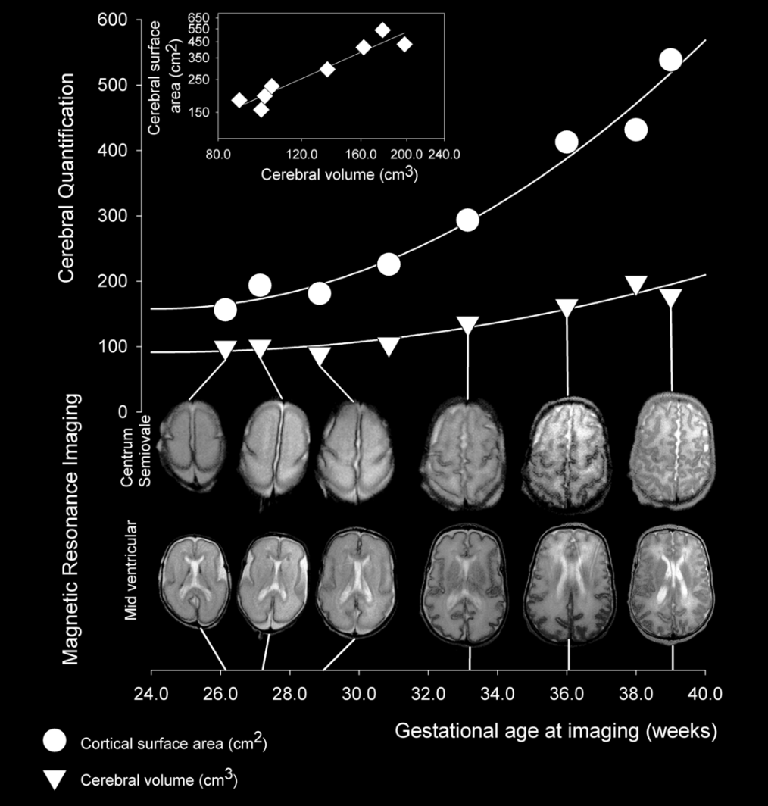
Human studies: Heterogeneous in Design and Difficult to Interpret
Human brain development is extremely complex
We do not know what duration of GA or age of exposure matters most in humans
Surgical intervention and co-morbid disease are inherent confounders in children who receive GA

Slide 8

Observational Human Studies
Studies of the Fetus in the Womb by Leonardo da Vinci

Slide 9

Large Observational Studies in Humans
Western Australia Pregnancy Cohort (Raine) Study
  Strong association with anesthesia before age 3 and deficits in language & abstract reasoning
  No correlation with achievement tests
Minnesota cohort study
  Significant effect from multiple anesthetics, but not a single anesthetic before age 4 on language and cognitive domains
  No effect on emotional or behavioral domains

Slide 10
Large Observational Studies in Humans
New York Medicaid database study
  Increase in risk of behavior and developmental diagnoses with hernia surgery before age 3 compared to age matched controls
Netherlands Twin Study
  Lower scores and cognitive assessments in twins exposed to GA vs controls; no difference within twin pairs in which only 1 twin exposed to GA
Danish Pyloromyotomy study
  No significant difference on standardized tests and teacher evaluations compared to age matched peers in children exposed to GA for pyloroplasty before 3 months

Slide 11
MASK (Mayo Anesthesia Safety in Kids) Study
Observational study of exposure to anesthesia before age 3
997 children born in Minnesota from 1994-2007
3 groups: unexposed vs single exposure vs multiple exposures
Results
  1º outcome: Wechsler IQ test: No significant differences in the 3 groups
  2º outcomes: neuropsychiatric battery and parental report
    No deficits in single exposure group
    Impaired fine motor and processing speed in multiple exposure group
    Parents of multiple exposure group reported more problems in executive function, behavior, and reading
Notes:
Original Minnesota Cohort Study (1976-1982) found increased risk of learning disability with multiple but not single exposure. Update of more recent cohort who had “modern” anesthetics

Slide 12

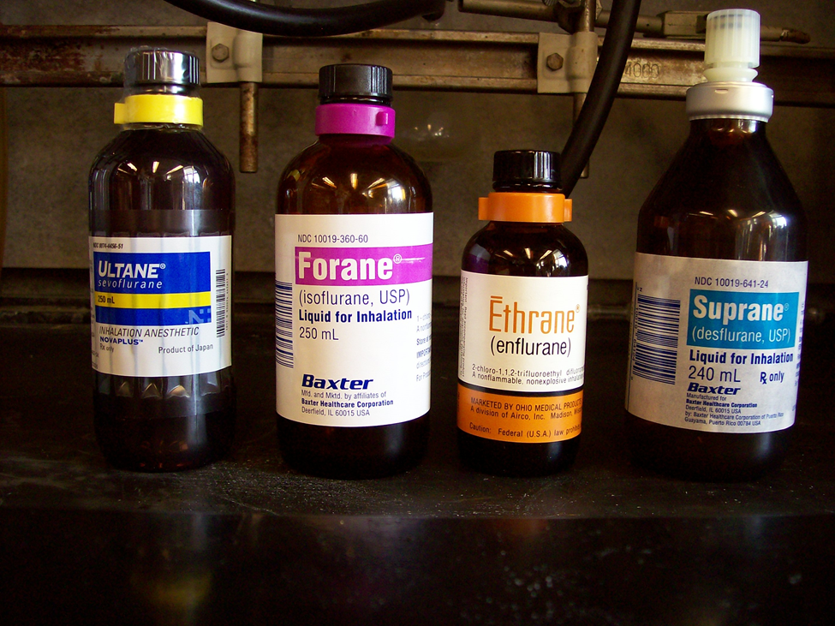
Seminal Clinical Data in Humans
PANDA Study
Pediatric Anesthesia & Neuro-development Assessment: 2016
GAS Study
General Anesthesia Compared to Spinal Anesthesia Study: 2016, 2019

Slide 13
PANDA Study
Question: Is a single anesthetic exposure in otherwise healthy young children associated with neurocognitive and behavior problems later in childhood?
Compared 105 children who had GA at ≤ 36 months vs. their siblings who did not
Outcomes
  1º: Wechsler IQ
  2º: Domain specific neurocognitive function and behavior

Slide 14
PANDA Study Design
From 5/2009 – 4/2015; 4 sites
Sibling-matched cohort study, prospective neurocognitive/behavior assessment, retrospective data on anesthesia exposure
Inclusion: Age 8-15 yrs, ASA 1 or 2, GA ≥ 36 weeks at birth → N=105 pairs
Cohorts
  Exposed: single GA for elective hernia surgery before 36 months
  Unexposed: full or ½ sib closest in age (< 3-year-age difference) with no anesthesia exposure before age 36 months
Reduces genetics, environmental, and socioeconomic effects
Neuropsychological testing at older age allows impairments enough time to emerge
Coincides with end of peak synaptogenesis in human brain development

Slide 15
PANDA Study Results
No significant difference in mean IQ scores between siblings
  No differences with exposure during 3 age ranges (0 – 11 months, 12– 23 months or 24-26 months.)
  No differences with exposure of different durations (0 - 59 min, 60 - 119 min, ≥ 120 min)
No significant difference in mean scores in memory/ learning, motor/processing speed, visuospatial function, attention, executive function, language, or behavior
Mean GA duration was 84 min (range 20-240 min)
Notes:
Mean difference was 0.2 IQ points [95% CI, -2.6, +2.9]

Slide 16
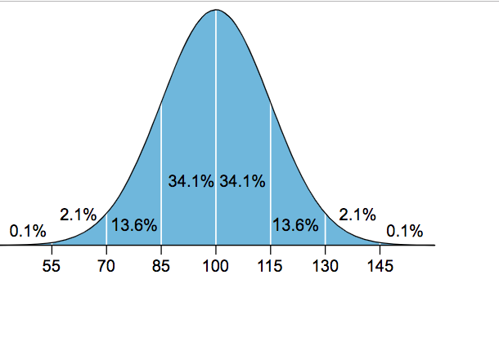
PANDA Study Limitations
90% male in exposed (GA) group, 56% male in unexposed (control)
Protective effect of relatively affluent socioeconomic status?
  Cohort had higher mean IQ (~110) than population mean IQ
  Relatively affluent, well-educated, intact families
  86% white
23 of 105 unexposed (control) siblings had anesthesia after age 3 and were included in the analysis → did this affect the average IQ of the control group?
IQ test normal distribution
Wechsler III IQ test classification
IQ Range | IQ Classification
130 and above | Very superior
120-120 | Superior
110-119 | High average
90-109 | Average
80-89 | Low Average
70-79 | Borderline
69 and below | Extremely Low

Slide 17
GAS study
Question: Is there a difference in outcome between infants undergoing hernia repair under GA vs awake regional (spinal / caudal)?
Only randomized controlled trial published to date
Outcomes:
  1º: Wechsler III IQ at age 5
  2º: Bayley-III test at age 2 (cognitive, language, motor, adaptive behavior, and social-emotional scales)
    2) Postoperative apnea

Slide 18
GAS Study Design
From 2/2007 – 1/2013, 28 centers in 7 countries
Inclusion criteria: Post-conceptual age of 60 weeks or less
Exclusion criteria: CHD, mechanical ventilation prior to surgery, neurologic injury or congenital abnormalities known to affect cognition, IVH > grade 2, chromosomal abnormalities, previous volatile anesthetic exposure, benzodiazepine exposure in-utero or infancy and social issues preventing follow-up
Randomization
  GA with sevoflurane (N=294)
  Awake regional with spinal or spinal/caudal (N=238)
Mean Sevoflurane exposure time: 54 min

Slide 19
GAS study: Neurodevelopmental Results at Age 2
Early life short exposure to GA resulted in no difference in neurodevelopmental composite scores at age 2
Subgroup analysis revealed no difference between groups except in social-emotional scales

Slide 20
GAS Study: Neurodevelopmental Results at Age 2
Limitations of Bayley-III assessment:
Bayley-III is designed to identify patients at risk for developmental delay
Effects may not be present at age 2 and may develop later
May not detect subclinical cognitive problems
No previous studies have shown a clear correlation between early anesthesia and global developmental delay

Slide 21

GAS study: Neurodevelopmental Results at Age 5
Found no difference in IQ scores at age 5
  General Anesthesia Mean IQ scores: 98.97 (SD 19.66)
  Awake regional Mean IQ scores: 99.08 (SD 18.35)
No significant differences in neurocognitive and behavioral outcomes

Slide 22
GAS Study: Limitations
  Predominantly boys – 81% in regional arm, 85% in GA arm
  Greater-than-expected loss to follow-up: complete date from only 447/719
  Awake regional anesthesia failure rate of about 20% due to block failure or inadequate block duration
  Conclusions only apply to single short anesthetic (mean duration < 1 hour)

Slide 23
Human Studies Summary
Human studies are heterogeneous in subjects examined and outcomes measured
  Only a few studies showed deficit in achievement test scores¹
  Most studies showed deficit in language, cognition, and behavioral domains^{2,3}
  Multiple exposures worse than single exposure^{4,5}
Most human studies are observational; can only show association not causation
Two recent studies, PANDA and GAS, showed no difference in neurocognitive outcomes associated with single relatively short anesthetic
Notes:
CITATIONS:
¹ Glatz P, Sandin RH, Pedersen NL, Bonamy AK, Eriksson LI, Granath F: Association of anesthesia and surgery during childhood with long-term academic performance. JAMA Pediatr 2017; 171:e163470
² Ing C, DiMaggio C, Whitehouse A, et al. Long-term differences in language and cognitive function after childhood exposure to anesthesia. Pediatrics 2012;130:e476-85.
³ HansenTG, PedersenJK, HennebergSW, MortonNS, ChristensenK. Educational outcome in adolescence following pyloric stenosis repair before 3 months of age: a nationwide cohort study. PaediatrAnaesth. 2013 Oct;23(10):883-90.
⁴ Wilder RT, Flick RP, Sprung J, Katusic SK, Barbaresi WJ, Mickelson C, Gleich SJ, Schroeder DR, Weaver AL, Warner DO. Early exposure to anesthesia and learning disabilities in a population-based birth cohort. Anesthesiology 2009; 110(4): 796-804.
⁵ Warner DO, Zaccariello MJ, Katusic SK et al. Neuropsychological and behavioral outcomes after exposure of young children to procedures requiring general anesthesia: The Mayo Anesthesia Safety in Kids (MASK) Study. Anesthesiology. 2018 Jul;129(1):89-105.

Slide 24
Future studies
We still lack robust data on longer or multiple anesthetics in humans

Slide 25
Does Dexmedetomidine Have Neuroprotective Effects ?
Dexmedetomidine actions:
  Hypnosis and anxiolysis via α₂ agonism in the brain
  Analgesia via α₂ agonism in the spinal cord
Rat model data by Sanders et al (2009)
  Neonatal rats exposed to dexmedetomidine alone showed no significant increase in apoptosis
  Dose-dependent reduction in apoptosis when used in addition to volatile anesthetic

Slide 26
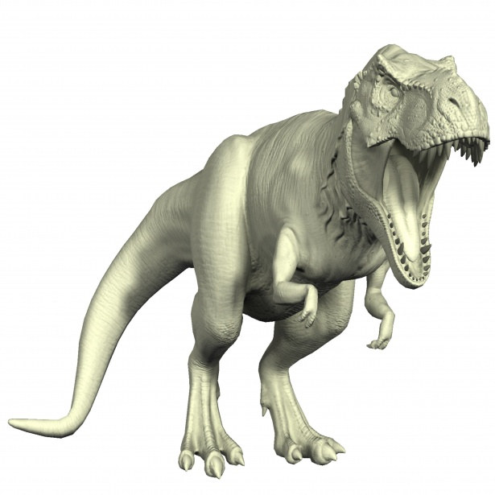
T-REX (Toxicity of Remifentanil and Dexmedetomidine) trial
Ongoing randomized controlled trial of 450 children up to 2 years of age
2 Groups: low dose sevoflurane + remifentanil + dexmedetomidine
  Standard dose sevoflurane : ET ≥ 2.5-3%
  Low dose sevoflurane + remifentanil + dexmedetomidine
Cognitive assessment (IQ) at age 3
Study start 2017, expected completion 2022
Notes:
Dex 1mcg/kg 10 min load → 1mcg/kg/hr gtt, Remi 1mcg/kg 2 min load → 0.1 mcg/kg/min + gtt, Sevo ET ≤ 0.6-0.8%

Slide 27
Ongoing Efforts and Resources
SmartTots established in 2009
Partnership between IARS and FDA that funds anesthesia research on child development
Website is a great resource for clinicians
Consensus statement 10/2015:
  Distinguish animal data vs human data, effect in children still uncertain
  No specific technique is any safer
  Risk vs benefit analysis for each individual case

Slide 28
Continuing Education and Discussions Needed
Knowledge about neurotoxicity in children in still evolving
Pediatric anesthesiologists have an opportunity to take a leadership role in providing continuing education for anesthesia colleagues and trainees
Best to develop coherent messages at division or departmental levels
Ongoing education and discussion with surgical and medical colleagues is needed

Slide 29
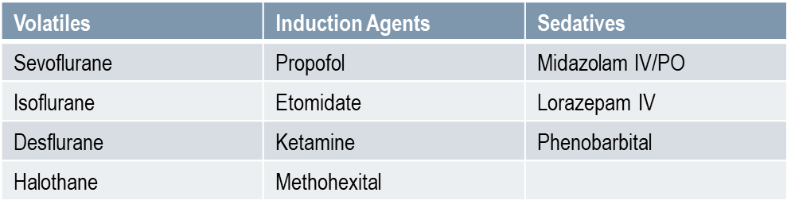
Regulatory Responses
In December 2016, the U.S. Food and Drug Administration (FDA) issued a warning regarding use of general anesthetics and sedation drugs in young children and pregnant women:
Warning label to be added to the following drugs
Repeated or lengthy use of general anesthetic and sedation drugs during surgeries or procedures in children younger than 3 years or in pregnant women during their third trimester may affect the development of children’s brains

Slide 30
Key Points in FDA Release
Most anesthetic drugs cause negative effects on brain development in animal models
No specific anesthetic medications have been shown to be safer than any other
Recent studies in children suggest that a single relatively short exposure to general anesthetic and sedation drugs in infants and toddlers is unlikely to have negative effects on behavior or learning
Vulnerability window during period of rapid synaptogenesis believed to be from 3rd trimester to 1 year, but may extend to 3 years

Slide 31
Key Points in FDA Release
FDA Recommendations:
Weigh risks vs benefits and discuss appropriate timing for:
  Age < 3 years
  Surgeries > 3 hours duration
Proceed for these pediatric surgical conditions
  Life-threatening: CHD, esophageal atresia, intestinal obstruction or malrotation, gastroschisis & omphalocele, diaphragmatic hernia, congenital lung lesions, pyloric stenosis
  Non-life-threatening: cleft lip/palate, orchiopexy

Slide 32
Reactions to FDA Warning
Raised many questions about safety of anesthesia in infants and young children
Provided few concrete answers
Created significant worry for pediatric anesthesiologists: Are we harming our patients?
Increased anxiety for parents of infants/children that need anesthesia
Prompted new concern among our surgical colleagues about timing of surgery

Slide 33
Consensus Response to FDA 12/16/2016
The American Society of Anesthesiologists, Society for Pediatric Anesthesia, International Anesthesia Research Society, American Academy of Pediatrics, American Pediatric Surgical Association, Society for Obstetric Anesthesia and Perinatology, and the Society for Maternal Fetal Medicine released a joint statement:
Human data suggests one brief anesthetic is not associated with cognitive/behavioral abnormalities
Most, but not all, studies suggest an association with repeated/prolonged exposure and learning/behavior problems; Not known whether anesthetic drugs or other factors are responsible
Caution against delaying needed surgery
Risk/benefit analysis on individual basis

Slide 34
Pediatric Anesthesia Community: Addressing Potential Neurotoxicity
Survey of pediatric anesthesia thought leaders: 100 members of PALC and PAPDA
Departmental education widely adopted to faculty, fellows and residents
Discussion of neurotoxicity with parents varied
  91% did “only if asked”
  6% did as part of routine preoperative evaluation
  7 institutions developed an educational brochure for parents
Discussion with surgical colleagues, but no consensus
  46% received requests for information from surgeons
  97% reported no consensus reached in discussions about age cutoff
Notes:
PALC: Pediatric Anesthesia Leadership Council
PAPDA: Pediatric Anesthesia Program Directors Association

Slide 35
Conclusions:
FDA advisory highlights potential neurotoxic effects of anesthetic drugs and urges discussion if age < 3 years or anesthetic > 3 hours long
PANDA study: No difference in IQ scores between healthy children who received a single general anesthetic for hernia repair before 3 years of age compared to matched siblings
GAS study: No difference in neurodevelopment composite scores at age 2 or IQ scores at age 5 after single short exposure to a general anesthetic as young infants

Slide 36
Conclusions (cont):
No current robust data on multiple exposures to general anesthetics or in sicker children with co-morbidities
Dexmedetomidine may have some neuroprotective effects in animal models
Pediatric anesthesiologist behavior: most (91%) discuss neurotoxicity with parents only if asked
No current consensus with surgical colleagues about age cutoffs or conditions for delaying surgery

Slide 37
References:
Ikonomidou C, Bosch F, Miksa M, et al. Blockage of NMDA receptors and apoptotic neurodenegeration in the developing brain. Science 1999;283:70-
Jevtovic-Todorovic V, Hartman RE, Izumi Y, et al. Early exposure to common anesthetic agents causes widespread neurodegeneration in the developing rat brain and persistent learning deficits. J Neurosci 2003;23:876-82.
Loepke AW, Istaphanous GK, McAuliffe JJ 3rd, et al. The effects of neonatal isoflurane exposure in mice on brain cell viability, adult behavior, learning, and memory. Anesth Analg 2009;108:90-104.
Ing C, DiMaggio C, Whitehouse A, et al. Long-term differences in language and cognitive function after childhood exposure to anesthesia. Pediatrics 2012;130:e476-85.
Wilder RT, Flick RP, Sprung J, Katusic SK, Barbaresi WJ, Mickelson C, Gleich SJ, Schroeder DR, Weaver AL, Warner DO. Early exposure to anesthesia and learning disabilities in a population-based birth cohort. Anesthesiology 2009; 110(4): 796-804.
DiMaggio C, Sun LS, Kakavouli A, Byrne MW, Li G. A retrospective cohort study of the association of anesthesia and hernia repair surgery with behavioral and developmental disorders in young children. J Neurosurg Anesthesiol. 2009 Oct;21(4):286-91.
Bartels M, Althoff RR, Boomsma DI. Anesthesia and cognitive performance in children: no evidence for a causal relationship. TwinRes Hum Genet. 2009 Jun;12(3):246-53.
HansenTG, PedersenJK, HennebergSW, MortonNS, ChristensenK. Educational outcome in adolescence following pyloric stenosis repair before 3 months of age: a nationwide cohort study. PaediatrAnaesth. 2013 Oct;23(10):883-90.
Warner DO, Zaccariello MJ, Katusic SK et al. Neuropsychological and behavioral outcomes after exposure of young children to procedures requiring general anesthesia: The Mayo Anesthesia Safety in Kids (MASK) Study. Anesthesiology. 2018 Jul;129(1):89-105.
Sun LS, Li G, Miller TL, et al. Association between a single general anesthesia exposure before age 36 months and neurocognitive outcomes in later childhood. JAMA 2016;315:2312-20.
Davidson AJ, Disma N, de Graaff JC, et al. Neurodevelopmental outcome at 2 years of age after general anesthesia and awake-regional anesthesia in infancy (GAS): an international multicentre, randomised controlled trial. Lancet 2016;387:239-50.
Abers CA, Grieve AJ. Bayley scales of infant and toddler development, third edition. J Psychoedu Assess 2007;25:180-190.
McCann ME, de Graaff JC, Dorris L, et al. Neurodevelopmental outcome at 5 years of age after general anaesthesia or awake-regional anaesthesia in infancy (GAS): an international, multicentre, randomised, controlled equivalence trial. Lancet 2019; 393: 664–77.
Sanders RD, Xu J, Shu Y, Januszewski A, Halder S, Fidalgo A, Sun P, Hossain M, Ma D, Maze M: Dexmedetodine attenuates isoflurance-induced neurocognitive impairment in neonatal rats. Anesthesiology 2009;110:1077-1085.
Ward CG, Hines SJ, Maxwell LG, et al. Neurotoxicity, general anesthesia in young children, and a survey of current pediatric anesthesia practice at US teaching institutions. Paediatr Anaesth 2016;2:60–5.

Slide 38
Online References:
http://smarttots.org/about/consensus-statement/
http://smarttots.org/wp-content/uploads/2017/01/Response-to-FDA-12-16-StatementV4.pdf
https://www.fda.gov/Drugs/DrugSafety/ucm532356.htm
https://www.aap.org/en-us/_layouts/15/WopiFrame.aspx?sourcedoc=/en-us/Documents/Response_FDA_12-16_Statement.docx&action=default
https://clinicaltrials.gov/ct2/show/NCT03089905

