Slide 1
Neonatal Resuscitation
Vasili Chernishof, M.D.
Andrew Costandi, M.D., M.M.M
Children’s Hospital Los Angeles
Updated 1/2020

Slide 2
Disclosures
No relevant financial relationship

Slide 3
Learning Objectives:
Recognize the signs and symptoms of neonates in distress
Describe the initial assessment steps post birth
Recognize the important steps that make up the “golden minute”
Describe the indications and components of neonatal resuscitation
Notes:
Focus of this presentation is on resuscitation of the newly born infant transitioning from intrauterine to extrauterine life

Slide 4
Introduction
Approximately 10% of newborns require some form of assistance to begin breathing at birth
Less than 1% require extensive resuscitation measures, such as cardiac compressions and medications¹

Slide 5
Clinical Scenario
You are called to attend a cesarean section delivery of a 33-week infant with an estimated weight of 1.9 kg.
The mother is a G3P2, 39-year-old woman with history of pre-eclampsia. The mother has been in labor for the past 18 hours with failure to progress.
Fetal heart rate tracing shows frequent, intermittent late decelerations.

Slide 6
Resuscitation Need
Assessment of perinatal risk e.g., preterm infant, IUGR, macrosomia, craniofacial abnormalities, congenital defects and malformations, prolonged labor, fetal distress
A standardized checklist to ensure that all necessary supplies and equipment are available and ready
Standardization of behavioral skills for effective teamwork and communication
Notes:
When perinatal risk factors are identiﬁed, a team should be mobilized, and a team leader identiﬁed. The team leader should assign roles and responsibilities.
A standardized checklist to ensure that all necessary supplies and equipment are present and functioning may be very helpful.
It is vital that the team demonstrates effective communication and teamwork to help ensure patient safety, and quality resuscitation efforts.

Slide 7
Clinical Scenario
The patient is rapidly transported to the OR for cesarean section delivery.
A 1.9 kg, 33-week-old male infant is delivered.

Slide 8
Initial Assessment
Initial assessment of a newly born infant should rapidly answer the following three questions?
Term gestation?
Good tone?
Breathing or crying?
Notes:
Initial assessment of the newly born infant should rapidly answer the following three questions.

Slide 9
Initial Assessment - YES
Initial assessment of a newly born infant should rapidly answer the following three questions?
Term gestation? Yes!
Good tone? Yes!
Breathing or crying? Yes!
“YES” → Infant may stay with the mother for routine care.
Notes:
YES: Routine care to make sure the infant is dried, covered with dry linen to maintain normothermia, and placed skin to skin with the mother. Breathing, activity, and color must continue to be monitored.

Slide 10
Initial Assessment
Routine care includes:
Making sure the infant is dried, and covered to maintain normothermia
Clearing secretions as needed
Placing the infant skin to skin with the mother
Continuing to evaluate breathing, activity, and color
Notes:
YES: Routine care to make sure the infant is dried, covered with dry linen to maintain normothermia, and placed skin to skin with the mother. Breathing, activity, and color must continue to be monitored.

Slide 11
Initial Assessment - NO
Term gestation?
Good tone?
Breathing or crying?
“NO” → Infant should be moved to a radiant warmer, and resuscitation should being in a step-wise fashion

Slide 12
Clinical Scenario
Post-delivery, the infant is limp, pale, and not crying.
Based on your initial assessment, you decide that resuscitation should begin promptly…

Slide 13
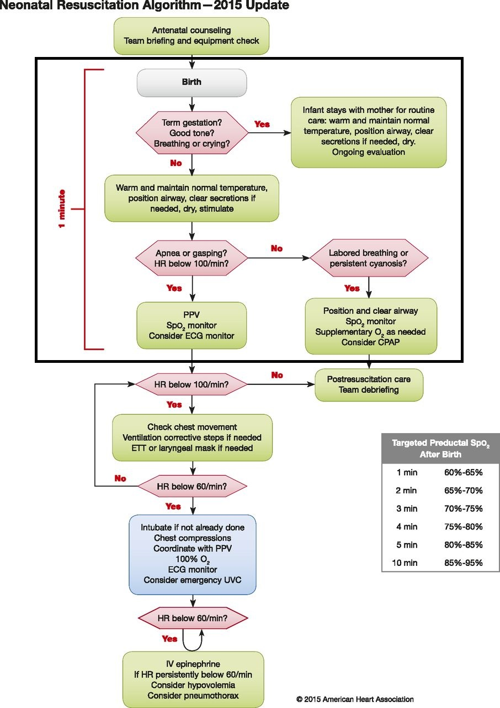
Notes:
This is an overview of the 2015 Neonatal Resuscitation Algorithm.
We will break up each important component as it pertains to the clinical scenario
Let’s focus on the first minute of the resuscitation algorithm

Slide 14
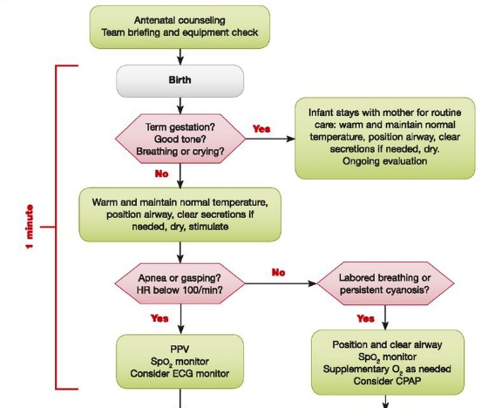
“Golden Minute”
Initial steps
Re-evaluation
Begin
Ventilation
Notes:
Golden minute: 60 seconds are allotted for completing the initial steps, reevaluating, and beginning ventilation. This is to avoid unnecessary delay in initiation of ventilation.

Slide 15
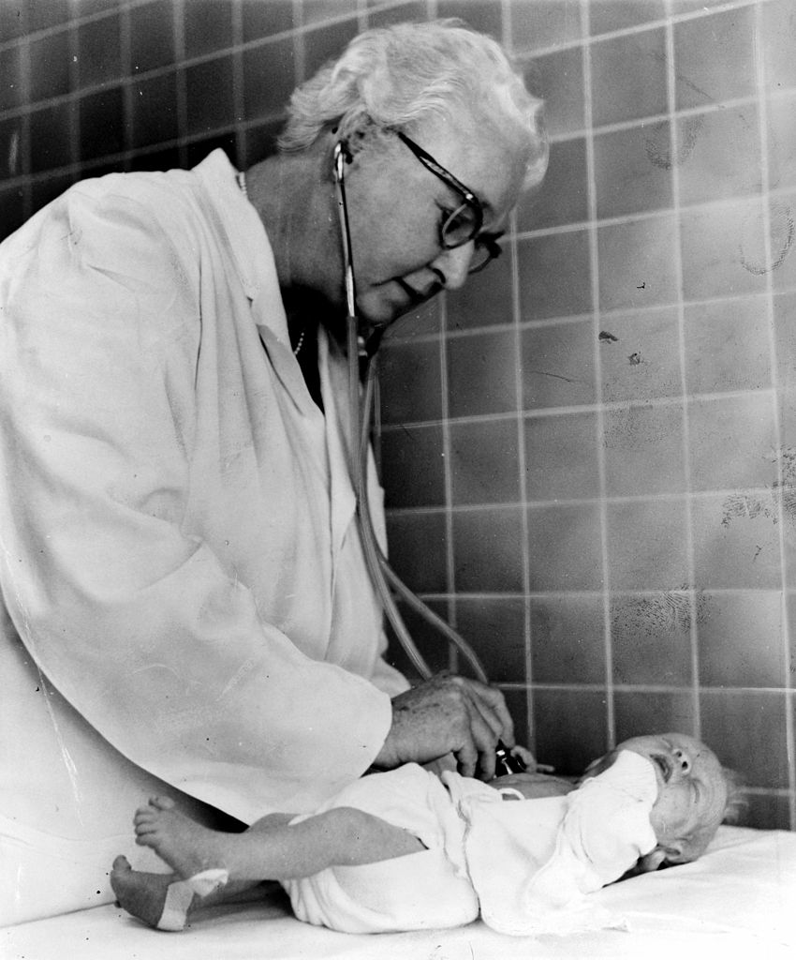
Apgar score
A method to quickly summarize the health of the newborn against infant mortality.
Generally done at 1 and 5 minutes after birth.
Apgar score is not used to determine if initial resuscitation is needed, but rather if resuscitation efforts should be continued.
https://en.wikipedia.org/wiki/Apgar_score
Notes:
Virginia Apgar, an anesthesiologist at New York–Presbyterian Hospital, developed the score in 1952 to quantify the effects of obstetric anesthesia on babies.

Slide 16
Apgar Score
Indicator |  | 0 Points | 1 Point | 2 Points
A | Activity (Muscle tone) | Absent | Flexed limbs | Active
P | Pulse | Absent | < 100 bpm | > 100 bpm
G | Grimace (reflex irritability) | Floppy | Minimal response | Prompt response
A | Appearance (Skin Color) | Blue, Pale | Pink body Blue extremities | Pink
R | Respiration | Absent | Slow and irregular | Vigorous cry
Total score: >7: Normal 4-6: fairly low <3: critical
Notes:
The Apgar score is a method to quickly summarize the health of newborn children against infant mortality. ^{38, 39}

Slide 17
Clinical Scenario
But wait, what about the umbilical cord?
Immediate or delayed umbilical cord clamping?

Slide 18
Umbilical Cord Management
Breathing or Crying ?
Delayed Cord Clamping in Preterm Infants is associated with:
less intraventricular hemorrhage (IVH)
higher blood pressure
higher blood volume
less need for transfusion
less necrotizing enterocolitis²
YES
NO
Delayed cord clamping
Clamp cord
Resuscitate
Notes:
A common practice has been to clamp the umbilical cord as soon after birth to quickly transfer the infant to the neonatal team for stabilization.
Delayed Cord Clamping in Preterm Infants is associated with less intraventricular hemorrhage (IVH) of any grade, higher blood pressure, higher blood volume, less need for transfusion after birth, and less necrotizing enterocolitis²
The only negative consequence is a slightly increased level of bilirubin, associated with more need for phototherapy
Delayed cord clamping for longer than 30 seconds is reasonable for both term and preterm infants who do not require resuscitation at birth.
Immediately after birth, infants who are breathing and crying may undergo delayed cord clamping.
Infants who are not breathing or crying should have the cord clamped so that resuscitation measures can commence promptly.

Slide 19
Umbilical Cord Management
Breathing or Crying ?
Delayed Cord Clamping in Preterm Infants is associated with:
Slightly increased level of bilirubin
Need for phototherapy
YES
NO
Delayed cord clamping
Clamp cord
Resuscitate
Notes:
A common practice has been to clamp the umbilical cord as soon after birth to quickly transfer the infant to the neonatal team for stabilization.
Delayed Cord Clamping in Preterm Infants is associated with less intraventricular hemorrhage (IVH) of any grade, higher blood pressure, higher blood volume, less need for transfusion after birth, and less necrotizing enterocolitis²
The only negative consequence is a slightly increased level of bilirubin, associated with more need for phototherapy
Delayed cord clamping for longer than 30 seconds is reasonable for both term and preterm infants who do not require resuscitation at birth.
Immediately after birth, infants who are breathing and crying may undergo delayed cord clamping.
Infants who are not breathing or crying should have the cord clamped so that resuscitation measures can commence promptly.

Slide 20
Clinical Scenario
To Summarize up to this point:
You are called to a cesarean section delivery of a 33 week infant with an estimated weight of 1.9 kg.
Post-delivery, the infant is limp, appears pale, and not crying.
Umbilical cord is clamped so that resuscitation can begin promptly.
Next, you decide to commence the initial steps of resuscitation…

Slide 21
Initial Steps
Dry the infant
Stimulate the infant to breathe
It is reasonable to place the newborn in a clean, food-grade plastic bag up to the level of the neck and swaddle them after drying.

Slide 22

Initial Steps:
Maintain Normal Temperature
Maintain temperature (36.5°C - 37.5°C)
Avoid Hypo and Hyperthermia
Hypothermia is associated with:
  Increased risk of intraventricular hemorrhage (IVH)
  Respiratory complications^{3,8,9},
  Hypoglycemia¹⁰⁻¹²
  Late-onset sepsis^{13,14}
Notes:
Temperature of the newborn should be maintained between 36.5°C and 37.5°C after birth

Slide 23
Initial Steps:
Temperature Interventions
Radiant warmers
Plastic wrap with a cap for preterm infants
Increase room temperature
Thermal mattresses
Warmed humidified resuscitation gases
The use of plastic wraps^{15,16} and skin-to-skin contact¹⁷⁻²¹ reduces hypothermia
Notes:
There is currently insufficient evidence to recommend a preference for either a rapid (0.5°C/h or greater) or slow (less than 0.5°C/h) rewarming of hypothermic newborns (temperature less than 36°C). Either approach to rewarming may be reasonable.
In a resource-limited settings, in order to maintain body temperature during the first one to two hours of life, it is reasonable to place the newborn in a clean, food-grade plastic bag up to the level of the neck and swaddle them after drying.

Slide 24
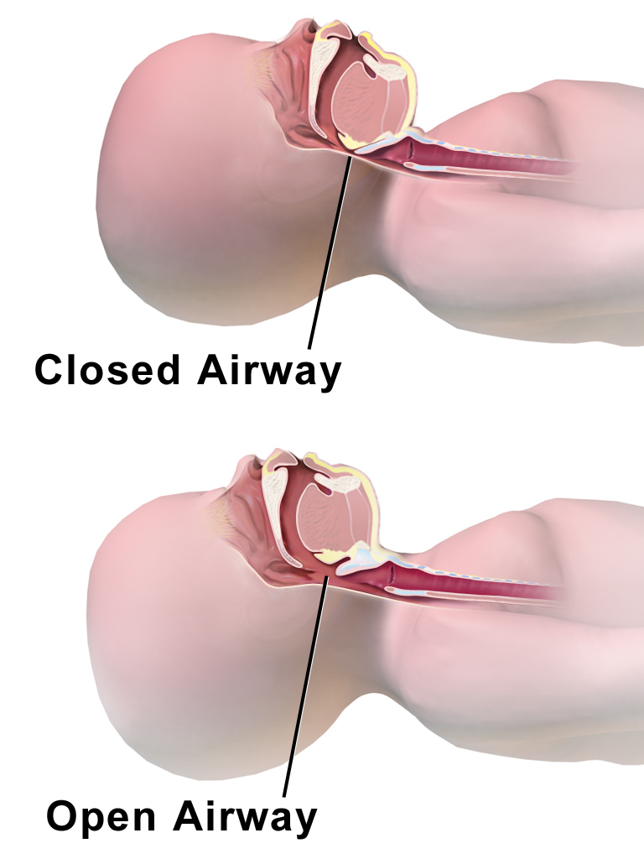
Initial Steps:
“Snifﬁng” Position
https://commons.wikimedia.org/wiki/Category:Airway_management#/media/File:CPR_Infant_Closed_vs_Open_Airway.png

Slide 25
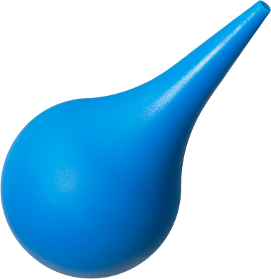
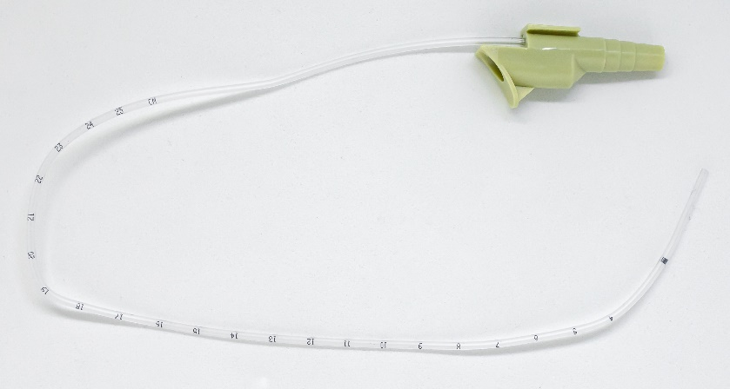
Initial Steps:
Clear Secretions
A bulb syringe or suction catheter may be used
Suctioning immediately after birth may be considered only if the airway appears obstructed or if Positive Pressure Ventilation (PPV) is required
Avoid unnecessary suctioning, which may induce bradycardia
Notes:
Author’s pictures

Slide 26
Clinical Scenario
You have undertaken the following steps of the initial resuscitation:
Dried the infant
Maintained normothermia
Placed the infant in the “sniffing position”
Cleared secretions
You noticed thick, green, meconium secretions!

Slide 27
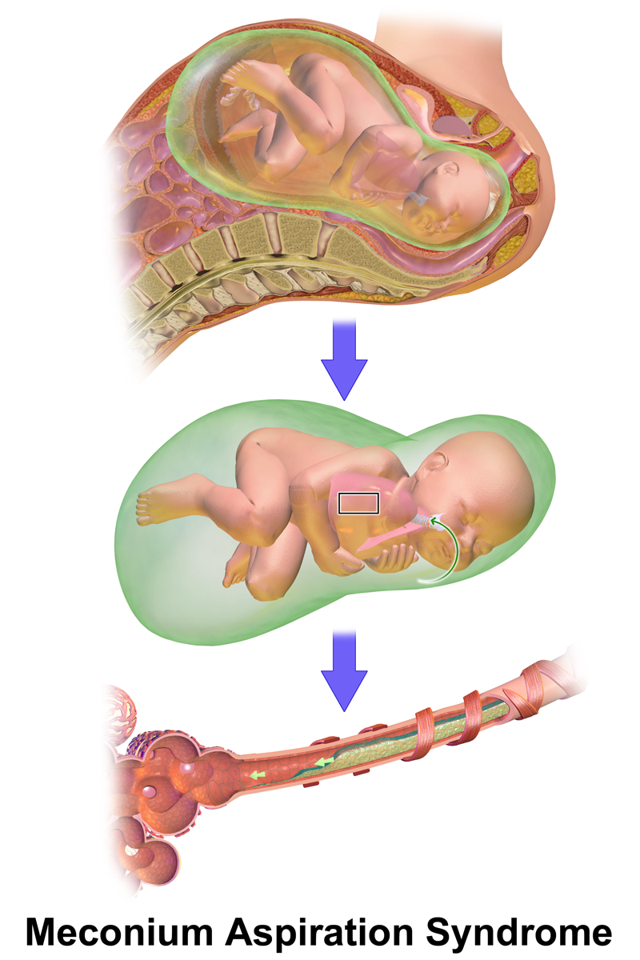
Clearing the Airway: Meconium
Respiratory effort?
Muscle tone?
Poor
Good
Ineffective breathing
Initial steps of newborn care
Or
HR <100 bpm
Clear mouth and nose
*Routine intubation for tracheal suction is not recommended²³⁻²⁶
PPV
https://commons.wikimedia.org/wiki/File:Meconium_aspiration_syndrome_(MAS).png
Notes:
Oropharyngeal suctioning followed by routine intubation and suctioning of the trachea at birth was accepted practice for many years.
Newborns born through meconium-stained amniotic ﬂuid who are vigorous at birth do not beneﬁt from interventions²²
Delays in providing bag-mask ventilation should be avoided.
If muscle tone is poor with inadequate breathing efforts, the initial steps of resuscitation should be completed under the radiant warmer.

Slide 28
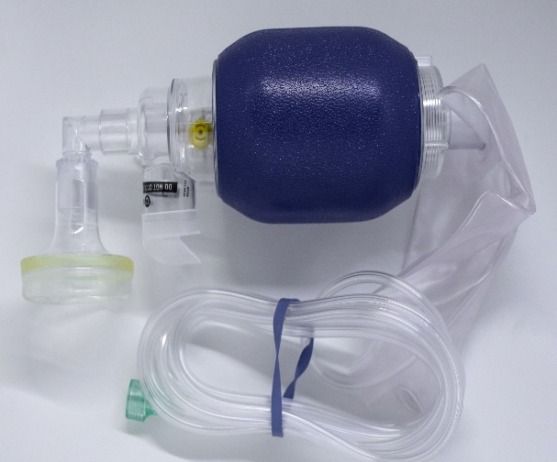
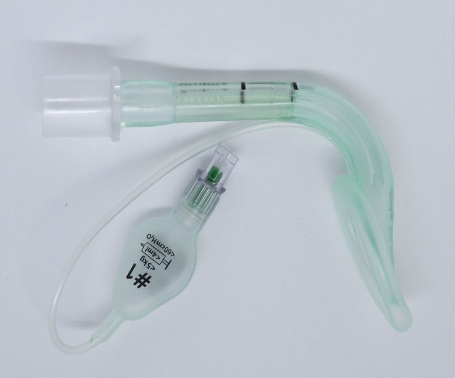
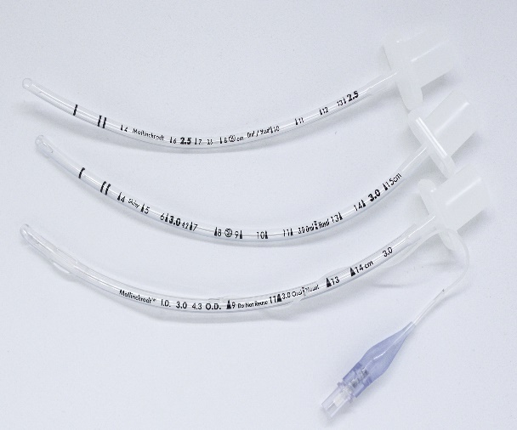
Clinical Scenario
You are about to provide positive pressure ventilation (PPV). The nurse in the room asked you about your device preference…

Slide 29
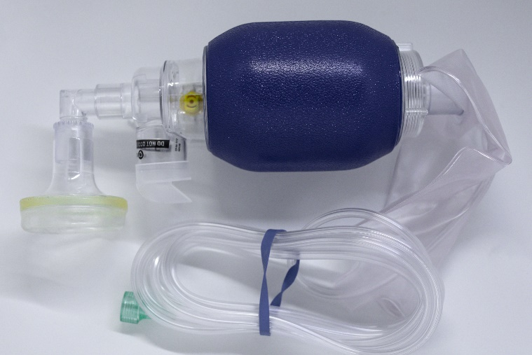
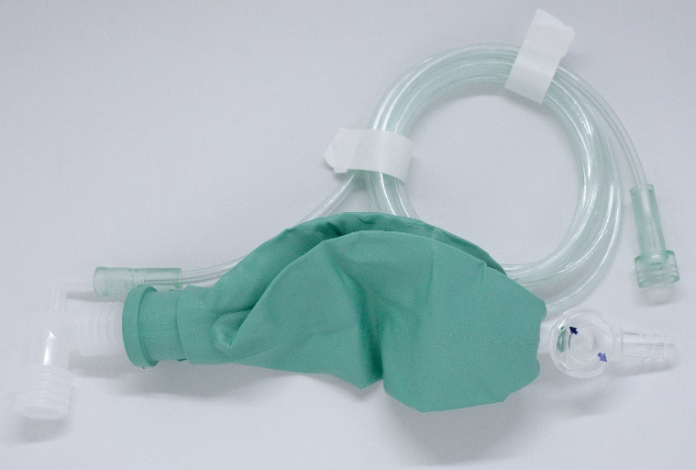
Positive Pressure Ventilation (PPV)
Standard recommended treatment for apneic infants
5 cmH₂O PEEP is suggested
Delivered effectively with:
  A ﬂow-inﬂating bag
  Self-inﬂating bag
  T-piece resuscitator^{27,28}
Notes:
Administration of PPV is the standard recommended treatment for both preterm and term infants who are apneic
5 cmH2O PEEP is suggested
PPV can be delivered effectively with a ﬂow-inﬂating bag, self-inﬂating bag, or T-piece resuscitator^{27,28}
Note: UK algorithm recommends 5 Inflation breaths at 30 cmH20 (20-25 in preemies) to expand the lungs.

Slide 30
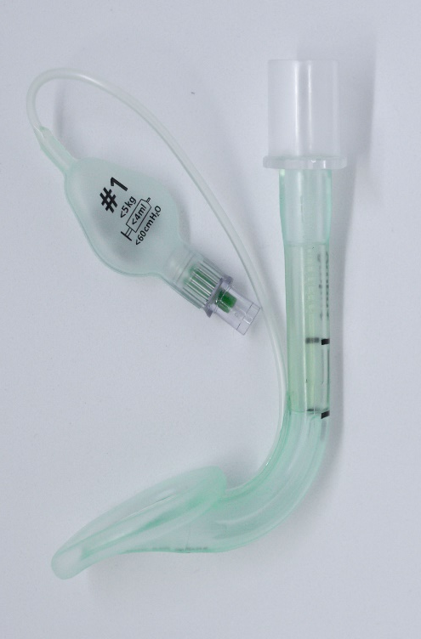
PPV: Supraglottic Airways (SGAs)
SGAs can facilitate effective ventilation for newborns > 34 weeks
Used when face-mask ventilation, or tracheal intubation is unsuccessful²⁹
Data for use is limited for infants under 34 weeks and/or under 2000 g
Notes:
Please note: It is the experience of the authors that SGAs used in newborns tend to dislodge very easily. This could be due to number of factors which include the overall smaller size of the SGA, as well as the anatomical differences between adults and neonates.

Slide 31
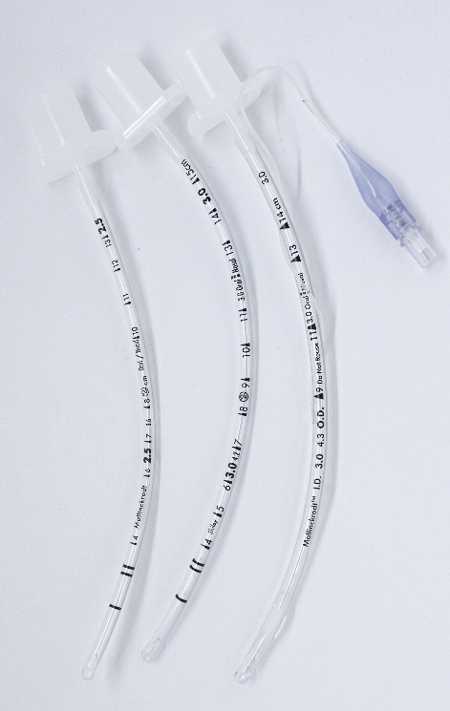
PPV: Endotracheal Tube
Indications:
Ventilation is ineffective or prolonged
Chest compressions are performed
Special circumstances such as congenital diaphragmatic hernia
The best indicator of successful endotracheal intubation is a prompt increase in heart rate
Notes:
Indicated when bag-mask ventilation is ineffective or prolonged, or when chest compressions are performed.
Special circumstances such as congenital diaphragmatic hernia may also require the use of an endotracheal tube
The best indicator of successful endotracheal intubation with successful inﬂation and aeration of the lungs is a prompt increase in heart rate.
Exhaled CO2 detection remains the most reliable method of conﬁrmation of correct endotracheal tube placement.^{29,30}
Failure to detect exhaled CO2 in neonates with adequate cardiac output strongly suggests esophageal intubation.
Keep in mind that poor or absent pulmonary blood ﬂow (eg, during cardiac arrest) may result in failure to detect exhaled CO2.
Additional indicators of correct endotracheal tube placement include: chest movement, presence of equal breath sounds bilaterally, and condensation in the endotracheal tube.

Slide 32
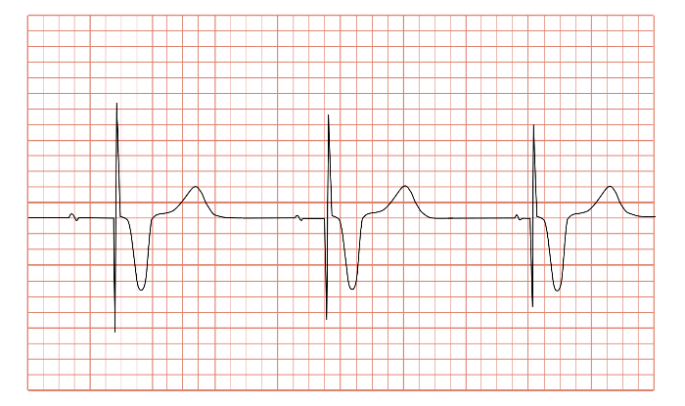
Clinical Scenario
Post completion of the initial resuscitation steps, you decide to evaluate the effectiveness of the newborn’s spontaneous respiratory effort.
How can you achieve this step?
Hint:
Notes:
ECG reflects heart rate reading but not cardiac output - need extra signs to do this

Slide 33
Clinical Scenario
Answer: Immediately after birth, assessment of the newborn’s heart rate is used to evaluate the effectiveness of spontaneous respiratory effort.
3-lead ECG is rapid, accurate, reliable, and easy to apply.
Increase in the newborn’s heart rate is considered the most sensitive indicator of successful response to each intervention.
Notes:
In previous guidelines, auscultation of the precordium was recommended as the preferred physical examination method, and pulse oximetry was recommended as an adjunct to providing a noninvasive, rapid, and continuous method for assessment of the heart rate during resuscitation.
The 2015 ILCOR systematic review findings suggest that clinical assessment is both unreliable and inaccurate. ECG was more likely to detect the newborn’s heart rate during the ﬁrst minute of life. The majority of the studies did not report any difﬁculties with applying the leads. Pulse oximetry tends to underestimate the newborn’s heart rate, which could lead to potentially unnecessary interventions.

Slide 34
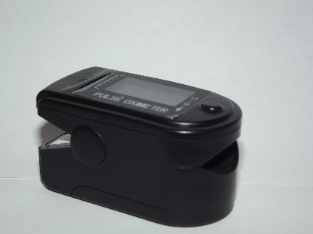
Assessment of Oxygen Need
Pulse Oximetry use is recommended in the following settings:
When resuscitation is anticipated
PPV is administered
Central cyanosis persists beyond the first 5-10 minutes of life
Supplemental oxygen is administered

Slide 35

Administration of Oxygen
It is reasonable to initiate resuscitation with air (21% Oxygen at sea level)
Resuscitation of preterm newborns of less than 35 weeks of gestation should be initiated with low oxygen as well (21% to 30%)
Initiating resuscitation of preterm newborns with high oxygen (65% or greater) is NOT recommended
Notes:
It is reasonable to initiate resuscitation with air (21% Oxygen at sea level)
The oxygen concentration should be titrated to achieve preductal oxygen saturation approximating the interquartile range measured in healthy term infants
Resuscitation of preterm newborns of less than 35 weeks of gestation should be initiated with low oxygen as well (21% to 30%)
Initiating resuscitation of preterm newborns with high oxygen (65% or greater) is not recommended

Slide 36
Targeted Preductal SpO₂ After Birth
1 min | 60% - 65%
2 min | 65% - 70%
3 min | 70% - 75%
4 min | 75% - 80%
5 min | 80% - 85%
10 min | 85% - 95%
The oxygen concentration should be titrated to achieve preductal oxygen saturation approximating the interquartile range measured in healthy term infants
Notes:
Preductal oxygen saturation is measured on the right hand
The oxygen concentration should be titrated to achieve preductal oxygen saturation approximating the interquartile range measured in healthy term infants.
Initiating resuscitation of preterm newborns with high oxygen (65% or greater) is not recommended

Slide 37
Clinical Scenario
Post completion of the initial resuscitation steps, you evaluate the effectiveness of the newborn’s spontaneous respiratory efforts, and notice that the HR remains under 100 bpm.
PPV is initiated using a ﬂow-inﬂating bag. Unfortunately, the HR continues to decline and is now under 60 bpm. You decide to intubate.
What is the next step in resuscitation?

Slide 38
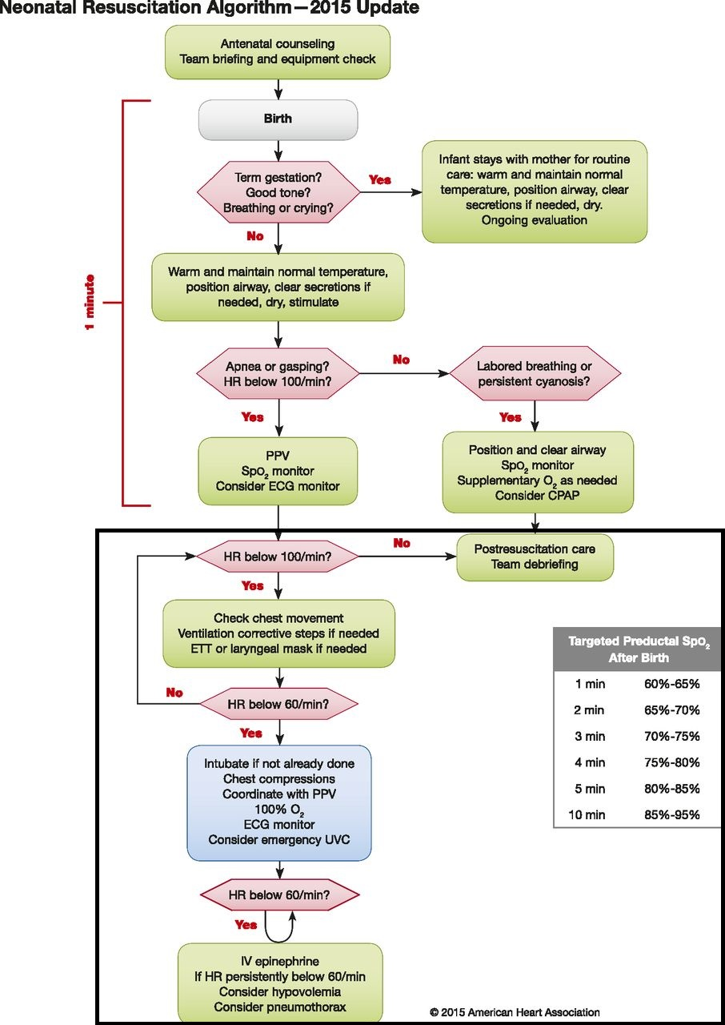

Slide 39
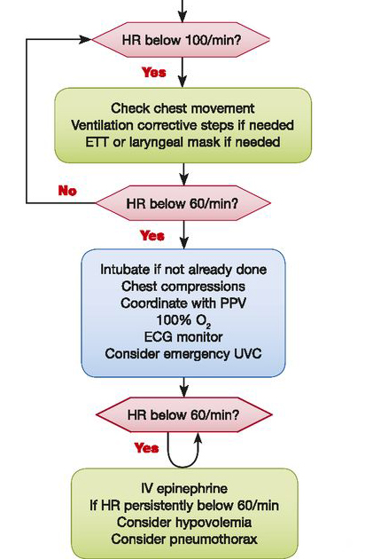

Slide 40
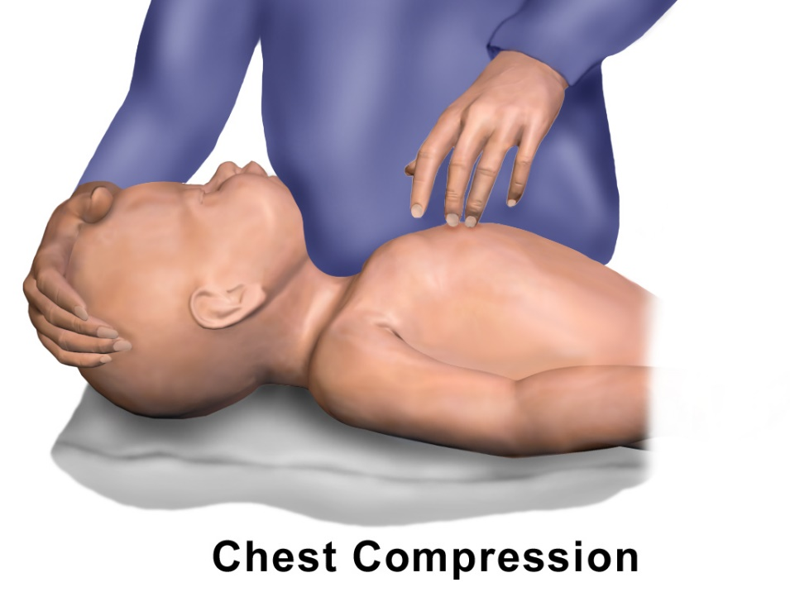
Chest Compressions
Heart rate less than 60/min despite adequate ventilation
3:1 ratio of compressions to ventilation
Increase the oxygen concentration to 100%
https://commons.wikimedia.org/wiki/File:CPR_Infant_Chest_Compression.png
Notes:
If the heart rate is less than 60/min despite adequate ventilation, chest compressions are indicated
Compressions are delivered on the lower third of the sternum to a depth of approximately one third of the anterior-posterior diameter of the chest³¹
The preferred method is the 2-thumb technique, which generates higher blood pressure and coronary perfusion pressure³²⁻³⁴
During ventilation, the chest should be allowed to re-expand fully during relaxation, but the rescuer’s thumbs should not leave the chest.
Compressions and ventilations should be coordinated to avoid simultaneous delivery.
90 compressions and 30 breaths to achieve approximately 120 events per minute^{35,36}

Slide 41
Clinical Scenario
Effective chest compressions are underway.
You are reminded to rule out other causes such as…
Pneumothorax, and hypovolemia.

Slide 42
Medications
Rarely indicated.
Bradycardia is usually due to hypoxemia.
Establishing adequate ventilation is the most important step.
Indication: Heart rate less than 60/min despite adequate ventilation with 100% oxygen, and chest compressions.

Slide 43
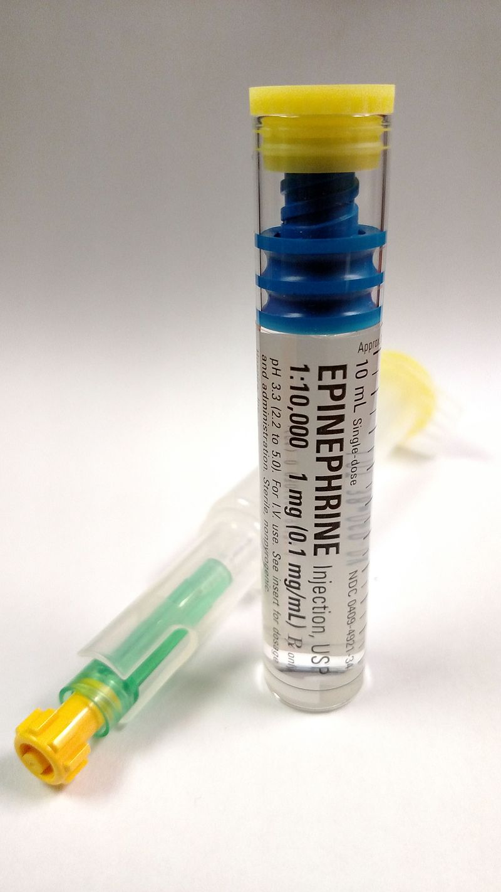
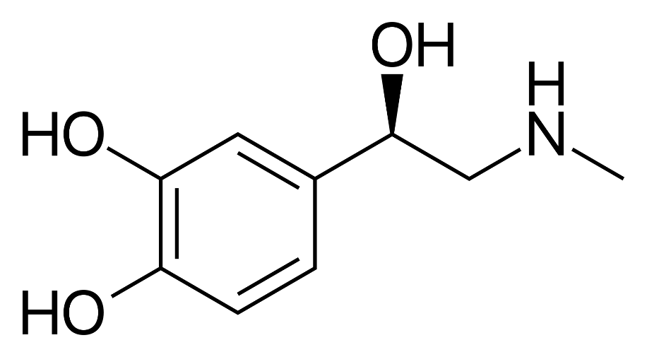
Medications: Epinephrine
Dose: 0.01 to 0.03mg/kg of 1:10000 epinephrine
ETT dose: 0.05 to 0.1 mg/kg

Slide 44
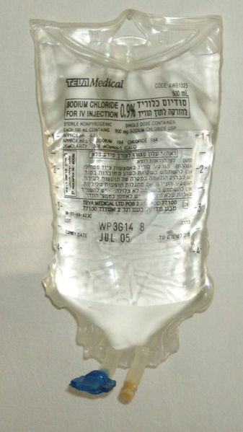
Medications: Volume
Isotonic crystalloid solution or blood
Dose: 10 mL/kg
Notes:
Indicated when blood loss is known or suspected and the infant’s heart rate has not responded adequately to other resuscitative measures
Findings include pale skin, poor perfusion, and weak pulses.
Caution: rapid infusions of large volumes have been associated with IVH in premature infants³⁷

Slide 45
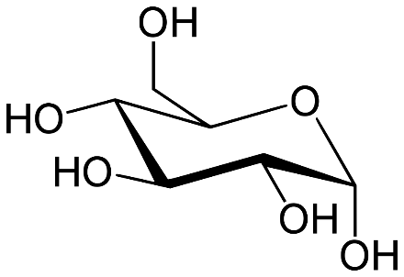
Medications: Glucose
Role of glucose in modulating neurologic outcome after hypoxia-ischemia:
Lower glucose levels were associated with an increased risk for brain injury, while increased glucose levels may be protective.
A specific protective target [glucose] range cannot be recommended at this time
Notes:
Infants who are preterm or require significant resuscitation should be monitored and treated to maintain blood glucose in the normal range.
An infusion of 10% glucose rather than repeated boluses is usually best at treating low blood glucose values and maintaining glucose in the normal range.

Slide 46
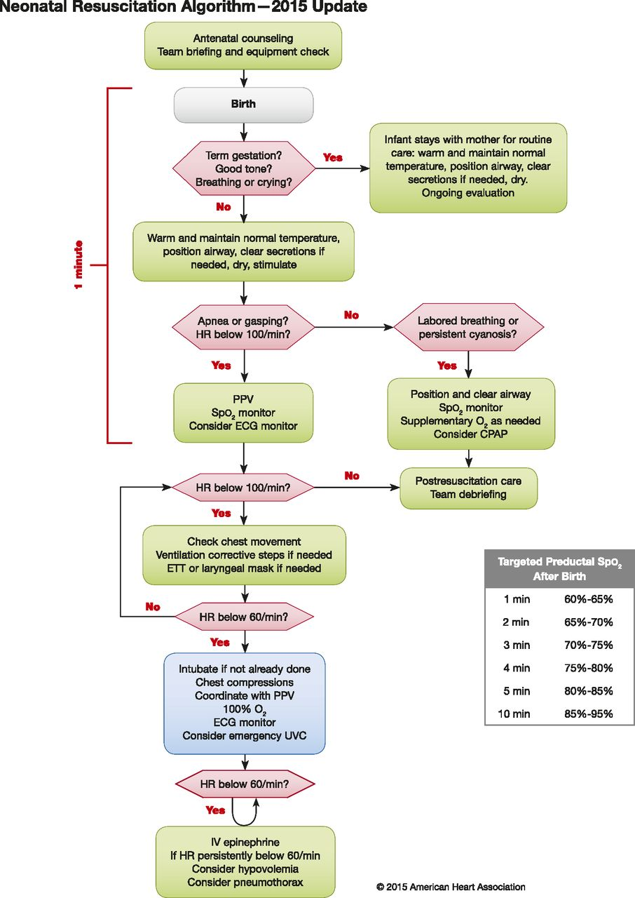
Notes:
Overview of the resuscitation process

Slide 47
Post Resuscitation Care
Close monitoring and anticipatory care should be provided for infants who have returned to normal after resuscitation

Slide 48
Conclusions
Initial step in stabilization is to warm and maintain normal temperature. Position the patient in the “sniffing” position, clear secretions only if copious. Dry and stimulate
Ventilate and oxygenate
Initiate chest compressions if HR < 60 bpm
Administer medications such as epinephrine and/or fluids if the above interventions are not enough
Notes:
Establishing adequate ventilation is the most important step

Slide 49
References
Barber CA, Wyckoff MH. Use and efﬁcacy of endotracheal versus intravenous epinephrine during neonatal cardiopulmonary resuscitation in the delivery room. Pediatrics. 2006;118:1028–1034. doi: 10. 1542/peds.2006-0416.
https://volunteer.heart.org/apps/pico/Pages/PublicComment.aspx?q=787.
Boo NY, Guat-Sim Cheah I; Malaysian National Neonatal Registry. Admission hypothermia among VLBW infants in Malaysian NICUs. J Trop Pediatr. 2013;59:447–452. doi: 10.1093/tropej/fmt051.
García-Muñoz Rodrigo F, Rivero Rodríguez S, Siles Quesada C. [Hypothermia risk factors in the very low weight newborn and associated morbidity and mortality in a neonatal care unit]. An Pediatr (Barc). 2014;80:144–150. doi: 10.1016/j.anpedi.2013. 06.029.
Miller SS, Lee HC, Gould JB. Hypothermia in very low birth weight infants: distribution, risk factors and outcomes. J Perinatol. 2011;31 suppl 1:S49–S56. doi: 10.1038/jp.2010.177.
Gleissner M, Jorch G, Avenarius S. Risk factors for intraventricular hemorrhage in a birth cohort of 3721 premature infants. J Perinat Med. 2000;28:104–110. doi: 10.1515/JPM.2000.013.
Van de Bor M, Van Bel F, Lineman R, Ruys JH. Perinatal factors and periventricularintraventricular hemorrhage in preterm infants. Am J Dis Child. 1986;140:1125–1130.

Slide 50
References:
Harms K, Herting E, Kron M, Schill M, Schiffmann H. [Importance of pre- and perinatal risk factors in respiratory distress syndrome of premature infants. A logical regression analysis of 1100 cases]. Z Geburtshilfe Neonatol. 1997;201:258–262.
Zayeri F, Kazemnejad A, Ganjali M, Babaei G, Khanafshar N, Nayeri F. Hypothermia in Iranian newborns. Incidence, risk factors and related complications. Saudi Med J. 2005;26:1367–1371.
Pal DK, Manandhar DS, Rajbhandari S, Land JM, Patel N, de L Costello AM. Neonatal hypoglycaemia in Nepal 1. Prevalence and risk factors. Arch Dis Child Fetal Neonatal Ed. 2000;82:F46–F51.
Anderson S, Shakya KN, Shrestha LN, Costello AM. Hypoglycaemia: a common problem among uncomplicated newborn infants in Nepal. J Trop Pediatr. 1993;39:273–277.
Sasidharan CK, Gokul E, Sabitha S. Incidence and risk factors for neonatal hypoglycaemia in Kerala, India. Ceylon Med J. 2004;49:110–113.
Mullany LC. Neonatal hypothermia in lowresource settings. Semin Perinatol. 2010; 34:426–433. doi: 10.1053/j.semperi.2010.09.007.
Levi S, Taylor W, Robinson LE, Levy LI. Analysis of morbidity and outcome of infants weighing less than 800 grams at birth. South Med J. 1984;77:975–978.

Slide 51
References:
Belsches TC, Tilly AE, Miller TR, Kambeyanda RH, Leadford A, Manasyan A, Chomba E, Ramani M, Ambalavanan N, Carlo WA. Randomized trial of plastic bags to prevent term neonatal hypothermia in a resource-poor setting. Pediatrics. 2013; 132:e656–e661. doi: 0.1542/peds.2013-0172.
Leadford AE, Warren JB, Manasyan A, Chomba E, Salas AA, Schelonka R, Carlo WA. Plastic bags for prevention of hypothermia in preterm and low birth weight infants. Pediatrics. 2013;132:e128–e134. doi: 10.1542/peds.2012-2030.
Bergman NJ, Linley LL, Fawcus SR. Randomized controlled trial of skin-to-skin contact from birth versus conventional incubator for physiological stabilization in 1200- to 2199-gram newborns. Acta Paediatr. 2004;93:779–785.
Fardig JA. A comparison of skin-to-skin contact and radiant heaters in promoting neonatal thermoregulation. J Nurse Midwifery. 1980;25:19–28.
Nimbalkar SM, Patel VK, Patel DV, Nimbalkar AS, Sethi A, Phatak A. Effect of early skin-to-skin contact following normal delivery on incidence of hypothermia in neonates more than 1800 g: randomized control trial. J Perinatol. 2014;34:364–368. doi: 10.1038/jp.2014.15.
Nimbalkar SM, Patel VK, Patel DV, Nimbalkar AS, Sethi A, Phatak A. Effect of early skin-to-skin contact following normal delivery on incidence of hypothermia in neonates more than 1800 g: randomized control trial. J Perinatol. 2014;34:364–368. doi: 10.1038/jp.2014.15.

Slide 52
References:
Gouchon S, Gregori D, Picotto A, Patrucco G, Nangeroni M, Di Giulio P. Skin-to-skin contact after cesarean delivery: an experimental study. Nurs Res. 2010;59:78–84. doi: 10.1097/NNR.0b013e3181d1a8bc.
Vain NE, Szyld EG, Prudent LM, Wiswell TE, Aguilar AM, Vivas NI. Oropharyngeal and nasopharyngeal suctioning of meconiumstained neonates before delivery of their shoulders: multicentre, randomised controlled trial. Lancet. 2004;364:597–602. doi: 10.1016/S0140-6736(04)16852-9.
Al Takroni AM, Parvathi CK, Mendis KB, Hassan S, Reddy I, Kudair HA. Selective tracheal suctioning to prevent meconium aspiration syndrome. Int J Gynaecol Obstet. 1998;63:259–263.
Hageman JR, Conley M, Francis K, Stenske J, Wolf I, Santi V, Farrell EE. Delivery room management of meconium staining of the amniotic ﬂuid and the development of meconium aspiration syndrome. J Perinatol. 1988;8:127–131.
Suresh GK, Sarkar S. Delivery room management of infants born through thin meconium stained liquor. Indian Pediatr. 1994;31:1177–1181.
Chettri S, Adhisivam B, Bhat BV. Endotracheal suction for nonvigorous neonates born through meconium stained amniotic ﬂuid: a randomized controlled trial. J Pediatr. 2015;166:1208–1213.e1. doi: 10.1016/ j.jpeds.2014.12.076.

Slide 53
References:
Dawson JA, Schmölzer GM, Kamlin CO, Te Pas AB, O’Donnell CP, Donath SM, Davis PG, Morley CJ. Oxygenation with T-piece versus self-inﬂating bag for ventilation of extremely preterm infants at birth: a randomized controlled trial. J Pediatr. 2011; 158:912–918.e1. doi: 10.1016/j.jpeds.2010. 12.003.
Szyld E, Aguilar A, Musante GA, Vain N, Prudent L, Fabres J, Carlo WA; Delivery Room Ventilation Devices Trial Group. Comparison of devices for newborn ventilation in the delivery room. J Pediatr. 2014;165: 234–239.e3. doi: 10.1016/j.jpeds. 2014.02.035.
Perlman JM, Wyllie J, Kattwinkel J, Atkins DL, Chameides L, Goldsmith JP, Guinsburg R, Hazinski MF, Morley C, Richmond S, Simon WM, Singhal N, Szyld E, Tamura M, Velaphi S; Neonatal Resuscitation Chapter Collaborators. Part 11: neonatal resuscitation: 2010 International Consensus on Cardiopulmonary Resuscitation and Emergency Cardiovascular Care Science With Treatment Recommendations. Circulation. 2010;122(suppl 2): S516–S538. doi: 10.1161/CIRCULATIONAHA.110.971127.
Wyllie J, Perlman JM, Kattwinkel J, Atkins DL, Chameides L, Goldsmith JP, Guinsburg R, Hazinski MF, Morley C, Richmond S, Simon WM, Singhal N, Szyld E, Tamura M, Velaphi S; Neonatal Resuscitation Chapter Collaborators. Part 11: neonatal resuscitation: 2010 International Consensus on Cardiopulmonary Resuscitation and Emergency Cardiovascular Care Science With Treatment Recommendations. Resuscitation. 2010;81 suppl 1:e260–e287. doi: 10.1016/j.resuscitation.2010.08.029.

Slide 54
References:
Meyer A, Nadkarni V, Pollock A, Babbs C, Nishisaki A, Braga M, Berg RA, Ades A. Evaluation of the Neonatal Resuscitation Program’s recommended chest compression depth using computerized tomography imaging. Resuscitation. 2010;81: 544–548.
Christman C, Hemway RJ, Wyckoff MH, Perlman JM. The two-thumb is superior to the two-ﬁnger method for administering chest compressions in a manikin model of neonatal resuscitation. Arch Dis Child Fetal Neonatal Ed. 2011;96:F99–F101.
Dorfsman ML, Menegazzi JJ, Wadas RJ, Auble TE. Two-thumb vs. two-ﬁnger chest compression in an infant model of prolonged cardiopulmonary resuscitation. Acad Emerg Med. 2000;7:1077–1082.
Houri PK, Frank LR, Menegazzi JJ, Taylor R. A randomized, controlled trial of twothumb vs two-ﬁnger chest compression in a swine infant model of cardiac arrest [see comment]. Prehosp Emerg Care. 1997;1:65–67.
Hemway RJ, Christman C, Perlman J. The 3:1 is superior to a 15:2 ratio in a newborn manikin model in terms of quality of chest compressions and number of ventilations. Arch Dis Child Fetal Neonatal Ed. 2013;98:F42–F45.
Solevåg AL, Dannevig I, Wyckoff M, Saugstad OD, Nakstad B. Return of spontaneous circulation with a compression: ventilation ratio of 15:2 versus 3:1 in newborn pigs with cardiac arrest due to asphyxia. Arch Dis Child Fetal Neonatal Ed. 2011;96:F417–F421.

Slide 55
References:
Kattwinkel J, Perlman JM, Aziz K, Colby C, Fairchild K, Gallagher J, Hazinski MF, Halamek LP, Kumar P, Little G, McGowan JE, Nightengale B, Ramirez MM, Ringer S, Simon WM, Weiner GM, Wyckoff M, Zaichkin J. Part 15: neonatal resuscitation: 2010 American Heart Association Guidelines for Cardiopulmonary Resuscitation and Emergency Cardiovascular Care. Circulation. 2010;122(suppl 3):S909–S919. doi: 10.1161/CIRCULATIONAHA.110.971119.
APGAR V. A proposal for a new method of evaluation of the newborn infant. Curr Res Anesth Analg. 1953;32(4):260-7.
Finster M, Wood M. The Apgar score has survived the test of time. Anesthesiology. 2005;102(4):855-7.

