Slide 1
Mechanical Ventilation in Infants and Children
Proshad Efune, MD
Iqbal Ahmed, MBBS FRCA
University of Texas
Southwestern Medical Center
Children’s Health System of Texas
Dallas, Texas

Slide 2
Disclosures
No relevant financial relationships

Slide 3
Learning Objectives
Describe the physiology and indications for mechanical ventilation
Distinguish anesthesia and ICU ventilators used for children
Describe the most commonly used modes of mechanical ventilation
Recognize strategies to avoid complications of mechanical ventilation

Slide 4
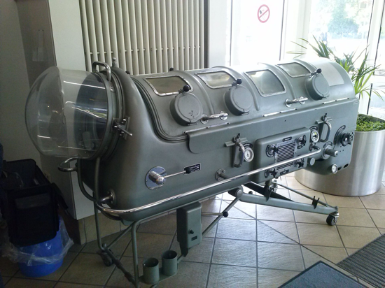
Controlled Ventilation: A Life Saving Innovation
Negative Pressure Ventilation
The body’s “natural” way to ventilate
Historically used in polio epidemics: e.g., “Iron lung”
Positive Pressure Ventilation (PPV): used in OR and ICU
By Kuebi = Armin Kübelbeck - Own work, CC BY 3.0, https://commons.wikimedia.org/w/index.php?curid=28965570

Slide 5
Physiology of PPV
Positive pressure is used to actively inflate the lungs
P_{rs} ≥ P_{elastic} + P_{resistance}
P_{rs} = P_{awo} + P_{mus}
j
Where P_{rs} = Pressure supplied to the respiratory system
Expiration is passive
Notes:
Pressure supplied to the respiratory system (P_{rs}) must exceed the opposing elastic (P_{elastic}) and resistance forces (P_{resistance}) of the lungs, chest wall, and conducting airways
P_{rs} of a patient on a ventilator is the sum of the pressure generated by the ventilator measured at the airway (P_{awo} ) and the pressure developed by the respiratory muscles (P_{mus})
P_{mus} is equal to zero if a patient is on full vent support
P_{elastic} = elastic forces of the lungs, chest wall, and conducting airways
P_{resistance} = resistive forces of the lungs, chest wall, and conducting airways
P_{awo} = pressure generated by the ventilator measured at the airway
P_{mus} = pressure developed by the respiratory muscles

Slide 6
Indications for Mechanical Ventilation
Hypoxemic or hypercarbic respiratory failure
Neuromuscular weakness
Decreased respiratory drive
To decrease work of breathing in patients with shock
To decrease afterload in patients with cardiac failure
Neurologic impairment (Intubate for Airway protection)
Need for controlled or supported ventilation during anesthesia

Slide 7
Cardiovascular Effects of PPV
Inspiration with positive pressure ventilation increases intrathoracic pressure
↑ RA pressure → ↓ venous return → ↓ RV stroke volume
↓ LV afterload: LV pumps against trans-mural pressure of the aorta
Transmural pressure = Intravascular pressure – intrathoracic pressure
PEEP → ↓ venous return → ↓ cardiac output
Positive pressure slightly decreases ventilation-perfusion (V-Q) matching

Slide 8
Simplest Ventilator: Manual Ventilation
  Components:
    Breathing system: e. g. Ambu Bag
    Fresh gas flow: oxygen source or air entrainment
    Reservoir bag
    Adjustable pressure limiting valve (APL) or an Ambu-type valve
Can be delivered via face mask, LMA, ETT, or tracheostomy

Slide 9
Manual Ventilation
Advantages | Disadvantages
Low cost/low tech | Imprecise
Ubiquitous availability | Operator fatigue
May be lifesaving in resource limited settings | Single provider may be unable to perform other important tasks
Practical for short periods

Slide 10
Problems with Older Anesthesia Machine Ventilators
Unable to deliver small tidal volumes precisely
Don’t function well at higher respiratory rates
Offer little more than volume-controlled mode
Changes in fresh gas flows can change delivered tidal volumes

Slide 11
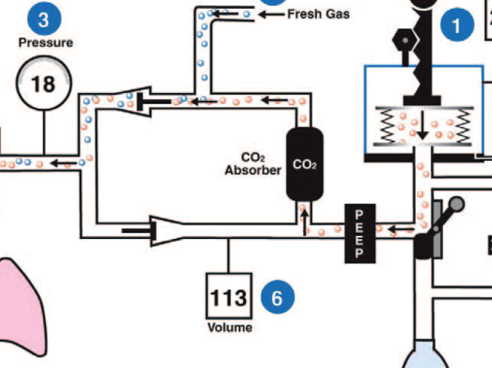
Ventilators on Older Anesthesia Machines
Schematic of a traditional anesthesia machine design indicating gas flows during mechanical inspiration
The set tidal volume enters the bellows compartment (1), but the tidal volume delivered to the patient (4) is altered because of circuit compliance and fresh gas flows (2)
From “Feldman JM. Optimal Ventilation of the Anesthetized Pediatric Patient. Anesth Analg. 2015;120(1):165-175”

Slide 12
Ventilators on Older Anesthesia Machines
Actual delivered tidal volume
set tidal volume
inspiratory pressure
circuit compliance
inspiratory time
fresh gas flow
Notes:
These are the factors affecting delivered tidal volume on older anesthesia machines

Slide 13
Newer Anesthesia Machine Ventilators
Have multiple modes available:
  Pressure Support
  Pressure Control
  Volume Control-SIMV
  Pressure Regulated Volume Control (Auto-Flow or Volume Guarantee)
Can more precisely deliver small tidal volumes and higher respiratory rates suitable for infants
Can compensate for circuit compliance and leaks and separate delivered tidal volumes from fresh gas flows

Slide 14
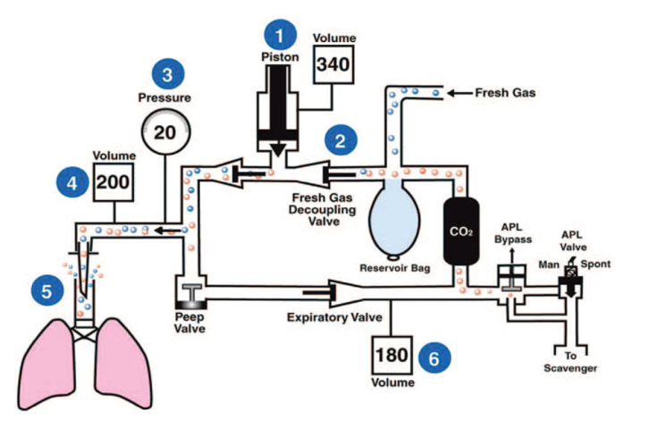
Ventilators on Newer Anesthesia Machines
Modern anesthesia ventilator capable of delivering the set tidal volume to the patient’s airway using compliance compensation and eliminating the interaction between fresh gas flow and tidal volume
The ventilator delivers a larger volume to compensate for circuit compliance (1) so that the set volume is delivered to the airway (4)
Fresh gas cannot enter the circuit during inspiration and influence tidal volume because of a valve between the fresh gas flow and the ventilator (2)
From “Feldman JM. Optimal Ventilation of the Anesthetized Pediatric Patient. Anesth Analg. 2015;120(1):165-175”

Slide 15
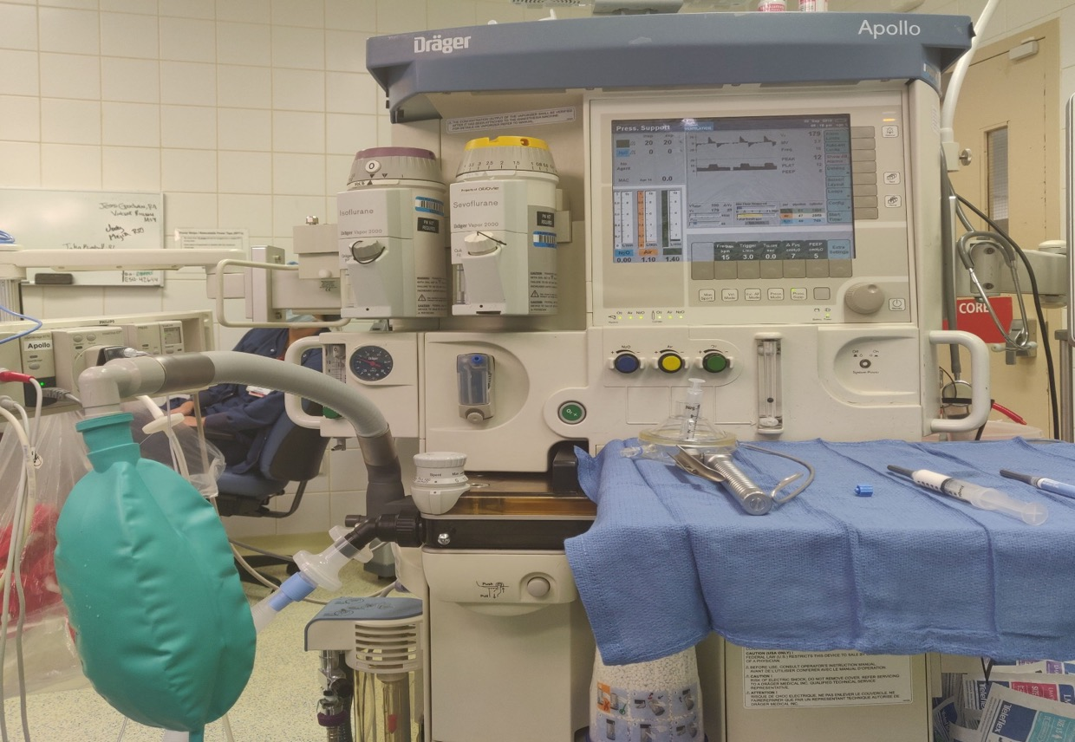
Modern Anesthesia Workstation
Vaporizers
Volumes/pressure-flow monitoring
Vent Modes
APL valve
Reservoir bag
CO2 Absorber

Slide 16
Regardless of how sophisticated the OR ventilator is, a backup manual system should always be ready in case of mechanical/electrical or gas supply failure

Slide 17
Using Older Anesthesia Machine Ventilators For Infants
If pressure-controlled mode available, set initial pressure limit low (< 15 cm H₂O)
Set appropriate respiratory rate and fresh gas flow
Watch chest excursion, auscultate, and monitor expired tidal volume and ETCO₂ (if available)
Slowly increase pressure limit, if necessary, to achieve desired results
If available, use arterial blood gas to confirm adequacy of ventilation when ETCO₂ is not available

Slide 18
Using Older Anesthesia Machine Ventilators For Infants
If pressure-controlled mode not available, set inspiratory time and expiratory pause to obtain desired respiratory rate appropriate for age
Set inspiratory flow rate low and slowly increase to achieve desired pressure limit on Paw dial
If available, use arterial blood gas to confirm adequacy of ventilation when ETCO₂ is not available

Slide 19
Using Older Anesthesia Machine Ventilators For Infants: Caution
Vigilance is required when ventilating infants on older anesthesia machines
Changes in airway compliance or lung/chest wall compliance can occur intraoperatively, increasing or decreasing the delivered tidal volume
Using appropriately sized CUFFED endotracheal tubes will decrease the leak and increase the accuracy of delivering tidal volumes in infants

Slide 20
Fundamental Principles
Use the lowest airway pressure, FiO₂ and tidal volume necessary to obtain desired gas exchange
Take measures and practice vigilance to avoid lung injury and ensure adequate ventilation
Minimize apparatus dead space for optimal gas exchange (circuit design, ETT length, connectors, valves)

Slide 21
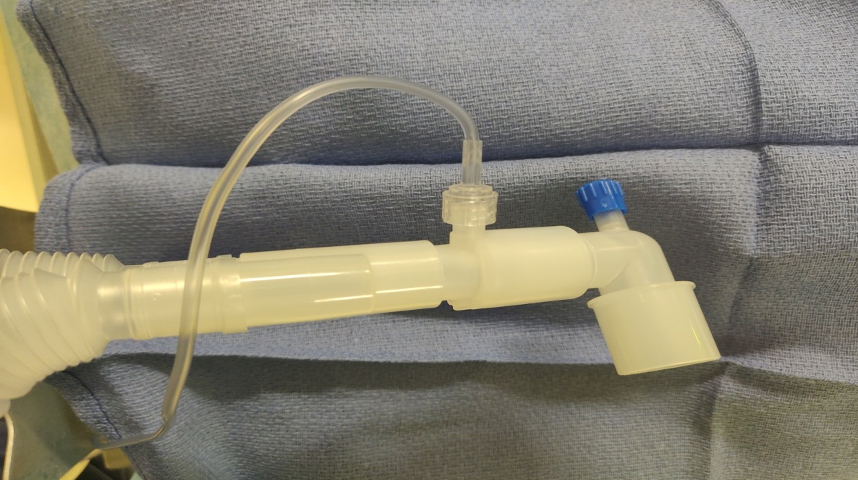
Apparatus Dead Space
Y-piece of circle breathing system
Redundant connector adding apparatus dead space
Elbow connector
Small increases in dead space can substantially increase the Vd/Vt ratio in children causing HYPOVENTILATION and HYPERCARBIA

Slide 22
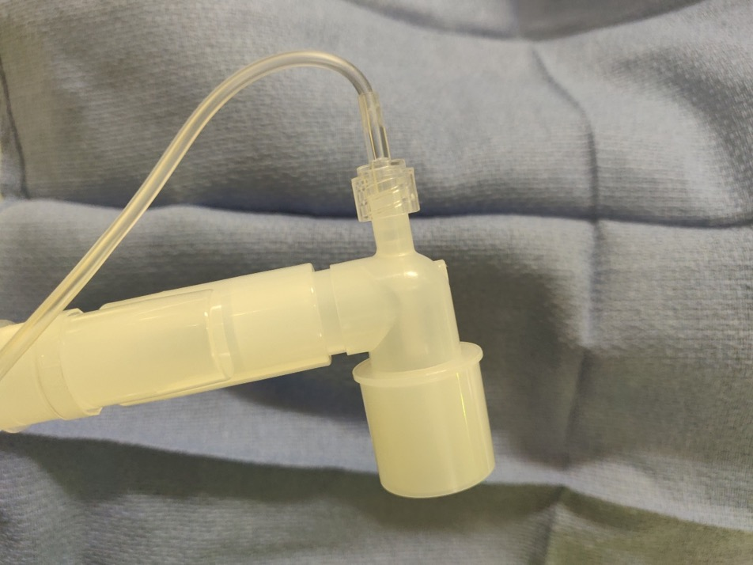
Removal of Connector Reduces Dead Space
Be diligent about minimizing apparatus dead space in children

Slide 23
OR vs ICU Ventilators
OR Ventilators | ICU Ventilators
Short term ventilation (minutes to hours) | Longer ventilation (days to weeks)
Simple modes of ventilation suitable for anesthetized patients | Many sophisticated modes for critically ill patients with severe lung disease
Circle systems, CO₂ absorbers and one-way valves popular in many countries | Almost never used in ICU
Designed for anesthetic delivery of inhalational anesthetic agents (IAA) | Inhalational agents rarely used in ICU ventilators
Scavenging systems in line for IAA | Scavenging separate for inhaled NO
Humidification through circuit HMEs or circle system | Integrated heater/humidifier
Adjustable pressure limiting valve (APL) integrated in system for manual mode | No APL. Need separate manual backup system

Slide 24
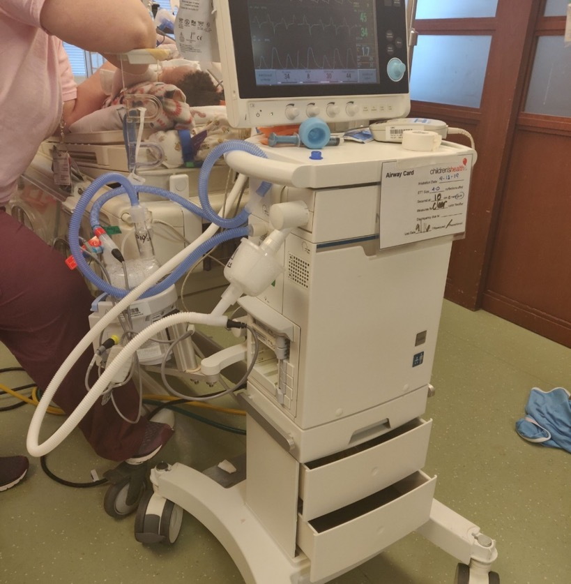
Infant and Neonatal Ventilator
Humidifier to prevent desiccation of respiratory tract on inspiratory limb
Expiratory limb

Slide 25
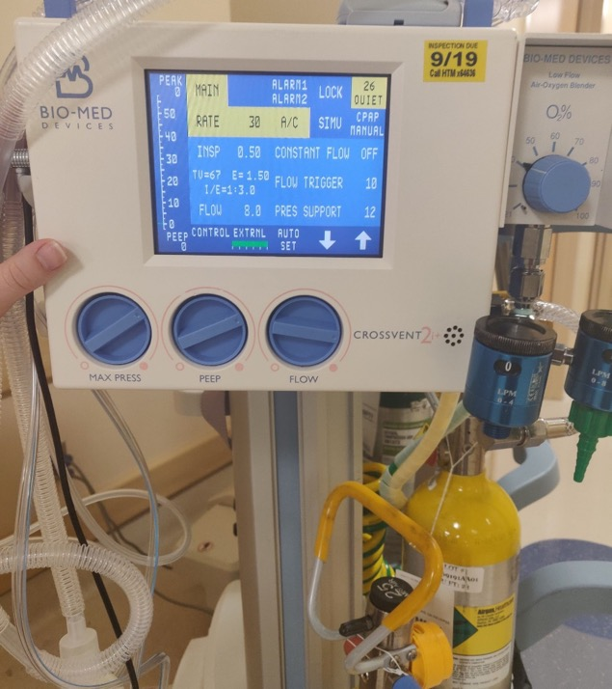
ICU Transport Ventilator With Basic ICU Modes
Can function adequately for most ICU patients
Suitable for lower resource settings as a main ICU workhorse
Needs electrical power to work. Older version works on compressed gas supplies without power

Slide 26
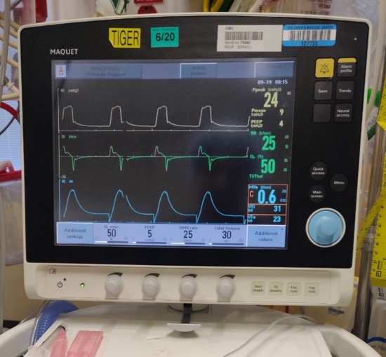
ICU Ventilators Modes
Controlled
Assist-control ventilation (ACV)
Synchronized intermittent mandatory ventilation (SIMV)
Pressure-controlled ventilation (PCV)
Pressure support ventilation (PSV)
Airway pressure release ventilation (APRV)
Pressure regulated volume control (PRVC)
Proportional assist ventilation (PAV)
Neurally adjusted ventilatory assist (NAVA)
Controls and settings

Slide 27
Controlled Ventilation
Pressure-controlled: Time cycled, pressure-limited, decelerating flow, constant pressure waveform
  Better for recruitment and maintaining lung volumes and preventing pressure injury, but tidal volume not guaranteed
Volume-controlled: Time cycled, volume-limited, constant inspiratory flow, ascending pressure waveform
  Higher peak pressures and pressure varies with lung compliance. Barotrauma can be prevented by setting pressure limit

Slide 28
Pressure-Controlled Ventilation
Target pressure is maintained throughout the duration of inspiratory time during which the flow decreases
Pressure
Time
Flow
Time
Notes:
airway pressure and flow as a function of time

Slide 29
Volume-Controlled Ventilation
Pressure
Time
Flow
Time
Constant flow is maintained through the set inspiratory time and peak pressure is reached towards end inspiration

Slide 30
Pressure-Regulated, Volume-Controlled (PRVC)
Combines decelerating flow pattern with guaranteed tidal volume
First breath delivered – volume limited, constant flow
Measured plateau pressure then used to pressure limit the following breath
Ventilator automatically adjusts the PIP required to deliver guaranteed TV for each subsequent breath
Best of both worlds?

Slide 31
PRVC
Pressure
Time
Flow
Time
Volume
Set tidal volume
Time

Slide 32
Pressure Support Ventilation
Only spontaneous breaths are augmented
Work of breathing imposed on the patient is reduced
Respiratory rate, inspiratory time, and tidal volume controlled by patient
A minimum negative inspiratory effort that exceeds the preset sensitivity (based on either pressure or flow) is necessary to trigger the ventilator

Slide 33
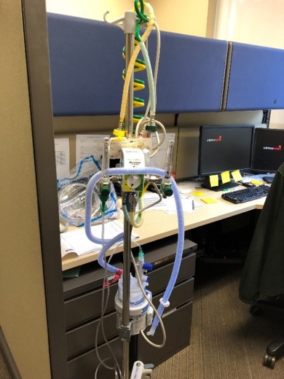
Can Intubation Be Avoided?
Supplemental O₂ by nasal cannula, Venti-mask, or non-rebreather
High flow nasal cannula – heated, humidified O₂ (HHFNC)
Non-invasive positive pressure ventilation: BiPAP, CPAP (including bubble CPAP)
  HHFNC and non-invasive ventilation may decrease the need for intubation
High flow nasal
cannula setup
Notes:
The heated/humidified nature of HFNC allows it to more comfortably deliver higher oxygen flow rates for longer periods of time.
The high flow rates may offer some amount of “PEEP,” as well as CO2 washout, which subsequently may improve oxygenation and ventilation.

Slide 34
Monitoring Ventilation in the OR
A trained anesthesia provider provides continuous vigilance
Continuous pulse oximetry: The LIFEBOX project aims to supply low cost oximeters to low resource settings
Oxygen analyzer to prevent delivery of hypoxic mixture
Continuous end tidal CO₂ monitoring (precordial stethoscope recommended if end tidal CO₂ not available)

Slide 35
Monitoring Mechanically Ventilated Children in the ICU
Continuous pulse oximetry is necessary; continuous end tidal CO₂ monitoring is ideal
Tidal volume, minute volume, airway pressures
Arterial blood gases at suitable intervals
Hemodynamic monitoring for cardiovascular changes
Trained respiratory therapists and ICU nursing staff
Technical support to operate and service ventilators
Sufficient bedside nursing staff

Slide 36
Complications During Mechanical ventilation
Ventilator-induced lung injury: barotrauma
Ventilator-associated respiratory infections
New infiltrates on chest X-Ray
Purulent endotracheal secretions
Fever/leukocytosis
Atelectasis
Utilize PEEP and recruitment maneuvers
Change patient position and chest physiotherapy
Notes:
Lung injury due to mechanical stretch caused by the continuous pressure and volume changes
Air leak syndromes
Respiratory Infections: Prevention strategies – maintain semi-recumbent position, change heat-moisture exchangers, maintain oral hygiene
Atelectasis: More common in patients under neuromuscular blockade/heavy sedation, underlying neuromuscular weakness, and head injury

Slide 37
Lung Protective Strategies
Well established in adults, but limited data in children
Limit tidal volume to＜7 ml/kg in the OR
Limit tidal volumes to 4-6 ml/kg in the ICU, particularly with ARDS
Use as low an FiO₂ as possible to prevent oxygen toxicity
Prevent atelectasis by utilizing at least 5 cm H₂O PEEP

Slide 38
Ventilator Bundles
Strict implementation of simple, inexpensive interventions in care of mechanically ventilated children can significantly decrease ventilator associated pneumonia (VAP) even in resource-limited settings
Elevate head of bed to 30°
Hand hygiene
Oral care with chlorhexidine
Stress ulcer prophylaxis
Daily sedation interruptions
Daily extubation readiness testing
Haque A, Riaz Q and Ali SA. Implementation of ventilator bundle in pediatric intensive care unit of a developing country. Journal of the College of Physicians and Surgeons Pakistan 2017; 27(5):316-318.

Slide 39
Management Strategies for Mechanically Ventilated Children
Extubate patients when ready with sufficient staff available if re-intubation is required
Utilize a minimum PEEP of 5 cm H₂O

Slide 40
Facilitating Patient Extubation
If appropriate, perform daily spontaneous breathing trials
If no endotracheal tube cuff leak → Consider a course of dexamethasone (0.5mg/kg q6h x 24 hours) starting at least 6 hours prior to extubation
  Upper airway obstruction accounts for 37% of failed extubations (Kurachek 2003)

Slide 41
Reducing Usage of Medical
Gas Supplies
Utilize oxygen concentrators if available
Require electricity
Can only provide 5 - 6 L/m
Maximum FiO₂ is approximately 90%
Limit flow rates when applicable
Wean respiratory support as quickly as feasible

Slide 42
Sedation Strategies During ICU Mechanical Ventilation
Drugs: Opioids, benzodiazepines, dexmedetomidine or clonidine
Routes of administration: IV, IM, PO/NG, SQ, PR
Continuous IV infusion provides best route of administration but requires a medication pump
Sedation scoring should be regularly performed to avoid under and over-sedating
Weaning of sedative agents should be performed to avoid withdrawal if greater than 5-7 days of exposure

Slide 43
Conclusions
Newer anesthesia machine ventilators approach the capabilities of ICU ventilators; older anesthesia machine ventilators are more limited
Lung protective ventilation strategies benefit intubated children
Mechanical ventilation is a scarce resource

Slide 44
References:
Feldman JM. Optimal Ventilation of the Anesthetized Pediatric Patient. Anesth Analg. 2015;120(1):165-175.
Kurachek SC, Newth CJ, Quasney MW, et al. Extubation failure in pediatric intensive care: A multiple-center study of risk factors and outcomes. Crit Care Med 2003; 31:2657-2664.
Haque A, Riaz Q and Ali SA. Implementation of ventilator bundle in pediatric intensive care unit of a developing country. Journal of the College of Physicians and Surgeons Pakistan 2017; 27(5):316-318.

