Slide 1
Management of the
Obese Pediatric Patient
Monica S. Ganatra MD, MPH
Assistant Professor of Anesthesiology
Assistant Professor of Pediatrics
Yale School of Medicine
Greg Lessans MD
PGY-3, Department of Anesthesiology
Yale New Haven Hospital
Updated 1/2018

Slide 2
Disclosures
None

Slide 3
Outline
Introduction
Definition of Obesity
Systemic Implications of Obesity
  Pulmonary
  Cardiovascular
  Other Organs
Pre-Operative Assessment
Intra-Operative Management
Post-Operative Concerns
Conclusion

Slide 4
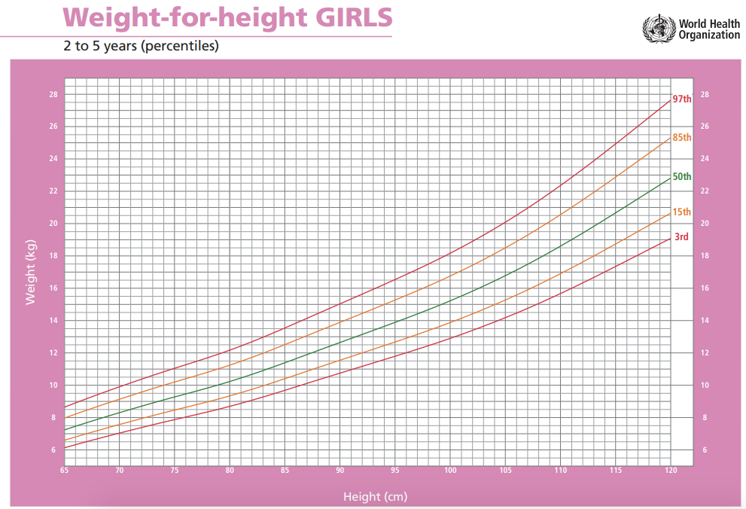
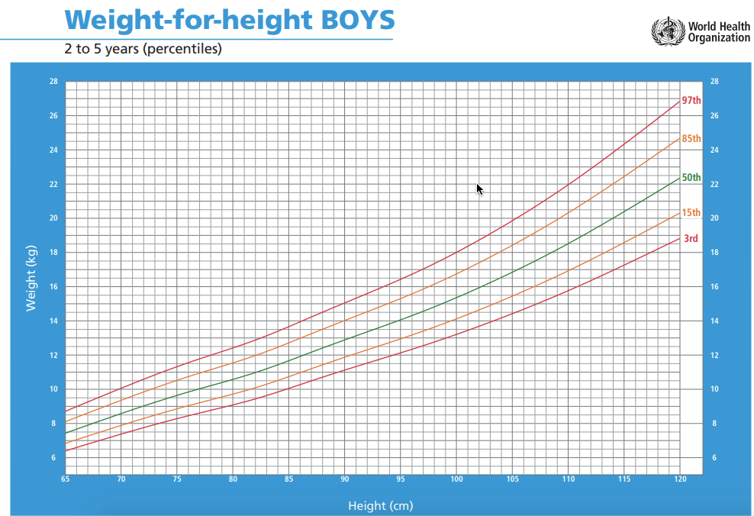
Definition of Obesity
Age and gender specific cut-offs by the National Center for Health Statistics (NCHS)/Centers for Disease Control and Prevention (CDC) 2000 Growth Charts
  Overweight is defined as:
  85th percentile < BMI < 95th percentile.
  Obesity is defined as:
  BMI > 95th percentile for children of the same age and sex
World Health Organization Child Growth Standards http://www.who.int/childgrowth/standards/weight_for_height/en/ (accessed 8/1/2017)
Notes:
Age and gender specific cut offs were established by the national center for health statistics and the centers for disease control and prevention in 2000. They defined “overweight” as having a BMI greater than the 85th percentile but less than the 95th percentile and “obese” as having a BMI greater than the 95th percentile for children of the same age and sex.

Slide 5
Definition of Obesity
Statistics
In the US, childhood obesity has more than tripled in the past 30 years.
Worldwide, the number of obese infants and young children has increased from 32 million in 1990 to i42 million in 2013 and is Projected to increase to 70 million in 2025 if current trends continue
Obese children become obese adults
Ogden CL, Carroll MD, Curtin LR, Lamb MM, Flegal KM. Prevalence of high body mass index in US children and adolescents, 2007–2008. JAMA2010;303(3):242–9.
National Center for Health Statistics. Health, United States, 2004 with Chartbook on Trends in the Health of Americans. Hyattsville, MD; 2004.
Serdula MK, Ivery D, Coates RJ, Freedman DS, Williamson DF, Byers T. Do obese children become obese adults? a review of the literature. PrevMed. 1993;22(2):167-177.
World Health Organization Committee on Ending Childhood Obesity. Facts and Figures on Childhood Obesity http://www.who.int/end-childhood-obesity/facts/en/ (Accessed 8/1/2017)
Notes:
Childhood obesity has increased in prevalence over the past 30 years. This is due to a variety of factors, including: decreased access to healthy food with urban sprawl; restaurants serving larger portion sizes of foods that have a high fat content; more families eating out as opposed to cooking food at home; and an increase in the cost of healthy food and a decrease in cost of unhealthy, processed foods. Children are also less active than before, due to decreases in mandatory physical education at school and access to sedentary activities at home – e.g. computer games, t.v. watching. You can see that in 2008, about 20% of children and teenagers from age 6-19 were found to be obese. A literature review from 1993 (Preventive Medicine March 22(2): 166-177) showed that “About a third (26 to 41%) of obese preschool children were obese as adults, and about half (42 to 63%) of obese school-age children were obese as adults. For all studies and across all ages, the risk of adult obesity was at least twice as high for obese children as for non-obese children. The risk of adult obesity was greater for children who were at higher levels of obesity and for children who were obese at older ages.”

Slide 6
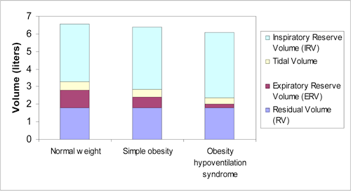
Implications of Obesity- Pulmonary
Effect of Obesity on Lung Volumes
Sood, A. and Ortiz-Cantillo. Obesity and Pulmonary Dysfunction. Figure 1. American College of Chest Physicians.
PCCSU Article | 05.01.08 (http://www.chestnet.org/accp/pccsu/obesity-and-pulmonary-dysfunction?page=0,3) (accessed 12/29/10)
Notes:
Expiratory reserve volume is decreased in obesity. Total lung capacity is usually preserved except with morbid obesity, excessive central adiposity, or with obesity-hypoventilation syndrome. Since FRC = ERV + RV, you can see that there is a decreased FRC in obese patients.

Slide 7
Implications of Obesity- Pulmonary
Closing Capacity
Closing volume (CV) = volume of the lung at which small dependent airways collapse
Normal/healthy patient: CV is less than the Functional Reserve Capacity (FRC) so that the airways remain open during normal tidal breathing
Patients with obesity, COPD have higher closing volumes, so even a small decrease in FRC can cause small dependent airway collapse

Slide 8
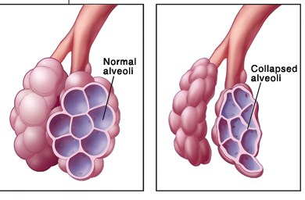
Implications of Obesity- Pulmonary
Atelectasis
Obese patients have decreased FRC
FRC may fall below CV and lead to alveoli closure during normal tidal volumes, causing atelectasis and a V/Q mismatch
V/Q mismatch during ventilation leads to hypoxemia
Chronic hypoxemia leads to the inability to normalize PaCO2
http://openphysio.co.za/index.php?title=Bronchopulmonary_dysplasia (accessCed 1/6/11)
Notes:
Atelectasis is derived from the Greek words ateles and ektasis, which mean incomplete expansion. Atelectasis is defined as diminished volume affecting all or part of a lung. This picture demonstrates atelectasis. Obese patients have decreased FRC, which may fall below the CV and lead to atelectasis. V/Q mismatch during ventilation leads to hypoxemia. Chronic hypoxemia leads to the inability to normalize PaCO2, and this can lead to hypersomnolence and pulmonary hypertension (with or without cor pulmonale).

Slide 9
Implications of Obesity- Pulmonary
Physiology
Increased metabolic rate =
  ↑ Oxygen demand
  ↑ CO₂ production
  ↑ Alveolar ventilation
Decreased chest wall compliance from adipose tissue over thorax
Increased abdominal mass forces the diaphragm cephalad decreasing lung volumes
Notes:
Obesity leads to an increased metabolic rate. The body has to work harder to perfuse the extra weight. This increased metabolic rate leads to increased oxygen demand, increased CO2 production, and increased alveolar ventilation. There is decreased chest wall compliance due to the adipose tissue that lies over the thorax. Lung volumes are decreased as the increased abdominal mass forces the diaphragm cephalad.

Slide 10

Implications of Obesity- Pulmonary
Physiology II
Pulmonary function tests consistent with restrictive lung disease
↑ work of breathing
Chronic hypoxemia and chronic hypercarbia
http://medstudentmom.com (accessed 12/23/10)
Notes:
This picture is of Pickwickian Joe, a character in Charles Dicken’s novel “The Pickwick Papers.” Joe is obese, eats often, and falls asleep at all times of the day. The description of this character led to the origin of the medical term “Pickwickian Syndrome,” which lead to the description of what we now call Obstructive Sleep Apnea.

Slide 11
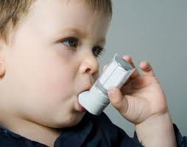
Implications of Obesity- Pulmonary
Asthma
Nearly 30% of obese children suffer from asthma
Usually more severe in nature than those children of normal weight
Obese infants and children are more likely to suffer from respiratory infections which can necessitate a change in the timing of elective surgery
http://familynatural.com/
Earl S. Ford, MD, MPH The Journal of Allergy and Clinical Immunology Volume 115, Issue 5, Pages 897-909, May 2005. The epidemiology of obesity and asthma
Shnur, M. and Pierece, M.E.P. “Optimal outcomes for the obese pediatric patient.” OR Nurse May 2010 pp. 26-33

Slide 12

Implications of Obesity: Pulmonary
Asthma and Anesthesia
Patients with bronchial asthma have an increased risk of developing intra-op bronchospasm, especially if they are receiving general anesthesia with an endotracheal tube
http://www.fireengineering.com/index/articles/display/350276/articles/fire-engineering/volume-162/issue-1/features/capnography-a-tool-for-every-patient.html (accessed 12/28/10)
Notes:
What you see here is a capnogram with characteristic “shark fin” appearance seen with bronchospasm. This occurs because as bronchoconstriction becomes more severe it takes a progressively longer time for the alveoli to empty their carbon dioxide during exhalation. As bronchoconstriction from asthma/bronchospasm worsens, the upslope angle becomes even more gradual.

Slide 13
Implications of Obesity- Cardiovascular
Physiology
Increased cardiac output (CO) and blood volume in order to perfuse additional fat stores
CO increases 0.1 L/min/kg of adipose tissue
↑ CO achieved through increased stroke volume and results in arterial hypertension and LVH
↑ in pulmonary blood flow and pulmonary artery vasoconstriction from persistent hypoxia can lead to pulmonary hypertension and cor pulmonale

Slide 14
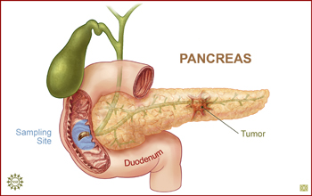
Implications of Obesity: Other Organs
CV: hypertension, hyperlipidemia, chronic inflammation, endothelial dysfunction
Pulm: Obstructive sleep apnea, asthma
GI: GERD, fatty liver disease, gallstones
Endocrine: Diabetes, hyperinsulinemia
Zina Deretsky, National Science Foundation (http://www.nsf.gov/news/news_images.jsp?cntn_id=109781&org=NSF) (accessed 12/30/10)
Notes:
Obesity has effects on all the major organs. While we do not have time to go over all the co-morbidities associated with obesity, I did want to highlight some of the more salient ones.

Slide 15

Implications of Obesity: Other Organs
GYN: Polycystic ovary disease, menstrual irregularities
Psych: Decreased self-esteem, poor body image, depression
Renal: glomerulosclerosis
building-selfesteem.com (accessed 12/30/10)

Slide 16
Pre-Operative Concerns
Retrospective review of 6,094 children at the University of Michigan:
Higher prevalence of medical comorbidities in overweight and obese patients
Most common diseases: hypertension, diabetes, and asthma
Difficult airway significantly more common in obese patients
Nafiu et al. Childhood body mass index and perioperative complications. Pediatric Anesthesia. 2007 17: 426-430

Slide 17
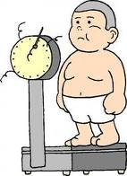
Pre-Operative Assessment
Pre-op Concerns
Privacy for child and family
Review history and medical chart, including previous anesthetic records
Airway assessment, including neck evaluation
Heart and lung exam
Vital signs
Height and weight on day of surgery
imway2fat.wordpress.com (accessed 12/20/10)

Slide 18
Pre-Operative Assessment
Airway Assessment
Physical exam signs of potential difficult airway include:
fleshy cheeks
large tongue
abundant flaps of palatal, pharyngeal, and supra-laryngeal tissues related to obesity

Slide 19
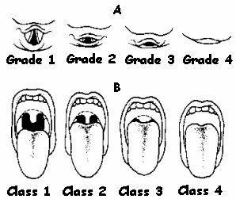
Pre-Operative Assessment
Mallampati Score
  Important, but not as clear a predictor of difficult intubation as with adult patients
Pediatric Emergency Medicine By Jill M. Baren, Steven G. Rothrock
(C) 2008 by Saunders, an imprint of Elselvier, Philadelphia. Page 46
Image: primumn0nn0cere.wordpress.com (accessed 12/20/10

Slide 20

Snorlax from “Pokemon…”
http://www.dltk-kids.com/pokemon/adoptions/snorlax.html (accessed 12/30/10)
Notes:
Some of you may be familiar with Snorlax from Pokemon in your interaction with children. Snoring is a great segue to our next topic, obstructive sleep apnea.

Slide 21
Pre-Operative Assessment
Obstructive Sleep Apnea
Up to 60% of obese children have symptoms of OSA such as snoring, gasping for breath at night, and daytime somnolence
Asking the questions, “Does your child snore?” has a sensitivity of 91% and a specificity of 75% for diagnosing OSA
Up to 27% of patients with OSA will have post-operative respiratory complications, depending on severity of OSA and younger age (< 3 years of age)
Children with OSA and/or “extreme obesity” status post T&A should be admitted for overnight observation
Narang I, Mathew JL. Childhood obesity and obstructive sleep apnea. J Nutr Metab. 2012;2012:134202.
Schwengel DA, Sterni LM, Tunkel DE, Heitmiller ES. Perioperative management of children with obstructive sleep apnea. Anesth Analg. 2009;109(1):60-75.
Notes:
In rare cases, the airway obstruction is so severe that a tonsillectomy and adenoidectomy may be indicated. This is to improve the symptoms of obstructive sleep apnea prior to proceeding with any elective surgery. [Pohl J, Stephen M, Wilson D. Pediatric obesity: impact and surgical management. South Med J. 2006;99(8):833-843] There needs to be more research done to determine which patients would benefit. With respect to pediatric patients with obstructive sleep apnea staying for overnight observation, this is actually an area currently under investigation. At this time, it is best to determine the need for overnight observation on a case-to-case basis. Some useful criteria for making this determination could include: how the patient did in the OR and in the PACU with respect to oxygenation, ventilation, and the frequency and severity of apnea spells.

Slide 22
Pre-Operative Assessment
Gastric Volumes
Currently no recommendations to change fasting guidelines in children based on obesity alone
Oral midazolam increases gastric residual volume more than oral acetaminophen
Higher incidence of GERD in obese patients
Cook-Sather et. al. Overweight/Obesity and Gastric Fluid Characteristics in Pediatrics Day Surgery: Implications for Fasting Guidelines and Pulmonary Aspiration Risk. Anesthesia and Analgesia. Vol 109: No. 3, Sept 2009 727-736
Notes:
While there is an increased incidence of GERD in obese patients, evidence to date fails to demonstrate increased incidence of aspiration in obese children

Slide 23
Pre-Operative Assessment
IV Access
Can be challenging in obese patients
Consider using EMLA cream with sufficient time for it to work, alone or with oral midazolam
Utilize transilluminator or ultrasound

Slide 24
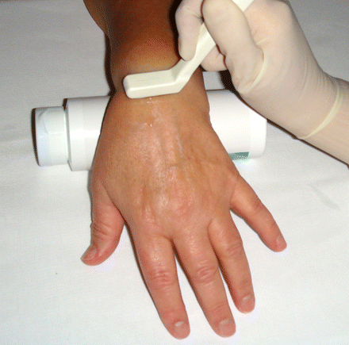
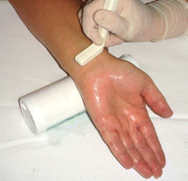
Show Me The Vein
Dorsal aspect of hand:
Most successful site in obese pts
Volar aspect of wrist: Second most successful site:

Slide 25
Intra-Operative Management
Pre-Oxygenation
Pre-oxygenation before induction helps offset the ↓ FRC
Obese children undergoing elective noncardiac surgery had a greater incidence of:
  Difficult mask ventilation
  Airway obstruction
  Bronchospasm
  Major oxygen desaturation
  Setzer, n et. Al Childhood obesity and anesthetic morbidity. Pediatric Anesthesiology. 2007 17: 321-326
  Tait A, Voepel-Lewis T, Burke C, et al. Incidence and risk factors for perioperative adverse respiratory events in children who are obese Anesthesiology 2008: 108 (3):375-380

Slide 26
Intra-Operative Management
Intubation
While difficult laryngoscopy is more common in obese pediatric patients, the overall incidence is still low
One explanation- characteristics that are known to contribute to difficulty in adults (such as beard, thick neck, pregnancy, large breasts) are not present in children
Nafiu et al. Childhood body mass index and perioperative complications. Pediatric Anesthesia. 2007 17: 426-430

Slide 27
Intra-Operative Management
Obesity and Pharmacology
Propofol: lipophilic drug; does not have increased volume of distribution in obese patients, so dose according to ideal body weight (IBW)
Thiopental, midazolam: very lipophilic and increased volume of distribution, so dose according to total body weight (TBW)
Neuromuscular blockers (such as rocuronium and vecuronium) and morphine: IBW, as obesity does not alter the pharmacokinetics and pharamacodynamics
Succinylcholine and fentanyl dosages: should be based on TBW
Brenn BR. Anesthesia for pediatric obesity. Anesthesiol Clin North America - 01-DEC-2005; 23(4): 745-764,
Barash et al. Clinical Anesthesia page 1237, table 47-5, 6th edition (2009)
Phillips S, Edlbeck A, Kirby M, Goday P. Ideal body weight in children. Nutr Clin Pract. 2007;22(2):240-5.
Notes:
-Obese children have increased lean body mass and fat
-Most of the pharmacological data is derived from adult literature
To calculate IBW, there are three current formulae: the McLaren method, the Moore method, and the body mass index method. In children under 8 years old, none of the methods have been shown to be superior to the others, and they provide very similar results. Above age of 8, recommend using the adult method of calculating IBW.

Slide 28
Calculating Ideal Body Weight (IBW)
McLaren Method: Determines 50th percentile height-for-age and uses expected body weight for this height as child’s IBW
Moore Method: Determines what percentile the child’s height-for-age is, and then uses the expected weight-for-age at the corresponding percentile as the child’s IBW
BMI Method: Multiply BMI at the 50th percentile for child’s age by the height in meters, squared. IBW = (BMI at 50th percentile) x (height in meters)²
No method has been proven superior to the others below age 8. Above age 8, recommend using adult method to calculate IBW.
Phillips S, Edlbeck A, Kirby M, Goday P. Ideal body weight in children. Nutr Clin Pract. 2007;22(2):240-5.
Notes:
-Obese children have increased lean body mass and fat
-Most of the pharmacological data is derived from adult literature
To calculate IBW, there are three current formulae: the McLaren method, the Moore method, and the body mass index method. In children under 8 years old, none of the methods have been shown to be superior to the others, and they provide very similar results. Above age of 8, recommend using the adult method of calculating IBW.

Slide 29
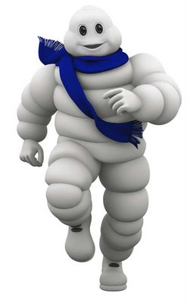
Intra-Operative Management
Positioning and Padding
.
Take care with positioning, especially bony prominences and areas in contact with the OR table
Adipose tissue: not as vascular; predisposes patients to pressure ulcers
Use adequate axillary support for lateral position to prevent brachial plexus injury
thekingpin68.blogspot.com/.../michelin-man.html (accessed 12/29/30)

Slide 30

Prone, lateral, and semirecumbent positions are tolerated better than supine and Trendelenburg positions
1. Positioning the Morbidly Obese Patient for Surgery Jay B. Brodsky, M.D. International Society for Perioperative Care of the Obese Patient (ISPCOOP) website –ispcop.org (accessed 1/2/11)
2. Image: Shoponline2011.com (accessed 1/2/11)
Notes:
Prone:
For an anesthetized and paralyzed normal weight patient, placement in the prone position improves oxygenation compared to the same patient when supine. If the abdominal wall is allowed to hang freely, there is a reduction in cephalad displacement of the diaphragm and a re-opening of atelectactic lung segments. In obese patients, the unloading of abdominal viscera significantly reduces pressure on the diaphragm, which in turn leads to an increase in FRC.
Lateral:
Tolerated in obese patients due to displacement of their panniculus off the abdomen, which in turn reduced intra-abdominal pressure and allowed greater diaphragmatic excursion during mechanical ventilation.
Semi-recumbent:
This unloads the weight of the intra-abdominal contents from the diaphragm and increases FRC.

Slide 31

Intra-Operative Management
Thermoregulation
Maintain thermoregulation to prevent increased metabolic demands
Utilize
  Forced air warming blankets
  Fluid warmers
  Warm Operating Room
  Warming mattresses
cartoonstock.com (accessed 12/28/10)

Slide 32
Post-Operative Concerns
PACU Stay
“Overweight and obese children were more likely to have prolonged stay (x>3 hours) in the PACU, probably a reflection of the ↑ incidence of upper airway obstruction and the need for more than two anti-emetics”
Pulse oximetry and end-tidal CO2 monitoring for patients with OSA that are admitted overnight
  There are not current recommendations on who requires overnight observation.
  Generally accepted that < 3 years old with OSA should be monitored overnight
  For >3 years, recommend early-in-day case, several hours PACU observation and –if no adverse events– discharge home
Nafiu et al. Childhood body mass index and perioperative complications. Pediatric Anesthesia. 2007 17: 426-430
Fung et. al Postoperative respiratory complications and recovery in obese children following adenotonsillectomy for sleep-disordered breathing: a case-control study. Al Otolaryngology Head Neck Surg. 2010 Jun;142(6):898-905
Notes:
In this retrospective study of more than 6,000 pediatric patients by Dr. Nafiu at the University of Michigan, increased airway obstruction, the need for more than 2 anti-emetics and a longer PACU stay for overweight and obese patients was found to be statistically significant when compared to their lean counterparts. More research has to be done to determine if there is always an increased incidence of PONV in obese children.
In the study by Fung et. Al, obese patients had a higher incidence of airway obstruction and respiratory complications, both in PACU and when admitted overnight. It makes sense, then, that pulse oximetry and end-tidal CO2 should be monitored for early diagnosis and management of respiratory problems.

Slide 33
Intra-Operative Management
PACU Considerations
Have oral and nasal airways, resuscitation equipment readily available
Teach staff to recognize and treat airway obstruction
Teach staff to distinguish between laryngospasm and upper airway obstruction
PONV prophylaxis with more than one drug to help shorten PACU duration
Notes:
It is important to have resuscitation equipment readily available, with nurses and physicians who are familiar with its use. This is essential to quickly diagnosing and treating complications in PACU. Anesthesia carts that are color-coded for age and approximate weight are useful to help guide sizes of oral airways, intubation blades, and endotracheal tubes in emergent situations.
Based on Dr. Nafiu’s results which suggested that obese patients stayed longer in PACU and required more anti-emetics, I would strongly consider giving at least two prophylactic anti-emetics intra-operatively. Further research is needed to better understand why obese patients have a higher rate of post-operative nausea and vomiting.

Slide 34
Conclusion
“Healthcare team members educated about special considerations for the obese pediatric patient will be better prepared to provide safe, sensitive, and knowledgeable care for these patients and their families”
Shnur, M. and Pierece, M.E.P. “Optimal outcomes for the obese pediatric patient.” OR Nurse May 2010 pp. 26-33

Slide 35
References
Brenn BR. Anesthesia for Pediatric Obesity. Anesthesiol Clin North America - 01-DEC-2005; 23(4): 745-64,
Cook-Sather et. al. Overweight/Obesity and Gastric Fluid Characteristics in Pediatrics Day Surgery: Implications for Fasting Guideline and Pulmonary Aspiration Risk. Anesthesia and Analgesia. Sept 2009; Vol 109: No. 3, pp. 727-736
Ogden CL, Carroll MD, Curtin LR, Lamb MM, Flegal KM. Prevalence of high body mass index in US children and adolescents, 2007–2008. JAMA 2010;303(3):242–9
Nafiu et al. Childhood body mass index and perioperative complications. Pediatric Anesthesia. 2007 ; 17: 426-430
Nafiu et al. Comparing peripheral venous access between obese and normal weight children. Pediatric Anesthesia. Feb 2010; Volume 20, Issue 2, pages 172–176,
Narang I, Mathew JL. Childhood obesity and obstructive sleep apnea. J Nutr Metab. 2012;2012:134202.
National Center for Health Statistics. Health, United States, 2004 with Chartbook on Trends in the Health of Americans Hyattsville, MD; 2004
Serdula MK, Ivery D, Coates RJ, Freedman DS, Williamson DF, Byers T. Do obese children become obese adults? a review of the literature. Prev Med. 1993;22(2):167-177.
Setzer, n et. Al Childhood obesity and anesthetic morbidity. Pediatric Anesthesiology. 2007; 17: 321-326
Sood, A and Ortiz-Cantillo, K. Obesity and Pulmonary Dysfunction American College of Chest Physicians PCCSU Article | 05.01.08
Shnur, M. and Pierece, M.E.P. “Optimal outcomes for the obese pediatric patient.” OR Nurse . May 2010; pp. 26-33
Schwengel DA, Sterni LM, Tunkel DE, Heitmiller ES. Perioperative management of children with obstructive sleep apnea. Anesth Analg. 2009;109(1):60-75.
Tait A, Voepel-Lewis T, Burke C, et al. Incidence and risk factors for perioperative adverse respiratory events in children who are obese. Anesthesiology. 2008; 108 (3):375-380.
Taljanovic et al. Ultrasound of the Intrinsic and Extrinsic Wrist Ligaments and Triangular Fibrocartilage Complex Radiographics Nov 15 , 2010.

