Slide 1
Anesthetic Considerations for Pediatric Burn Patients
Marisa K. Bell MD, FAAP
Clinical Assistant Professor of Anesthesiology
Children’s Hospital Los Angeles
Keck School of Medicine of USC
Updated 12/2019

Slide 2
Disclosures:
No relevant financial relationships to disclose

Slide 3
Learning Objectives:
Appreciate the global impact of burn injuries
Describe basic burn characteristics
Distinguish the two distinct phases of burn injury
Recognize inhalational injury
Identify the pharmacologic impact of burn injury

Slide 4
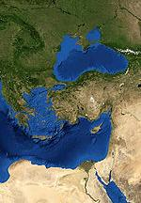
Global Impact:
Majority of burns occur in children < 5 years old
Majority of burn injuries occur in Africa, South-East Asia and the Eastern Mediterranean
Over 95% of fire-related burns
occur in low-middle income countries
Fire-related burns account for 10 million disability adjusted life years lost each year
Figure 1

Slide 5
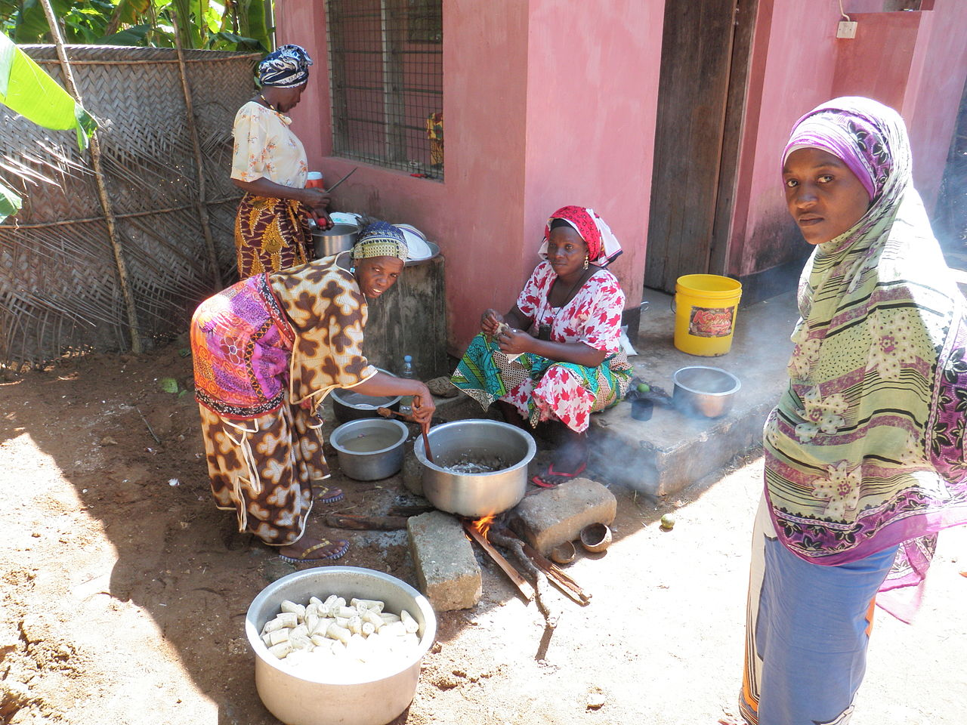
Burn Injuries: Gender Disparity
Females have a higher rate of burn injuries
Open fire cooking
Fossil fueled cookstoves
Ground level cooking
Figure 2

Slide 6
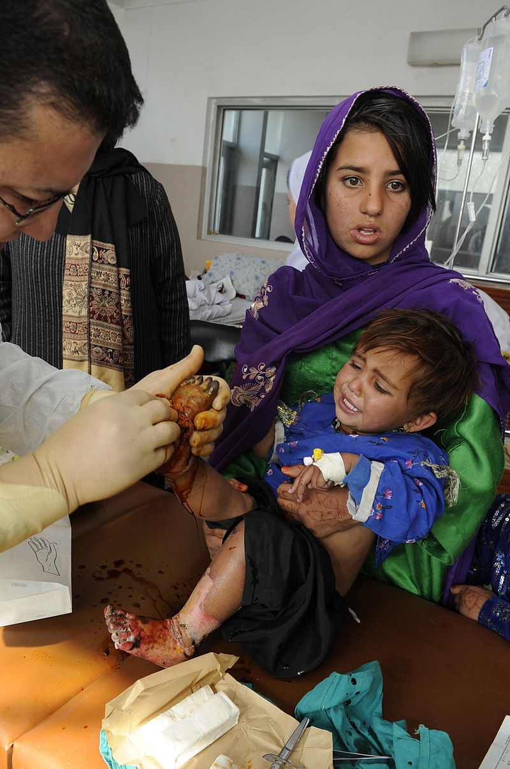
What is a Burn?
A burn is an injury to skin or other organic tissue caused by
Heat
Radiation
Radioactivity
Electricity
Friction
Chemicals (acid)
Smoke inhalation
Figure 3

Slide 7
Burns are described in terms of:
Depth
Total Body Surface Area

Slide 8
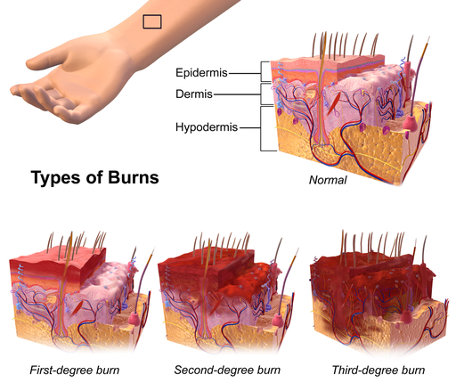
Depth
Superficial: limited to epidermis, typically does not require hospital management, heals within 7 days, looks like a bad sunburn
Partial-Thickness: damage extends to dermis, blistering, some heal without surgery, some require debridement and grafting, re-epithelialize within 14-21 days
Full-Thickness: dermis destroyed, insensate (the nerves get burned), will only heal with grafting
Figure 4

Slide 9
Total Body Surface Area (TBSA)
Separate charts are used to estimate TBSA in children because of differences in body proportion.
Children have proportionally larger heads, smaller legs, and smaller hands than adults

Slide 10
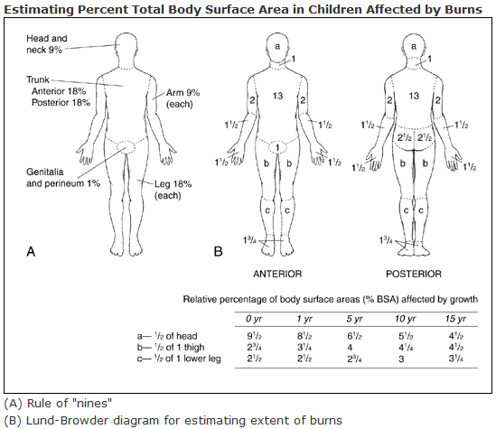
(C) Palmar hand surface of the child is approximately 1% TBSA
Figure 5

Slide 11
When did the Burn Occur?
The physiologic derangements associated with burns occur in 2 phases
The bigger the burn, the bigger the derangements

Slide 12
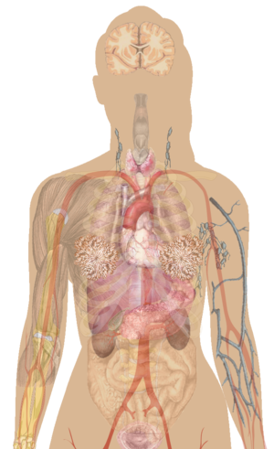
The “Ebb” Phase: First 24-48 Hours of Burn Injury
Cerebral edema?
Mental Status?
Pain response
Tachycardia
Myocardial depression
Decreased cardiac output
Metabolic acidosis
Pulmonary edema
Bronchospasm
ARDS
Myoglobinuria
Oliguria
Aldosterone & Cortisol secretion
Circumferential burns of limbs, chest, abdomen can cause compartment syndrome.
Fluid loss through burned skin & generalized edema in > 25% TBSA burns
Figure 6

Slide 13
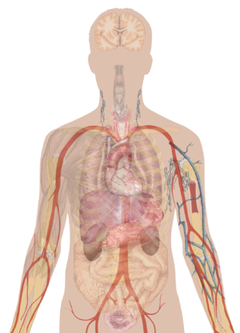
The “Flow” Phase: > 48 Hours After Burn Injury
Cerebral edema?
Mental Status?
Pain response
Tachycardia
Increased cardiac output
Increased oxygen consumption
Decreased SVR
Pulmonary edema
Bronchospasm
ARDS
Altered metabolic function
Altered drug clearance
Liver blood flow
Albumin
Clotting factors
O2 consumption
CO2 production
Muscle breakdown
Insulin resistance
Generalized edema
with > 25% TBSA burn
Renal blood flow
Tubular function
Bone marrow depression
Figure 7

Slide 14
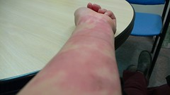
Burns in Infants and Children
Thinner skin
Lose more fluid proportionately
More prone to hypothermia
Mount a greater systemic inflammatory response
Figure 8

Slide 15
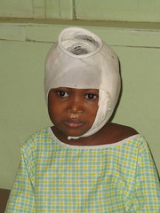
The anesthetic management of infants and children with burns requires understanding the physiologic changes that occur from the moment of the burn until the wounds are healed.
Figure 9

Slide 16
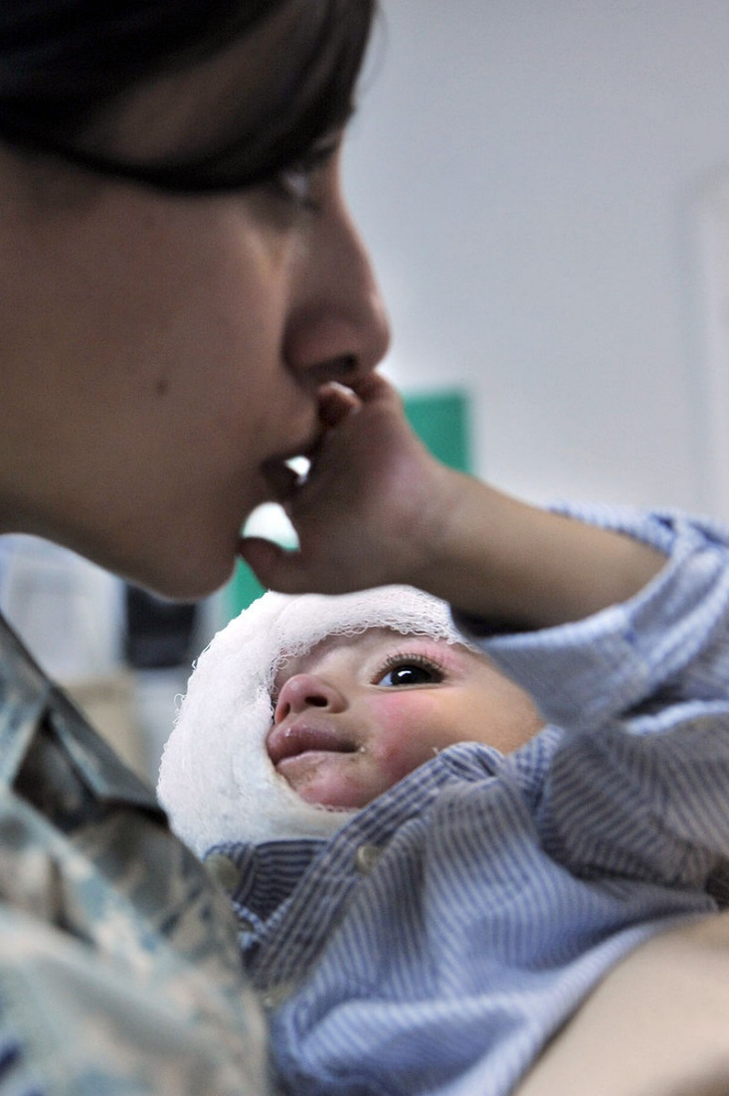
Indications for Anesthesia:
Pediatric burn patients will present for
Wound debridement
Excision, grafting, & reconstruction
Dressing changes
Figure 10

Slide 17
Pre-Operative Evaluation
Burns can be associated with
  Tracheobronchial injury
  Inhalational injury
  Multi-organ injury
  Contractures
  Hyperalgesia
  Allodynia
  Post-traumatic stress disorder

Slide 18
Pre-Operative Evaluation:
Is there inhalational injury?
  Steam and hot gases
  Toxic products from the fire
  Impairment of oxygen transport by inhalation of carbon monoxide and cyanide

Slide 19
Inhalational Injury
Recognition: singed nose hairs, soot at nose & mouth
Treatment: supportive respiratory care
    Airway management
    Lung-protective mechanical ventilation
    Aggressive pulmonary toilet
Clinical manifestations: delayed post-exposure
    Sloughing mucosa
    Cast formation causing atelectasis
    Bronchial obstruction and mucosal plugging
    Rarely manifest < 24hrs, evolve over 48-72hrs
Notes:
Airway management can range from nasal canula oxygen, face mask oxygen, non-rebreather mask oxygen, to early intubation and mechanical ventilation.

Slide 20
Carbon Monoxide (CO) Inhalation
CO has higher affinity for hemoglobin (Hb) than oxygen
    CO binds to Hb to form carboxy-hemoglobin (COHb)
    Hb is then unavailable for O2 transport
The half-life of COHb is 4 hours on room air
    Reduced to 40-60 min on 100% oxygen
    Treatment: 100% oxygen, supportive care and hyperbaric oxygen if available
Notes:
Supportive care can range from observation to nasal canula oxygen, face mask oxygen, non-rebreather oxygen, to intubation and mechanical ventilation.

Slide 21
Cyanide Inhalation
Cyanide (CN) is produced by burning nitrogenous materials
    CN binds to mitochondria and prevents oxygen from making ATP
    Cells revert to anaerobic metabolism
    Lactic acid production causes metabolic acidosis
Suspect cyanide with anion gap metabolic acidosis
    Antidotes: hydroxocobalamin, amyl nitrate, sodium nitrite, sodium thiosulfate
    Treatment: supportive care
Notes:
Anion Gap Acidosis: the normal anion gap is between 8-12 mEq/L. An anion gap greater than 12 suggests an increased presence of unmeasured anions such as lactate (from anaerobic metabolism).
Anion Gap = [Na⁺] - ([Cl⁻] + [HCO ⁻ ])
Medical Management of Chemical Toxicity in Pediatrics
Elora Hilmas, et al. Handbook of Toxicology of Chemical Warfare Agents, 2009
The US standard cyanide antidote kit uses a small inhaled dose of amyl nitrite followed by intravenous sodium nitrite and sodium thiosulfate (Rotenberg, 2003a; Anon, 1998).
Therapy with nitrites is not innocuous, since methemoglobin cannot transport oxygen in the blood. The doses given to an adult can potentially cause a fatal methemoglobinemia in children or may cause profound hypotension. Treatment of children affected with cyanide intoxication must be individualized and is based upon their body weight and hemoglobin concentration. Once an ampule of amyl nitrite has been broken one at a time into a handkerchief, the contents should be held in front of the patient's mouth for 15 s, followed by 15 s of rest. This should be reapplied using this interrupted schedule until sodium nitrite can be administered. Continuous use of amyl nitrite may prevent adequate oxygenation.
Taylor Pharmaceuticals, the manufacturer of the kit, recommends the dose for children of sodium nitrite to be 6 to 8 ml/m² (approximately 0.2 ml/kg body weight) but not to exceed an adult dose of 10 ml of a 3% solution (approximately 300 mg). While excessive sodium nitrite can cause methemoglobinemia, it should be noted that in the 70-year history of using the kit, the only reported fatality of such toxicity from using the kit involved a child without serious cyanide poisoning who was given two adult doses of sodium nitrite (Berlin, 1970; Hall and Rumack, 1986). In fact, the scientific literature recommends pediatric dosing based on monitoring hemoglobin levels.
The next part of the cyanide antidote kit is sodium thiosulfate, which is administered intravenously (Rotenberg, 2003a; Baskin and Brewer, 1997; Anon, 1998; Hall and Rumack, 1986). The sodium thiosulfate and cyanmethemoglobin become thiocyanate, releasing hemoglobin; thiocyanate is excreted by the kidneys. Table 61.8 provides a dosing chart for the safe dosing of sodium nitrite and sodium thiosulfate with continuous monitoring of hemoglobin levels. Before treating pediatric patients with nitrites, it is imperative that prescribers inquire about conditions that may predispose a victim to anemia and, if there are concerns, doses should be decreased. Methemoglobin levels must be monitored sequentially in children and should not exceed 20% (Rotenberg, 2003a). Due to concerns about the excessive methemoglobinemia, along with the complicated administration procedures associated with the cyanide antidote kit, experts have suggested that alternative therapies may be preferable to use in children such as hydroxocobalamin (Geller et al., 2006).

Slide 22
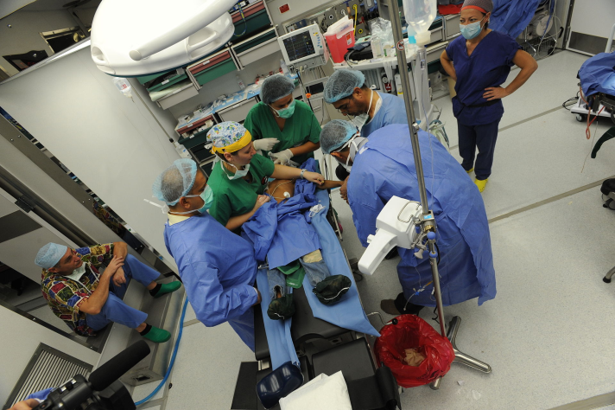
Procedure Location:
May need to provide anesthesia in the
OR
ICU
Sedation Unit
Bedside
Does the patient need to be transported to a higher-level hospital?
Figure 11

Slide 23
Procedure Location:
Sedation outside of the OR is common, especially in limited resource settings
Ideally, monitoring, O₂, suction, airway and rescue equipment should be available
A qualified anesthesia provider should be capable of
  Administering anesthesia, sedation and analgesic medications
  Monitoring vital signs
  Managing the airway and cardiorespiratory status
  Appropriate fluid management
Notes:
Monitoring can range from a hand-held pulse-oximeter to EKG, blood pressure, oxygen saturation, end tidal CO2 and temperature.

Slide 24
Pre-Medication:
Children with burns often require frequent multiple procedures that are painful
Children with burns can display extreme anxiety and post traumatic stress disorder
Premedication can help alleviate this anxiety and distress

Slide 25
Pre-Medication:
DRUG | DOSE
Midazolam PO | 0.5 mg/kg (max 20 mg)
Midazolam IV | 0.05 - 0.1 mg/kg/dose (max 5 mg)
Midazolam Nasal | 0.2 - 0.4 mg/kg (max 10mg)
Ketamine PO | 5 mg/kg (max 200 mg)
Ketamine IM | 3 - 5 mg/kg (max 200 mg)
Ketamine IV | 0.5 - 2 mg/kg (max 200mg)
Dexmedetomidine Nasal | 3 - 5 mcg/kg (max 200 mcg)

Slide 26
Induction Considerations
Distraction techniques and a quiet, soothing environment without bright lighting can be helpful
An inhalational induction with parental presence could be offered in an induction room or operating room.

Slide 27
Anesthetic Technique
There are no specific agents nor techniques that are proven to be superior for burn anesthesia
Regional, general, and local anesthesia can all be utilized
Airway management:
      Natural airway, nasal cannula, facemask
      Nasal airway, Oral airway
      LMA and ETT

Slide 28
Anesthetic Technique
 | Mild Sedation | Moderate Sedation | Deep Sedation | General Anesthesia
Spontaneous Ventilation | Unaffected | Adequate | Intervention might be required | Intervention required
Airway | Unaffected | No intervention required | Intervention might be required | Intervention often required
Responsiveness | Responds normally to verbal stimulation | Responds purposefully to verbal/tactile stimulation | Responds to deep/painful stimulation | Unarousable
Cardiovascular Function | Unaffected | Typically maintained | Typically maintained | Might require intervention
Notes:
This slide is meant to classify the different depths of sedation and to describe what cardio-respiratory support needs can be anticipated .

Slide 29
Anesthetic Agents to Minimize:
Nitrous Oxide | Repeated and prolonged use can precipitate pernicious anemia in children with poor nutritional status
Etomidate | Repeated use can cause adrenal suppression
Haloperidol | Can cause extra-pyramidal symptoms and neuroleptic malignant syndrome

Slide 30
Fluid Resuscitation
Burn edema is maximal in the first 18 - 30 hours
IV fluid resuscitation is essential for supporting intravascular volume and perfusion
Formulas based on body weight (i.e. Parkland Formula) likely underestimate resuscitation in children
Endpoints such as capillary refill, mental state, and urine output should be followed
Notes:
Parkland Burn Formula = (4cc) x (kg) x (TBSA burned)
Half of this volume is given in the first 8hrs after the burn, the other half is given over the next 16hrs.
Lactated Ringers is the crystalloid of choice.
In younger children, hypoglycemia may be of concern. Consider using D5LR at a maintenance rate

Slide 31
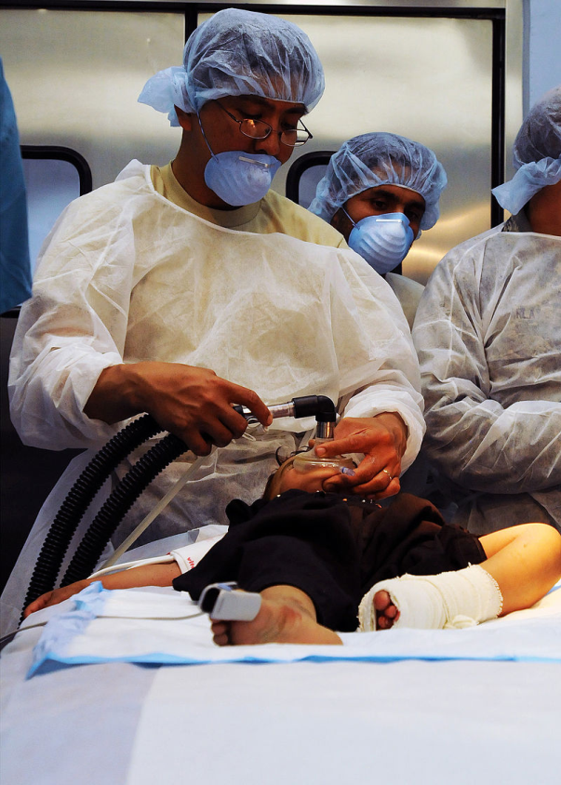
Intra-Operative Considerations
Active warming will likely be needed
Monitoring can be difficult
Sites for peripheral intravenous access may be limited
Significant blood loss during burn debridement procedures
Figure 12

Slide 32
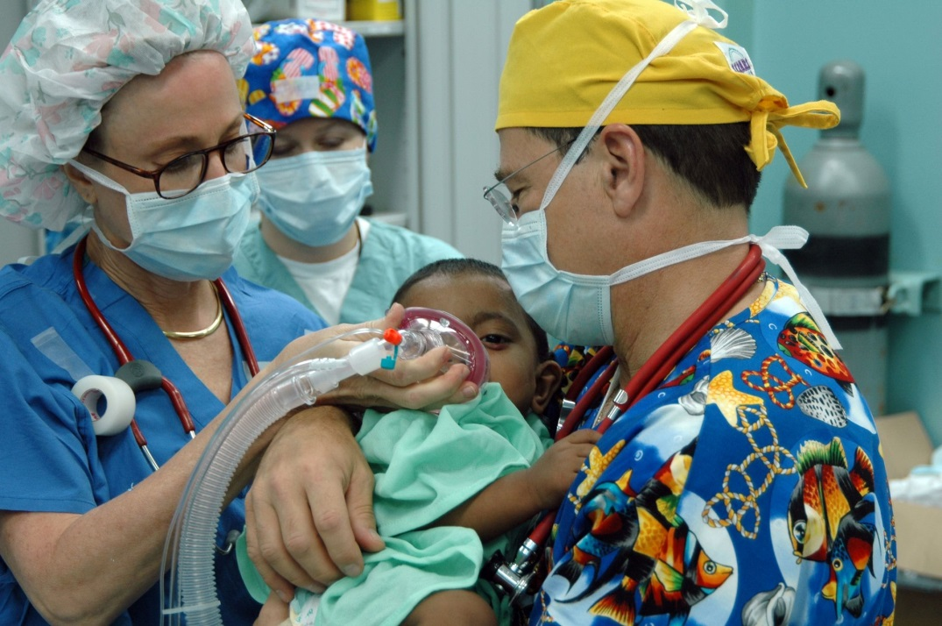
Pharmacologic Considerations Unique to Burn Patients
Figure 13

Slide 33
Succinylcholine
Upregulation of extra-junctional acetylcholine receptors occurs in skeletal muscle after the acute phase
In the first 24 – 48 hours it is safe to use succinylcholine in these patients
After the first 24 - 48 hours succinylcholine can lead to life threatening hyperkalemia
Notes:
Also known as Suxamethonium
Hyperkalemic response can continue until 1 year after the injury

Slide 34
Non-Depolarizing Muscle
Relaxants (NDMRs)
Due to the upregulation of extra-junctional acetylcholine receptors, patients in the hypermetabolic phase (after 24 – 48 hours), show resistance to NDMRs
Higher and more frequent dosing of rocuronium or vecuronium are needed

Slide 35
Hypermetabolic Phase
Increased drug clearance because of increased hepatic and renal blood flow; may need to re-dose medications more frequently
Production of alpha-1-glycoprotein increases as it is an acute phase reactant which may decrease the free fraction of medication; may need larger doses
Notes:
AAG binds cationic drugs, such as lidocaine, propranolol, muscle relaxants, and some opioids. AAG is also an acute-phase reactant. Its concentration increases twofold or greater in burn-injured patients, which decreases the free fraction of drugs bound by AAG. (Bittner et al)

Slide 36
Pain Management
Hyperalgesia
Neuropathy
Regeneration of peripheral nerves can result in paresthesia and opioid resistant neuropathic pain; consider gabapentin
Tolerance to narcotics often develops and requires larger doses

Slide 37
Pain Management (con’t)
Procedures such as daily debridements and dressing changes can be intensely painful and often require multimodal approaches to pain management
Narcotics: fentanyl, morphine, hydromorphone
Opioid agonists/antagonists
Methadone
Ketamine and/or clonidine
Regional anesthesia if possible
Notes:
Fentanyl: 0.5 – 2 mcg/kg IV
Morphine: 0.05 mg/kg IV
Hydromorphone: 0.005 mg/kg IV
Methadone: 0.1 mg/kg/dose IV every 8 hours; maximum initial dose: 10 mg/dose; maximum daily dose: 0.7 mg/kg/day divided every 4-6 hours as needed for pain or 90 mg/day. NOTE: Since methadone steady-state is reached at 4-5 days, I.V. methadone dosing changes should NOT be made more frequent than every 72 hours. Baseline EKG recommended, beware of prolonged QTc
Ketamine: 0.5 – 1 mg/kg IV

Slide 38
Conclusions:
Burn injuries have a significant global impact
Burns are described in terms of depth and total body surface area
The “Ebb” and “Flow” phases have distinct pharmacological impact
Inhalational injuries include carbon monoxide and cyanide poisoning.
There are unique pediatric considerations

Slide 39
References:
Bittner E, et al. Acute and Perioperative Care of the Burn-injured Patient. Anesthesiology. 2015; 122:448-64.
Thomas J, et al. Paediatric burns anaesthesia: the things that make a difference. Southern African Journal of Anaesthesia and Analgesia. 2015; 20:5, 190-196.
Fenlon S, et al. Burns in Children. Continuing Education in Anaesthesia, Critical Care & Pain. British Journal of Anaesthesia, 2007;7(3): 76-80.
Fagin A, et al. Considerations for pediatric burn sedation and analgesia. Burns & Trauma. 2017; 5:28.
Krishnamoorthy V, et al. Pediatric Burn Injuries. Int J Crit Illn Sci. 2012 Sep-Dec; 2(3):128-134.
Kaplan R. et al, Intramuscular Rocuronium in Infants and Children: A Multicenter Study To Evaluate Tracheal Intubating Conditions, Onset, and Duration of Action. Anesthesiology. 1999;91(3):633.
Mock C, et al. A WHO plan for burn prevention and care. Geneva, World Health Organization, 2008.

Slide 40
Figures:
Wikimedia Commons, “Mar Mediterraneo Oriental”, RM Silva, 13 June 2009, CC-BY-3.0.
Creative Commons, “Women cooking using the open fire stove”, WambuiMwangi, CC-BY-SA-3.0.
Wikimedia Commons, “Christmas Comes Early and Often for Those at Indira Gandhi Institute of Child Health”, Petty Officer 1st Class Monica Nelson, 23 November 2008, CC-PD-Mark.
Wikimedia Commons, “Burns”, BruceBlaus, 3 November 15, CC-BY-SA-4.0. CC-BY-SA-4.0
Wikimedia Commons, “Lund-Browder chart”, U.S. Department of Health and Human Services, 24 April 2013, CC-PD-Mark.
Creative Commons, “Man Shadow with organs”, Mikael Haggstrom, CCO 1.0.
Creative Commons, “Female shadow with organs”, Mikael Haggstrom, CCO 1.0.

Slide 41
Figures (continued):
Creative Commons, “Soup burn – 2 days later”, Quasimime, CC BY-NC-ND-2.0.
Creative Commons, “Happy”, MikeBlyth, CC-BY-NC-SA-2.0.
Wikimedia Commons, “Bagram medics save Afghan family from losing three generations”, Staff Sgt. Sheila deVera, 11 January 2011, Public Domain.
Creative Commons, “Smile Train Surgery”, Staff Sgt. Brendan Stephens, 27 October 2008, Public Domain.
Wikimedia Commons, “American Medical Professionals Treat Injured Child”, Sgt. Spencer Case, 31 August 2010, Public Domain.
Wikimedia Commons, “US Navy Operation Smile volunteers Janet Casabon Benowitz and Dr. Bill Pond anesthetize a young child before undergoing corrective plastic surgery on his cleft lip”, Seaman Josephe Caballero, 2 July 2006, CC-PD-Mark.

