Slide 1
Management of the Patient with Congenital Diaphragmatic Hernia
Premal Trivedi, MD, FAAP¹
Courtney Hardy, MD, MBA, FAAP²
Updated 4/2018
Notes:
¹ Assistant Professor of Anesthesiology
Arthur C. Keats Division of Pediatric Cardiovascular Anesthesiology
Texas Children’s Hospital
Baylor College of Medicine
² Associate Professor of Anesthesiology
Ann and Robert Lurie Children’s Hospital of Chicago
Northwestern University

Slide 2
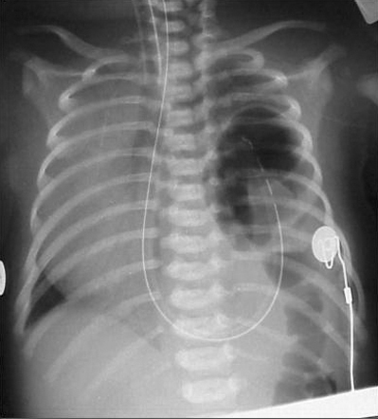
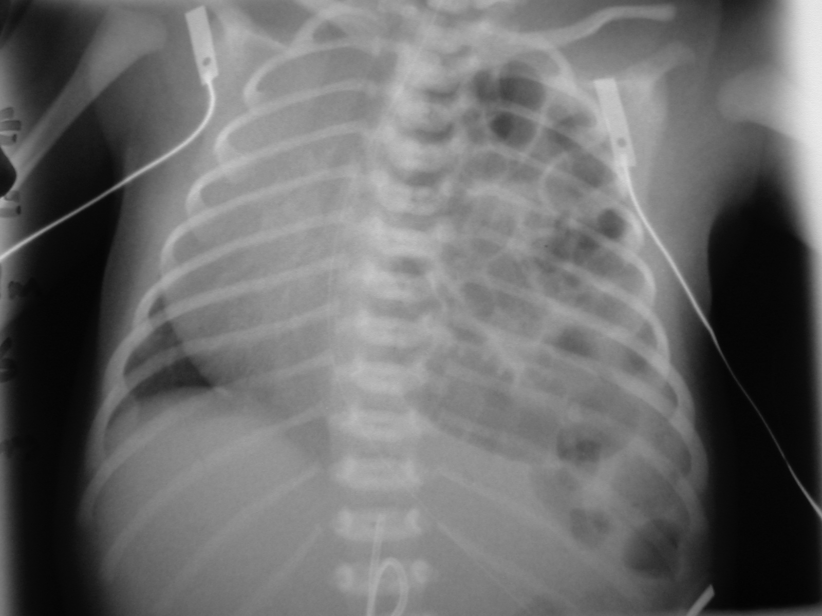
No Disclosures
Notes:
Images courtesy of Drs. Nicola Lewis and Philip Glick

Slide 3
Learning Objectives
Review the pathophysiology of congenital diaphragmatic hernias (CDH)
Identify the anomalies often associated with CDH
Discuss the evolution of CDH management and current therapeutic goals and maneuvers
Compare the different surgical strategies for repair and the different settings in which surgery may occur
Devise an anesthetic plan that minimizes the risk of common complications associated with repair

Slide 4
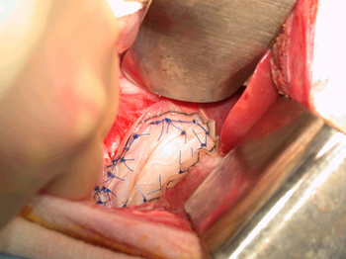
Outline
Defining CDH
  Associated anomalies
  Diagnosis
Physiologic consequences
Management
  Prenatal interventions
  Postnatal strategies
Anesthetic considerations & post-op management
Long-term concerns in CDH repair

Slide 5
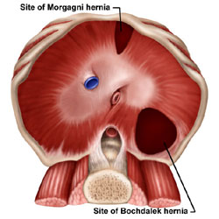
What is a CDH?
A diaphragmatic defect
  Allows abdominal contents to enter the thorax
Location of the defect^{1,2}
  ~80% left-sided
  ~20% right-sided
  ~1-2% bilateral
Etiology unknown
Incidence of 1:2000-5000^{1,2}
Notes:
During development, closure of the pleuroperitoneal canal allows separation of the thoracic and abdominal contents³. This usually occurs by gestational week 10. If closure does not occur, herniation of the abdominal viscera into the thorax results, accompanied by varying degrees of pulmonary hypoplasia. Clinical presentation and outcome correlate with the severity of pulmonary hypoplasia and the presence or absence of associated anomalies.
No one factor has been identified as being causative in CDH. It is becoming evident, though, that genetic factors play a significant role. Mutations in nearly all chromosomes have been described, and one mutation in particular at 15q26 is frequently identified in isolated CDH. Environmental exposures to insecticides and drugs like nitrofen or thalidomide appear to be lesser contributors.
1. Bosenberg AT, Brown RA. Management of congenital diaphragmatic hernia. Current Opinion in Anesthesiology 2008; 21: 323-31
2. Deprest J, et al. Current consequences of prenatal diagnosis of congenital diaphragmatic hernia. Journal of Pediatric Surgery 2006; 41: 423-30
3. Grosfeld, Jay, et al. Pediatric Surgery, 6th edition, Chapter 60: Congenital Diaphragmatic Hernia and Eventration. Mosby, 2006

Slide 6
Associated Anomalies
Present in ~40-60% of infants with CDH¹
  Neural
  Cardiac
  Renal & GI
  Chromosomal & Syndromal
Independent predictors of survival^{1,2}
  ~15% survival in those with associated anomalies
Overall survival rates of CDH patients unclear²
  ~50-70% postnatal survival
Notes:
Commonly associated anomalies include neural tube defects and congenital cardiac lesions such as ventricular septal defects, vascular rings, and aortic coarctation. Gastrointestinal anomalies include esophageal atresia, omphalocele, gastroschisis, and cleft palate. CDH can be part of a syndrome as well. Over 50 different syndromes have been associated with CDH, including trisomies 13, 18, and 21, and Goldenhar’s and Beckwith-Wiedemann syndromes.
The presence of associated anomalies is a significant predictor of mortality. Less than 15% of such patients survive. Isolated cases of CDH have better survival, but to what to extent is unclear. Overall survival appears to be 50-70%, and in highly specialized centers may be as high as 80%. Right-sided, bilateral, and large defects associated with significant pulmonary hypoplasia and pulmonary hypertension are associated with poor outcome and increased mortality. Prematurity, with its implications on cardiopulmonary function, further increases the risk of mortality.
1. Bosenberg AT, Brown RA. Management of congenital diaphragmatic hernia. Current Opinion in Anesthesiology 2008; 21: 323-31.
2. Deprest J, et al. Current consequences of prenatal diagnosis of congenital diaphragmatic hernia. Journal of Pediatric Surgery 2006; 41: 423-30.

Slide 7
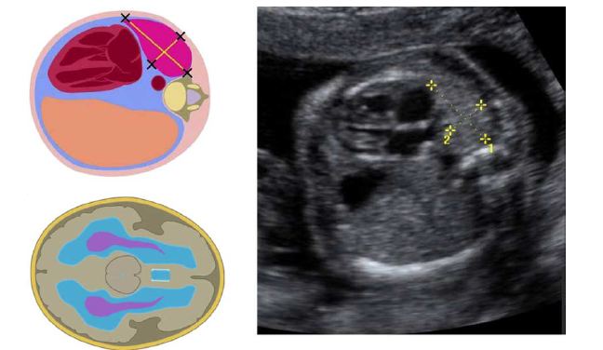
How Is It Diagnosed?
Prenatally^{1,2}
  50-60% can be detected via US
At birth
  Respiratory distress
  Scaphoid abdomen
  Distended chest
  NG coiled in thorax on CXR
Later in life
  Recurrent pulmonary issues
  Bowel incarceration
  Gastric Volvulus
Notes:
Ultrasound can be used both to diagnose CDH and to assist in determining prognosis prenatally. CDH can be diagnosed with ultrasound as early as the first trimester, but is limited by the location of the defect and the imaging quality and technical expertise available. Factors on ultrasound that appear to be prognostic include the lung to head circumference ratio (LHR), and the presence or absence of the liver in the thorax. The image above, obtained from Deprest et al, depicts the ultrasound determination of the LHR. The contralateral lung is measured in its longest length and width at the level of the 4-chamber view of the heart. These measurements are multiplied together, and the product is compared to the head circumference in the standard biparietal view. When the liver is in the thorax and the LHR is < 1.0, the condition is considered severe.
Those patients diagnosed at birth tend to have severe pulmonary hypoplasia. They may have a scaphoid abdomen, due to the absence of intraabdominal contents, and a concurrently distended chest. The chest may become more distended with spontaneous breaths as swallowed air fills the stomach. For this reason, positive pressure bag mask ventilation may be deleterious, and should be avoided prior to intubation.
Although most CDH patients present within the first 24 hours of life, 10-20% of CDH patients present later in life. Reasons for diagnosis later in life include recurrent pulmonary issues, incarceration of bowel, or gastric volvulus.
1. Bosenberg AT, Brown RA. Management of congenital diaphragmatic hernia. Current Opinion in Anesthesiology 2008; 21: 323-31.
2. Deprest J, et al. Current consequences of prenatal diagnosis of congenital diaphragmatic hernia. Journal of Pediatric Surgery 2006; 41: 423-30.

Slide 8
Consequences of CDH
Impaired lung development bilaterally
pHTN & persistence of fetal circulation
Hypoxemia, hypercapnea, & acidosis
Notes:
Pulmonary hypoplasia and its sequelae are the primary cause of death in CDH. Each lung is affected, with both having a decreased number of bronchial branches and a decreased quantity and quality of alveoli. The pulmonary vasculature is also abnormal. Not only is there a decreased cross-sectional area due to lung hypoplasia, but there is also excessive muscularization of the arterial adventitial and medial walls. These patients have impaired oxygenation and ventilation as a consequence of their deficient and undeveloped airways, and a tendency towards pulmonary hypertension due to changes in their pulmonary vasculature. The hypoxemia, hypercapnea, and acidosis that ensue all act to exacerbate pulmonary hypertension.
In this setting of severe pulmonary hypertension, blood preferentially bypasses the lungs via the ductus arteriosus and the foramen ovale, creating a right to left shunt. This acts to aggravate the existing hypoxemia and acidosis. A downward spiral ensues.

Slide 9
Management of CDH
Prenatal
Postnatal

Slide 10
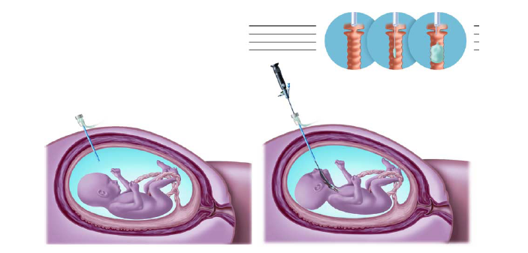
Prenatal Interventions
Antenatal steroids⁴
  No evidence to support their use
Fetal interventions: tracheal occlusion²
  Novel procedure with further study needed
Notes:
Since the pathology in CDH involves lung hypoplasia, it was thought that glucocorticoids administered after 34 weeks gestational age would help promote lung maturity. A recent report by the CDH Study Group did not support their use.
A more intriguing area of study has developed around the concept of fetal endoluminal tracheal occlusion. This procedure, in which the fetal trachea is temporarily occluded, is being trialed in those fetuses with CDH deemed to be a greatest risk for mortality, and who are otherwise anatomically and chromosomally normal. The procedure was initiated after the observation that fetuses with congenital laryngeal atresia had excessive lung growth. Initial results were mixed, due in part to preterm premature rupture of membranes (PPROM) following the procedure. Efforts are ongoing to identify the optimal timing for the procedure and to hone the surgical technique. The images above demonstrate the technique of tracheoscope advancement and balloon inflation.²
No information was found on institutions performing ex utero intrapartum therapy (EXIT) procedures to surgically correct CDH.
2. Deprest J, et al. Current consequences of prenatal diagnosis of congenital diaphragmatic hernia. Journal of Pediatric Surgery 2006; 41: 423-30.
4. Logan JW, Rice HE, Goldberg RN, Cotton CM. Congenital diaphragmatic hernia: a systematic review and summary of best-evidence practice strategies. Journal of Perinatology 2007; 27: 535-49.

Slide 11

Postnatal Interventions
Historical perspective⁵
  Once treated as a surgical emergency
  Aggressive hyperventilation was common
Evolution of management
  NICU stabilization
    Gentle ventilation
    Alleviation of pHTN
  Delayed surgery
Notes:
Between the 1940s and the 1980s, CDH was managed as a surgical emergency. The paradigm shifted when it was noted that these neonates often had decreased pulmonary compliance and respiratory failure following surgery. This was thought to be due in part to the distortion of the repaired diaphragm and the increase in intraabdominal pressure that accompanied the reduction of intrathoracic contents. Today, CDH is not a surgical emergency, and surgery can be delayed for stabilization of the neonate in certain cases.
The management of ventilation has also evolved. Whereas hyperventilation-induced alkalosis was once desired, the goal is now a lung protective strategy. It had been thought that by decreasing PaCO₂ via aggressive ventilation, pulmonary hypertension would improve and shunting would lessen, thereby improving tissue oxygenation. This form of ventilatory management, however, resulted in lung injury through elevated airway pressures. These patients are now managed by limiting peak airway pressures and allowing permissive hypercapnea.
5. Harting MT, Lally KP. Surgical management of neonates with congenital diaphragmatic hernia. Seminars in Pediatric Surgery 2007; 16: 109-114.

Slide 12
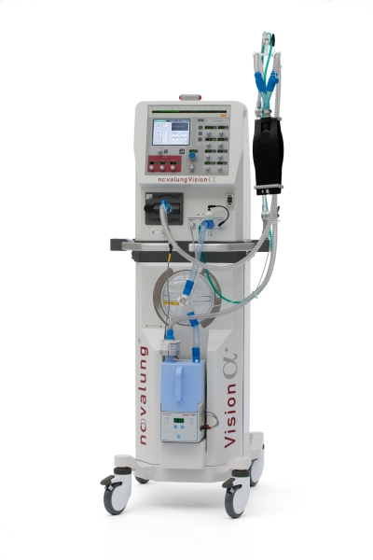
Vent Management in the NICU
Most will need ventilatory support
Institution dependent guidelines⁴
  Lung protective strategy
  pH/PaCO2/PaO2 goals
  Blood pressure goals
Rescue treatment
  HFOV
  iNO
  ECMO
Notes:
Most institutions appear to agree on the need for lung protective ventilation, but differ in what they deem acceptable for peak inspiratory pressures. The range is broad, with some institutions choosing a cut off of 25cm H₂O and others 35cm H₂O. Institutions also differ in their use of sedation and paralysis, with some choosing to leave the patient spontaneously breathing, and others choosing deep sedation and paralysis. Currently the trend is towards the use of narcotics and avoidance of paralysis. Differences also exist in what are deemed to be acceptable blood gases. In general, the goals are pH > 7.25, paCO2 < 65, and preductal SaO2 > 90%. Preductal SaO2 as low as 80% is tolerated in some institutions provided there is evidence of adequate end-organ perfusion as measured by some combination of lactate levels, urine output, and pH.
When these goals cannot be met by increasing ventilatory support or when peak airway pressure thresholds have been reached, further management can include high frequency oscillatory ventilation (HFOV), the use of inhaled nitric oxide (iNO), or the use of extracorporeal membrane oxygenation (ECMO).
HFOV is a mode of ventilation that provides a constant airway pressure and end-expiratory lung volume without causing overdistension that is associated with lung injury. iNO can be used to treat pHTN and to promote V/Q matching leading to better oxygenation. Assuming the patient is an appropriate candidate, ECMO is often initiated when the above modalities have failed to provide acceptable oxygenation, ventilation, or tissue perfusion.
4. Logan JW, Rice HE, Goldberg RN, Cotton CM. Congenital diaphragmatic hernia: a systematic review and summary of best-evidence practice strategies. Journal of Perinatology 2007; 27: 535-49.

Slide 13
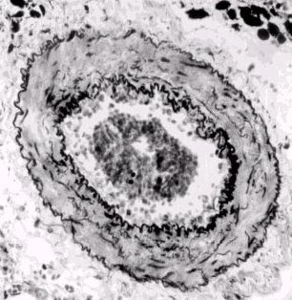
Control of Persistent pHTN
iNO
Sildenafil
  PDE inhibitor
Iloprost
Treprostinil
Epoprostenol
Bosentan
  Endothelin receptor antagonist
Prostacyclins
Notes:
Different pharmacologic agents that can be used in those who have reversible components to their pulmonary hypertension.

Slide 14
Timing of Surgery
Generally delayed for
  Physiologic stabilization
  Improvement in pHTN
  Minimal ventilatory support
Exact criteria institution-dependent
Surgery on ECMO
  Infrequent
  Often performed if patient fails to wean off ECMO
Notes:
It is important to note that some neonates may stabilize quickly, needing no more than 48 hours, whereas others will need weeks of medical management.
Contraindications to ECMO are again institutional-specific, but in general include: gestational age < 32-33 weeks, birth weight < 2000g, major intraventricular hemorrhage, or anomalies that would preclude long-term survival.
Mortality of infants who underwent repair on ECMO was noted to be 50% in the 2002 CDH Study Group. Mortality was 17% in those who were repaired after ECMO decannulation^{4,5}.
5. Harting MT, Lally KP. Surgical management of neonates with congenital diaphragmatic hernia. Seminars in Pediatric Surgery 2007; 16: 109-114
6. Tsao K, Lally KP. Surgical management of the newborn with congenital diaphragmatic hernia. Fetal Diagn Ther 2010

Slide 15

You’re now asked to give an anesthetic for a CDH repair...
Questions to ask
  Location for repair?
    OR versus NICU
  Associated anomalies?
  Ventilatory and HD status?
  Medication regimen?
  Access?
  Technique for repair?
Notes:
Neonates on ECMO or HFOV are often repaired in the NICU. Depending on the institution, either the anesthesia service or the neonatology team may be responsible for managing these patients. For the anesthesiologist, the NICU environment presents challenges in terms of the relative lack of space, supplies, and assistance compared to the operating room. Moreover, monitoring the patient can be more challenging as end-tidal CO₂ may not be used, and access to the patient’s airway and intravenous or intra-arterial lines can be limited.
Compared to patients surgically managed in the NICU, patients presenting to the OR are usually stabilized neonates or individuals with an incidental finding of CDH. Consequently, the risk associated with these two groups can be substantially different.
Traditional techniques for repair include a subcostal incision on the ipsilateral side of the diaphragmatic defect. 90% of surgeons preferred this approach as of 1998. The procedure can also be performed via a thoracotomy, or increasingly via thoracoscopic or laparoscopic surgery. General strategies for repair include primary closure if the defect is small, or the use of a prosthetic patch like PTFE if the defect is large. A patch prevents flattening of the diaphragm and decreases pulmonary compliance in immediate post-operative period. Prosthetic patches also can be problematic in that they do not grow with the patient. Hernia recurrence is not unexpected with this repair.

Slide 16
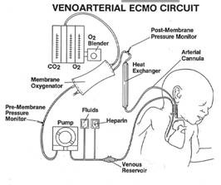
Considerations for Repair on ECMO
1998, 33% of patients placed on ECMO underwent repair on ECMO⁴
  Hemorrhage is a known complication for infants requiring ECMO
Role of aminocaproic acid
  Decreases surgical site bleeding
Notes:
The use of ECMO entails the use of anticoagulants to prevent thrombosis. As such, repairs on ECMO are often associated with increased blood loss. Aminocaproic acid, an anti-fibrinolytic, has been demonstrated to decrease surgical blood loss for this patient population.
Harting MT, Lally KP. Surgical management of neonates with congenital diaphragmatic hernia. Seminars in Pediatric Surgery 2007; 16: 109-114.
Tsao K, Lally KP. Surgical management of the newborn with congenital diaphragmatic hernia. Fetal Diagn Ther 2010

Slide 17
General Considerations*
Avoid PPV via mask
Intubate while spontaneously ventilating
Avoid nitrous
  Bowel distension impaired ventilation
Minimize peak inspiratory pressures
Note the effects of hernia reduction on the lung
  Taut abdomen decreased lung compliance
increased airway pressure
Notes:
*Particularly relevant to the neonate presenting for surgical repair
Prior to surgical reduction of the hernia, care must be taken not to distend the stomach with air/oxygen as this can further compromise ventilation. To this end, one should try to minimize any positive pressure ventilation via mask, either before or in the process of intubation.
Care should also be taken to avoid increasing tidal volumes once the hernia contents are reduced back into the abdomen. The ipsilateral hypoplastic lung will not expand to fill the void, and increasing tidal volume may only exacerbate lung injury or induce a contralateral pneumothorax.
Vigilance is also necessary in noting any changes in airway pressure upon the reduction of the hernia. The abdominal cavity is not well developed in these patients, and hernia reduction often leads to an increase in intraabdominal pressure, thereby decreasing pulmonary compliance and reducing preload to the heart. This is particularly true in infants undergoing repair on ECMO. If the new airway pressures are above acceptable limits, or if ventilation or hemodynamics are compromised, this should be communicated to the surgical team.
7. Hillier SC, Krishna G, Brasoveanu E. Neonatal Anesthesia. Seminars in Pediatric Surgery 2004; 13(3): 142-151.

Slide 18
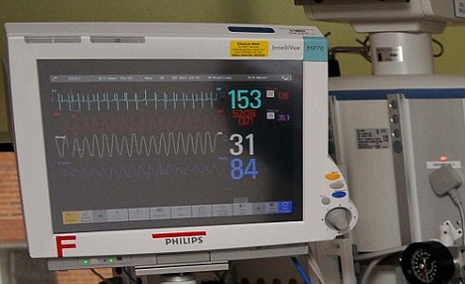
Drugs, Supplies, & Monitors to Have Available
Standard ASA monitors
Invasive monitoring with arterial line
Adequate venous access
Blood available
iNO
Inotropes
Notes:
This slide is directed towards those CDH patients who present to the OR after NICU stabilization. This population is theoretically optimized in regards to pulmonary hypertension, ventilatory requirements, acid-base and hemodynamic status.
In addition to the standard ASA monitors, an arterial line, if not already present, would be beneficial for several reasons. The primary rationale for an arterial line would be the ability to monitor the effectiveness of ventilation. This would be particularly relevant for those patients undergoing thoracoscopic repair.
Central venous access can be considered as well, particularly if there is difficulty obtaining adequate peripheral venous access or if there are cardiac concerns. An umbilical venous or arterial catheter may already be present.
And though they may not be used, nitric oxide and inotropes should be readily available if issues with pulmonary hypertension or cardiac dysfunction arise.

Slide 19
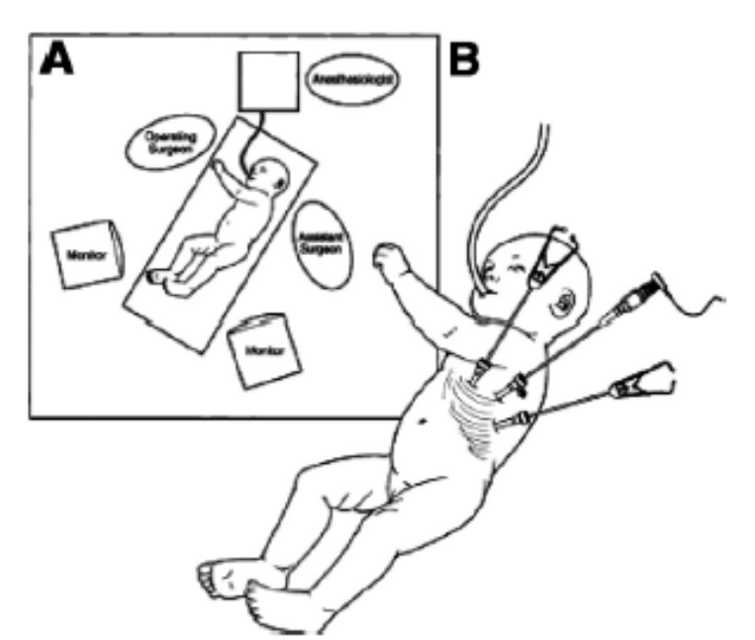
Considerations for Thoracoscopic Repair
Effects of the lateral decubitus position
Effects of CO₂ insufflation
  Ventilation
  Acid-base status
  Hemodynamics
Effects of lung compression & retraction
Notes:
This slide is directed towards those CDH patients who present to the OR after NICU stabilization. This population is theoretically optimized in regards to pulmonary hypertension, ventilatory requirements, acid-base and hemodynamic status.
In addition to the standard ASA monitors, an arterial line, if not already present, would be beneficial for several reasons. The primary rationale for an arterial line would be the ability to monitor the effectiveness of ventilation. This would be particularly relevant for those patients undergoing thoracoscopic repair.
Central venous access can be considered as well, particularly if there is difficulty obtaining adequate peripheral venous access or if there are cardiac concerns. An umbilical venous or arterial catheter may already be present.
And though they may not be used, nitric oxide and inotropes should be readily available if issues with pulmonary hypertension or cardiac dysfunction arise.

Slide 20
Analgesia for thoracic surgery
Options dictated by
  Surgical technique: open versus thoracoscopic
  Severity of disease: ECMO/HFOV vs incidental finding
  Co-morbid conditions
  End-organ injury
    Liver
    Kidneys
  Age of patient at time of surgery
Notes:
Golianu B, Hammer GB. Pain management for pediatric thoracic surgery. Current Opinion in Anesthesiology 2005; 18(1): 13-21

Slide 21
Mainstays of therapy
Opioids
  Fentanyl (tolerance may be an issue if used pre-op)
Local anesthetic*
  Infiltrated at the incision
  Via caudal epidural threaded to the thoracic level
  Via direct thoracic epidural in older patients
  Via paravertebral block
Adjuvants
  Acetaminophen*
  Ketorolac*
  Dexmedetomidine
Notes:
*Tests of coagulation should be assessed prior to performing a neuraxial block. ECMO (which would entail anticoagulation with heparin) or abnormal coagulation otherwise would be a contraindication to epidural, spinal, or paravertebral analgesia.
*Acetaminophen can be used assuming intact liver function and can be given orally, rectally, or intravenously.
*Ketorolac can be used assuming controlled bleeding and intact renal function
Tobias JD. Anesthesia for neonatal thoracic surgery. Best Pract Res Clin Anaesthesiol. 2004 Jun;18(2):303-20

Slide 22
Summary of Potential Intraoperative Complications
Exacerbation of pHTN
  Promotes shunting
  Increases RV afterload
Hypotension and impaired ventilation secondary to the mechanical effects of insufflation*
Contralateral pneumothorax
  Altered hemodynamics and lung compliance with hernia reduction
Hemorrhage
Hypothermia
Hypoxia, Acidosis, Hypotension
Notes:
*Assuming thoracoscopic surgery with CO₂ insufflation
pHTN is often worsened by elevations in PaCO₂ that occur with hypoventilation or the insufflation of CO_{2.} Not only does a respiratory acidosis result, but eventually a metabolic acidosis also occurs due to the tissue hypoxia resulting from the increased shunting of blood via the patent ductus arteriosus. The combination of hypercapnea, acidosis, and hypoxemia all act to worsen pHTN and can lead to cardiovascular collapse in the neonate.
pHTN can also be worsened by acute increases in sympathetic tone, highlighting the importance of an adequate level of anesthesia during these procedures.

Slide 23
Post-operative Management
Pre-operative and intraoperative status should determine timing of extubation
  Historically left intubated
Immediate concerns are similar to those pre-operatively
  Ventilation/oxygenation/airway pressures
  Acid-base status
  Hemodynamics
  Analgesia
Notes:
The rationale for leaving a neonate intubated following CDH repair is that time may be needed to stabilize from a ventilatory and hemodynamic perspective. The diaphragm may not be in the ideal conformation following repair, particularly if a patch is used, and may not contract efficiently in the immediate post-operative period. Moreover, as noted earlier, the patient may need to adjust to increased intraabdominal pressures following reduction of the hernia and closure of the abdominal fascia and skin.

Slide 24
What Happens Down the Road?
Hernia recurrence^{4,5}
  14-22%
Associated morbidity
  Long-term pulmonary outcome?
  Neuro-developmental deficits?
  GI concerns
  Musculoskeletal issues
Notes:
Hernia recurrence is unfortunately fairly common. These patients may present for repeat surgery electively out of concern for incarceration, or more emergently if there are signs of strangulation.
The risks of reoperation are weighed against the benefits of repair.
The long-term effects of CDH on those patients who survive repair is currently being studied. The true incidence of chronic lung disease in adult CDH survivors is unknown, but pulmonary function has been noted to be good in general. Factors associated with poor pulmonary outcome include ECMO use, patch repair, and pulmonary hypertension. In regards to neurologic status, deficits have been noted in motor function and cognition. The prevalence of these deficits in this patient population is unknown. The neurological deficits may be influenced by the severity of the illness and its treatment modalities such as prolonged ventilation and ECMO. The most common GI problem in CDH survivors seems to be gastroesophageal reflux. Bowel obstruction may also occur if an abdominal approach was used, and volvulus can occur following either an abdominal or thoracic approach. Growth failure is also common, with many survivors remaining below the 25th percentile for weight.
4. Harting MT, Lally KP. Surgical management of neonates with congenital diaphragmatic hernia. Seminars in Pediatric Surgery 2007; 16: 109-114
5. Tsao K, Lally KP. Surgical management of the newborn with congenital diaphragmatic hernia. Fetal Diagn Ther 2010

Slide 25
Key Points
CDH presentation and the length needed for stabilization are highly variable
Many have associated anomalies
Delayed surgical repair is now preferred to allow for stabilization
Repair may take place in NICU or OR indicating different clinical pictures
Techniques for repair are evolving
Anesthetic management entails a continuation of NICU management

Slide 26
References
Bosenberg AT, Brown RA. Management of congenital diaphragmatic hernia. Current Opinion in Anesthesiology 2008; 21: 323-31.
Deprest J, et al. Current consequences of prenatal diagnosis of congenital diaphragmatic hernia. Journal of Pediatric Surgery 2006; 41: 423-30.
Grosfeld, Jay, et al. Pediatric Surgery, 6th edition, Chapter 60: Congenital Diaphragmatic Hernia and Eventration. Mosby, 2006.
Logan JW, Rice HE, Goldberg RN, Cotton CM. Congenital diaphragmatic hernia: a systematic review and summary of best-evidence practice strategies. Journal of Perinatology 2007; 27: 535-49.
Harting MT, Lally KP. Surgical management of neonates with congenital diaphragmatic hernia. Seminars in Pediatric Surgery 2007; 16: 109-114.
Tsao K, Lally KP. Surgical management of the newborn with congenital diaphragmatic hernia. Fetal Diagn Ther 2010.
Hillier SC, Krishna G, Brasoveanu E. Neonatal Anesthesia. Seminars in Pediatric Surgery 2004; 13(3): 142-151.
Cote, Charles, et al. A Practice of Anesthesia for Infants and Children, 4th edition, Chapter 13: Anesthesia for Thoracic Surgery. Philadelphia: Saunders, 2009.

