Slide 1
Anesthetic Considerations for Pediatric Patients with Anterior Mediastinal Masses
Vasili Chernishof, M.D.
Carl Lo, M.D.
Children’s Hospital Los Angeles
Updated 9/2019

Slide 2
Disclosures
No relevant financial relationships to report

Slide 3
Learning Objectives:
Identify anatomical and physiological perturbations that occur with mediastinal masses
Identify perioperative complications likely to occur in these patients and discuss their management
Discuss pre-operative testing used for anesthetic planning and risk stratification
Present anesthesia techniques helpful for management of anterior mediastinal mass

Slide 4
Introduction
Signs and Symptoms
Transient decrease in blood pressure
Airway obstruction
Complete cardiovascular collapse
Death
Perioperative complications are estimated to occur during 9% to 20% of anesthetic procedures.^{1, 2}
The differences between adult and pediatric populations relate to the histology, location, and symptomatology of the mediastinal masses.³
Notes:
Patients with mediastinal masses often present with a range of signs and symptoms.
Patients with anterior mediastinal mass may have severe cardiopulmonary compromise that can be exacerbated when undergoing general anesthesia.
Perioperative complications are defined as anything from transient decreases in blood pressure or mild airway obstruction to complete cardiopulmonary collapse and death.
Unfortunately, many examples of serious complications and death found in the literature have occurred in the pediatric population.

Slide 5
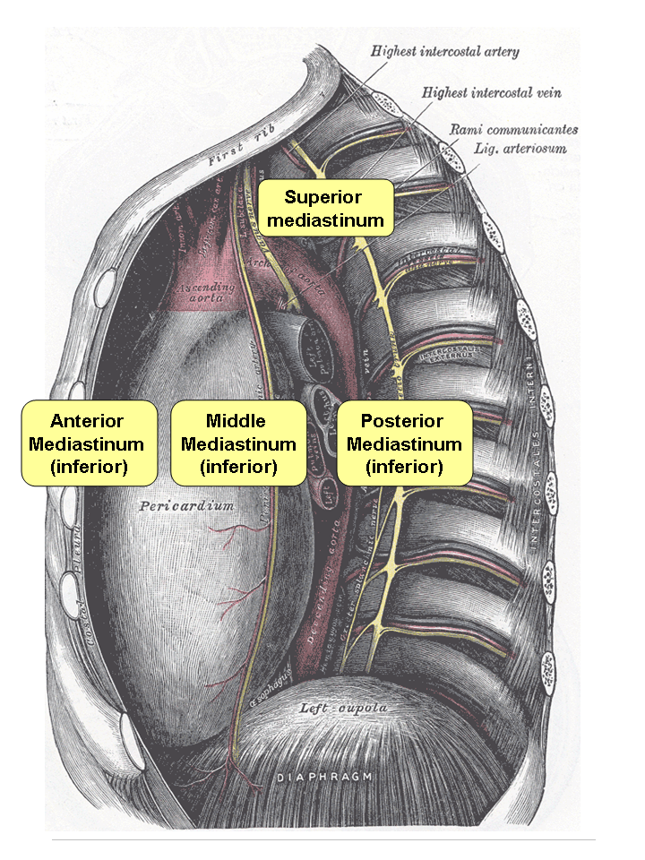
Anatomy
Most masses in the pediatric population are found in the anterior compartment, which are associated with increased perioperative risks. ⁴⁻⁶
Notes:
The mediastinum can be divided into 3 compartments: Anterior (superior and inferior segments), middle, and posterior.
Note that no anatomical or fascial planes exist to separate these compartments.
A mass originating in one compartment frequently crosses over to another compartments. For example, a mass originating in the anterior compartment can grow and invade structures in the middle compartment, making surgical resection very challenging.
Image: https://commons.wikimedia.org/wiki/File:Mediastinum.png

Slide 6
Mediastinal Masses
Anterior |  | Middle |  | Posterior
Benign | Malignant | Benign | Malignant | Benign | Malignant
*Thymoma Thyroid Cystic hygroma Thymic cyst Thymic hyperplasia | Thymic carcinoma Thyroid carcinoma Seminoma Mixed Germ Cell Lymphoma | Adenopathy Cysts Esophageal mass Vascular structures Hiatus hernia | *Lymphoma Esophageal Cancer Thyroid carcinoma Metastasis | *Neurofibroma Schwannoma Chemodectoma | Neuroblastoma
Notes:
Data from Yoneda KY, Louie S, Shelton DK. Mediastinal tumors. Curr Opin Pulm Med 2001;7:226–33.

Slide 7
Anterior Mediastinal Mass (AMM)
 | Children (%) | Adults (%)
Lymphomas | 45 | 23
Germ cell tumors | 24 | 14
Thymomas | 16 | 47
Others | 15 | 16
T-cell lymphoblastic leukemia, non-Hodgkin’s lymphoma, and neurogenic tumors have an increased incidence and an increased risk of perioperative complications in children.^{4,7,12}
Notes:
Diagnosis by percentage of anterior mediastinal mass comparing children with adults.
There is no correlation between tissue diagnosis and anesthetic risk in adults.⁶

Slide 8
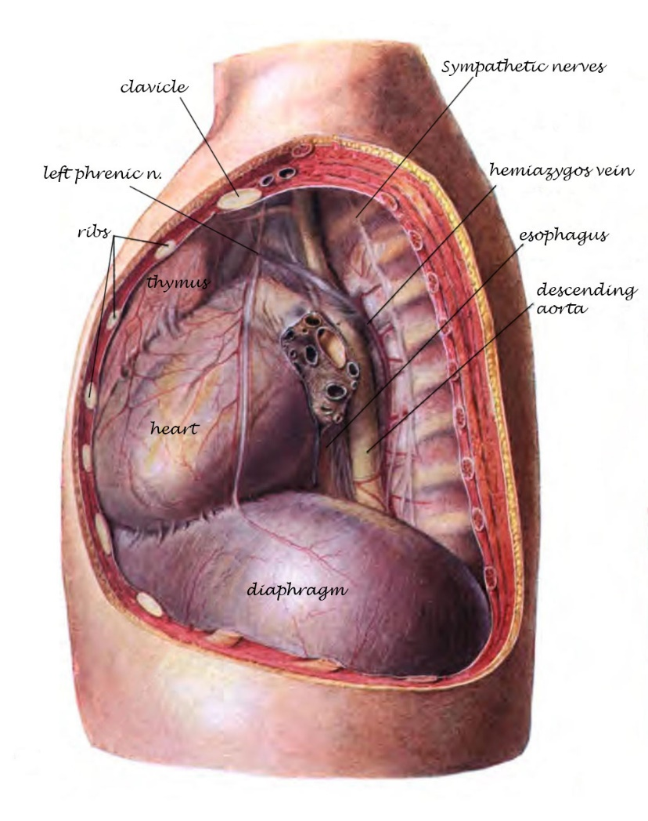
Physiology
Cardiopulmonary symptoms can be explained by compression of airway, cardiac, or major vessels by the mass
Notes:
Image: https://commons.wikimedia.org/wiki/File:Sobo_1906_461.png

Slide 9
Physiology
Hemodynamic compromise
Mass
Compression
Superior
Vena
Cava
Right
Cardiac
Chambers
Pulmonary Arteries
Pulmonary Veins
Left Ventricular Preload
Cardiac Output
Notes:
Hemodynamic compromise can occur when the mass compresses the right cardiac chambers, superior vena cava (SVC), pulmonary arteries, or pulmonary veins, resulting in decreased left-ventricular preload and cardiac output.

Slide 10
Physiology
Hypoxemia
Mass
Compression
Superior
Vena
Cava
Right
Cardiac
Chambers
Pulmonary Arteries
Pulmonary Veins
Pulmonary Perfusion
Hypoxemia
RV
Failure
Notes:
Compression of the pulmonary arteries not only decreases pulmonary perfusion, resulting in hypoxemia and hypoventilation, but can also lead to right-ventricular failure.
Respiratory compromise can occur from direct tracheal or bronchial compression, which can presents as shortness of breath, cough, or stridor.⁸

Slide 11
Physiology
Hypoxemia
Mass
Compression
Superior
Vena
Cava
Right
Cardiac
Chambers
Pulmonary Arteries
Pulmonary Veins
Pulmonary Edema
Cardiac Output
Hypoxemia
Notes:
Pulmonary vein compression can lead to decreased cardiac output, hypoxemia, and pulmonary edema.
Respiratory compromise can occur from direct tracheal or bronchial compression, which can presents as shortness of breath, cough, or stridor.⁸

Slide 12
Physiology
Worsening V/Q mismatch
Gravity
Increased Intrathoracic Pressure
Airway Collapse
Supine position
Notes:
Due to effects of gravity, patients in the supine position often experience worsening V/Q mismatch.
External compression of the airway and major vessels occurs mainly because of increased intrathoracic pressure exerted by the cephalad movement of the diaphragm and the gravitational effects on the chest wall and mediastinal mass.
These effects are magnified under general anesthesia with bronchial and tracheal smooth muscle relaxation, especially in pediatric patients (more collapsible airway tissues).
Positive pressure ventilation can further increase intrathoracic pressure, which may cause complete collapse of the trachea, bronchi, or major vessels.
Neuromuscular blockade leads to loss of tone of the supporting musculature of the chest wall, which further enhances the collapse of these structures.
Note: If the anterior mediastinal mass sits at or below the level of the carina, inability to ventilate or oxygenate may persist despite endotracheal intubation.⁹
Image: https://commons.wikimedia.org/wiki/File:Sobo_1906_461.png

Slide 13
Signs and Symptoms
Airway | Cardiovascular | Constitutional
Shortness of breath Stridor Pleural effusion Accessory muscle use Orthopnea Cough Dyspnea Hoarseness Hx of respiratory arrest | Cyanosis Syncope Tachycardia SVC syndrome Upper body edema Jugular venous distension Arrhythmias | Weight loss Fever Night sweats
Dependent on size, location, and the rate of growth
Systemic effects of the tumor
Thyroid function abnormalities
Myasthenic Crisis
Notes:
The signs and symptoms of anterior mediastinal mass are dependent on size, location, and the rate of growth.
One must keep in mind the systemic effects of some tumors:
Patients who have an intrathoracic goiter may have abnormalities of thyroid function that require monitoring and treatment prior to surgery.
Up to 30% of patients with a thymoma are also symptomatic with signs and symptoms of myasthenia gravis, which presents with its own anesthetic implications.^{14, 15}

Slide 14
Signs and Symptoms
As compared to adults, children experience more signs and symptoms
AMM tend to be more central
More likely to compress on the softer airway and vascular structures
More likely to be malignant and grow/infiltrate at a faster rate
Smaller intrathoracic volumes may not be able to accommodate the mass as easily

Slide 15
Pre-operative testing
Anatomic Testing:
Anterior-posterior and lateral chest X-rays
CT scan
MRI
Positron Emission tomography
Angiography
Echocardiography
Notes:
Anterior-posterior and lateral chest X-rays will often demonstrate a widened mediastinum.
MR imaging is helpful if a posterior neurogenic tumor is suspected.
Positron emission tomography is not used for primary imaging, but can be used to monitor response of germ-cell tumors after initiation of treatment.
If invasion or obstruction of vascular structures such as the pulmonary arteries or superior vena cava (SVC) is suspected, angiography and/or echocardiography may provide useful information.

Slide 16
Pre-operative testing
Physiologic Testing:
Complete blood count, electrolytes
Pulmonary function tests
Transthoracic echocardiography (ECHO)
Thyroid scan
Notes:
Pulmonary function testing reliability and accuracy in children is dependent on patient cooperation and effort.
A thyroid scan may also be helpful if a thyroid mass is suspected.

Slide 17
Pre-operative testing
Tumor markers:
Uric acid, LDH, β-HCG, α-fetoprotein, thyroid function test
Flow cytometry
Lumbar puncture
Bone marrow aspirate and biopsy

Slide 18
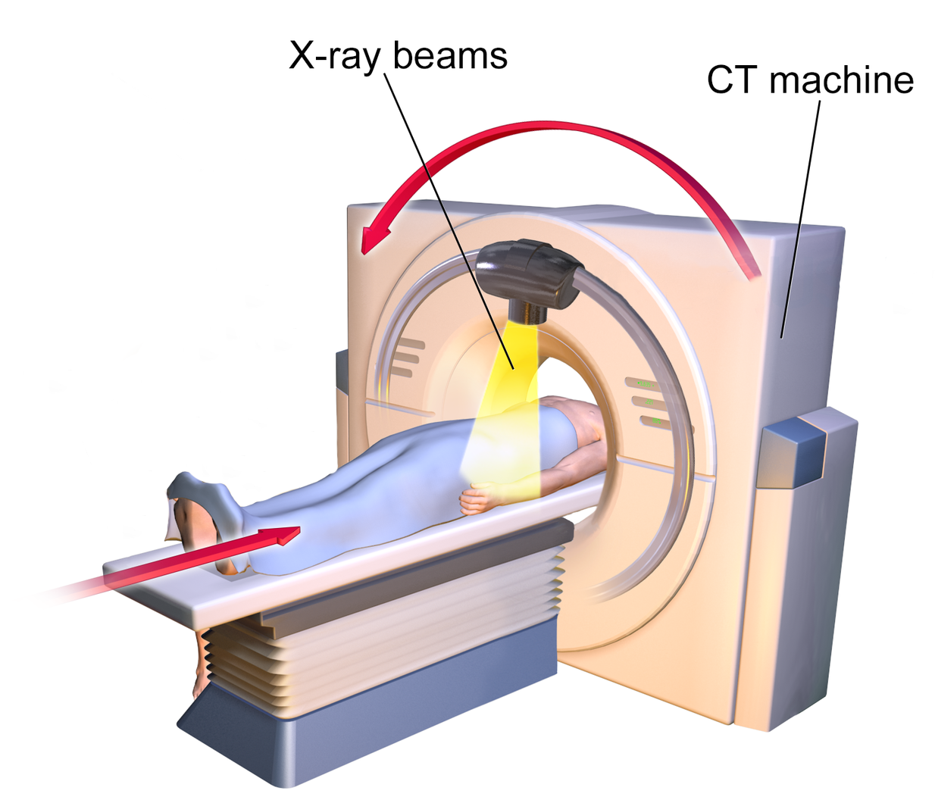
Computed Tomography Scan
It is imperative that patients undergo a CT scan to further delineate the exact location of the mass, as well as the degree of airway and cardiovascular structure compression
Notes:
It is imperative that patients undergo a CT scan to further delineate the exact location of the mass, as well as the degree of airway and cardiovascular structure compression.
There is often a poor relationship between signs and symptoms and degree of airway compression seen on CT scan.¹
Image: https://commons.wikimedia.org/wiki/Category:Computed_tomography#/media/File:Blausen_0205_CATScan_01.png

Slide 19
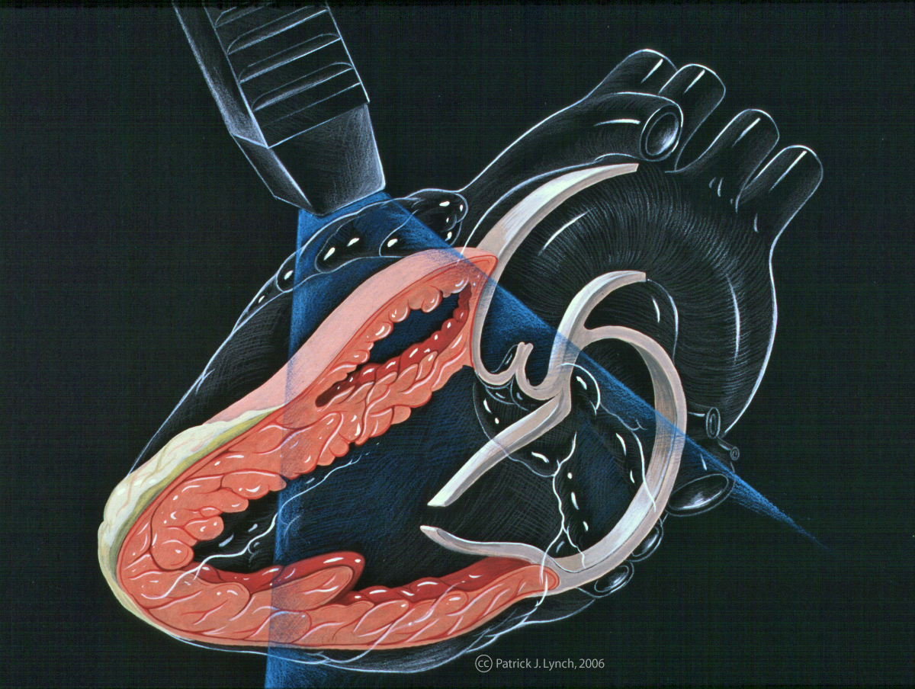
Transthoracic Echocardiography
ECHO done in the supine position will evaluate cardiovascular compression, reduction of pulmonary blood flow, cardiac output, and pericardial tamponade physiology
Notes:
ECHO done in the supine position will evaluate cardiovascular compression, reduction of pulmonary blood flow, cardiac output, and pericardial tamponade physiology.
Image: https://commons.wikimedia.org/wiki/File:Heart_lpla_echocardiography_diagram.jpg

Slide 20
Risk Stratification
 | Low Risk | Intermediate Risk | High Risk
Signs | No airway, cardiac, or vascular compression | Mild tracheal compression (<70%) No bronchial compression | Tracheal compression (>70%) Bronchial compression Great vessel compression Tamponade physiology
Symptoms | None | Mild to moderate Postural | Orthopnea Stridor Cyanosis
Notes:
The above system was developed by Blank and de Souza to stratify pediatric patients into categories of intraoperative risk based on their presenting signs and symptoms.⁸
Low risk may undergo general anesthesia with positive pressure ventilation if necessary.
Intermediate and high risk are best managed with an individualized plan.
High risk patients are often pre-treated with steroids, empiric chemotherapy, and/or radiotherapy prior to obtaining a biopsy.
Tracheobronchial stenting is also an option to maintain an adequate airway by allowing spontaneous respiration. As chemotherapy and/or radiotherapy progresses and the tumor responds, the
stents can be removed. This approach might be less practical in small children.¹³

Slide 21
Anesthetic Management
Consider referring to a high-level pediatric surgery center
Notes:
Ongoing discussion between all team members is critically important in understanding the patient-specific risks of general anesthesia and in determining the safest management approach.
The timing and location of procedures needs to be discussed between team members.
Patients often present acutely and require an exact diagnosis prior to start of treatment. However, if a child presents with severe signs and symptoms (orthopnea, stridor, dyspnea), it may be possible to administer the initial treatment prior to obtaining a definitive diagnosis.
The location of the procedure is just as important as the timing.
Lumbar puncture, bone marrow aspiration and biopsies are often done in the oncology infusion clinics. Diagnostic or therapeutic interventions such as central line placement are also done outside of the operating room, usually in radiology suites.
One must consider the availability of support staff, necessary rescue equipment such as difficult airway cart, rigid bronchoscope, and response delay from other medical providers in the event an emergency.
It may be prudent for the anesthesiologist to ask for such procedures to take place in a more familiar setting, such as the operating room, for all children with AMM.

Slide 22
Anesthesia Type
Local Anesthesia
+/- Sedation
General Anesthesia
Procedures
Extrathoracic lymph node biopsy
Percutaneous needle aspiration of mass, pericardial fluid, or pleural fluid
Open biopsy or resection of the mass
Thoracoscopic biopsy of the mass
Notes:
Adults are able to undergo diagnostic procedures with relative ease under local sedation but this can be challenging in the pediatric population. Age, ability to cooperate, and level of maturity are factors to consider.
Performing a superficial lymph node biopsy rather than biopsy of the mass itself permits use of local rather than general anesthesia.
Local anesthesia with sedation in children in the intermediate or high-risk group for various diagnostic procedures has successfully been attempted without complications.¹⁰

Slide 23
Undiagnosed mediastinal mass
Consult pediatrics, hematology/oncology, anesthesiology, PICU, radiation oncology, pediatric surgery
CBC, LP, bone marrow biopsy/aspiration
Chest X-ray, CT scan, ECHO
Airway or cardiovascular obstruction
No Airway or cardiovascular obstruction
Biopsy under local anesthesia
Tracheostomy, CPB available
Biopsy under local anesthesia NOT feasible
Radiation therapy*
Biopsy
Local Anesthetic
OR
General Anesthesia
*If radiation therapy is NOT available, proceed with multidisciplinary operative plan
Notes:
Algorithm for anesthetic management at Lucile Packard Children’s Hospital of the child with an anterior mediastinal mass.¹⁸

Slide 24
Anesthesia Techniques
Volatile Agents
Ketamine
Positive pressure ventilation?
Dexmedetomidine
Muscle relaxation?
Propofol
Notes:
No agent is superior, as long as the agents are used in a judicious manner.
Ketamine
Larger doses of ketamine will produce a state of general anesthesia. Even after small doses there is potential for apnea or airway obstruction, particularly when combined with other sedating medications.¹⁹
Dexmedetomidine
Unlike propofol, the respiratory rate, CO2 tension, and oxygen saturation are generally maintained during dexmedetomidine sedation in children.²⁰
It is most prudent to maintain spontaneous ventilation throughout the anesthetic procedure to avoid worsening any compressive effects of the anterior mediastinal mass.
The general recommendation is to maintain spontaneous ventilation and avoid the use of positive pressure ventilation and muscle relaxation. Several case series claim that positive-pressure ventilation and muscle relaxants may still be safely administered in some instances.¹⁰
If paralysis is absolutely necessary for the procedure, one should start by deepening the anesthetic with short-acting drugs and verify that the patient can safely tolerate positive-pressure ventilation before administering neuromuscular blockade.⁹

Slide 25
Airway Management
Posture
Induce in sitting position
Change supine position to lateral or prone
Spontaneous Respiration
Inhalational induction
Intravenous induction
Awake fiberoptic intubation
Airway Stenting
Long ETT
Double-lumen ETT
Rigid bronchoscope
Insertion of tracheobronchial stents
CPB
Commenced under local anesthesia before induction
Vessels prepared under local anesthesia→ GA
Notes:
Diagram: Airway management during anesthesia: anterior mediastinal mass¹⁶
During anesthesia, lung volume is reduced and bronchial smooth muscle relaxes, thereby increasing the compressibility of large airways¹⁷
Airway stenting: rigid bronchoscopy is used to establish an airway prior to stent deployment in the affected segments of the tracheobronchial tree. This is achieved by having the patient in a semi-upright position. Anesthesia is induced via conventional intravenous technique. Ventilation can be maintained down the rigid bronchoscope via a venture injector. Anesthesia is maintained intravenously.

Slide 26
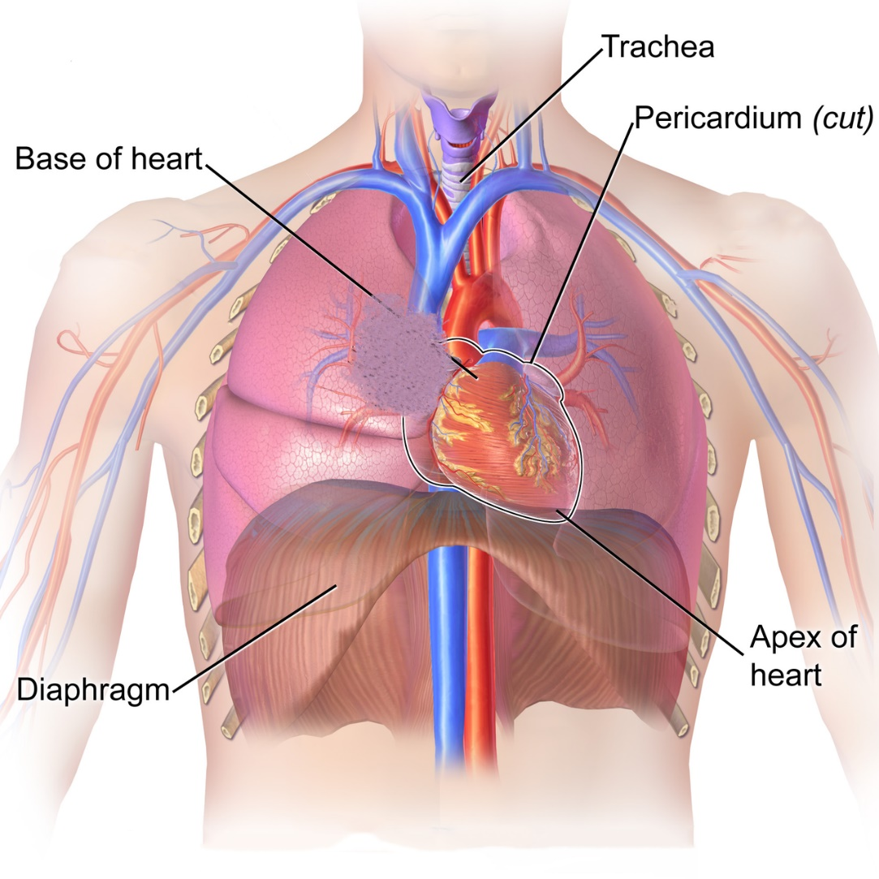
Vascular Involvement
SVC Syndrome
Intraoperative Hemorrhage
It is prudent to place a large bore intravenous cannula in the lower body, preferably in the femoral vein, to facilitate transfusion if the SVC is breached surgically.
Notes:
Superior Vena Cava (SVC) syndrome due to obstruction is a common presenting sign in patients with large anterior mediastinal tumors.
Intra-operative bleeding is also a relatively common problem during surgery.
It is prudent to place a large bore intravenous cannula in the lower body, preferably in the femoral vein, to facilitate transfusion if the SVC is breached surgically.
Image: https://commons.wikimedia.org/wiki/File:Blausen_0458_Heart_ThoracicCavity.png

Slide 27
Intraoperative Considerations
Large-bore IV X 2
(SVC Syndrome: place in the lower limbs)
Blood in OR
Arterial line (left radial artery)
+/- CVP/PA
Notes:
Have blood for transfusion available in the OR prior to start of surgery.
Patients with SVC syndrome may have impaired venous return from the upper limbs. It is advisable to place all large-bore I.V. cannula in the lower limbs for fluid and blood administration.
Invasive monitors such as arterial line, CVP/PA catheters may be appropriate for patients who are high risk or those with large mediastinal masses.
Mass may compress the innominate artery causing reduction in right radial pulse and right arm blood pressure. Place arterial line on the left side if possible.

Slide 28
Managing Intraoperative Complications
Rescue position
Rigid bronchoscopy
Cardiopulmonary bypass
Emergent sternotomy
Notes:
During the preoperative visit, ascertain about a possible “rescue position”. This is the position in which the patient reports the most comfort with the least reported symptoms.
If the patient develops signs of cardiopulmonary insufficiency while under anesthesia, the patient can be placed in this “rescue position” to help alleviate the problem.
If such a position is unknown or unavailable, consider placing the patient prone.
A physician with expertise and necessary skills in using the rigid bronchoscopy should be available, along with the necessary equipment in the operating room during anesthesia, in the event that airway collapse occurs.
Emergency placement of a rigid bronchoscope may lift the mass away from the airway structures alleviating the obstruction and restoring proper ventilation and oxygenation.
Cardiopulmonary bypass on “standby” might take too much time to establish in case of an emergency. In high-risk patients, one might consider placement of bypass cannulae under local anesthesia prior to induction.
Rapid and emergent sternotomy may be lifesaving, and should readily be available.¹¹

Slide 29
Postoperative Considerations
Pain management
Parenteral opioids
+/- Epidural catheter
+/- Peripheral nerve block

Slide 30
Conclusion
H&P
CT Scan
ECHO
Patient Safety
Location
Timing
Type
Patient,
Family
GA
vs.
Local +/- sedation
Multidisciplinary
team
Notes:
All pediatric patients presenting with an anterior mediastinal mass require a thorough history and physical examination, CT imaging, and ECHO to determine the extent of the disease burden. The presence and severity of cardiopulmonary compression and any associated signs and symptoms must be elucidated.
An open discussion with the patient, family members, and providers in the form of a multidisciplinary team approach should answer the following questions: appropriate timing, type of procedure, location for procedure, associated risks, course and type of treatment.
Although multiple anesthetic techniques and drugs have been used successfully in the past including volatile anesthetics, ketamine, dexmedetomidine, and propofol, most emphasize the importance of maintaining spontaneous ventilation throughout the procedure.
Adequate preoperative planning should include management of intraoperative complications. Backup plans should include rigid bronchoscopy, cardiopulmonary bypass, and emergent sternotomy.

Slide 31
References:
Hack HA, Wright NB, Wynn RF. The anaesthetic management of children with anterior mediastinal masses. Anaesthesia. 2008;63:837-846.
Bechard P, Letourneau L, Lacasse Y, Cote D, Bussieres JS. Perioperative cardiorespiratory complications in adults with mediastinal mass: incidence and risk factors. Anesthesiology. 2004;100:826-834; discussion 5A.
Takeda SI, Miyoshi S, Akashi A, et al. Clinical spectrum of primary mediastinal tumours: a comparison of adult and pediatric populations at a single Japanese institution. J Surg Oncol 2003;83(1):24–30.
Anghelescu DL, Burgoyne LL, Liu T, et al. Clinical and diagnostic imaging findings predict anesthetic complications in children presenting with malignant mediastinal masses. Paediatr Anaesth. 2007;17:1090-1098.
King RM, Telander RL, Smithson WA, Banks PM, Han MT. Primary mediastinal tumors in children. J Pediatr Surg. 1982;17:512-520.
Grosfeld JL, Skinner MA, Rescorla FJ, West KW, Scherer LR III. Mediastinal tumors in children: experience with 196 cases. Ann Surg Oncol. 1994;1:121-127.
DR, Patrick LE, Ginn-Pease ME, McCoy KS, Klopfenstein K. Pulmonary function is compromised in children with mediastinal lymphoma. J Pediatr Surg. 1997;32:294-299; discussion 299-300.

Slide 32
References:
Blank RS, de Souza DG. Anesthetic management of patients with an anterior mediastinal mass: continuing professional development. Can J Anaesth. 2011;58:853-859, 860-867.
Pearson JK. Pediatric anterior mediastinal mass: a review article. Semin Cardiothorac Vasc Anesth. 2015;3:248–54.
Ng A, Bennett J, Bromley P, Davies P, Morland B. Anaesthetic outcome and predictive risk factors in children with mediastinal tumours. Pediatr Blood Cancer. 2007;48:160-164.
Lin C.M., Hsu J.C. Anterior mediastinal tumour identified by intraoperative transesophageal echocardiography. Can J Anaesth, 2001. 48(1):78-80.
Azarow KS, Pearl RH, Zurcher R, et al. Primary mediastinal masses. A comparison of adult and pediatric populations. J Thorac Cardiovasc Surg 1993;106:67–72.
Schmidt B, Massenkeil G, Matthias J, et al. Temporary tracheobronchial stenting in malignant lymphoma. Ann Thorac Surg 1999;67:1448–50.
Abel M, Eisenkraft JB. Anesthetic implications of myasthenia gravis. Mt Sinai JMed 2002; 69(1–2):31–7.

Slide 33
References:
Chevalley C, Spiliopoulos A, de Perrot M, et al. Perioperative medical management and outcome following thymectomy for myasthenia gravis. Can J Anaesth 2001;48:446–51.
Gothard JW. Anesthetic considerations for patients with anterior mediastinal masses. Anesthesiol Clin. 2008;26(2):305–14. doi: 10.1016/j.anclin.2008.01.002.
Neuman GG, Weingarten AE, Abramowitz RM, et al. The anesthetic management of the patient with an anterior mediastinal mass. Anesthesiology 1984;60:144–7.
Hammer G. B. Anaesthetic management for the child with a mediastinal mass. Paediatric Anaesthesia. 2004;14(1):95–97. doi: 10.1046/j.1460-9592.2003.01196.
Green SM, Rothrock SG: Transient apnea with intramuscular ketamine. Am J Emerg Med. 15:440-441 1997.
Koroglu A, Teksan H, Sagir O, et al.: A comparison of the sedative, hemodynamic, and respiratory effects of dexmedetomidine and propofol in children undergoing magnetic resonance imaging. Anesth Analg.

