Slide 1
Inherited Coagulopathies in Children: Hemophilia
Andrew J. Costandi, MD, MMM
Children’s Hospital Los Angeles
USC Keck School of Medicine

Slide 2
Faculty Disclosures
None
Notes:
Neither author has any conflicts of interest to disclose.
All images provided by the authors, by the toolbox art staff, from openi.nlm.nih.gov, or licensed from Dreamstime Inc, unless otherwise specifically cited. All images used for educational purposes only.

Slide 3
Learning Objectives
Upon completion of this activity, participants will be able to:
Describe the physiology of hemostasis in the pediatric patient
Describe the pathophysiology of various types of Hemophilia
Discuss appropriate perioperative management of children with Hemophilia

Slide 4
Hemostasis
Primary Hemostasis
  Vascular spasm
  Platelet plug formation
Secondary Hemostasis
  Coagulation Cascade
  Formation of blood clot
Tertiary Hemostasis
  Clot lysis
  Vascular remodeling
Notes:
In order for us to understand the diseases related to factor deficiencies in children, we must have a solid understanding of coagulation physiology. Normal coagulation represents a balance between the pro coagulant pathway that is responsible for clot formation and the inhibitory control of several inhibitors that limit clot formation thus avoiding thrombus propagation. Any imbalance in these pathways will lead to either poor or excessive formation of clot. Normally, the endothelial cells lining the vascular wall exhibit antithrombotic properties to prevent clot formation.
When a blood vessel is injured, the body tries to stop the bleeding to achieve “Hemostasis”.Hemostasis, defined as arrest of bleeding, comes from Greek, “heme” meaning blood and “stasis” meaning to stop. So how does the body achieve Hemostasis?
When a vascular injury is encountered:
The affected vessel immediately spasms in an attempt to control bleeding.
A platelet plug is then formed within minutes at the site of injury (Primary Hemostasis).
With the formation of platelet plug a clotting cascade is triggered leading to generation of fibrin to reinforce the platelet plug (Secondary Hemostasis).
Finally, this is eventually followed by removal of clot by fibrinolysis or what we call Vascular Remodeling.

Slide 5
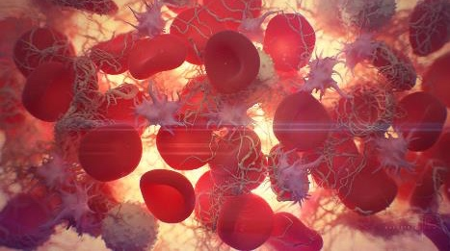
Primary Hemostasis Platelet Response
Platelet adhesion
Platelet activation
Platelet aggregation
"Blood clotting" by Alexey Kashpersky, Radius Digital Science is licensed under CC BY-NC 4.0
Notes:
The three primary functions of platelets in response to a vascular injury are to adhere to the damaged subendothelial surface, activate through the release of substances in dense and alpha granules, and to aggregate through platelet-platelet cohesion.

Slide 6
Primary Hemostasis: Platelet Adhesion
Normal: Endothelial cells lining the vascular wall exhibit antithrombotic properties
Intimal injury: Release of procoagulant subendothelial elements like collagen and VWF
Platelet adhesion to site of injury
  Collagen on the subendothelial surface is bound by platelet integrins
  VWF on the subendothelial surface is bound by platelet glycoprotein GPIb-IX-V
Notes:
Platelet Adhesion:
Normally, the endothelial cells lining the vascular wall exhibit antithrombotic properties to prevent clot formation. When intimal injury occurs, “procoagulant” subendothelial elements such as collagen and von Willebrand Factor (VWF) are exposed leading to platelet adhesion at the site of vascular injury.
VWF on the subendothelial surface is bound by platelet surface glycoprotein GPIb-IX-V
Collagen on the subendothelial surface is bound by platelet integrins.
Of note, platelet glycoprotein deficiency can lead to certain inherited bleeding disorders like Glanzmann thrombo-asthenia (deficiency of IIb/IIIa) or Bernard-Soulier syndrome (deficiency of platelet glycoprotein Ib).

Slide 7
Primary Hemostasis: Platelet Activation
Release of
    Thromboxane A2
    Fibrinogen
    Factor V
    ADP
Conformational and shape change
  Elongated pseudopods
  Extremely adhesive platelets
Notes:
Platelet Activation:
With platelet activation, compounds like fibrinogen, factor V, ADP and thromboxane A2 are released. Conformational and significant shape change occurs in platelets leading to production of elongated pseudopods that make the platelets extremely adhesive.
Platelet aggregation and Stabilization
VWF and fibrinogen serve as bridges between platelets leading to platelet aggregation. This is further enhanced by the Thromboxane A2 and ADP produced by the activated platelets providing stimulus for further platelet aggregation and formation of platelet plug. The coagulation cascade is then triggered leading to fibrin deposition on the plug to reinforce it.

Slide 8
Primary Hemostasis: Platelet Aggregation
Thromboxane A2 and ADP stimulate platelet aggregation
VWF and fibrinogen bridge between platelets
Coagulation cascade is triggered and fibrin is deposited
"Blood clotting" by Alexey Kashpersky, Radius Digital Science is licensed under CC BY-NC 4.0
Notes:
Platelet aggregation and Stabilization
VWF and fibrinogen serve as bridges between platelets leading to platelet aggregation. This is further enhanced by the Thromboxane A2 and ADP produced by the activated platelets providing stimulus for further platelet aggregation and formation of platelet plug. The coagulation cascade is then triggered leading to fibrin deposition on the plug to reinforce it.

Slide 9
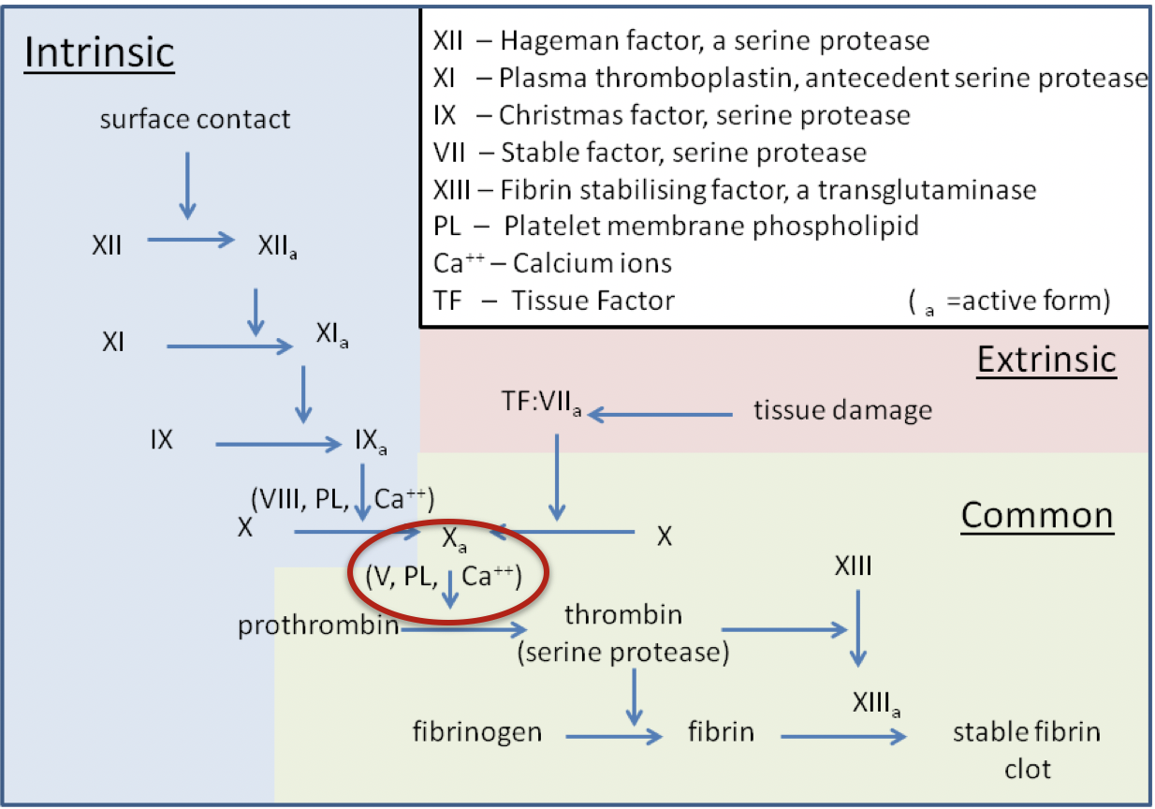
Secondary Hemostasis
The “Classic” model
By Dr Graham Beards - Own work, CC BY-SA 3.0, https://commons.wikimedia.org/w/index.php?curid=19094276
Notes:
The classic coagulation cascade proposed in 1964: Two pathways, “extrinsic” and ”intrinsic”, operating in parallel with a common goal to activate Factor X via two separate mechanisms.
The Extrinsic pathway is triggered by vascular injury leading to the exposure of Tissue Factor (TF) or Factor III (FIII) (NOT usually found in the intravascular space) to Factor VIIa and calcium, leading to activation of Factor X.
The Intrinsic pathway, on the other hand, depends on elements found in intravascular space. Contact activation of factor XII occurs when blood comes into contact with a surface containing negative electrical charges. The subsequent cascade involves factors XI, XI, VIII, each activating the next to ultimately activate Factor X and arrive at the Common pathway..
The Common pathway: Activated factor X (Fxa) along with factor V (FV), calcium (FIV), tissue phospholipids and platelet phospholipids form the prothrombinase complex (RED OVAL) which converts prothrombin (FII) to thrombin (FIIa). This thrombin further cleaves circulating fibrinogen (FI) to insoluble fibrin and activates factor XIII (FXIII - fibrin stabilizing factor). FXIII covalently crosslinks fibrin polymers incorporated in the platelet plug stabilizing the clot and forming a permanent secondary hemostatic plug.

Slide 10
Cell-based Model of Coagulation
Simultaneous, interactive pathways that overlap to augment production of thrombin
Initiation
Termination
Amplification
Propagation
Notes:
Current evidence changed our understanding of the coagulation pathway from 2 separate and parallel pathways systems that activate FX to: interactive cellular, physical and biochemical reactions that work in overlapping stages to form and augment thrombin generation and clot formation. The cell-based model of hemostasis proposes that coagulation requires the participation of 2 different cells types: a cell‐bearing TF, and platelets and 4 multicomponent complexes, 3 of which are procoagulant and 1 anticoagulant
Coagulation takes place on different cell surfaces in four overlapping steps: initiation, amplification, propagation and termination with each phase occurring on a different cell surface. Thrombin generation is primarily initiated by the generation or exposure of tissue factor (TF) at the wound site and its interaction with activated factor VII via the extrinsic pathway. This initial small amount of generated thrombin primes the clotting cascade and activates platelets, leading to explosive thrombin generation during the amplification phase.

Slide 11
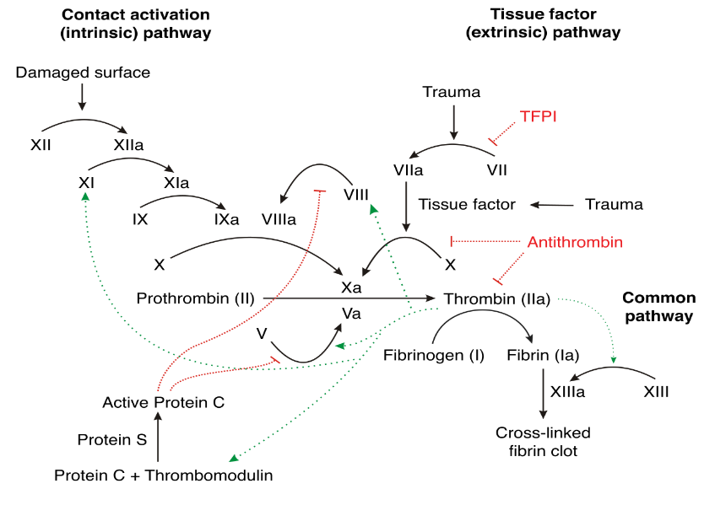
Secondary Hemostasis
1. Extrinsic X-ase
3.Intrinsic X-ase
2. Prothrombinase
Joe D [CC BY-SA 3.0 (http://creativecommons.org/licenses/by-sa/3.0/)]
Notes:
The cell‐based model represents a significant improvement in our understanding of the hemostatic process including the contributions of cells and the role of the extrinsic and intrinsic systems in generating FXa that occur on different cell surfaces simultaneously, rather than separate pathways. This adequately explains the significant clinical bleeding observed with FXI, FIX, and FVIII deficiencies (required for generation of FXa on platelet membranes). It also highlights the importance of generating thrombin directly on the activated platelet surface, not just on the surface of the TF‐bearing cell.
Image Source
Joe D [CC BY-SA 3.0 (http://creativecommons.org/licenses/by-sa/3.0/)]

Slide 12
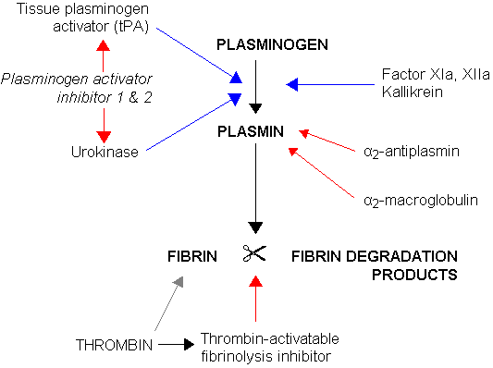
Tertiary Hemostasis
    Tissue plasminogen activators activate plasminogen to plasmin Fibrinolysis
Notes:
To restore vessel patency, the clot must be organized and removed. Plasminogen is activated by Plasminogen activators (tissue plasminogen activator, urokinase) to plasmin which acts on the fibrin clot to dissolve it and regulate the coagulation process. Fibrinolysis is controlled by plasminogen activator inhibitors (PAIs) such as PAI-1 and plasmin inhibitors such as α2-antiplasmin.

Slide 13
Neonatal Coagulation
~ 50% adult levels at birth
  Decreased Vitamin K dependent factors (II, VII, IX, X)
  Decreased factor XI and XII, Prekallikrein, Kallikrein
  Decreased anticoagulant proteins (C, S, AT‐III)
Vitamin K critical for coagulation
Neonates have low Vitamin K
Notes:
Hemostasis in the pediatric patient evolves as the child grows and matures, and normal adult laboratory values are not often the norm for a child. All of the procoagulants are synthesized in the liver except for von Willebrand factor (VWF), which is synthesized in megakaryocytes and endothelial cells, and factor VIII, which is produced in endothelial cells in the liver as well as other tissues such as lymphatics and renal glomeruli.
Factors II, VII, IX, and X have levels that are at least half that of adults in the neonatal period and gradually increase to adult values over the first 6 months of life due to an immature neonatal liver and deficiencies in vitamin K. Factor VIII has been reported to have levels that are higher in childhood compared to adults (increased on day 1 of life then falling in the newborn period before rising in childhood to adult levels). Levels of von Willebrand factor are similar to adults, although some children have elevated levels. The levels of the coagulation inhibitors “protein C and protein S” are low in the neonate and increase throughout childhood.
Term infants, especially those who are exclusively breast fed, are deficient in vitamin K and consequently may have vitamin K deficiency bleeding (VKDB).

Slide 14
Bleeding Disorders In Children
Coagulation Protein Disorders
  Acquired Disorders:
    Vitamin K Deficiency Bleeding
    Liver Disease
    Chronic Kidney Disease
    Coagulation Inhibitors
    Disseminated intravascular coagulation (DIC)
Notes:
Acquired coagulation protein disorders are much more common than inherited disorders with vitamin K deficiency being the most common. Disseminated Intravascular Coagulation (DIC) is a consumptive coagulopathy characterized by intravascular activation of coagulation that leads to unregulated thrombosis and secondary fibrinolysis or inhibited fibrinolysis.

Slide 15
Bleeding Disorders In Children
Coagulation Protein Disorders
  Inherited coagulation protein disorders
Rare (3-5% of congenital bleeding disorders)
Autosomal recessive
Isolated factor deficiency:
      Hemophilia (VIII, IX)
      Other (I, II, V, VII, X, XI)
Notes:
Inherited deficiencies of factors I (fibrinogen), II (prothrombin), V, VII, X, XI, and XIII as well as combined factor V+ VIII and vitamin K-dependent factors are rare. They represent 3–5% of all congenital bleeding disorders and are usually transmitted as autosomal recessive. Hemophilia is the most common disorder.

Slide 16
Clinical Presentation of Coagulation Protein Disorders
Large ecchymoses
Hemarthrosis
Soft tissue hematomas
Excessive bleeding after surgery
Notes:
In assessing the patient's bleeding history, it is important to characterize the type of bleeding. Bleeding disorders can be divided into 2 main broad categories:
Purpuric dysfunction (Disorders of platelets and blood vessels)
Coagulation Protein Disorders.
Bleeding into the skin and mucous membranes is characteristic of disorders of platelets and their interaction with blood vessels (purpuric disorders) and may be manifested as petechiae and/or ecchymoses. Bleeding into soft tissue, muscle, and joints suggests the presence of hemophilia or other disorders of coagulation proteins.

Slide 17
Laboratory Tests
CBC and platelets
Peripheral blood smear
Coagulation Studies
  PTT (INR)
  aPTT
  Fibrinogen
Notes:
In cases of suspected bleeding disorders in children, the following laboratory tests should be ordered first:
Complete blood cell (CBC) count
Peripheral blood smear (platelet size and shape)
Prothrombin time (PT)/INR - Measures the extrinsic and common pathway. Sensitive to alterations in the vitamin K-dependent coagulation factors, factors II, VII, IX and X
activated partial thromboplastin time (aPTT) - Measures the intrinsic and common pathways of coagulation
Fibrinogen.

Slide 18
Laboratory Tests
Disorder | Platelet Count | PT/INR | aPTT | Fibrinogen
Qualitative Platelet Disorder | Normal/Low | Normal | Normal | Normal
Quantitative Platelet Disorder | Low | Normal | Normal | Normal
Hemophilia | Normal | Normal | Prolonged | Normal
Von Willebrand Disease (VWD) | Normal | Normal | Normal/Prolonged | Normal
DIC | Low | Prolonged | Prolonged | Low
Notes:
This chart summarizes how platelet disorders, hemophilia, Von Willebrand Disease and DIC have different results with testing. Note platelet disorders have low or normal platelet values, but the other tests are normal. DIC is alone in the above conditions which results in a low fibrinogen level. Hemophilia and VWF both have normal PT and prolonged aPTT emphasizing the effect of these conditions on the intrinsic and common coagulation pathways.

Slide 19
Coagulation Protein Disorders
Hemophilia
Isolated Factor Deficiency:
  Fibrinogen,
  Factor VII
  Factor V
  Factor II
  Factor X
  Factor XIII
Notes:
We will now move on to discuss coagulation protein disorders by focusing on the most common disease of this type you will encounter: hemophilia

Slide 20
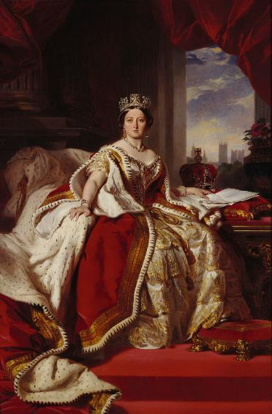
Hemophilia
X‐linked bleeding disorder
1 in 10,000 births
Notes:
Hemophilia was one referred to the ”royal disease.” This was likely due to Britain’s Queen Victoria passing the disease to multiple of her descendants across several royal families.
Image source:
https://commons.wikimedia.org/wiki/File:Victoria_in_her_Coronation.jpg

Slide 21
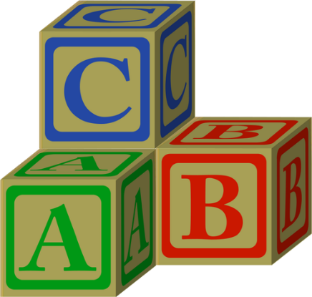
Types of Hemophilia
(based on factor deficiency)
  Hemophilia A
  Hemophilia B
  Hemophilia C
  Acquired Hemophilia
  +/- Congenital Hemophilia with Inhibitors ?
CC0 1.0 Universal (CC0 1.0) Public Domain
Notes:
Hemophilia A is characterized by deficiency or lack of coagulation factor VIII (FVIII)
Hemophilia B is characterized by deficiency or lack of coagulation factor IX (FIX).
Hemophilia C is an autosomal recessive disorder characterized by deficiency or lack of coagulation factor XI.
Autoantibodies formed against FVIII can also lead to Acquired Hemophilia.

Slide 22

Hemophilia A
Mutation in the long arm of chromosome X at F8 gene
Deficiency or lack of factor VIII (FVIII)
80-85% of the total hemophilia population
1 in 5000 males
20-30% develop inhibitory antibodies
CC0 1.0 Universal (CC0 1.0) Public Domain
Notes:
Hemophilia A is characterized by deficiency or lack of coagulation factor VIII (FVIII) due to a mutation in the long arm of chromosome X at F8 gene. Hemophilia generally affects males on the maternal side. However, both F8 and F9 genes are prone to new mutations, and as many as 1/3 of all cases are the result of spontaneous mutation where there is no prior family history.
Approximately 20–30% and 1–6% of patients with severe hemophilia A and B, respectively, develop inhibitory antibodies that render replacement therapy ineffective, potentially leading to life‐threatening bleeding events.

Slide 23

Hemophilia B:
Christmas Disease
Mutation in the long arm of chromosome X at F9 gene
Deficiency or lack of coagulation factor IX (FIX)
1 in 25,000 males
1-6% develop inhibitory antibodies
CC0 1.0 Universal (CC0 1.0) Public Domain
Notes:
It is named after Stephen Christmas who was one of the first patients diagnosed with the disease in 1952 and was studied by researchers in Oxford, England. Hemophilia B is characterized by deficiency or lack of coagulation factor IX (FIX). Hemophilia B is due to a mutation in the long arm of chromosome X at F9 gene.
Hemophilia A and B are X-linked diseases that almost exclusively affect males, although females can be affected in some rare cases as shown above. Hemophilia A and B usually present in male children of carrier females.

Slide 24
Hemophilia C
Factor XI deficiency
  Homozygotes: < 4% factor XI
  Heterozygotes: 15-65% factor XI
Autosomal recessive
Higher Incidence in Ashkenazi Jewish population
Bleeding diathesis may not correlate well with factor concentrations
Notes:
Hemophilia C is due to a factor XI deficiency. It has a higher incidence in the Ashkenazi Jewish population
Hemophilia C is an autosomal recessive condition and factor XI levels are based on the genotype:
Homozygotes: < 4% factor XI
Heterozygotes: 15-65% factor XI
Bleeding diathesis may not correlate well with factor concentrations. This is thought to be because the initial steps in hemostasis (eg, initial platelet plug and initial thrombin generation in response to tissue factor exposure) occur normally in individuals with factor XI deficiency, and only the subsequent amplification of the thrombin response and resistance of the clot to fibrinolysis are affected by lack of factor XI.

Slide 25
Acquired Hemophilia
Rare
Potentially life-threatening bleeding disorder
Autoantibodies against endogenous plasma coagulation factors
Notes:
Acquired hemophilia A (AHA) is a rare, potentially life-threatening bleeding disorder, predominantly in the elderly, resulting from autoantibodies (inhibitors) against endogenous plasma coagulation factors.
Acquired Hemophilia is different from Congenital Hemophilia with Inhibitors.

Slide 26
Congenital Hemophilia with Inhibitors
Development of IgG Ab against exogenous factor
10-20% with severe hemophilia A
1-5% with severe hemophilia B
Median age of 3 years
Suspected when an increase in the frequency of bleeding occurs
Notes:
Inhibitors are anti-factor VIII or anti-factor IX allogeneic antibodies generated against factor VIII and factor IX in pharmaceutical preparations as a result of replacement therapy with coagulation factor preparations.
The incidence of Congenital hemophilia with inhibitors ranges from 10-20% with severe hemophilia A to 1-5% with severe hemophilia B (severe cases require more replacement therapy).
Inhibitors are suspected when an increase in the frequency of bleeding occurs.

Slide 27
Congenital Hemophilia with Inhibitors
Bethesda units (BU) = amount of inhibitors present
1 BU = 50% inactivation of:
factor VIII or IX in 1 mL of plasma
Positive for inhibition → 0.6 BU/mL
High responder → 5BU/mL
Notes:
The inhibitor titer is measured in Bethesda units (BU). This number represents the amount of inhibitors in the person’s body.
The amount of antibody that inactivates factor VIII or factor IX contained in 1 ml of normal plasma by 50% is defined as 1 Bethesda Unit/ml (BU/ml).
Normally, greater than 0.6 BU/ml is judged to be positive for inhibitors. A high responder has greater than 5 BU/ml.
Anamnestic Response: Once an inhibitor is present, the strength with which the body reacts to further exposure of factor concentrate, also called anamnestic response, can further classify the inhibitor type.
Low Responder – when people with low-responding inhibitors receive factor VIII or factor IX, the inhibitor titer does not rise. Because the titer stays low, they may be able to control bleeding by using larger quantities of those factor concentrates.
High Responder – when people with high-responding inhibitors are exposed to factor VIII or factor IX the immune system quickly triggers even more inhibitor development.

Slide 28
Hemophilia: Clinical Presentation
Mild and Moderate Deficiency: bleeding after trauma or surgery
Severe Deficiency: Spontaneous bleeding
Serious | Life‐threatening
Joints (hemarthrosis) Muscles (deep compartments calf and forearm) Mucous membranes in the mouth, gums, nose, and genitourinary tract | Intracranial Neck/throat Gastrointestinal
Notes:
Patients with MILD to MODERATE hemophilia, can present later in life with bruising and bleeding after trauma/surgery.
Patients with SEVERE hemophilia usually present with spontaneous bleeding in the first two years of life.

Slide 29
Clinical Presentation of Severe Hemophilia
  Spontaneous bleeding in the first two years of life
  Common sites of bleeding
    Newborn: central nervous system or sites of medical intervention (circumcision, heel stick)
  Toddler: frenulum or oral injury
  Children: bruising or bleeding into joints
  Older children and Adults: hemarthrosis (80% of hemorrhages)
Notes:
Patients with SEVERE hemophilia usually present with spontaneous bleeding in the first two years of life.
Newborn: Common sites of bleeding include the central nervous system and sites of medical interventions including circumcision and heel sticks.
Children: Bruising, joint bleeds, and other sites of musculoskeletal bleeding become more common once children begin walking.
Toddlers: Frenulum and oral injuries are common sites
Older Children and Adults: Hemarthrosis is the most common site for bleeding (80% of hemorrhages)

Slide 30
Hemophilia: Classification
Severity | Factor Activity | Symptoms | Age at Diagnosis
Severe | < 1% | Frequent spontaneous bleeding; abnormal bleeding after minor injuries, surgery, or tooth extractions | Age ≤2 years
Moderate | 1% - 5% | Rare spontaneous bleeding; abnormal bleeding after minor injuries, surgery, or tooth extractions | Age <5-6 years
Mild | > 5% - 40% | No spontaneous bleeding; abnormal bleeding after major injuries, surgery, or tooth extractions | Often later in life, depending on hemostatic challenges
Notes:
Hemophilia severity is classified as mild, moderate, or severe. Patients with severe disease usually have less than 1% FVIII/FIX activity, patients with moderate disease have 1-5% FVIII/FIX activity and patients with mild hemophilia have more than 5% but less than 40% FVIII/FIX factor activity.

Slide 31
Hemophilia: Diagnosis
Laboratory Test Results with Hemophilia
Prolonged bleeding time
Normal platelet count
Normal PT
Prolonged or normal aPTT
Diagnosis confirmed with Factor assay (FVIII, FIX)
Notes:
Hemophilia is characterized by normal platelet count, normal prothrombin time (PT) and prolonged activated partial thromboplastin time (aPTT). However, the aPTT may be normal in individuals with milder factor deficiencies (eg, factor activity level >15%).
In patients with hemophilia, the aPTT corrects in mixing studies, unless an inhibitor is present, which only applies to individuals who have received factor infusions or who have another autoantibody such as a lupus anticoagulant or an acquired factor inhibitor. Thus, mixing studies that do not show correction of a prolonged aPTT suggest an alternative diagnosis such as an acquired factor inhibitor.
Measurement of the factor activity level shows a reduced level

Slide 32
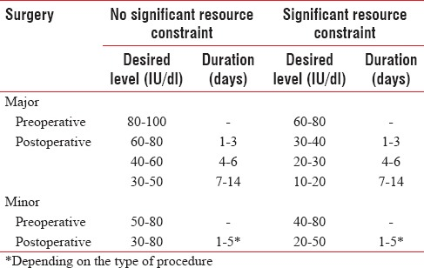
Hemophilia: Treatment
Guidelines for perioperative factor levels in patients with hemophilia for major and minor surgical procedures. Source: Srivstava A, Brewer AK, Mauser-Bunschoten et al. Haemophilia. 2013 Jan;19:e1-47.
Notes:
Shown here are guidelines for desired perioperative factor levels in patients with hemophilia for major and minor surgical procedures.

Slide 33
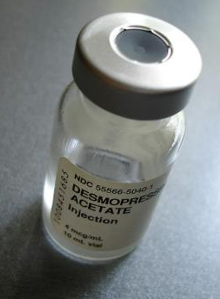
Hemophilia A: Treatment
Mild – Moderate
  Desmopressin (DDAVP)
Severe
  Factor replacement
      Viral inactivated plasma-derived
      Recombinant factor concentrates
  Cryoprecipitate
  Fresh Frozen Plasma
Severe with Inhibitors
  Factor replacement
  Bypassing agents
"DDAVP" by ballookey is licensed under CC BY-NC-ND 2.0
Notes:
Mild to moderate hemophilia A is usually treated with desmopressin. Recall that hemophilia A is a Factor VIII deficiency and VWF helps to protect Factor VIII from degradation and helps to present it to the site of bleeding. Demospressin is a useful agent as it poses no risk for infection and does not induce inhibitors.
The World Federation of Hemophilia (WFH) strongly recommends the use of viral‐inactivated plasma‐derived or recombinant factor concentrates in preference to cryoprecipitate or fresh frozen plasma for the treatment of severe hemophilia.

Slide 34
Desmopressin (DDAVP)
  Protects factor VIII from degradation
  Presents Factor VIII to site of bleeding
  Produces 3-5 fold increase in VWF:FVIII
  Peak @ 30-90 mins
  Duration of 8-12 hours
  Intranasal dose = 150 mcg if < 50 kg or 300 mcg if > 50 kg
  IV dose = 0.3 mcg/kg (max 20mcg)
"DDAVP" by ballookey is licensed under CC BY-NC-ND 2.0
Notes:
DDAVP is effective in almost all patients with mild or moderate type 1 disease
Nasal administration of high-dose desmopressin acetate (Stimate®) is often effective for minor bleeding, but intravenous administration is the preferred route for surgical bleeding prophylaxis and for treatment of major hemorrhage.
Intranasal dose for children older than 5 years and <50 kg = 150 mcg and 300 mcg for patients who are >50 kg.
The dosing for intravenous therapy is 0.3 mcg/kg (max of 20 mcg) diluted into 20 ml of saline and infused over 30 mins.
Tachyphylaxis occurs inconsistently to patients who are dosed repeatedly at relatively short interval (12-24 hours for more than 2-3 days of therapy).
The development of tachyphylaxis is thought to occur due to partial or complete depletion of FVIII:C and VWF in the storage pool sites
Minor side effects of DDAVP are common and include: facial flushing, transient hypertension or hypotension, headache, or gastrointestinal upset.
Water retention after a dose of DDAVP, with an increase in urinary osmolality, is common; however, decreased serum sodium in otherwise healthy adults is variable and is related to multiple dose.
Children less than 2 years old have a lower response to DDAVP in general and its use is NOT recommended. Water retention, hyponatremia and seizures have been reported in young children and infants who received multiple doses of DDAVP and aggressive hydration.

Slide 35
Desmopressin (DDAVP)
  Mild or Moderate hemophilia A
  No value in hemophilia B
  Low cost
  No risk of transmission of viral infections
  Complications of prolonged treatment:
    Tachyphylaxis
    Hyponatremia
"DDAVP" by ballookey is licensed under CC BY-NC-ND 2.0
Notes:
DDAVP is used in mild or moderate hemophilia A as well as carriers. As mentioned earlier it has not value in hemophilia B. DDAVP is diluted in 30-50 mL of normal saline and infused over 20 to 30 minutes.
Tachyphylaxis and Hyponatremia can occur with prolonged treatment

Slide 36
Hemophilia B: Treatment
  Mild, Moderate & Severe
Factor Replacement
Fresh Frozen Plasma
"DDAVP" by ballookey is licensed under CC BY-NC-ND 2.0
Notes:
Reminder that there is no role for Desmopressin for the treatment of Hemophilia B

Slide 37
Factor VIII Concentrates
Recombinant FVIII (Recombinate)
  Number of units of FVIII required =
  Weight of patient x % factor level desired x 0.5
  1 Unit/Kg IV will raise the plasma FVIII level by 2%
  Half life of FVIII: 8-12 hours
Plasma derived factor VIII (Monoclate P & Hemofil-M)
Plasma derived factor VIII-VWF (Humate P)
Porcine factor VIII concentrates
Notes:
Factor VIII replacement remains the mainstay of therapy for patients with hemophilia A. Due to advancements in coagulation factor preparations, hemophilia treatment has progressed from conventional bleeding replacement therapy to periodic replacement therapy. Historically, the aim has been to perform symptomatic treatment, but currently, the aim of treatment is preventive.
FVIII concentrates come in several different forms (shown on the slide).
Vials of factor concentrates are available in dosages ranging from approximately 250–3000 units each. Ideally, the patient's factor level should be measured 15 min after the infusion to verify the calculated dose achieved the desired response.
Porcine factor VIII is usually reserved for patients the inhibitors that are low-titer/low-responders. The dose is 50 – 100 U/kg q8h.

Slide 38
Factor IX Concentrates
Recombinant Factor IX Concentrate (BeneFIX)
  Number of units of FVIII required =
  Weight of patient x % factor level desired x 1
  1 Unit/Kg IV will raise the plasma FVIII level by 1%
  Half time FIX: 18–24 hours
Plasma-derived Factor IX Concentrate (Alphanite)
Prothrombin complex concentrates (PCCs): contain factors II, VII, IX and X
Notes:
Whenever possible, the use of pure FIX concentrates is preferable for the treatment of hemophilia B.
FIX concentrates fall into two classes: Pure FIX concentrates, which may be plasma‐derived or recombinant, and
FIX concentrates that also contain factors II, VII, IX, and X, also known as prothrombin complex concentrates (PCCs). Vials of Factor IX concentrates are available in doses ranging from approximately 250–2000 units each.

Slide 39
Cryoprecipitate or FFP?
Cryoprecipitate:
1 ml = 3-5 U FVIII + VWF + Fibrinogen + FXIII, but not FIX or FXI
Risk of viral pathogen transmission
Fresh frozen plasma
Large volume needed
Risk of viral pathogen transmission
Limited rise of FVIII levels
Notes:
In the past, fresh-frozen plasma (FFP) and cryoprecipitate were used for hemorrhagic events. However, FFP is no longer used due to the large volume required for adequate hemostasis, the risk of transmission of infectious agents, and the limited rise in factor VIII levels. Cryoprecipitate and FFP are not subjected to viral inactivation procedures (such as heat or solvent/detergent treatment), leading to an increased risk of transmission of viral pathogens, which is significant with repeated infusions.
Cryoprecipitate can be used to attain normal levels of factor VIII. However, cryoprecipitate is pooled from multiple plasma products, and the actual level of factor VIII can only be estimated.
Roughly speaking, each unit (15ml) contains a minimum of 80 IU of factor VIII and at least 150 mg of fibrinogen, in addition to significant amounts of von Willebrand factor and factor XII.

Slide 40
Clot Stabilizers Antifibrinolytics
Promotes clot stability by inhibiting the conversion of plasminogen to plasmin → inhibiting fibrinolysis
Adjunctive therapy in VWD and Hemophilia
Valuable in oral and dental surgery
Can cause nausea and vomiting
Contraindicated in patients treated with PCC
Notes:
Antifibrinolytic drugs like aminocaproic acid and tranexamic acid inhibit the conversion of plasminogen to plasmin, inhibiting fibrinolysis and thereby helping to stabilize clots that have formed.
These are important adjuvant agents for hemorrhage prevention and treatment especially during oral and dental surgeries because they act by inhibiting the fibrinolytic action of salivary enzymes.
Both drugs can cause nausea and vomiting
Both drugs are contraindicated in patients with factor VIII inhibitors being treated with prothrombin complex concentrate, due to the risk for thromboembolism.
As noted earlier, antifibrinolytics are used in the treatment of von Willebrand's disease but are also used as adjunctive therapy for hemophilia. These agents should not be given to patients receiving prothrombin complex concentrate because of the increased risk of thrombosis and thromboembolism

Slide 41
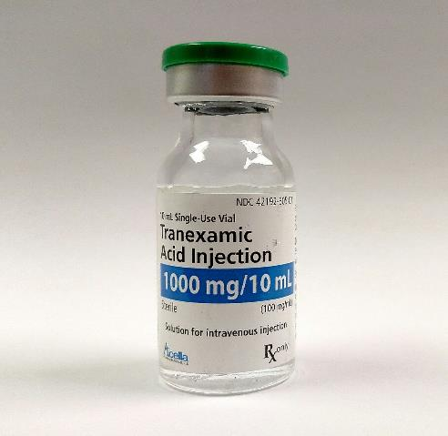
Clot Stabilizers: Antifibrinolytics
  Tranexamic acid (TXA)
  10 mg/kg IV q8h
  25 mg/kg PO daily
  Epsilon aminocaproic acid
  50 mg/kg IV or PO
  Shorter plasma half-life
  Less potent than TXA
CC BY-SA 4.0
Notes:
Tranexamic acid (TXA) is given intravenously at a dose of 10 mg/kg every 8 hours or orally at 25 mg PO q daily.
Epsilon aminocaproic acid may be orally or intravenously administered @ 50 mg/kg. Lower doses (25 mg/kg) can be used when gastrointestinal side effects interfere with therapy. It has a shorter plasma half-life is lest potent than TXA.

Slide 42
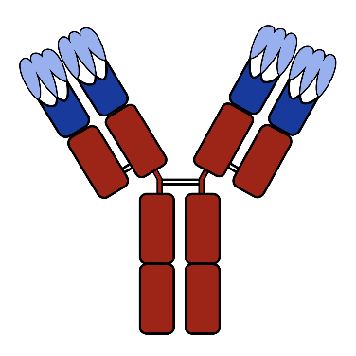
Hemophilia with Inhibitors
Low Titers/Low Responders:
  Defined as Inhibitor level < 5 BU/ml
  High Dose Factor Replacement
  Porcine Factor VIII
High Titers/High Responders
  Defined as Inhibitor level ≥ 5 BU/ml
  Bypassing Agent (rFVIIa and aPCC)
Public domain.
Notes:
Inhibitors usually only develop in those with severe disease due to multiple treatments with replacement therapy. As mentioned earlier, testing can determine the presence of inhibitors. A low responding inhibitor is defined as an inhibitor level that is persistently <5 BU mL⁻¹, whereas a high responding inhibitor is defined by a level ≥5 BU mL⁻¹.
Treatment of Low-titer/Low-responder inhibitors include the use of high dose of the factor or the recombinant procine factor. The porcine factor is sufficiently different from human FVIII to be unrecognized by the circulating inhibitors.
Treatment of High-titer/High-responder inhibitors include agents other than factor VIII (bypass products) and/or inhibitor ablation via immune tolerance induction. Bypassing agents include recombinant factor VII and prothrombin complex concentrates.

Slide 43
Hemophilia With Inhibitors: Treatment
High-titer/High-responding inhibitors: Bypassing Agents
 | Preoperative dosing | Postoperative dosing
 |  | Days 1–5 | Days 6–14
Recombinant Factor VIIa (rFVIIa)
Minor Surgery | 120-150 µg/kg q 2h | 90–120 µg/kg q2h up to four times then q3–6 h for 24 h
Intermediate/Major Surgery | 150 µg/kg q 2h | 90–120 µg/kg q2 h Day 1, then q3 h Day 2, then q4 h Days 3–5 | 90-120 µg/kg q6 h
Continuous infusion | 15–50 µg/kg q 1h | 15–50 µg/kg/h | 15-50 µg/kg/h
Activated Prothrombin Complex Concentrate (aPCC)
Minor Surgery | 50–75 U/kg | 50–75 U/kg q12–24 h one to two times
Intermediate/Major Surgery | 75–100 U/kg | 75–100 U/kg q8–12 h | 75–100 U/kg q12 h
Kulkarni R¹. Comprehensive care of the patient with haemophilia and inhibitors undergoing surgery: practical aspects. Haemophilia. 2013 Jan;19(1):2-10. doi: 10.1111/j.1365-2516.2012.02922.x. Epub 2012 Aug 27.
Notes:
Low-titer & Low-responding inhibitors. You can overcome with higher doses of FVIII
High-titer/High-responding inhibitors must be treated with bypassing agents
Recombinant factor VIIa (rFVIIa, NovoSeven®) and activated prothrombin complex concentrate (aPCC, FEIBA®—plasma‐derived, containing factors II, IX, and X and VIIa) are both appropriate first‐line bypassing treatments
Approximately 20% to 33% of moderate and severe hemophilia A patients develop factor VIII inhibiting antibodies. The development of such inhibitors complicates the management of hemophilia patients because it makes them refractory to factor VIII therapy. These patients may be divided in low and high response groups, as for the production of inhibitors. Treatment of factor inhibitors include the use of agents other than factor VIII (bypass products) and/or inhibitor ablation via immune tolerance induction. Bypass products would include: Prothrombin complex concentrate, therapy with activated factor VII
Prothrombin complex concentrates and activated prothrombin complex concentrates contain proteases that account for their procoagulant activity. They are partially purified mixtures of the vitamin K-dependent clotting factors prepared from plasma.

Slide 44
References
Smith SA. The cell-based model of coagulation. J Vet Emerg Crit Care. 2009;19(1):3-10.
Lee, JW. Von Willebrand Disease, Hemophilia A and B, and Other Factor Deficiencies. Int Anesthesiol Clin. 2004;42(3):59-76.
Srivastava A, Brewer AK, Mauser-Bunshoten EP, et al. Guidelines for the management of hemophilia. Hemophilia. 2013;19(1):e1-47.
Srivastava A. Hemophilia care – beyond the treatment guidelines. Hemophilia. 2014; Suppl 4:4-10.
Elsey NM. Hemophilias. In: Lalwani K, Cohen IT, Choi EY, Raman VT, ed. Pediatric Anesthesia: A Problem-Based Learning Approach. Oxford University Press; 2018
Kulkani R. Comprehensive care of the patient with haemophilia and inhibitors undergoing surgery: practical aspects. Hemophilia. 2013;19(1):2-10. doi: 10.1111/j.1365-2516.2012.02922.x. Epub 2012 Aug 27.

