Slide 1
Epidermolysis Bullosa:
An Anesthetic Challenge
Gail Shibata, MD
Health Sciences Clinical Professor
Andrew Infosino, MD
Health Sciences Clinical Professor
UCSF Benioff Children’s Hospital
UCSF Department of Anesthesiology & Perioperative Care
Updated 10/2019

Slide 2
Disclosures
We have no relevant financial relationships.

Slide 3
Learning Objectives
Describe the Pathophysiology of Epidermolysis Bullosa (EB)
Differentiate the three types of Epidermolysis Bullosa
Summarize the preoperative concerns for children with Epidermolysis Bullosa
Formulate a plan for the intraoperative anesthetic management of children with Epidermolysis Bullosa

Slide 4
What is Epidermolysis Bullosa?
Epiderm-o-lysis Bullosa
Outer layer of skin Breakdown Blisters

Slide 5
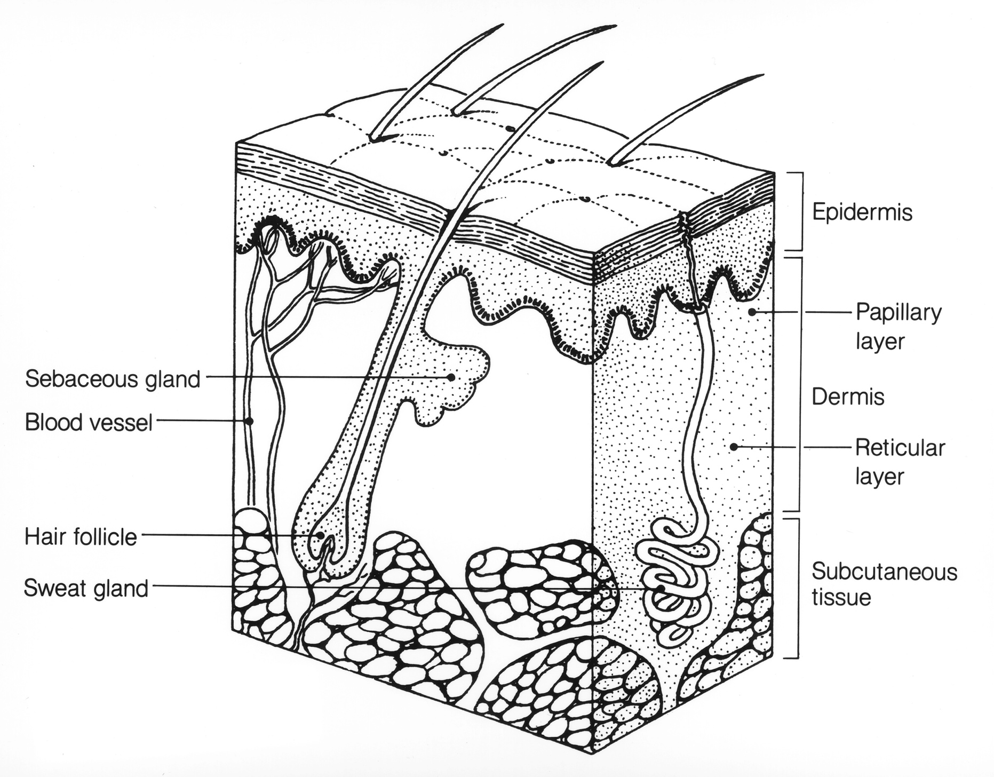
The Three Layers of Normal Skin
Key structural proteins which anchor the dermis and the epidermis
Keratin
Laminin
Collagen XVII, VII
Integrin
Epidermis
Dermis
Subcutaneous Tissue (fat)
Notes:
Image: https://visualsonline.cancer.gov/details.cfm?imageid=1809
Reuse Restrictions: None - This image is in the public domain and can be freely reused.
The normal skin is composed of the epidermis, dermis and subcutaneous tissue. A basement membrane lies between the epidermis and dermis. In normal skin, these structural proteins(keratin, laminin, collagen and integrin) anchor the epidermis to the dermis. Normal skin requires proper adhesion between epidermal cells and the basement membrane and the basement membrane to the upper layers of the dermis by these anchoring proteins. It is important to note that the three layers of skin or epidermis is present in all epithelial lined tissues throughout the body and can lead to extracutaneous problems.

Slide 6
Genetics of Epidermolysis Bullosa
Heterogeneous group of rare genetic mutations (1 in 17,000 live births)
These mutations affect the function of the structural proteins that bind the epidermis to the dermis in the skin (keratin, laminin, collagen, integrin)
These mutations can be dominant, recessive, or spontaneous
Extremely variable penetrance
Notes:
It is estimated that 500,000 people worldwide are living with EB.
EB is a heterogenous group of inherited rare diseases in which there are thirteen major genes responsible for the majority of the cases of EB. The underlying cause is a functional deficiency of structural proteins at the dermo-epidermal junction.

Slide 7
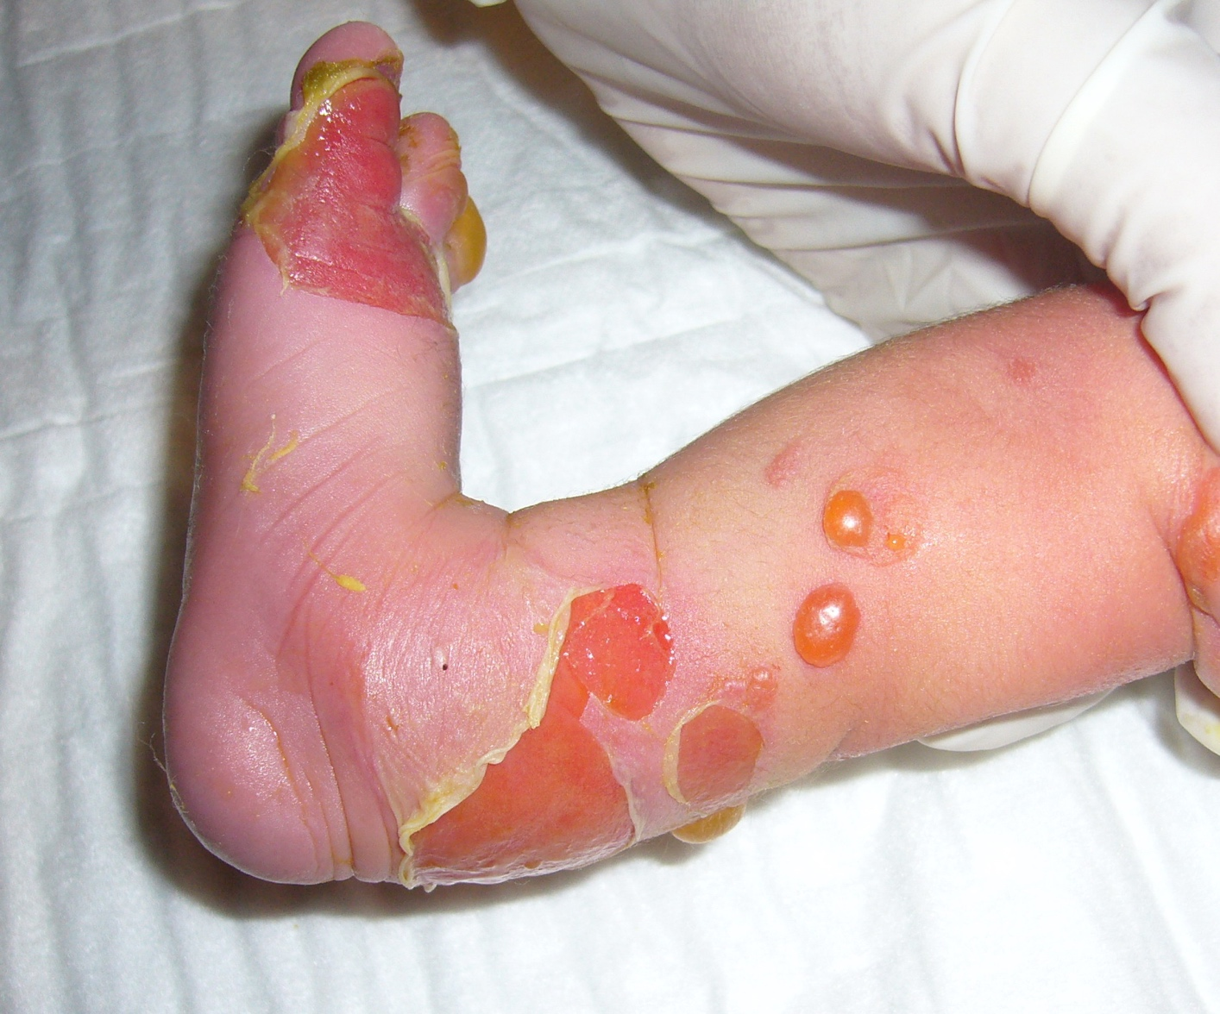
Pathophysiology of EB
Decrease in function of anchoring skin proteins
Extreme skin weakness/fragility
Shearing force separates the epidermis from dermis
Blister formation
Repetitive injury leads to scarring and increased infection risk
Notes:
Image:https://commons.wikimedia.org/wiki/File:%D0%91%D1%83%D0%BB%D0%BB%D0%B5%D0%B7%D0%BD%D1%8B%D0%B9_%D1%8D%D0%BF%D0%B8%D0%B4%D0%B5%D1%80%D0%BC%D0%BE%D0%BB%D0%B8%D0%B7.jpg
EB is characterized by trauma-induced blister formation of the skin and mucosa. EB skin is never able to heal properly with normal strength leading to open wounds and extensive scarring. Each time the skin is damaged, there is progressive disfigurement.

Slide 8
Three Main Types of EB
EB simplex:
  Keratin 4
  Keratin 5
Junctional EB:
  Laminin 332
  Collagen 17
Dystrophic EB
  Collagen 7
Epidermis
Basement Membrane
Dermis
Notes:
Original Drawing by author’s daughter
Myriad of different genetic types of EB, but three major histological groups have been described. Each type of EB has localized vs generalized forms and within generalized types, there are intermediate and severe forms.
There are more than 30 subtypes/variants which have been identified.

Slide 9
EB Simplex
Most common type (70%)
Fragility limited to the epidermis
Autosomal dominant
Most have mild clinical presentation with good prognosis
EB
Simplex
  Blistering commonly on hands and feet
  Oral mucosa rarely involved
  Few extra-cutaneous manifestations
Notes:
Original Drawing by author’s daughter
Severe, generalized form of EB carries the eponym Dowling-Meara.
EB simplex do not have a lot of extra-cutaneous manifestations therefore they rarely need surgery.
Subtypes of EBS: EBS generalized intermediate, EBS generalized severe, EBS localized. There are some forms of EBS which are very rare and have very serious effects on the lives of those affected.

Slide 10
Junctional EB
Least common type (10%)
Defect at the junction of the dermis and epidermis
Autosomal recessive
Significant pharyngeal and upper esophageal blistering and scarring
Junctional
EB
Notes:
Original Drawing by author’s daughter
Because the distal esophagus is comprised of ciliated columnar epithelium, it is not affected by EB. However, the proximal one third of the esophagus is comprised of squamous epithelium and is affected.
Scarring of the airway can occur anywhere from the throat down to the vocal cords. Severe scarring is usually associated with stridor and muffled voice.

Slide 11
Junctional EB: Non-Herlitz
Intermediate subtype of Junctional EB
Often survive to adulthood
Mild extra-cutaneous problems
Rarely present for surgery
Junctional
EB
Notes:
Original Drawing by author’s daughter

Slide 12
Junctional EB: Herlitz
Severe clinical presentation
High infancy mortality from malnutrition (pain and difficult feeding), respiratory complications and infection
Laryngotracheal mucosa involvement: hoarse cry, stridor and stenosis from
Junctional
EB
granulation tissue
If possible, avoid laryngoscopy and intubation
Notes:
Original Drawing by author’s daughter
Although the pseudostratified columnar epithelium of the trachea is not involved in JEB-H, these patients can present with respiratory distress usually due to granulation tissue which often require prompt airway intervention. It is the buildup of granulation tissue in the airway that can lead to weak cry, stridor and difficulty with breathing. Many young children with JEB-H die in infancy due to respiratory complications, infection and from malnutrition(due to pain and difficult feeding, anemia)

Slide 13
Dystrophic EB
Patients with dystrophic EB often present for surgery
Defect is deep to the basement membrane
Autosomal recessive
Often survive to adulthood, but many develop aggressive and metastatic squamous cell skin CA
Tendency for the blisters to heal
Dystrophic
EB
forming significant amount of scar tissue
Extracutaneous scarring can also occur on internal organs
Notes:
Original Drawing by author’s daughter
The most common type presenting for surgical treatment. This often leads to fusion of digits and significant amount of cutaneous scar tissue. In addition, the blistering and scar tissue are found in many non-cutaneous membranes like for example the esophagus, joint and periorbital contractures. DEB will often survive in adulthood however, this risk of aggressive squamous cell CA before the age of 35 years are high and are a major cause of death in adulthood. Oral and upper esophageal blistering is commonly seen and leads to progressive contractures of the mouth, ankyloglossia, dysphagia, poor oral intake and gastroesophageal reflux.
Inheritance is variable. Mutations in genes encoding collagen VII are commonly encountered.

Slide 14
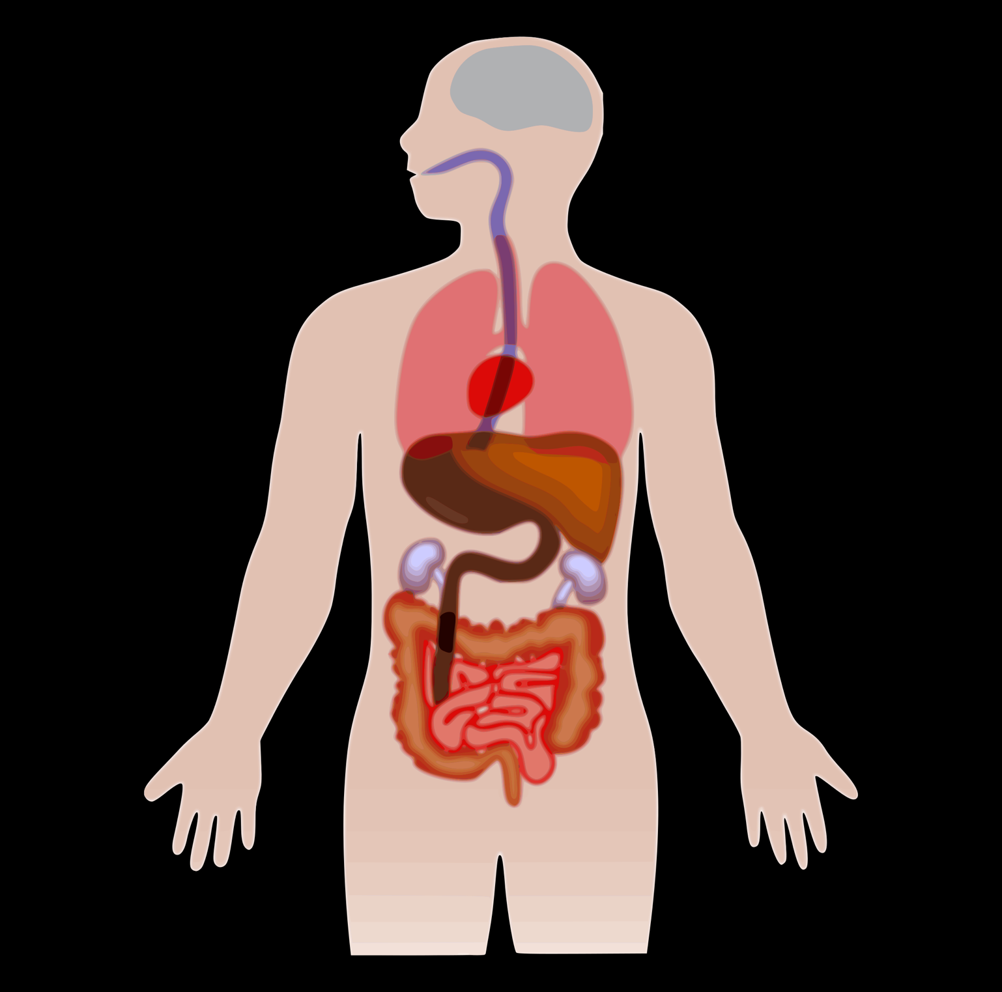
Extra-cutaneous Manifestations of Dystrophic EB
Microstomia (contractures at oral commissures)
Ankyloglossia (tongue tie)
Reduced oral opening
Corneal scars
Eyelids scarred open
Poor dentition
Esophageal blisters/strictures
Oral mucosa: blisters/scars
TRACHEA/LUNGS SPARED
Cardiomyopathy
Renal failure
Cutaneous malignancies
Pseudosyndactyly
Poor intestinal absorption
Osteopenia
Anal Stenosis
Notes:
Image:
Image: https://www.goodfreephotos.com/vector-images/anatomy-figure-vector-clipart.png.php
EB is an epithelial disease and even non-epithelial-lined organs can be affected for example the heart.
Scarring of the airway can occur anywhere from the throat down to the vocal cords. Severe scarring is usually associated with stridor and muffled voice.

Slide 15
Clinical Challenges with Dystrophic EB
EB skin does not heal properly and is always weak
Chronic pain from continuous skin damage
Chronic wounds and extensive scarring decrease mobility
Chronic scarring of hands and feet results in mitten deformities
Oral mucosa blistering prevents good oral hygiene and results in dental decay
Internal mucosa involvement results in poor feeding, FTT, anemia and osteoporosis

Slide 16
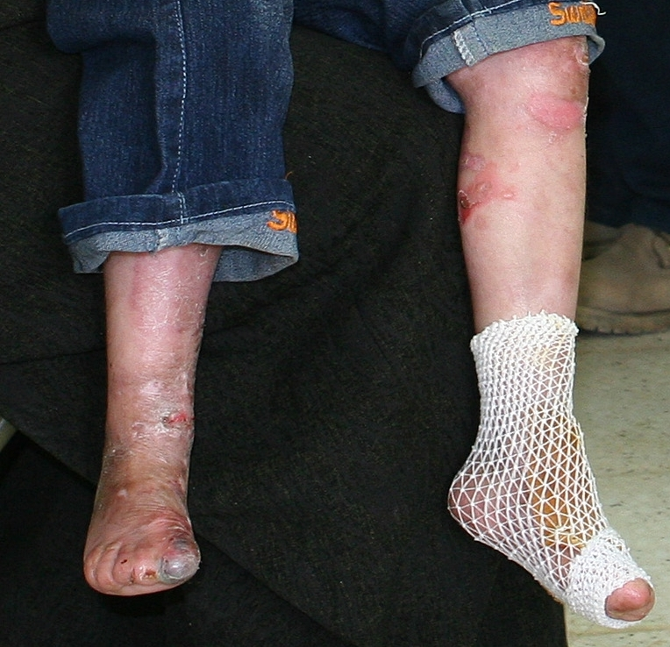
Common Surgeries in Patients With Dystrophic EB
Esophageal dilation (most common)
Gastrostomy tube placement
Pseudosyndactyly release
Dressing changes
Dental restoration
Circumcision
Airway surgery
Notes:
Image: https://commons.wikimedia.org/wiki/File:Iraqi-boy-epidermolysis_bullosa-090216-M-8096M-00-legs.jpg

Slide 17
Preoperative evaluation of Patients with Dystrophic EB
Consult patient’s primary care and dermatologist
Consult parents or caregivers
High risk of localized skin infections, cellulitis or sepsis
Although rare, may have dilated cardiomyopathy; consider echocardiogram and cardiology consult if signs of orthopnea, edema, or shortness of breath
May have chronic anemia
Esophageal involvement may result in GERD and poor nutritional intake

Slide 18
Airway Evaluation in Patients with Dystrophic EB
  Difficult intubation
  Microstomia can decrease mouth opening
    Ankyloglossia (harder to displace tongue into submandibular space during laryngoscopy
    Decreased neck mobility
    Oral mucosal scarring
    Review previous anesthetic records of airway management. Remember that these patients may become more difficult to intubate over time.

Slide 19
Intraoperative Management of Patients with Dystrophic EB
Avoid shearing and sliding
Handle patient gently
Place patient on foam egg-crate or sheepskin
Avoid tourniquets
Avoid adhesive dressings or adhesive monitors (e.g. EKG pads or pulse-oximeter sensors)
Notes:
Image: https://www.pexels.com/photo/child-sliding-1105541/
All photos on Pexels are free to use.
Attribution is not required. Giving credit to the photographer or Pexels is not necessary but always appreciated.
You can modify the photos. Be creative and edit the photos as you like.

Slide 20
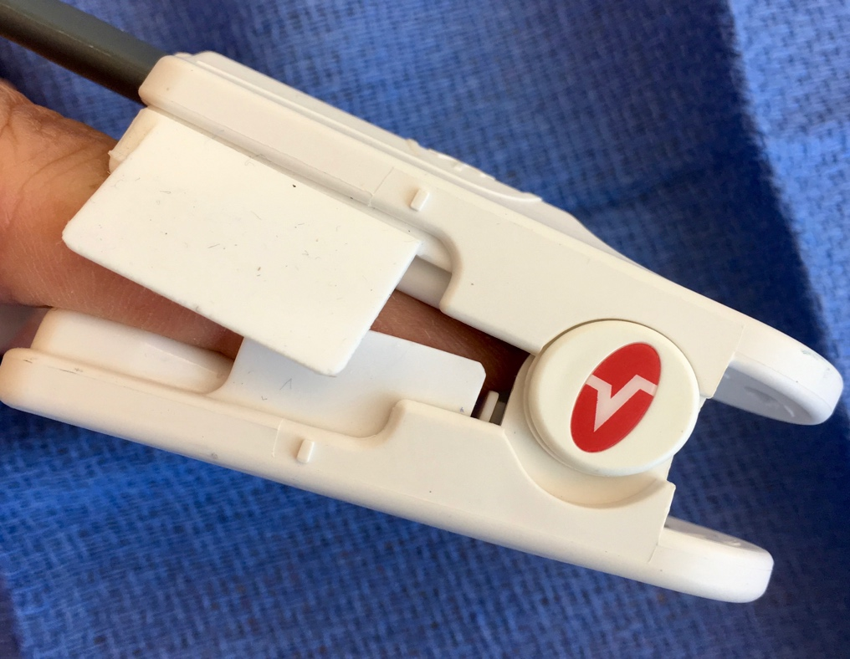
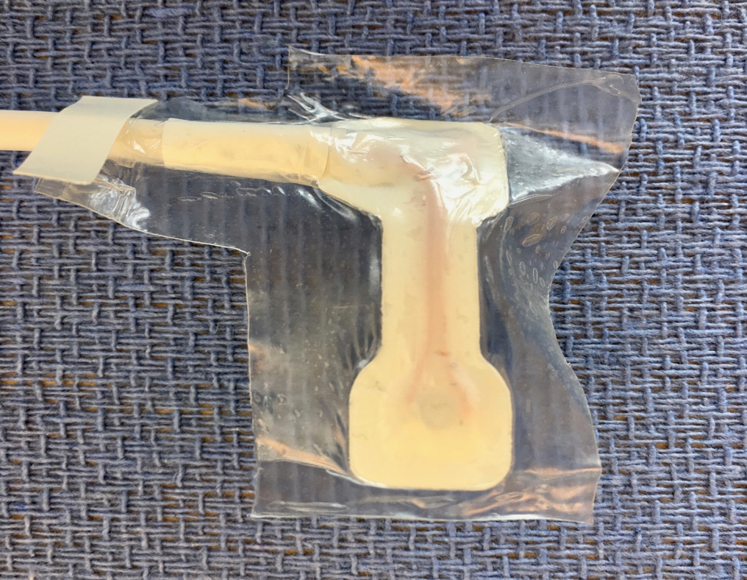
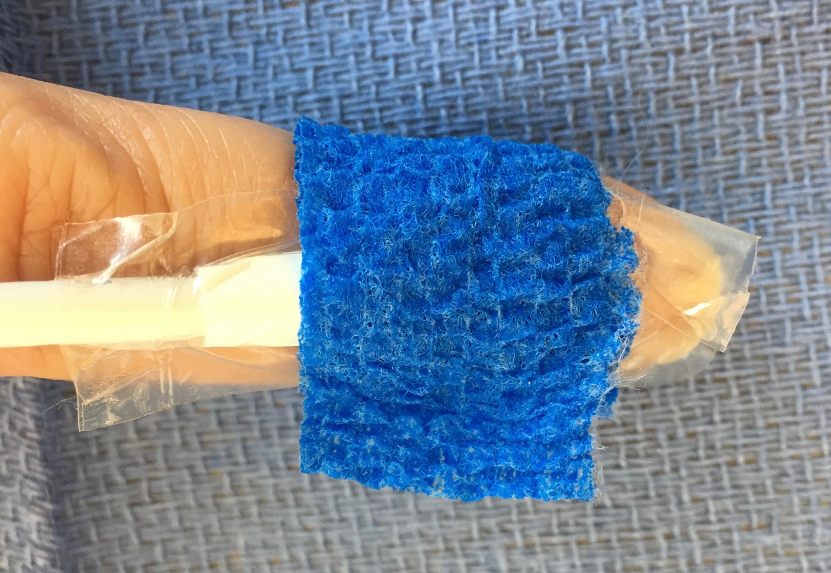
Intraoperative Monitoring of Patients with Dystrophic EB
Pulse oximetry:
Avoid adhesive sensors
Use clip on “adult” finger sensor
Can also use 2 tegaderm technique placed sticky side to sticky side sandwiched on both sides of sensor and trimmed and then wrapped with coban
Notes:
Images: Photos taken by authors
Monitoring is an essential part of safe anesthetic delivery but can also cause great harm to a patient with EB if not applied in the correct manner.

Slide 21
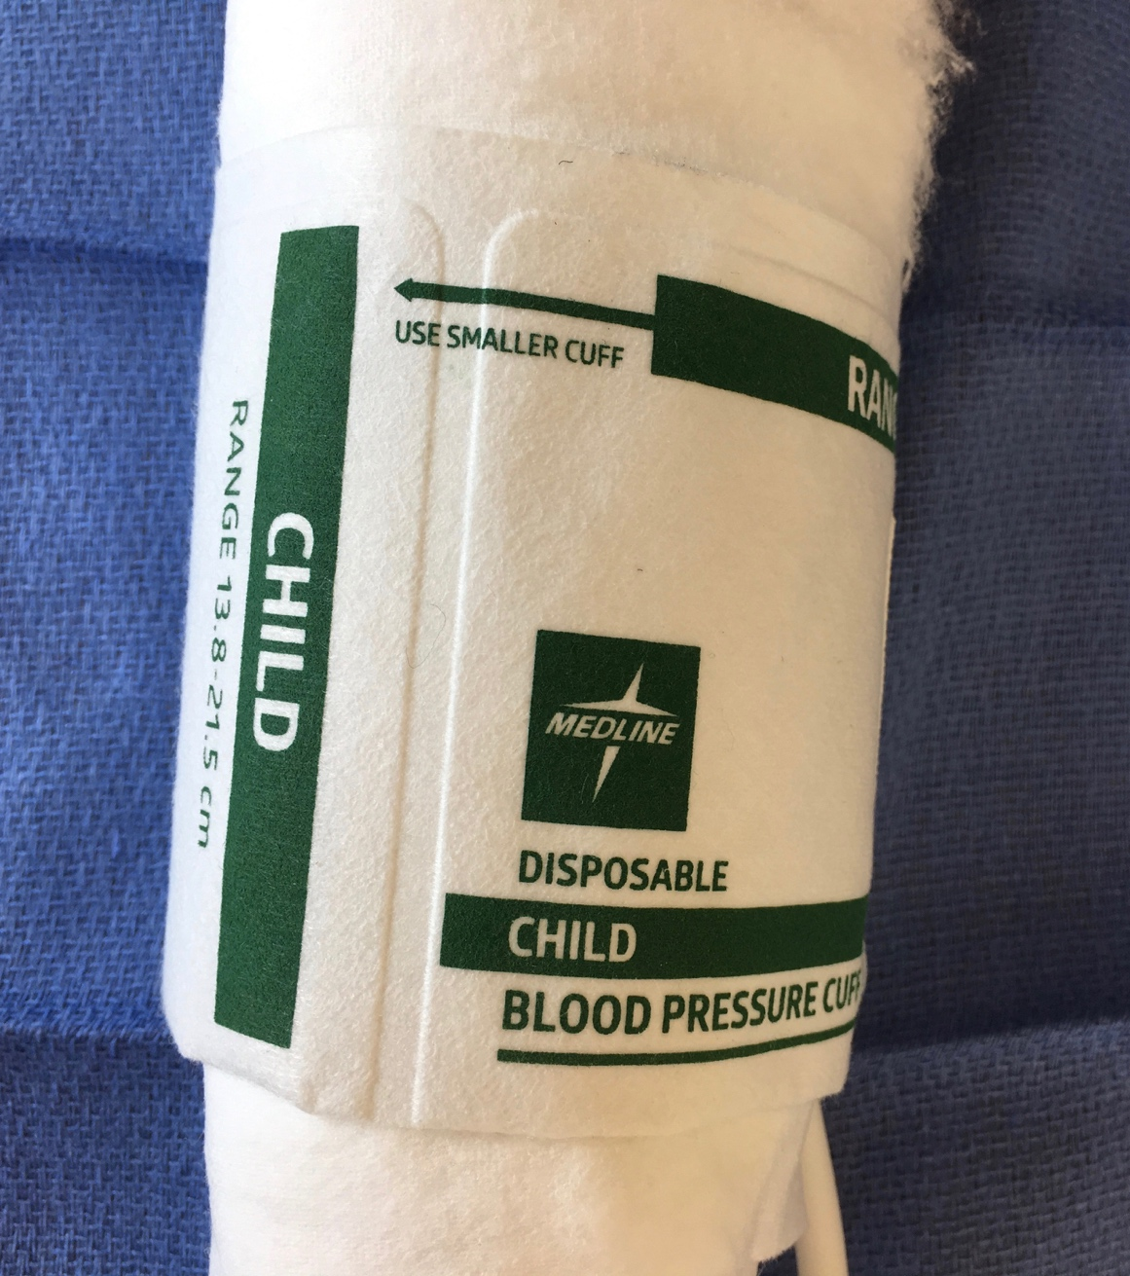
Intraoperative Monitoring of Patients with Dystrophic EB
Blood Pressure Monitoring
Place blood pressure cuff over existing bandages
Utilize Webril or cotton undercast padding under blood pressure cuff
Consider cycling BP cuff less frequently if clinically stable
Consider arterial line for large cases with significant blood loss
Notes:
Image: Photo taken by author

Slide 22
Intraoperative Monitoring of Patients with Dystrophic EB
EKG Monitoring
Consider not utilizing EKG electrodes and utilize pulse-oximeter to monitor heart rate and basic rhythm
If EKG necessary, can place petrolatum impregnated gauze between skin and neonatal EKG electrodes
Notes:
Monitoring is an essential part of safe anesthetic delivery but can also cause great harm to a patient with EB. Clinical judgement should be used to weigh the risks and benefits of EKG monitoring in these patients.
EKG leads can be applied to the skin of EB patients using some modifications. ECG leads can be stuck to 3M defib pads which are applied to the skin of the EB patient and then secured with coban wrap.

Slide 23
Inhalational Inductions in Patients with Dystrophic EB
Consider premedication with oral midazolam
Intravenous induction preferable to minimize need to mask ventilate
Inhalational induction: lubricate facemask with petroleum jelly (Vaseline) to reduce friction and torsional force

Slide 24
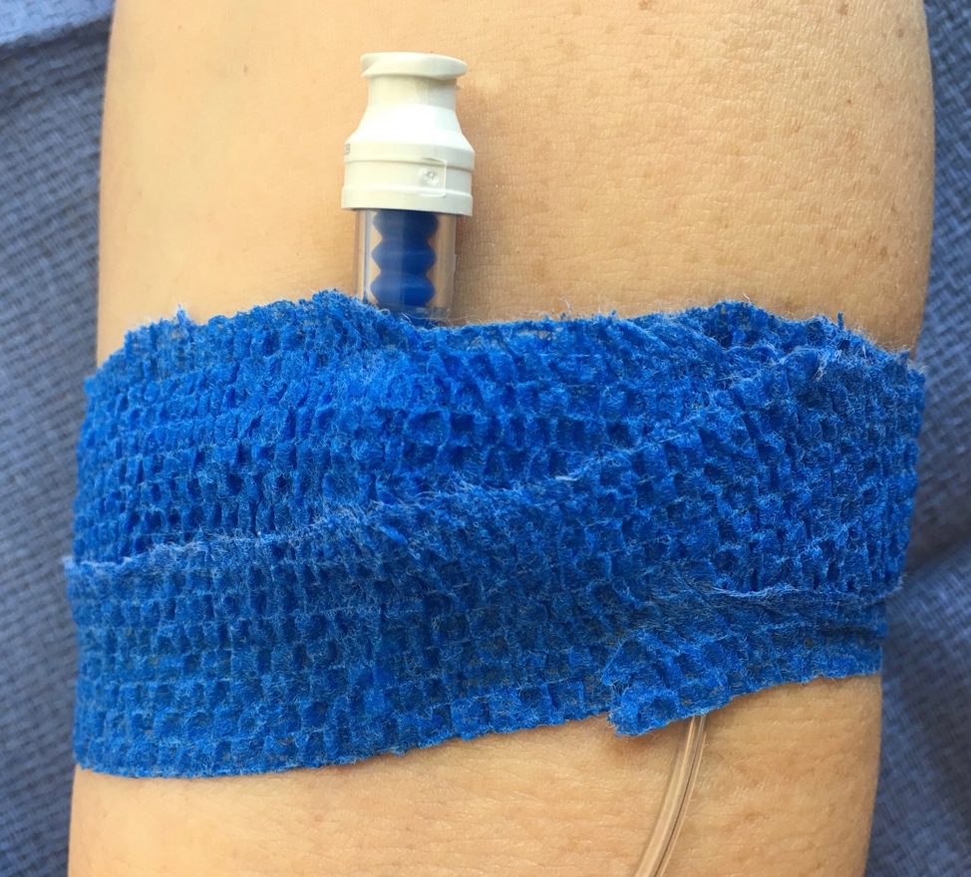
Intraoperative Management of Patients with Dystrophic EB
Intravenous Access
Do not use tourniquet
Veins are often easy to see as these patients have little subcutaneous fat and very thin skin
EMLA cream can be utilized for awake IV starts
Utilize ultrasound if necessary
Use silicon based adhesive tape such as Mepitac or coban to secure IV
Remember that IV is not well secured; be careful when moving patient
Notes:
Image: Photo taken by author

Slide 25
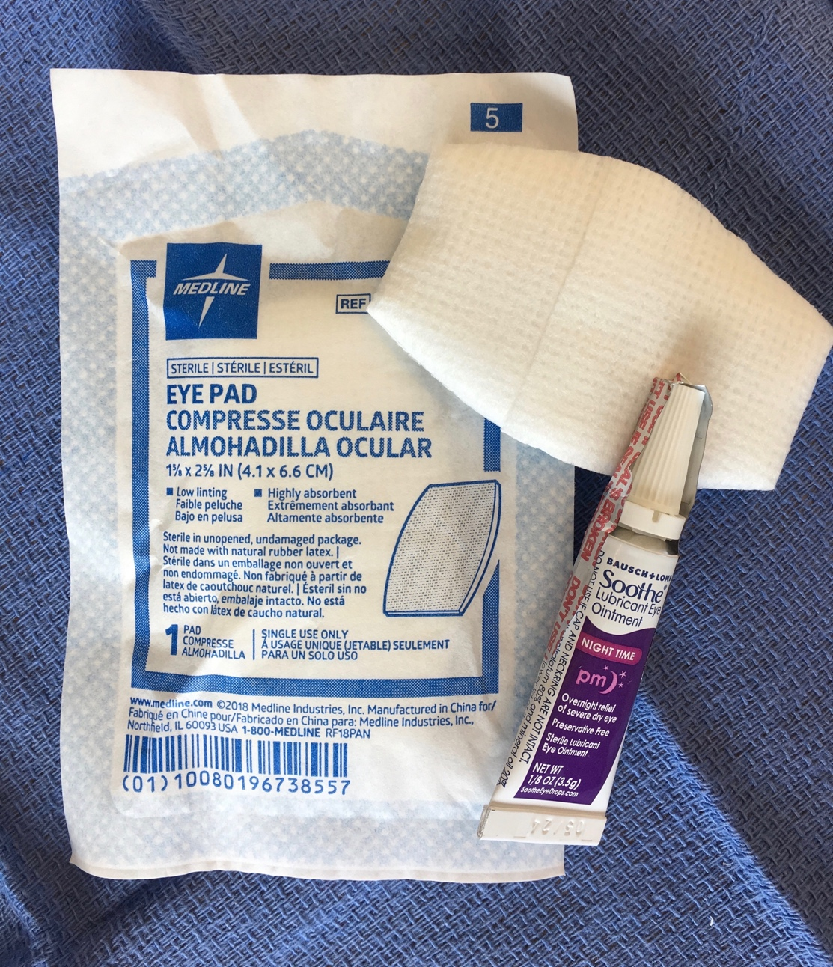
Intraoperative Management of Patients with Dystrophic EB
Ocular Protection
Do not tape eyes shut
Apply eye ointment to protect cornea from dying and abrasions during surgery
For longer cases remember to reapply eye ointment
Can utilize silicone sheeting and saline moistened gauze for additional ocular protection
Saline moistened gauze
Notes:
Image: photo taken by authors

Slide 26
Intraoperative Management of Patients with Dystrophic EB
Airway Management
Review previous anesthetic records
Remember past history of easy intubation does not always predict future easy intubations
Consider type and length of surgery
Natural airway may be best option
  Tongue is usually tethered from scarring and does not obstruct airway
  Scarring of intraoral and pharyngeal tissues can produce a patent airway
Notes:
.

Slide 27
Intraoperative Management of Patients with Dystrophic EB
Airway Management (con’t)
Recommend slightly smaller endotracheal tube as there may be scarring/stenosis
If adequate mouth opening, consider gentle laryngoscopy or videolaryngoscopy
If mouth opening inadequate consider either nasal or oral fiberoptic intubation
Nasal endotracheal tube can be secured with head wrap
Oral endotracheal tube can be secured with silicone based adhesive tape (e.g., Mepitac)
Supraglottic airway not recommended due to trauma to the oral tissues by their blind insertion.

Slide 28
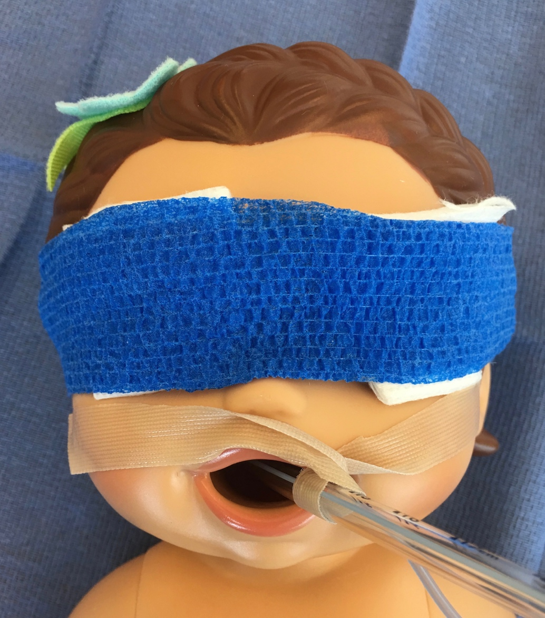
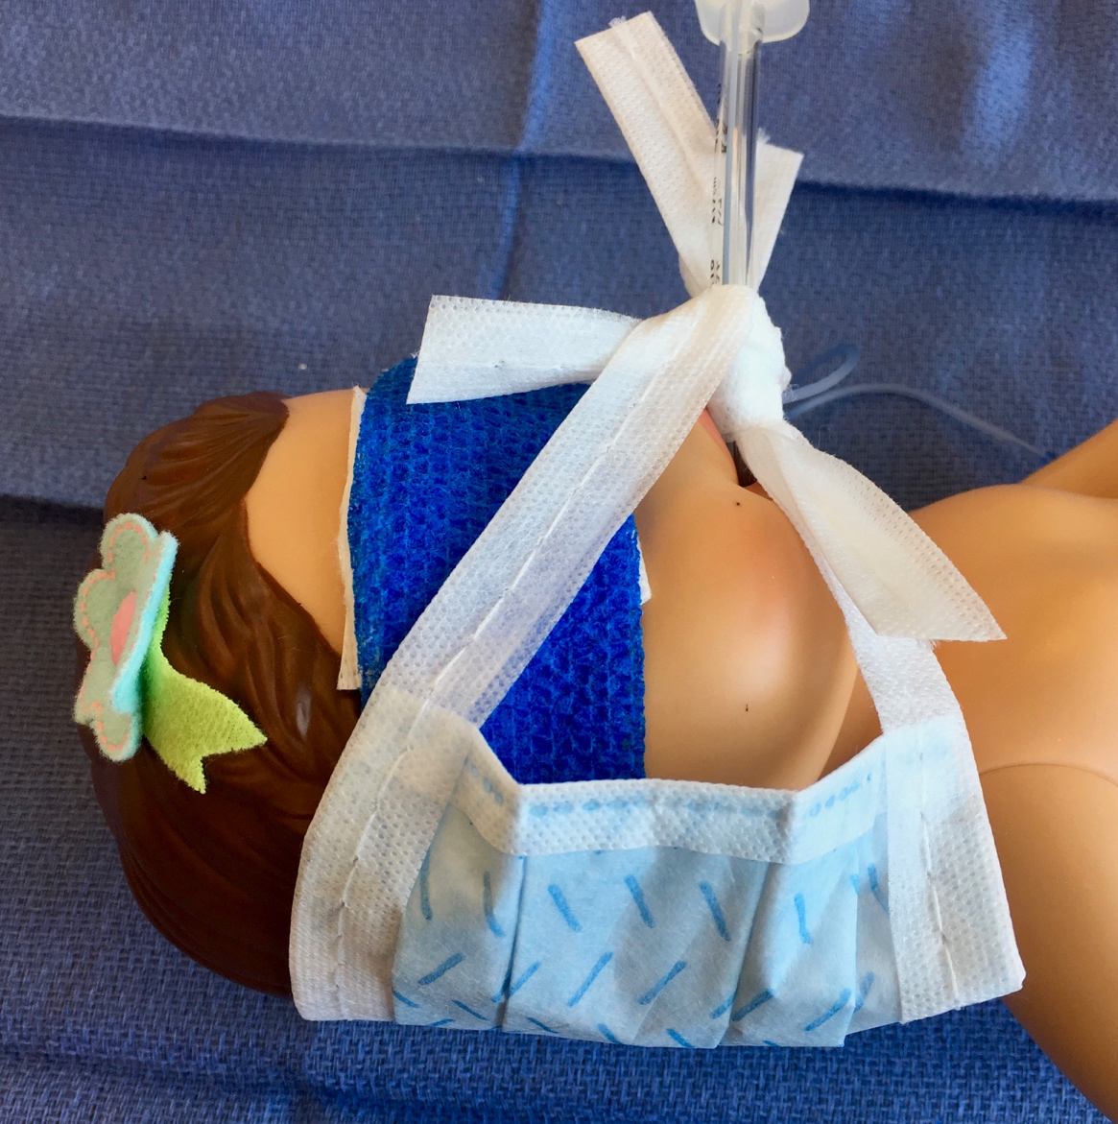
Airway Management in Patients with Dystrophic EB
Securing the endotracheal tube
Tie on tube
Silcone based tape
Using surgical face-mask
to secure ETT
Notes:
Images: Photos taken by authors

Slide 29
Postoperative Management of Patients with Dystrophic EB
Analgesia: key to smooth emergence from anesthesia
Avoid oral and nasal airways
Face masks should be lubricated with petroleum jelly
Notes:
Smooth emergence is as important as smooth induction of anesthesia.
Regional anesthesia is an excellent alternatives to pain management in surgeries appropriate for a regional block. It is not recommended to apply a dermal wheal infiltration of local anesthetic prior to a needle stick.

Slide 30
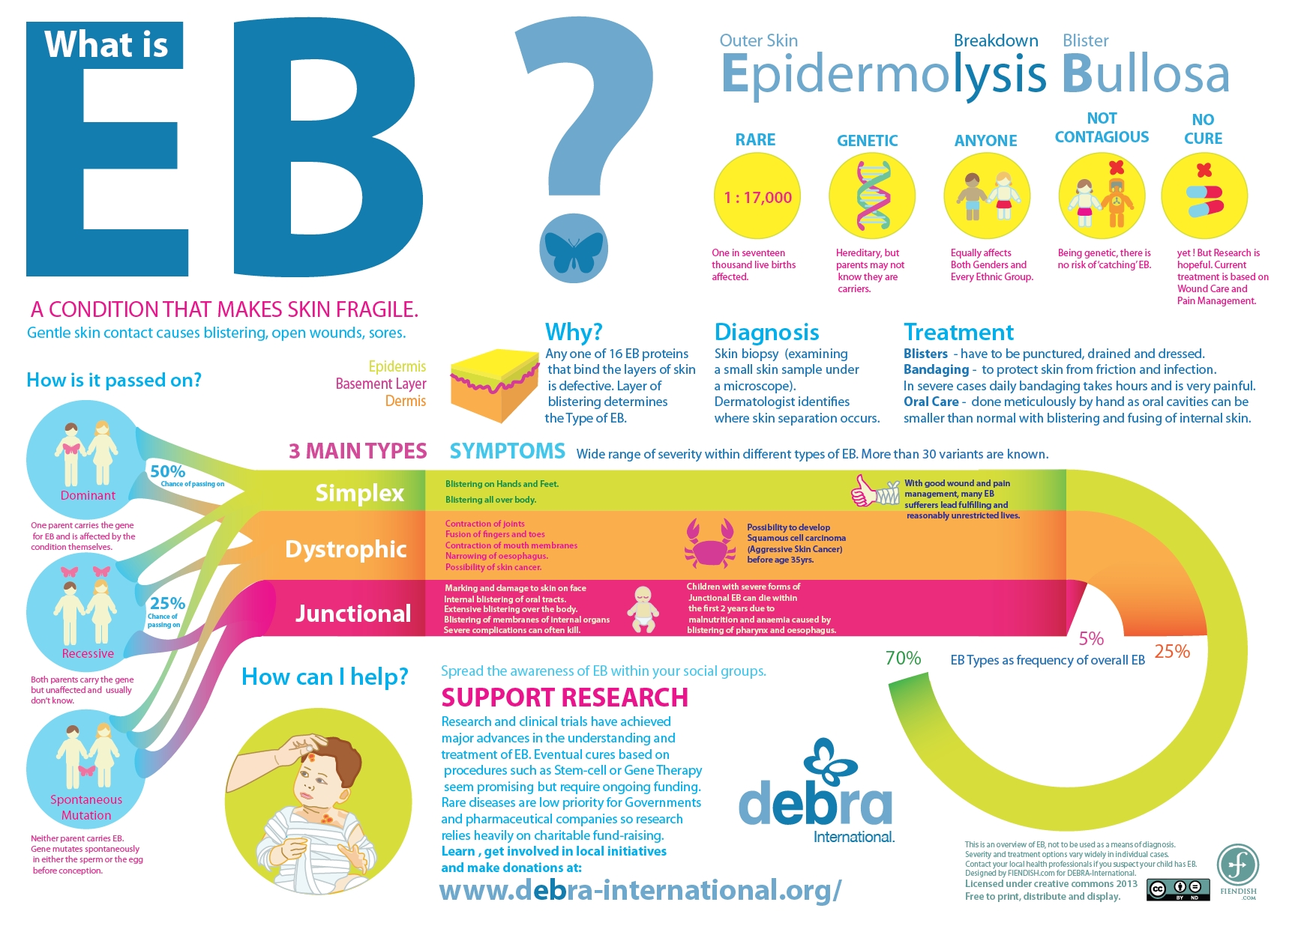
Notes:
DEBRA is the dystrophic EB research association: website has many resources for patients, families and physicians. www.debra-international.org

Slide 31
References:
Furukawa L, Krane E. Guidelines for the anesthetic management of EB. Pediatric anesthesia and pain management. Lucille Salter Packard Children’s Hospital, 10/21/2012 revised.
Bowen L, Burtonwood MT. Anaesthetic management of children with EB. BJA Education. 18(2): 41-45 (2018).
Ji SM et al. Anesthetic considerations in pediatric patients with EB: A case report. Journal of Anesthesia and Clinical Research. 2017;8:6.
Goldschneider et al. Perioperative care of patients with epidermolysis bullosa: Proceedings of the 5th international symposium on epidermolysis bullosa, Santiago Chile, Dec 4-6, 2008. Pediatric Anaesth. 2010 Sep;20(9):797-804.
Saraf S, et al. EB: Careful monitoring and no touch principle for anesthetic management. J. of Anesthesiology Clinical Pharmacology. 2013 Jul-Sept; 29(3): 390-393.
Fine JD et al. Inherited EB: updated recommendations on diagnosis and classifications. J. Am Acad Dermatol. 2014;70:1103.
Lin AN et al. Anesthetic management in EB: review of 129 anesthetic episodes in 32 patients. J. AM Acad Dermatol. 1194;30:412-6.

