Slide 1
Drowning: Management of Pediatric Submersion Injuries
Anna K. Swenson, MD
Assistant Professor of Anesthesiology
University of Minnesota

Slide 2
Disclosures
No relevant financial relationships

Slide 3
Learning Objectives:
Define drowning and describe its pathology.
Recognize global burden of drowning.
Describe initial stratification and treatment of drowning victims
Discuss the potential causes of hypothermia and their implications for a drowning victim’s prognosis
Identify short and long term causes of morbidity and mortality for drowning victims

Slide 4
What is Drowning?
The process of experiencing respiratory impairment from submersion or immersion in liquid
Can be fatal or non-fatal
Formerly-used categories such as “near drowning,” “wet/dry drowning,” and “active/passive drowning” are not helpful

Slide 5
Pathophysiology of Drowning
Laryngospasm, breath holding, aspiration
Surfactant destruction, alveolitis, pulmonary edema
Pulmonary hypertension
Ventilation-perfusion mismatch
HYPOXIA and respiratory acidosis
Notes:
Surfactant disruption happens differently in salt-water and fresh-water drowning, but the resulting increased membrane permeability and pulmonary edema is similar

Slide 6
Pathophysiology of Drowning
Cardiac depression, arrhythmia
Hypoxia
Acidosis
Notes:
Hypoxia is the main pathological driver in drowning and what needs to be reversed as quickly as possible. Metabolic acidosis and hypoxia can lead to cardiac depression and arrhythmias, which further worsen hypoxia due to decreased cardiac output. Cold water can cause hypothermia, which also leads to cardiac depression and bradycardia, decreasing oxygen delivery.

Slide 7
Pathophysiology of Drowning
Vomiting
  Victims often swallow more liquid than they aspirate
  Difficulties with rescue breathing
Electrolyte disturbance
  Mainly acidosis
  Other abnormalities uncommon unless high volume aspirated or drowning in unusual medium (e.g. the Dead Sea)
Hypothermia
Notes:
Earlier animal studies that showed large electrolyte derangements used high volumes of fluid instilled into the trachea. People who drown usually aspirate much less fluid, 1-4ml/kg.

Slide 8

Global Burden of Drowning¹
372,000 annual deaths
91% in LMICs (Low and Middle Income Countries)
Leading cause of death of
Figure 1
  children ages 5-14 in Western-Pacific region
  2-3rd cause of death children ages 5-14 in Americas and South-East Asian Regions
3rd leading cause of unintentional death

Slide 9
Drowning Deaths per 100,000¹
By region and income
Notes:
Age-standardized, as drowning death rate higher in younger populations
High Income countries not included in regions’ data

Slide 10
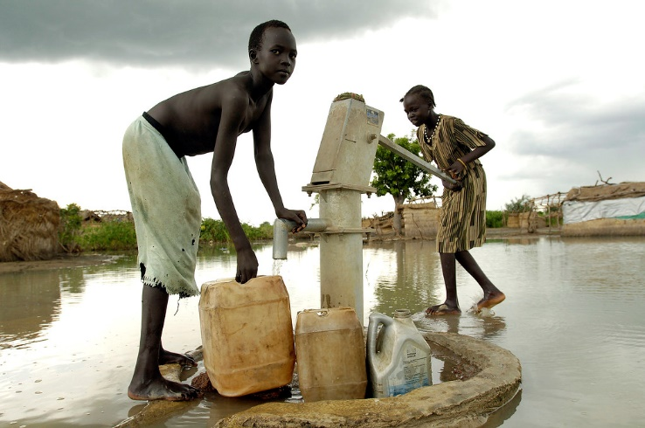
Health Disparities
Drowning rates are higher. . .
Lower socio-economic status
Minority populations
Males (2 times > females)¹
  Occupational hazards
  Risk taking behavior
Children
  Highest rates age 1-4, followed by 5-9
  Mobile, but don’t understand risks
Figure 2

Slide 11
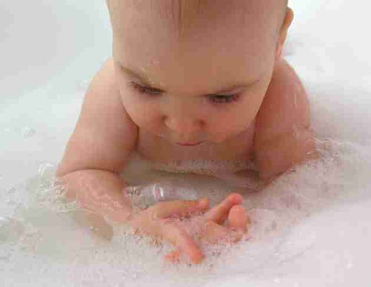
Drowning Rates are Higher in Pediatric Patients
Over half of drowning victims < 25 years
Characteristics change with age
  Infants: small amounts of water, e.g. unattended during bath
  Toddlers: unsupervised at home, e.g. large buckets
  Children: unsupervised at home, e.g. swimming pools
  Adolescents: e.g. boating accidents often associated with alcohol or drug use
Majority of drownings are preventable!
Figure 3

Slide 12
Physicians Leading Prevention
Doctors noticed toddlers drowned in 5-gallon (19-L) buckets
Reviewed all cases of toddler drowning and 12/49 (24%) were bucket drownings²
  9 to 16 months of age
  9/12 male
  11/12 minority race
  Industrial buckets being used at home
Notes:
Initial investigation was in Cook County, which includes Chicago.
This investigation led to a nationwide survey which had similar findings regarding type of bucket, use, age, gender and race.

Slide 13
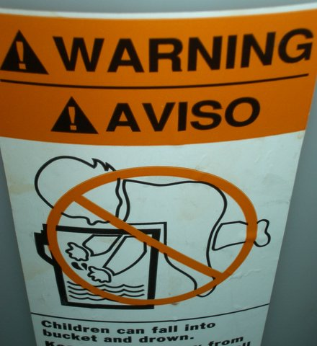
Physicians Leading Prevention
Toddlers are curious, fall into buckets and can’t get out
Buckets are heavy and don’t tip over; toddlers can drown in several inches of liquid
Prevention
  Warning Labels
  Education from pediatricians
Figure 4
Notes:
https://commons.wikimedia.org/wiki/File:Drowning_child_warning.jpg

Slide 14
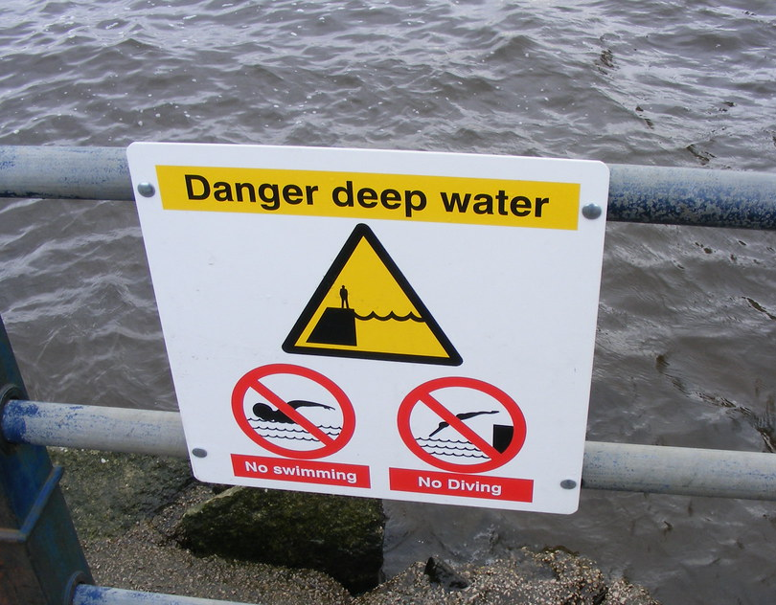
Prevention is Vital
Locally specific
Barriers, signage
  Wells
  Open water
  Sewers
Childcare/supervision
Swimming, water safety skills and BLS education
Swimming with lifeguards
Public awareness, vulnerability of children
Caregiver education, e.g., people with epilepsy 15-19 x risk of drowning³
Figure 5
Notes:
Prevention efforts have been successful in more and less developed countries, and there is public health opportunity to decrease preventable death and disability.

Slide 15
Questions at the Scene
Why did they drown?
  Suicide
  Trauma
  Medical events: epilepsy, cardiac arrest, arrhythmia
  Inability to swim
Water temperature?
How long submerged?
How long until BLS started? Vital signs?
Notes:
These questions are important for informing patient management and prognosis as well as guiding prevention efforts.

Slide 16
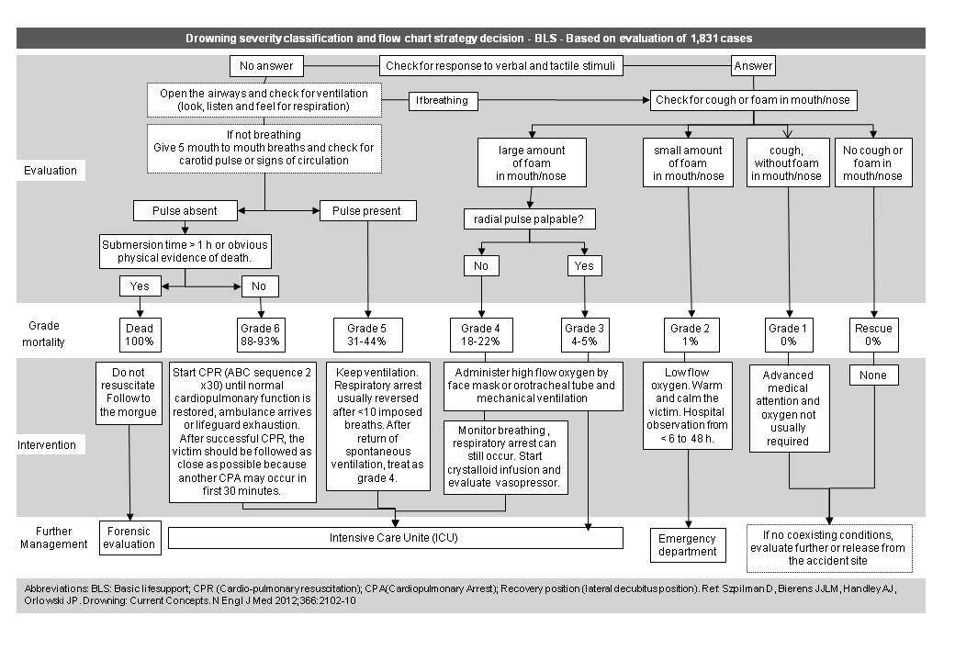
Szpilman’s Drowning Severity Classification and Mortality⁴
Figure 6
Notes:
Patients who are conscious on presentation and have a pulse have good outcomes. Usually even patients with a large amount of foam in their airway survive if they have a radial pulse, although they should be provided with oxygen and monitored closely for decompensation. Few unconscious patients without a pulse survive.

Slide 17
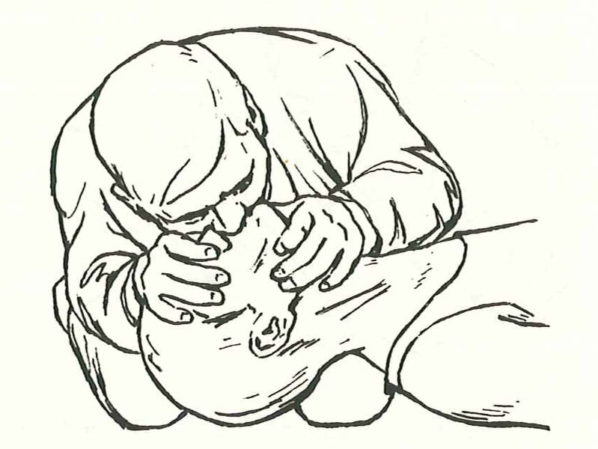
Management at the Scene
Remove from water when safe
Early BLS vital
  Rescue breaths first
  ABCs: Airway → Breathing → Circulation
In drownings there is no residual oxygen in the lungs, unlike other causes of arrest
Figure 7
Notes:
Rescuers can become additional victims. Thrown flotation devices, objects for the victim to grab (rope, branch) are safer with a conscious victim.
Rescue breaths can begin while the patient is in the water, as soon as safe for the rescuer.

Slide 18
Management at the Scene
Warm patient
  Remove clothes
  Dry patient
  Cover with dry material
Immobilize spine if trauma suspected
  Mechanism of injury (e.g. boating accident)
  Facial/neck trauma (e.g. diving accident)
  Do not delay respirations to immobilize spine

Slide 19
Management at the Scene
Does aspirated water need to be removed before rescue breaths? NO!
  In most drownings only a small volume of water is aspirated
  Aspirated water is absorbed quickly
  Stomach thrusts or positioning do not effectively remove aspirated water

Slide 20
Management at the Scene
Establish IV or IO access
  Tracheal medications unlikely to be effective
Start advanced life support
  Administer oxygen for respiratory distress
  Early rapid sequence intubation if unresponsive or not breathing
  Orogastric or nasogastric tube after intubation
Treat hypothermic diuresis with 10-20 ml/kg boluses of 0.9% saline or isotonic fluid
Notes:
Intubation particularly important in submersion injury both for gas exchange in setting of pulmonary edema and frothy secretions, and, with gastric tube, to protect airway from vomiting

Slide 21
Hypothermia Concerns
Bradycardia is a response to hypothermia
Can consider no chest compressions for HR < 60 IF intact circulation
Secondary issues
  Irritable myocardium
  Increased coagulopathy
  Infection
  Confusion

Slide 22
Hypothermia Concerns
At < 30°C epinephrine is less effective
  Consider holding epi until > 30°C or give only 3 doses until > 30°C
At < 30°C defibrillation is less effective
  Consider using higher doses if 2-4 J/kg insufficient (up to 10 J/kg or adult dose)
Notes:
< 30°C

Slide 23
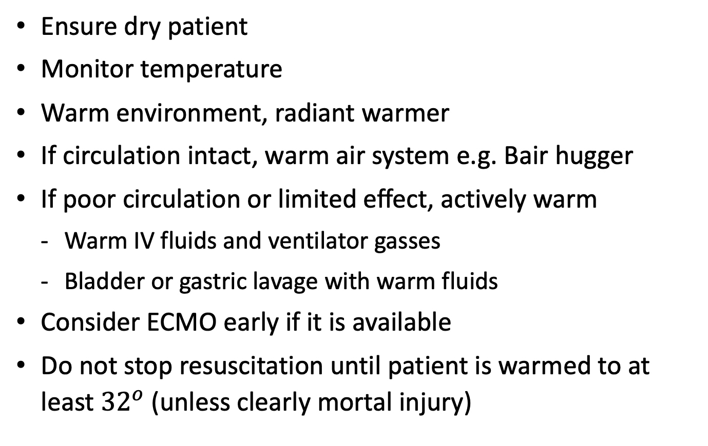
Hospital Management
Ensure dry patient
Monitor temperature
Warm environment, radiant warmer
If circulation intact, warm air system e.g. Bair hugger
If poor circulation or limited effect, actively warm
  Warm IV fluids and ventilator gasses
  Bladder or gastric lavage with warm fluids
Consider ECMO early if it is available
Do not stop resuscitation until patient is warmed to at least ${32}^{o}$ (unless clearly mortal injury)

Slide 24
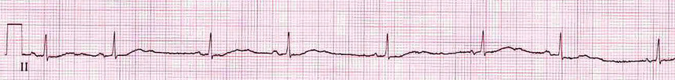
Initial Hospital Assessment: Conscious Patient
SpO₂
EKG
  Arrhythmia secondary to hypoxia or hypothermia
  Arrhythmia (e.g. long QT) precipitating the drowning
Imaging and treatment of potential injuries and conditions
  Spine imaging with X-rays/CT if potential cervical trauma
  Epilepsy treatment if seizure
  Alcohol level, drug screen
Figure 8

Slide 25
Initial Hospital Assessment: Unconscious Patient
Vital signs, including SpO₂
Arterial blood gas
Blood glucose and electrolytes
Hemoglobin, white blood count, coagulation profile
EKG
Chest X-ray: useful for tracking changes
Head CT: poor prognosis if abnormal
Imaging as indicated by injuries and mechanism of drowning
Notes:
Normal head CT on presentation not helpful for prognosis.
Initial chest x-ray don’t correlate with prognosis or ABG.

Slide 26
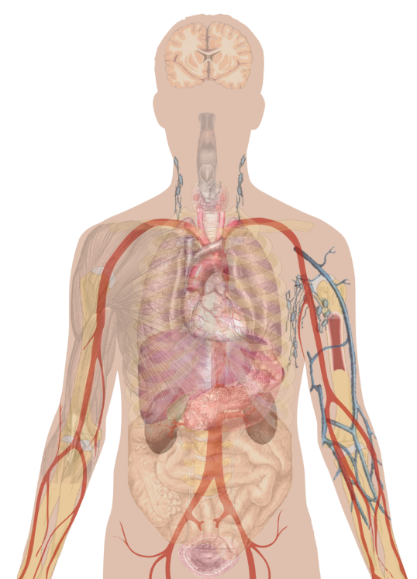
Ongoing Care
Ischemic injury
  Brain: Hypoxic ischemic encephalopathy
  Heart
  Kidneys
Evolving Pneumonia/ARDS
    Microorganisms in water or healthcare-acquired
    No data for prophylactic antibiotics
    Antibiotic choice ideally determined by culture
Figure 9

Slide 27
Ongoing Care: Pulmonary
Lung protective ventilation⁴
  Low tidal volumes (6 – 8 ml/kg)
  Plateau pressure < 30 mmHg
  PEEP, levels as needed for oxygenation
  PaO₂ goal of 55 - 80 mmHg
  Similar to ARDS management but reconsider permissive hypercapnia in setting of cerebral edema and intracranial hypertension
  Watch for pneumothorax
No data for prophylactic steroids
Notes:
See reference 4 for free downloadable reference card for ARDSnet ventilation protocol

Slide 28
Ongoing Care: Cardiac
  Low cardiac output can happen via different mechanisms
    hypoxic injury
    increased pulmonary pressures
    arrhythmia
  Can cause worsened pulmonary edema
  Echocardiography can guide therapy
    ionotropic agents, such as Dobutamine
    diuretics if fluid overloaded ventricles

Slide 29
Ongoing Care: Neurologic
  Minimize increased ICP from edema
    Head of bed at 15 degrees
    Maintain normoglycemia and normal electrolytes
    Low-normal PaCO₂
    Seizure control
    Invasive ICP monitoring not shown to improve outcome
  Avoid hyperthermia
    Therapeutic hypothermia: No data to support
Treatment of associated injuries when stable

Slide 30
Long-term Care: Residual Neurologic Defects
May require long term institutional care
Rehabilitation can improve function with mild-moderate motor deficits, especially in younger children
Notes:
Prevention efforts targeting the cause of the incident may gain traction in the wake of a drowning and save lives in the future.
Rehabilitation has been shown to improve functioning for pediatric drowning victims, especially with mild-moderate motor deficits.

Slide 31
Prognosis: Conscious Patient
Refer to Szpilman’s classification system of drowning grades
Responsive Patients
If conscious on presentation and normal SpO₂ at 8 hours → Good prognosis
Figure 10
Notes:
Percentages in the table are mortality

Slide 32
Prognosis: Unconscious Patient
Difficult to prognosticate
Submersion time
  < 6 min: good outcomes
  > 25 min: approaching 100% mortality/poor outcomes
Delayed BLS, delayed emergency medical services arrival, or no ROSC within 30 minutes: poor outcomes
Unresponsive Patients
Figure 11
Notes:
Less submersion time is better across intervals

Slide 33
Prognosis: Hypothermia and Water Temperature
Case reports of successful resuscitation of children after prolonged submersions in cold water⁵
  Likely hypothermic before arrest
  More likely in very cold water
    < 6°C
    Young children cool faster with larger surface area

Slide 34
Prognosis: Hypothermia and Water Temperature
Retrospective study of 160 Dutch children with drowning, hypothermia, and cardiac arrest⁶
  100% mortality or vegetative state if no ROSC after 30 min resuscitation
  62 children with ROSC < 30 min, 17 survived 1 year with no, mild, or moderate neurological disability
Meta-analysis of prognosis with variable water temperature < or > 6-8 °C⁷
  Very low quality evidence, high-income countries
  No significant difference in outcomes

Slide 35
Conclusions:
Drowning is a major cause of preventable deaths in infants, children and adolescents worldwide
Higher incidence of drowning in LMICs
Morbidity and mortality due to hypoxia
Early intervention: rescue breaths
Prevention can save lives

Slide 36
References:
World Health Organization. November 2014. “Global Report on Drowning: Preventing a leading killer.” https://www.who.int/publications/i/item/global-report-on-drowning-preventing-a-leading-killer. ISBN 9789241564786.
Jumbelic M, Chambliss M. Accidental Toddler Drowning in 5-Gallon Buckets. JAMA 1990;263(14):1952-1953.
Bell G, Gaitatzis A, Bell C, Johnson A, Sander J. Drowning in people with epilepsy: how great is the risk? Neurology 2008; 7(8):578-82.
NIH NHLBI ARDS Clincal Network. Clinical Network Mechanical Ventilation Protocol Summary. 2008. http://www.ardsnet.org/files/ventilator_protocol_2008-07.pdf
Bauman BD et al. Treatment of a Hypothermic Cardiac Arrest in the Pediatric Drowning Victim, a Case Report, and Systematic Review. Pediatr Emerg Care. 2019. doi:10.1097/PEC.0000000000001735. Online ahead of print.
Kieboom, JK et al. Outcome after resuscitation beyond 30 minutes in drowned children with cardiac arrest and hypothermia: Dutch nationwide retrospective cohort study. BMJ 2015;350:h418.
Quan L, Bierens J, Lis R, Rowhani-Rahbar A, Morley P, Perkins G. Predicting outcome of drowning at the scene: A systematic review and meta-analyses. Resuscitation July 2016;104:63-75.

Slide 37
Bibliography
Handley A. Drowning. BMJ 2014;348:bmj.g1734
Macintosh I, Austin S. Management of drowning in children. J Paediatr. Child Health 2017; 27(9):415-419.
Orlowski, JP, Szpilman D. Drowning. Rescue, Resuscitation, and Reanimation. Pediatr Clin North Am 2001;48(3):627-46.
Quan L, Mack C, Schiff M. Association of water temperature and submersion duration and drowning outcome. Resuscitation 2014;85(6):790-794.
Schmidt A, Sempsrott J, Hawkins S, Arastu A, Cushing T, Auerbach P. Wilderness Medical Society Clinical Practice Guidelines ofr the Treatment and Prevention of Drowning: 2019 Update. Wilderness Environ Med 2019;30(4S):S70-S86.
Szpilman D, Biernes JJLM, Handley AJ, Orlowski JP. Drowning. N Engl J Med 2012;366:2102-2110.
Venema A, Absalom A, Idris A, Bierens J. Review of 14 drowning publications based on the Utstein style for drowning. Scand J Trauma Resusc Emerg Med 2018;26:19.

Slide 38
Figures
Figure 1: Creative Commons. "Children playing in water, Thailand" by water.alternatives is marked with CC0 1.0
Figure 2: Creative Commons. "Children Fetch Water During Flooding" by United Nations Photo is licensed under CC BY-NC-ND 2.0
Figure 3: Creative Commons. "baby in bath with bubble" by Chesi - Fotos CC is licensed under CC BY-SA 2.0
Figure 4: https://commons.wikimedia.org/wiki/File:Drowning_child_warning.jpg.
Figure 5: Creative Commons. "No Swimming Sign" by Pimlico Badger is licensed with CC BY-SA 2.0. To view a copy of this license, visit https://creativecommons.org/licenses/by-sa/2.0/
Figure 6: Wikimedia commons. “Drowning severity classification and flow chart strategy decision – BLS-Based on Evaluation of 1,831 cases. Ref Szpilman D, Bierens JJLM, Handley AJ, Orlowski JP. Drowning: Current Concepts. N Engl J Med 2012;366:2102-10.” Aliceasz, 10 August 2014, CC-BY-SA-4.0.
Figure 7: Wikimedia commons. “Mund-zu-Mund-Beatmung IV.” Hauptabteilung der Schutzpolizei der DDR. 19 August 2010, CCA-SA-3.0. https://commons.wikimedia.org/wiki/File:Mund-zu-Mund-Beatmung_IV.jpg
Figure 8: Creative Commons. "Sinus bradycardia with sinus arrhythmia" by Popfossa is licensed with CC BY-NC 2.0. To view a copy of this license, visit https://creativecommons.org/licenses/by-nc/2.0/
Figure 9: Wikimedia Commons. “Man shadow with Organs.” Mikael Häggström. May 2011, CC0. https://commons.wikimedia.org/wiki/File:Man_shadow_with_organs.png

