Slide 1
Developmental Pharmacology
B. Randall Brenn M.D.
Associate Professor of Anesthesiology
Monroe Carrell Children’s Hospital at Vanderbilt
Vanderbilt University Medical Center
Updated: 4/19/2019

Slide 2
Let’s start with a few questions?
When can an infant metabolize morphine?
When can an infant metabolize propofol?
When can an infant concentrate their urine?
Why do we dose muscle relaxants in infants like adult patients?
What age has the highest MAC? The lowest?
Notes:
The purpose of this slide is to focus the discussion.

Slide 3
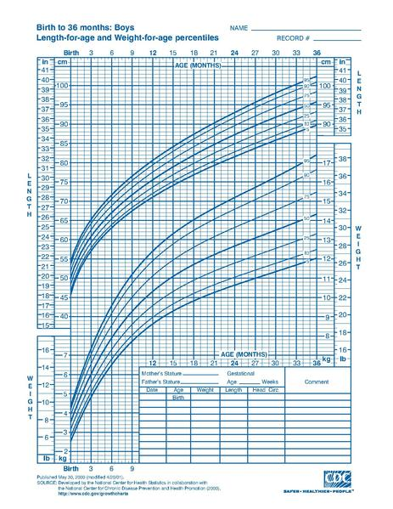
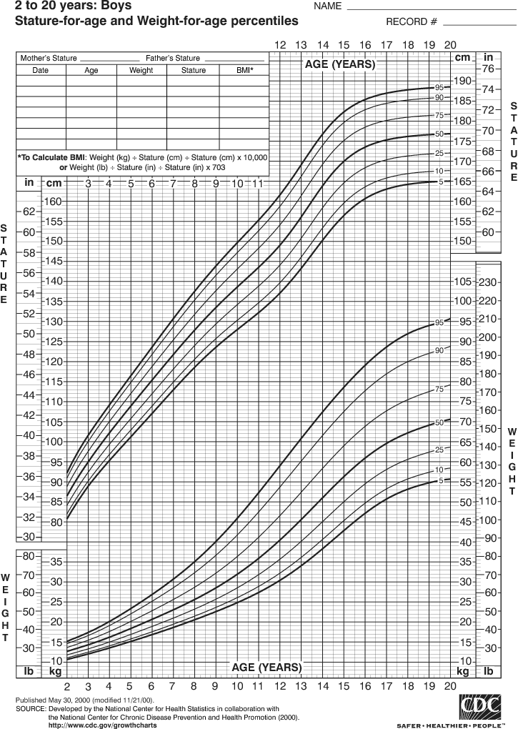
Normal Growth
Notes:
The growth curves for young children and older children are different. Young children have a curvilinear pattern reflecting greater growth that slows early on. Older children/adolescents see a more linear pattern till a little after puberty.

Slide 4
Dr. Abraham Jacobi
(1830-1919)
“Children are not miniature men and women, with reduced drug doses and the same class of disease in a smaller body…”
“Age-appropriate pharmacotherapy is important”
Notes:
Dr. Jacobi was a physician in New York who spent a large part of his practice with newborns.

Slide 5
Consider this…
The majority of medications used in children have not been tested in children
Of 140 drugs used routinely in children, only 38% are labeled for use in children
90% of PICU drugs are used for purposes other than what they are approved for
Tod, Fund Clin Pharm, 2008
Notes:
In the United States many medications that are in common use are not necessarily approved for use.

Slide 6
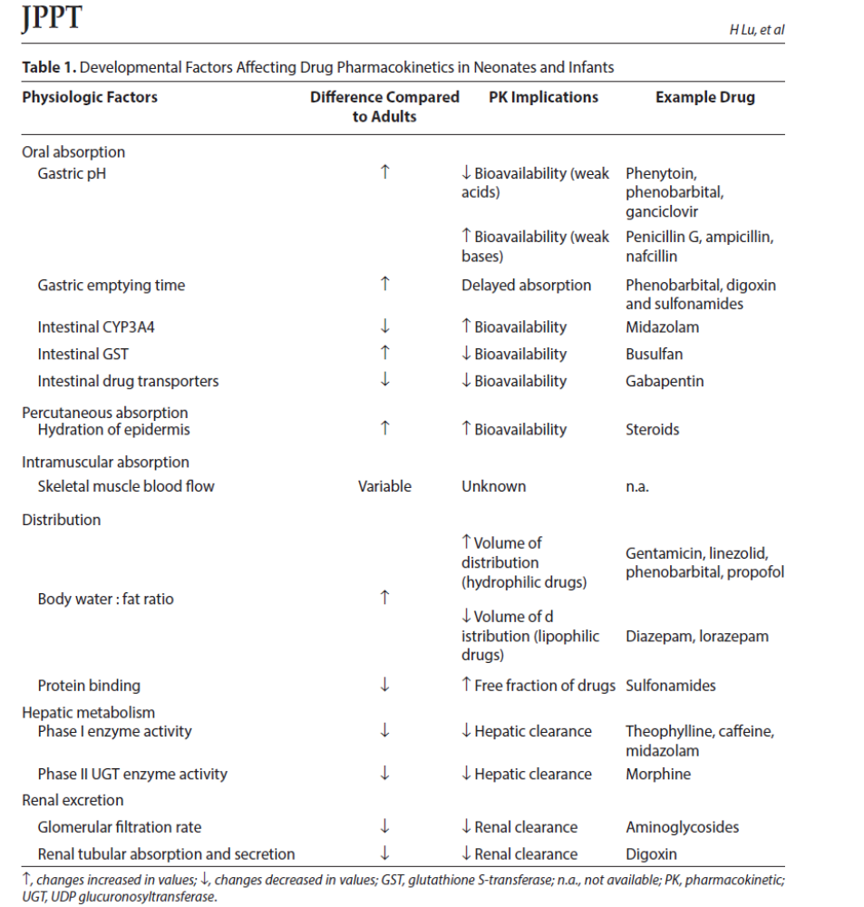
Lu et al JPPT 2014
Notes:
This is a general table of neonatal physiologic functions as compared with adults. The implications for the type of medication and examples are presented.

Slide 7
Factors Affecting Drug
Distribution
Volume of distribution
Protein binding
Metabolism
Elimination
Notes:
Basic factors slide.

Slide 8
Changes in Body Composition
Changes in body composition during growth
Body Compartment | Premature Infant (1.5 kg) | Full-Term Infant (3.5 kg) | Adult (70 kg)
Total body water (% body weight) | 83 | 73 | 60
Extracellular fluid (% body weight) | 62 | 44 | 20
Blood volume (mL/kg) | 60 | 85-105 | 70
Intracellular water (% body weight) | 25 | 33 | 40
Muscle mass (% body weight) | 15 | 20 | 50
Fat (% body weight) | 3 | 12 | 18
From Cook DR, Marcy JH: Neonatal anesthesia, Pasadena, Calif, 1988, Appleton Davies.
Notes:
Focus on Body compartments and differences between adult and infant compartments that is very important to drug distribution.

Slide 9
Volume of Distribution (Vd)
Calculated value
ECF is greatest at birth thus, water soluble drugs have greater Vd and lower concentration.
A larger loading dose is thus required.
Which drugs are water soluble?
Notes:
Realize that Volume of distribution as a metric is a derived value. Those drugs that have a large Vd require a larger loading dose. This is unrelated to clearance but to effective dose.

Slide 10
Factors Affecting Drug
Distribution
Protein binding in a neonate
  Albumin binds acids and acid 1 glycoprotein binds bases
  Both quantitative and qualitative immaturity
  Local anesthetics may have larger free fraction of drug
Metabolism is age dependent
Elimination is usually faster in infants but may be slower in neonates.
Notes:
Protein binding is also a process. Just like hemoglobin which has fetal and mature variants, albumin and transport glycoproteins also involve fetal to adult transformation. While elimination is faster in infants it is generally slower in neonates.

Slide 11
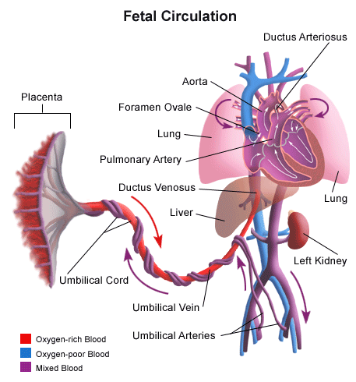
Hepatic Function
Transition at birth:
Umbilical arteries form a part of the internal iliac arteries
Ductus venosus atrophies and forms ligamentum venosum
Now blood actually goes to the liver…and not past it.
Notes:
How does it all start? Basically at the time of birth when transition of circulation occurs in the neonate. We are familiar with the transition in the heart to take a cardiovascular system from a parallel to a series system. The perfusion to the liver and kidney also undergo a change in perfusion which allows these two organs to grow and develop.

Slide 12
Hepatic Function
Hepatic drug clearance determined by
  Liver blood flow
  Intrinsic clearance (bio-transformation)
  Plasma protein binding
Extraction ratio
  High ratio, depends on blood flow
  Low ratio, intrinsic clearance (metabolism)
Notes:
Drugs that use the liver for transformation have two overall factors.

Slide 13
Hepatic Reactions
Phase I reactions
Reactions available in endoplasmic reticulum of liver, kidney, lung and GI tract
Hydrolysis is present from birth.
  Water breaks up molecules…
  Ester local anesthetics, succinylcholine
Oxidation and reduction are not developed until 2 weeks of age
  Enzymes help move electrons around
  Pentothal, amide local anesthetics
Notes:
Phase I chemical reactions are fairly simple. Available from birth and involve hydrolysis or simple transfer of electrons. The oxidation and reduction reactions may require enzymatic involvement.

Slide 14
Hepatic Reactions
Phase II reactions
Cytochrome p450 (among other enzyme systems)
What is conjugation?
Conjugation level is about 50% by 3 months of age; reaches 100% by 5 years of age.
Glucuronide – Morphine, Fentanyl, Propofol
Sulfate - Acetaminophen
When can an infant metabolize morphine?
Notes:
Phase II reactions require more enzymatic machinery which develop over the first three months of life.

Slide 15
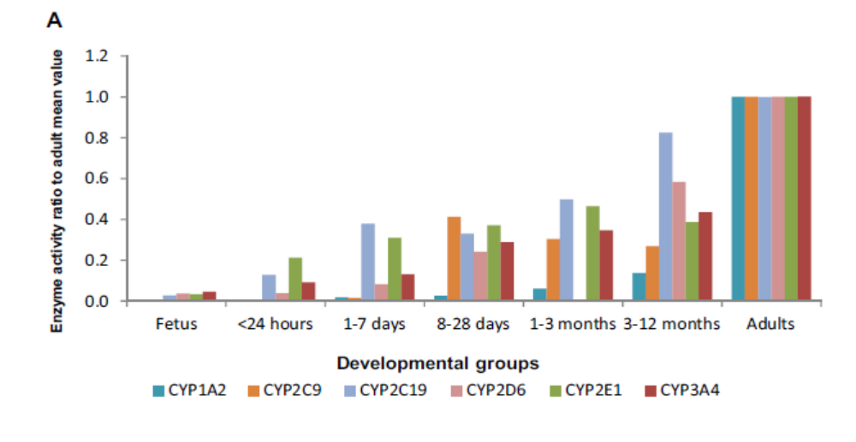
Hepatic Enzyme Development
Lu et al JPPT 2014
Notes:
Shows that all of the different CYP-450 systems have to develop over the first few months to a year.

Slide 16
Hepatic Function
Consider a 4-month-old, ex 28-week infant versus a 1-week-old, term infant
Who can metabolize morphine?
Postnatal age more important than gestational age
Notes:
This is a quick question to test the concept that the liver requires development to function. Because postnatal age is more important for liver development, the 4-month-old will be able to metabolize morphine

Slide 17
What Drugs are Affected?
Atracurium/Cisatracurim: Ester hydrolysis
Local Anesthetics
  Amides-hepatic, then 10% renal excretion
  Esters-hydrolysis then liver then renal excretion
Morphine: glucuronidation with some active metabolites
Propofol
  Highly protein bound
  Glucuronidation-liver and extrahepatic (lungs, kidneys?)
Notes:
Some sample medications students may be familiar with.

Slide 18
Renal Function
Kidney is the most important organ for water soluble drug elimination.
Nephrogenesis starts at 5-9 weeks and is complete by 36 weeks gestational age
GFR and tubular function nearly mature by 5-6 months and fully mature at 2 years of age
Notes:
On to general statements about renal development.

Slide 19
Renal Function
Creatinine measurements
  Reflect maternal levels
  Change in the first days to weeks
Glomerular filtration rate
  Low in the newborn
  Increases sharply in first two weeks of life
  Reaches adult levels by 1-2 years of age
Notes:
Facts about renal function.

Slide 20
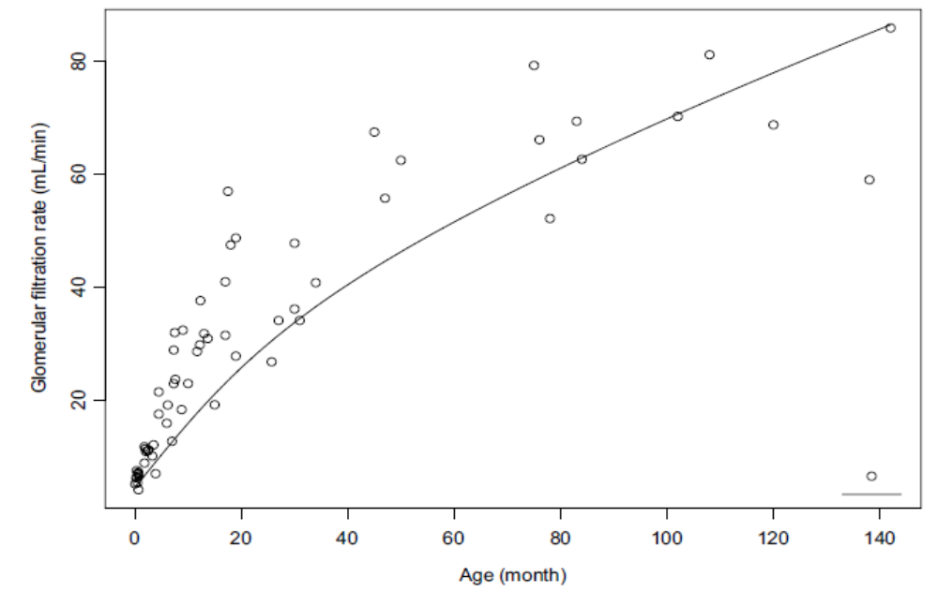
GFR as a Function of Age
Lu et al JPPT 2014
Notes:
Glomerular filtration rate as a function of age.

Slide 21
Renal Function
Urine concentrating ability
  Neonate 600 milliosmoles/L
  Adult 1,200 milliosmoles/L
The neonate with concentrated urine is probably very dehydrated
Notes:
Realize that infants are not supposed to have a concentrated urine except in a very dehydrated state.

Slide 22
Specific Anesthetic Drugs
Vecuronium
Pancuronium
Rocuronium
Propofol
Thiopental
Midazolam
Fentanyl
Morphine
Notes:
These are the drugs that are commonly used in Pediatric Anesthesia.

Slide 23
Vecuronium
ED ₉₅
  Infant: 47-60 mcg/kg
  Child: 81-100 mcg/kg
  Adult: 43 mcg/kg
Duration
  Infant: T_{1/2} beta 64.7 min
  Child: T_{1/2} beta 41 min
  Adult: T_{1/2} beta 32 min
Notes:
Vecuronium has an age related change in Effective dose 95. Note that effective dose of the infant is similar to an adult, despite immature neuromuscular endplates. This is largely due to the large volume of distribution of infants and the necessity to give a dose similar to adults. The duration is a different story with the half live longer in infants than adults.

Slide 24
Rocuronium
ED ₉₅
  Infant: 250-300 mcg/kg
  Child: 400-450 mcg/kg
  Adult: 350 mcg/kg
Duration of action is longer in infants than in children and adults
  Infant: 50% recovery in 60 min
  Child: 50% recovery in 30 min

Slide 25
Pancuronium
Long acting non-depolarizing muscle relaxant
Older children need a larger dose than infants and small children
Age | ED₅₀ (mcg/kg) | ED₉₅ (mcg/kg)
3-6 months | 24 ± 7 | 45 ± 7
7-12 months | 30 ± 5 | 52 ± 9
1-3 years | 34 ± 9 | 62 ± 18
4-6 years | 29 ± 8 | 62 ± 13

Slide 26
Propofol
Alkylphenol
  Large volume of distribution
  Slow elimination half-life
  Rapid clearance via glucuronidation in liver and extra-hepatic sites
Comparative metabolism: Clearance
  Infant: 77 ml/kg/min
  Child: 34 ml/kg/min
Notes:
In infants compared to children clearance is greater in young infants than children.

Slide 27
Thiopental
Ultra-short acting barbiturate
Induction doses (ED₅₀) vary with age
  Neonates = 3.5 mg/kg
  Infants (1-6 months) = 7 mg/kg
  Children (4-7 years) = 5 mg/kg
  Adults = 4 mg/kg
Clearance (T_{1/2}) is slower in younger patients
  Neonates: 6.1 ml/kg/min
  Infants : 6.6 ml/kg/min
  Adults: 12 ml/kg/min

Slide 28
Midazolam
Water soluble
95% protein binding
Hepatic CYP3A4 dependent
Metabolized to 5,7-hydroxy midazolam
 | Neonates | Children
Clearance (ml/kg/min) | 1.8 | 9.1
T_{1/2} (minutes) | 540 | 70
Notes:
The difference in half-life is very significant for neonates compared with children

Slide 29
Fentanyl
Dealkylation, hydroxylation, hydrolysis
High hepatic extraction ratio
Comparative Metabolism
  Neonatal clearance comparable with older children and adult (significantly less in premature infants)
  Clearance is gestational age and body weight dependent

Slide 30
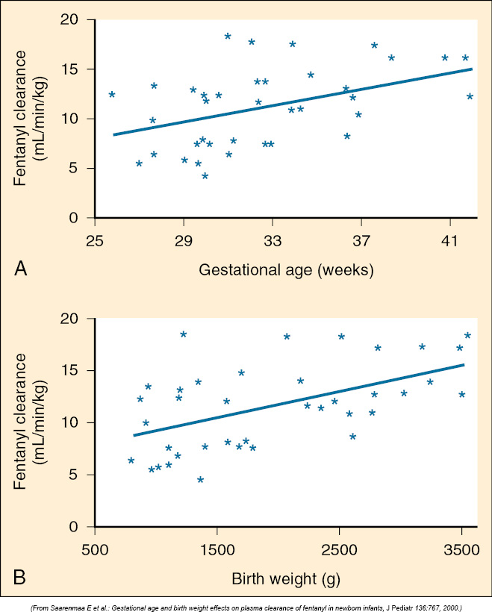
Notes:
In general it appears that fentanyl has poorer clearance in premature infants than term infants.

Slide 31
Morphine
Low hepatic extraction
Metabolism via Glucuronidation M3 and M6
Comparative metabolism
 | Neonate | Child | Adult
Protein Binding | 18-22% |  | 30-50%
Vol Distribution | 2.7 L/kg | 1.13 L/kg
Clearance | 3.6 ml/kg/min | 6.2 ml/kg/min
T_{1/2} | 534 min | 183 min
Notes:
In general morphine has slower clearance and larger half-life in neonates than older children.

Slide 32
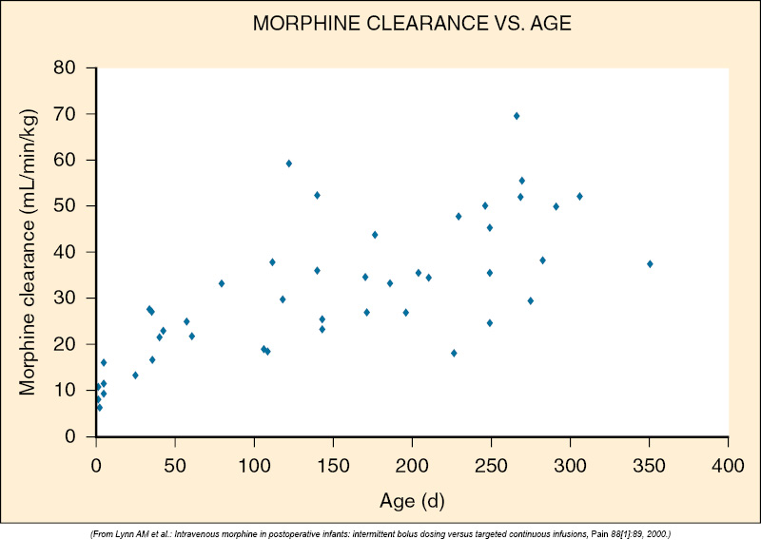
Notes:
With age it seems that clearance improves for morphine.

Slide 33
Inhalational Agents
Is the induction of an infant faster or slower than that of an adult?
Why would that be?
What factors affect the uptake of inhalational agents?
Notes:
Student should note that induction is faster in an infant than older child and an adult. Let’s review what factors effect uptake of inhalational agents.

Slide 34
Inhalational Agents
Factors involved with uptake of agent
Alveolar ventilation
Inspired concentration
Functional Residual Capacity
Cardiac output
Blood-Gas solubility
Tissue-Blood solubility
Notes:
Students should be able to recite these factors.

Slide 35
Inhalation Agents in Infants
 | Infant uptake compared to Adults
Alveolar Ventilation | Higher
Inspired Concentration | Same
Functional Residual Capacity | Same
Cardiac Output | Higher
Blood-Gas Solubility | Lower
Tissue-Blood Solubility | Lower
Notes:
However when you go step by step through the factors, the picture is not so clear.

Slide 36
Factors Explaining Wash In
Neonates have a higher ventilation to FRC ratio (5:1 vs 1.5:1) compared to adults
Inhalational agents are less soluble in the blood of neonates than older children and adults
Inhalational agents are less soluble in the tissues in neonates
A higher percentage of cardiac output in neonates goes to the vessel rich groups (to the brain)
Notes:
These factors are agreed to be at play in infants which explain the faster wash in of agent and faster induction.

Slide 37
Minimum Alveolar Concentration
Definition of MAC: Minimum concentration of vapor in the lungs that achieves anesthesia in 50% of subjects
MAC is age dependent
Let me show you…
Notes:
Very important that students understand that MAC is age dependent. The next slide helps illustrate this.

Slide 38
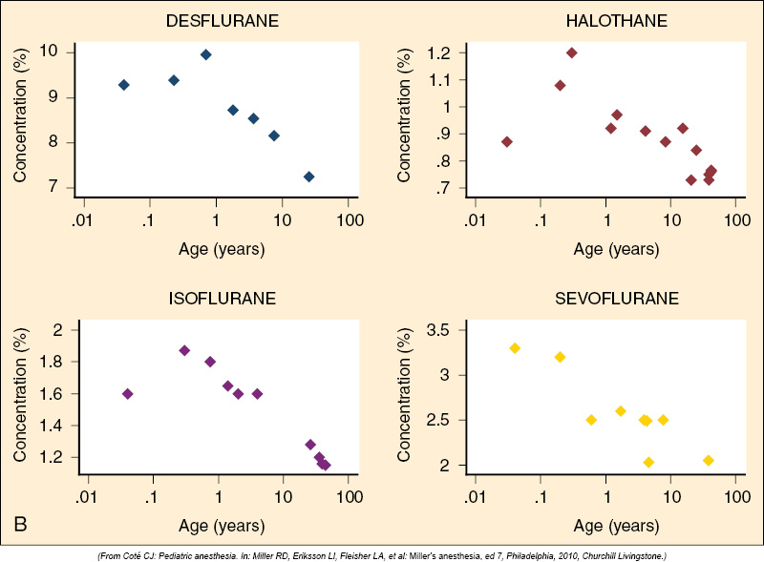
Notes:
In general, the MAC is lower in premature infants/neonates compared to 6mos-1 year olds with the highest MAC. The MAC drops. One question is why would this be? What other patient group has a low MAC? (one answer is the elderly, but this is not the reason). Pregnancy is associated with decreased MAC felt to be due to the effects of estrogens and progesterone. These hormones are also still being cleared by neonates!

Slide 39
Questions
What age has the highest MAC? The lowest?
When can an infant metabolize morphine?
When can an infant metabolize propofol?
When can an infant concentrate urine?
Why do we dose muscle relaxants like adult patients?
Notes:
So have we answered all of these questions?

