Slide 1
Congenital Cardiac Disease
A Guide to Evaluation, Treatment and Anesthetic Management
Les Garson M.D.
Associate Clinical Professor
UCI Department of Anesthesiology and Perioperative Care
J. Matthew Kynes, MD
Assistant Professor
Monroe Carell, Jr Children’s Hospital at Vanderbilt
Updated 11/2017

Slide 2
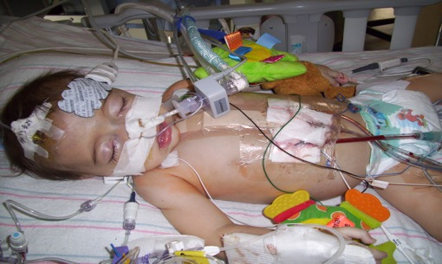
Congenital Heart Disease
Congenital heart disease (CHD) occurs in 1/125 live births.
Most common birth defect
Occurs during the 1st 8 weeks of fetal development
Majority have no known cause

Slide 3
Congenital Heart Disease
Epidemiology
Incidence: 8/1000 live births
3-4/100 still born
2/100 premature infants excluding PDA
10-25/100 aborted fetuses
Most congenital defects are well tolerated during fetal life

Slide 4
Congenital Heart Disease
Etiology
Unknown in most cases
Genetic factors
Single gene defect
Chromosomal abnormality.
Environmental factors
Gender differences in type of CHD

Slide 5
Relative Frequency of Congenital Heart Lesions
Lesions | % of all Lesions
Ventricular septal defect | 25-30
Atrial septal defect (Secundum) | 6-8
Patent ductus arteriosus | 6-8
Coarctation of aorta | 5-7
Tetralogy of Fallot | 5-7
Pulomnary Valve Sterosis | 5-7
Aortic Valve Stenosis | 4-7
d-Transposition of great arteries | 3-5
Hypoplastic left ventricle | 1-3

Slide 6
Relative Frequency of Congenital Heart Lesions (cont.)
Lesions | % of all Lesions
Hypoplastic right ventricle | 1-3
Truncus arteriosus | 1-2
Total anomalous PVR | 1-2
Tricuspid atresia | 1-2
Single ventricle | 1-2
Double-outlet right ventricle | 1-2
Others | 5-10

Slide 7
Factors Contributing to CHD
85 to 90 % of cases: no identifiable cause  caused by multifactorial inheritance.
Both genetic and environmental factors
Maternal Factors:
  Seizure disorders w/ intake of anti-seizure medications
  Intake of lithium for depression
  Uncontrolled IDDM
  Lupus
  German measles (rubella) – 1st trimester of pregnancy

Slide 8
Factors Contributing to CHD
Risk of CHD increases if parents or siblings have CHD
  A child with CHD increase the chance that another child will be born with CHD ranges from 1.5 to 5%
  Having two children with CHD,  the risk of a subsequent child to 5 to 10 %
  A mother with CHD increases the risk for a child to be born with CHD from 2.5 to 18 percent
Chromosome abnormalities:
  5 to 8 % of all babies with CHD have a chromosome abnormality
  Includes Down syndrome, trisomy 18 and trisomy 13, Turner’s syndrome, Cri-du-chat syndrome

Slide 9
Fetal Circulation
Illustration from Anatomy & Physiology, Connexions Web site. http://cnx.org/content/col11496/1.6/, Jun 19, 2013.

Slide 10
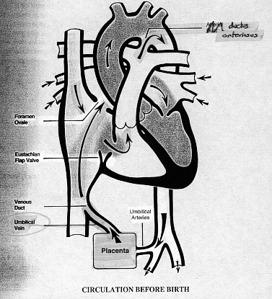
Fetal Circulation
Blood flows from the placenta…
→ IVC
→ RA
→ through the FO
→ LA
→ LV
→ ascending aorta
→ head & upper extremities
→ returns via the SVC

Slide 11
Fetal Circulation:
From the SVC…
→ RA
→ RV
→ pulmonary artery
→ through the PDA
→ descending aorta
→ lower extremities and placenta

Slide 12
Fetal Circulation:
Only a very small amount of blood is directed through the right and left pulmonary arteries to the lungs

Slide 13
Blood Circulation After Birth
The transformation from fetal to neonatal circulation involves two major changes:
A marked increase in systemic resistance caused by loss of the low-resistance placenta
A marked decrease in pulmonary resistance caused by pulmonary artery dilation with the neonate’s first breaths

Slide 14
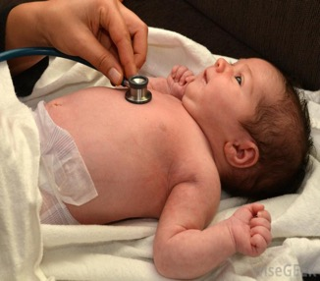
Examination for CHD
Clues for evaluation of an infant with suspected CHD
On History and Physical Examination (color)
    Acyanotic
    Cyanotic
Auscultation
Chest roentgenogram
    Normal
    Increased/Plethora Pulmonary blood flow
    Decreased/Oligemia

Slide 15
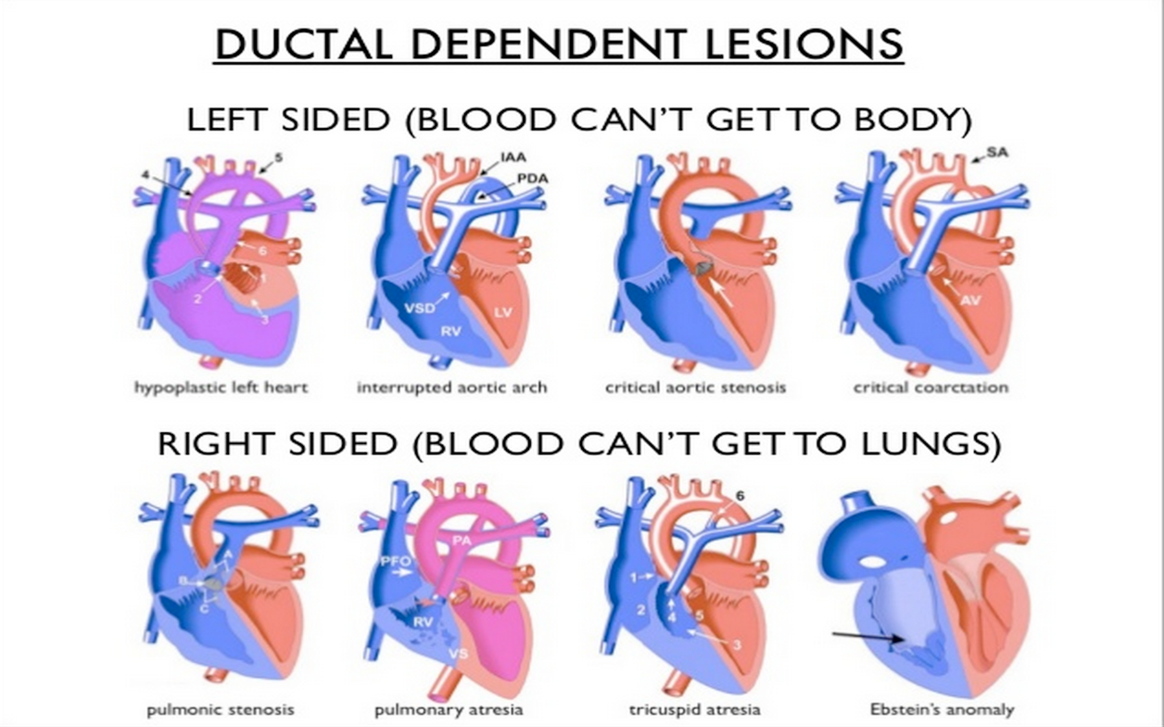
Ductal Dependent Lesions

Slide 16
Acyanotic Congenital Heart Defects
Pink Baby: (L→ R shunt)
L → R shunts cause CHF and pulmonary hypertension
This leads to RV enlargement, RV failure
These babies present with CHF and respiratory distress
They are not typically cyanotic
Examples:
  Patent Ductus Arteriosus (PDA)
  Ventricular Septal Defect (VSD)
  Atrial Septal Defect (ASD)
  Coarctation of the Aorta

Slide 17
Acyanotic Heart Defects
Move blood from arterial → venous system
Acyanotic
Increase in pulmonary
blood flow
ASD
VSD
AVC
PDA
Obstruction of blood flow
from ventricle
Pulmonary stenosis
Aortic stenosis
Coarctation of the aorta

Slide 18
Defects with Increased Pulmonary Blood Flow
ASD (Atrial septal defect )
PDA ( patent ductus arteriosus)
VSD (ventricular septal defect )
AVC (Atrioventricular canal defect )

Slide 19
Acyanotic CHD
Clinical Diagnosis
  CXR: Right ventricle and atrial enlargement
      Large pulmonary artery
      ↑ Pulmonary vascularity
  ECG: volume overload
      Right axis deviation
      Minor right ventricular conduction delay
  Echocardiography
  Catheterization
Complications: Pulmunary HTN → Eisenmenger syndrome
Treatment: Surgery for all symptomatic ASD or asymptomatic patients with shunt ratio > 2:1

Slide 20
Atrial Septal Defect
Allows oxygenated blood to pass from the left atrium, through the opening in the septum, and then mix with unoxygenated blood in the right atrium
During fetal heart development  the partitioning process does not occur completely, leaving an opening in the atrial septum
Occurs in 4-10% of all infants w/ CHD
EFFECTS: larger volume of blood than normal must be handled by the right side of the heart  extra blood then passes through the pulmonary artery into the lungs  pulmonary hypertension and pulmonary congestion

Slide 21
Capac M. Atrial_septal_defect-en.png. Own work. Accessed commons.wikimedia.org

Slide 22
Atrial Septal Defect
Signs and Symptoms:
Infants tire easily when feeding
Fatigue: children tire easily when playing
Poor growth
Sweating and tachycardia
Tachypnea, shortness of breath, crackles
Diagnostic tests:
CXR: enlarged heart
2D echo – show pattern of blood flow through the septal opening and measure size of ASD
Cardiac catheterization

Slide 23
Atrial Septal Defect
20% of atrial septal defects will close spontaneously in the first year of life
Usually, an ASD will be repaired if it has not closed on its own by the time the child is 4-5 years of age
If not repaired, ASDs can lead to pulmonary HTN with thickened pulmonary arteries/arterioles

Slide 24
ASDS: Treatment
Medical management
  Digoxin - helps strengthen the heart muscle, enabling it to pump more efficiently
  Diuretics – relieve pulmonary congestion
  Prophylactic antibiotics to prevent bacterial endocarditis before dental procedures and other invasive procedures
Surgical repair
  On cardiopulmonary bypass, the right atrium is opened to allow repair the atrial septum below via direct closure or patch
  Patch may be the patient’s own pericardium, commercially available bovine pericardium, or synthetic material (Gore-Tex, Dacron)

Slide 25
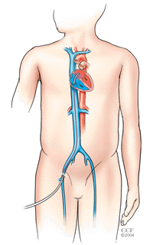
ASD Device Transcatheter Closure
Rapidly becoming the preferred method for ASD closure
Involves threading a catheter from the femoral vein across the ASD and deploying a fabric covered device that seals the ASD
Some ASDs due to size or location are not suitable for this technique

Slide 26
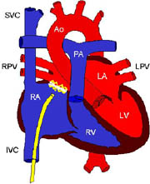
ASD Device Transcatheter Closure
The ASD closure device is inserted across the ASD via the femoral vein
Within a few weeks the device is epithelialized
By 3 to 6 months, the device is completely covered by heart tissue

Slide 27
ASD Surgery: Anesthetic Considerations
Eliminate air bubbles from intravenous lines
High incidence of perioperative arrhythmias
Inhalation induction is usually well tolerated
Usually suitable for fast discharge
Endocarditis prophylaxis for the first 6 months post surgery
Incidence of atrial fibrillation/flutter post surgery
  4% < 11 years old
  59% > 41 years old
Persistent RV dilation or pulmonary hypertension if late repair

Slide 28
PDA (Patent Ductus Arteriosus)
Failed to closed at birth, blood will shunt from the aorta to the pulmonary artery.
Complete closure occurs usually by 3 months
More common in girls than boys

Slide 29
Patent Ductus Arteriosus
Source: http://www.nhlbi.nih.gov/health/dci/Diseases/pda/pda_what.html. PD-USGov-HHS-NIH

Slide 30
PDA (Patent Ductus Arteriosus)
Can cause…
Reduced glomerular filtration rate.
Impaired platelet aggregation
Decreased GI & CNS blood flow

Slide 31
Patent Ductus Arteriosus (PDA)
From the aorta to the pulmonary artery
In utero, with fetal circulation, the PDA bypasses the lungs and flows from the pulmonary artery to the aorta
The transition from fetal to normal circulation involves the baby breathing which decreases pulmonary vascular resistance allowing the blood from the RV to flow to the lungs via the Pulmonary arteries and the PDA closes
The ductus arteriosus usually closes by 72 hours after birth
A patent ductus arteriosus allows oxygenated blood from the aorta (high pressure) to flow into the pulmonary circulation (lower pressure system)
PDA occurs in 6-11% of all children with CHD

Slide 32
PDA (Patent Ductus Arteriosus)
Treatment options:
Medical
Transcatheter device closure
Surgical intervention
Untreated PDA can lead to CHF and infected endocarditis

Slide 33
PDA: Treatment
Medical
  Treatment of CHF and pulmonary edema
  Indomethacin trial in preterm infants
Interventional cardiology
Surgical
  Preterm infants and neonates who fail medical therapy
  Older asymptomatic children (age 2-4 years)
  Surgical approach is via posterolateral thoracotomy or VATS
BruceBlaus. Own work. 11 July 2017. Accessed commons.wikimedia.org

Slide 34
PDA: Anesthetic Considerations
Pre- and post-ductal oxygen saturation monitoring to detect ligation of the wrong vessel
Upper and lower extremity blood pressure monitoring to determine pressure gradient
Ligation of PDA should increase diastolic pressure
In older children lung isolation may be requested
Preterm infants may have surgical PDA ligation in NICU
Post PDA ligation:
    Endocarditis prophylaxis during the first 6 months
    Recurrent laryngeal nerve injury
    Pulmonary HTN and heart failure if late repair

Slide 35
Ventricular Septal Defect
Most common CHD (20-25%)
30-40% close spontaneously within the first year of life
Pathophysiology:
  Left to right shunt
  Pulmonary over-circulation
  Congestive heart failure
  Decreased cardiac output
Associated anomalies: trisomy 13, 18, 21
Physical Exam: holosystolic murmur, systolic thrill at the LSB
BruceBlaus. Own work. 3 August 2017 Accessed commons.wikimedia.org

Slide 36
VSD: Treatment
Medical:
    ACE inhibitors (decrease Left to Right shunt in cases with increased SVR)
    Diuretics
    Digoxin
Transcatheter VSD device closure
Surgical
  Infants with CHF and FTT not responding to medical treatment
  Large left to right shunt: Qp/Qs>2:1
  Elective repair to asymptomatic children around 2 years of age

Slide 37
VSD: Anesthetic Considerations
Small VSD with no obvious CHF:
  Careful inhalation induction; reduced cardiac reserve
Large VSD with or without CHF:
  IV induction is preferred
  High FiO₂ and low PaCO₂ decrease PVR → increased left to right shunting
  Risk for shunt reversal with increase PVR or hypotension
S/P repair:
  Endocarditis prophylaxis for the first 6 months
  Dysrhythmias and conduction defects: RBBB, ventricular arrhythmias, AV block
  Ventricular dysfunction from ventriculotomy
  Pulmonary hypertension if late repair

Slide 38
AVC: Atrioventricular Canal Defect
Low atrial septal defect continuous with high ventricular defect and distortion of the mitral and tricuspid valve
Assessment: Echo is important for surgical planning as sometimes need a new valve
After surgery give antibiotic and anticoagulant

Slide 39
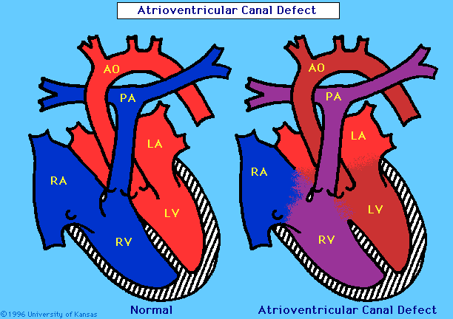
Atrioventricular Canal Defect

Slide 40
Obstruction of Blood Flow From the Ventricle
Pulmonary stenosis
Aortic stenosis
Coarctation of the Aorta

Slide 41
Pulmonary Stenosis
Classification:
Valvular
Infundibular
Supra-valvular
Peripheral
Pathophysiology:
Right outlet obstruction
Pressure work
Right ventricular hypertrophy
Dake~commonswiki. 16 July 2006. commons.wikimedia.org

Slide 42
Pulmonary Stenosis
Diagnosis
Clinical
CXR - Right ventricular hypertrophy, reduced pulmonary blood flow
ECG
Echocardiography
Prognosis: Good in mild to moderate PS
Complications: CHF in severe PS
Treatment
Valvular PS → balloon valvuloplasty
Surgical repair

Slide 43
Aortic Stenosis
Classification:
Valvular - the commonest
Supra-valvular
Subvalvular (subaortic)
BruceBlaus. Own work. 22 October 2013 Accessed commons.wikimedia.org

Slide 44
Aortic Stenosis
Mild stenosis
Normal pulse & apical impulse
Systolic ejection murmur
Normal to enlarged heart size
Critical stenosis
Left ventricular failure
Pulmonary edema, cardiomegaly
Weak peripheral pulses
Weak systolic murmur
Paradoxical split 2nd heart sound

Slide 45
Aortic Stenosis
Diagnosis
Clinical
CXR
ECG
Echocardiography
Graded exercise testing
Treatment
Balloon valvuloplasty
Surgical

Slide 46
Coarctation of Aorta
Infants
  Congestive heart failure
  Pulmonary over circulation and edema if large VSD
  Often ductal dependent
  Tachypnea, FTT, hepatomegaly, metabolic acidosis, poor perfusions
Child/adolescent
  HTN and murmur
  Often asymptomatic
  Occasionally exercise induced claudication or headaches
  Decreased lower extremities pulse
  Systolic pressure gradient upper and lower extremity

Slide 48
Coarctation of Aorta
Diagnosis
Clinical
CXR - cardiomegaly and pulmonary congestion, notching of ribs
ECG
Echocardiography
Prognosis: Untreated cases succumb by 20-40 years
Complications
CVA
Aneurysms
Treatment
Medical: IV PGE₁ in neonatal age
Surgery

Slide 49
Coarctation of Aorta:
Anesthetic Considerations
Infants with CHF: careful IV induction, narcotic based
Arterial line in the right arm
Additional BP monitoring and pulse oximetry in lower extremities
Cross clamping: Volatile agents and short active vasodilators
Un-clamping: vasoactive drugs available
Postoperative complications
  Persistent HTN
  Post-coarctectomy syndrome: abdominal pain, vomiting
  Myocardial hypertrophy (diastolic dysfunction, premature coronary artery disease

Slide 50
Cyanotic Congenital Heart Defects
R → L shunts cause hypoxia and central cyanosis as shunted blood bypasses lungs
Examples:
  Tetralogy of Fallot (TOF)
  Transposition of the Great Arteries (TGA)
  Truncus Arteriosus (TA)
  Tricuspid Atresia

Slide 51
Cyanotic Heart Defects
Cyanosis
Decreased pulmonary
blood flow
Mixed blood flow
(Single Ventricle)

Slide 52
Tetralogy of Fallot
National Heart Lung and Blood Institute (NIH). Accessed commons.wikimedia.org

Slide 53
Tetralogy of Fallot
Characteristic “boot shaped” heart of a child with tetralogy of Fallot
Heilman J. Own work. 2 June 2011. Accessed commons.wikimedia.org
Notes:
This is an CXR of a child with tetralogy of Fallot with a characteristic “boot shaped” heart

Slide 54
Tetralogy of Fallot: Physiology
Severe right ventricular obstruction or high pulmonary artery pressure  Right to left shunt through VSD to left ventricle ad the aorta  cyanosis
The more blood that goes through the VSD, the less blood that goes through the pulmonary artery to the lungs  decreased oxygenated blood to the left side of the heart
Soon, nearly all the blood in the left ventricle is oxygen-poor

Slide 55
TOF: Signs and Symptoms
Severely cyanotic newborn to a “pink Tet” with CHF
Pansystolic murmur at left upper sternal border
Cyanosis and hypoxemia: SaO₂ 70-90%
Decreased exercise tolerance, dyspnea on exertion, easy fatigability
Squatting increase SVR and arterial oxygenation
Polycythemia: Risk of spontaneous thrombosis and ischemic strokes
Hypercyanotic (Tet) spells in 20-30% of uncorrected patients often peaking in first 2-3 months of life

Slide 56
“Tet-Spells:” Treatment
Knee chest position or abdominal compression
Supplemental oxygen
Sedation
  Morphine: 0.1 mg/kg IM/SC
  Ketamine 1-2 mg/kg IV/IM
Volume expansion: 10-20 ml/kg crystalloids
Phenylephrine 0.5-2 mcg/kg
Propranolol 0.1 mg/kg IV
Esmolol 50-300 mcg/kg/min + loading dose 100-500 mcg/kg IV

Slide 57
TOF: Surgical Treatment
Historically multi-stage approach
  Palliation with modified Blalock-Taussig shunt in infancy from subclavian artery to PA
  Full repair later in life
More recently elective one stage repair at 3-4 months
  Patch closure of VSD
  Excision of RVOT muscle bundles
  Transannular or infundibular patch
  Complex repair with extra cardiac conduit for TOF with pulmonary atresia

Slide 58
TOF: Anesthesia Considerations
Polycythemia: Avoid dehydration and long fasting period
Endocarditis prophylaxis
Careful removal of all air bubbles from IV lines
Phenylephrine, propanol, esmolol
Induction: careful inhalation induction (likely delayed induction because of the right-to-left shunt)
Hemodynamic goals:
  Maintain SVR and preload
  Avoid tachycardia
Postoperative problems:
  Right ventricular dysfunction
  Pulmonary regurgitation
  Complete heart block
  Junctional ectopic tachycardia

Slide 59
Defects of Mixed Blood Flow and Single Ventricle Physiology
Transposition of the Great Arteries
Truncus arteriosus
Ebstein’s anomaly
Total pulmonary venous return
Single Ventricle: hypo-plastic left heart syndrome

Slide 60
Transposition of the Great Arteries
Parallel circulation
Fatal if no inter-circulatory mixing via ASD, VSD or PDA
Right ventricle support systemic circulation
Right ventricle failure
Left ventricle supports low pulmonary pressure
Left ventricle reconditioning
BruceBlaus. Own work. 3 Aug 2017. Accessed commons.wikimedia.org

Slide 61
TGA: Treatment
Cardiac catheterization
Balloon atrial septostomy: to increase mixing at atrial level
Surgical Repair

Slide 62
TGA: Arterial switch (Jatene)
Within first week of life
Switch of great vessels just above the ventricles
Problems: coronary artery kinking, stenosis, ischemia
The native pulmonary valve becomes the neoaortic valve

Slide 63
TGA: Anesthesia Considerations
Induction: High dose opioids
Careful maintenance of cardiac output and adequate mixing: Balancing PVR and SVR
Post CPB myocardial dysfunction
  Poor LV function (deconditioned LV)
  Poor myocardial protection
  Coronary mal-transfer
  Coronary air
Post operative problems:
  Arrhythmias
  Poor LV function
  Poorly compliant LV
  Residual ASD/VSD

Slide 64
Truncus Arteriosus
Embryology: the aorta and pulmonary artery arise from a single blood vessel which eventually separates; failure to separate completely results in truncus arteriosus
Usually accompanied by a ventricular septal defect
Oxygen-poor (blue) and oxygen-rich (red) blood mix via the ventricular septal defect and then flow out the common truncal vessel to the lungs and body
The mixed blood that goes to the body does not have as much oxygen as normal → varying degrees of cyanosis

Slide 65
Truncus Arteriosus
Degree of cyanosis and CHF Depends on PVR/SVR ratio
Risk of pulmonary over-circulation when PVR drops
Early development of pulmonary vascular obstructive disease
Not ductal dependent
Often truncal valve regurgitation
Additional volume load on ventricles leads to CHF
Often wide pulse pressure and bounding pulses
Centers for Disease Control and Prevention. Accessed commons.wikimedia.org

Slide 66
Truncus Arteriosus: Surgery
Often done during the first week of life
Definitive repair
  Patch closure of VSD
  Detachment of the PA’s from truncus
  Valved homograft to establish RV-PA continuity
  Inspection of truncal valve, possible repair

Slide 67
TA: Anesthetic Considerations
Very sick neonate, often intubated with inotropic support
Careful balancing of PVR/SVR
Post bypass:
  Inotropic support
  Rate dependent cardiac output
Postoperative complications
  Homograft stenosis or calcification → right ventricular dysfunction
  Valvular insufficiency

Slide 68
Ebstein Anomaly
Apical displacement of the septal and posterior tricuspid valve leaflets
Atrialization of the right ventricle
Variable degree of malformation and displacement of the anterior leaflet

Slide 69
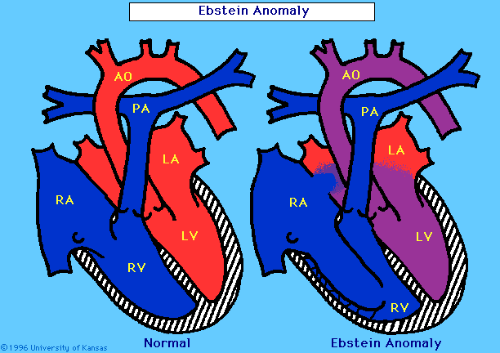
Ebstein Anomaly

Slide 70
Ebstein’s Anomaly: Treatment
Medical
  PGE1 to maintain ductal patency
  CHF and antiarrhythmic therapy
Cardiac catheterization
  Radiofrequency ablation of SVT locus
Surgical
  Total ventricular repair (cone procedure)
  Staged repair to Fontan palliation
  Heart transplant

Slide 71
Ebstein Anomaly:
Anesthetic Considerations
Delayed onset of pharmacologic effects from pooling and dilution in RA
Risk of paradoxical air embolism
Right ventricular depression leads to increase RA pressure and cyanosis
Supraventricular arrhythmias
Goals
  Maintaining RV contractility
  RV afterload reduction

Slide 72
Total Pulmonary Venous Return
Pulmonary vein return to the right atrium or the superior vena cava instead of the left atrium
Treatment:
Give PGE₁
Cardiac catheterization
Surgical repair

Slide 73
Single Ventricle Defects
Tricuspid atresia (with or without TGA, PS)
Double inlet left ventricle (with or without TGA)
Unbalanced complete AV canal
Pulmonary atresia with intact ventricular septum
Hypoplastic left heart syndrome
Double outlet right ventricle
Heterotaxy syndromes (situs ambiguous)

Slide 74
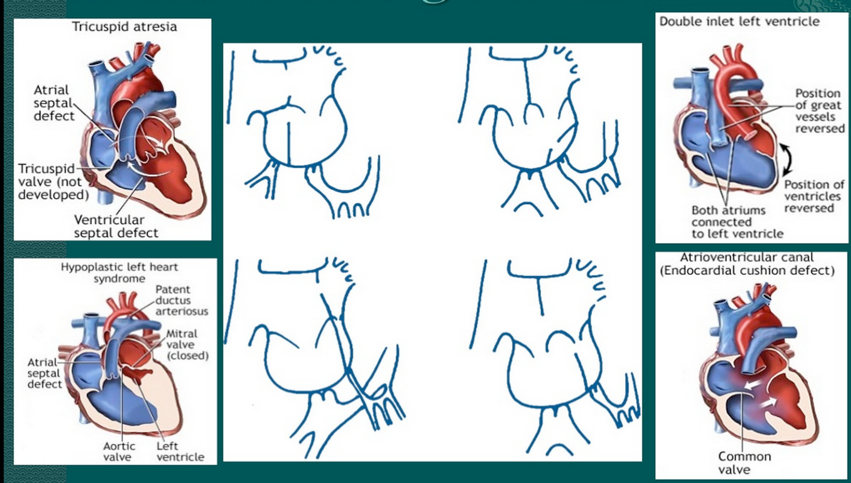
Single Ventricle Defects

Slide 75
Hypoplastic Left Heart Syndrome
1% of all CHD
High mortality
7 years survival of 50-60%
12% associated defects
Parallel circulation
Staged repair
  Norwood/Sano within 1st week
  Bidirectional Glenn at 3-6 months
  Modified Fontan at 18-24 months
Centers for Disease Control and Prevention. Accessed commons.wikimedia.org

Slide 76
Hypoplastic Left Heart Syndrome
Stage I (Norwood):
Surgical Procedure
  Creation of neoaorta
  Atrial septoplasty
  Modified Blalock-Taussig shunt
  PDA ligation
Goals
  Provide systemic perfusion
  Preserve function of single ventricle
  Allow normal maturation of pulmonary vasculature

Slide 77
Hypoplastic Left Heart Syndrome
Stage II: Bidirectional Glenn
Usually performed at 3-6 months of age
Pulmonary blood flow via SVC-RPA anastomosis
Ligation of shunt
Venous return via IVC mixes with fully saturated blood in single ventricle
SaO₂ 80-85% but with reduced volume overload
    Ventricular remodeling
    Preservation of ventricular function

Slide 78
Hypoplastic Left Heart Syndrome
Stage III: Fontan
IVC blood flow connected to pulmonary artery via intra- or extra-cardiac conduit
Separation of pulmonary and systemic circulating
Single ventricle provides kinetic energy for systemic blood flow
Pulmonary blood flow dependent on pressure gradient across the lungs
RupertMillard. Diagram_of_the_human_heart_(cropped).svg. Accessed commons.wikimedia.org

Slide 79
Fontan: Anesthesia Considerations
Avoid long NPO times
Limit inflation pressure for laparoscopy
Rehydration if sepsis, fever or nausea/vomiting, trauma
Often benefit from low dose inotropic support
Arrhythmia risk, non-sinus rhythm poorly tolerated
Open fenestration: sudden cyanosis with increase in PVR
Minimize AW pressure
Avoid hypoventilation, hypoxia, hypercapnia
Minimal PEEP
Low RR and long inspiratory time

Slide 80
Fontan: Long Term Problems
Arrhythmias: 20% of patients in 10 years post-op
Thromboembolism: increased risk for stroke, DVT and clots
Protein losing enteropathy
Plastic bronchitis: Lymph fluid builds in the airways and forms rubbery or caulk-like plugs
Decrease exercise tolerance: fixed pulmonary blood flow and SV
Open fenestration: possible desaturation with R-L shunt if PVR increases

Slide 81
General Principles for Preoperative Assessment
Knowledge of the underlying lesion and type of circulation? Significance of changes in SVR/PVR; significance of oxygen saturation
Evidence of long-term complications and other features that put children into a high-risk category
Evidence of recent upper or lower respiratory tract infections which may increase airway reactivity and PVR, especially in infants and children with a Glenn or Fontan circulation
Venous and arterial access may be difficult: utilize ultrasound as needed
Routine drug therapy: continue most cardiac medications through the preoperative period
Sedative premedication: may minimize anxiety and distress, minimize oxygen consumption, and reduce the amount of induction agent
Endocarditis prophylaxis: follow national guidelines

Slide 82
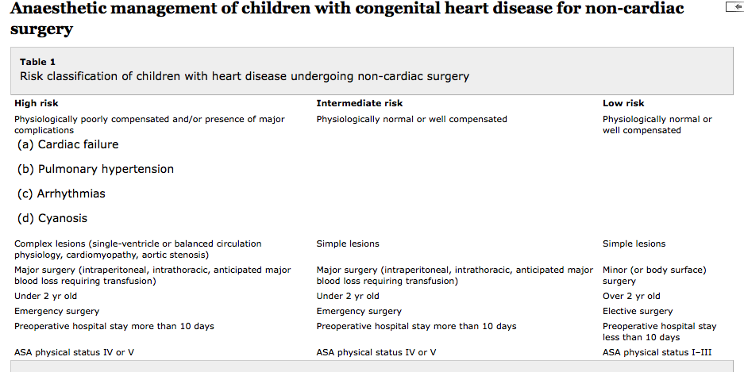
Risk Classification of Children with Heart Disease
Undergoing Non-cardiac Surgery

Slide 83
Manipulation of SVR
Increase:
Sympathetic stimulation
  Pain and agitation
  Epinephrine
  Dopamine
  Norepinephrine
  Phenylephrine
  Ketamine
Negative intrathoracic pressure
Hypothermia
Decrease:
Adequate sedation and analgesia
Vasodilators
  Milrinone
  Dobutamine
  Nitroprusside
  ACE inhibitors
  Angiotensin II receptor blockers
Positive pressure ventilation
Fever
Sepsis

Slide 84
Manipulation of PVR
Increase:
PEEP
High PIP
Atelectasis
Low FiO₂
Acidosis
Hypercapnia
Increased HCT
Pain, agitation
Epinephrine, dopamine
Vasoconstrictors: phenylephrine
Decrease:
No PEEP
Low PIP
Normal FRC
High FiO₂
Alkalosis
Hypocapnia
Low HCT
Blunted surgical response
NO
Vasodilators: Milrinone, prostacyclin

Slide 85
Cases
1. 6 month old with an unrepaired VSD presenting for emergency surgery for a scrotal swelling.
Physiology: compensated (on examination in moderate cardiac failure, on diuretics but feeding well and gaining weight)
Lesion: simple. Awaiting VSD repair next month
Risk category: intermediate (physiologically well-compensated, simple lesion, minor surgery, but less than 2 yr old, emergency surgery)
Management: depends on local anaesthesia and surgical expertise—if local hospital routinely performs surgery on children under 2 yr then safe to undertake locally. Otherwise, consider discussion with and transfer to specialist centre
Anaesthesia considerations: slow cautious gas or IV induction, beware of possibility of poor cardiac reserve. Avoid high inspired oxygen concentration in order to minimize left-to-right shunt and maximize systemic perfusion. May require higher ventilator pressures than expected because of pulmonary edema. Avoid air bubbles in venous lines because of the risk of paradoxical embolus. Endocarditis prophylaxis unnecessary

Slide 86
Cases
2. 6 year old with a repaired tetralogy of Fallot presenting for dental extractions due to dental caries
Physiology: compensated (on examination good exercise tolerance, no signs of right heart failure. ECG shows RBBB and no ventricular ectopy)
Lesion: simple
Risk category: low (physiologically well compensated, simple lesion, minor surgery, over 2 yr old, elective surgery)
Management: perform procedure in local hospital. If ventricular ectopy present on ECG—consider to be high risk and seek cardiology advice. May need to postpone surgery or transfer to specialist center as high risk of life-threatening arrhythmias
Anaesthesia considerations: gas or IV induction. No need for endocarditis prophylaxis.

Slide 87
Cases
3. 8 year old with a Fontan circulation presenting for emergency surgery for reduction and fixation of a supracondylar fracture with neurovascular compromise
Physiology: may be well-compensated working single-ventricle circulation
Lesion: complex single ventricle
Risk category: high (physiologically well compensated, but complex single-ventricle lesion, emergency surgery)
Management: discuss with specialist centre paediatric cardiac anaesthetist. Transfer to specialist centre risks limb loss so may not be possible. Needs discussion on individual basis to balance risk of loss of limb vs loss of life if local hospital anaesthetist does not understand complex single-ventricle physiology.
Anaesthesia considerations: gas or IV induction, consider spontaneous ventilation as this aids PBF but must avoid hypoxia, hypercarbia and atelectasis which increase PVR and compromise PBF. Full stomach may require rapid sequence intubation and positive pressure ventilation (PPV). If using PPV avoid high pressures, high PEEP, and long inspiratory times all of which compromise PBF. Slight head-up position aids venous return and PBF as does raising the legs. Endocarditis prophylaxis unnecessary.

