Slide 1
Approaches to Ventilatory Support in
Neonatal Anesthesia
Dua M. Anderson, MD, MS
Payam Vali, MD
Satyan Lakshminrusimha, MD
UC Davis Children’s Hospital
Updated 9/2019

Slide 2
Disclosures
No relevant financial relationships.
Any images of equipment are for illustrative purposes only. This presentation is not an endorsement for any product or manufacturer.

Slide 3
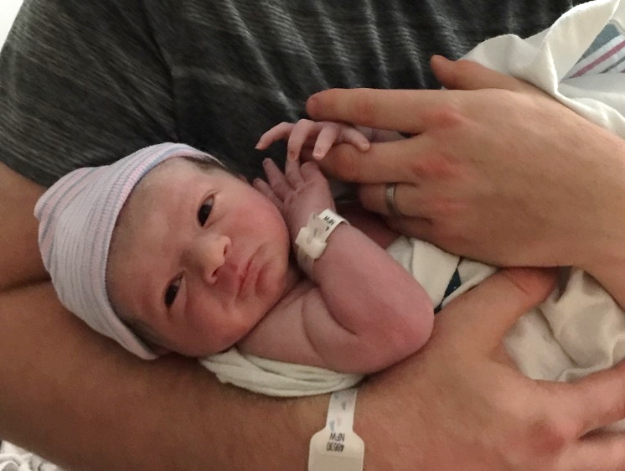
Learning Objectives:
Identify differences between neonatal and pediatric lung mechanics
Become more familiar with ventilation goals and strategies in the neonate
Identify and explain ventilation risks and pitfalls unique to the neonate: volutrauma, barotrauma, hyperoxia, post-anesthetic apnea
Review emergency maneuvers for neonates
Retain resources for further reading
Notes:
The primary goal of this lecture is to promote discussion of topics relevant to the care of the neonate in the perioperative setting. It is not exhaustive, but should prompt teachers and learners to think of critical concepts central to neonatal ventilation. Every site and environment for care has unique resources and challenges. Further reading is highly encouraged, with many additional resources available online. Please see the References slide as a launching-point for more reading.
Personal photo included.

Slide 4
Physiologic Differences
When compared to infants, an anesthesiologist caring for a neonate is more likely to encounter:
Congenital lesions or syndromes (may or may not be defined/diagnosed)
Patent ductus arteriosus (PDA)
Persistent pulmonary hypertension of the newborn (PPHN)
Necrotizing enterocolitis (NEC) or Spontaneous Intestinal Perforation (SIP)
Difficulty with correct ETT placement/depth
Apnea during and after the anesthetic (up to 24-48 hrs)
Reference: Bang
Notes:
Perioperative care of the neonate requires a high degree of vigilance with each aspect of physiologic support, including all technical interventions.

Slide 5
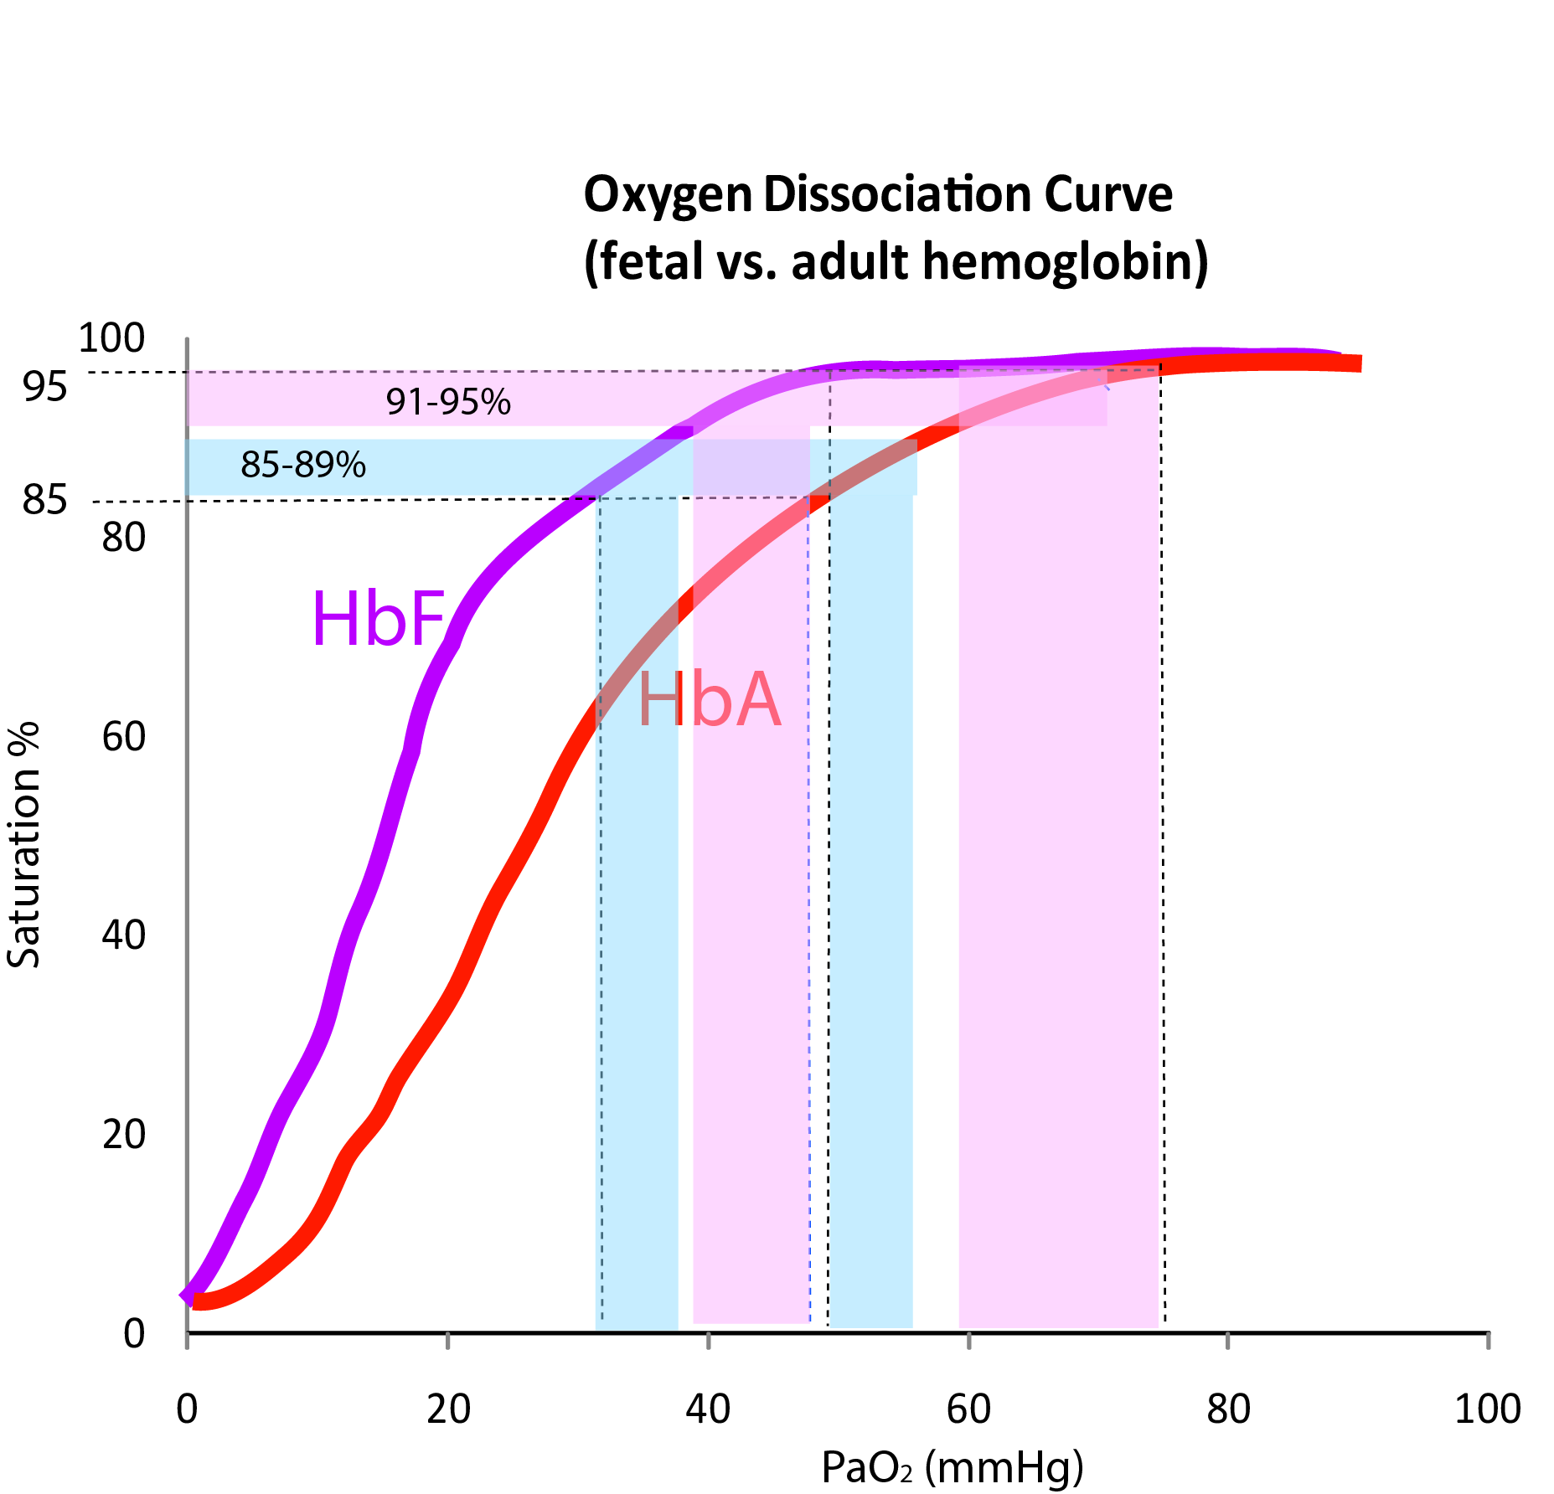
Physiologic Differences (cont’d)
Normal PaO₂ of the neonate:
  55-85 mmHg for first month of life
  Approaches 95-100 mmHg thereafter
Neonatal oxygen consumption:
  6-10 ml O₂/kg/min
  2-3x that of an adult
  Respiratory rate (RR) of 30-60
Reference: Smith’s
Illustration Copyright: Satyan Lakshminrusimha, MD, used with permission
Notes:
Transition from fetal to neonatal circulation is not instantaneous, and physiologically stressful conditions in the perioperative period can rapidly shift the balance from a compensated to an uncompensated state. Neonatal regulation of ventilation during these stressful conditions can deteriorate quickly, shifting to a need for significant support.

Slide 6
Physiologic Differences (cont’d)
Intrinsic/spontaneous rapid RR means less expiratory time (T_{e}) when spontaneous, so easier to maintain FRC (functional gas-trapping)¹
  Maintain PEEP 5-7 cm H₂O to avoid lung volumes below FRC, especially if using a lower RR
  I:E ratio can be as high as 1:1
  Inspiratory time (T_{i}) may be as low as 0.35-0.5 sec²
Reference: ¹Cote, ²Habre

Slide 7
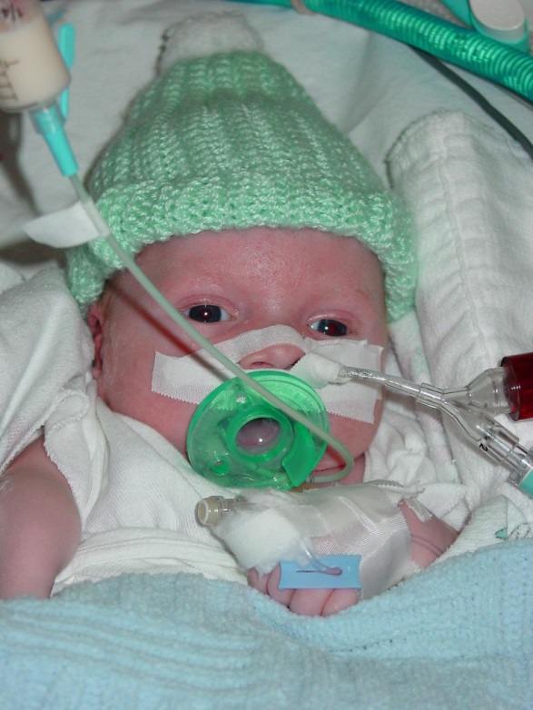
The Challenges with Prematurity
Terminal air sacs¹:
  Important for gas exchange and parenchymal integrity
  Develop from 28-36 weeks
Alveolar development:
  Begins at ≈ 36 weeks¹
  Continues rapidly until 2-3 years²
Neonates with history of prematurity:
  Goal SpO₂ 88-94%
  If born 26-32 weeks, PaO₂ ≥ 60 mmHg may be hyperoxic¹
Reference: ¹Smith’s, ²Herring
https://search.creativecommons.org/photos/ef44c068-2848-48e3-91df-ad1db7d3073b
Notes:
Exact goals for optimum SpO₂ in neonates has been a debated and studied topic of great interest. Though the literature supports avoiding low-goal of 85-89% to avoid hypoxemic stress, high goal of 91-95% has been associated with hyperoxic injury. Current recommendations seem to “split the difference” with a range of 88-94% as referenced above. During intraoperative anesthetic management, where changing conditions may disrupt previously stable oxygenation/ventilation, a goal of 90-94% is practical and may avoid having to intervene & perform rescue maneuvers, without undue hyperoxic stress.

Slide 8
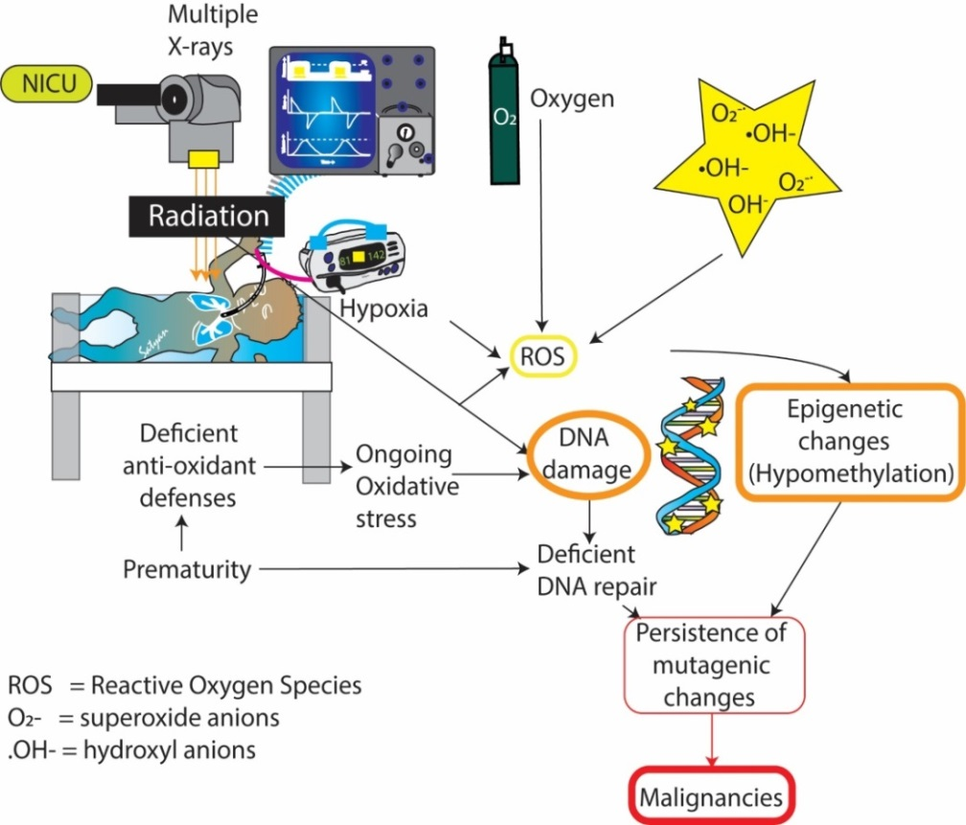
The Problems with Oxygen
Hyperoxia is associated with¹:
Retinopathy of prematurity
Oxidative lung injury:
  Oxygen toxicity leads to:
    Interstitial and alveolar edema
    Inflammatory cascade
  Prolonged exposure → fibrosis
Respiratory depression
Suppression of erythropoiesis
Pulmonary vascular vasodilation
Systemic vasoconstriction
Increased risk of leukemia²
Illustration Copyright: Satyan Lakshminrusimha, MD, used with permission
Reference: ¹Weinberger, ²Naumburg
Notes:
Reactive oxygen species have effects on many organ systems. Retinopathy of prematurity (ROP) can lead to blindness, lung injury can have chronic effects, marrow suppression can be associated with anemia of prematurity, worsening apnea risk.

Slide 9
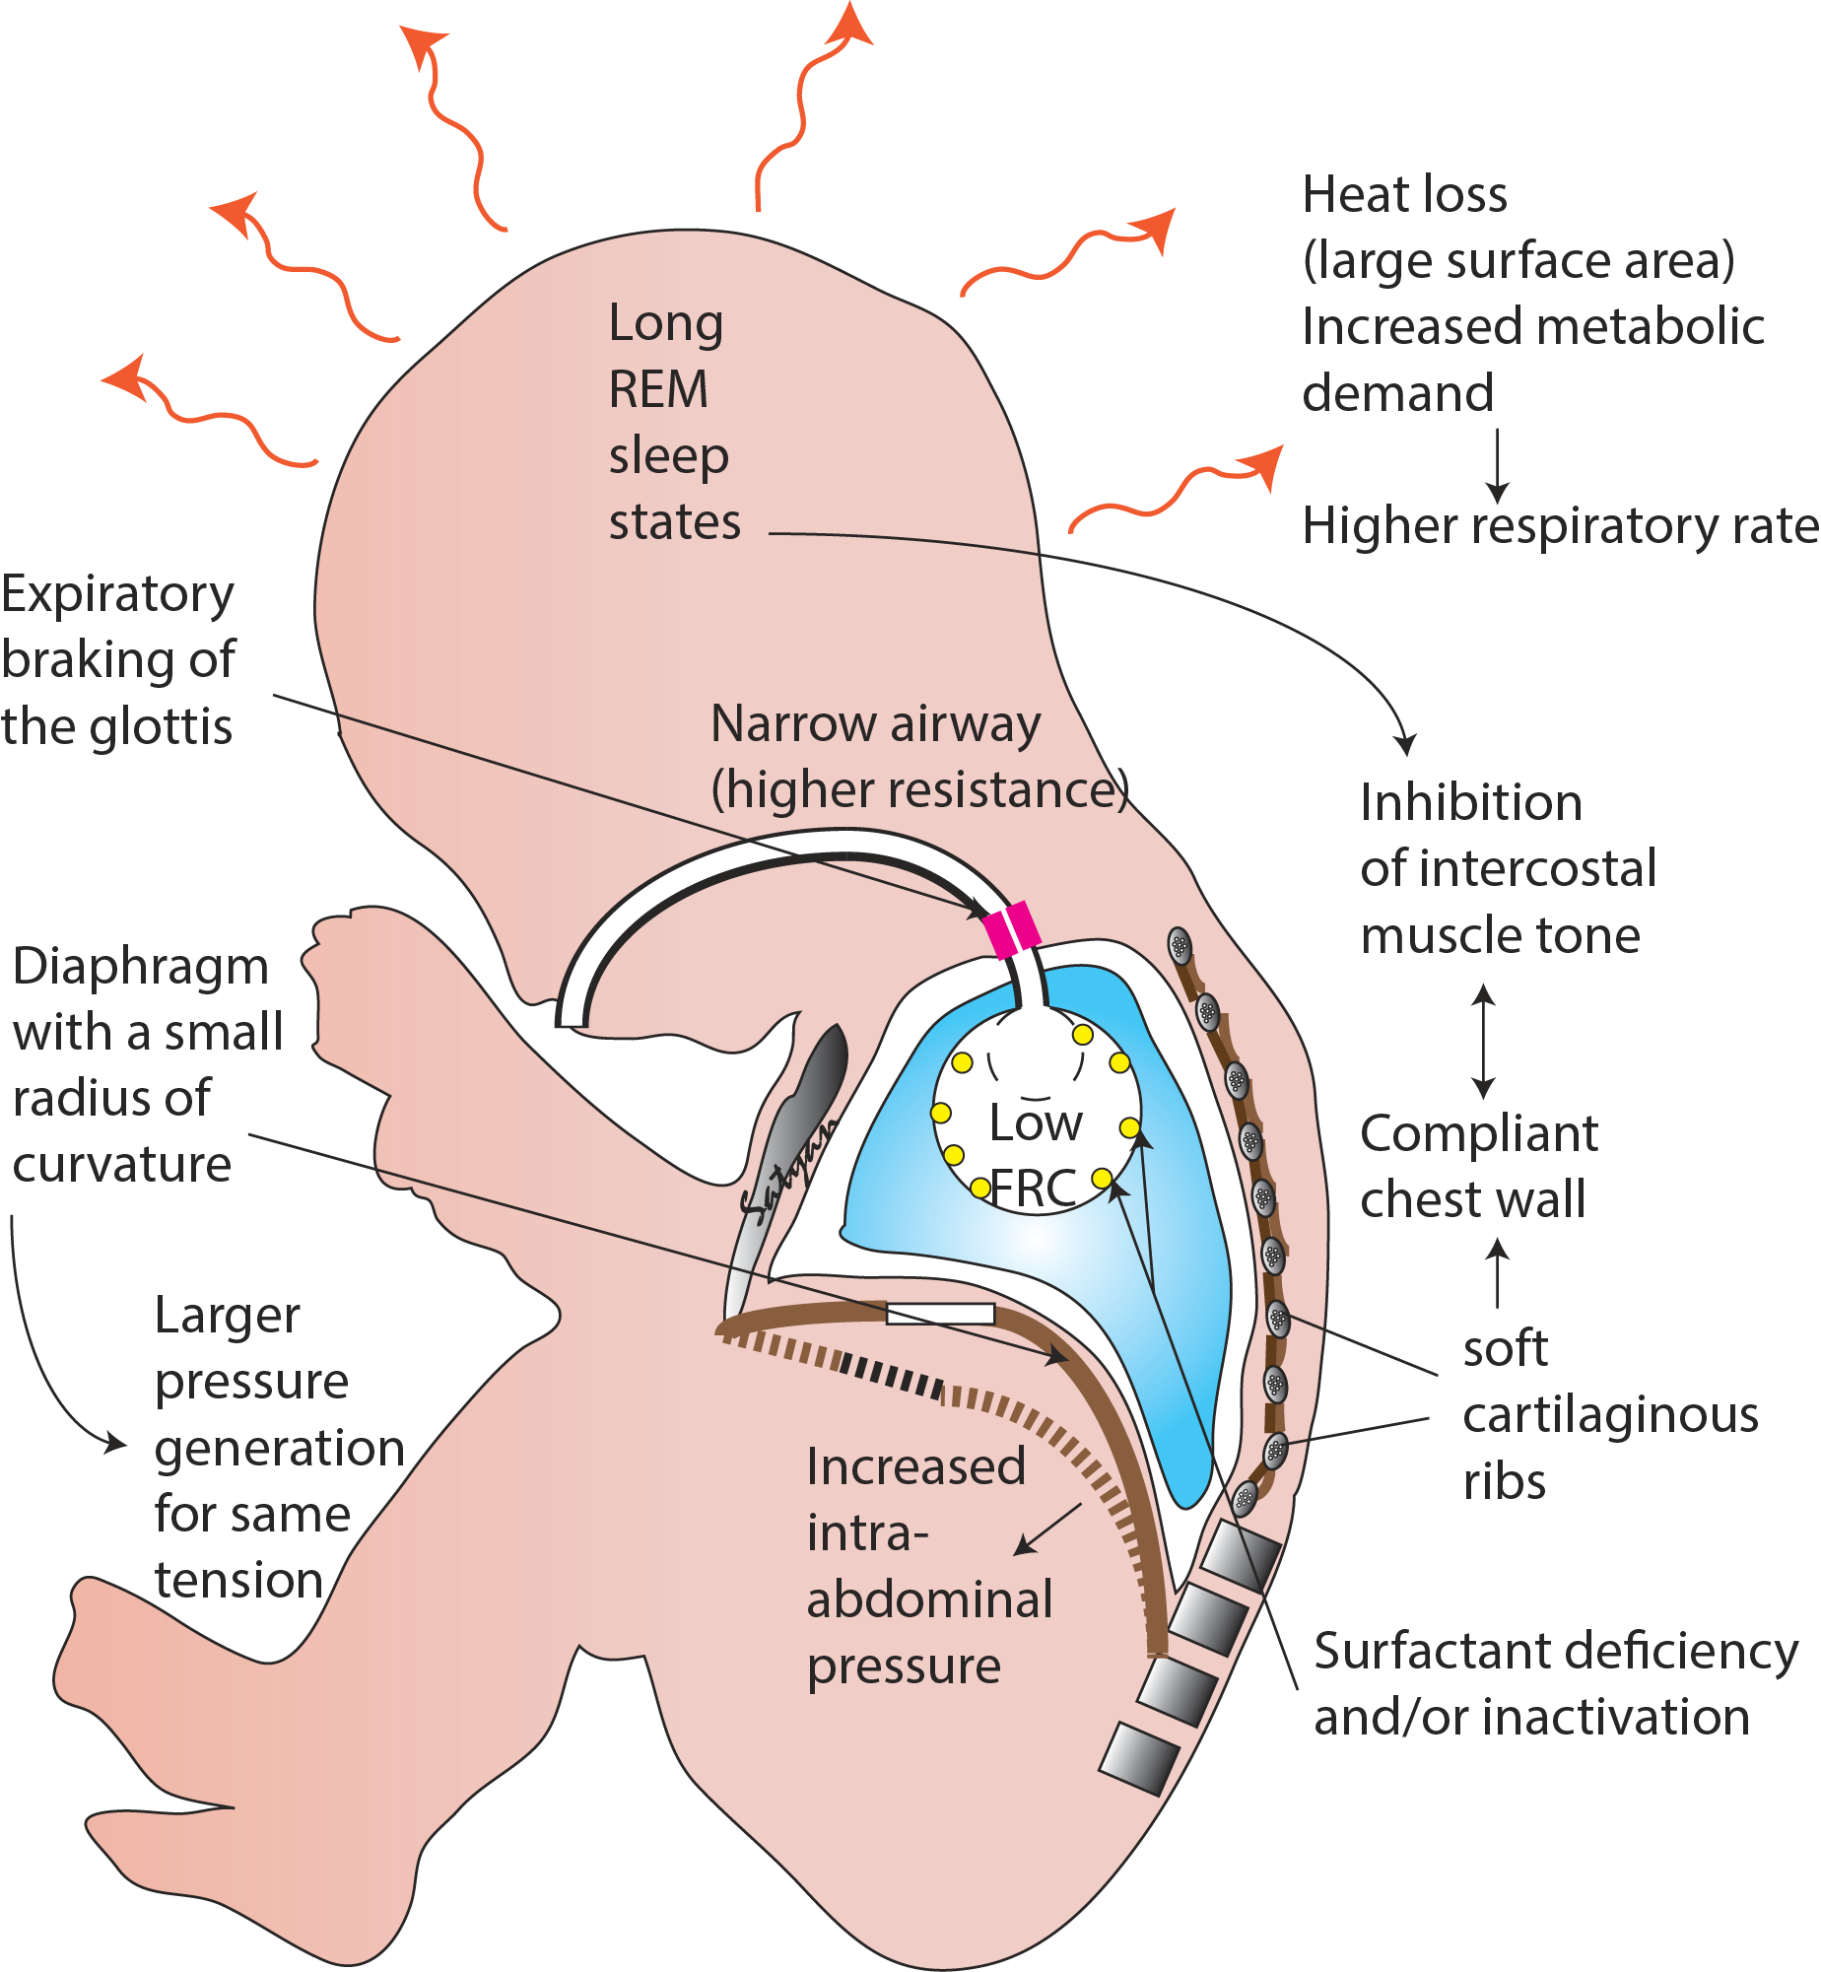
Anatomic Differences
High chest wall compliance – no elastic recoil outward at end-expiration¹
Compliant chest wall collapses easily with negative inspiratory force → paradoxical chest motion limits air flow¹
Lower trans-pulmonary pressures lead to difficulty maintaining FRC²
Upper airway soft tissue compliance leads to collapse and obstruction
Persistent R→ L Shunt more likely
  PDA
  ASD/PFO with elevated right-sided pressures
Illustration Copyright: Satyan Lakshminrusimha, MD, used with permission
Reference: ¹Smith’s, ²Bang
Notes:
Physiologic stressors such as infection and acidemia, or iatrogenic causes of hypotonia (anesthetics, sedative, or opioids) can drastically decrease airway and chest wall tone, necessitating positive pressure airway and ventilatory support.

Slide 10
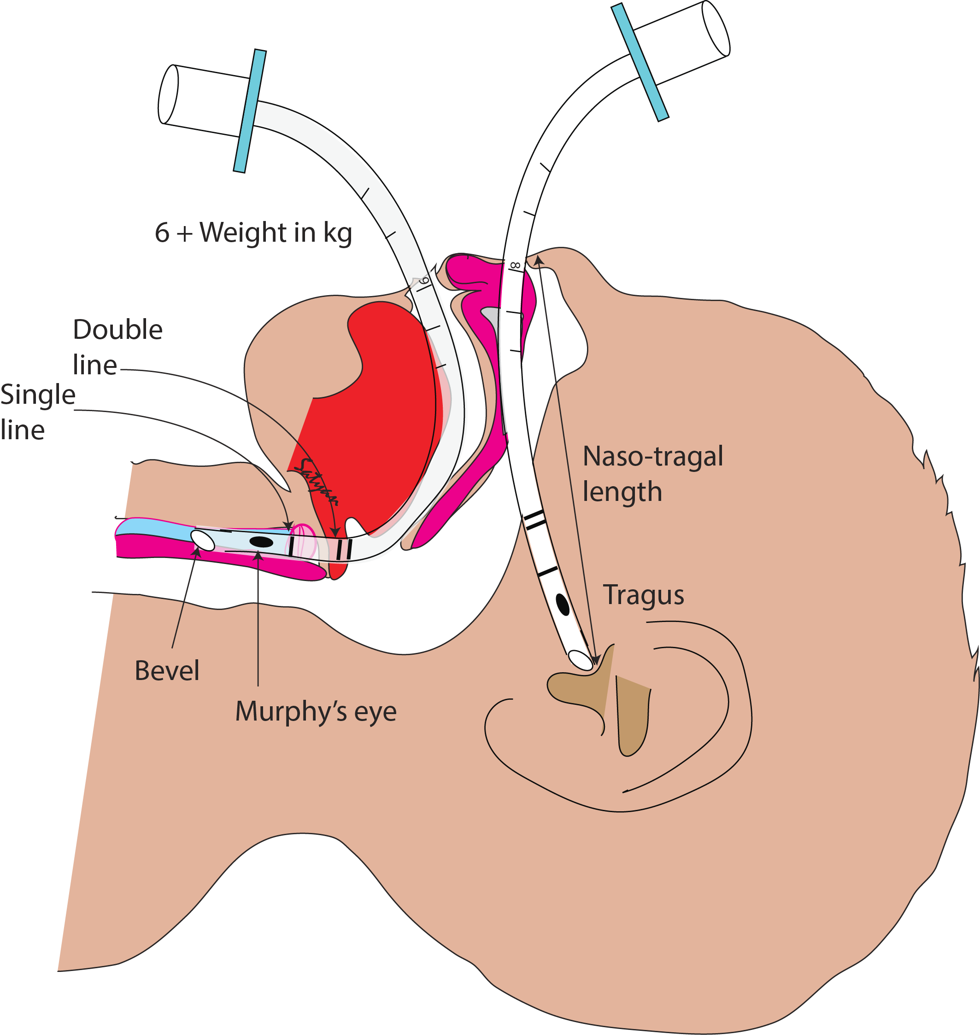
Anatomic Differences (cont’d)
Diaphragmatic Fatigue: Muscle Makeup¹
Adults have ≈ 55% slow-twitch, Type I muscle fibers (slow to fatigue)
  Term neonates have ≈ 25%
  Preterm infant has ≈ 10%
Short trachea requires specificity with ETT depth: midpoint between vocal cords & carina is typically T1-T2
  Initial ETT depth for neonates³:
6 cm + weight (in kg)
or
Naso-Tragal Length + 1
(NTL + 1)
Illustration Copyright: Satyan Lakshminrusimha, MD, used with permission
Reference: ¹Smith’s, ²Sakhuja, ³Weiner
Notes:
Even minor adjustments in positioning (e.g. neck flexion/extension, head rotation to side) can have significant impact on ETT tip position in the trachea. Instances of laryngeal extubation into oropharynx or esophagus (with no change to ETT fixation at the gum/lip) or inadvertent mainstem position are common with changes in position, particularly during transport. All providers should have immediate access to re-intubation supplies when caring for or transporting a neonate.

Slide 11
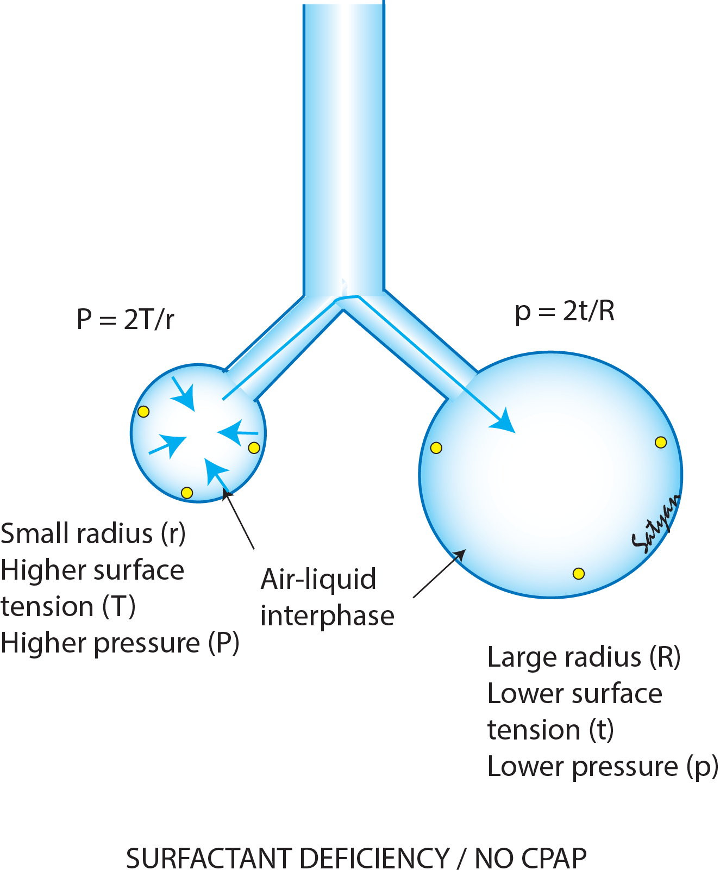
Respiratory Distress Syndrome
RDS of the newborn: absence, loss, or inactivation of surfactant
  Low surfactant → increased alveolar surface tension → collapse during exhalation, remaining collapsed¹
  Reduced compliance with normal airway resistance → rapid RR and atelectasis²
  CPAP or PEEP to support lung volumes into effective range on compliance curve
  High PEEP →
  Increased PVR→
  Increased Right to Left shunt
Reference: ¹Smith’s, ²Rajiv
Illustration Copyright: Satyan Lakshminrusimha, MD, used with permission
Notes:
In the setting of worsening RDS, elective procedures and interventions should be postponed if feasible. Once oxygen requirements and ventilatory support changes have stabilized, discussion with primary team and surgeon should be collaborative, to determine a plan that reduces risk and physiologic stress as much as possible. Intraoperative time is a major determinant of physiologic stress.

Slide 12
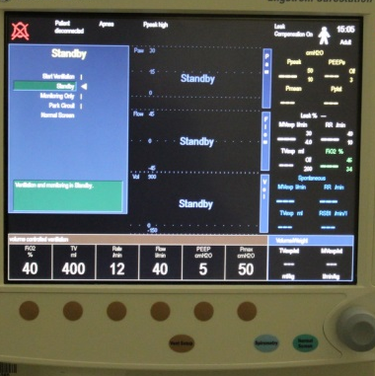
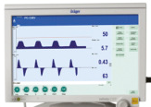
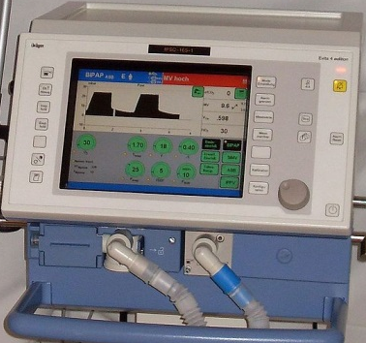
Ventilation Goals
Avoidance of lung injury:
Structurally and biochemically immature lungs are susceptible to injury from mechanical ventilation
Hyperoxia, Barotrauma, Volutrauma can all lead to Bronchopulmonary Dysplasia (BPD)¹
²GE Carestation
³www.drager.com
Reference: ¹Rajiv
²https://search.creativecommons.org/photos/acf9777a-b59b-4768-9c07-03a2b22e2376#panel0
³https://commons.wikimedia.org/wiki/File:Respirator_icu.JPG

Slide 13
Ventilation Goals (con’t)
Avoid inducing increased Pulmonary Vascular Resistance (PVR):¹
Normoxia (avoid hypoxia and hyperoxia): goal SpO₂ 88-94%²
Normocarbia (w/ permissive hypercapnia): PaCO₂ 45-60 mmHg can reduce lung injury
Minimize Peak and Mean Airway Pressures
Favor Pressure-Regulated modes, use support modes wherever feasible
Reference: ¹Bang, ²Sola
Notes:
It can be challenging for an anesthesia provider to become comfortable with lower saturation goals (see slide #7 for more background). Remind learners to think of oxygen delivery and positive pressure as drug administration, and that over-dose always has side effects.

Slide 14
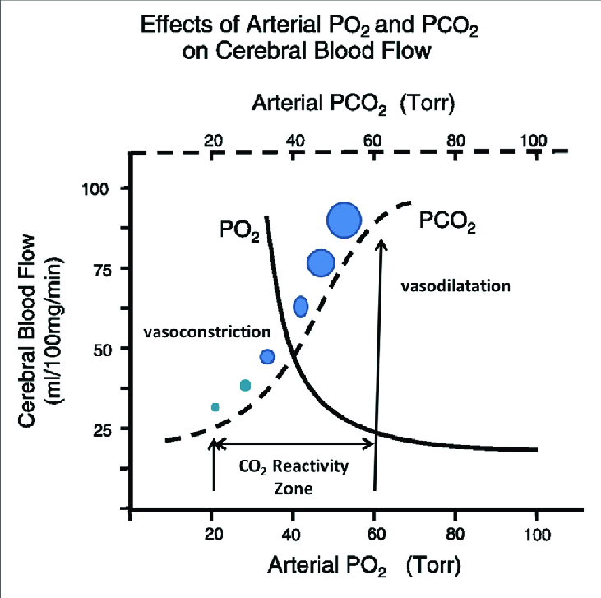



Illustration Copyright: Satyan Lakshminrusimha, MD, used with permission
Notes:
The neonatal brain is more vulnerable to changes in blood flow, and cerebral perfusion can be drastically altered with changes in PO₂ and PCO₂.

Slide 15
Ventilation Goals (con’t)
Challenges:
  Limited utility of ETCO₂ in neonates:
    Qualitative only: inaccurate mixing in the circuit, large Dead Space:Tidal Volume ratio, may not be able to even evaluate trends
    Alternatives: blood gas analysis after changes are made, NIRS prior to intubation/ventilation (track trends to maintain cerebral perfusion as a marker of PaCO₂)¹, transcutaneous CO₂
  If already intubated with stable ventilation, modes, volumes, and minute ventilation:
    Needs will change under anesthesia and surgical stress conditions
    Monitor CO₂ to assess changes and effects
Reference: ¹Dix
Notes:
NIRS: Near InfraRed Spectroscopy is a direct marker of cerebral tissue oxygenation, and an indirect indicator of cerebral perfusion. It can be an indirect (though incomplete) secondary marker of changes in perfusion if cerebral autoregulation is intact and responsive to changes in PaCO₂. See Dix et al for more background. In lower-resource settings, NIRS and transcutaneous carbon dioxide monitoring may be unavailable.

Slide 16
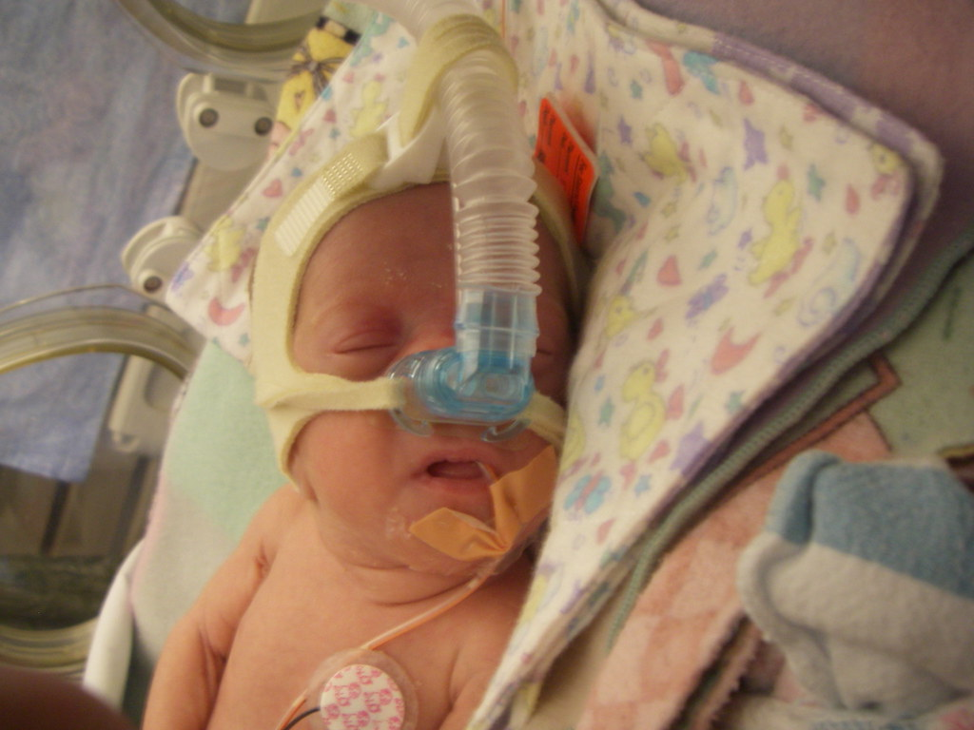
Non-invasive Positive Pressure Ventilation
Contraindications:
Congenital Diaphragmatic Hernia
Recent bowel surgery/anastomosis
Necrotizing enterocolitis (NEC)
Spontaneous Intestinal Perforation (SIP)
Bowel obstruction (e.g. duodenal atresia or pyloric stenosis)
Relative contraindications to PPV:
Tracheoesophageal fistula (TEF)
Tracheal foreign body
https://search.creativecommons.org/photos/cdf118d1-9ba6-4247-93a0-8b935956f5b1
Notes:
Frank and frequent discussion with primary team and surgical colleagues are crucial, with thorough hand-over when perioperative care is transitioned to and from the floor or NICU team. Consider using a handover tool or cognitive aid to prompt complete disclosure of events and medications, as well as discussion of goals, Plan A, Plan B, etc.

Slide 17
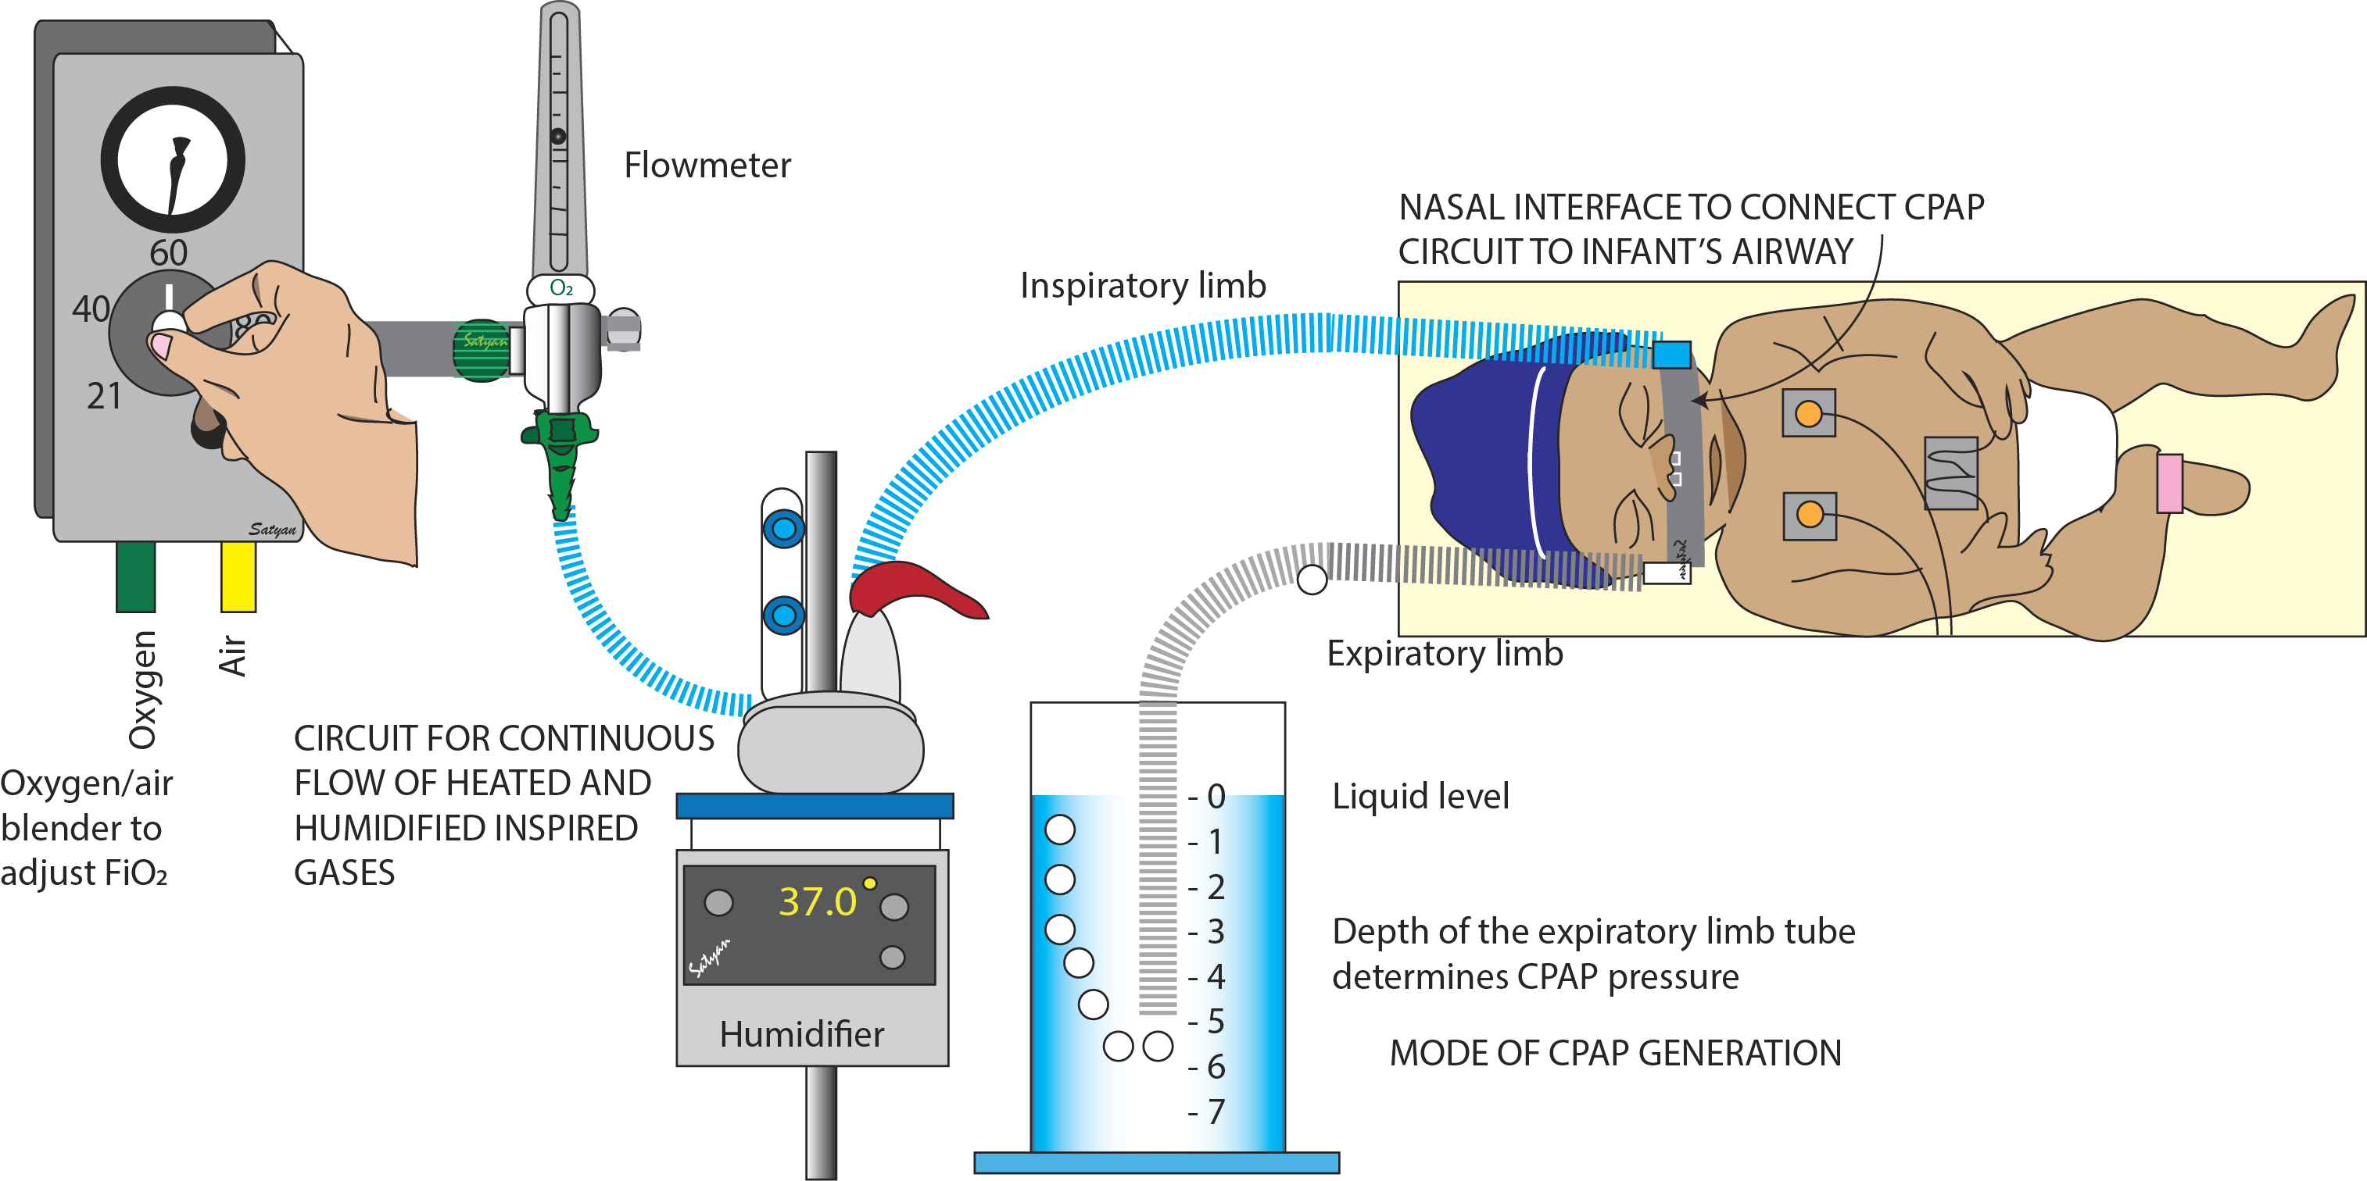
Bubble CPAP
Reference: ¹Agarwal
Illustration Copyright: Satyan Lakshminrusimha, MD, used with permission
Notes:
Bubble CPAP has been available since 1971, and has many devices and forms. In general, heated humidified air (blended to a given FiO₂) is administered at a given flow rate via well-seated nasal prongs. The expiratory limb passes through a water chamber at a specified depth, lending resistance pressure to the expiratory phase. Because it is flow dependent rather than mechanical, it has long been a mainstay of non-invasive positive pressure support for infants in low-resource settings. In neonates, this is a common mode of support immediately post-extubation.

Slide 18
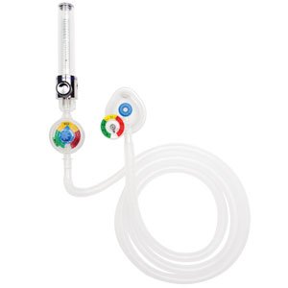
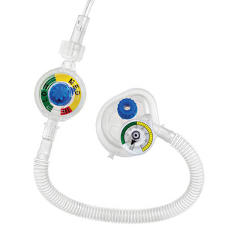
Alternatives to
Conventional Ventilators
High frequency oscillatory ventilator (HFOV)
If NIPPV not available, consider High-Flow Nasal Cannula, heated, humidified air/O₂ mixture, titrate FiO₂ to maintain SpO₂ of 88-94%
Flow-controlled, pressure limited circuit, such as NeoTee® (inexpensive, flow-dependent, disposable)
https://mercurymed.com/product/neo-tee-infant-t-piece-resuscitator/
Notes:
Practice and train with new devices prior to depending on them for patient care. In a new care setting, providers should seek guidance from local experts on use of tools/devices that are available.

Slide 19
Modes of Ventilation
Pressure regulated modes: favored due to lower peak airway pressures for a given tidal volume
Patient-initiated modes are ideal (SIMV, Pressure Support, Assist-Control)
Intraoperative TV and MV requirements may be increased over pre-operative values
In low resource settings, some anesthesia ventilators may not be able to safely deliver the small tidal volumes needed for preterm infants or neonate
  Consider using NICU ventilator if available with TIVA
  Collaborate with Neonatologist or local respiratory therapists
Reference: Habre

Slide 20
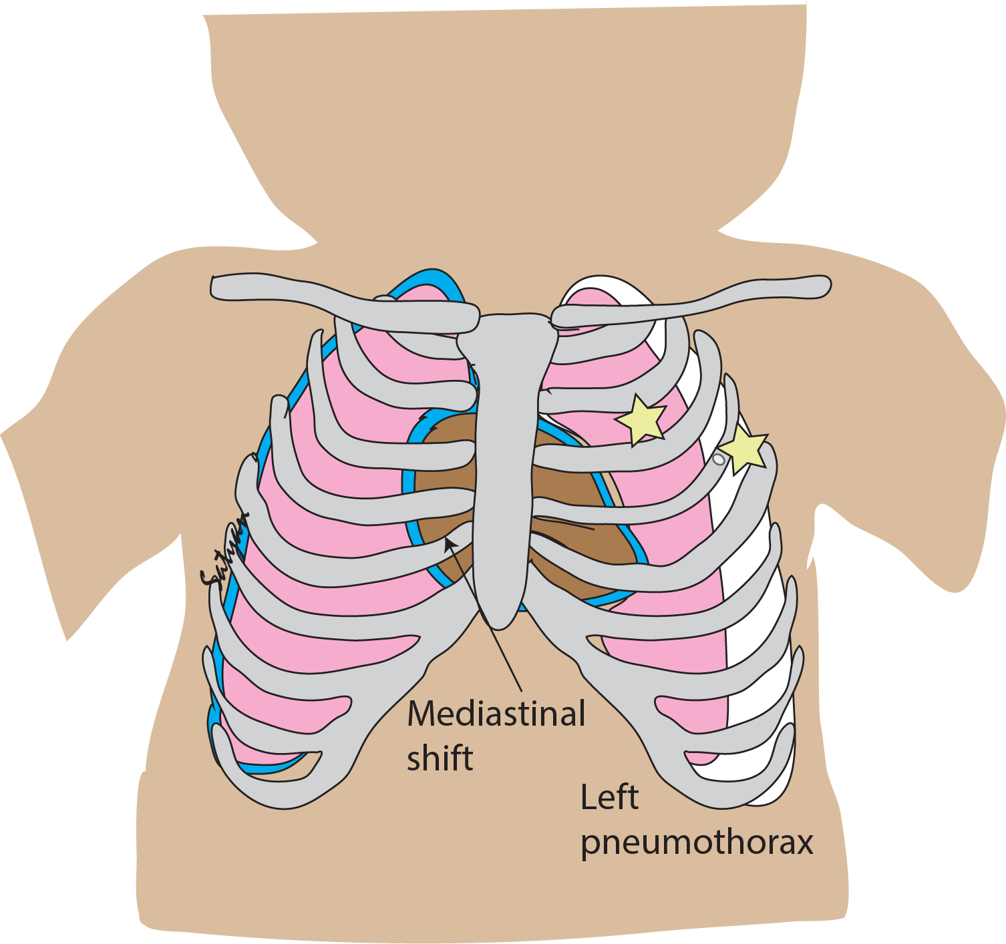
Rescue Interventions
Bradycardia secondary to hypoxia:
  Atropine 20 mcg/kg (IV or IM)
Inability to intubate:
  Call for help
  Consider temporizing with supraglottic or laryngeal mask airway
Pneumothorax:
  If emergent or unstable, call for help
  Consider needle thoracentesis with 22g angiocath
    Between 2nd - 3rd rib in the mid-clavicular line
    Or
    Between 4th - 5th intercostal space in anterior axillary line¹
Illustration Copyright: Satyan Lakshminrusimha, MD, used with permission
Reference: ¹WANMHS

Slide 21
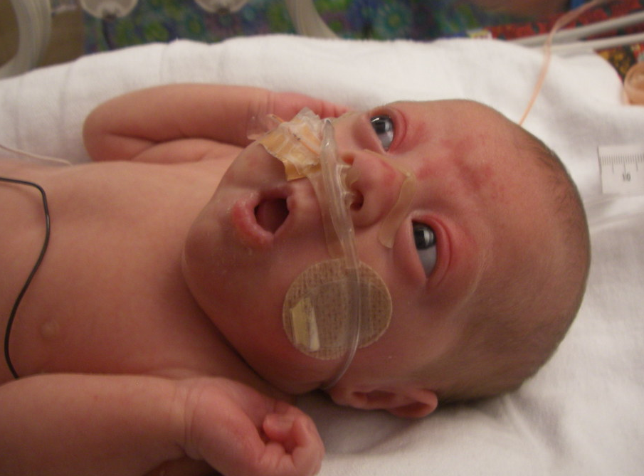
Post-Extubation Challenges
Laryngospasm, breath-holding, and apnea: more frequent in neonates
Premature extubation is a factor – better to wait until patient has fully emerged from anesthetic¹
Pulse oximetry and apnea monitoring²
  If history of prematurity, monitor 24 hrs post-anesthesia until 60 weeks post-conceptual age (PCA)
  If history of term birth, monitor overnight until 44 weeks PCA
https://search.creativecommons.org/photos/374fdb92-ff02-46de-96a7-20995fbeaadf
Reference: ¹Cote, ²Kurth

Slide 22
Review
Identify differences between neonatal and pediatric lung mechanics
    Compared with older children, neonates have more compliant chest wall, lower FRC, increased O₂ consumption and required minute ventilation in ml/kg, and lower pulmonary reserve
Ventilation Goals
    Permissive hypercapnea and normoxia (PaCO₂ 45-60 mmHg, PaO₂ 40-60 mmHg) may be beneficial
    Pressure-regulated, patient-initiated ventilator modes are preferred where possible
    Shorter expiratory time may support physiologic PEEP
Review emergency maneuvers such as chest decompression for life-threatening pneumothorax

Slide 23
References:
Agarwal, S. et al. (2016) A Randomized Trial Comparing Efficacy of Bubble and Ventilator Derived Nasal CPAP in Very Low Birth Weight Neonates with Respiratory Distress. J. Clinical and Diagnostic Research. Sep, Vol-10(9).
Bang, S.R. Neonatal anesthesia: how we manage our most vulnerable patients. Korean Journal of Anesthesiology, 2015 October; 68(5):434-441.
Brett, C., & Robinowitz, D. (2015) Neonatal Ventilation. In Lerman (Ed.), Neonatal Anesthesia (pp213-224). New York: Springer.
Cote, C.J., Lerman, J., Todres, I.D. A Practice of Anesthesia for Infants and Children (Fourth Ed.), p.64-67, Philadelphia, WB Saunders, 2009.
Dix, L.M.L et al. Monitoring Cerebral Oxygenation in Neonates: An Update. Frontiers in Pediatrics. vol. 5 Article 46 (March 2017).
Government of Western Australia North Metropolitan Health Services. (2014) Needle Aspiration of the Chest. Clinical Practice Guideline. Women and Newborn Health Service. Australia. https://www.kemh.health.wa.gov.au/~/media/Files/Hospitals/WNHS/For%20health%20professionals/Clinical%20guidelines/NEO/WNHS.NEO.NeedleAspirationoftheChest.pdf
Gregory, G., & Brett, C., (2011) Neonatology for Anesthesiologists. In Davis et al (Eds.), Smith’s Anesthesia for Infants and Children (pp. 512-533). Philadelphia, PA: Elsevier.
Habre, W. (2015) Neonatal Ventilation. In Lerman (Ed.), Neonatal Anesthesia (pp213-224). New York: Springer.
Kurth, C.D. et al. (1987) Postoperative apnea in preterm infants. Anesthesiology. 66(4):483-8.
Naumburg, E. et al. (2002). Supplementary oxygen and risk of childhood lymphatic leukaemia. Acta Paediatr. 91(12): 1328–1333.
Pankaj Sakhuja, P., Whyte, H. ETT tip position in Neonatal Resuscitation Guidelines. Resuscitation 106 (2016) e23. Elsevier Ireland.
Rajiv, P., Vidyasagar, D., and Lakshminrusimha, S., (2018). Essentials of Neonatal Ventilation. Elsevier India.
Sola, A. et al. (2014) Safe oxygen saturation targeting and monitoring in preterm infants: can we avoid hypoxia and hyperoxia? Acta Paedeatrica 103: 1009-18 (2014).
Weiner, G. M., & Zaichkin, J. (2016). Textbook of neonatal resuscitation. Elk Grove Village, IL: American Academy of Pediatrics.
Weinberger, B. et al. Oxygen Toxicity in Premature Infants. Toxicology and Applied Pharmacology 181, 60–67 (2002).

