Slide 1
Anesthetic Considerations For Pyloric Stenosis
Denise Chang, MD
Andrew Infosino, MD
UCSF Benioff Children’s Hospital
Department of Anesthesia and Perioperative Care
Updated 4/2018

Slide 2
Disclosures
None

Slide 3
Learning Objectives
Describe the clinical presentation of pyloric stenosis including its associated metabolic abnormalities
Review the tests used to confirm the clinical diagnosis of pyloric stenosis
Describe the medical and surgical treatment of pyloric stenosis
Formulate an anesthetic plan for infants with pyloric stenosis

Slide 4
Clinical Presentation
Hypertrophy of the pyloric sphincter leads to gastric outlet obstruction
Infant presents with projectile, non-bilious vomiting after feeding
Can progress to significant dehydration and electrolyte abnormalities with possible weight loss and lethargy

Slide 5
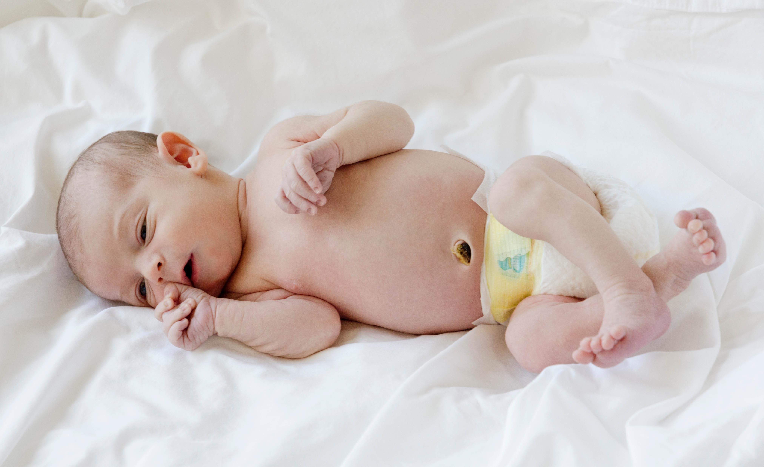
Epidemiology
Incidence: 1.5 – 4 cases/1000 live births
More prevalent in Caucasians
M:F ratio of 4:1
Typically, present at 3-6 weeks of age but may present up to 12 weeks of age
https://commons.wikimedia.org/wiki/File%3AHuman-Male-Newborn-Infant-Baby.jpg

Slide 6
Clinical Diagnosis: Physical Exam Findings
Visible gastric peristalsis especially after feeding
Palpable pyloric mass or “olive” in the right upper quadrant of the abdomen

Slide 7
Diagnostic Tests: Ultrasound
Feed infant during exam
Optimal positioning: Right lateral
Sensitivity: 90-95%
Longitudinal view often shows pyloric muscle thickness > 3 mm and pyloric channel length > 14 mm
Transverse view shows “olive”

Slide 8
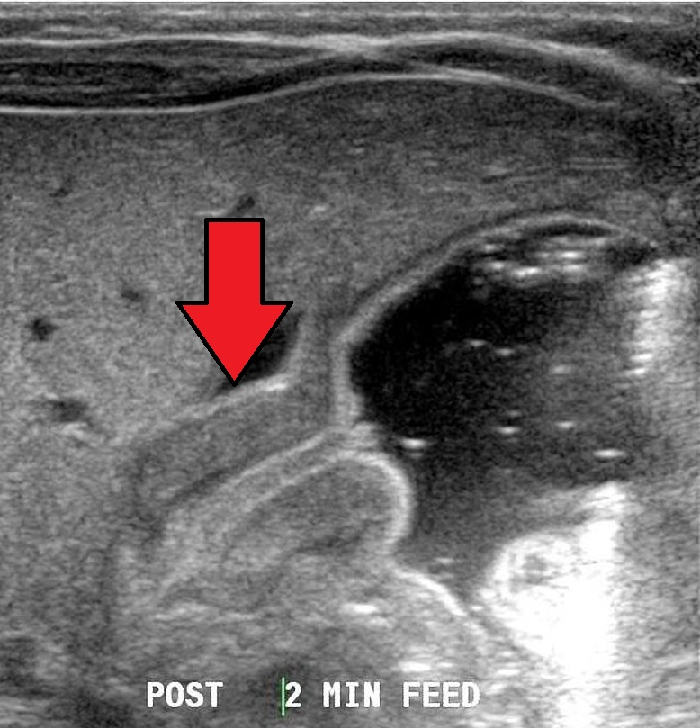
Diagnostic Tests: Ultrasound
By Dr Laughlin Dawes (https://radiopaedia.org/cases/pyloric-stenosis) [CC BY-SA 4.0 (https://creativecommons.org/licenses/by-sa/4.0)], via Wikimedia Commons

Slide 9
Metabolic Abnormalities
Hypochloremia from vomiting HCl stomach secretions
Hypokalemia as kidney exchanges K⁺ to retain H⁺ (due to metabolic alkalosis) and K⁺ is lost in urine
Metabolic alkalosis from vomiting HCl stomach secretions
Dehydration from vomiting

Slide 10
Assessing Degree of Dehydration
Appearance
Fontanelle
Skin turgor
Mucous membranes
Weight loss
Heart rate/pulse
Blood pressure
Urine output

Slide 11
Assessing Degree of Dehydration
 | MILD (< 5% weight loss) | MODERATE (5-10% weight loss) | SEVERE (> 10% weight loss)
Appearance | Thirsty, alert | Thirsty, drowsy | Drowsy, limp, cold
Fontanelle | Normal | Sunken | Very sunken
Skin turgor | Skin retracts immediately after pinch | Skin retracts slowly after pinch | Skin retracts very slowly after pinch
Mucous membranes | Moist | Dry | Very Dry
Weight loss | < 5% | 5-10% | > 10%
Heart rate/pulse | Normal | Rapid and weak | Rapid and thready
Blood pressure | Normal | Normal/low | Low
Urine output | Normal | 1-2 ml/kg/hr | < 1 ml/kg/hr

Slide 12

Remember, pyloric stenosis is a medical emergency, not a surgical emergency!
http://www.thebluediamondgallery.com/wooden-tile/e/emergency. Creative Commons 3 - CC BY-SA 3.0

Slide 13
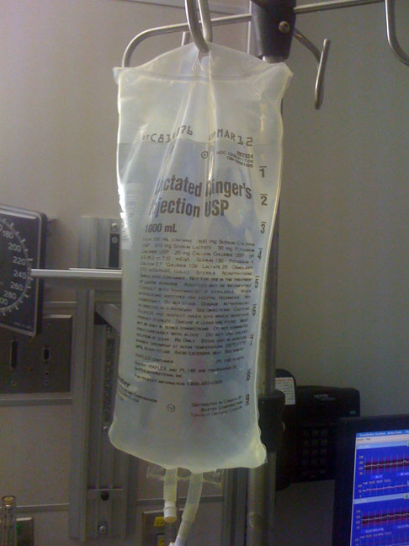
Preoperative Medical Treatment
NPO
Orogastric/nasogastric tube
Fluid resuscitation
  Severe dehydration: Lactated Ringer’s, 0.9% saline or 5% albumin 10 ml/kg fluid bolus; Reassess and repeat as needed
  Deficit: Correct with 0.9% saline over 24 hours
  Maintenance: Use 5% dextrose 0.22% saline with 20-40 mEq/L KCl
https://commons.wikimedia.org/wiki/File%3ALactateRingers.jpg

Slide 14
Preoperative Management
Proceed with surgery only when the infant is rehydrated & labs have normalized (may take up to 24-48 hours)
Normal pH
Chloride > 100 mEq/L
Bicarb < 30 mmol/L
K > 3.0 mEq/L
Urine specific gravity < 1.020

Slide 15
Induction of Anesthesia
No premedication
Decompress the stomach by suctioning via orogastric or nasogastric tube
  Consider multiple suction passes
  Consider suctioning in supine, lateral and prone positions

Slide 16
Induction of Anesthesia
Consider modified rapid sequence intravenous induction with pre-oxygenation, cricoid pressure and gentle mask ventilation
Consider awake intubation in patients with a difficult airway

Slide 17
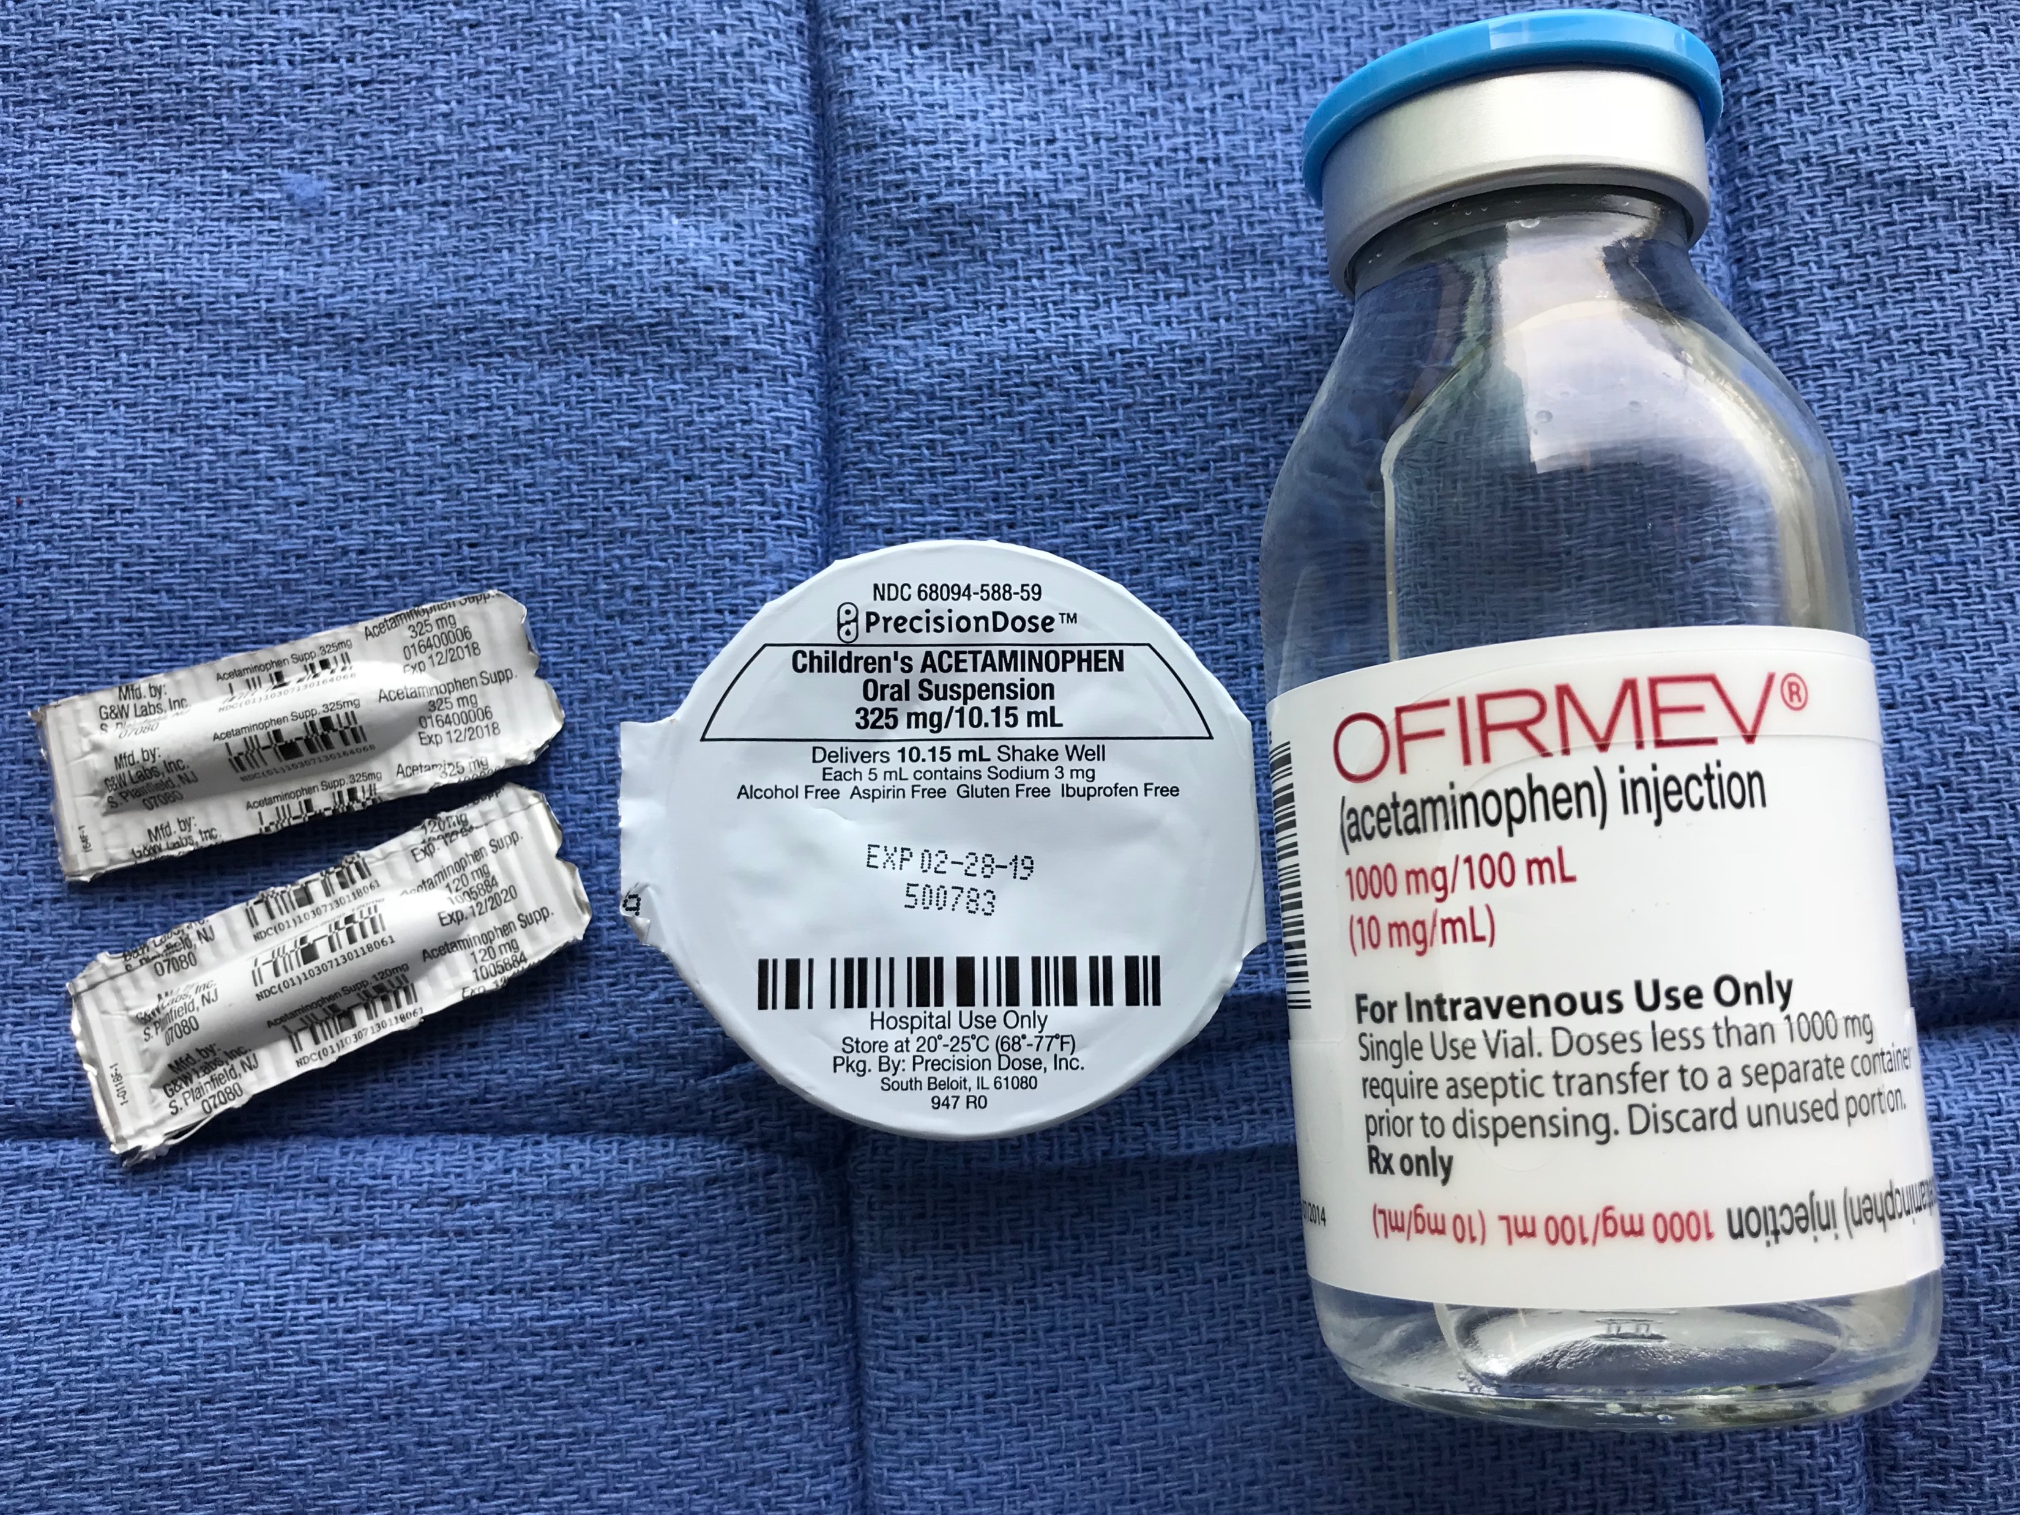
Maintenance of Anesthesia
Standard monitors, temperature and consider blood glucose monitoring
Sevoflurane, can also use halothane or isoflurane
Avoid or minimize narcotics, use IV or rectal acetaminophen to allow more rapid refeeding and discharge
Encourage surgeons to use local anesthetic at incision site

Slide 18

Surgical Approach
Classic approach is open pyloro-myotomy through a small (1 cm) horizontal abdominal incision
Laparoscopic pyloromyotomy is now the most common surgical approach
https://pixabay.com/en/scalpel-hand-gloved-medical-doctor-31123/ Creative Commons CC0

Slide 19
Emergence From Anesthesia
Full reversal of neuromuscular blockade
Consider suctioning the stomach with an orogastric tube prior to extubation
Infant should be fully awake and vigorous prior to extubation

Slide 20
Postoperative Issues
Postoperative apnea
Increased risk since many patients will be < 60 weeks post-conceptual age at the time of surgery
Monitor with pulse oximetry and/or respiratory monitor for 12-24 hours

Slide 21

Postop Refeeding Schedule
Maintenance fluids until able to resume PO intake
Will typically resume PO intake within 6 hours after surgery
If unable to tolerate feeds, consider monitoring for hypoglycemia
https://pixabay.com/en/breast-feeding-motherhood-mother-1831508/ Creative Commons CC0

Slide 22
References
Lerman, J., Anderson, B. and Coté, C. (2013). Coté and Lerman's: A Practice of Anesthesia for Infants and Children. Elsevier Health Sciences.
Davis, P. and Cladis, F. (2017). Smith's Anesthesia for Infants and Children. St. Louis, Missouri: Elsevier.
Holzman, R. (2016). A Practical Approach to Pediatric Anesthesia. Philadelphia [u.a.]: Wolters Kluwer.
Gregory, G. and Andropoulos, D. (2012). Gregory's Pediatric Anesthesia. Chichester, West Sussex: Wiley-Blackwell.

