Slide 1
Anesthetic Considerations for Meningomyelocele
Monica Williams, MD
Children's Hospital of Philadelphia
Updated 10/2021

Slide 2
Objectives
To learn about the pathophysiology of meningomyelocele
To understand co-morbidities associated with meningomyelocele
To better understand how to optimize perioperative care of neonates presenting with meningomyelocele

Slide 3
Disclosures
No relevant financial relationships

Slide 4
Incidence and Definitions
Most common congenital primary neural defect (0.6-6.3:1000 live births worldwide)
Spina Bifida Occulta: most mild type
  May be dimple, hairy patch, or dark patch
  Patients are often asymptomatic
  Closed defect
Meningocele:
Involves meninges and not neural components
  Combination of skin, dura, arachnoid
  Open defect
Meningomyelocele: most severe form
  Includes meninges and neural components
  Left untreated can lead to paralysis, bowel and bladder issues
  Open defect

Slide 5
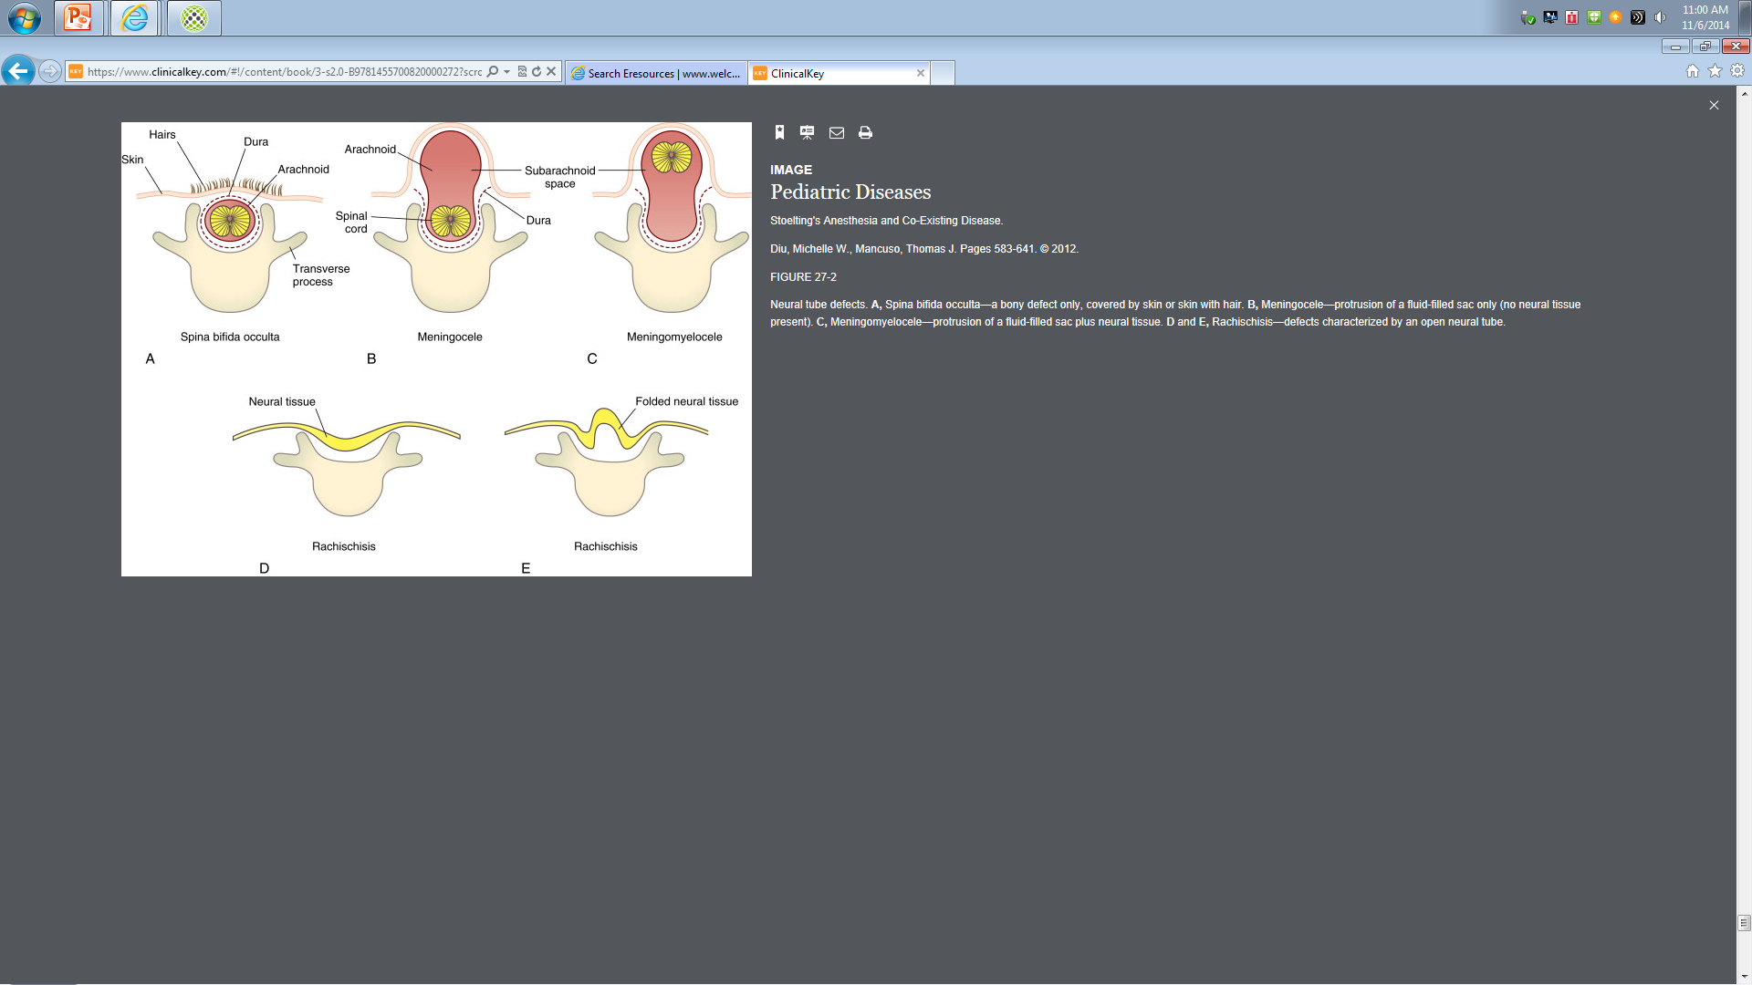
Types of Neural Defects

Slide 6
Causes of Myelomeningocele (MM)
Defect is failure of closure of neural tube
  Neural plate forms in first month of gestation
  During primary neurulation, neural folds arise and gradually fuse to convert the neural plate into a neural tube
  Any failure in that closure results in exposed neural tissue called a placode
Most commonly occurs over lumbar or sacral spine
Associated with genetic and environmental factors
  Folate deficiency, anti-seizure medications implicated
  Maternal diabetes and history of prior birth with MM increases risks
  Increased incidence of MM in trisomy 13 and 18

Slide 7
Associated Findings
Over 90% of MM are associated with Arnold Chiari II malformation
    Brainstem anomaly that has caudal displacement of cerebellum
    This can lead to apnea, stridor, and sleep disordered breathing
Over 90% also have hydrocephalus
  This can lead to elevated intracranial pressure (ICP)
  Symptoms of ↑ICP include headache, nausea/vomiting, bradycardia, and altered mental status and if left untreated can lead to brain herniation

Slide 8
Diagnosis
Prenatal diagnosis – possible as early as the first trimester
  Diagnosed by amniocentesis in the first trimester
  Ultrasonography during the second trimester
  Alpha fetoprotein levels in maternal serum
Postnatal diagnosis
  Baby with a closed defect may only have muscle weakness in legs, hips, and feet, or a tuft of hair or dimple over site of defect.
  Medical imaging such as x-rays or ultrasound can be used to look at spine

Slide 9
Fetal Meningomyelocele
Prenatal diagnosis allows for fetal surgery
  Some institutions are performing an intrauterine procedure
  Management of Myelomeningocele Study (MOMS) trial in 2011 showed improved outcomes (reduced need for shunting, decreased incidence of Chiari II malformation, and improved scores of mental development and motor function) in the fetal prenatal repair group compared to the postnatal group
  This involves closing the defect via fetoscopy or open fetal repair between 22-26 weeks gestation

Slide 10
Neonatal Meningomyelocele
Goal is to operate within 24-48 hours after birth
  This reduces long term neurological defects
  Surgery involves closing the defect and possibly placing a shunt
    Can delay shunt if risks of infection are high and patient doesn’t have signs of hydrocephalus
    Clinical characteristics evaluated to determine need for shunt include apneic and bradycardic spells, CSF leak, level of the MMC, head circumference, and rate of head growth
    Alternatives to a shunt include endoscopic third ventriculostomy with choroid plexus cauterization (ETV/CPC)

Slide 11
Pre-operative Management
Goals:
Prevent sac injury – pad for supine positioning.
Cover MM with soaked gauze to prevent fluid loss and infection
Plan for primary closure within first 24-48 hours of life to minimize infection and neurological damage
Increased maintenance IV fluids for continuous fluid loss from MM
Look for other genetic syndromes, such as acrocallosal syndrome, Fraser syndrome, Jarcho-Levin syndrome.
Look for signs of Arnold Chiari malformation, which often presents in neonates as difficulty swallowing, inspiratory stridor, weak/poor cry and can lead to respiratory insufficiency

Slide 12
Intraoperative Care
Positioning
    Prone or lateral decubitus – will need endotracheal tube
    Supine for intubation – use doughnut pillow or padding around mass to minimize trauma.
    If defect is too large, may need to intubate in lateral position
Latex precautions
Succinylcholine is safe and not associated with hyperkalemia in these patients
FLUIDS, FLUIDS, FLUIDS – keep up with insensible losses, blood loss is usually small but should have some available for larger defects
If Arnold-Chiari malformation is present, careful with flexion and extension of head, as that may cause brainstem compression.

Slide 13
Intraoperative Care
Avoid hypothermia – these babies lose a lot of heat and fluid
Intraoperative neuromonitoring – consider this possibility before giving a long acting paralytic
Respiratory insufficiency/apnea – can be an issue post-operatively. Plus these babies may need to stay prone for days.

Slide 14
Post-operative Care
May consider keeping patient intubated and ventilated because of young age, need for continuous prone position, and +/-Chiari malformation!
Keep an eye out for:
Bradycardia
Apnea
Stridor
Brainstem herniation
S/S of hydrocephalus such as lethargy and vomiting

Slide 15
Long term considerations
Many of these patients have multisystem disease resulting from injury of CNS during gestation and need other operations
  Ventricular-peritoneal shunts and revisions
  Orthopedic surgeries such as clubfoot repair, spinal fusion for scoliosis
Also high risk for latex reactions due to repeated exposures.
  Those with latex allergies may have cross reactions with tropical fruits and some antibiotics

Slide 16
Conclusions:
Meningomyelocele is a complex lesion. Remember in the preoperative period to consider infection risks, fluid loss, and minimizing trauma to mass
Intraop: remember to minimize exposure to latex, carefully pad mass for intubation, and these neonates need fluid
Postop: remember the associated conditions of Chiari Malformation and hydrocephalus

Slide 17
References:
Conran A, Anesthetic Considerations for Neonatal Neurosurgical Patients. Neurosurgical Clinics of North America, 1998, 9(1): 181-185.
John HM, Harvey BS, Laura FS. Malformations of the central nervous system J. Child Neurology 2006:285-366.
Deepak Singh, MD,DM , Girija Prasad Rath, MD, DM et al.Anaesthetic concern and perioperative complications in repair of mylomeningocele; J. of neurosurgical anaesthesiology, 2010; 22: 11-15.
Phillips BC, Gelsomino M, Pownall AL, Ocal E, Spencer HJ, O'Brien MS, Albert GW. Predictors of the need for cerebrospinal fluid diversion in patients with myelomeningocele. J Neurosurg Pediatr. 2014 Aug;14(2):167-72.
Elbabaa SK, Gildehaus AM, Pierson MJ, Albers JA, Vlastos EJ. First 60 fetal in-utero myelomeningocele repairs at Saint Louis Fetal Care Institute in the post-MOMS trial era: hydrocephalus treatment outcomes (endoscopic third ventriculostomy versus ventriculo-peritoneal shunt). Childs Nerv Syst. 2017 Jul;33(7):1157-1168.
Singh D, Rath GP, Dash HH, Bithal PK. Anesthetic concerns and perioperative complications in repair of myelomeningocele: a retrospective review of 135 cases. J Neurosurg Anesthesiol. 2010 Jan;22(1):11-5.
Northrup H, Volcik KA. Spinia bifida and other neural tube defects. Curr Probl Pediatr 2000:30(10):313-32.

