Slide 1
Anesthetic Considerations For Patients With Trisomy 21
Andrew Infosino, MD
Jina Sinskey, MD
UCSF Department of Anesthesia and Perioperative Care
Updated 8/2017

Slide 2
Disclosures
None

Slide 3
Learning Objectives
Indicate the incidence and major risk factor for having a child with trisomy 21
Describe characterizing features of patients with trisomy 21
List key areas for preoperative assessment in patients with trisomy 21
Describe the major issues regarding intraoperative management of patients with trisomy 21

Slide 4
Incidence of Trisomy 21
Most prevalent chromosomal abnormality worldwide
Occurs in approximately 1 in 700 newborns in the US
6,000 infants born with trisomy 21 annually in the US
Estimated > 400,000 individuals with trisomy 21 currently living in the US

Slide 5
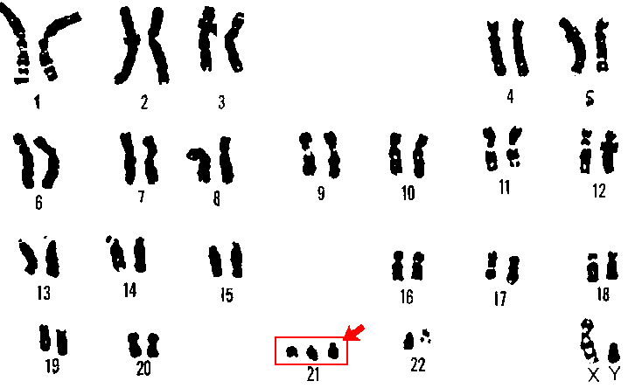
Trisomy 21
Extra copy of chromosome 21
Image: U.S. Department of Energy Human Genome Program. [Public domain], via Wikimedia Commons

Slide 6
Types of Trisomy 21
> 95%: Non-disjunction (extra copy of chromosome 21 in every cell)
4%: Translocation (additional full or partial copy of chromosome 21 attached to another chromosome, usually chromosome 14)
1%: Mosaic trisomy 21 (extra chromosome 21 is present in some, but not all cells)

Slide 7
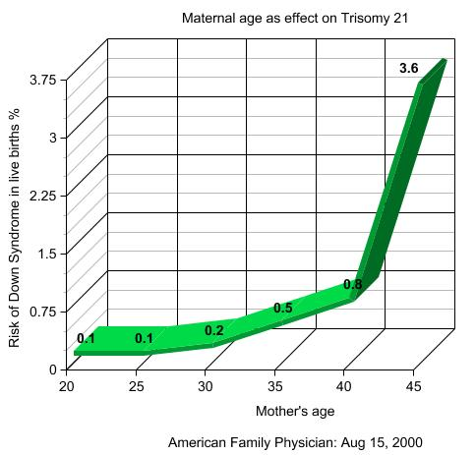
Risk Factors for Trisomy 21
Advanced maternal age is the major risk factor
The risk of having a child with trisomy 21 increases in a linear fashion with advancing maternal age until age 30, then increases exponentially thereafter

Slide 8
Risk Factors for Trisomy 21
Advanced paternal age may contribute to a small increase in risk
Environmental factors not shown to increase risk

Slide 9

Characterizing Features
Mental retardation: very mild to severe
Short stature
Obesity
Simian crease
Hypotonia
Image: By WurdBendur (Own work) [GFDL (http://www.gnu.org/copyleft/fdl.html) or CC BY-SA 4.0-3.0-2.5-2.0-1.0 (http://creativecommons.org/licenses/by-sa/4.0-3.0-2.5-2.0-1.0)], via Wikimedia Commons

Slide 10
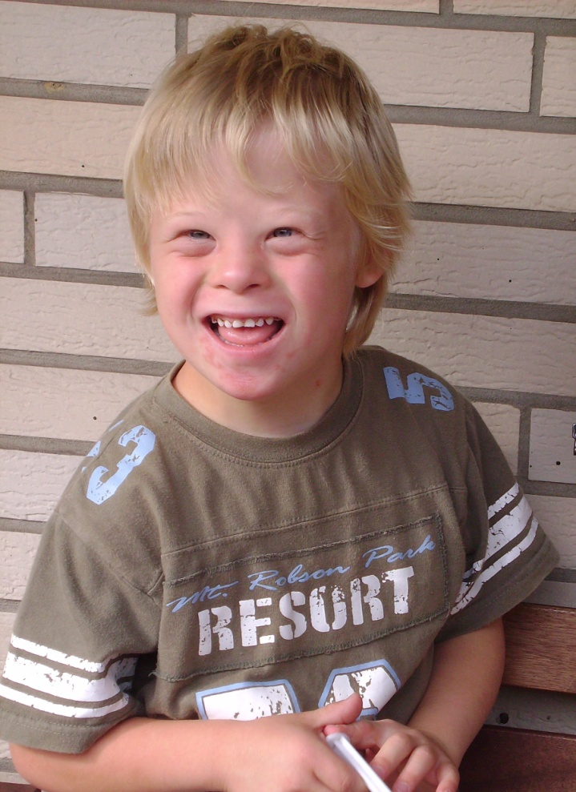
Craniofacial Abnormalities
Microbrachycephaly
Epicanthal folds
Oblique palpebral fissures
Small and low-set ears
Macroglossia
Microdontia
Mandibular hypoplasia
Broad, flat nose
By Vanellus Foto (Own work) [GFDL (http://www.gnu.org/copyleft/fdl.html) or CC BY-SA 3.0 (http://creativecommons.org/licenses/by-sa/3.0)], via Wikimedia Commons

Slide 11
Trisomy 21: Associated Conditions
Significant hearing loss (75%)
Obstructive sleep apnea (50-80%)
Ophthalmic disorders (60%)
Congenital heart disease (50%)
Atlanto-axial instability (20%)
Gastrointestinal atresias (12%)
Hypothyroidism (5-10%)
Leukemia (1%)

Slide 12
Congenital Heart Disease
Congenital heart defects in patients with trisomy 21 include:
Atrioventricular septal or AV canal defects (45%)
Ventricular septal defects (35%)
Secundum atrial septal defects (8%)
Patent ductus arteriosus (7%)
Tetralogy of Fallot (4%)

Slide 13
Common Surgical Procedures
Eye exam under anesthesia
Tonsillectomy and adenoidectomy for OSA
Myringotomy tubes
Repair of congenital cardiac defects
Repair of intestinal atresia
Pull-through for Hirschsprung’s Disease

Slide 14
Anesthesia Risk
Children with trisomy 21 have a higher frequency of complications associated with general anesthesia than the general population
Trisomy 21 patients tend to have more URIs
Anesthetic complications include bradycardia, airway obstruction, difficult intubation, bronchospasm, post-intubation croup

Slide 15
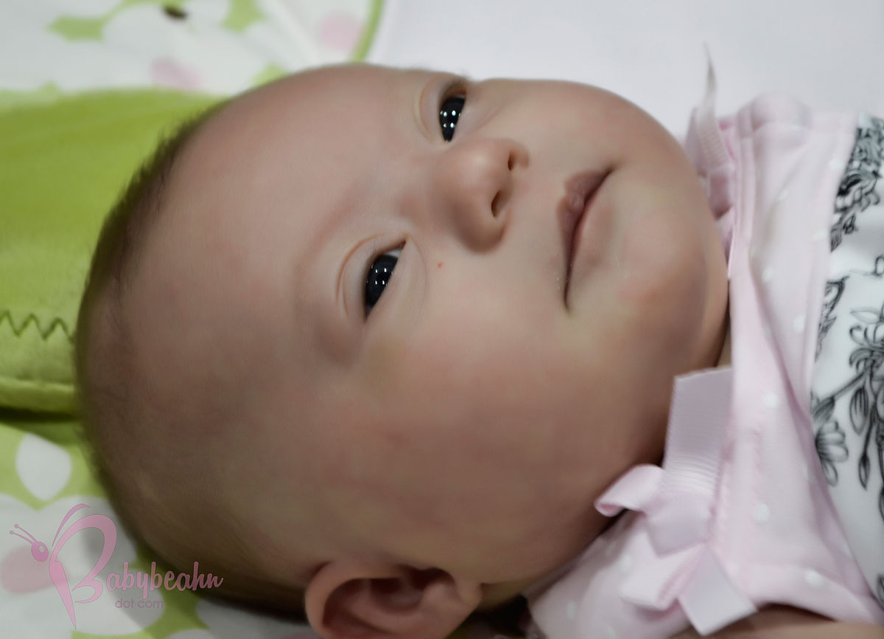
Minimizing Anesthesia Risk
Consider combining surgical procedures under one anesthetic
Thorough preoperative evaluation of these patients is essential

Slide 16
Anesthetic Risk: Cardiac
Important to assess the cardiac status of all patients with trisomy 21, even for non-cardiac surgery
Trisomy 21 patients with congenital heart disease should have a thorough preoperative cardiac evaluation
  Functional status assessment
  Physical exam
  EKG
  Echocardiogram

Slide 17
Anesthetic Risk: Cardiac
Assessing Cardiac Risk:
Severity of the lesion
Status of the repair
Need for subacute bacterial endocarditis (SBE) prophylaxis
Presence of shunting
Presence of pulmonary hypertension

Slide 18
Anesthetic Risk: Pulmonary Hypertension
Patients with trisomy 21 have an increased incidence of pulmonary hypertension
Pulmonary hypertension may be related to congenital heart disease, obstructive sleep apnea, pulmonary hypoplasia and reduced nitric oxide bioavailability

Slide 19
Atlanto-Axial Instability
Excessive movement between the atlas (C1) and axis (C2)
Present in 20% of trisomy 21 patients
Assess all trisomy 21 patients for atlanto-axial instability with history and physical exam
Increased risk for subluxation and neurologic damage
Limit neck mobility peri-operatively in all trisomy 21 patients: Consider Videolaryngoscopy for intubation

Slide 20
Atlanto-Axial Instability
Consider preoperative radiologic assessment only in patients with pain or neurological symptoms with neck flexion or extension
Cervical spine films in neutral, flexion and extension
If radiographic evidence of atlanto-axial instability (≥ 5 mm between C1-C2), refer to neurosurgery or orthopedic surgery

Slide 21
Obstructive Sleep Apnea
Due to upper airway obstruction at multiple sites
Physical exam: macroglossia, mandibular hypoplasia, adenotonsillar hypertrophy, hypotonia, airway malacia, subglottic stenosis
Worsened by obesity

Slide 22
Intraoperative Anesthesia
Management
All trisomy 21 patients are prone to bradycardia, especially during induction with sevoflurane
Have atropine or glycopyrrolate readily available (may need to give IM if no IV)
Vascular access can be difficult, may need ultrasound
Some patients with trisomy 21 have hypoplastic or abnormal radial arteries

Slide 23
Airway Management
Difficult mask ventilation
Oral airway or laryngeal mask airway may help during induction and emergence
Minimize neck flexion and extension during laryngoscopy and surgery: Consider Videolaryngoscopy for intubation
Stabilize neck when moving or positioning
Subglottic stenosis: may need smaller endotracheal tube than expected for age

Slide 24
Intraoperative Cardiac Management
Patients with congenital heart disease (CHD) may require SBE prophylaxis
Severe or uncorrected CHD: Consider anesthesiologists with expertise in pediatric cardiac anesthesia
Significant pulmonary hypertension
  Minimize hypoxia
  Consider sildenafil
  Consider inhaled nitric oxide

Slide 25
Postoperative Management
Extubate “awake” rather than “deep”
May need oral or nasal airway
Carefully titrate and minimize long acting opioids
If obstructive sleep apnea, consider overnight admission or ICU stay
Alert all providers of the potential for atlanto-axial instability

Slide 26
References
National Down Syndrome Society Website. http://www.ndss.org/Down-Syndrome
https://www.pediatricheartspecialists.com/blog/55-down-syndrome-and-congenital-heart-disease
http://pediatrics.aappublications.org/content/pediatrics/128/2/393.full.pdf
Lewanda AF, et al. Preoperative evaluation and comprehensive risk assessment for children with Down syndome. Paediatr Anaesth, 2016; 26: 356–362
Borland LM, Colligan J, Brandom BW. Frequency of anesthesia-related complications in children with Down syndrome under general anesthesia for noncardiac procedures. Pediatric Anesthesia 2004; 14:733-738
Roodman S, Bothwell, M and Tobias, JD. Bradycardia with sevoflurane induction in patients with trisomy 21. Pediatric Anesthesia, 2003; 13: 538–540.
Hamilton J, Yaneza MMC, Clement WA and Kubba H. The prevalence of airway problems in children with Down’s syndrome. International Journal of Pediatric Otorhinolaryngology, 2016; 81:1-4.

