Slide 1
Anesthesia for Tracheoesophageal Fistula Repair
Shazia Mohammad, M.D.
Chyongjy Joyce Liu, D.O.
Texas Children’s Hospital
Baylor College of Medicine
Updated 8/2019

Slide 2
Disclosures
No relevant financial relationships

Slide 3
Learning Objectives:
Review the clinical presentation of a patient with tracheoesophageal fistula (TEF)
Understand the prevalence of TEF, types, and associated syndrome
Discuss the diagnosis of TEF
Describe the medical and surgical management of TEF
Understand the anesthetic-related implications and develop an anesthetic plan

Slide 4
Clinical Scenario
1-day-old male with PMH significant for excessive secretions despite suctioning, recurrent coughing, and choking with episodes of cyanosis
Symptoms worsen with feeding

Slide 5
Background
Tracheoesophageal fistula (TEF) – abnormal connection between the upper gastrointestinal tract and respiratory tract
Occurs sporadically in 1/3000 live births⁵
No preference between sex or race⁵
20-40% of infants with TEF are born premature and/or small for gestational age⁷

Slide 6
TEF Associated Syndrome
Associated with other congenital anomalies in 25-50% patients
  25-35% - congenital heart disease (CHD)⁷
  16-24% - gastrointestinal abnormalities (duodenal or ileal atresia, malrotation)⁷
  15-25% - renal and genitourinary abnormalities⁷
  10% - central nervous system disorder⁷
  20-25% has at least 3 lesions included in VACTERL syndrome⁷
Common in Trisomy 18 (25%) & 13 or 21

Slide 7
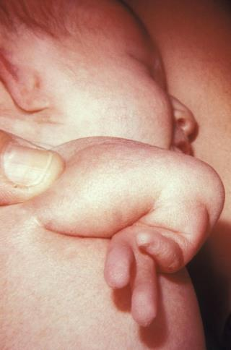
VACTERL Syndrome
Vertebral defects (60-80%) - fused vertebrae, missing vertebrae, or vertebrae not formed correctly¹
Anal atresia (60-90%) - narrowing or atresia of anus. May have genitourinary anomalies.
Cardiac defects (40-80%) - can be a small defect or a life-threatening one
Tracheo-esophageal fistula (50-80%)
Renal anomalies (50-80%) - missing kidney or kidney not developed correctly
Limb abnormalities (40-50%) -undeveloped forearms, hands, or thumbs¹
Image obtained from WikiCommons:
https://commons.wikimedia.org/wiki/Category:VACTERL_association#/media/
Notes:
The percentage next to each VACTERL component is the percent change the patient will have that problem if they have the VACTERL syndrome

Slide 8
Pathophysiology
Embryogenesis - incompletely understood but proposed to be foregut malformation⁷
Trachea & esophagus develop from foregut in first 4-5 weeks of gestation
During this time, the trachea does not separate from the foregut correctly

Slide 9
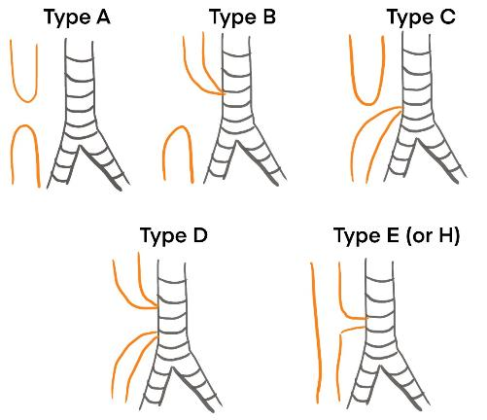
Types and Prevalence of TEF
Orange – Esophagus Gray –Trachea
No TEF – isolated esophageal atresia (EA)
Second most common - 7%⁷
Esophageal atresia with proximal fistula
Distal TEF
Esophageal blind pouch
Most common: 80-90% of the time⁵
Image drawn by Shazia Mohammad, MD.

Slide 10
Types and Prevalence of TEF
Orange – Esophagus Gray –Trachea
Proximal and distal TEF
Esophagus is continuous (not interrupted)
Often diagnosed later in life due to recurrent pneumonia
Image drawn by Shazia Mohammad, MD.

Slide 11
Pre-natal Diagnosis
Non-specific findings
Polyhydramnios (fetus cannot swallow)
Absent or small fetal stomach bubble on ultrasound
Prenatal detection rate: 40-50%⁷

Slide 12
Post-natal diagnosis
Inability to pass orogastric tube (OGT)
Infant crying leads to stomach distention
Choking, coughing, regurgitation, respiratory distress, or cyanosis with feeding
Excessive salivation and drooling despite suctioning

Slide 13
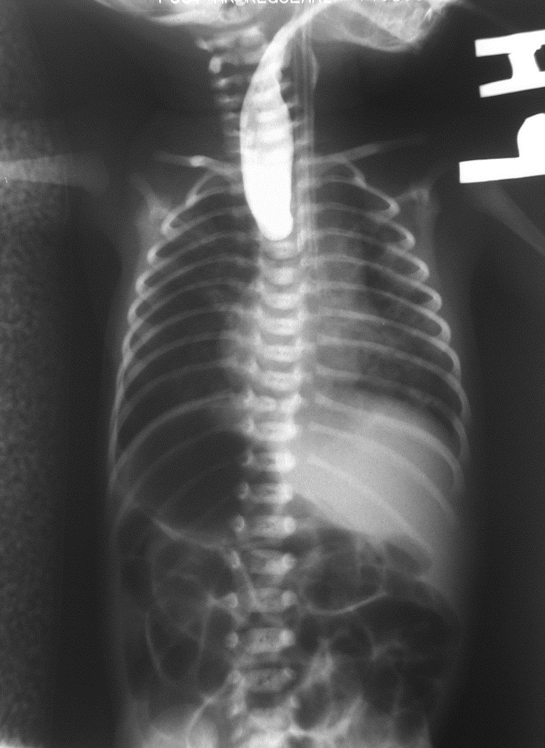
Chest X-ray Findings
CXR shows contrast stopping in the esophagus (as seen in the picture)
OGT curled in esophageal pouch
Gas bubble in the stomach (air passes through the fistula to stomach)
Image obtained from WikiCommons:
https://commons.wikimedia.org/wiki/Category:X-rays_of_oesophageal_atresia#/media/File:Esophageal_atresia_contrast.png
Notes:
Please note that contrast is not required to make diagnosis. Contrast leads to aspiration. Most of the time, diagnosis is made prenatally or based on catheter curing in the esophageal pouch along with other findings.

Slide 14
Preoperative Care
Keep NPO
Upright position to minimize regurgitation of gastric contents through fistula
Intermittent suctioning of upper pouch
Correct any electrolyte imbalances
Consider antibiotics
If patient requires mechanical ventilation then repair or gastrostomy may become urgent

Slide 15
Preoperative Concerns
High aspiration risk
  Air will travel through fistula to stomach (stomach has less resistance compared to the lungs) causing distention → difficult ventilation and high risk of vomiting/aspiration
  Pulmonary complications from aspiration
  Replogle/OGT – to reduce secretions in the esophageal pouch; placed on continuous low suction
Neonate
  Smaller blood volume
  Challenging airway (floppy epiglottis, larger tongue)
  Higher resistance through the pulmonary tree
Associated anomalies especially cardiac issues
Notes:
https://www.rch.org.au/rchcpg/hospital_clinical_guideline_index/Replogle_tube_management/

Slide 16
Preoperative Assessment
Complete preoperative assessment (H&P)
Ruling out other associated anomalies
  Echocardiogram
  Renal ultrasound/labs
Cross-matched blood
Multi-disciplinary approach – discuss post-op pain control and post-operative location (i.e. ICU)

Slide 17
Surgical Management
Waterston and Okamoto classification systems may be used to determine when and what type of surgery should be done⁵
Depends on prognostic factors such as patient’s comorbidities, weight, and other anomalies
Determines if the case should be done urgently, completely repaired in one surgery, or have a staged-repair
May have open thoracotomy or thoracoscopic repair with insufflation of CO₂
Notes:
There are other classification systems as well. The Waterston and Okamoto classification system was cited in Cote’s pediatric anesthesia book.

Slide 18
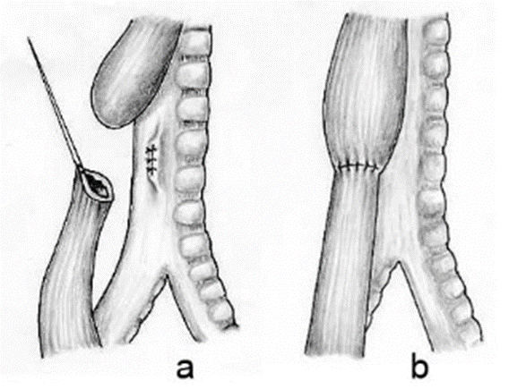
Surgical Management
Primary Complete Repair
  Fistula is ligated
  Esophagus is anastomosed
Staged Repair
  Staged repair for high risk patients who cannot tolerate thoracotomy
  Gastrostomy (to decompress stomach)
  Fistula ligation or occlusion
  May need intermittent surgeries to help lengthen the esophagus
  Esophageal anastomosis at around 3-6 months of age
Image obtained from WikiCommons:
https://commons.wikimedia.org/wiki/Category:Oesophageal_atresia

Slide 19
Anesthetic Management
Operating Room Set-Up
  Lines: Two PIVs, possible arterial line (for CHD patients)
  Monitors: standard ASA monitors (EKG, pulse oximeter, temperature, blood pressure, ETCO₂), urine output
  Temperature: Warm the room, forced air warmer, blood warmer
  Fluids: Crystalloids, 5% albumin, PRBCs/FFP
  Airway: Multiple size ETTs (consider microcuff without Murphy eye), fiberoptic scope (if available)

Slide 20
Anesthetic Management
Induction:
  Preoxygenate with 100% FIO₂
  Keep spontaneous ventilation/avoid using paralytics
  May use inhalational induction or ketamine
  Avoid or minimize positive pressure ventilation to minimize gastric distention
  If a gastrostomy is present, can access it to decompress stomach

Slide 21
Anesthetic Management
Endotracheal tube (ETT) position:
  Ideal position: below the fistula and above carina
  Place ETT in right main stem, then slowly withdraw the ETT until bilateral breath sounds are heard
  If fiberoptic scope is available, use it to confirm position
  Cuff can be inflated to prevent ventilation through the fistula
  Complication – intubating the fistula

Slide 22
Anesthetic Management
One-lung ventilation (OLV):
  Selective bronchial intubation to the non-surgical lung
  Pro: improve surgical exposure after collapse of the lung
  Con: most premature neonate would not tolerate single lung ventilation due to underdeveloped lungs
  In case of decrease oxygenation saturation in OLV:
    Increase FiO₂ to the ventilating lung
    Continuous positive airway pressure (CPAP) to the nonventilated lung
    Return to two-lung ventilation

Slide 23
Anesthetic Management
Patient position:
  Left lateral decubitus (due to left aortic arch)
  Exception: right aortic arch –place in right lateral decubitus

Slide 24
Anesthetic Management
Maintenance:
  If patient not tolerating inhalational anesthetics, small doses of fentanyl may be used
  After the ligation of fistula, positive pressure ventilation and paralytics can be used
  Close communication with surgeon: Compression of vessels may impede cardiac output or ventilation
  Can use an epidural catheter/caudal (threaded from the caudal space to the thoracic level) for pain control if planning to extubate

Slide 25
Intraoperative Events
Respiratory events
  Difficulty with ventilation and oxygenation
    ETT obstruction: blood clots, secretions
    Gastric distention
    Displacement of ETT/kinking of trachea
  One-lung ventilation – absorptive atelectasis
  CO₂ insufflation – hypercarbia
Cardiac events
  Bradycardia from vagal response to tracheal manipulation
  Compression of mediastinal structures including large vessels

Slide 26
Postoperative Management
Depending on the procedure and patient’s condition, the patient may be extubated or kept intubated
Most patients require ventilatory support due to:
  Lung disease (due to premature birth)
  Tracheomalacia (especially at the site of fistula – predisposed to airway collapse)⁷
  Inadequate pain control
  Avoiding emergent re-intubation and damage to the tracheal repair
  Need for suction and expansion of lungs
  Transanastomotic tube may be in place to protect the repair
Keep head in neutral position to prevent stretching of the esophageal anastomosis⁵
Disposition (postop location): NICU (prolonged stay)

Slide 27
Outcomes
TEF mortality rate is related to the severity of the associated congenital cardiac anomalies and birth weight⁷
Lower birth weight (<1500 g) is associated with higher mortality
Co-existing major cardiac anomalies is associated with higher mortality

Slide 28
Outcomes - Complications
Early complications:
  Anastomotic leaks
  Esophageal strictures – may required serial dilation
Long-term complications:
  Tracheal diverticulum (at site of previous fistula)^{6:} Caution – can possibly intubate into the diverticulum
  Esophageal strictures, dysmotility, and dysphagia
  Gastroesophageal reflux disease (GERD)
  Respiratory disease
  Tracheomalacia
  Neuromuscular abnormality (thoracic nerve damage, winged scapula, chest wall asymmetry)⁷

Slide 29
References:
Condition, gene, or chromosome summary: National Library of Medicine (US). Genetics Home Reference [Internet]. Bethesda (MD): The Library; 2019 June 4. Cystic fibrosis; [reviewed 2011 Dec; cited 2019 June 4]; [about 5 screens]. Available from: https://ghr.nlm.nih.gov/condition/vacterl-association#definition
“ABA Keywords.” OpenAnesthesia, IARS, www.openanesthesia.org/te_fistula_ett_positioning/.
Sharma, Sat, and Donald Duerksen. “Tracheoesophageal Fistula.” Edited by Vinay K Kapoor, Background, Pathophysiology, Etiology, Medscape, 2 Feb. 2019, emedicine.medscape.com/article/186735-overview.
Andropoulos, D.B.; Rowe, R.W.; Betts, J.M. Anaesthetic and surgical airway management during tracheo-oesophageal fistula repair. Paediatr Anaesth: 1998, 8(4);313-9
Coté, Charles J., Lerman, Jerrold, and Anderson, Brian J. Coté and Lerman’s a Practice of Anesthesia for Infants and Children. Sixth edition. Philadelphia, PA: Elsevier, 2018. Print.
Lerman, Jerrold., Coté, Charles J., and Steward, David J. Manual of Pediatric Anesthesia : with an Index of Pediatric Syndromes . Philadelphia, PA: Churchill Livingstone/Elsevier, 2010. Print.
Davis, Peter J., and Cladis Franklyn P. Smith’s Anesthesia for infants and Children. Ninth Edition. Philadelphia, PA: Elsevier, 2017. Print.

