Slide 1
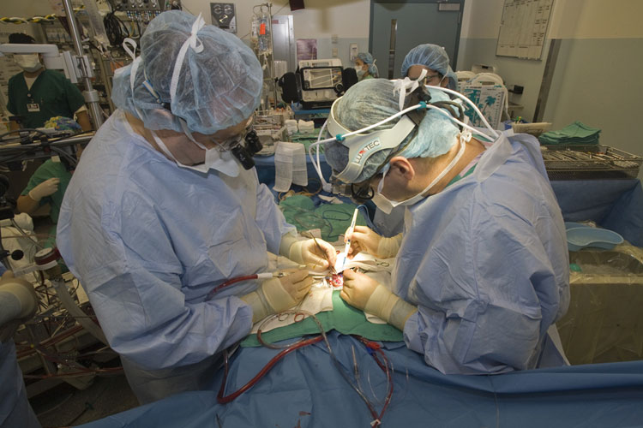
Anesthesia for Neonatal Surgical Emergencies
Leslie M. Garson M.D.
Associate Clinical Professor
University of California, Irvine Health
Updated 5/2018

Slide 2
Newborn Anatomy
The Airway
https://www.dvidshub.net/image/1880421/continuing-promise-2015

Slide 3
The Airway is...
A “Negative Space” defined by surrounding structures…
Skull – superior
Tongue & mandible – inferior
Lips & nares – anterior
Palate – internal
Pharynx – posterior
Larynx – caudad

Slide 4
Still do your....
...Basic Airway Assessment
Neck Flexibility
Mallampati score (as possible)
Thyromental distance
Mouth opening (incisor distance)
Teeth prominence
Mandibular protrusion

Slide 5
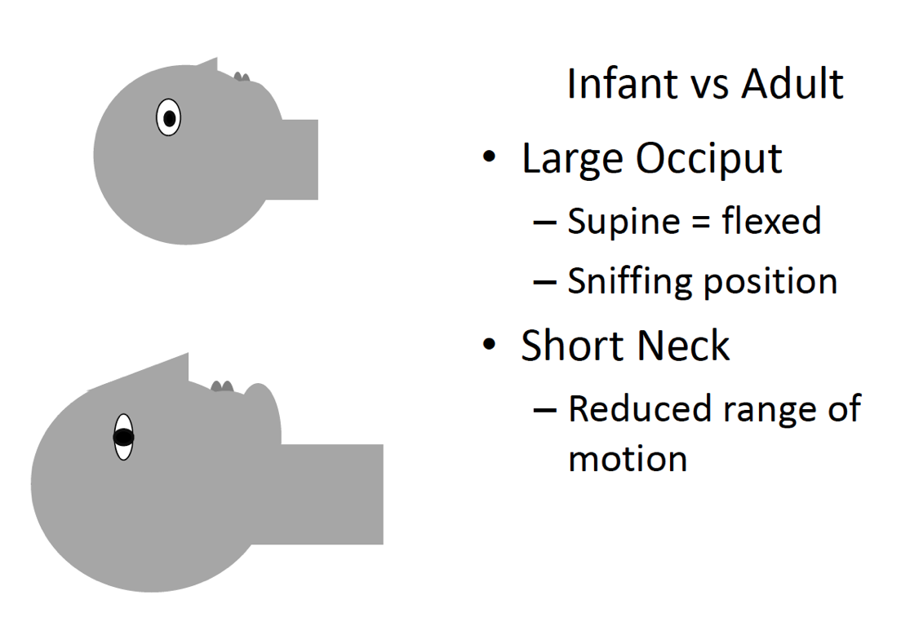

Slide 6
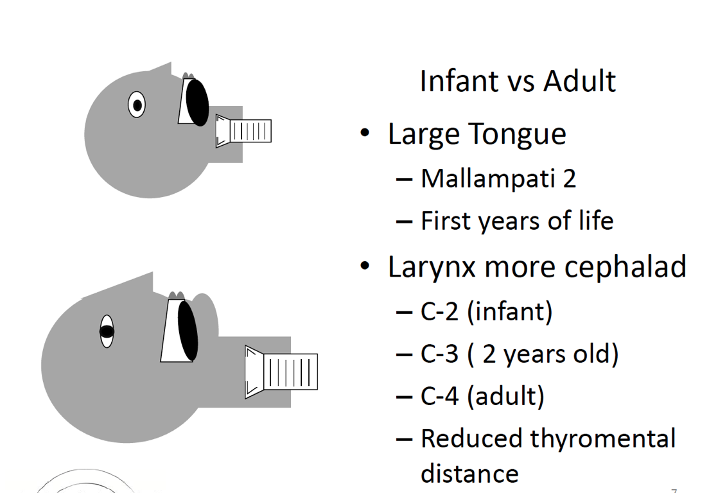

Slide 7
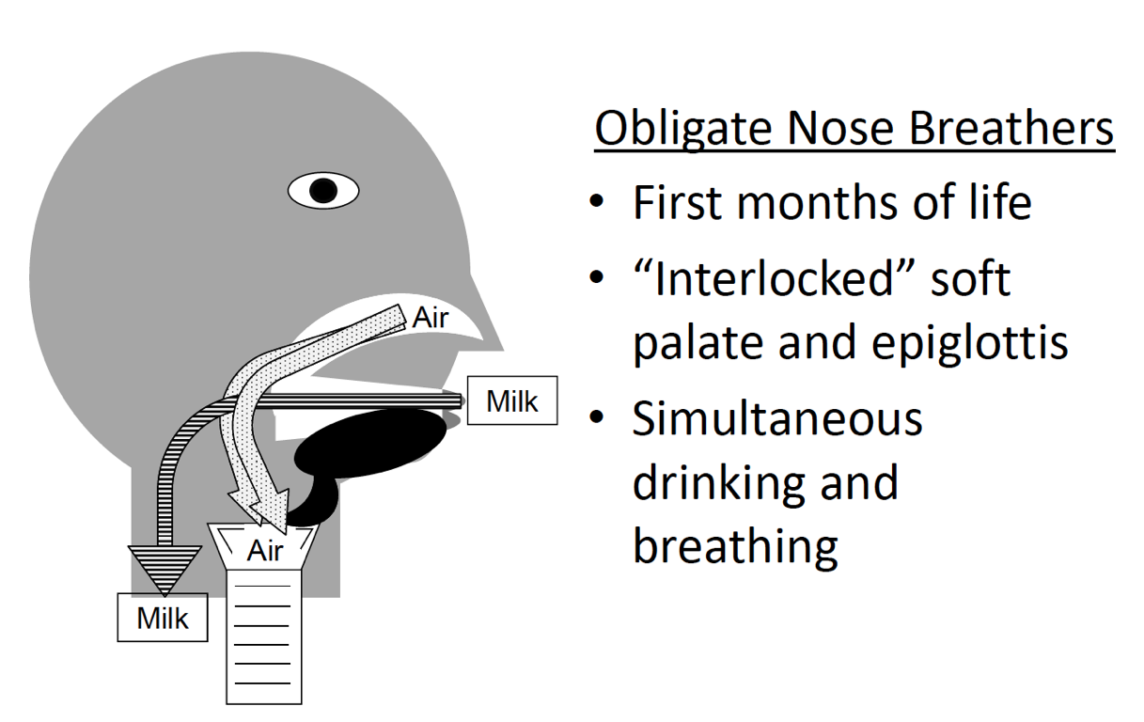

Slide 8
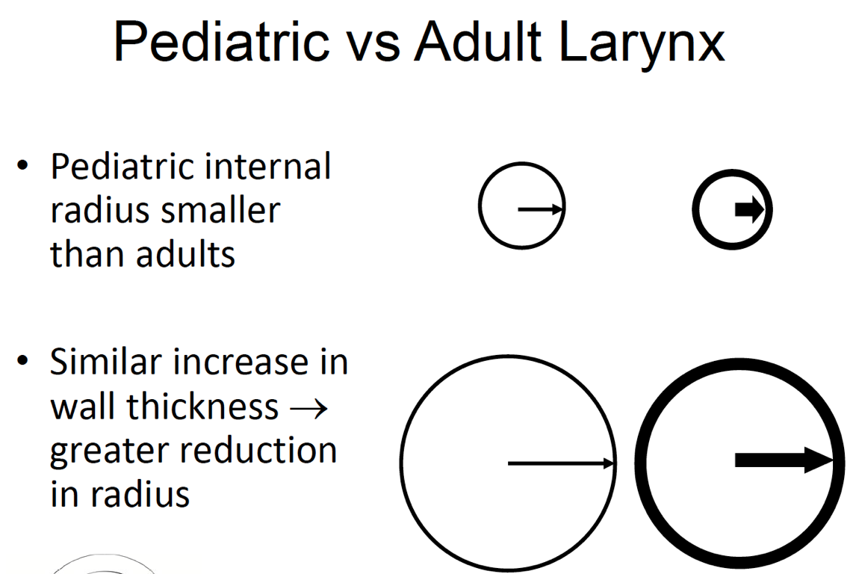

Slide 9
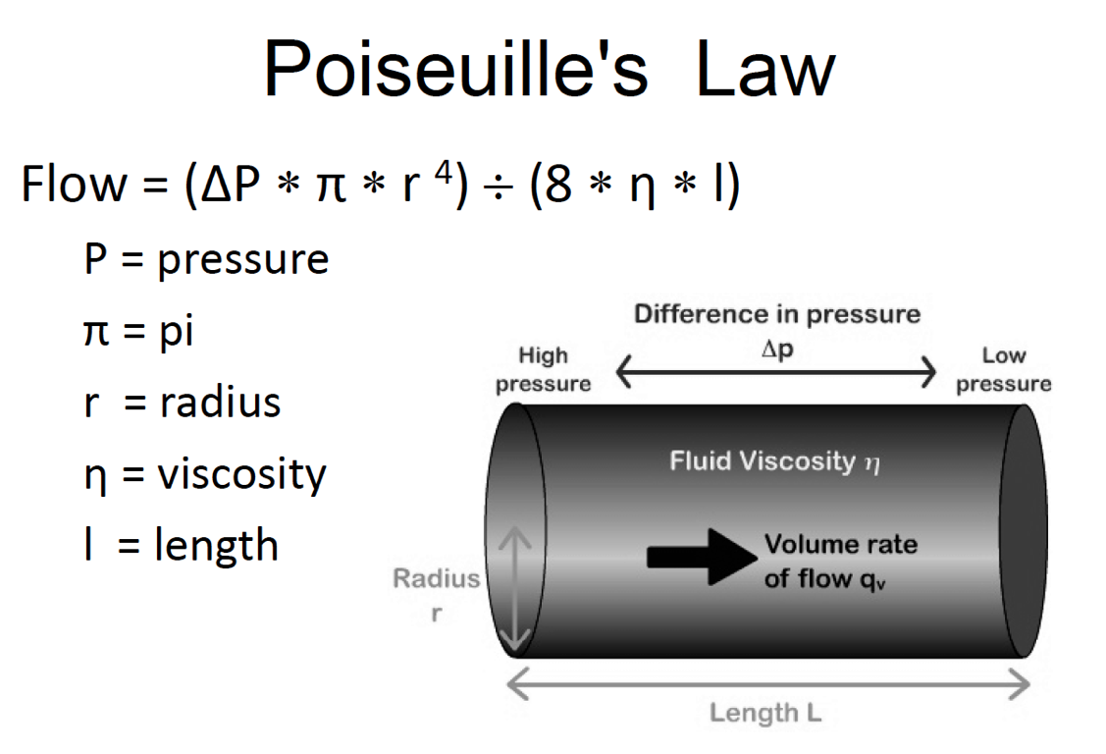
Notes:
Small changes in airway radius have a large impact on air flow in children and infants

Slide 10
Newborn Physiology
Respiratory

Slide 11
Respiratory
Respiratory System – In utero and transition
Umbilical cord clamping – rhythmic breathing
Elevated PaO₂ augments/maintains SV
1st breaths: 40‐80 cmH₂O overcome surface forces and air into fluid filled lungs
Breathing independent of PaCO₂
HYPOxia depresses breathing

Slide 12
Respiratory
Lung Mechanics ‐ Neonate
High lung compliance
  Elastic fibers develop post‐natal
  Static elastic recoil pressure is low
High chest wall compliance
  Cartilaginous ribs
  Limited thoracic muscle mass
Prone to atelectasis and resp. insufficiency

Slide 13
Respiratory Physiology – Key Points
Postnatal adaptation: especially respiratory control until 44 wks PCA
Post GA apnea common in premature and/or anemic infants
Alveoli formation until 18 months
Elastic/collagen fiber development continues until 10 years

Slide 14
Respiratory Physiology – Key Points
Chest wall VERY Compliant difficulty sustaining FRC against lung elastic recoil
Worsen by GA and/or relaxation
Leads to airway closure progressive atalectasis
PEEP helps
Hb O2 affinity changes during first months
HbF – low P₅₀
P₅₀ increases and peaks in later infancy

Slide 15
Newborn Physiology
Cardiac

Slide 16
Cardiac Physiology: Key Points
Parallel fetal circulation changes with high pulmonary vascular resistance goes to transitional and then neonatal circulation with low pulmonary vascular resistance
Myocyte has less contractile elements and is more dependent on extracellular calcium
Myocardium is less compliant and is generating near maximal force

Slide 17
Cardiac Physiology: Key Points
Decreases in preload, increases in systemic vascular resistance and decreases in HR are poorly tolerated
Goal of treating low cardiac output is to increase oxygen delivery to tissues
MAC of volatile agents varies with age, but all decrease BP

Slide 18
The ‘Big 5’
Omphalocoele
Gastroschisis
Myleomeningocoele
Diaphragmatic Hernia
TracheoEsophageal Fistula (TEF)

Slide 19
Omphalocele
Figure: Centers for Disease Control and Prevention, National Center on Birth Defects and Developmental Disabilities

Slide 20
Omphalocele
Herniation of viscera into base of umbilical cord
Typically covered and midline
50‐75% of infants with omphalocele have other congenital anomalies
45% have cardiac anomalies
20‐30% have chromosomal anomalies

Slide 21
Omphalocele
Incidence 1:5000
Male:Female 2:1
Represents a failure of the gut to return from the yolk sac into the abdomen during the first trimester (occurs earlier than gastroschisis)
Bowel is covered, and is morphologically normal

Slide 22
Omphalocele
Central defect
Generally larger than 4cm in diameter
Always covered by sac, into which umbilicus inserts
Usually contains liver and midgut, sometimes spleen and gonads
GI tract: malrotation, atresia, stenosis, Meckel’s
Cardiac: 20‐40% VSD, TOF, ASD, ectopia cordis
GU: bladder extrophy, hypoplastic kidney
Craniofacial: cleft lip and palate

Slide 23
Omphalocele: Associated Syndromes
Beckwith‐Weidemann
Macroglossia
Hypoglycemia
Organomegaly
Pentalogy of Cantrell
Upper midline Omphalocele
Anterior CDH
Sternal cleft
Ectopia cordis
Intracardiac defects

Slide 24
Gastroschisis
Figure: Centers for Disease Control and Prevention, National Center on Birth Defects and Developmental Disabilities

Slide 25
Typically, NOT associated with other congenital anomalies
GI: jejuno‐ileal atresia (10‐ 15%) and stenosis, autoamputation, strangulation and bowel malrotation
Incidence 1:2500 (more common than omphalocele)
Male:Female 1:1
Develops later in fetal life, after abdominal contents have returned to abdominal cavity
Typically, right of umbilicus (normal umbilical insertion)
Due to occlusion of right omphalomesenteric artery

Slide 26
Generally small (<4cm) abdominal wall defect
Uncovered, bowel is inflamed, edematous, foreshortened
Midgut herniated through defect
Teratogens: maternal aspirin, pseudoephedrine, acetaminophen, smoking

Slide 27
Gastroschisis/Omphalocele
Pre‐operative Considerations
Herniated viscus wrapped in sterile dressing
Maintain normothermia
NG in place
Antibiotics
Assess fluid status, as these patients are prone to significant fluid and protein loss (gastro>>omphalo)
Fluid requirements can be significant ( > 100 to 200 ml/kg)
Rule out other congenital anomalies

Slide 28
Gastroschisis/Omphalocele: Intra‐operative Considerations
Induction: awake or rapid sequence
Monitors: routine, with possible a‐line, CVP, foley
Consider intra‐gastric or bladder pressures
No nitrous oxide
Watch CVP, airway, and other pressures as closure proceeds; be prepared to re‐open!
Plan on post‐operative ventilation

Slide 29
Omphalocele/Gastroschisis
Surgical Treatment
Primary vs. Staged Closure
Primary advantages
Preferred for smaller defects
Decreased infection risk
Earlier return of GI function
Single anesthetic
Primary Disadvantages
IVC compression
Respiratory compromise
Bowel ischemia
Decreased renal blood flow
Wound dehiscence

Slide 30
Gastroschisis/Omphalocele: Post‐op Considerations and Surgical Outcome
Post‐op ventilation due to pulmonary compromise and need for muscle relaxation
TPN dependent
Early complications: NEC, renal insufficiency, PDA, cellulitis/breakdown of abdominal incision
Omphalocele: mortality 10‐30%, usually due to associated congenital anomalies
Gastroschisis: virtually all patients survive

Slide 31
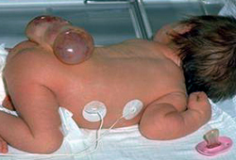
Myelomeningocele

Slide 32
Discussion
A treatable spinal cord malformation that occurs in varying degrees of severity
A meningocele, which is a cystic swelling of the dura and arachnoid, protrudes through the spina bifida defect in the vertebral arch
Spina bifida cystica causes a problem when cord tissue extends into the meningocele, in which case the cyst is called a myelomeningocele
Myelomeningocele results from failed closure of the caudal end of the neural tube, usually occurring between the 17th and 30th day of gestation resulting in an open lesion or sac that contains dysplastic spinal cord, nerve roots, meninges, vertebral bodies, and skin
Patients with myelomeningocele present with a spectrum of impairments, but the primary functional deficits are lower limb paralysis and sensory loss, bladder and bowel dysfunction, and cognitive dysfunction

Slide 33
The anatomic level of the myelomeningocele sac roughly correlates with the patient's neurologic, motor, and sensory deficits.
CNS anomalies: cerebellar hypoplasia and varying degrees of caudal displacement of the lower brainstem into the upper cervical canal through the foramen magnum. This deformity impedes the flow and absorption of cerebrospinal fluid (CSF) and causes hydrocephalus, which occurs in more than 90% of infants with myelomeningocele.
Myelomeningocele often occurs along with multiple system congenital anomalies. Commonly associated anomalies are facial clefts, heart malformations, and genitourinary tract anomalies.

Slide 34
Surgery…
In the United States, antibiotics, sac closure, and ventriculoperitoneal shunt placement implemented in the perinatal period in 93-95% of patients
Closure of the myelomeningocele is performed immediately after birth if external cerebrospinal fluid (CSF) leakage is present. In the absence of CSF leakage, closure typically occurs within the first 24-48 hours. 80-90% of children with myelomeningocele ultimately require shunting.
Surgery involves freeing lateral muscles and skin for coverage and attempting to form a closure of the neural elements with minimal scarring, because the late complication of a tethered cord has frequent and severe consequences

Slide 35
Anesthesia for Myelomeningocele
Primary closure within 1st 24-48 hours of life.
Positioning for induction may be difficult
If supine, avoid pressure on the lesion
Lateral intubation if lesion is very large.
Blood loss for adequate skin closure.
High risk for latex allergy.
Possibility of post-op respiratory compromise due to tight skin closure

Slide 36
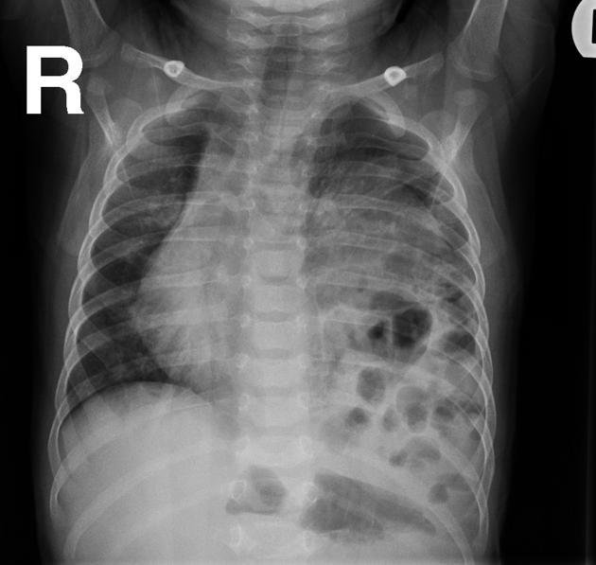
Congenital Diaphragmatic Hernia

Slide 37
CDH
Extrusion of abdominal viscera into thoracic cavity via defect in the diaphragm
Occurs at 7‐10 weeks gestation as diaphragm completes its formation
Incidence 1:2000 ‐ 1:5000 live births
Significant cardiovascular, pulmonary, and GI sequelae

Slide 38
CDH ‐ Anatomy
Herniation occurs through the postero‐lateral foramen of Bochdalek in 90% of cases, 75% of which occur on the left
Remaining 10% include foramen of Morgagni defects, para-esophageal hernias and eventrations
Bilateral hernias < 1% are associated with high mortality

Slide 39
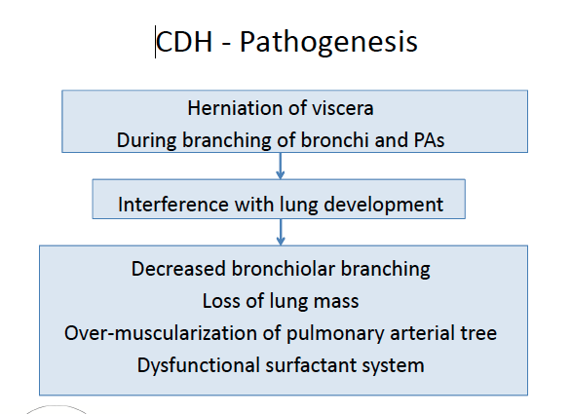

Slide 40
CDH – Associated Conditions
50‐60% are isolated: CDH + its consequences ‐ pulmonary hypoplasia, malrotation and cardiac dextroposition
Congenital heart disease in 11% of cases ‐ VSD, ASD, aortic arch obstruction, single ventricle, TOF, other
Neural tube defects ‐ anencephaly, encephalocele, hydrocephalus myelomeningocele
Other midline defects ‐ esophageal atresia, omphalocele, cleft palate, hypospadias
Chromosomal anomalies ‐ trisomies 18, 13, and 21, others
Syndromes ‐ Apert, Beckwith Wiedemann, CHARGE, Goldenhar, Cornelia‐ De Lange, Pentalogy of Cantrell, other rare syndromes

Slide 41
CDH ‐ Prenatal Diagnosis
Ultrasound by experienced sonographer
  Left CDH: heterogeneous mass in L chest, R mediastinal shift, fluid filled stomach, bowel peristalsis or fluid filled bowel in chest, liver
  Right CDH: liver, gall bladder, bowel in R chest, L mediastinal shift
Fetal echocardiography to identify congenital cardiac anomalies
Prenatal diagnosis of CDH should prompt delivery at tertiary care center equipped to provide specialized services for the neonate
http://www.radpod.org/

Slide 42
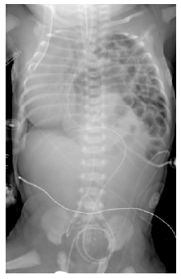
CDH ‐ Clinical Presentation
Respiratory distress, cyanosis
Barrel shaped chest, scaphoid abdomen
AuscultationAbsent breath sounds
Heart sounds displaced to the right
Bowel sounds heard in the chest
X‐Ray
Bowel loops in left chest
Heart displaced to right
N/g tube in stomach within chest cavity
Displaced course of UVC

Slide 43
CDH: Pre‐surgical Management
Goals of initial management:
  Avoid surgery in an infant with cardiorespiratory instability
  Medical management used to improve preductal SpO₂ to >90%
Correct metabolic acidosis, reduce R‐L shunting and increase pulmonary perfusion using gentle ventilation to prevent lung injury
Delivery room – avoid bag‐mask ventilation to minimize overdistension of non-compliant lung and distension of stomach and intestines in the chest
  Early intubation of trachea and decompression of stomach
  Low PIP and PEEP, Vt 5‐10 ml/kg, permissive hypercapnea (PaCO₂ 60‐65 mm Hg), HFOV as primary vs. rescue therapy per institutional preference

Slide 44
CDH: Surgical Management
Surgical repair ‐ approach via abdominal incision, thoracotomy or thoracoscopy
Infants with severe pulmonary dysfunction may not tolerate 1‐lung ventilation making it difficult to use MIS.
Infants with large defects may not tolerate primary closure of the abdomen once the hernia is reduced – may require a patch closure, silastic pouch or chimney prosthesis
In such cases, lower extremity venous access is best avoided due to IVC compression after reduction of hernia

Slide 45
CDH: Anesthetic Management
Ventilation strategy: Use of low PIP, adequate PEEP, small tidal volumes to maintain oxygenation, avoid atelectasis and volu-trauma, avoid acidosis
Meticulous attention to temp maintenance
Hypothermia increases PVR, R‐L shunting and O₂ consumption causing tissue hypoxia and acidosis
Acidosis leads to pulmonary vasoconstriction and decrease in SpO₂
N₂O should be avoided to maintain higher FiO₂ and avoid distension of bowel loops in chest
Anesthetic agents selected on the basis of cardiopulmonary status

Slide 46
CDH: Outcomes
Long term pulmonary complications:
  Chronic lung disease from ventilator associated injury
  25% of survivors have obstructive lung disease
  Need for bronchodilators, inhaled steroids, tracheostomy
GI complications:
Oral aversion,
GERD in 45‐90%
Neurocognitive disorders including motor and language deficits especially in those who required ECMO
Chest wall deformities and scoliosis

Slide 47
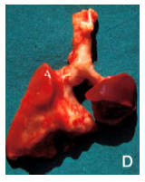
CDH ‐ Survival
Survival improved from 40‐60% in 1980s to 70‐80% in 1990s
Improved survival largely credited to strategy of delaying surgery for neonatal stabilization, use of techniques such as ventilation with low tidal volumes and permissive hypercapnea to avoid barotrauma, ECMO.
Survival and long-term sequelae in survivors are inversely proportional to severity of pulmonary hypoplasia and pulmonary HTN.
Mortality figures distorted by number of
stillbirths and pregnancy terminations

Slide 48
Tracheo-Esophageal Fistula

Slide 49
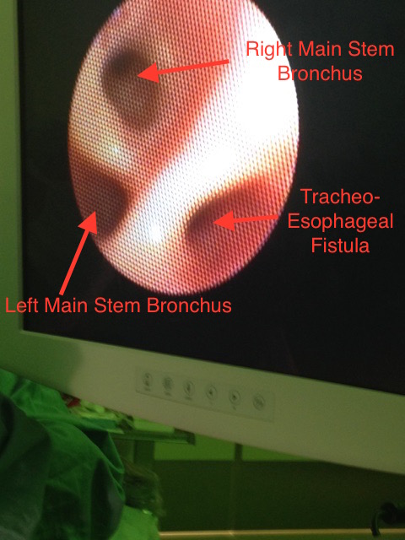
Bird’s Eye View…

Slide 50
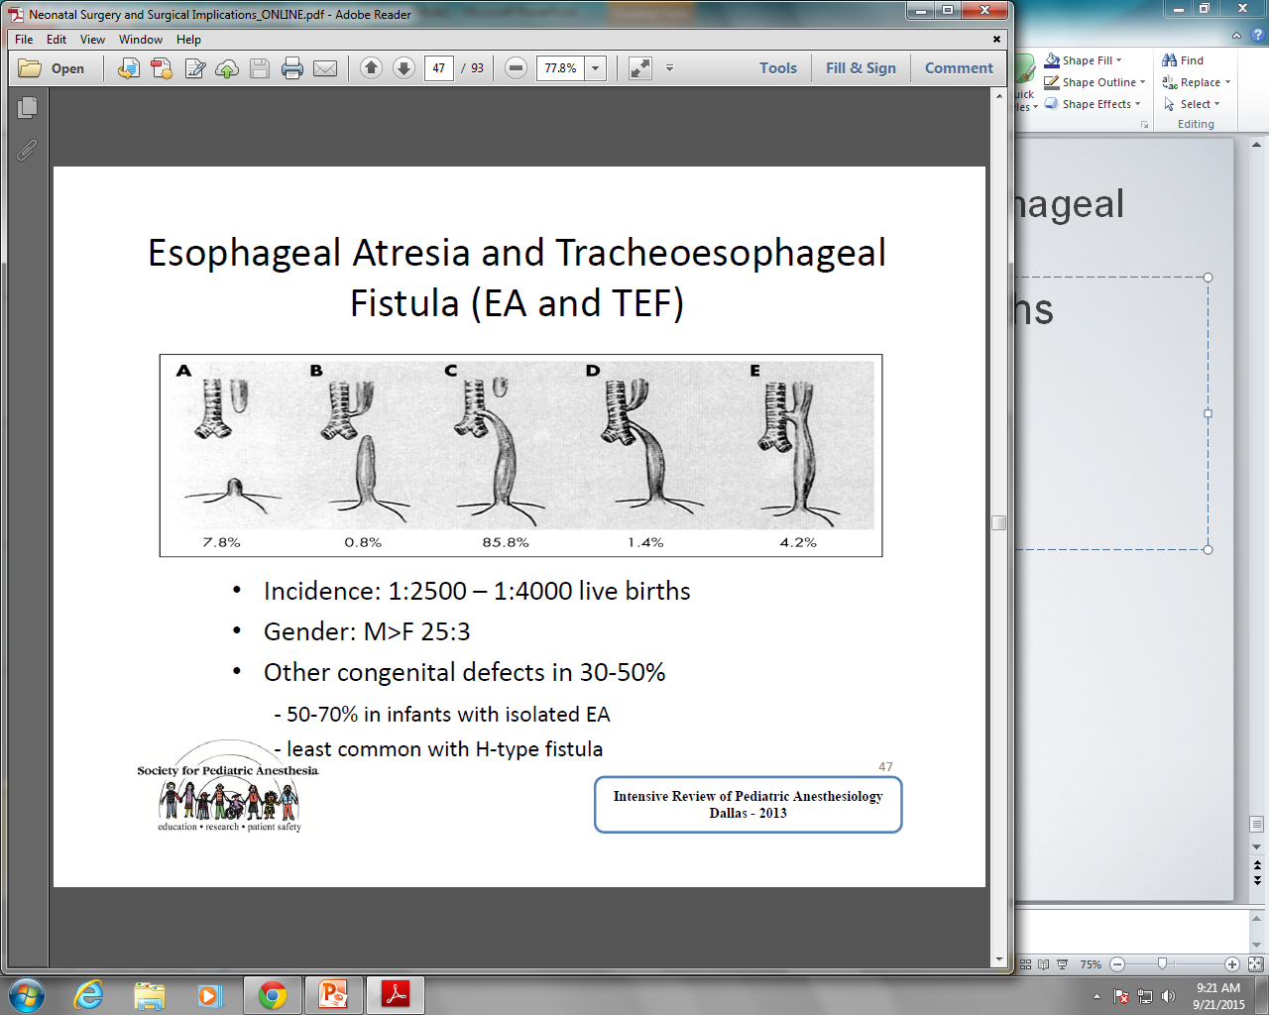
Esophageal Atresia and Tracheo-esophageal Fistula (EA and TEF)
Incidence: 1:2500 – 1:4000 live births
Gender: M > F ratio of 25:3
Other congenital defects in 30‐50%
50‐70% in infants with isolated EA
Least common with H‐type fistula

Slide 51
EA and TEF: VACTERL Association
20‐25% of infants with EA have at least 3 of the VACTERL lesions
Vertebral (15%)- Hemivertebrae, scoliosis, rib deformities
Anal (24%) -Imperforate anus, cloacal deformities, duodenal or ileal atresia, malrotation
Cardiac (25‐30%) -VSD, TOF, PDA, ASD, AV canal, R sided aortic arch
Tracheoesophageal EA, TEF
Renal (24%) =Renal agenesis or dysplasia, Potter syndrome, horseshoe kidney, polycystic kidneys, urethral atresia, ureteral malformations
Limb- Radial dysplasia, absent radius, polydactyly, syndactyly, tibial deformities

Slide 52
EA and TEF
Mortality depends on severity of heart disease and birth weight
Survival Rates | 1994 | 2006
> 1500 grams, no cardiac anomaly | 97% | 98%
< 1500 grams or major cardiac anomaly | 59% | 82%
Birthweight < 1500 grams + major cardiac anomaly | 22% | 50%

Slide 53
EA and TEF: Prenatal Diagnosis
Ultrasound Findings:
Polyhydramnios
Esophageal obstruction prevents swallowing of amniotic fluid
Seen at ≥ 24-week gestation
Increased intrauterine volume may precipitate preterm labor
Absent stomach bubble may be seen at 18 week
Upper pouch sign: dilated blind ending upper pouch of esophagus
Low sensitivity & specificity, prenatal detection rate of 40‐50%
Prenatal detection should prompt karyotyping and search for other structural anomalies

Slide 54
EA and TEF: Presentation
In delivery room – inability to pass orogastric tube
Cough, choking and cyanosis during the first feed
Respiratory distress exacerbated by feeding
Excessive salivation and drooling, regurgitation of feeds
Distended abdomen when TEF present
Scaphoid abdomen ‐ absence of stomach/bowel gas in isolated EA
H‐fistula often presents later with episodes of recurrent pneumonia, aspiration

Slide 55
EA and TEF: Pre‐operative workup
H&P:
Extent of respiratory compromise ‐ this is a significant prognostic indicator
Consider ability to tolerate one‐lung ventilation
Hemodynamic stability
Limb defects, anorectal anomalies
Echocardiogram to assess cardiac anomalies, aortic arch
Renal ultrasound to identify renal and other GU anomalies
CBC, electrolytes, type and cross match

Slide 56
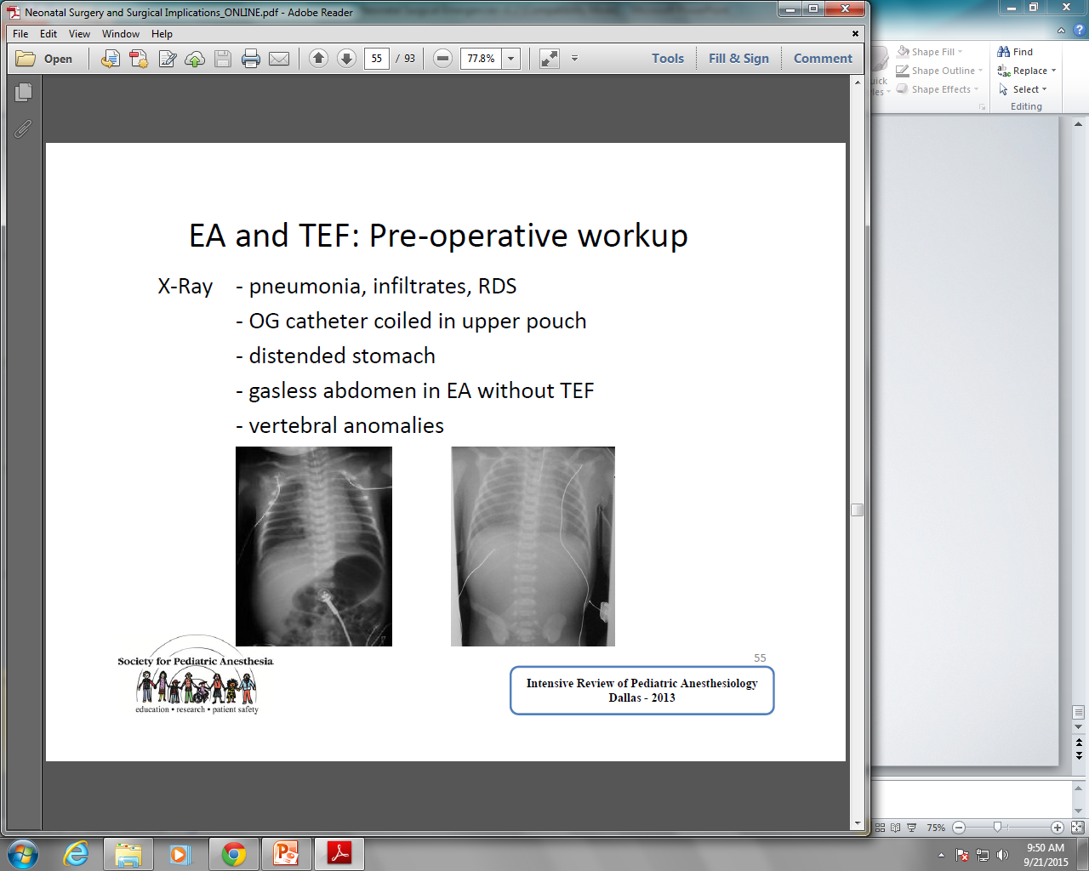
X‐Ray ‐ pneumonia, infiltrates
‐ OG catheter coiled in upper pouch
‐ distended stomach
‐ gasless abdomen in EA without TEF
‐ vertebral anomalies

Slide 57
EA and TEF: Risk Factors for Worse Outcomes
Co‐existing complex CHD
Low birth weight
Poor pulmonary compliance
Large fistula
Fistula very close to carina
Planned thoracoscopic repair

Slide 58
EA and TEF: Pre‐operative Management
Surgical repair of TEF is urgent
Emergent only if infant requires IPPV such that dilation of stomach is compromising respiration
Protect the lungs from aspiration pneumonia
Avoid feeding
Upright positioning of infant to minimize regurgitation of gastric contents through fistula
Replogle tube for suctioning the upper pouch
Antibiotics to treat pneumonia

Slide 59
EA and TEF: Surgical Management
Optimal surgical management comprises a 1‐stage repair:
Fistula is ligated
Esophagus is primarily anastomosed
Right thoracotomy, posterolateral extrapleural approach
Left thoracotomy in case of a right aortic arch
Open thoracotomy
Rigid or fiberoptic bronchoscopy prior to surgical procedure
Locate fistula, determine if more than one fistula is present
Assess for tracheomalacia
Evaluate correct position of ETT

Slide 60
EA and TEF: Staged Repair
High risk infants unable to tolerate thoracotomy
Gastrostomy ‐ decompress stomach, prevent regurgitation via fistula into lungs
  Local or general anesthesia
  In large fistula, avoids excessive gastric distention and rupture
  May permit tidal volume to escape in infants with poor lung compliance
  Occlusion of fistula using balloon‐tipped catheter placed via FOB guidance or retrograde via gastrostomy
  Emergent ligation of fistula if unable to ventilate
Definitive procedure when infant has stabilized

Slide 61
Has 100% incidence of dysmotility and severe Nutrition via gastrostomy until definitive surgery
Esophageal anastomosis between 3 and 6 months of age if spontaneous growth of esophagus is adequate
Techniques for lengthening native esophagus include placement of external or internal traction sutures and thoracoscopic elongation of esophagus
Interposing non esophageal tissue reflux

Slide 62
EA and TEF: Anesthetic Management
Meticulous operating room set up:
Warm room, overhead warmer, forced air warmer
Standard monitoring: EKG, pulse oximetry, end-tidal CO₂, arterial line, urine output
Precordial stethoscope
ETT without Murphy’s eye, microcuff ETT
Fiberoptic bronchoscope
5% albumin, PRBCs, Blood warmer

Slide 63
EA and TEF – Anesthetic Management
Goal for induction is to establish airway without aspiration or gastric distension
  Pre‐oxygenation, continuous suction of upper pouch
  Maintain spontaneous ventilation
  Avoid PPV to avoid insufflation of stomach via fistula
Inhalation induction with cautious gentle PPV as needed
Ideally, maintain spontaneous ventilation until fistula ligated with assisted ventilation if needed using low airway pressures

Slide 64
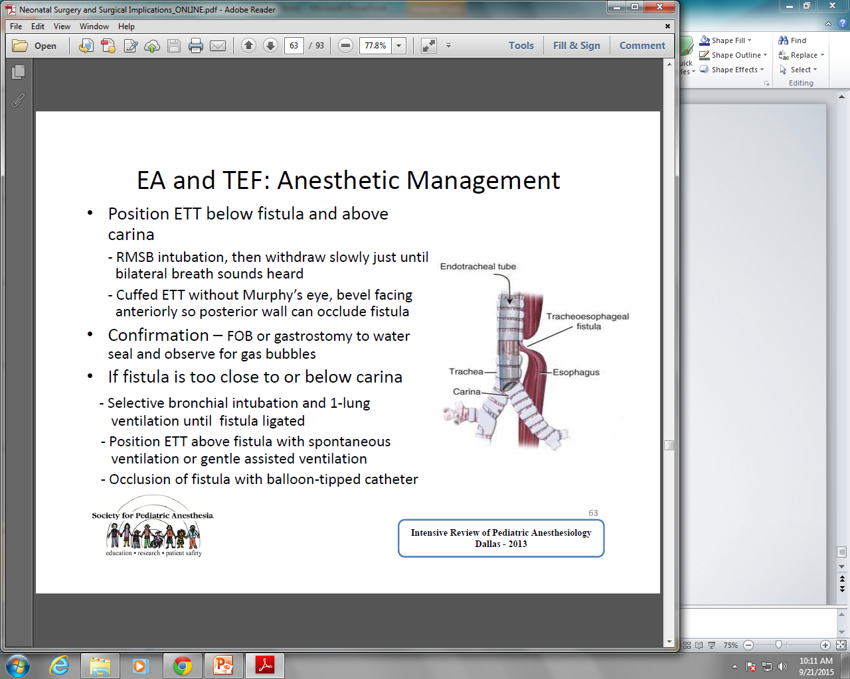
EA and TEF: Anesthetic Management
Position ETT below fistula and above carina
  Right mainstem intubation, then withdraw slowly just until bilateral breath sounds heard
  Cuffed ETT without Murphy’s eye, bevel facing
  anteriorly so posterior wall can occlude fistula
If fistula is too close to or below carina:
  Selective bronchial intubation and 1‐lung
  ventilation until fistula ligated
  sition ETT above fistula with spontaneous
  ventilation or gentle assisted ventilation
  Occlusion of fistula with balloon‐tipped catheter

Slide 65
EA and TEF – Intraoperative Events
Difficulty with ventilation, hypoxemia, hypercarbia
  Displacement of ETT into bronchus or fistula, or above the fistula
  Displacement of balloon tipped catheter causing tracheal obstruction
  Surgical manipulation causing kinking of trachea
  Insufflation of CO2 during thoracoscopic procedure
  ETT obstruction: blood clot, secretions
  One‐lung ventilation ‐ may need to re‐expand lung intermittently
  Gastric distention
Hemodynamic instability, bradycardia
Compression of mediastinal structures
Vagal response: tracheal manipulation and bradycardia

Slide 66
EA and TEF: Postoperative Management
Early extubation desirable to avoid pressure of ETT on suture line
Rarely accomplished due to:
  Degree of pulmonary dysfunction, associated anomalies, prematurity
  Tension at esophageal anastomotic site following long‐gap EA repair makes deep sedation, neuromuscular blockade and controlled ventilation preferable
  Defective tracheal wall at the site of fistula or tracheomalacia may cause airway collapse
Avoid extension of neck to minimize tension on anastomosis
Postoperative pain management
  IV opioid infusions
  Epidural analgesia via catheter inserted in caudal space and threaded cephalad

Slide 67
EA and TEF: Outcomes
Early complications
  Anastomotic leaks in 15% of cases, managed expectantly or by surgical exploration depending on extent of leak
  Esophageal strictures in 30‐40%, may require serial dilations
Long‐term complications
GERD in 40‐70%, more common in long‐gap EA, prolonged gastrostomy feeds, non‐esophageal tissue interposition
GERD associated with recurrent aspiration and pulmonary disease
Esophageal dysmotility, feeding aversion, dysphagia, growth failure
Tracheomalacia ‐ common but clinically significant in only 10% of cases
Abnormal cilia and goblet cells in tracheal epithelium – frequent URIs
Open thoracotomy – higher incidence of musculoskeletal defects such as winged scapula

Slide 68
References
Pediatric Anesthesia, 2nd and 3rd Edition, Vol 1 &2 Edited by George Gregory M.D.
Anesthesia for Neonatal Surgical Emergencies Wheeler, Melissa M.D., ASA Refresher Courses in Anesthesiology: 2002 - Volume 30 - Issue 1 - pp 201-214

