Slide 1
Anesthetic Considerations for Craniosynostosis Repair
Sung-Wook Choi, MD, MALD
Medical University of South Carolina
Department of Anesthesia and Perioperative Medicine
Updated 1/2020

Slide 2
Disclosures
No disclosures to report

Slide 3
Learning Objectives:
Define craniosynostosis and describe the underlying pathogenesis and pathophysiology
Discuss the types of pediatric patients likely to undergo craniofacial surgery
Review indications for surgical repair, treatment options available, and optimal timing of surgery
Describe the pre-, intra- and postoperative anesthetic considerations for infants and toddlers requiring craniofacial surgery

Slide 4
Craniosynostosis: Definition
Premature fusion of one or more cranial sutures, resulting in abnormal skull development and head shape
Growth of skull perpendicular to the affected suture is restricted
Compensation in growth occurs parallel to the affected suture so brain growth can continue
Notes:
The primary reason why surgery is performed to correct craniosynostosis is that if it is left uncorrected, the deformed cranium can result in increased intracranial pressure and compression of the growing brain, with potential sequelae such as developmental delay and visual impairment. Psychosocial implications for children with untreated craniosynostosis is also significant, given that children with these deformities may face social exclusion and ostracization.

Slide 5
Cranial Bones and Sutures
Notes:
Open access image accessed at: https://openi.nlm.nih.gov/detailedresult?img=PMC4425620_nihms678690f1&query=cranial%20sutures&it=xg&req=4&npos=2

Slide 6
Classification
Overall incidence: ~1 : 2,000 live births¹
Simple (non-syndromic: sagittal, coronal, metopic, lambdoid) – single suture
Compound/complex: Non-syndromic with multiple sutures or syndromic
Notes:
Craniosynostosis usually presents as an isolated abnormality (non-syndromic), but it can also manifest as part of an identified genetic syndrome in 15-40% of cases. The clinical implication or significance of this is that syndromic craniosynostosis is more commonly associated with increased intracranial pressure as well as multiple cranial sutures. This is associated with longer surgical times as well as an increased risk of morbidity secondary to major blood loss. (Over 150 syndromes associated with craniosynostosis have been described, though the majority of cases are linked with a small number of specific syndromes)
1) Stricker PA, Fiadjoe JE. Anesthesia for Craniofacial Surgery in Infancy. Anesthesiol Clin 2014;32(1): 215-235

Slide 7
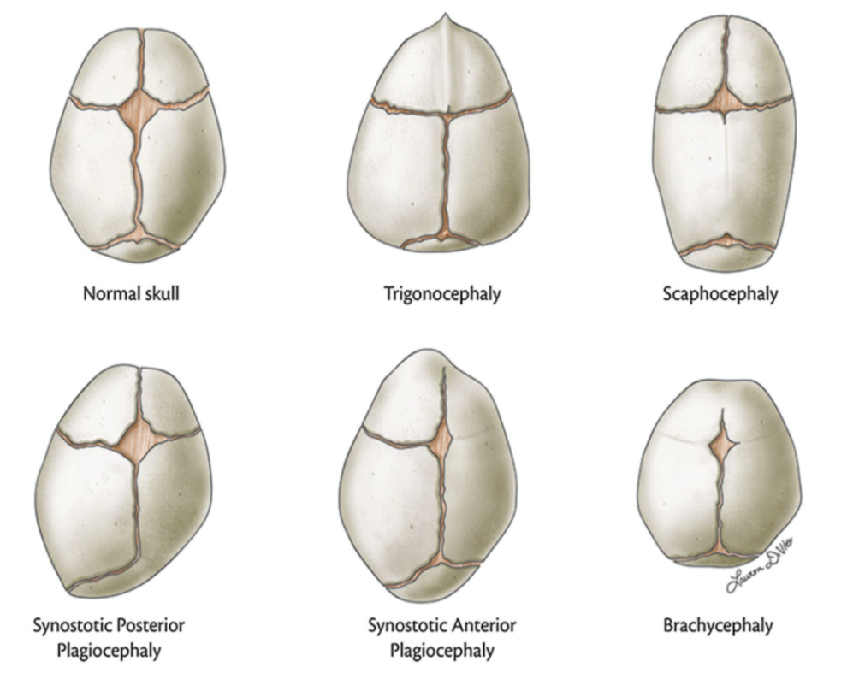
Anatomic Variations
Trigonocephaly: fusion of the metopic suture that runs from the top of the head toward the nose (5-15% of cases)
Scaphocephaly: The sagittal suture that runs from to back on top of the skull (40-55% of cases)
Plagiocephaly: a fusion of either the right or left coronal suture (20-25% of cases)
Brachycephaly: fusion of both coronal sutures
Notes:
Image used with written permission by the author (reference: Pearson A, Matava CT. Anaesthetic management for craniosynostosis repair in children. BJA Educ 2016;16(12): 410-416)

Slide 8
Pathogenesis
Intrauterine constraint of fetal head²
Metabolic and hematological disorders (rickets, hypothyroidism, polycythemia vera, thalassemia)
Teratogens (nicotine, retinoic acid, valproic acid, SSRIs)
Genetic defects (discussed later under syndromic craniosynostosis)
Notes:
Non-syndromic craniosynostoses are postulated to occur secondary to constraint of the fetal head during pregnancy. It is also suspected that this does not occur in isolation, but through a complex, incompletely understood interaction of environmental factors that medical comorbidities and antenatal fetal exposure to various agents.
In contrast, patients with syndromic craniosynostosis often acquire their deformities via an autosomal dominant pattern of inheritance, though sporadic new mutations from unaffected parents have been described. The most common genetic mutation involves altered forms of fibroblast growth factors (FGFs), which are critical to bone and cartilage development; this accounts for the abnormal cranial development in Apert, Crouzon, Muenke and Pfeiffer syndrome, for example. Saethre-Chotzen syndrome, another well-described form of syndromic craniosynostosis, occurs secondary to mutations in the TWIST 1 gene.
2) Thomas K, Hughes C, Johnson D et al. Anesthesia for surgery related to craniosynostosis. Part 1. Pediatr Anesth 2012(11): 1033-41
3) Durham EL, Howie RN, Cray JJ. Gene/environment interactions in craniosynostosis: a brief review. Orthod Craniofac Res. 2017 (20): 8–11

Slide 9
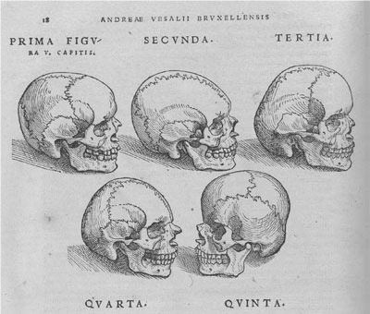
Pathophysiology, Clinical Features and Complications
Elevated intracranial pressure (ICP)
Disturbances in intellectual and neurologic development
Midface hypoplasia: associated with obstructive sleep apnea, airway complications, exorbitism
Notes:
Open Access image from De Humani Corporis Fabrica, Andreas Vesalius, 1543. Accessed at: https://openi.nlm.nih.gov/detailedresult?img=PMC5051481_JMedLife-02-5-g001&query=craniosynostosis&it=xg&req=4&npos=13

Slide 10
Syndromes Associated with Craniosynostosis
Most show an autosomal dominant pattern of inheritance
Most commonly associated with craniosynostosis:
Apert
Crouzon
Pfeiffer
Others: Saethre-Chotzen, Muekne

Slide 11
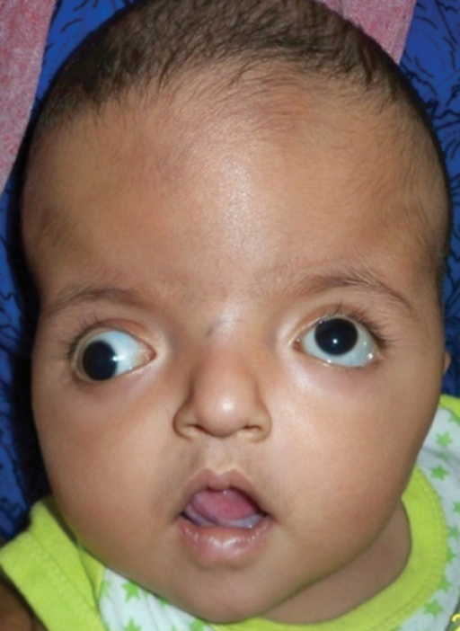
Apert Syndrome
Incidence: 1:65,000
Mutation: FGFR-2 (chromosome 10)
Autosomal dominant inheritance pattern or sporadic
Associated with midface hypoplasia, proptosis, hyper-telorism, cleft palate
Intelligence can be normal
Notes:
Accessed 06/24/2019 at: https://openi.nlm.nih.gov/detailedresult?img=PMC4155880_ijcpd-05-203-g001&query=apert%20syndrome&it=xg&req=4&npos=64

Slide 12
Apert Syndrome:
Anesthetic Implications
Airway
  Midface hypoplasia
  Choanal stenosis/atresia
  Tracheal stenosis
  High arched palate
  C5-6 fusion
  40-50% with OSA
Cardiovascular
  10% have congenital heart disease
  Pulmonary stenosis
  ASD/VSD
  Tetralogy of Fallot

Slide 13
Apert Syndrome:
Anesthetic Implications
Neuromuscular
  Possible cognitive delay
  Crainosynostosis
  Corpus callosum agenesis
  Increased ICP
Genitourinary
  10% have renal abnormalities
  Musculoskeletal
  Syndactyly → difficult IV access

Slide 14
Crouzon Syndrome
Incidence: 1:60,000
2/3 familial – autosomal dominant; 1/3 sporadic
Mutation: FGFR2 on chromosome 10
Characterized by brachycephaly, maxillary hypoplasia, strabismus, beaked nose
Often have normal intelligence
Notes:
Accessed 06/24/2019 at: https://openi.nlm.nih.gov/detailedresult?img=PMC5233708_ijcpd-09-384-g003&query=crouzon%20syndrome&it=xg&req=4&npos=43

Slide 15
Crouzon Syndrome:
Anesthetic Implications
  Prognathism → difficult mask ventilation
  High-arched palate and retrognathism → difficult intubation (consider videolaryngoscopy)
  Ocular proptosis → higher risk for corneal abrasions

Slide 16
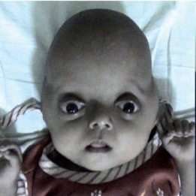
Pfeiffer Syndrome
Incidence: 1:100,000 (most autosomal dominant, some sporadic)
Mutations:
  FGFR1 (chromosome 8)
  FRGR2 (chromosome 10)
Characterized by midface hypoplasia, proptosis, strabismus, beaked nose, hearing loss, cartilaginous tracheal sleeve
Often normal intelligence
Notes:
Access 06/24/2019: https://openi.nlm.nih.gov/detailedresult?img=PMC2964784_JPN-5-72-g005&query=pfeiffer%27s%20syndrome&lic=by&req=4&npos=42

Slide 17
Pfeiffer Syndrome:
Anesthetic Implications
  All major sutures and skull base involved
  Increased ICP
  Chiari malformations
  Hydrocephalus
  OSA → Monitor for airway obstruction
  Difficult airway management rare
  Ocular proptosis → higher risk for corneal abrasions

Slide 18
Craniosynostosis:
Indications for Surgery
Increased ICP
Severe exophthalmos
OSA
Craniofacial deformity
Prevention of neurologic sequelae
Psychosocial concerns

Slide 19
Timing of Surgery
Emergency surgery required in cases of raised ICP
Benefits of early surgery (4-6 months of age) include softer, more malleable bone and continued growth of cranial vault
Disadvantages include risks of anesthesia in a younger patient, potential for increased relative blood loss
Surgery generally performed between 6-12 months of age

Slide 20
Surgical Techniques: Strip Craniectomy
Cranial vault split into multiple segments
Allows skull to grow with brain
Requires protective helmet post-op
Used for children less than 6 months old
May be done endoscopically
Notes:
The endoscopic approach is less invasive and has been reported to result in less blood loss and shorter lengths of stay.
This procedure is more commonly used for sagittal synostosis, although it has been described for the repair of other single-suture, syndromic synostosis and even multisutural synostosis. The patients are typically younger (2 to 3 months of age), and they require postoperative helmet therapy for up to 6 months for the development of a normal head shape. The surgical approach is through smaller incisions than the open vault. As with open approaches, significant blood loss can occur if the sagittal sinus is entered, but this is rare. Recent reports suggest that there is less blood loss and shorter lengths of stay with this approach.

Slide 21
Surgical Techniques:
Spring Assisted Cranioplasty
Used in infants 4-6 months
Midline osteotomy along sagittal suture: springs placed to increase dimensions
Advantages
Lower transfusion requirement
Shorter surgery, faster recovery
Notes:
The approach involves surgically removing the synostotic suture and placing a spring between the two bone edges. Over time, the force exerted on the two bone edges corrects the defect. A second operation is required to remove the spring. A limitation of this procedure is that it is typically used for isolated sagittal synostosis.

Slide 22
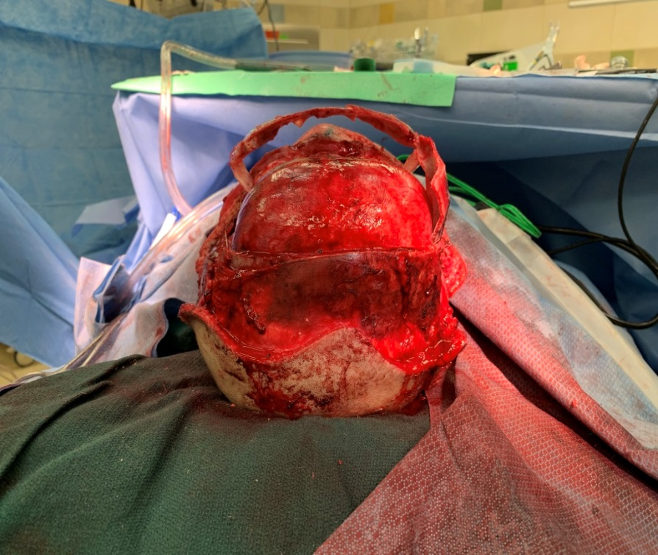
Surgical Techniques: Total Vault Reconstruction, Fronto-orbital Remodeling
  Removal of plates and reconstruction
  Longer surgery
  Higher blood loss
  Specific procedures include:
    Frontal advancement
    Posterior vault expansion
Notes:
Photo taken during fronto-orbital advancement: primary goal to enlarge cranial cavity, bifrontal flap displaced forward with bandeau (photograph taken at author’s institution with written permission/release from patient’s parents)
This procedure involves dissecting a scalp flap off the forehead and mobilizing it down to expose the superior orbital rim. The calvarium is typically removed by the neurosurgeons in one or several pieces. The surgical team may request hyperventilation during in order to optimize intracranial pressure and facilitate completion of this portion of the procedure. A “bandeau” osteotomy is then performed along the lateral temporal bones and the nasion to mobilize the superior orbital rim. Once the osteotomies are complete, the surgical field is protected with moist gauze. The calvarium and the orbital bandeau are sectioned and the pieces are reshaped and replaced in a manner that replicates a normal head shape. The bone is secured with a craniofacial plating system, the scalp flaps are replaced, and the coronal incision is closed.

Slide 23
Preoperative Considerations
Most patients with non-syndromic craniosynostosis are otherwise healthy
Preoperative testing for these and all other patients should generally include a complete blood count and specimen for type and screen/type and cross
Coagulation profile routinely performed at some centers
Syndromic craniosynostosis may be associated with midface hypoplasia or retrusion resulting in OSA and other perioperative airway considerations
Use preoperative sedatives with caution in the setting of severe obstructive disease

Slide 24
Preoperative Considerations
In severe cases, patients may present for surgery with a tracheostomy, or one may be placed intraoperatively prior to the surgical procedure
Further evaluation may be necessary in the setting of syndromic craniosynostosis and associated congenital cardiac disease
Induction usually performed via inhalational technique; consider IV induction in the setting of intracranial hypertension
Notes:
Certain syndromes, such as Apert’s or Pfeiffer syndrome, may have associated cardiac anomalies such as an atrial septal defect (ASD), ventricular septal defect (VSD) or pulmonary stenosis. Unless the patient is symptomatic or showing signs of heart failure, a complete cardiac workup is typically unnecessary.

Slide 25
Airway Management
Obtaining facemask seal may be difficult
Endotracheal tube may be oral or nasal
Secure endotracheal tube carefully
Verify endotracheal tube position in both flexed, extended and rotated head positions with auscultation or fiberoptic bronchoscope
It is critical to have various forms of emergency airway management equipment available and techniques discussed should the preoperative evaluation suggest any possibility of a difficult intubation
Notes:
At the author’s institution, nasotracheal intubations are the most commonly performed method of securing the airway, with subsequent suturing to the nares by the surgery team. It is critical to verify that the tracheal tube remains below the glottis but above the carina in all the flexed, extended and rotated positions mentioned above as this mimics the movement of the head as it is manipulated intraoperatively by the surgeon. Inadvertent extubations during these cases are extremely difficult to manage in a timely and sterile fashion.

Slide 26
Blood Management
Significant and often unrecognized blood loss.⁴
Large bore intravenous access required (at least 22-20G preferred in infants)
Antifibrinolytic infusion: TXA
Invasive arterial catheter useful during open procedures
Central venous access usually not required unless peripheral access difficult
Urinary catheter required for urine output monitoring
Notes:
One of the most critical concerns during craniosynostosis repairs, with risk increasing with longer surgeries, younger patient age, and the involvement of multiple suture lines.
4) Faberowski LW, Black S, Mickle JP: Blood loss and transfusion practice in the perioperative management of craniosynostosis repair. J Neurosurg Anesthesiol. 11:167 1999

Slide 27
Blood Management (con’t)
Transfuse pRBCs by following hemoglobin and hematocrit; low MAPs may indicate need for transfusion
Administer FFP in a 1:1 ratio with pRBCs⁵
Albumin use may result in increased transfusion requirements and coagulation abnormalities
Check arterial blood gases at least every hour, more frequently if bleeding is severe, and monitor glucose, electrolytes.
If available, pulse pressure variation can guide fluid therapy (values above ~12% suggest fluid responsiveness)
Notes:
Key goal is not to dilute clotting factors, and knowing when blood loss is most likely to occur (scalp dissection, periosteum manipulation)
Transfusing early (i.e. start of case) when expecting blood loss may result in exposure to multiple donors due to requiring more product administration.
Other tools (less readily available) such as thromboelastometry (TEG/ROTEM) may help guide blood product administration in the setting of clinical coagulopathy.
5) Stricker PA, Shaw TL, Desouza DG et al. Blood loss, replacement, and associated morbidity in infants and children undergoing craniofacial surgery. Pediatr Anesth 2010(20): 150-159

Slide 28
Blood Management (con’t)
Intraoperative strategies to minimize blood loss⁶
Maintain normothermia
Intraoperative cell salvage (CS)
Acute normovolemic hemodilution (ANH)
Fibrin sealants
Antifibrinolytics:Tranexamic acid (TXA) 10 mg/kg bolus followed by continuous infusion of 5 mg/kg/hr⁷
Notes:
In addition, the surgeon may infiltrate local-containing solution (epinephrine 1:400,000) to help reduce scalp bleeding
ANH involves collecting blood from the child after induction of anesthesia but immediately before surgery and replaced with an appropriate volume of crystalloid or colloid, such as 5% albumin; efficacy questionable and labor-intensive, technique is rarely used in craniofacial surgery.
Other strategies available (preoperatively):
Preoperative autologous donation (PAD) – weaker evidence supporting its use
Preoperative erythropoietin (EPO) – given in combination with elemental iron, at a dose of 4 mg/kg, up to 200 mg for 6 weeks prior to surgery in order to increase hematocrit value) – likely cost-prohibitive and EPO has been associated with complications in adults
Postoperatively: drain reinfusion (DRI)
***Earlier study from Boston Children’s studied higher TXA bolus (50 mg/kg) followed by the same infusion rate; lower doses now recommended to avoid high peaks as well as potential complications such as seizures***
6) White N, Bayliss S, Moore D. Systematic review of interventions for minimising perioperative blood transfusion for surgery in craniosynostosis. J Craniofacial Surg, 25 (2015), pp. 126-136
7) Goobie SM, Meier PM, Sethna NF et al. Population Pharmacokinetics of Tranexamic Acid in Pediatric Patients Undergoing Craniosynostosis Surgery. Clin Pharmacokinet. 2013 Apr;52(4):267-76

Slide 29
Blood Management (con’t)
Transfusion related concerns:
Allergic/febrile/hypersenitivity reactions
Metabolic/electrolyte derangements (hypocalcemia, hyperkalemia in the setting of massive transfusion)
Transfusion-associated Lung Injury (TRALI)
Transfusion-associated circulatory overload (TACO) ⁸
Notes:
8) Pearson A, Matava CT. Anaesthetic management for craniosynostosis repair in children. BJA Educ 2016;16(12): 410-416

Slide 30
Positioning and Temperature Management
Patient may be supine (coronal, metopic sutures), prone or modified prone (sagittal, lambdoid sutures)
Proper padding of joints, peripheral nerves, and head is critical
Eye care provided by transparent film dressing or corneal shields placed by surgeon superior to eye tape only
Patients with midface hypoplasia or proptosis will require extra care to ensure eyes are adequately protected
Long operations with wide tissue exposure will require measures such as forced-air warming, blankets, warmed fluids to maintain temperature homeostasis

Slide 31
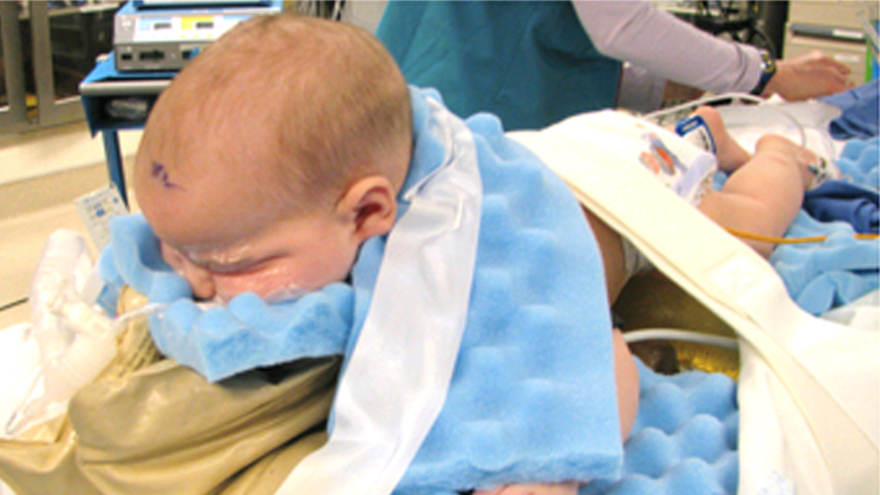
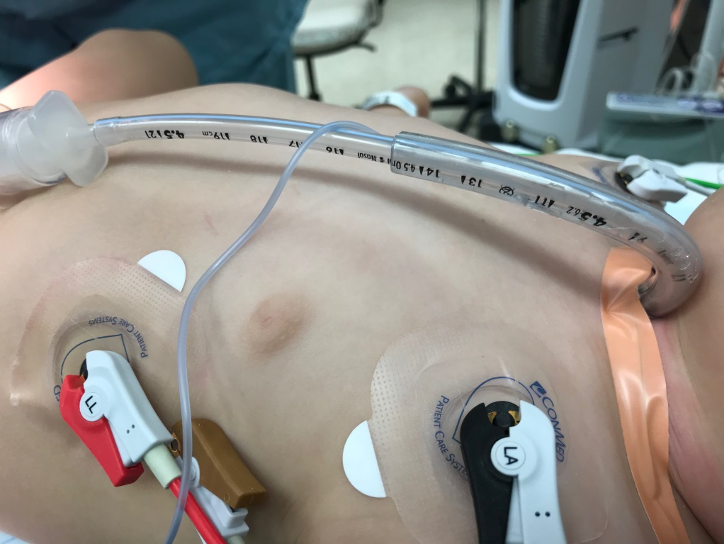
Notes:
The image on the top left demonstrates a patient in the modified “sphinx” position for a sagittal craniosynostosis repair. (Image obtained from open access article available at: https://thejns.org/pediatrics/view/journals/j-neurosurg-pediatr/20/5/article-p410.xml, access January 3, 2020)
The photography on the bottom right was taken at the author’s institution and illustrates a patient who tracheostomy was replaced with a cuffed endotracheal tube, threaded through a larger tube to help augment stiffness and prevent any kinking/obstruction that would be difficult to troubleshoot underneath the surgical drapes

Slide 32
Venous Air Embolism (VAE)
Causes:
Surgical field above heart with open sinusoids
CVP decreased due to hypovolemia (bleeding) – air entrained due to pressure gradient formed between the surgical site and the right atrium
Prevention:
Surgeon should apply bone wax to open edges of bone
Limit reverse Trendelenburg positioning, but remember that even when supine, children may be at risk due to their larger heads
Diagnosis:
A precordial doppler may assist in early detection, but use not routine⁹
Hemodynamically significant VAEs rare (resulting from RV outflow obstruction), and may be heralded by hypoxemia, hypotension, decreased or absent end-tidal CO₂, cardiac arrest in extreme cases)
Notes:
May occur in as many as 83% of cases, though significant hemodynamic concerns are more rare.
The use of precordial doppler, though it is very sensitive in detecting VAEs, is not widely placed (as with transesophageal echocardiography)
Most likely to occur during the craniectomy and cranial reconstruction portions of the procedure.
9) Stricker PA, Goobie SM, Cladis FP et al. Perioperative Outcomes and Management in Pediatric Complex Cranial Vault Reconstruction: A Multicenter Study from the Pediatric Craniofacial Collaborative Group. Anesthesiology 2017;(126):276-287

Slide 33
Venous Air Embolism: Treatment
Notify surgeon to flood surgical field
Lower surgical field relative to heart
Increase central venous pressure with crystalloid, colloids, blood products as indicated
IV epinephrine may be necessary in the setting of hypotension
Aspirate air from central venous catheter if placed

Slide 34
Postoperative Considerations
  Most patients extubated at the end of surgery (consider delaying extubation after prolonged procedures, massive transfusion, prone positioning, preoperative OSA or airway concerns)¹⁰
    Analgesia best achieved with combination of acetaminophen and IV opioids
    Local infiltration by the surgeon may be utilized to supplement
  Monitor for airway obstruction, electrolyte disturbances (hyponatremia), and anemia/coagulation abnormalities from blood loss
Notes:
The amount of airway edema may be evaluated by:
Direct laryngoscopy and assessment of the glottis and surrounding airway structures
Performing a leak test (deflating cuff of endotracheal tube, applying positive pressure and assessing for an audible leak or observing ventilator for loss in tidal volume)
Cuff leak/evaluation for airway edema generally not needed if risk factors listed above not present. If risk factors are present and leak is not observed, it is prudent to have the patient remain intubated upon transport to the ICU, with consideration given to steroid therapy, such as dexamethasone.
Many institutions use opioid infusions intraoperatively, such as remifentanil or sufentanil. If an agent with a short context-sensitive half time is utilized (remifentanil), a bolus of a longer-acting agent prior to emergence such as morphine will be helpful in optimizing analgesia.
Ketorolac use generally avoided (context of blood loss) and is controversial in this surgical population intraoperatively.
Hyponatremia may be due to a combination of factors such as administration of hypotonic solutions or anti-diuretic syndrome (SIADH); sequelae such as cerebral edema, seizures or death may be involved)
10) Hughes K, Thomas K, Johnson D et al. Anesthesia for surgery related to craniosynostosis. Part 2. Pediatr Anesth 2013(1): 22-7

Slide 35
Conclusions:
Craniosynostosis is the premature fusion of one or more cranial sutures
Craniosynostosis can occur in isolation or as part of a large number of associated syndromes
Preoperative evaluation should focus on the presence of any comorbidities such as obstructive sleep apnea, congenital heart disease, and the possibility of difficult airway management
Major intraoperative concerns include securing the endotracheal tube, significant blood loss, and hemodynamically significant venous air embolism
Postoperative concerns include airway obstruction after extubation, electrolyte derangements, and anemia/coagulopathy

Slide 36
References
Durham EL, Howie RN, Cray JJ. Gene/environment interactions in craniosynostosis: a brief review. Orthod Craniofac Res. 2017 (20): 8–11
Faberowski LW, Black S, Mickle JP: Blood loss and transfusion practice in the perioperative management of craniosynostosis repair. J Neurosurg Anesthesiol. 11:167 1999
Goobie SM, Meier PM, Sethna NF et al. Population Pharmacokinetics of Tranexamic Acid in Pediatric Patients Undergoing Craniosynostosis Surgery. Clin Pharmacokinet. 2013 Apr;52(4):267-76
Hughes K, Thomas K, Johnson D et al. Anesthesia for surgery related to craniosynostosis. Part 2. Pediatr Anesth 2013(1): 22-7
Pearson A, Matava CT. Anaesthetic management for craniosynostosis repair in children. BJA Educ 2016;16(12): 410-416
Stricker PA, Fiadjoe JE. Anesthesia for Craniofacial Surgery in Infancy. Anesthesiol Clin 2014;32(1): 215-235
Stricker PA, Shaw TL, Desouza DG et al. Blood loss, replacement, and associated morbidity in infants and children undergoing craniofacial surgery. Pediatr Anesth 2010(20): 150-159
Stricker PA, Goobie SM, Cladis FP et al. Perioperative Outcomes and Management in Pediatric Complex Cranial Vault Reconstruction: A Multicenter Study from the Pediatric Craniofacial Collaborative Group. Anesthesiology 2017;(126):276-287
Thomas K, Hughes C, Johnson D et al. Anesthesia for surgery related to craniosynostosis. Part 1. Pediatr Anesth 2012(11): 1033-41
White N, Bayliss S, Moore D. Systematic review of interventions for minimising perioperative blood transfusion for surgery in craniosynostosis. J Craniofacial Surg, 25 (2015), pp. 126-136

