Slide 1
Cleft Lip and Palate Repair
Sudha Bidani M.D.
Assistant Professor of Anesthesiology & Pediatrics
Baylor College of Medicine
Houston, Texas
Updated 4/2017
Notes:
Cleft is gap in soft tissue, bone or both. It usually results from inadequate tissue growth and migration during the development of face.

Slide 2
Disclosure
Nothing to disclose

Slide 3
Objectives
Upon completion of this lecture/slide presentation, readers should be able to:
Explain the embryology and epidemiology associated with cleft lip and palate
Evaluate a child coming in for cleft lip and/or palate repair including the potential for difficult airway
Formulate an anesthetic plan for an infant for cleft lip or cleft palate surgery
Describe options for postoperative pain management in infants after cleft lip and palate surgery

Slide 4
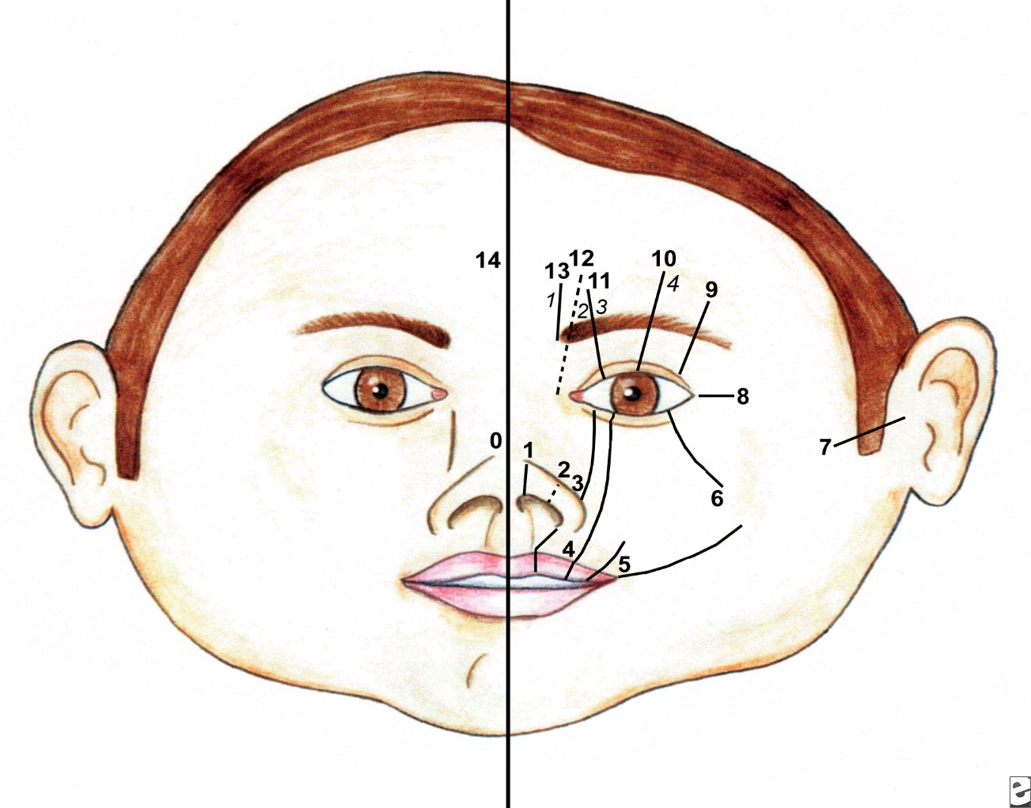
Tessier Classification of Soft Tissue Clefts
www.cleftline.com Patricia Bacon Smith, MD. Jan. 2008
Notes:
French plastic surgeon Tessier came up with this numbering system in 1976. The clefts have a consistent anatomic pathway. They are numbered from 0 to 14 using mouth, nose and orbit to indicate the location and severity of the defect. 1, 2 and 3 are commonly encountered clefts. Cleft no. 4 and 5 go through upper lip, lower eyelid and eyeball. These patients present with coloboma of lower eyelid, absent eye ball, absent zygoma if there is a corresponding bony cleft. Cleft 6, 7 and 8 go through angle of the mouth, lower eyelid, lateral canthus and external ear. They exist either in isolation or combination. Clinically they present as Treacher Collin’s, Goldenhar or hemifacial microsomia if there are corresponding bony clefts present. Any time you have a patient with preauricular tags, defective external ear, one must look for hypo plastic mandible which will help in anticipating difficult intubation.
www.cleftline.com article by Patricia Bacon Smith, MD.

Slide 5
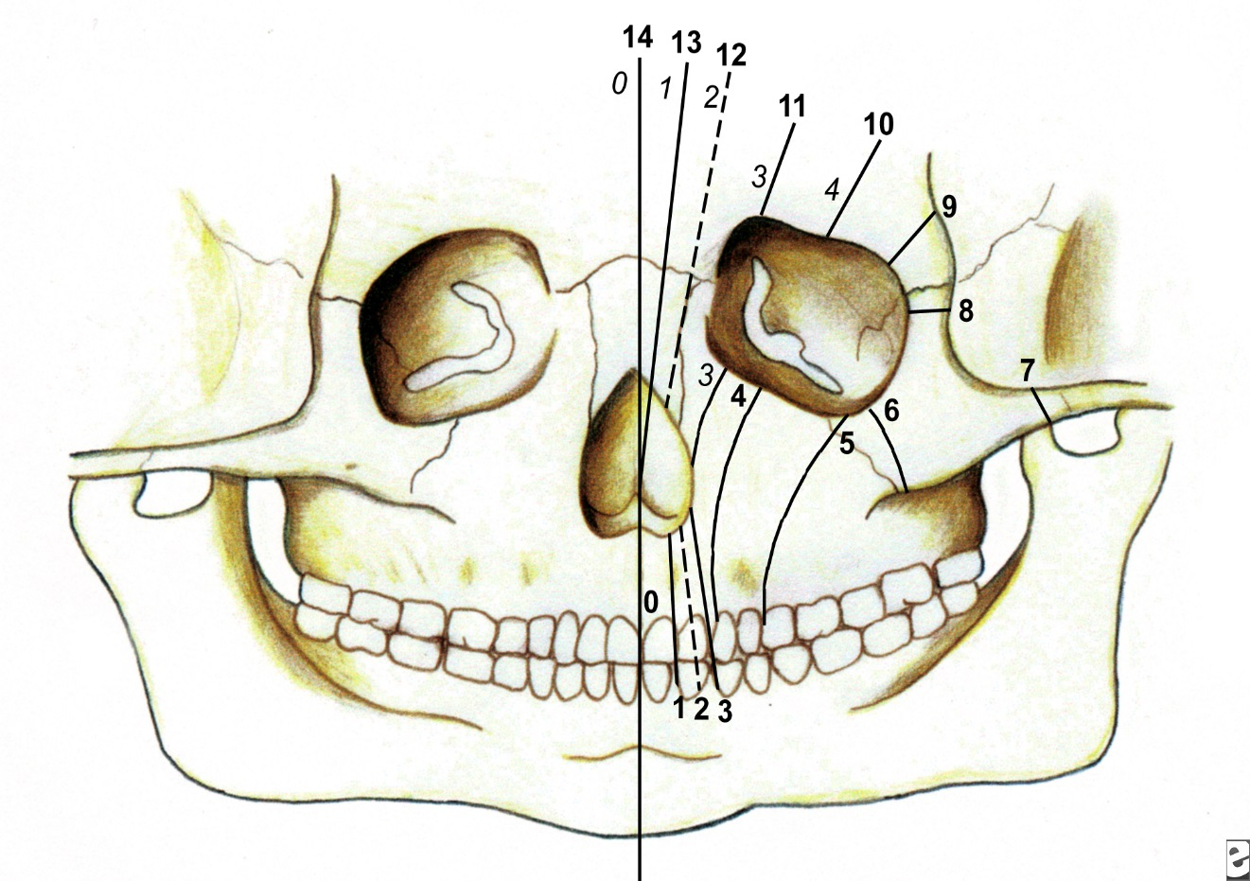
Tessier Classification of Bony Clefts
www.cleftline.com Patricia Bacon Smith, MD. Jan. 2008
Notes:
Bony clefts are similarly numbered starting from midline and progressing outwards, orbit being the central point. Cleft number 6,7 and 8 go through mandible, zygoma , orbit and inner ear. With complete clefting these patients will have deafness, hypo plastic mandible, and relatively immobile temporo-mandibular joint. Again, all this should wake one up to the possibility of difficult intubation.
www.cleftline.com article by Patricia Bacon Smith, MD.

Slide 6
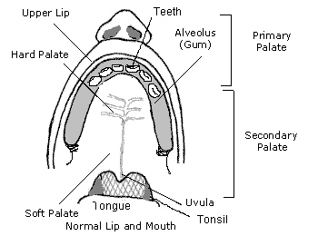
Normal Palate
www.moondragon.org/obgyn/peditrics/cleft.html Jan. 2008
Notes:
The purpose in showing the normal palate diagram is to emphasize the anatomy of blood supply of the palate. Long palatine arteries enter the palate through palatine foramina behind the molars and run parallel to the alveolar margin. This is the area of infiltration of local anesthetic with epinephrine. With all the rich blood supply, epinephrine can get absorbed very quickly. The infiltration is done right at the beginning of the surgery. If the patient is not sufficiently anesthetized, this will cause tachycardia and hypertension in these patients.

Slide 7
Embryology
Primary palate forms: 4-7 weeks
Secondary palate forms: 7-12 weeks
Fusion occurs in anterior to posterior direction
Palatal deformity can be complete, incomplete and sub mucous
Notes:
Primary palate formation starts in the 4th week of gestational life. Primary palate consists of pre maxilla, upper incisors and extreme anterior part of the palate. Secondary palate or the main bulk of the palate starts developing in 7th week and the growth is complete by the 12th week. The deformity occurs when there is a failure for primary and secondary palate to fuse. Palatal fusion progresses from anterior to posterior direction. Therefore incomplete deformities tend to be posterior.

Slide 8
Epidemiology
1:800 live births
Combined defect: male: female ratio of 2:1
Isolated cleft palate: male: female ratio of 1:2
Asian:Caucasians ration of 2:1
Genetic factor is commonest
10-20% associated anomalies
Isolated cleft lip: least likely to have associated anomalies
Notes:
Cleft lip and palate is a fairly common deformity and occurs in 1:800 live births. It is commoner in males, especially of oriental descent. Cleft lip and palate deformity does run in families. It can occur as an isolated defect or it can be part of the craniofacial syndrome i.e. Treacher Collins, Pierre Robin sequence etc. . With that in mind, about 10-20% of the patients will have associated defects. Isolated clefting of the lip is usually not associated with any other anomalies.

Slide 9
Associated Anomalies
Skeletal anomalies of digits and limbs
Neural defects: encephalocoele, anencephaly,
Cervical vertebral synostosis
Part of a more complex facial defects: Treacher Collins, Pierre Robin, Apert etc.
Notes:
Associated defects usually tend to be skeletal. Anomalies of digits and limbs i.e. syndactyly, It is not uncommon to see midline cranial defects like encephalocoele. As I mentioned earlier, it can be part of the more complex facial defects such as Treacher Collins, Pierre Robin sequence, Goldenhar. The last one can be associated with cardiac anomalies, Chiari malformation.

Slide 10
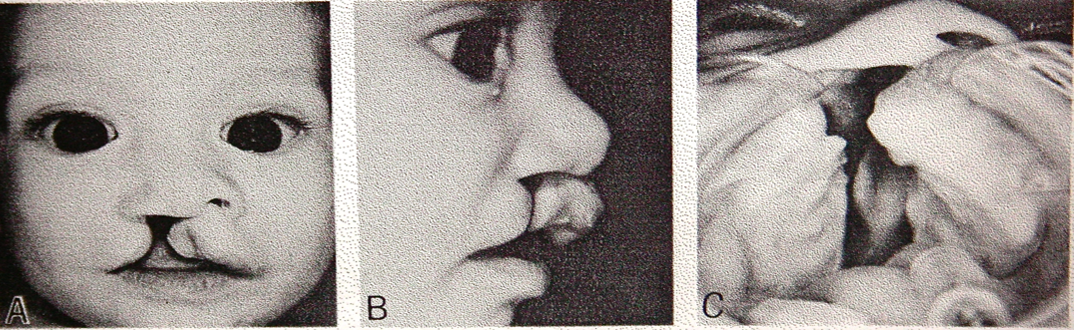
Unilateral Cleft Lip and Palate
Human Embryology: University of Michigan Collection, EH 164. Modified from Patten: 3d edition 1968
Notes:
There is hypoplasia of the tissue along the cleft. As you can see in this picture the clefting on the right side is complete and extensive. Cleft is wide, the right ala of the nose is flat, palatal cleft is wide enough to show the bottom part of the nasal septum. The premaxilla is out of line with maxilla on right side. During laryngoscopy, it is a good idea to keep the proximal part of the blade out of the cleft, otherwise the intubation can be difficult.

Slide 11
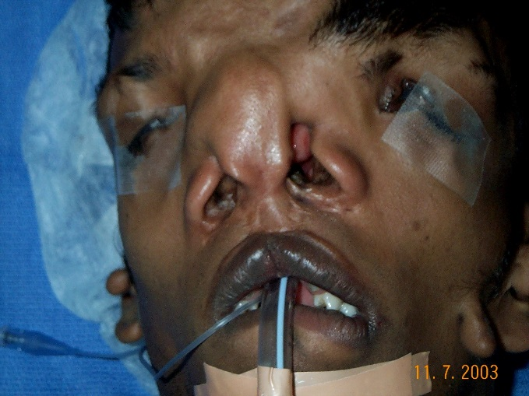
Multiple Surgeries
Primary: lip & palate repair
Secondary: CL and CP revision
Correction of nasal deformity
Palatal and/or alveolar fistulae
Pharyngoplasty/pharyngeal flap
Ear tubes
Orthodontics
Notes:
Unfortunately these patients will frequent flyers if they have the privilege of living in the Western society. Primary cleft lip repair to be done at 3-4 months and palate at 6-8 months of life. Then on as mid face growth takes place, for touch ups here and there for fistuale, cleft nose deformities, pharyngoplasty, orthodontics etc.

Slide 12
Multispecialty Management
Pediatrician
Plastic surgeon
Oral surgeon
Speech therapist
Orthodontist
Oto-rhino-laryngologist
Geneticist
Anesthesiologist
Cardiologist
Psychiatrist
Notes:
Palatal appliance may be necessary to bring the premaxilla and maxilla in line before attempting lip repair. Hearing is going to be impaired because of defective insertion of levator and tensor palatine muscles resulting in Eustachian tube malfunction. Palate can be shortened because of scarring resulting in nasal speech. Multiple surgeries on the palate can result in impaired growth of the maxilla and misaligned teeth. Families will need genetic counseling. Since facial appearance can be severely distorted in some cases, these patients will also need psychiatric counseling. Overall, there is a need for a provision of comprehensive care to these patients. The referral from one specialty to another has to be automatic and timely .

Slide 13
Surgical Aim
Restoration of facial appearance
Restore the competence of velo-pharyngeal sphincter
Achieve better occlusion of maxilla and mandible
Improved speech
Notes:
Main surgical aim is to restore the facial appearance to as near normal as possible. This is true for cleft lip defects. With cleft palate, primarily isolate the nasal cavity from oral cavity. In doing so, every effort is to be made to preserve and restore the maxillary-mandibular occlusion. All these efforts may result in shortening of the palate and velo-pharyngeal insufficiency. This will need to be corrected before the speech becomes too unintelligible.

Slide 14
Surgical Timing
Cleft lip: 1 to 5 months
Cleft palate: 6-9 months allows for normal speech development
Notes:
In plastic surgical field, there has been an ongoing debate as to what is the best timing to repair the cleft lip. The debate has vacillated between very early to delayed one. Early repair was considered necessary when babies could not suck on the nipple effectively. In these days and age in western world, feeding can be accomplished by other means. In order to avoid transfusions, palate repair was either done in stages or until baby was big enough to lose 25 cc blood. We used to wait until the baby was about 15 lbs or more. In old days that would be around 6-9 months. Now the babies are that size at an earlier age. With an appliance on the palate they do thrive.

Slide 15
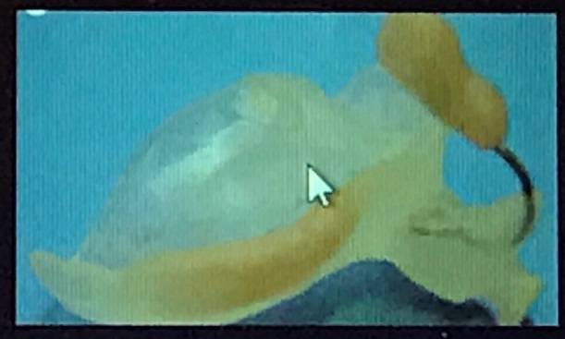
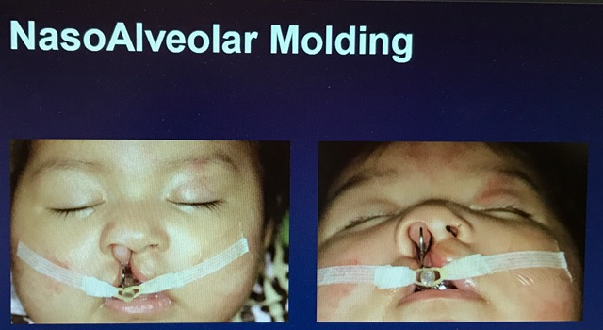
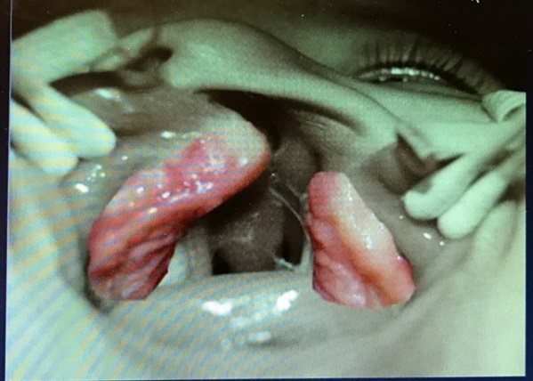
Latham or Nam device
Notes:
In order to have a better outcome with the lip and nose application of custom made device during the early life has become a standard of care. NAM device mold is usually custom made for a given child. In our institution, for the initial visit, the child is brought in the treatment room or the OR depending upon individual comfort level. A dental impression is done oral surgeon with anesthesiologist watching the patient without any monitors on. The device is left in place for a period of a week at a time and changed depending upon new alignment of the maxillae. These subsequent changes do not need involvement of anesthesiologists. The appliance ends being in place for a total of 2-3 months depending upon the correction achieved. This period also allows the nasal ala to lengthen and grow. The improvement in maxillary alignment and growth of the nasal ala allows for much better reconstruction of the lip and nose. At our institution surgeons have discontinued using Latham device.

Slide 16
Benefits of Delaying Surgery
Decrease in anesthetic risk
Diagnosis of other anomalies
Latham/NAM device
Better repair of lip and nose
Allows more time for parents to make mental adjustments to child with deformity
Notes:
Debate for delaying the surgery has definitely won. Anesthetic risk is definitely lesser as the baby grows. In older days, that gave time for assessing any coexisting anomalies. In today’s world with tremendous technological advances, that is not an excuse one can give for delaying. Latham device is something much more common in last two decades or so. It brings the premaxilla and maxilla in line before definitive lip repair is accomplished. The device needs to be left in place for a few weeks to be effective. It definitely allows time for the parents and family to make mental adjustments toward the child.

Slide 17
Psychological Aspects
Radical effect on appearance
Presence of other anomalies
Conductive hearing loss
Unintelligible speech
Perceived prevalence of mental retardation
Notes:
Even a presence of an incomplete lip deformity has a devastating effect on baby’s facial appearance. More complete deformity plays a havoc not only with external appearance but with other functions such as speech, hearing, dentition and chewing. Unintelligible speech on top of flawed facial features, gives an impression of mental retardation and social rejection amongst peers in school and playground. Because of conductive hearing loss, there is some prevalence of mental retardation in this population.

Slide 18
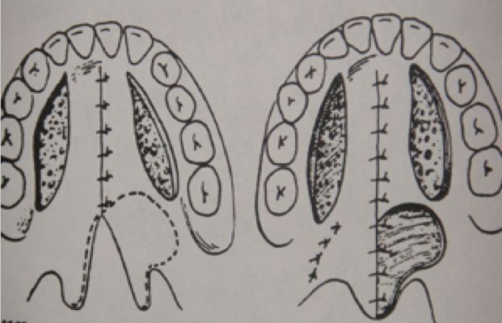
Push-back Palatoplasty
Oldest primary repair, credited to Starr and Von Langenbeck in 1907
Usually performed at 6-10 months of age
2 release incisions parallel to alvealor margin
Mobilize periosteal flaps to close the defect
Notes:
Push back palatoplasty was one of the oldest and commonest primary procedures these patients underwent. Usually, it was done between 6-10 months of age. The classic repair consisted of making two release incisions parallel to alveolar margin, mobilizing mucoperiosteal flaps towards midline to close the defect. This leaves good size raw surface area in the mouth as well as floor of the nose. The flap is not attached to the bone. In older times, surgeons would tie a piece of gauze to the flap, hoping to put some pressure on the flap for hemostasis. It is difficult to have total hemostasis regardless of what is attempted and it only tends to gets worse during and after extubation because of coughing and breath holding resulting in higher venous pressure in the head and neck area. The surgeons tend to leave a heap of thrombin or surgi-seal on the raw surface which can come loose after extubation or with suction catheter. Indiscriminate suction of nasal and oral cavity is counter productive in this situation. Accumulation of sufficient evidence regarding the morbidity produced by this repair i.e. velopharyngeal insufficiency, impaired growth of the palate/maxilla and inferior repair of the palate muscles, this classic repair has fallen out of favor and is replaced by Furlow repair.

Slide 19
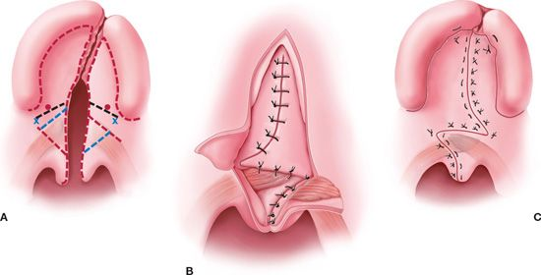
Furlow : Lengthening of Palate
Furlow Repair: Z-plasty as primary approach to repair of cleft and lengthening of palate
Notes:
Furlow repair has almost become a standard approach for primary palatoplasty. With the Z plasty, the palate is repaired and lengthened at the same time, does not leave a raw surface on the oral aspect of the palate and allows for better repair of the palatal muscle structure. Incidence of oronasal/palate fistulae is about the same.

Slide 20
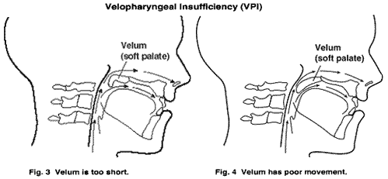
Velopharyngeal Insufficiency
Ann Kummer Ph.D. CCC-SLP, ASHA Fellow: Resonance Disorders & velopharyngeal Dysfunction: Simple low-tech and no-tech procedure for evaluation and treatment. Ph.D. speechpathology.com Jan. 2008
Notes:
Some of these patients will develop velo-pharyngeal insufficiency as they grow and with multiple surgical procedures in the area. Velum means palate in Latin. During speech and swallowing, the pharyngeus muscle along with soft palate and uvula contract and isolate the naso-pharynx from oro-pharynx and prevent escape of air and food into the nose. These patients tend to have nasal twang and unintelligible speech depending upon the extent of insufficiency. The severity of deficiency also decides on what kind of repair they will end up with.

Slide 21
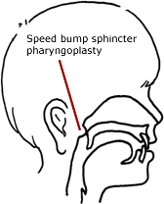
Pharyngoplasty
www.seattlechildrens.org/medical-conditions/chromosomal-genetic-conditions/vpi-treatment/ Jan. 2008
Notes:
Pharyngoplasty is usually done for milder form of velo-pharyngeal insufficiency. The “bump” may be an implant, fat injection of the posterior pharyngeal wall or tonsilar pillar rotation flaps In any given version, the posterior pharyngeal wall edema is not sufficient to result in post operative airway obstruction. Usually these patients do not need ICU admission after surgery.

Slide 22
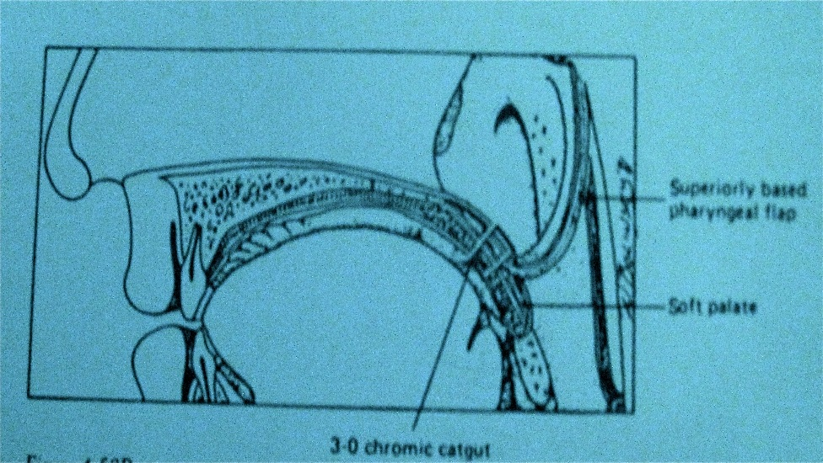
Pharyngeal Flap
Jackson IT: Sphincter Pharyngoplasty: Symposium on Cleft Lip and Cleft Palate. Clinics in Plastic Surgery . October 1985, Vol 12, No. 4 March 1988
Notes:
Pharyngeal flap repair is usually done for more severe forms of velo-pharyngeal insufficiencies. A strip of muco-muscular flap is raised from the posterior pharyngeal wall and attached to the superior surface of the palate. Here the diagram shows example of a superior flap. In this kind of repair, the donor site can be closed primarily but that still leaves the narrow flap with a raw undersurface. The potential post operative airway swelling is very high. In the beginning all these patients used to stay intubated for 2-3 days post operatively. Now a nasal trumpet used to bypass the incisional area and is sewn in place in one nostril and naso-gastric tube is left in place via the other nostril. The patient gets admitted in step down unit for a couple of days and then discharged home. With the development of newer techniques of palatoplasty and palate lengthening, this procedure is becoming a rarity as well.

Slide 23
Preoperative Evaluation
Birth history
Associated defects
Prior anesthetic history
URI: recent or concurrent
Appropriate fasting periods
Premedication
Blood availability
Post op ICU admission
Notes:
After all the preliminary information we have gone through, for any pediatric anesthesiologist, the preoperative evaluation is not a lot different from all the frequent flyers we have in the OR. Prior anesthetics and surgical history is absolutely necessary. Many of these patients have ongoing nasal congestion with runny nose. One has to differentiate acute on chronic from just usual runny nose. On an average no chest x-rays are needed and are not done as a routine work up. Giving clear liquids 2 hrs prior to the surgery is now fairly routine in all the children’s hospitals. Since the oral intake on all these patients almost never gets back to normal for several days, it is important to keep them hydrated. Repeat visitors do deserve premedication and/or parental presence during induction time. Depending upon one’s preferences and circumstance, parental presence may be advantageous for even the non-frequent flyers. There was a time when we used to type and screen for blood on all the palatoplasties. After years of experience with these surgeries, that is not done as a routine. On an average, outside of the pharyngeal flap repairs, no palatoplasty patient needs ICU admission unless a difficult airway is anticipated. There is a class of patients with difficult intubations, who may stay intubated post operatively for a day or so. The difficult intubation without bleeding in the mouth only gets more difficult in emergency situation. When the need arises, only the intensivists are around to do the job and that is not a good situation to be in.

Slide 24
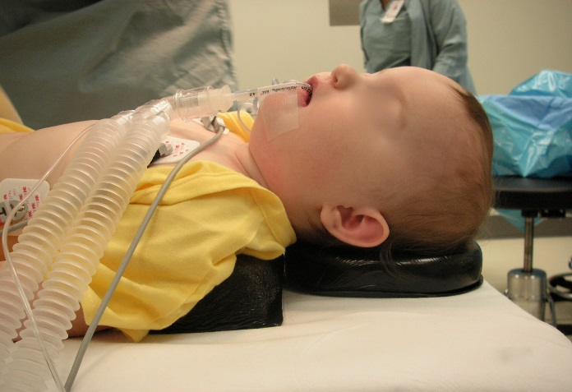
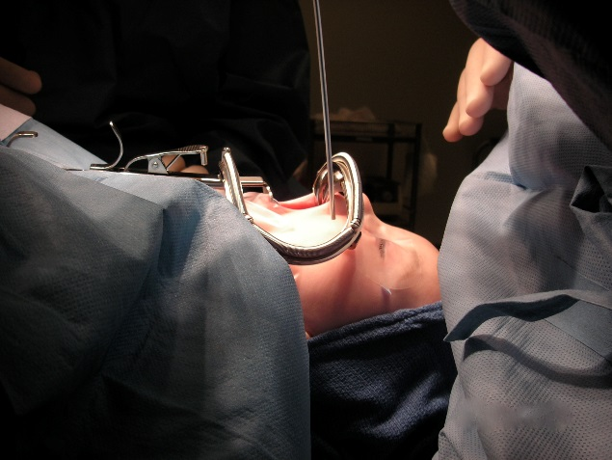
Anesthetic Management
Location of equipment
Low profile endotracheal tubes
Light weight yet long enough circuit
Standard monitoring
Eye lubrication
PIP, endobronchial intubation
Epinephrine infiltration
Generous IV fluids
Blood loss
Notes:
There are some special needs for performing a smooth anesthetic for these patients. Now that we do have micro cuffed oral low profile endotracheal tubes available, it is a good idea to use them even on the young palatoplasty patients. Operating table and in effect the patient is always turned away at 90 degrees. This necessitates positioning of the equipment correctly to facilitate smooth transition. A low profile endotracheal tube and a light weight breathing circuit that is long enough to prevent drag on the endotracheal tube are a must. Since the eyes are in the operating field, lubrication or cornea occluders are necessary. Monitoring is non invasive and standard. In these patients, it would be a good idea to monitor air entry in the left lung field.
Most of the times, it is a good idea to use volume cycled/controlled ventilation mode on the ventilator (if available). In such cases, monitoring the peak inspiratory pressures at all times during the case (once the mouth gag is in place ) is of paramount importance. This helps in detection of kinking of the endotracheal tube secondary to mouth gag placement in a timely manner. If patient is allowed to breath spontaneously during the procedure, it would be a good idea to periodically give a positive pressure breath to check for airway obstruction.
With changing of the head and neck position, one may end up with endobronchial intubation during the surgery. Some of the surgeons use a lot of epinephrine, either for infiltration or soaked cottonoids for hemostasis. Sometimes, especially in a smaller babies, it can result in tachycardia and hypertension. Awareness of the situation helps in timely management of the issue. All these patients need to stay well hydrated into the post operative period.

Slide 25
Airway Management/Monitoring
Kinking of endotracheal tube
Inadvertent migration of the endotracheal tube into the right main stem bronchus
Accidental extubation
Notes:
Moving the table at right angle, movement of the head and neck during the surgery, constant surgical presence in the mouth and no easy access to the airway during the surgery makes the airway quite vulnerable during the entire procedure. It is quite important to effectively monitor and take care of the issues in a timely manner becomes a central point of management of these patients.
Depending upon the availability of the ventilators, it is a good idea to use volume cycled/controlled ventilation mode and monitor the PIP as a surrogate monitor for changes in the delivered volume. Letting the patient breath spontaneously during the procedure means one must assess the patency of the tube frequently by giving a positive pressure breath. Pressure cycled/controlled ventilation mode leads the hypoventilation in the event of kinking of the tube. Unless one has the ability to monitor the end tidal CO2, awareness and more vigilance is necessary to avert hypoxia and atelectasis. Resultant hypoventilation and hypercarbia will lead to increased oozing from the operating site where hemostasis is borderline difficult because of the nature of the surgery i.e. raising a muco-periosteal flap.
A syndromic cleft palate patient tends to have a hypoplastic mandible i.e. Pierre Robin sequence or Treacher Collins/Goldenhar syndrome. Mouth gag placement without kinking the endotracheal tube has to be done quite carefully and more vigilance is necessary in monitoring the airway in these patients. These are the patients whose length of the airway tends to be shorter and may be more prone to endobronchial migration of the endotracheal tube. If cuffed oral Rae tubes are not available and in order to get a good airway fit, one ends up using a larger sized uncuffed tube, then one may end up with the same issue even in a normal patient.
Accidental extubation tends to be more common in inexperienced surgeon’s hands. In some of the syndromic patients, palate exposure may need more changes in the head and neck position during the surgery, making the endotracheal tube more vulnerable to undesirable migration in both directions.

Slide 26
Intraoperative Complications
Airway…Airway…Airway
Kinking of ETT
Disconnection of the circuit
Accidental extubation
Endobronchial intubation
Laryngospasm
Notes:
Airway in some form or shape is at risk during the oral surgeries. Alertness to the fact during surgery and after extubation will go a long way towards avoiding the problems. Anticipation of the problem will make for a timely and effective handling of the issues. All the monitoring, ventilation technique, opioids + adjuvants and their timing, local anesthetic blocks should all be oriented to the end of the surgical procedure management. An uneventful management involves a lot of planning on the part of the anesthesiologist.

Slide 27
Extubation
Oral-nasal suction?
Oral airway?
Pharyngeal pack
Tongue traction sutures
Awake/asleep
Pain relief
Arm restraints, arm board for IV
ICU admission
Notes:
Awake or deep extubation is a million dollar question for anethesiologist of note. The airway is always at risk. If the patient coughs excessively on the endotracheal tube, there is a risk of activating bleeding from the raw surface area of the palate and the mucoperiosteal flap. If the patient is extubated at deeper level, laryngospasm and breath holding/apnea may become an important complication to deal with. In both cases, it is extremely important to have a mechanism in place to make sure that the pharyngeal packs are removed prior to removing the mouth gag. The mechanism may be in any form, either a time out at the end of the surgery, a string attached to the pack and is hanging out side the mouth or a reminder written on the board so that everyone in the room is aware of the event.
Providing adequate pain relief without leading to airway obstruction may be difficult in some of the younger patients, especially with a borderline difficult airway. An airway that is difficult to secure to begin with becomes more difficult to handle after surgery because of raw surface areas of the flap, closure of the gap in the palate, lengthening of the palate and swelling of the tissues (pharyngeal flap repair). In such cases, extubation may have to be differed to another day. At the very least, post operative ICU admission may be a necessity. Oral or nasal suction needs to be done with caution because of the raw surface of the nasal surfaceof mucoperosteal flap or the donor site on the palate.
Many surgeons tend to leave a tongue traction suture in place to help in dealing with airway obstruction. Most of these patients have restraint on their arms to avoid pulling at repaired lip, nose or palate. Both the issues, tongue traction suture and restraints on the arms, can be a great source of irritation for even a comfortable patient. Since the oral feeding is way below par for a couple of days, IV access needs to be well protected. Intra operative fluid replacement must be more than adequate to allow for preoperative deficit and blood loss during surgery.

Slide 28
Pain Management
Opioids
Adjuvants: dexmedetomidine, acetominophen
Field block: Subperiosteal infiltration of palate
Nerve blocks: infraorbital block
Notes:
Opioids are still the mainstay of the intra and post operative pain management. Since the subperiosteal infiltration is painful, an adequate amount of opioid dose needs to be on board before the surgeon starts infiltrating the palate. Choice of opioid is individual and in case of global missions, availability. Adjuvants, such a dexmedetomidine have definitely made the pain management a lot easier. Needless to say, I have used it on my patients since the day it was available in our institution. All the patients do get a field block regardless, simply because of the need for vasoconstrictor to accomplish hemostasis. Whether to use lidocaine or bupivacaine in combination with epinephrine is a matter of surgical preference, duration of surgery etc. In our institution, we have never really found any difference in field block vs. nerve block vs. opioids in terms of ease of extubation, laryngospasm, speed of oral intake or hospital discharge for that matter. Even on surgical missions ( I have plenty under my belt ), this has not really been an issue.
Infraorbital nerve block can be easily done by the surgeon from inside the mouth before the start of cleft lip repair. On the other hand, depending on one’s relationship with the surgeon, the anesthesiologist can do the block very easily before and after the surgery. For palate repair hemostasis is a lot trickier than lip repair. This need dictates the subperiosteal infiltration of a local anesthetic in combination with a vasopressor. That infiltration is usually at the incision site along the alveolar margin. The incision site does extend to the palatine foramina which are located in the immediate posterior vicinity of the third molars. Having a totally numb mouth does not necessarily make for a comfortable patient, evident by all of our post crown/root canal discomfort. In the days of leaving a gauze piece tied to the palate repair site for pressure/hemostasis, no amount of block or pain medicines made up for the discomfort of constant salivation and inability to swallow effectively. Many a times arm restraints make the judgement cloudy indeed.
In the view of this experience, I am unable to recommend/discourage any block procedure for these patients. Most of patients are non verbal, with arm restraints in place and that makes it very difficult to assess the source of their discomfort.

Slide 29
Post-operative Complications
Post-extubation croup
Swelling of the uvula
Sublingual edema
Forgotten pharyngeal packs
Reintubation
Notes:
With the advent of the cuffed ORAE tubes and need for movement of the head and neck during the surgery, many a times, post extubation croup is not a rare event, Presence of some amount of chronic post nasal drip makes for a susceptible upper airway. Staying away from acute on chronic URI can go a long ways to avoid getting into laryngospasm and post extubation croup.
Uvular swelling is known complication but have not seen it that often.
A prolonged surgery leads to prolonged presence of compressed tongue and sublingual lymphatics. The swelling is usually not obvious until after the gag is removed and one is ready to extubate. What is difficult to gauge is how much swelling is going to happen. It would be wiser to wait at least for half an hour before decision can be made to proceed or leave the patient intubated.
A word about reintubation. The unavoidable factors : mandibular anatomy, pharyngeal flap repair, prolonged surgery, associated morbidities. Anticipation is really the key to success. We have learned to handle the pharyngeal flaps by inserting and keeping nasopharyngeal airway in place for at least 24 hours. The nasal trumpet bypasses the surgical flap. It is done electively at the end of the surgery under vision by the surgeon. If the patient has a prior pharyngeal flap and still has velopharyngeal insufficiency, surgeon is injecting fat in the pharyngeal wall, one needs be aware that this will lead to worsening of an effective airway. Perhaps in this case one needs to have a discussion with the surgeon regarding the feasibility of taking the flap down and do a palate lengthening procedure i.e. Furlow instead.
I reserve the forgotten pharyngeal packs for last. With all the safety precautions, time outs etc. being in place, in modern times I am not sure if there is any excuse for it.

Slide 30
References
Aylsworth AS: Symposium on Cleft Lip and Cleft Palate: Genetic considerations. Clin. in Plastic Surgery 1985, Vol. 12, No. 4
Jackson IT: Symposium on Cleft Lip and Cleft Palate: Sphincter Pharyngoplasty. Clin. in Plastic Surgery 1985, Vol. 12, No. 4
Rohrich RJ, Byrd HS: Optimal timing of Cleft Palate closure: Speech, Facial Growth and hearing considerations. Clin. in Plastic Surgery 1990, Vol. 17 No. 1
Human Embryology: University of Michigan Collection, EH 164. Modified from Patten: 3d edition 1968

Slide 31
Acknowledgement
I was privileged to work together with Dr. Stal for thirty-five years, and to participate in plastic surgery missions organized by Mr. Tom Flood. These experiences have taught me humility and about how much I still do not know about the anesthetic management of these patients.

