Slide 1
Anesthesia for the Pediatric Patient with Epiglottitis
Updated 7/2019
Jennifer Chiem, MD
Seattle Children’s Hospital
Seattle, WA USA

Slide 2
Disclosures
No relevant financial relationships

Slide 3
Learning Objectives:
Identify signs and symptoms of epiglottitis
Explain anesthetic techniques for a patient with epiglottitis
Describe antibiotic regimens used to treat epiglottitis

Slide 4
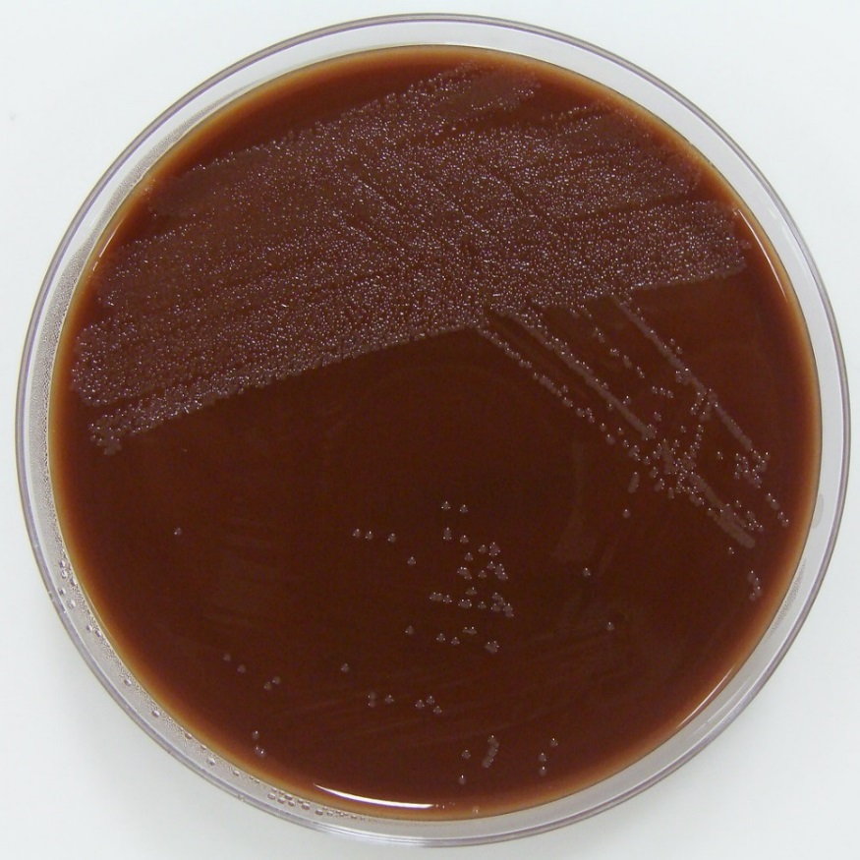
Overview of Epiglottitis
Infectious Etiology
Haemophilus influenza Type B (HiB), most common
Haemophilus influenza Type A, F, and non-typable
Streptococci, including Group A Streptococci
Staphylococcus aureus

Slide 5
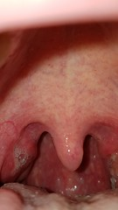
Overview of Epiglottitis
Non-infectious Etiology
Trauma: thermal injury
Foreign Body Ingestion
Caustic Ingestion
Picture: erythematous oropharynx

Slide 6
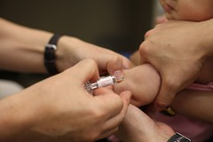
Overview of Epiglottitis
Epidemiology
  Decreased incidence with HiB vaccination, although epiglottitis can still occur
  Median age increased from 3 years old to 6-12 years old in vaccinated patients
  Estimated epiglottitis rates: 0.6-0.8 cases per 100,000
Risk Factors
  Immune deficiency
  Lack of HiB immunization

Slide 7
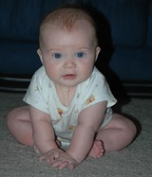
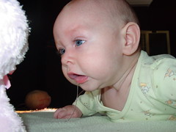
Signs and Symptoms of Epiglottitis
Respiratory Distress
  Stridor
  Tachypnea
  Anxiety
  Refusal to lie down
  “Sniffing” or “Tripod” posture
Dysphagia
Drooling
Fever
Sore Throat
Picture: Toddler in “tripod” position (top); Toddler drooling (bottom)

Slide 8
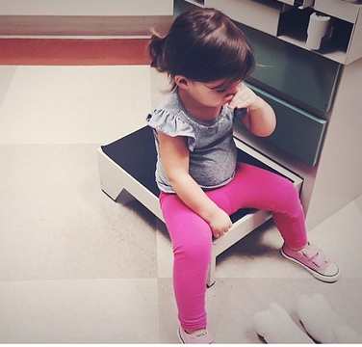
Differential Diagnosis of Epiglottitis
Viral laryngotracheobronchitis (Croup)
Gradual Onset
Low grade fever
Stridor
Hoarseness
Barking Cough

Slide 9
Differential Diagnosis of Epiglottitis
Bacterial tracheitis
Acute onset
Fever
Imaging studies: X-ray
  Irregular tracheal wall
  Normal epiglottis

Slide 10
Differential Diagnosis of Epiglottitis
Retropharyngeal abscess
Less toxic appearance
Fever may be present
Imaging studies (CT scan) will help determine if abscess is present

Slide 11
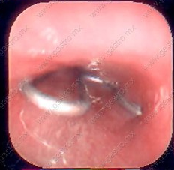
Differential Diagnosis of Epiglottitis
Foreign Body
History
Lack of fever
Acute onset
Can cause partial vs. complete airway obstruction
Foreign body in the airway

Slide 12
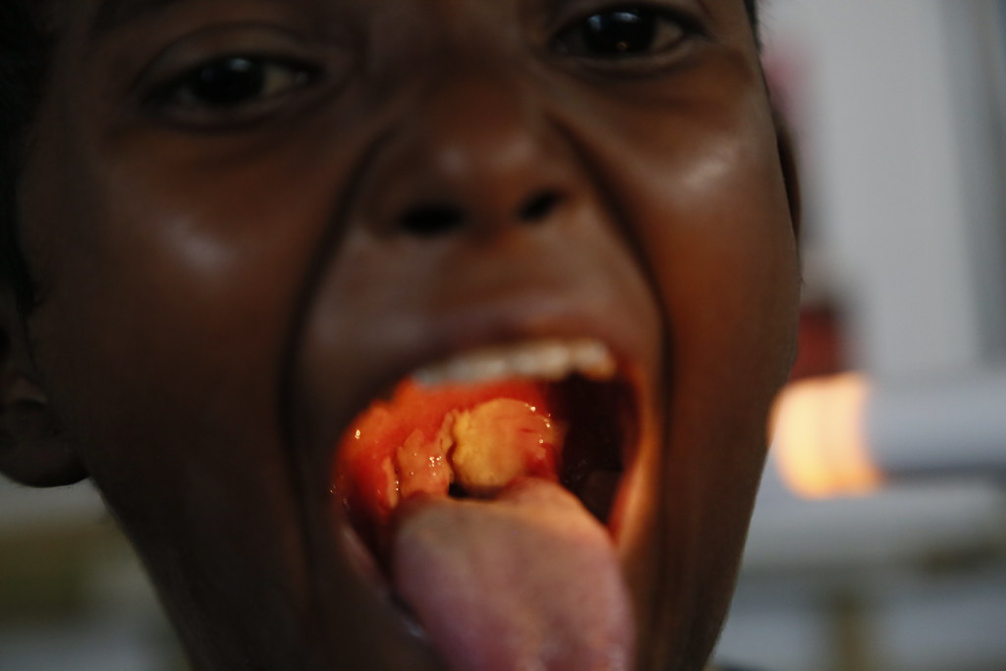
Differential Diagnosis of Epiglottitis
Diphtheria
Gradual onset
Sore throat
Low grade fever
Gray, sharply demarcated membrane in the oropharynx
Gray membrane in the oropharynx

Slide 13
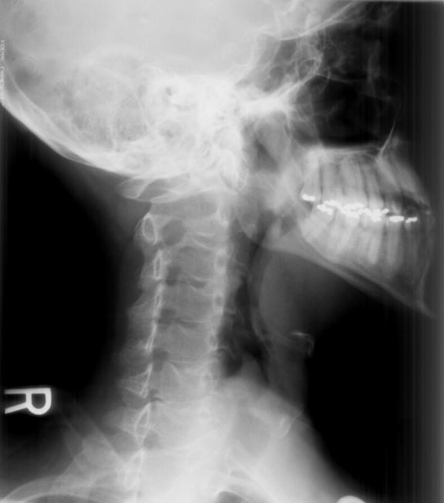
Diagnosis of Epiglottitis
History and clinical presentation
Radiologic imaging can help to confirm diagnosis, but not always necessary - Enlarged epiglottis “Thumb Sign” on lateral neck X-ray
Lateral neck X-ray
Notes:
Abrupt onset (within hours) of dysphagia, drooling, and distress
Sudden onset of high fever
Severe sore throat
Stridor
“Toxic” appearance
“tripod” posture – trunk leaning forward, hyperextended neck, chin forward
Does NOT have hoarseness, cough

Slide 14
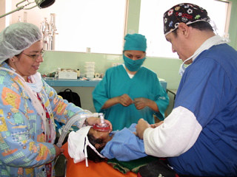
Airway Management of Epiglottitis
Determine severity of obstruction
Determine if intubation is necessary vs. observation
Involve anesthesiologist and otolaryngologist as soon as possible
The provider with the most airway experience should make first intubation attempt

Slide 15
Airway Management of Epiglottitis
If patient is able to maintain airway
Transport to operating room for airway management
Minimize distress to the patient (no awake IV, parental presence if appropriate)
Mask induction with Sevoflurane/Halothane – try to maintain spontaneous ventilation
Propofol, Ketamine, and/or Dexmedetomidine to maintain spontaneous ventilation
Consider Glycopyrrolate to minimize secretions
First intubation attempt with advanced airway equipment (bougie, video laryngoscopy vs. fiber-optic scope)
Back up: tracheostomy tray set up

Slide 16
Airway Management of Epiglottitis
If Patient is not able to maintain airway
Bag valve mask
Transport, if appropriate, to operating room for airway management
Mask induction with Sevoflurane/Halothane – try to maintain spontaneous ventilation
Propofol, Ketamine, and/or Dexmedetomidine to maintain spontaneous ventilation
First intubation attempt with advanced airway equipment (bougie, video laryngoscopy vs. fiber-optic scope)
Back up: tracheostomy tray set up

Slide 17
Airway Management Tips
At least a half size smaller than an age appropriate endotracheal tube should be used due to tissue swelling
Do NOT use a supraglottic airway (laryngeal mask airway) as this can cause further airway obstruction

Slide 18
Antimicrobial Treatment
Ideally draw cultures prior to starting antibiotics
Empiric treatment: third generation cephalosporin (ceftriaxone, cefotaxime) AND anti-staphylococcal agent (vancomycin)
Once susceptibility results are available, adjust antibiotic regimen
Duration of treatment: approximately 7-10 days

Slide 19
Post-Operative Management
All epiglottitis patients should be monitored in an intensive care unit
If the patient is intubated, after 2-3 days of antibiotics, can assess for possible extubation

Slide 20
Post-Operative Management
Extubation considerations
  Resolution of epiglottic/supraglottic swelling
  Air leak
  Can swallow comfortably

Slide 21
Conclusions:
Haemophilus influenza Type B is the most common cause of epiglottitis
Provider with the most airway experience should make first attempt at intubation
Have all the advanced airway equipment available and prepared, including tracheostomy set up

Slide 22
References:
Abdullah, Claude. Acute epiglottitis: Trends, diagnosis, and management. Saudi Journal of Anesthesia, 2012 Jul-Sept; 6(3): 279-281.
Woods, Charles. Epiglottitis (supraglottitis): Clinical features and diagnosis. UpToDate. Sept 2018.
Woods, Charles. Epiglottitis (supraglottitis): Management. UpToDate. Sept 2017.
Images from Creative Commons

