Slide 1
Anesthetic Considerations for Pediatric Patients with Achondroplasia
Andrew J. Costandi MD, MMM
Children’s Hospital Los Angeles
USC Keck School of Medicine
Updated 10/2019

Slide 2
No Relevant Financial Disclosures

Slide 3
Learning Objectives
Describe the pathophysiology of Achondroplasia
Recognize the clinical features and comorbidities associated with achondroplasia
Discuss preoperative evaluation of pediatric patients with achondroplasia
Develop an appropriate anesthetic plan to care for pediatric patients with achondroplasia

Slide 4
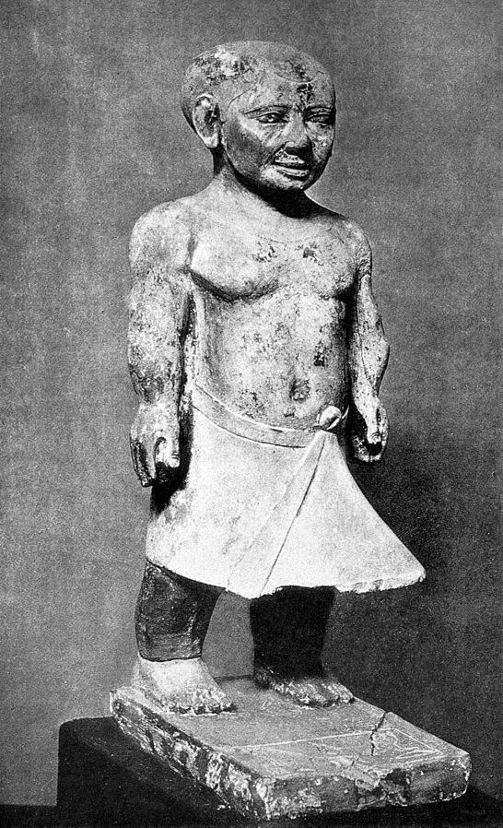
What is Achondroplasia?
“A-khondros-plasisia”:
no Cartilage growth
Ancient Egypt around 2700 BC
1/20,000 live births
Most common cause of short stature or “dwarfism”
Wellcome Collection gallery (2018-04-03): https://wellcomecollection.org/works/cgpb7a6c CC-BY-4.0
Notes:
Achondroplasia is a skeletal dysplasia occurring in 1/20,000 live births and affecting over 250,000 individuals worldwide.
It is the most common cause of short stature or “dwarfism,” with an average adulthood height of 4 feet.
The earliest biological evidence of this type of skeletal dysplasia dates back to ancient Egypt around 2700 BC.
Achondroplasia is derived from the Greek word “a-khondros-plasisia”, which means “no cartilage growth,” but inaccurately describes the actual pathophysiology of the condition.

Slide 5
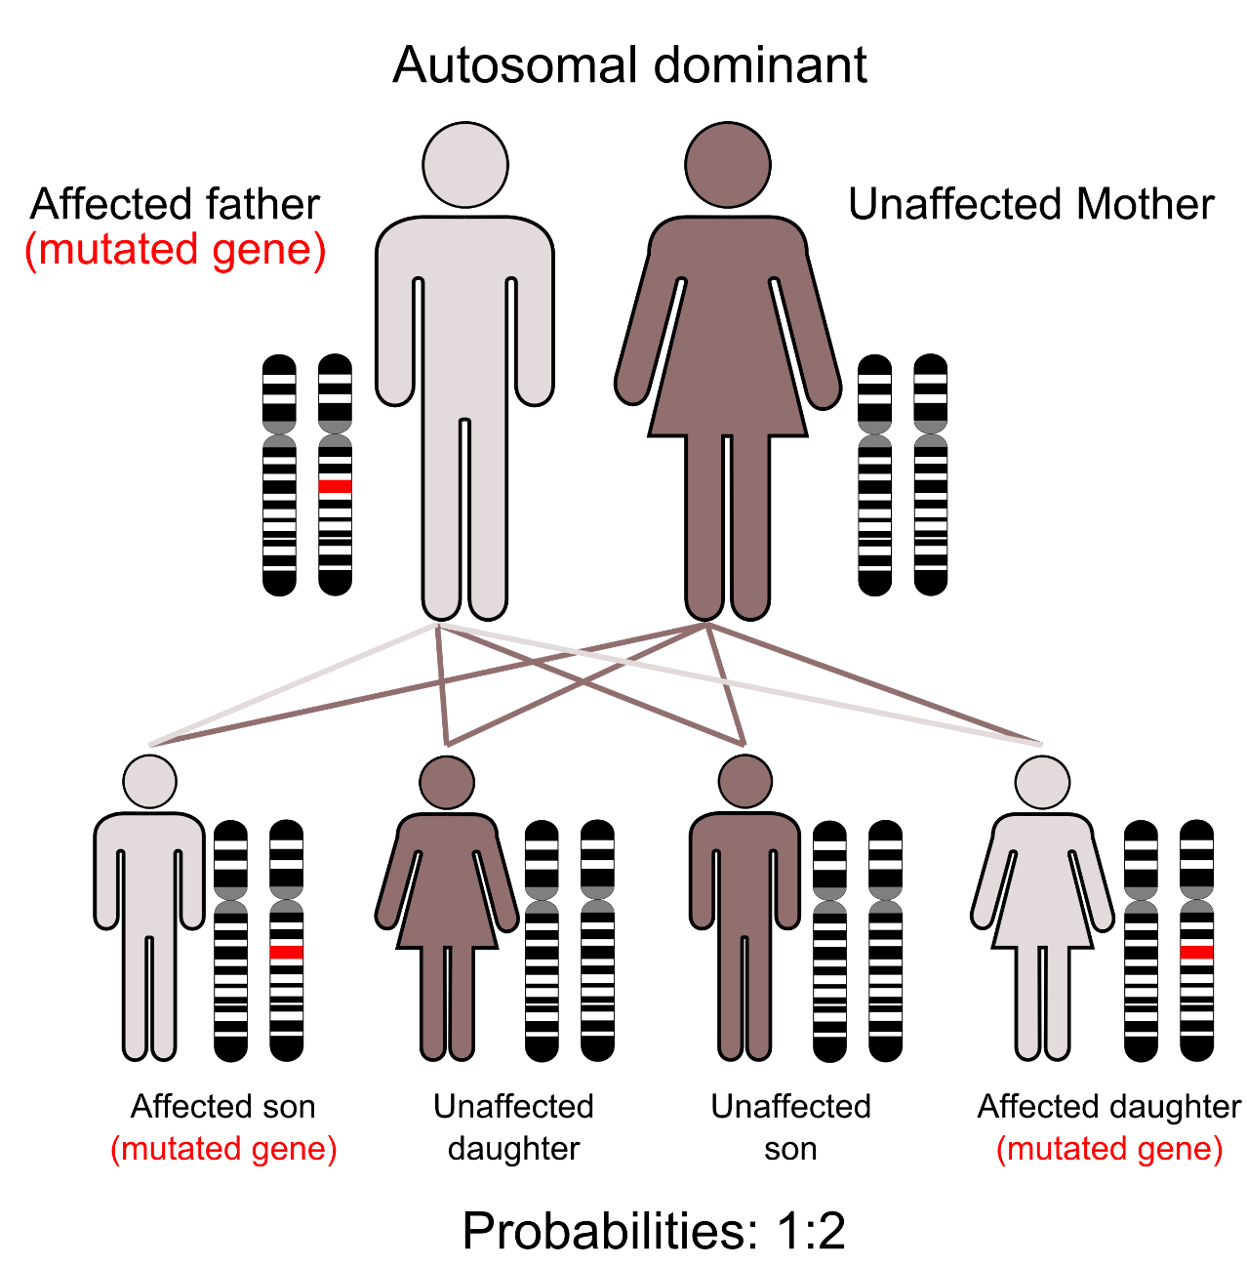
Inheritance
20%
by Kuebi is licensed under CC BY-SA 3.0
Notes:
Inherited in an autosomal dominant fashion. Homozygous achondroplasia is a lethal condition that leads to still birth or mortality in early infancy due to pulmonary hypoplasia and severe respiratory insufficiency resulting from deformed rib cage.

Slide 6
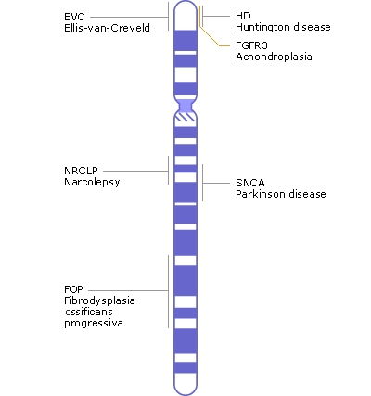
Point Mutation: (80%)
Associated with increased paternal age
New point mutation in the Fibroblast Growth Factor Receptor 3 gene (FGFR3)
Notes:
80 % of cases are a result of a new point mutation in the Fibroblast Growth Factor Receptor 3 gene (FGFR3)

Slide 7
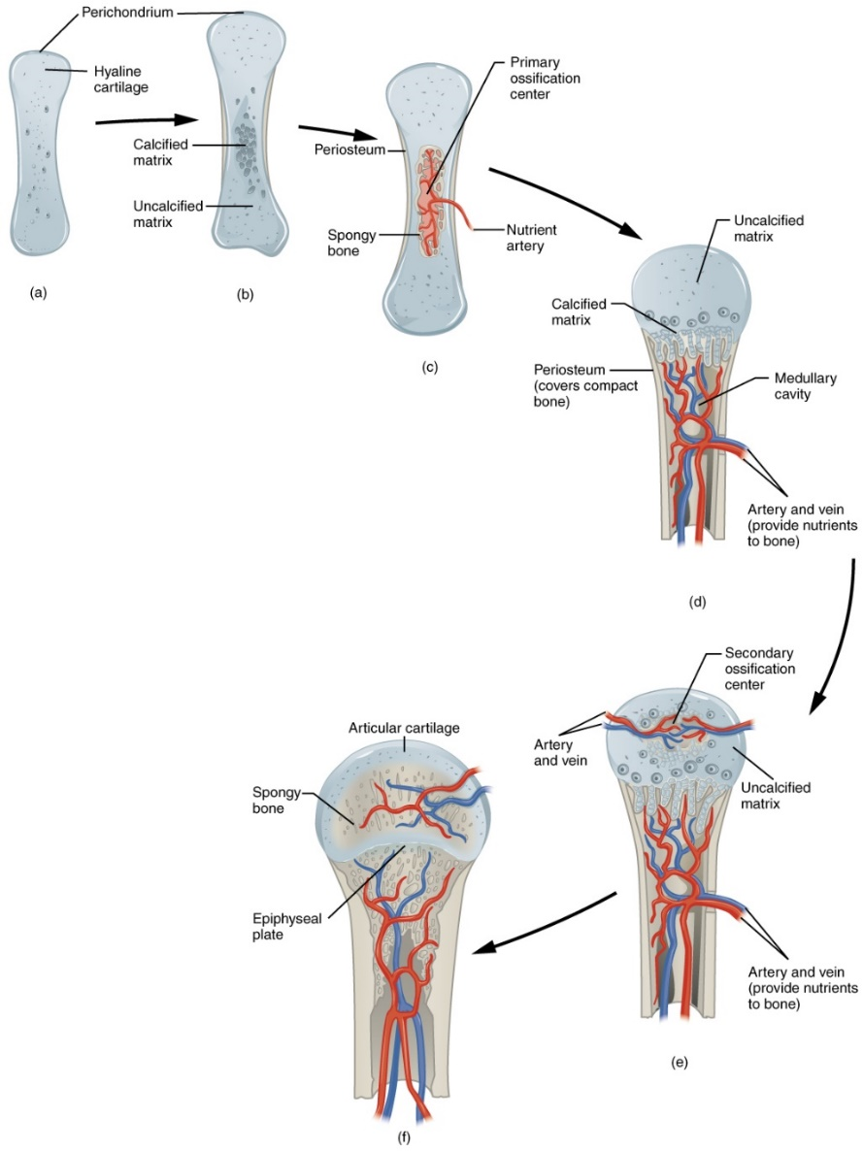
Pathophysiology of Achondroplasia
Over-activation of the FGFR3 receptor expressed in chondrocytes and mature osteoblasts
Inhibition of growth plate size and cartilage proliferation and premature ossification of epiphyseal cartilage
Impaired bone growth during childhood
https://commons.wikimedia.org/wiki/File:608_Endochrondal_Ossification.jpg
Notes:
Physiologically, FGFR3 regulates bone growth by inhibiting endochondral ossification in the long bones
With the point mutation, over activation of the FGFR3 receptor expressed in chondrocytes and mature osteoblasts occurs
As a result, growth plate size and cartilage proliferation are inhibited in association with premature ossification of epiphyseal cartilage, leading to impaired bone growth during childhood. Diagnosis can be made prenatally during the 3rd trimester

Slide 8
Achondroplasia: Common Surgeries and Procedures that Require Anesthesia
Magnetic Resonance Imaging of the spine and brain
Decompressive sub-occipital craniectomy
Cerebrospinal fluid shunting procedures
Adenotonsillectomy & myringotomy tube placement
Various orthopedic procedures including limb lengthening, laminectomies, and kyphoscoliosis correction.

Slide 9
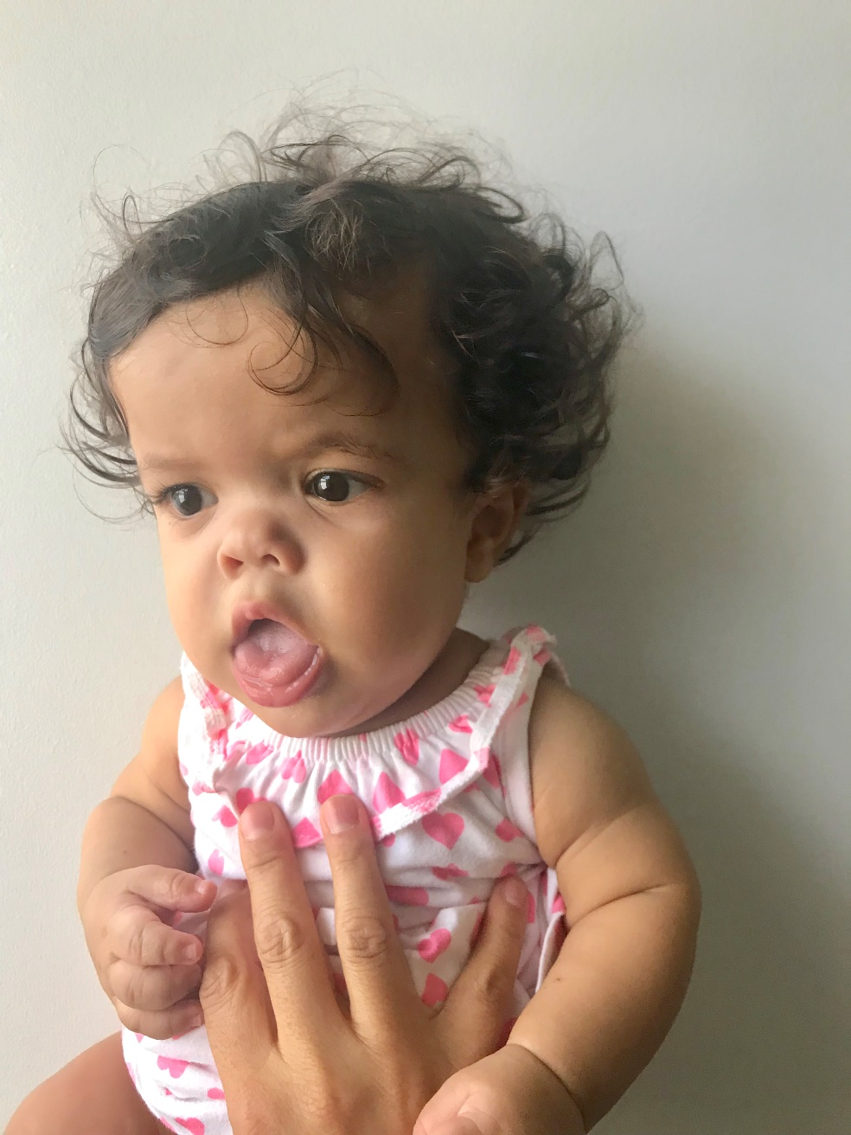
Clinical Features: Craniofacial
Large head
Frontal bossing,
Midface hypoplasia
Large tongue

Slide 10
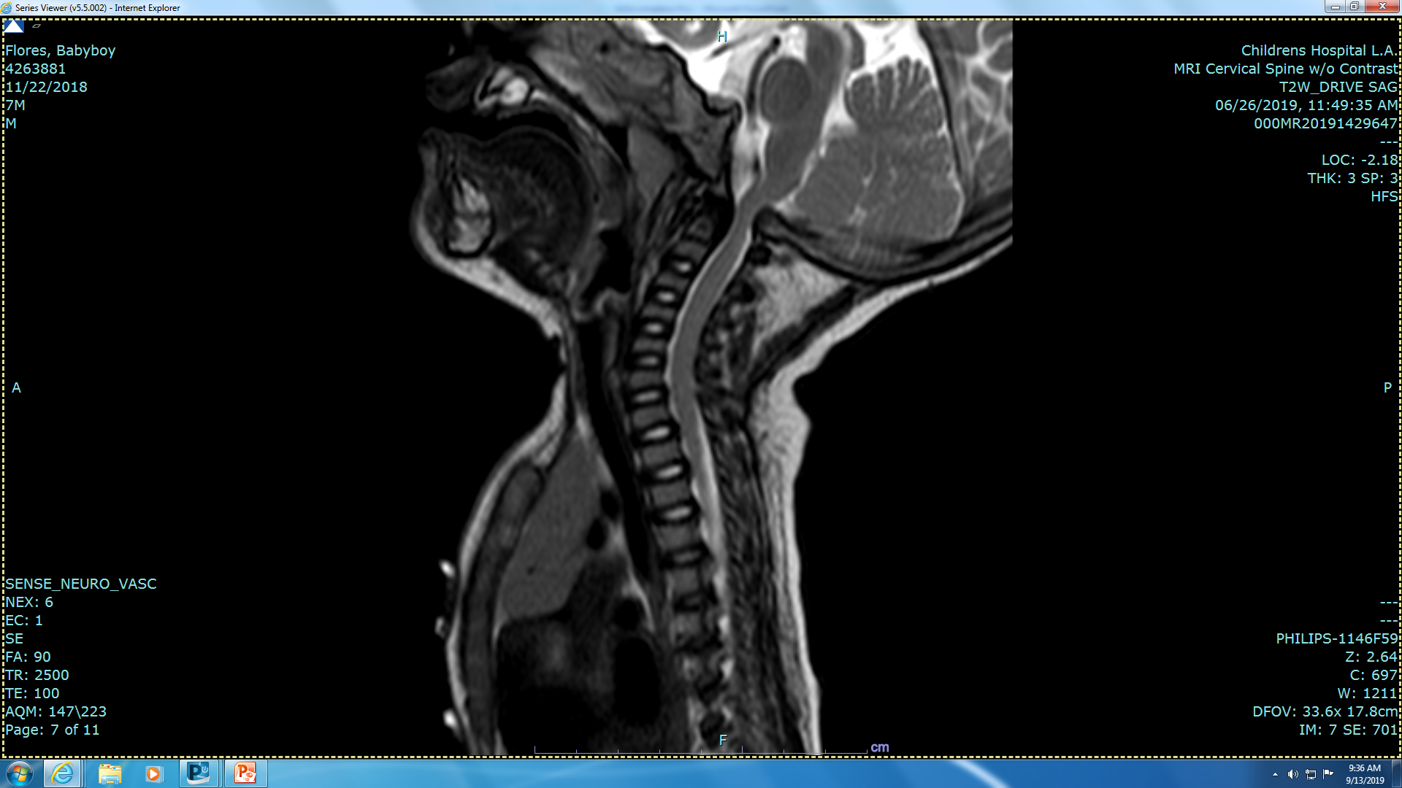
Clinical Features: CNS
Normal intelligence
Delayed motor development
Cervical medullary compression
Cervical myelopathy
Hydrocephalus
Psychosocial problems
Notes:
Affected children may show delay in motor developmental milestones like crawling and walking due to global hypotonia, but this improves as they grow and regain muscle tone.
Most individuals with achondroplasia have normal intelligence and life expectancy, but may face many psychosocial problems.
1.Abnormal bone growth at the level of the foramen magnum and premature fusion at the base of the skull
-> Progressive narrowing of the foramen and cervical canal, leading to cervical medullary compression and cervical myelopathy.
2. Odontoid hypoplasia may result in atlantoaxial sublaxation
3. Enlarged suprasellar cistern.
4. Increased risk of hydrocephalus during the first 2 years of life due to increased intracranial venous pressure or venous obstruction at sigmoid sinus

Slide 11
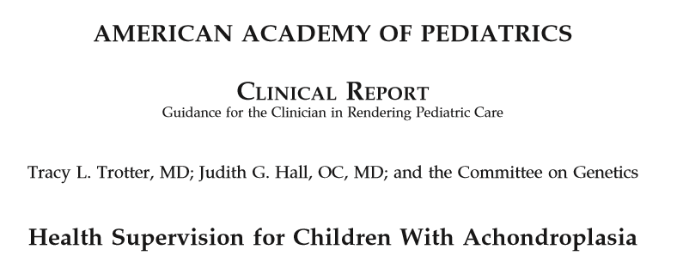
Ten percent of affected individuals suffer from true cervical medullary compression requiring surgical decompression and 2-5% experience sudden infant death in the absence of aggressive evaluation
Notes:
The American Academy of Pediatrics recommends:
Careful neurologic history and examination, polysomnography, and surveillance neuroimaging of the head and neck in the form of CT scan or MRI for all infants with achondroplasia.

Slide 12
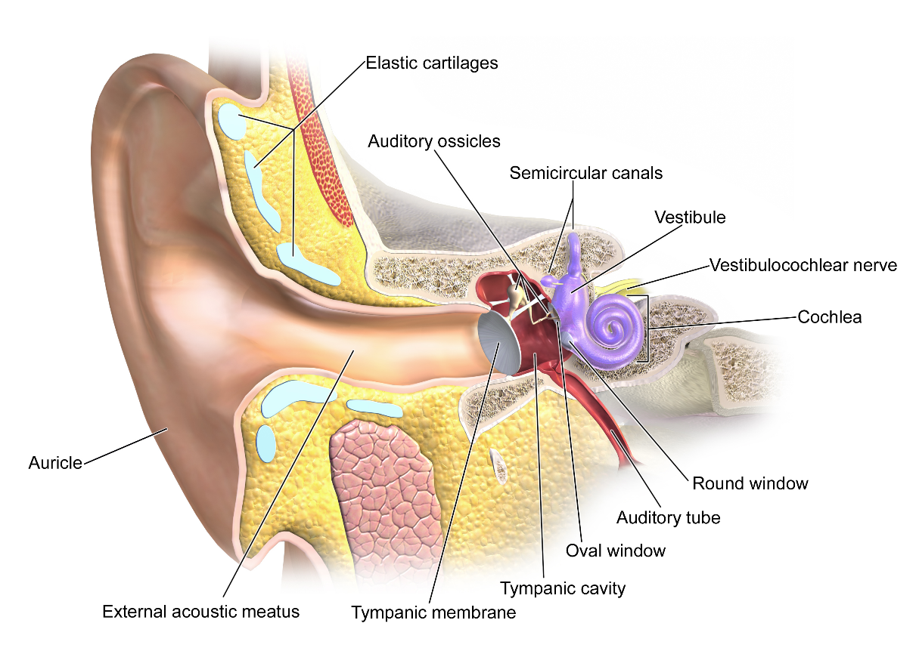
Clinical Features: ENT
Recurrent otitis media
Risk of hearing loss
Language and speech articulation problems
Learning disabilities.
Both central apnea and obstructive sleep apnea
https://commons.wikimedia.org/wiki/File:Blausen_0328_Ear
Notes:
Short eustachian canals, midface hypoplasia, and adenoidal hypertrophy have been attributed to recurrent otitis media, increasing the risk of hearing loss, problems with language and speech, and learning disabilities.
Specific muscles (the levator veli palatini and the tensor veli palatini) cooperate to open the tube regularly with a traction on a cartilaginous structure (these muscles pull the structure made of cartilage). But in a child with achondroplasia, these muscles do not have the same efficacy:
Prevention and aggressive treatment, including ventilatory myringotomy tube placement during childhood, is essential to avert these problems.

Slide 13
Sleep Disordered Breathing (SDB)
Central Sleep Apnea
Medullocervical compression
Obstructive Sleep Apnea
Compression of the lower motor neurons
Altered craniofacial features
Small upper airway
Physiologic adenoidal hypertrophy
Hypotonia of nasopharyngeal airway muscles
Infants with achondroplasia have attenuated arousal response which could play a role in SIDS
Notes:
Sleep disordered breathing is very common among children with achondroplasia.
Both central (CSA) and obstructive sleep apnea (OSA) have been reported with incidences ranging between 40 and 75%, especially in early childhood.
Polysomnography is helpful in predicting the presence of CSA and /or OSA in up to 60% of children with achondroplasia.
CSA is thought to be caused by compression of the medullary respiratory center at the level of the foramen magnum.
Although adenotonsillectomy has a high success rate in treating children with OSA, this rate is much less (60%) in children with achondroplasia.
These patients may require continuous positive airway pressure (CPAP) therapy following adenotonsillectomy due to persistent airway obstruction.

Slide 14
Clinical Features: Cardiopulmonary
Restrictive Lung Disease
Pulmonary hypertension
Cor-pulmonale
Notes:
Restrictive pulmonary disease occurs in less than 5% of children with achondroplasia who are younger than 3 years of age. Recurrent pneumonias from reduced chest circumference and rib hypoplasia, abnormal spine curvature, and obesity alter respiratory mechanics resulting in decreased FRC, increased closing volume, atelectasis and chronic respiratory insufficiency.
While failure to gain weight during childhood can occur due to restrictive lung disease, obesity is also very common later in life and may worsen OSA as well as the genu vara, arthritis, and lumbar lordosis that often plague achondroplastic patients.
Pulmonary hypertension and cor pulmonale may develop as a result of chronic respiratory insufficiency, sleep apnea, kyphoscoliosis, and the associated chronic hypoxemia and hypercarbia.
A 42 year follow up study looking at premature death rates in patients with achondroplasia showed a ten-fold increase of heart disease related mortality between ages 25-35 years old compared to general population.

Slide 15
Clinical Features: Gastrointestinal
Children with Neuro-Respiratory Complications:
Severe Gastroesophageal Reflux (GERD)
Hyper salivation
Chronic aspirations
Notes:
A subcategory of patients present with severe gastroesophageal reflux with tendency for hyper salivation.
More common in children with neuro-respiratory complications and may lead to chronic aspirations and worsen their respiratory problems.

Slide 16
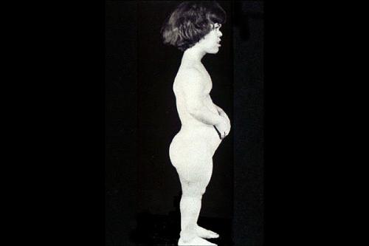
Clinical Features: Musculoskeletal
Thoracolumbar kyphoscoliosis
Worse during infancy
Improves with age
Lumbar lordosis
Worsens with Age
Notes:
Thoracolumbar kyphoscoliosis
worst during infancy due to poor muscle tone and unsupported sitting.
Resolve with age as muscle tone improves and the child starts walking
Lumbar lordosis
Becomes more pronounced as the child grows and commonly leads to lumbar spine stenosis in adulthood presenting as weakness and altered deep tendon reflexes in the lower extremities.

Slide 17
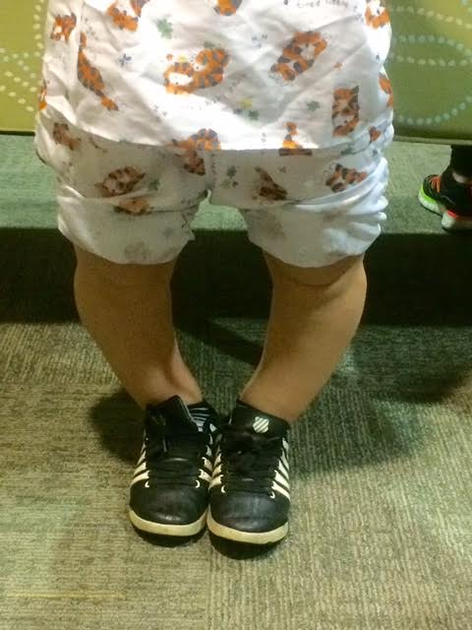
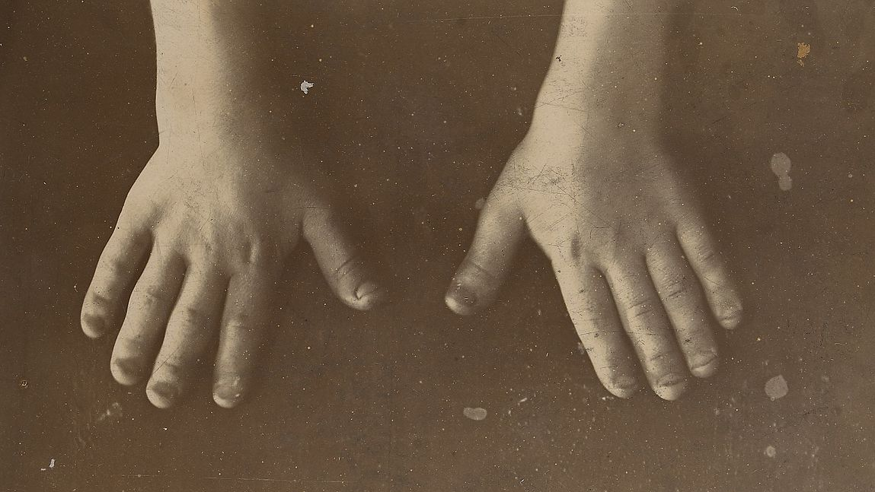
Clinical Features: Musculoskeletal
Rhizomelic Shortening
Brachydactyly
Genu varum
Notes:
Disproportionate proximal shortening of both upper and lower results in limited elbow mobility and lower extremity axis deviation.
Brachydactyly
Genu varum
Shortening of the upper arms and thighs leads to an altered trunk to limb ratio.
40-50% of affected individuals present with bowing of both lower legs (genu varum). This is usually a result of lax joints early in childhood, and tibial bowing and fibular overgrowth later in life.

Slide 18
Preoperative Evaluation
Preoperative history and exam should focus on:
Airway: potential difficult ventilation and intubation
Cardiopulmonary Status:
  Restrictive lung diseases,
  pulmonary hypertension
  Cor-pulmonale
Neurological Status
  Baseline neurological exam
  Consider baseline neuro-imaging
Notes:
Patients with achondroplasia should be thoroughly evaluated with an emphasis on:
Airway Management:
Clinical craniofacial features suggestive of potentially difficult mask ventilation and intubation include: obesity, large head, maxillary hypoplasia, saddle nose, nasopharyngeal hypotonia, and odontoid hypoplasia with atlantoaxial instability.
Cardiopulmonary Status:
Patients with restrictive lung diseases, pulmonary hypertension, cor pulmonale, and heart disease may warrant echocardiography, pulmonary function tests, chest radiography, and a baseline blood gas analysis
Neurological Status
Thorough baseline neurological evaluation & neuroimaging should be considered

Slide 19
Preoperative Medication
Anxiolytics: Emotional and Physical Stress
Anti-sialagogues: Helps with Fiberoptic intubation (FOI)
Histamine H₂ antagonists: GERD patients
Notes:
Emotional and physical stress, due to multiple surgical procedures, contribute to heightened anxiety.
Anxiolysis may be beneficial, but should be used judiciously., especially with those at risk of difficult airway management and sleep apnea.
Anti-sialagogues may be considered in patients with excessive salivation to minimize aspiration and help with fiberoptic visualization during intubation.
Histamine H₂ antagonists should also be considered in the subcategory of patients experiencing severe gastroesophageal reflux.

Slide 20
Perioperative Management
Monitors
ASA standard monitoring.
Challenging BP cuff size
Invasive monitoring:
  Surgical procedure
  Patient’s baseline cardiopulmonary function.
Notes:
ASA standard monitoring should be utilized in all patients.
Right size blood pressure cuff could be challenging.
Invasive monitoring such as arterial cannulation, central venous pressure as well as transesophageal echocardiogram (TEE) is determined on a case by case basis depending on surgical procedure and patient’s baseline cardiopulmonary function.

Slide 21
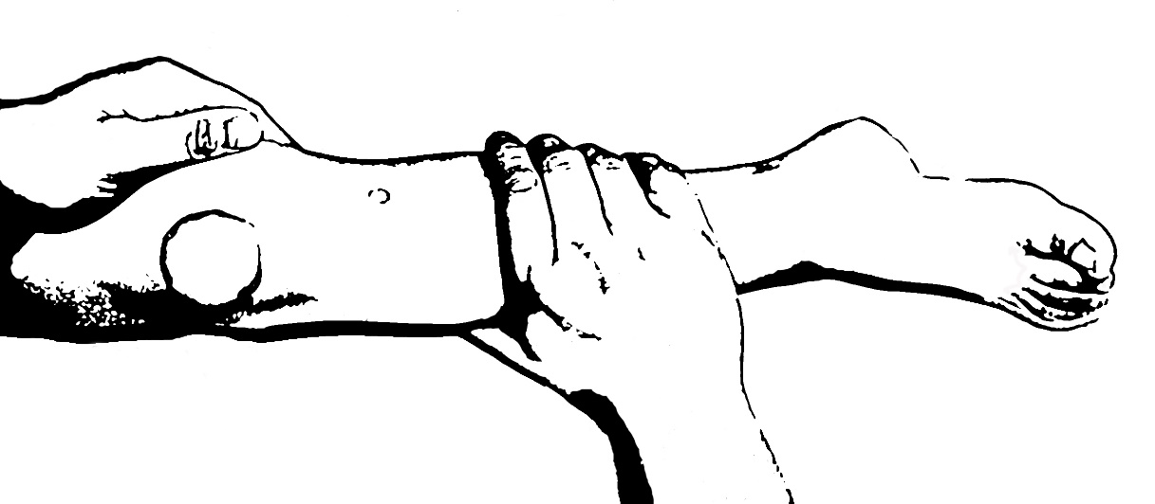
Perioperative Management
Difficult Peripheral Access:
  Short proximal extremities
  Redundant soft tissue
  Increased subcutaneous fat
  Contracted joints
Difficult Central Access:
  Short neck and large head: difficult internal jugular access
  Narrow deformed chest: difficult subclavian access
  Contracted Hips : difficult femoral
Notes:
Difficult Peripheral Access:
Short proximal extremities
Redundant soft tissue
Increased subcutaneous fat
Contracted joints.
Difficult Central Access:
Short Neck : IJ
Narrow deformed chest: Subclavian
Contracted Hips : Femoral
Use vessel visualization equipment (like vein viewer)
Ultrasound guidance is encouraged when CVP is needed.
Use of Intraosseous (IO) route is not reported in literature.

Slide 22
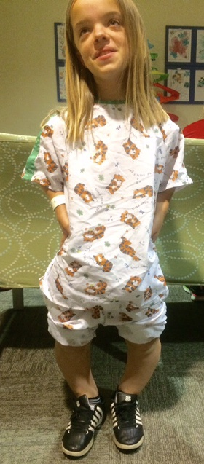
Perioperative Management
Positioning
Knee joints are often very lax
Hip & elbow Joints often have limited mobility and contractures
Temperature
Head is relatively large and patients can lose heat through their head
Warm the operating room and cover the head
Notes:
Care and proper positioning should be exercised while positioning patients on operating tables as joints present with a mixed pattern.
Knee Joint: Exaggerated lax joints are prone to accidental injuries under anesthesia
Hip & Elbow Joints: Limited mobility and contractures necessitate adequate padding.
Head is relatively big -> Significant drop in body temperature -> Adjusting the ambient room temperature and covering the head is recommended.

Slide 23
Perioperative Management
Pediatric patients with achondroplasia may have difficult airways to manage
Review airway management on previous anesthetic records
Maintain spontaneous ventilation if possible
Ventilatory difficulty with chronic lung disease patients
Mask ventilation may be challenging
Supraoglottic airways may not fit well and a variety of sizes and types should be available
Notes:
Multiple studies in the literature reported difficult mask ventilation and intubation in only 5-10% of achondroplastic children.
The possibility of difficult airway management should always be kept in mind.
Previous airway management records should be obtained when possible
Maintaining spontaneous ventilation is encouraged.
Mask Ventilation in the presence of midface hypoplasia?
Establishing mask ventilation is imperative before administering neuromuscular blockade.
LMA?
Distorted craniofacial anatomy may complicate an optimal fit for LMA
Restrictive lung disease may cause increased ventilatory difficulty

Slide 24
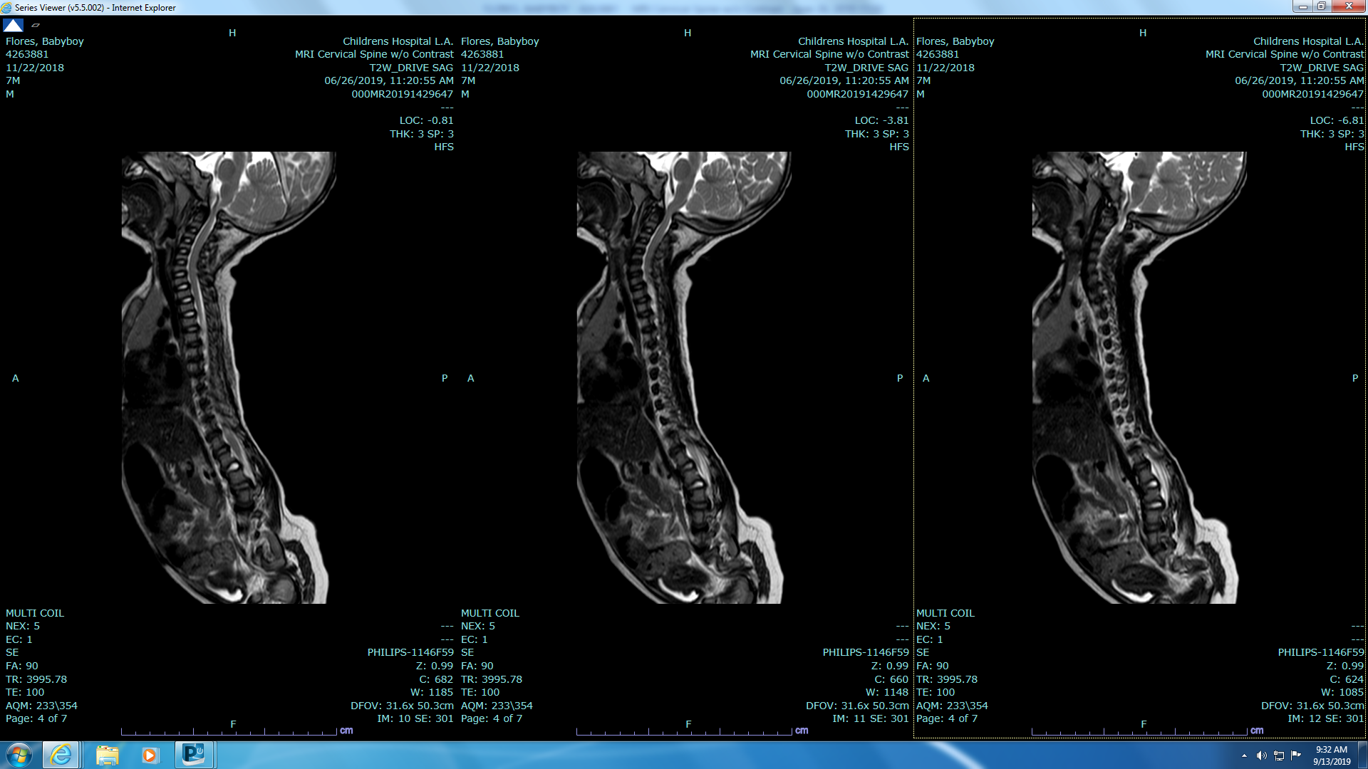
Airway Management
Caution should be exercised while manipulating the neck during intubation
Foramen magnum stenosis
Odontoid hypoplasia
Cervical kyphosis
Cervical neck fusion
Large tongue
Narrow nasopharynx
Recommend In line stabilization and Video-laryngoscope or Fiberoptic bronchoscope for intubation
Notes:
Caution should be exercised while manipulating the neck during intubation
Foramen Magnum Stenosis
Odontoid Hypoplasia
Conventional direct laryngoscopy
Cervical kyphosis
Cervical neck fusion.
Large Tongue
Narrow Nasopharynx
In line stabilization using Glidescope vs FOB
ET size: In children a smaller ETT is often required due to laryngeal hypoplasia and arytenoid hypertrophy.

Slide 25
Intraoperative Management
Intravenous and inhalational anesthetic agents
Medication dosages based on weight.
Multimodal analgesia with sleep apnea.
For patients with cardiopulmonary compromise:
  Maintain blood pressure
  Maintain adequate tidal volume
  Avoid hypoxia and hypercarbia
Notes:
Intravenous anesthetics and inhalational agents have both been used without issues.
Medication dosages should be based according to weight.
A multimodal analgesic approach is preferred especially in the presence of sleep apnea.
For patients with cardiopulmonary compromise, all efforts should be taken to maintain adequate tidal volume, avoid hypoxia and hypercarbia, both of which worsen pulmonary hypertension.

Slide 26
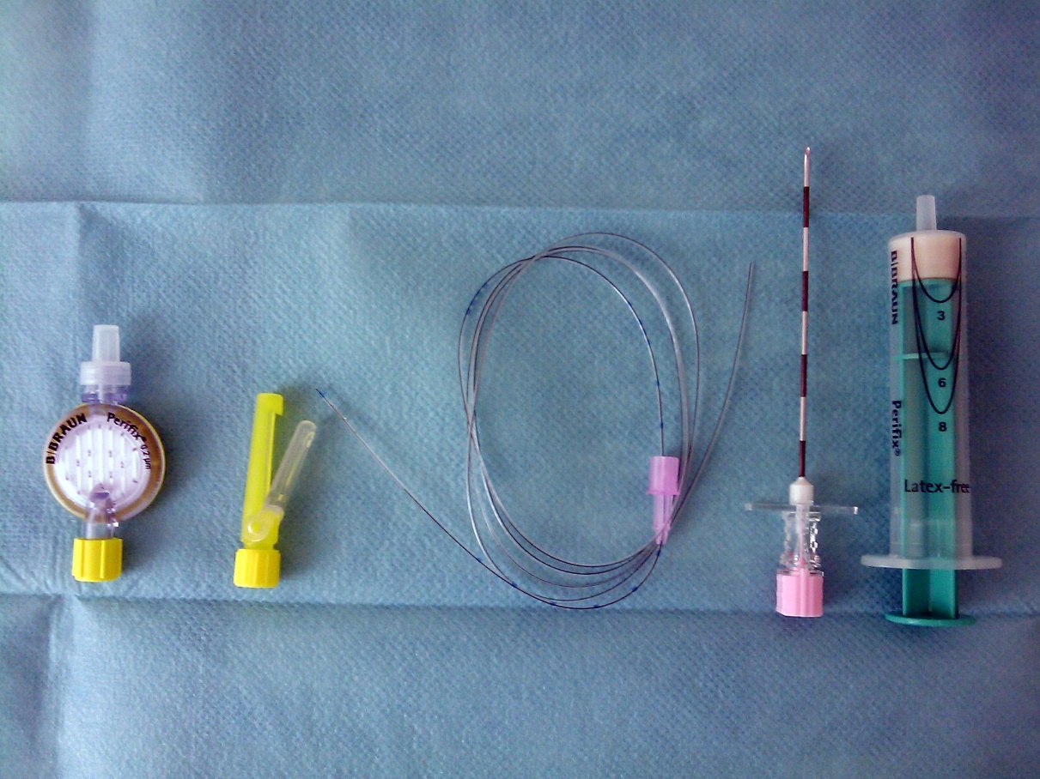
Regional Anesthesia
Epidural catheter
Spinal single injection
Single caudal injection
Caudal catheter
Peripheral nerve blocks
Notes:
Neuraxial blocks may be technically difficult:
Stenosed spinal canals
Decreased lumbar interpedicular distances
Kyphoscoliosis, lordosis
Osteophyte formation
Engorged epidural veins
Reduced epidural space
Contracted Hips
Epidural Catheter Analgesia:
Narrow epidural space with engorged veins increase the incidence of inadvertent dural or venous puncture, as well as difficulty in placing epidural catheters and reliability of local anesthetic spread
In children, injection of local anesthetic into the caudal canal is easier and more predictable.
Needle placement and catheter insertion for peripheral nerve blocks could sometimes prove challenging especially in the presence of joint contracture.
Epidural Catheter Analgesia:
Difficulty in placing epidural catheters
Inadvertent dural or venous puncture
Dural puncture difficult to detect
Reliability of local anesthetic spread
Spinal
Difficulty in identifying the space
Unreliable spread
Concerns for high spinal
Caudal Injection in children
Relatively easy and more predictable.
Caudal Catheter
Relative difficulty in advancing catheter in the presence of lumbar lordosis
Peripheral nerve blocks can be performed following careful documentation of preexisting abnormalities.
Can be technically difficult because of poor landmarks, contracted joints.
Ultrasound guided block recommended

Slide 27
Conclusions
Autosomal dominant disorder caused by mutations in the fibroblast growth factor receptor 3 (FGFR3) gene
Achondroplasia presents with unique craniofacial, short stature with disproportionate trunk to limb ratio due to rhizomelic shortening of the limbs.
Life threatening in 5 - 10% of affected individuals.
Preoperative anesthetic evaluation should focus on assessment of airway, neurological and cardiopulmonary function
With appropriate knowledge and proper care, anesthesia can be delivered safely to pediatric patients with achondroplasia

Slide 28
References
Horton WA, Hall JG, Hecht JT. Achondroplasia. Lancet. 2007;370(9582):162–172.
American Academy of Pediatrics Committee on Genetics Health supervision for children with achondroplasia. Pediatrics. 1995;95(3):443–451.
Sisk EA, Heatley DG, Borowski BJ, Leverson GE, Pauli RM. Obstructive sleep apnea in children with achondroplasia: Surgical and anesthetic considerations. Otolaryngol Head Neck Surg 1999;120:248-54.
Jain A, Jain K, Makkar JK, Mangal K. Anaesthetic management of an achondroplastic dwarf undergoing radical nephrectomy. S Afr J Anaesthesiol Analg 2010;16:77-9.
Krishnan BS, Eipe N, Korula G. Anaesthetic management of a patient with achondroplasia. Paediatr Anaesth. 2003 Jul;13(6):547-9.
Kalla GN, Fening E, Obiaya MO. Anaesthetic management of achondroplasia. Br J Anaesth. 1986 Jan;58(1):117-9.
Mayhew JF, Katz J, Miner M, Leiman BC, Hall ID. Anaesthesia for the achondroplastic dwarf. Can Anaesth Soc J. 1986 Mar;33(2):216-21.
Di Nardo SK. Anesthetic consideration for the achondroplastic dwarf. AANA J 1988 Feb;56(1):42-

