Slide 1
Abdominal Wall Defects:
Omphalocele vs. Gastroschisis
Francine S Yudkowitz, MD FAAP
Professor of Anesthesiology,
Perioperative and Pain Medicine, and Pediatrics
Icahn School of Medicine at Mount Sinai
The Mount Sinai Hospital
New York, NY
Updated 5/2017

Slide 2
Disclosures
No relevant financial relationships

Slide 3
Learning Objectives
Compare and contrast omphalocele and gastroschisis
Perform an appropriate preoperative evaluation
Formulate an anesthetic plan including fluid management and prevention of heat loss
Identify when primary vs. staged closure is performed
Describe the postoperative management

Slide 4
Embryology
Gut in yolk sac 5-9 weeks gestation
Gut returns to abdomen 9-11 weeks

Slide 5
Etiology
Omphalocele
Gastroschisis
Failure of gut to return to the abdomen
Peritoneal sac
Umbilical cord attached
Vascular abnormality
  omphalomesenteric artery
  right umbilical vein
Ischemia in R paraumbilical area allowing for rupture of abdominal wall
No sac
Notes:
Omphalocele - there is a failure of the cephalic, lateral, and caudal folds at umbilical ring to fuse so when the midgut elongates during 7-12 weeks of gestation it herniates into the umbilical cord and fails to return to the abdominal cavity even though it is now large enough to accommodate intraabdominal organs. Therefore, a peritoneal sac is around the herniated bowel and the umbilical cord is attached.
Gastroschisis – abnormal development of either the omphalomesenteric artery or right umbilical vein resulting in ischemia in the paraumbilical area. Abnormal development of the mesoderm leads to dysplastic abdominal wall growth that ruptures when the intraabdominal organs grow and exert pressure on the abdominal wall. Therefore, no periotneal sac.

Slide 6
Location
Omphalocele
Gastroschisis
Epigastric
Mid-abdominal
Hypogastric
Right lateral to umbilicus
Notes:
Omphalocele is a midline structure whereas gastroschisis is separate from the umbilicus and to the right.

Slide 7
Size
Omphalocele
Gastroschisis
2-5 cm
Vertical
Small and large intestine
Rarely liver
< 4 cm (umbilical cord herniation)
> 4 cm
> 10 cm
  Giant omphalocele
  Liver may be in sac (30-50%)
Notes:
Liver herniation is associated with small abdominal cavity and pulmonary hypoplasia.

Slide 8
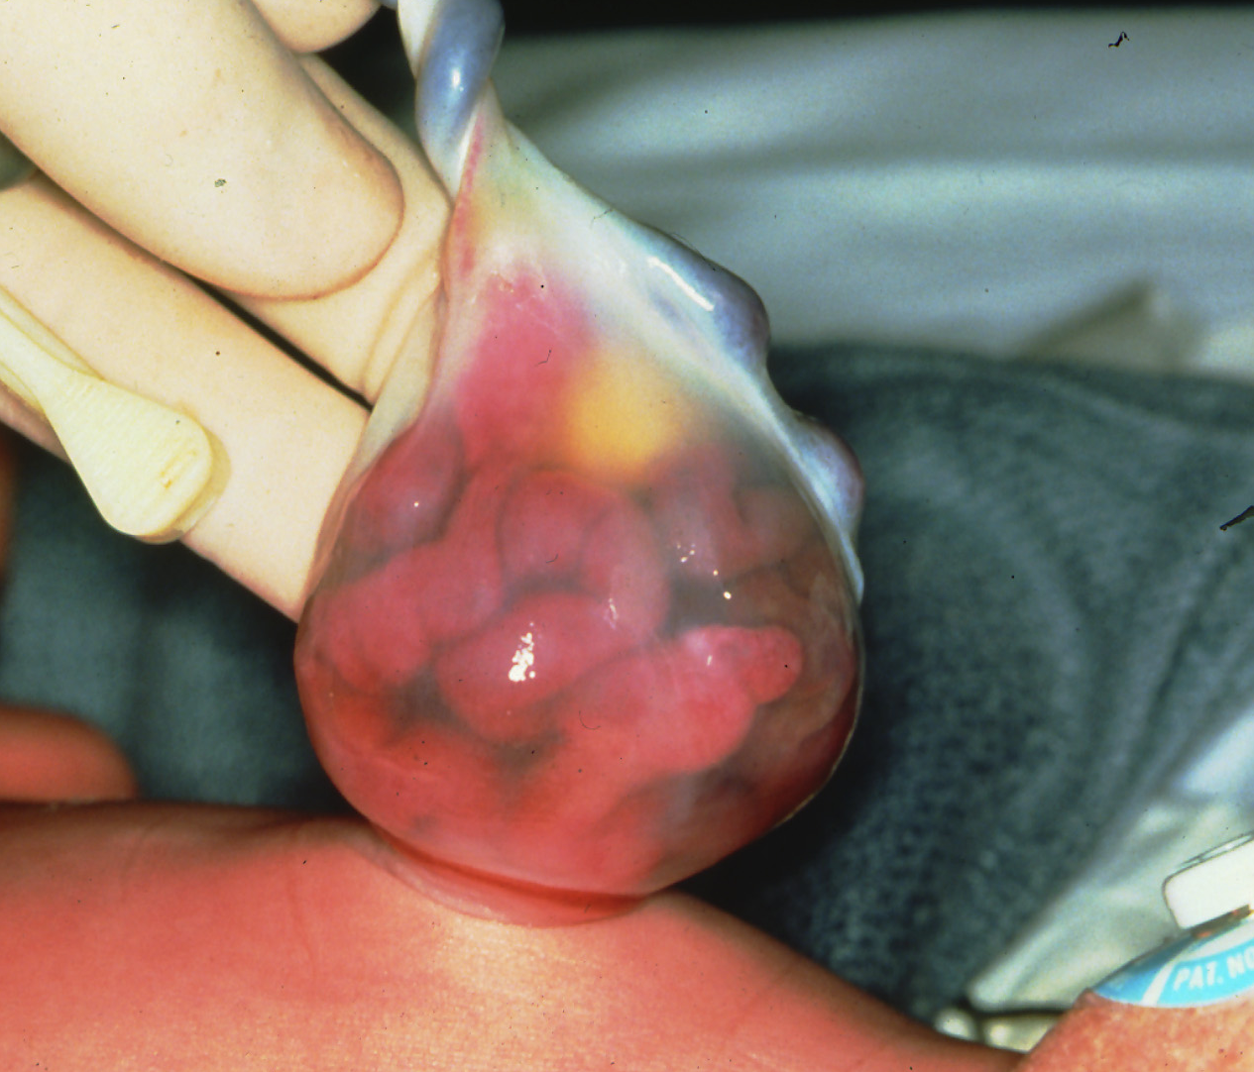
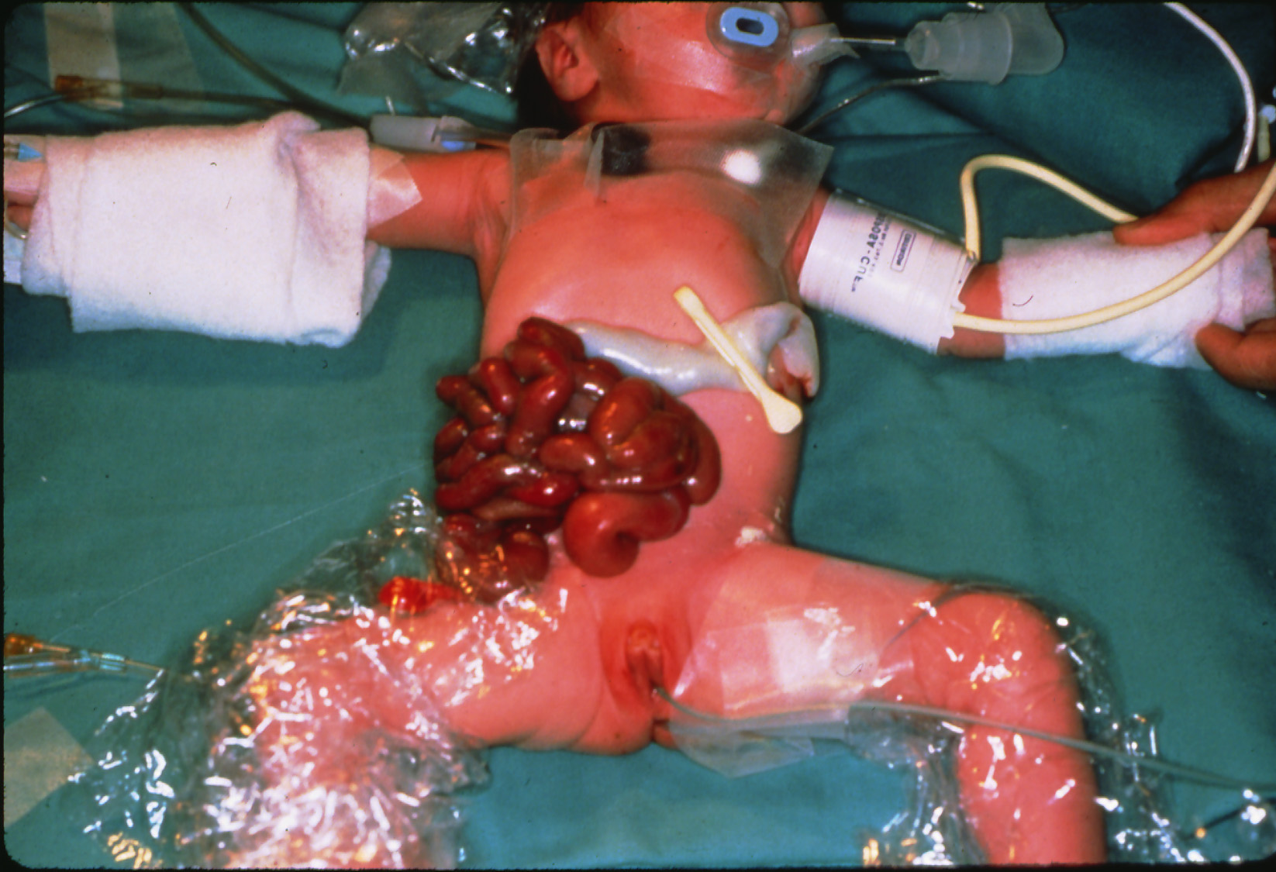
Abdominal Wall Defects
Omphalocele
Gastroschisis
Notes:
Notice that in the omphalocele the intestines are contained in a sac with the umbilical cord at the top of the sac.
Gastroschisis, the defect is right lateral to the umbilicus. It may be hard to appreciate but the defect does not involve the umbilical cord. Note the matted and thickened appearance of the bowel in gastroschisis secondary to exposure to amniotic fluid in utero.

Slide 9
Epidemiology
Omphalocele
Gastroschisis
1:4000-7000
Advanced maternal age
Full-term
Congenital anomalies in ~50%
Chromosomal abnormalities in ~20%
  13, 15, 18, and 21
1:3000-8000
Young mothers (< 20 y.o.)
Smokers
Preterm
Low birth weight
GI abnormalities
  malrotation
  atresia
  volvulus
Notes:
Omphalocele is commonly associated with other congenital anomalies and/or chromosomal abnormalities (13, 15, 18, 21). Malrotation – incomplete rotation of the gut – may occur in both but atresias most commonly occur in gastroschisis.

Slide 10
Omphalocele: Associated Abnormalities
Approximately 60% have 1 associated anomaly
CVS - Congenital heart disease
GI - Imperforate anus, malrotation
GU - Bladder exstrophy
Craniofacial - cleft palate
Chromosomal – 13, 15, 18, and 21
Notes:
Approximately 60% of patients with omphalocele will have at least one associated anomaly.

Slide 11
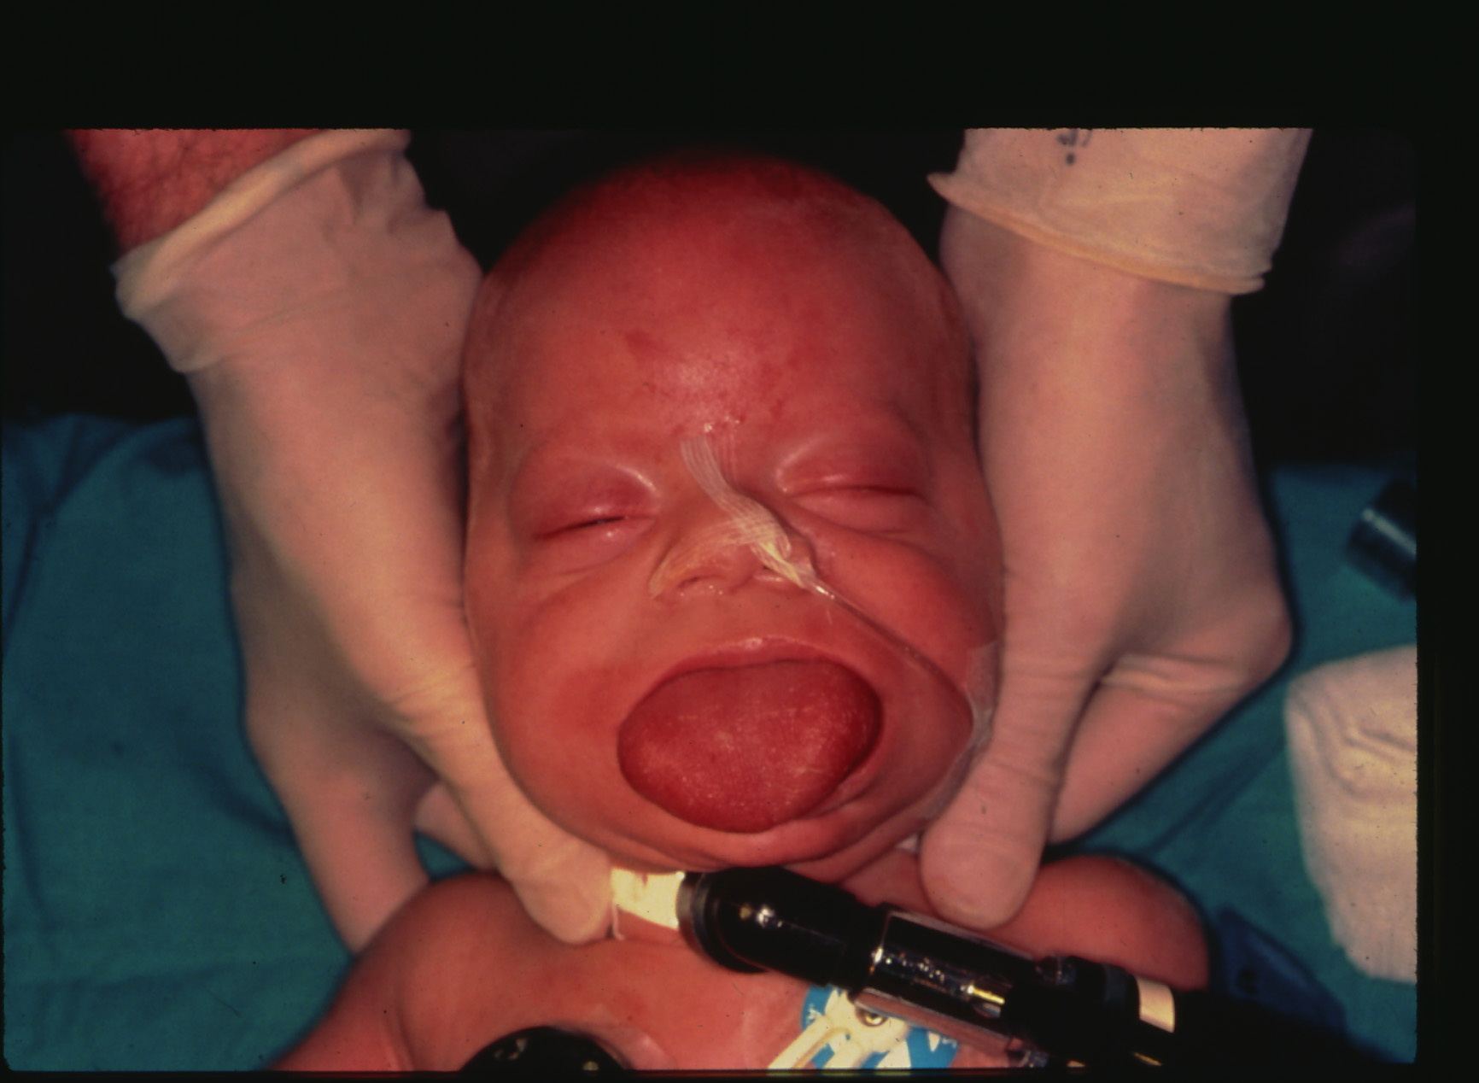
Omphalocele: Syndrome
Beckwith-Wiedermann Syndrome
Omphalocele
Organomegaly
Macroglossia
Hypoglycemia
Notes:
Syndrome associated with omphalocele. Macroglossia can result in obstruction of the airway and may require a surgical airway.

Slide 12
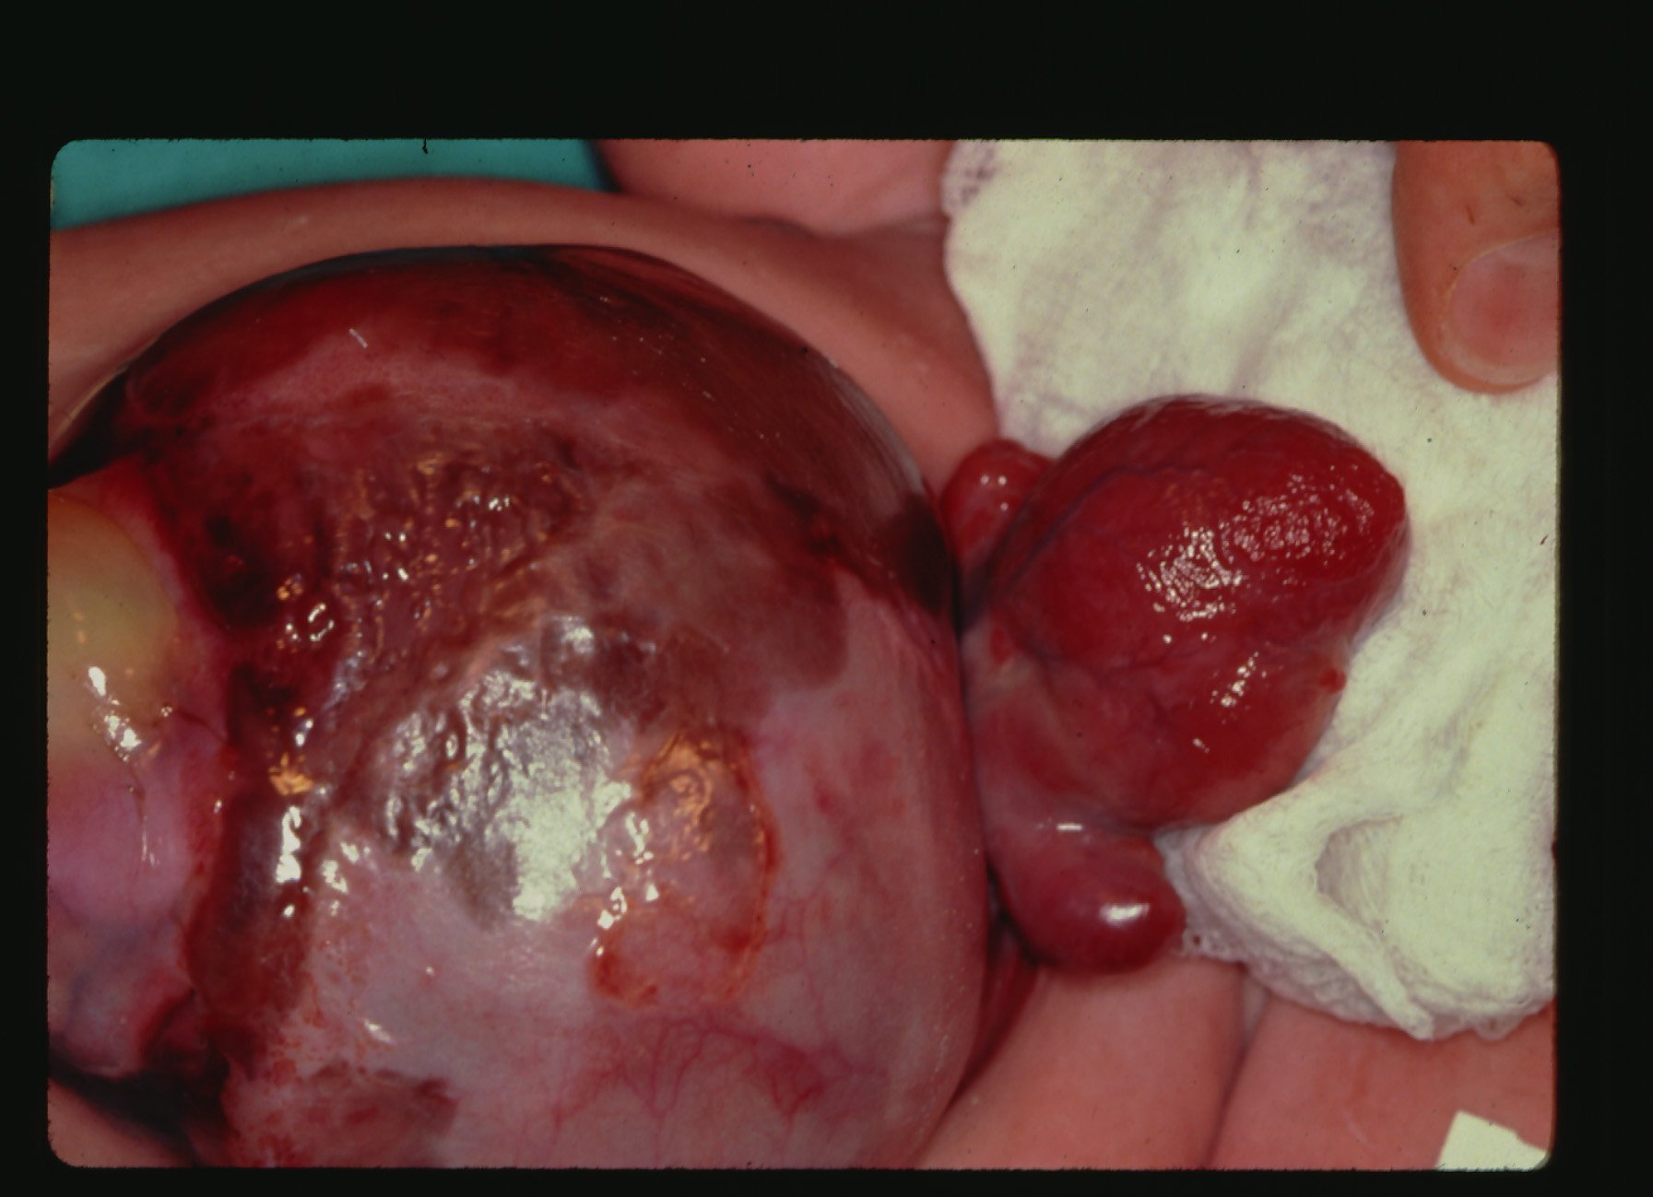
Omphalocele: Syndrome
Pentalogy of Cantrell
Epigastric omphalocele
Sternal cleft
Anterior diaphragmatic defect
Pericardial defect
Cardiac lesion (ASD, VSD, TOF)
Notes:
Pentalogy of Cantrell consists of 5 components as listed above. In the picture the head of the patient is to the right and the legs to the left. The heart can be seen on the right above the omphalocele.

Slide 13
Omphalocele: Syndrome
OEIS
  Omphalocele
  Exstrophy of the bladder
  Imperforate anus
  Spinal defect

Slide 14
Preoperative Concerns
Fluid resuscitation
Heat loss
Sepsis
Trauma to intraabdominal organs
Notes:
Preoperative management consists of fluid resuscitation, measures to decrease heat loss, treatment of sepsis, and preventing trauma to the intraabdominal organs. Although both lesions will require some fluid resuscitation and prevention of heat loss, this will be a greater concern in gastroschisis.

Slide 15
Fluid Resuscitation
Gastroschisis > omphalocele
Loss of fluid secondary to peritonitis, edema, and third spacing
  Hypovolemia
  Hemoconcentration
  Metabolic acidosis
Isotonic fluids (without glucose)
  10-15 mL/kg/hr (may need 60-120 mL/kg/hr)
Adequate resuscitation
  Heart rate and blood pressure
  Capillary refill
  Urine output (1-2 mL/kg/hr)
Monitor electrolytes and acid-base balance
Glucose should be administered in maintenance fluids
Notes:
Although there is fluid loss in both abdominal wall defects, this occurs to a greater extent in gastroschisis because of the exposed bowel. Fluid loss results in hypovolemia, hemoconcentration, and metabolic acidosis. Resuscitation of fluid loss should be with isotonic fluids (without glucose) and anticipate need for large volume of fluid to maintain euvolemia. Adequate fluid resuscitation can be monitored by: heart rate, BP, capillary refill, and urine output. Glucose infusion at maintenance rate should be administered to prevent hypoglycemia. Glucose, electrolytes, and acid-base balance should be monitored as well.

Slide 16
Heat Loss
Large surface area exposed
Radiant warmer
Cover defect with non-adherent dressing
  Warm saline gauze
    Quickly loses warmth and may promote cooling if not constantly changed
  Bowel bag
Notes:
Heat loss is a serious problem because of the large surface area exposed. Again, this will be greater in gastroschisis vs. omphalocele. The newborn should be placed under a radiant warmer and the bowel covered, whether with a bowel bag (sterile plastic bag) or warm saline soaked gauze. Important to not use material that will adhere to the bowel. Also, need to maintain the warm saline soaked gauze because it will lose its warmth and result in cooling of the newborn.

Slide 17
Sepsis
Antibiotic may need to be started

Slide 18
Trauma
Incarceration at exit site: Careful not to twist the bowel at the base
Blunt injury to exposed bowel
Place nasogastric tube to decompress the stomach
Notes:
Care should be taking to avoid trauma to the exposed organs. There may be incarceration at the exit site and must be careful when handling the newborn to not cause direct trauma to the exposed organs or twist them at the base.

Slide 19
Timing of Surgery
Omphalocele
Not emergent/urgent
Preoperative evaluation should include identifying:
  Congenital anomalies: CVS and renal
  Chromosomal abnormalities
Giant omphalocele
  Urgent
Gastroschisis
Emergent/urgent
Preoperative evaluation directed at:
  Volume status
  Electrolyte/Acid-base balance
Notes:
Omphalocele in the majority of cases is not emergent or urgent. Because omphalocele is commonly associated with other congenital anomalies and chromosomal abnormalities, these should be investigated prior to any operative procedure. In assessing these other abnormalities, the decision to proceed to surgery will depend on the severity/stability of the associated findings. Of the congenital anomalies, the cardiac and renal system is of utmost importance and will impact anesthetic management. A giant omphalocele will be considered more urgent because of the organs involved in the hernia and the high risk for rupture if not treated early.
Gastroschisis is emergent. Ongoing fluid and heat loss will be ongoing until the defect is repaired. Also, sepsis and trauma to the organs is an ongoing concern. There is a small subset of patients with gastroschisis in which the surgeon may choose NOT to take to the operating room initially but rather will place a silo to protect the bowel and over the next few days will slowly push the bowel back into the abdomen. Once most of the bowel has been reduced, the baby will be taken to the operating room for definitive closure of the defect.

Slide 20
Intraoperative Concerns
Airway
  “Full stomach”
  Rapid sequence induction
Fluid management
  D5/D10 at maintenance
  Isotonic fluid 10-15 mL/kg/hr (may need much more)
Prevent heat loss
  Warm operating room (27⁰-29⁰C)
  Warming blanket
  Fluid warmer
  Place plastic barriers on all sides of the patient
Notes:
In most cases, the newborn should be considered to have a “full stomach” because of the concomitant GI abnormalities. Therefore, a rapid sequence induction with cricoid pressure should be performed. Induction agent used will depend upon the volume status of the newborn. It may be prudent to bolus (10-20 mL/kg/hr) with isotonic fluid prior to induction to prevent hypotension that may result. Fluid management is similar to the preoperative management, glucose infusion at maintenance to prevent hypoglycemia and isotonic fluid for fluid losses. It is important to employ all modalities available to prevent heat loss – warming the OR, fluid warmer, and warming blanket. It is very common that during the course of surgery, irrigation fluid and fluid losses from the bowel will accumulate around the patient resulting in the patient lying in a pool of liquid. This will contribute to heat loss. One method to prevent this is to place plastic drapes around the patient (at each side and from above and below the surgical field) so that fluid cannot accumulate under the patient but rather is directed away from the patient over the plastic barrier.

Slide 21
Intraoperative Concerns
Intravenous access
  Adequate peripheral intravenous access for resuscitation
  Consider central venous catheter
    Large defects
    Repeated surgery
Consider intraarterial catheter
  Blood sampling
  Associated anomalies
Anesthetic management
  No one best anesthetic
  Avoid N₂O
  Adequate muscle relaxation
Notes:
Intravenous access should be adequate for large volume resuscitation. This may be accomplished with 2 peripheral IV catheters of adequate size. Central venous (large defects or repeated surgeries) and intraarterial catheters (blood sampling, associated anomalies eg., cardiac) are not absolutely indicated but may be considered. They may be helpful in monitoring volume status and laboratory studies, respectively. Furthermore, central venous pressure may be helpful in determining if surgical closure of the abdomen is too tight (will discuss later). The type of anesthetic agents used for maintenance of general anesthesia will be dictated by the medical condition of the patient. Nitrous oxide should not be administered to avoid bowel distension and muscle relaxation is important to facilitate surgical closure of the abdomen.

Slide 22
Primary Closure
Preferred method
  No need to return to the OR for definitive closure
  Abdominal organs within the abdominal cavity
May result in abdominal compartment syndrome
  Impairment of respiratory function
  Decreased perfusion to intraabdominal organs
  Impaired venous return to the heart
  Increased intracranial pressure
  Wound dehiscence
Notes:
Primary closure is the preferred method. The intraabdominal organs are returned to the abdominal cavity and the defect is repaired. The organs therefore are no longer exposed and fluid loss, heat loss, and risk of sepsis and trauma to the organs are reduced. However, depending on the development of the abdominal cavity in utero and the condition of the bowel (edematous etc) returning the intraabdominal organs to the abdominal cavity may result in a too tight closure resulting in abdominal compartment syndrome leading to respiratory compromise, decreased perfusion to the intraabdominal organs, and decreased venous return to the heart and CO. Wound dehiscence may occur.

Slide 23
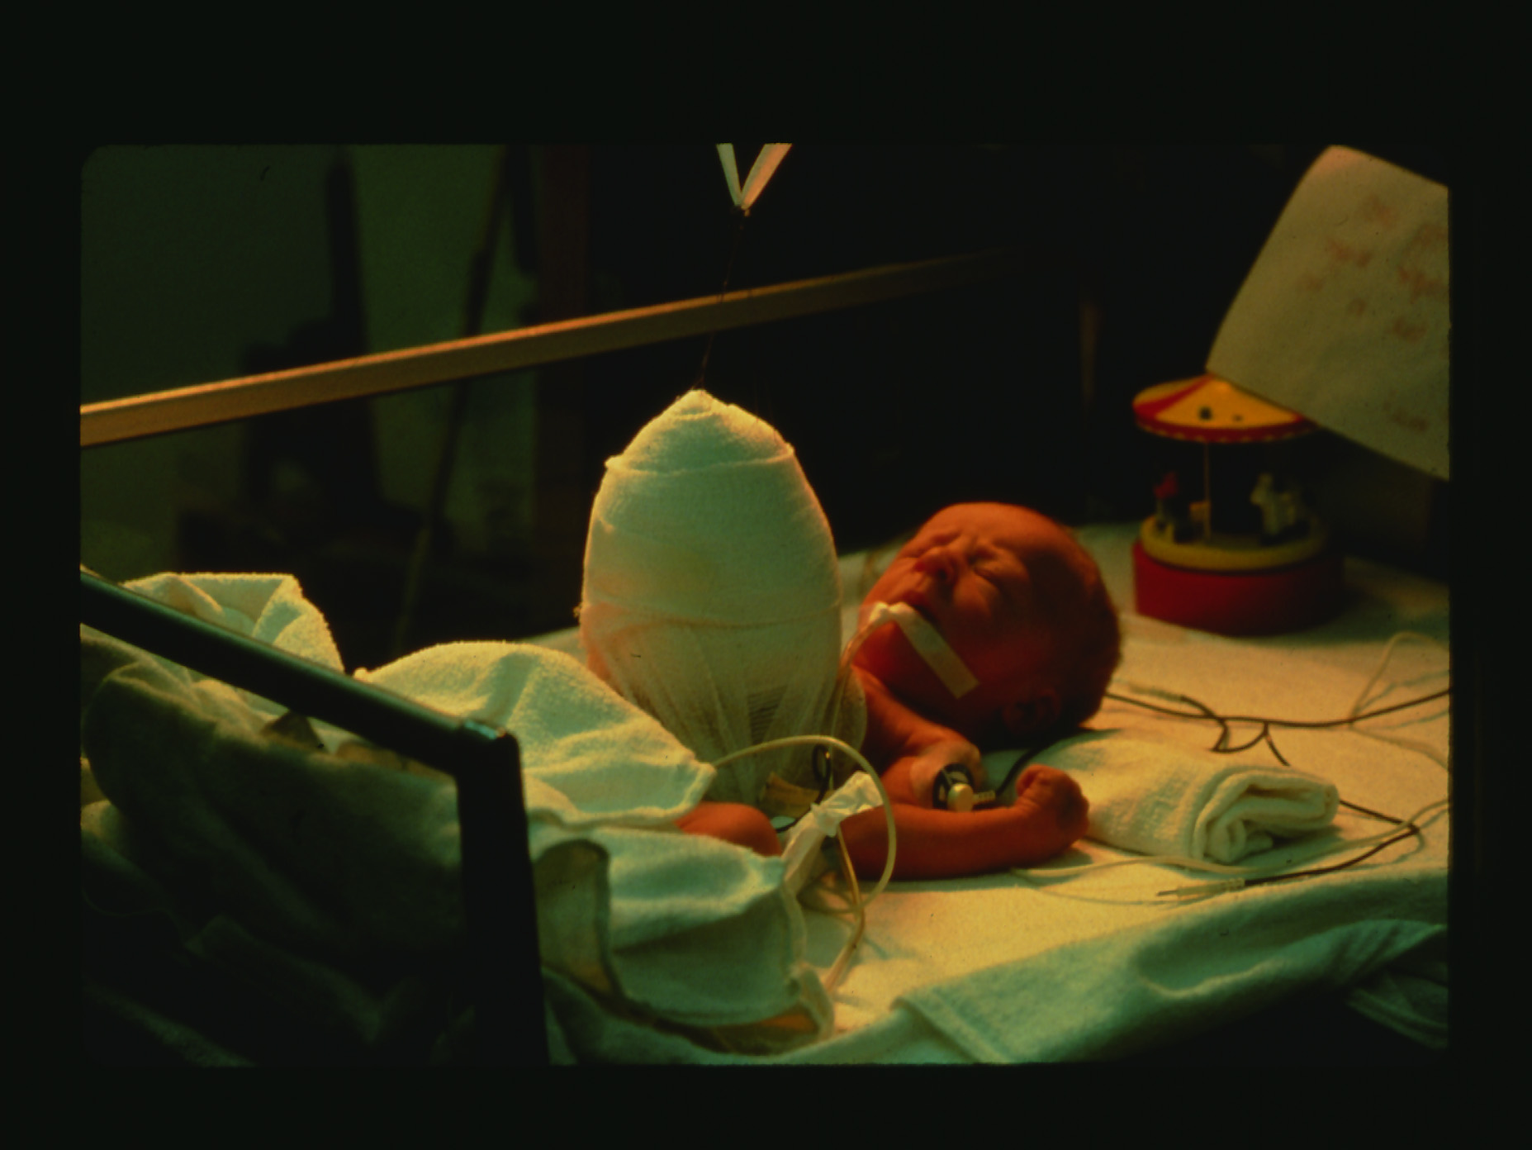
Staged Closure
Creation of a silo
Abdominal organs reduced slowly over days
Notes:
Secondary closure consists of placing the exposed intraabdominal contents in a silo. In the subsequent days, the silo contents are slowing reduced into the abdominal cavity. When most of the bowel is reduced, the baby is returned to the OR for definitive closure of the defect. This may require that the newborn remains intubated and mechanically ventilated. Also, muscle relaxation may be required to facilitate accommodation of the reduced organs.

Slide 24
Primary vs Staged
Criteria for staged repair
Peak inspiratory pressure (plateau) > 25 cm H₂O
Intragastric pressure > 20 mmHg
Intravesicular pressure > 20 mmHg
Central venous pressure > 4 mmHg above baseline
Notes:
Primary closure in the majority of cases will be attempted first. If any of the above listed parameters occur after closure, concern for abdominal compartment syndrome should be entertained and consideration should be made to open the abdomen and do a staged repair.

Slide 25
Postoperative Concerns
Extubation
  Small defect
  No significant associated anomalies
Mechanical ventilation until respiratory compliance improves
Monitor for abdominal compartment syndrome
  Continued edema of the bowel may result in a tight closure
Parenteral nutrition if delayed bowel function
Notes:
In most cases, the baby will remain tracheally intubated at the end of the surgery. If it was a small defect and/or there are no significant associated anomalies, extubation at the end of the procedure can be considered. Respiratory compliance may take 1-2 days to improve. Abdominal compartment syndrome may occur postoperatively even though there was no evidence of this in the OR after closure because of ongoing bowel edema. Important to make sure baby is relaxed to maximize abdominal cavity accommodation of reduced organs. Bowel function may be delayed requiring parenteral nutrition.

Slide 26
Long Term Outcomes
Depends on associated congenital anomalies and chromosomal abnormalities, particularly congenital heart disease
Gastrointestinal
  Necrotizing enterocolitis
  Short gut syndrome
  Adhesions
  Obstruction
Total parenteral nutrition side effects
  Liver injury
  Sepsis
Scar complications
Notes:
Long term outcomes and mortality are dependent on what associated anomalies and/or chromosomal abnormalities co-exist. This is particular true for congenital heart disease. Short gut syndrome occurs when large amounts of bowel must be resected due to ischemia. NEC, adhesions, and obstruction may occur. Delayed feeing and need for long-term TPN may result in liver injury and sepsis.

